Slide 1
Color-pattern diversity,
with and without history
Demo 8 · pavo + phylogeny + measurement error
EEB 187 · Wednesday May 20, 2026

Slide 2
Today's question, in three parts
Are your family's color-pattern variables…
1.
structured?
2.
structured because of phylogeny?
3.
structured robust to measurement noise?
Each part builds on the one before.
EEB 187 · Demo 8 · May 20 2026

Slide 3
Last week — Frédérich et al. 2026
the result this demo benchmarks against
K = 0.10
Chaetodontidae · multivariate Blomberg's K · 30 binary motifs
Color patterns evolve fast.
Convergent across the tree.
A landmark — not a target. Your per-variable Ks won't hit 0.10.
EEB 187 · Demo 8 · May 20 2026

Slide 4
Today's data (walkthrough)
Chaetodontidae mini-bundle — pre-built, watch-only
19 butterflyfish species, 5 genera, matched to a pruned chronogram
One error-species, photographed 5 times — the noise stack for Part 3
9 pavo pattern statistics per species
4 FishBase traits: trophic level, max depth, max length, vulnerability
After Part 1, every group builds a bundle of this shape for their own family.
EEB 187 · Demo 8 · May 20 2026

Slide 5
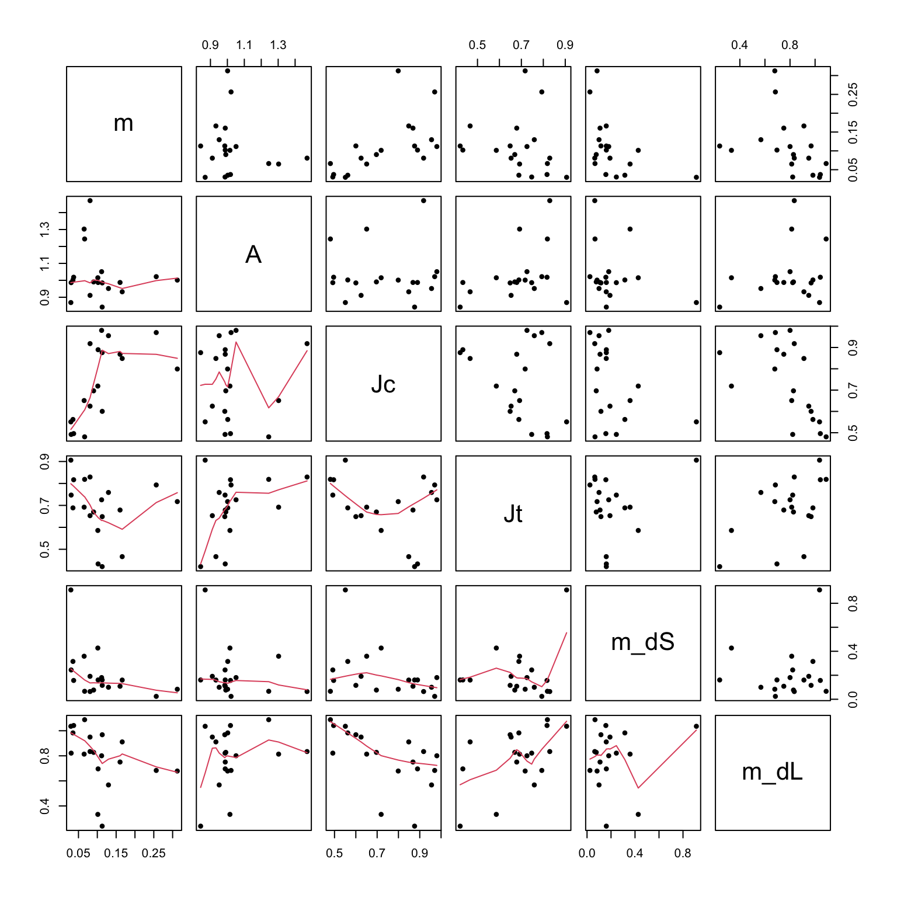
Part 1 — describe what you've got
6 pattern stats per species · pavo classify() + adjacent()
Diagonal: distribution
Off-diagonal: scatter + smoother
Six full-rank descriptors:
m, A, Jc, Jt, m_dS, m_dL.
Watch for tight scatter:
redundant axes → fewer
real pattern dimensions.
EEB 187 · Demo 8 · May 20 2026

Slide 6
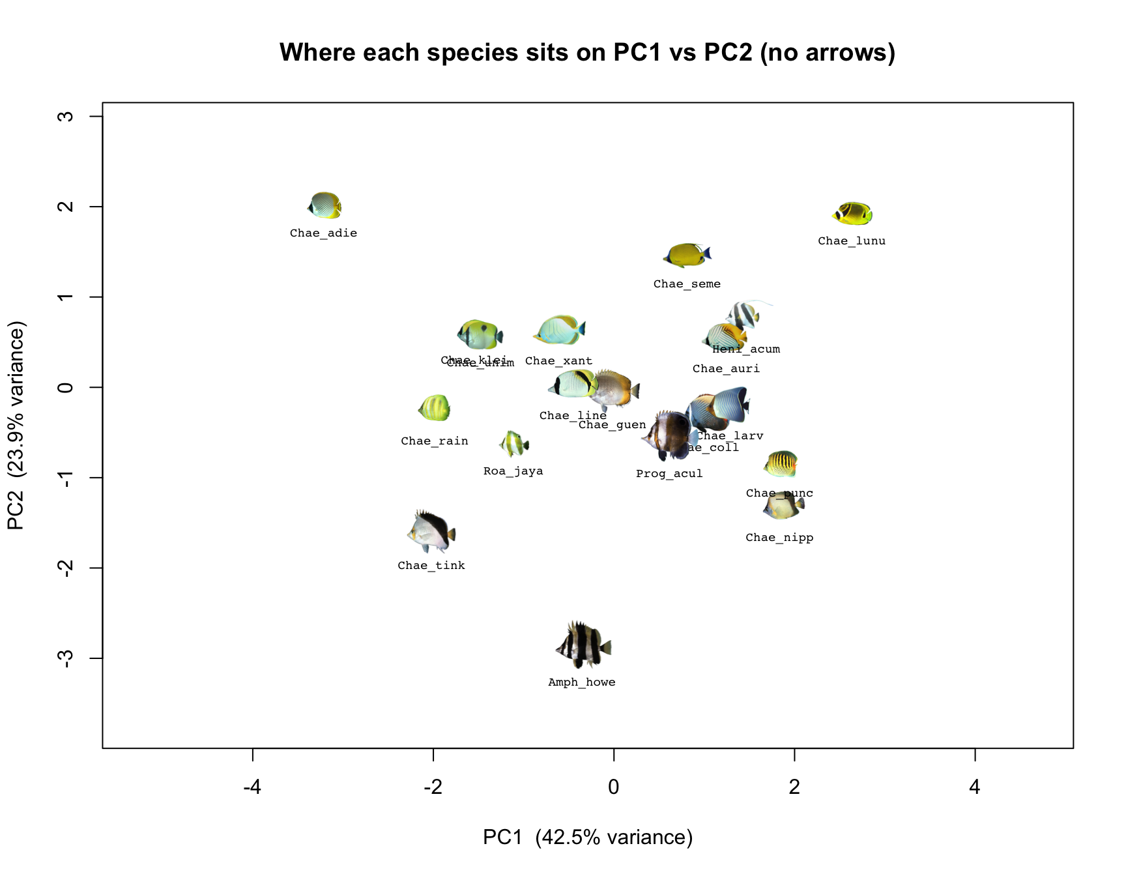
PC1 vs PC2 — where each species sits
PC1 ≈ 46 % · PC2 ≈ 17 % of pattern variation
EEB 187 · Demo 8 · May 20 2026

Slide 7
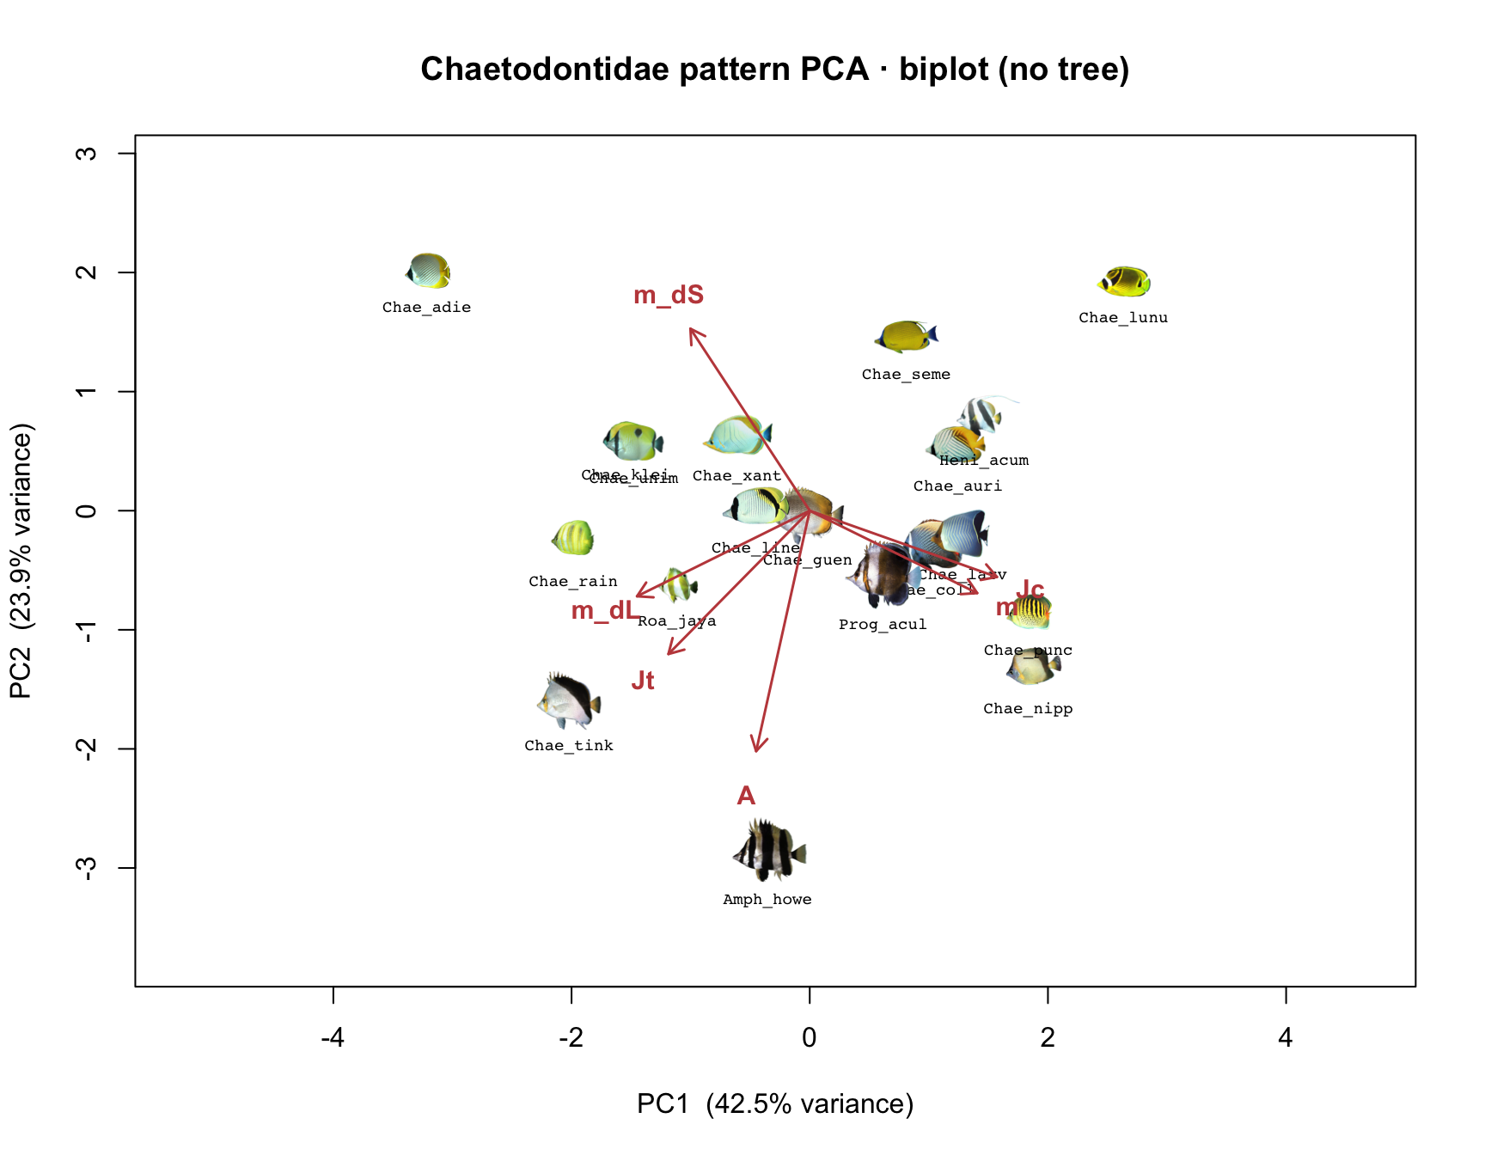
What drives the two axes
arrows = pavo variables · long arrow = high contribution
EEB 187 · Demo 8 · May 20 2026

Slide 8
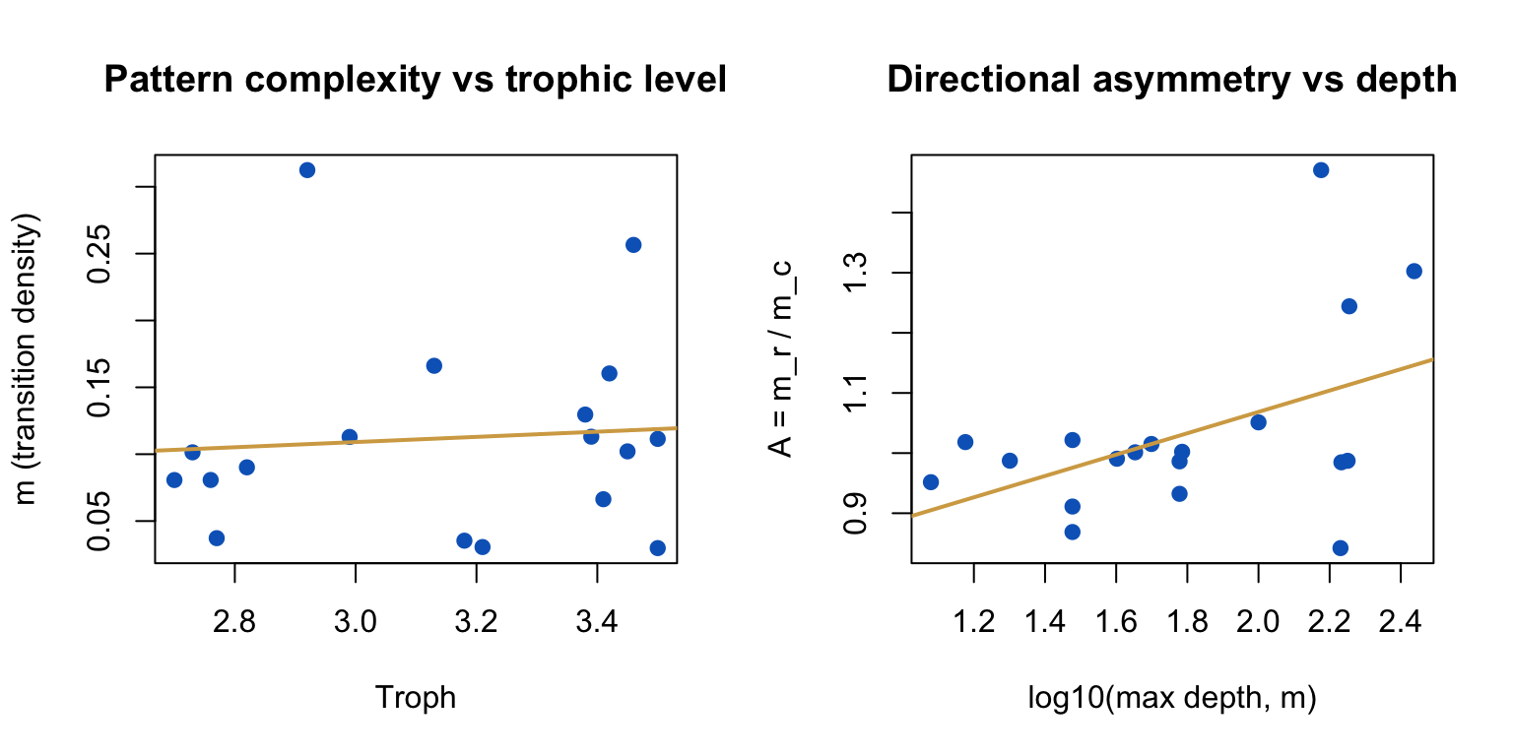
Does pattern track how the fish lives?
two named bivariate tests · ahistorical
Trophic level →
complexity (m)
Depth →
asymmetry (A)
Part 2 will redo these
with the tree.
EEB 187 · Demo 8 · May 20 2026

Slide 9
Now you build your bundle
15 min on FishView · same login as Demo 7
Pick ≥ 15 species across ≥ 5 genera from your family
Star one exemplar image per species
Mark ONE species as the error-species → tick 5 images for it
Hit Export. Drop the ZIP next to your Chaetodontidae bundle.
The choices you make here ARE the analysis.
Pick the species and the photos you'd defend in a paper.
EEB 187 · Demo 8 · May 20 2026

Slide 10
Part 2 — bring the tree back
Closely related species share trait values because they share genes.
Three corrections, in order:
phyl.pca — PCA reweighted by the tree's variance-covariance
PGLS — bivariate regression where residuals can correlate via the tree
K and λ — phylogenetic signal, per variable
Same questions as Part 1. Different answer if phylogeny was driving things.
EEB 187 · Demo 8 · May 20 2026

Slide 11
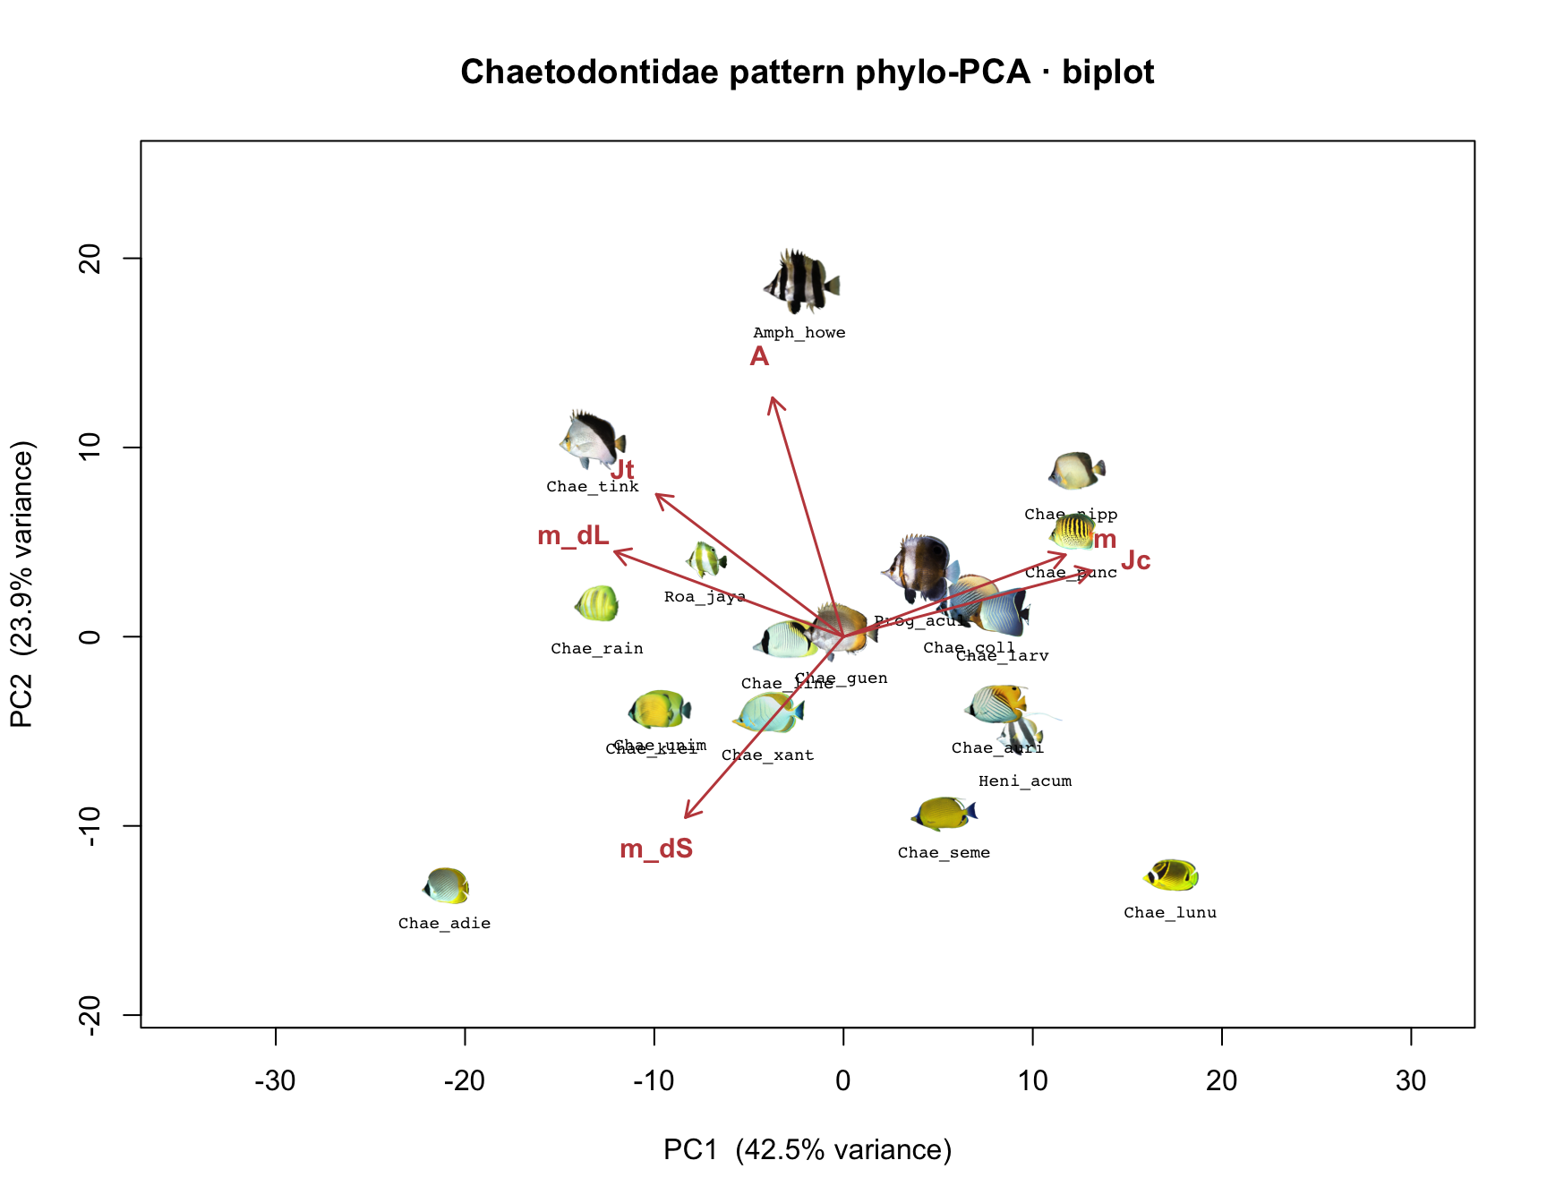
phyloPCA — same axes, different math
same 6 variables · centering uses the tree's BM variance-covariance
EEB 187 · Demo 8 · May 20 2026

Slide 12
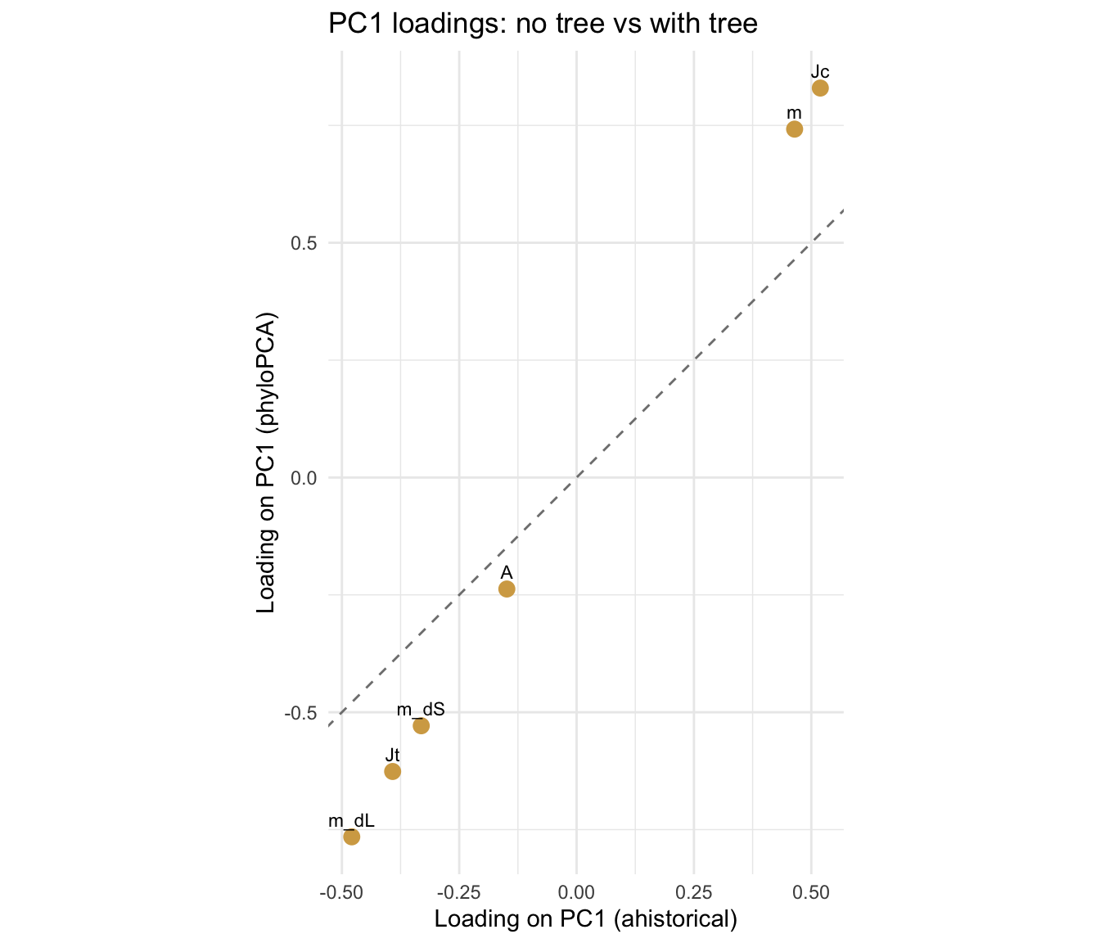
Did phylogeny change which variables matter?
PC1 loading: phyloPCA vs ahistorical
On the dashed
line:
phylogeny
didn't change
that variable's
loading.
Far from it:
shared ancestry
was inflating it.
EEB 187 · Demo 8 · May 20 2026

Slide 13
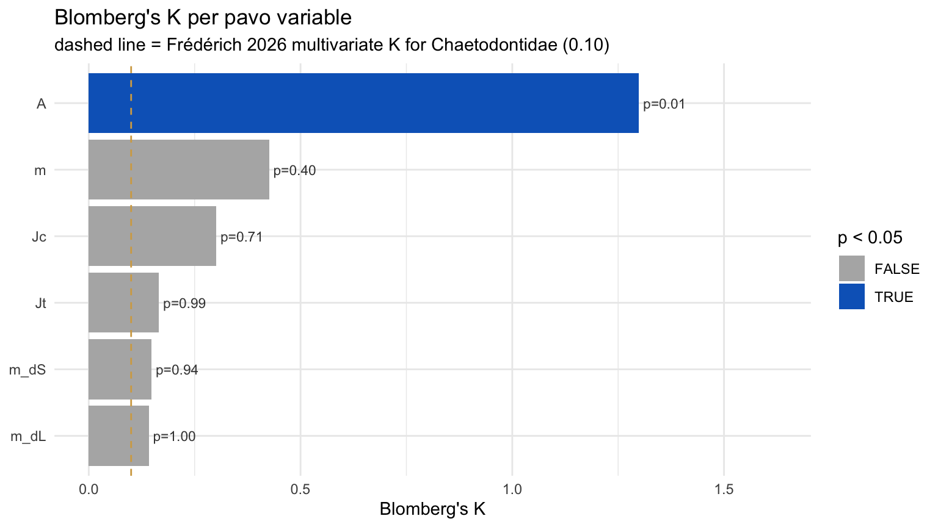
Blomberg's K per pavo variable
K < 1 = relatives more different than Brownian expectation
Blue bars:
p < 0.05 —
real signal.
Dashed line:
Frédérich's
K = 0.10 as
a landmark,
not a target.
EEB 187 · Demo 8 · May 20 2026

Slide 14
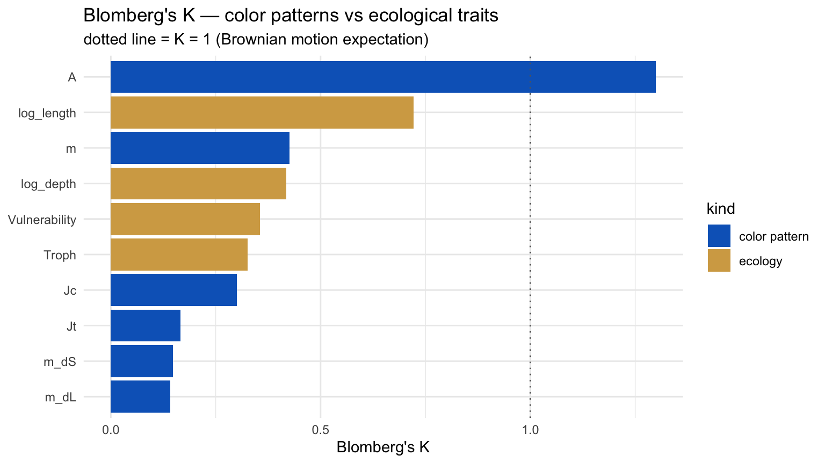
Color signal vs ecology signal
where the demo lands
Dotted line:
K = 1, BM
expectation.
Watch for
ecology bars
above color
bars in your
own family —
Chaetodontidae
is too small to
see it sharply.
EEB 187 · Demo 8 · May 20 2026

Slide 15
Side trip: how we got the ecology data
§2.8 walkthrough · rfishbase 3.1.10
Trophic level, depth, body size, vulnerability all came from FishBase.
Worksheet §2.8 shows you the rfishbase calls that built species_traits.csv.
Same recipe runs unchanged on your family's tip labels.
species_fb <- gsub("_", " ", species) sp <- species(species_fb, fields = c("Length", "DepthRangeDeep", "Vulnerability")) ec <- ecology(species_fb, fields = c("FoodTroph", "DietTroph"))
Pinned to rfishbase 3.1.10 — newer releases depend on duckdb and fail to build.
EEB 187 · Demo 8 · May 20 2026

Slide 16
Part 3 — admit you got the numbers from a photograph
Pick one species. Photograph it five times.
Compute pavo on each photo.
The spread is your measurement noise.
Now ask: how much of Part 2 survives noise of that size?
Monte Carlo: re-run Parts 1 & 2 a hundred times under that noise.
EEB 187 · Demo 8 · May 20 2026

Slide 17
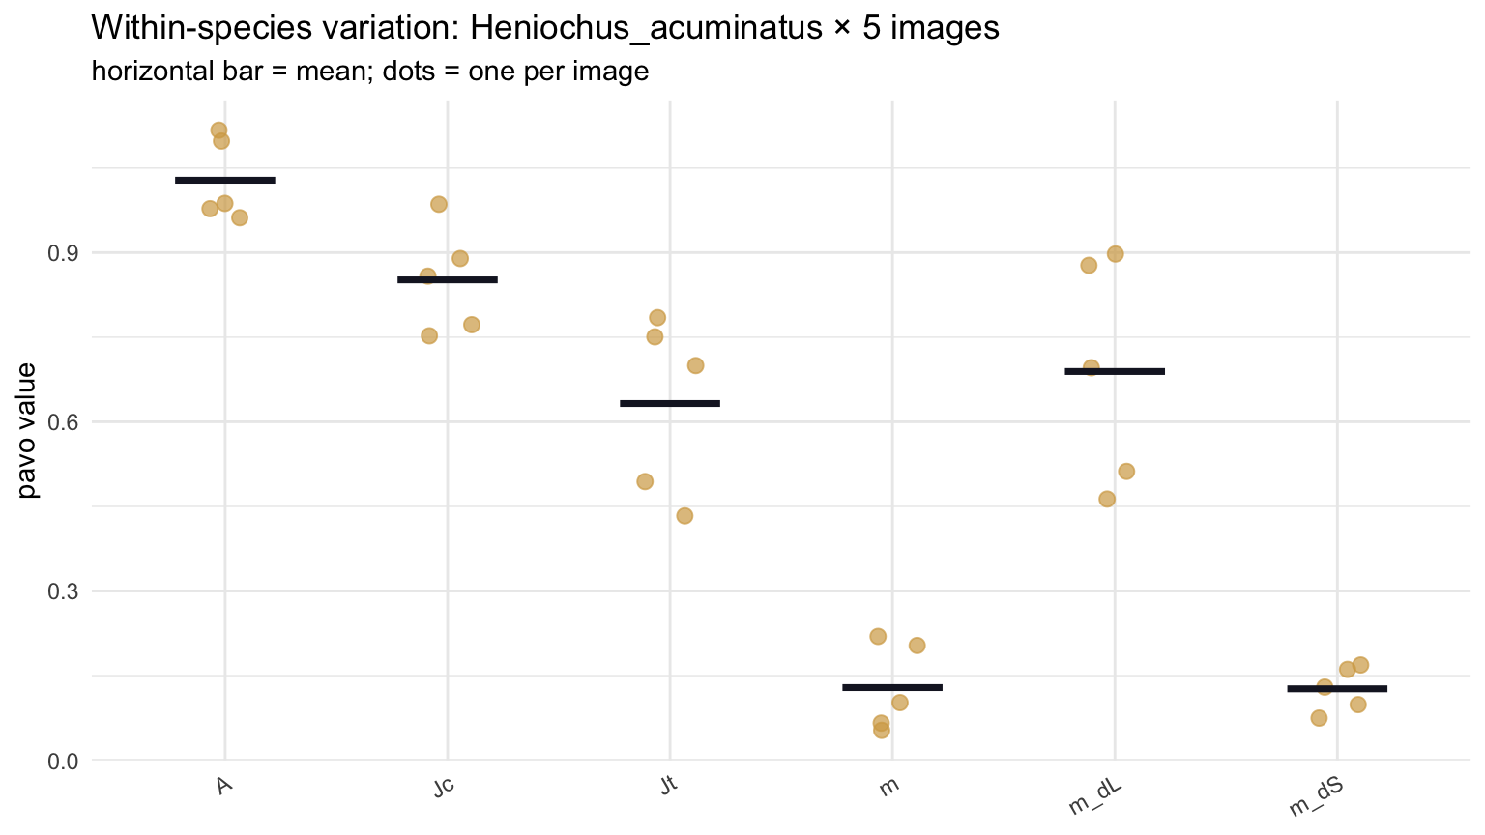
Within-species noise — Heniochus_acuminatus × 5 images
five dots per variable; bar = mean
Tight clusters
→ pavo is
reliable.
Wide spread
→ that variable's
Part 2 result
is fragile.
EEB 187 · Demo 8 · May 20 2026

Slide 18
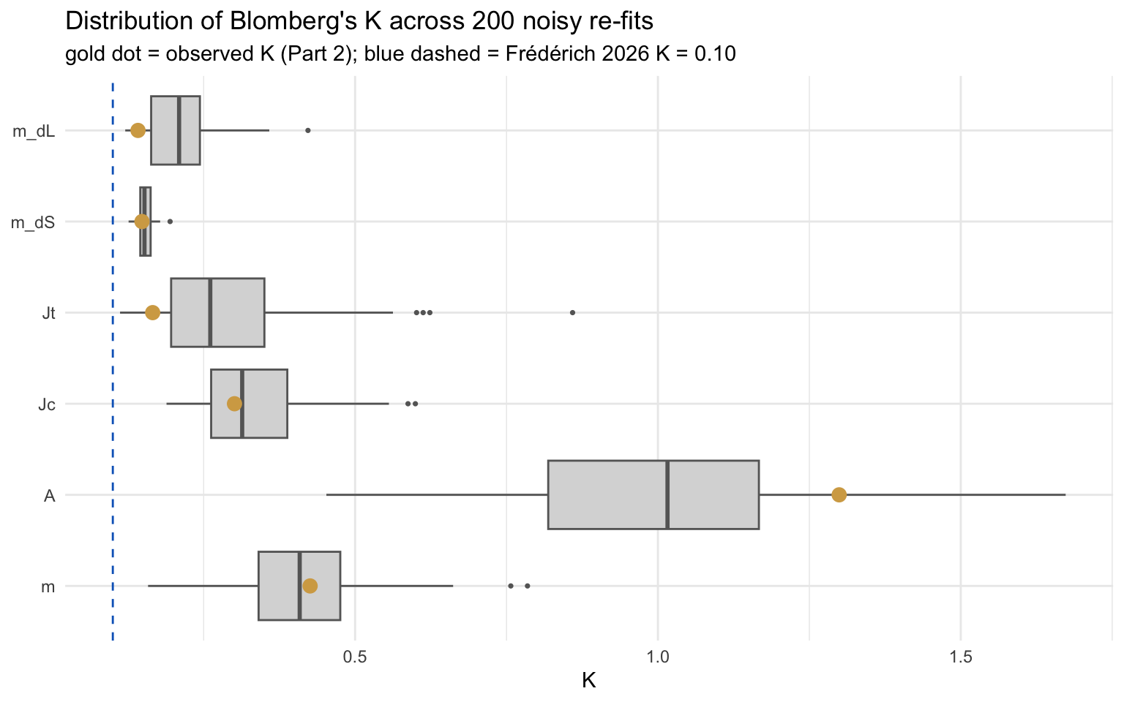
K under noise — 100 Monte Carlo re-fits
gold dot = observed K (Part 2)
Gold inside the
box: robust.
Gold outside:
you got lucky —
a different photo
would have given
a different K.
EEB 187 · Demo 8 · May 20 2026

Slide 19
What you turn in
BruinLearn · end of day Wednesday
1. Part 1 PCA scatter — your family
2. Part 2 K plot + one-line interpretation per variable
3. Part 3 Monte-Carlo CI on one statistic of your choosing
4. One paragraph (≤ 250 words): does color in your family match Frédérich,
and which conclusions survive measurement error?
EEB 187 · Demo 8 · May 20 2026

Slide 20
Tonight
prep page · ~20 minutes
1. Install R packages (one chunk on the prep page)
2. Download the Chaetodontidae walkthrough bundle
3. Run the readiness check until it prints PASS
4. Confirm your Demo 7 FishView login still works — you'll build your bundle in class
michaelalfaro.github.io/eeb187-demos/demo8/demo8-prep.html
EEB 187 · Demo 8 · May 20 2026

Slide 21
See you Wednesday.
Bring your laptop charged. We move fast.
EEB 187 · Demo 8 · May 20 2026

