Slide 1
Demo 7 — Mapping Color Patterns onto a Phylogeny
EEB 187: Ecology and Evolution of Color Week 8 Demo Section

Slide 2
Today’s big question
Do closely related fish species have similar color patterns?
Or does natural selection override evolutionary history?
We’ll answer this with data, a phylogeny, and two statistical tests.

Slide 3
What is a phylogeny?
A family tree for species
Branch lengths = time (millions of years)
Closely related species share a recent common ancestor
The tree is estimated from DNA sequences
Today’s tree: 65 surgeonfish species (Acanthuridae)
Root age: 65 million years — right at the end-Cretaceous extinction!
┌── Acanthurus ┌───┤ │ └── Ctenochaetus ────┤ │ ┌── Zebrasoma └───┤ └── Naso
(simplified — the real tree has 65 tips)

Slide 4
Frédérich et al. 2026 — the paper at a glance
Rapid and repeated evolution of pigmentation patterns in reef fishes. Frédérich, Mittelheiser, Gillet, Hodge, Laudet & Dornburg. BMC Biology (2026) 24:46. https://doi.org/10.1186/s12915-026-02544-4

Slide 5
The scope
6 reef-fish families
918 species total
75%+ of extant diversity in every family
The coding
30 motifs (stripes, spots, eyespots, marbling, beehive, saddle, …)
× 3 body regions (head, trunk, tail)
= a per-species binary fingerprint

Slide 6
Today: the Acanthuridae sub-dataset → 83 species × 57 columns (the 30 motifs expand to 57 binary columns with “1 vs 2+” splits, eye-overlap variants, and 5 whole-body indices).

Slide 7
How they coded color — body regions × motifs
HEAD 22 chars TRUNK 14 chars TAIL 17 chars
Every species = a row of 57 binary characters across these three zones
Motif vocabulary (scored in each region)
Each scored as 1 = present, 0 = absent, with extra splits for 1 vs 2+ occurrences (e.g., H_2_h_strips_+ means 2 or more horizontal stripes on the head).

Slide 8
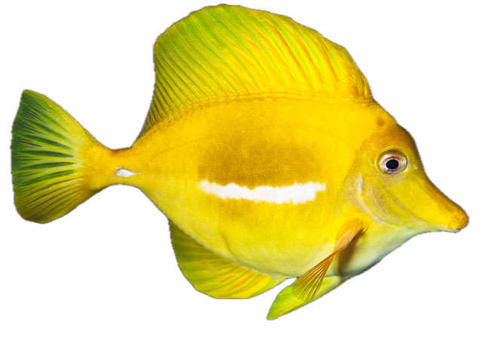
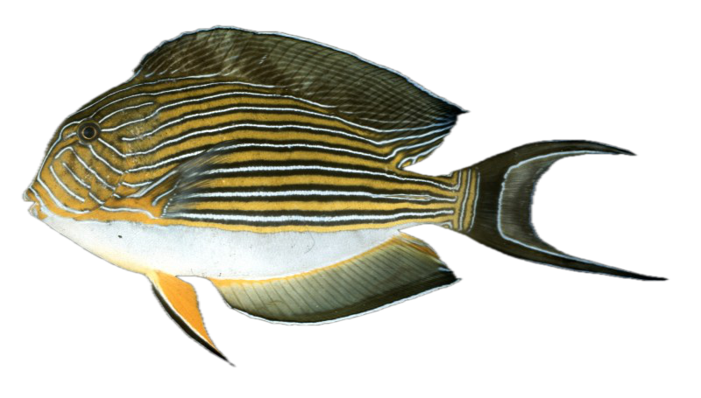
Three species, coded — the intuition

Slide 9
The pattern complexity score is just rowSums(motifs) — the headline number you’ll map onto the tree today.

Slide 10
Five species, all 57 characters — the formal view
Each row = a species; each column = one of the 57 binary characters.
Green = motif present (1); red = absent (0).
Top bands label the body region: INDEX · HEAD · TRUNK · TAIL.
Range from 6 active motifs (Zebrasoma rostratum) to 22 (Acanthurus bariene) across the family.

Slide 11
Pattern complexity varies across the family
Distribution of motif counts across 83 Acanthuridae species. Median = 12. Min = 6 (Zebrasoma rostratum). Max = 22 (Acanthurus bariene).
This single number per species is what you’ll run through contMap, Blomberg’s K, and Pagel’s λ in the worksheet.

Slide 12
Result 1 — motif richness tracks species richness
Fig 1 from Frédérich et al. 2026. Each panel = one family × 5 biogeographic regions. Top row = full dataset, bottom row = re-sampled to avoid widespread-species inflation.
Every family × every sampling regime: R > 0.96, p < 0.01. More species in a region → more motif diversity.
Implication: speciation events drive pattern divergence — pattern diversity scales linearly with the species pool, not with the latitude/longitude of the reef.

Slide 13
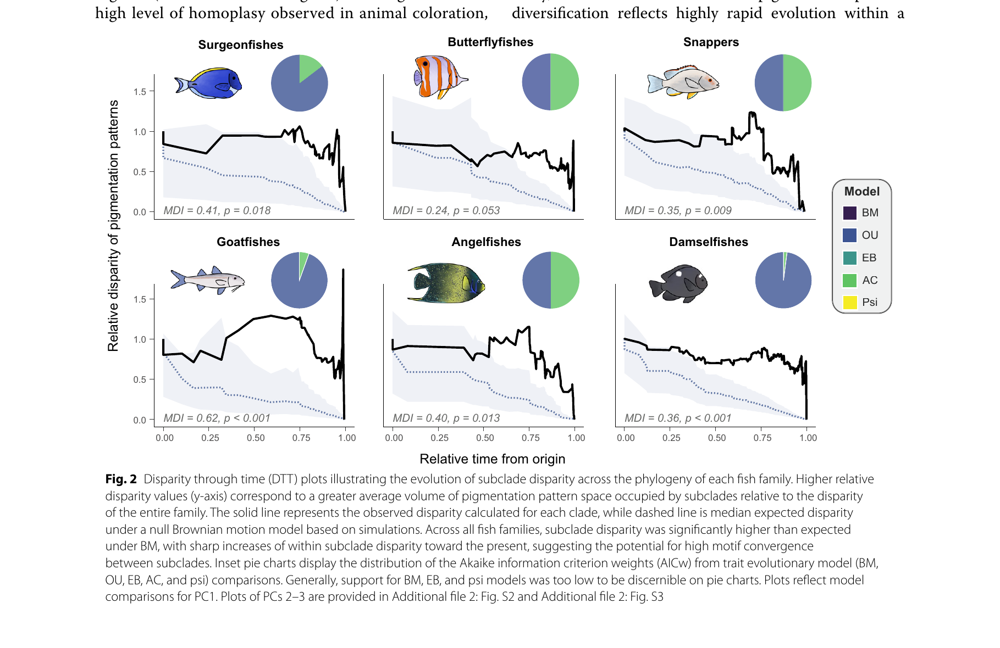
Result 2 — pattern evolution is rapid AND bounded
Phylogenetic signal is weak in every family (multivariate Blomberg’s K, all p < 0.01):
Best-fit evolutionary model: OU1 (single optimum, bounded morphospace) + AC (accelerating rate).
Phylogenetic half-life ≈ 1.5 Myr vs ~37.5 Myr for other fish morphological traits.
Punchline: patterns evolve fast within a constrained set of motifs → strong convergence + recurring labyrinths, stripes, spots across distantly related lineages.

Slide 14
What is phylogenetic signal?
The tendency for closely related species to resemble each other more than distantly related species.

Slide 15
Strong signal
Relatives look alike → color patterns evolve slowly
Pattern is “conserved” on the tree
Weak/no signal
Relatives look different → color changes fast, convergence is common
Pattern evolves independently of relatedness

Slide 16
We measure this with two statistics: Blomberg’s K and Pagel’s λ

Slide 17
Blomberg’s K — what the number means
K value | Interpretation
K = 0 | No signal — trait is random on the tree
0 < K < 1 | Signal exists, but weaker than expected under Brownian motion
K = 1 | Trait matches Brownian motion prediction exactly
K > 1 | Relatives are MORE similar than Brownian motion predicts

Slide 18
The p-value tells you if the signal is statistically significant:
p < 0.05 → yes, there’s real signal
p > 0.05 → can’t distinguish from random
K = 0.16 with p = 0.04 → “there IS signal, but it’s modest — color patterns show some phylogenetic conservatism but also a lot of independent change”

Slide 19
contMap — painting traits on the tree
contMap reconstructs ancestral trait values and paints them along every branch.

Slide 20
Cool colors (blue) = simple patterns
Warm colors (red) = complex patterns
You can SEE where on the tree complexity changed
Look for abrupt shifts — those are evolutionary events
You’ll generate one of these in Section 5 of the worksheet.
The most complex species? Acanthurus bariene — 19 pattern elements!
The simplest? Zebrasoma rostratum — only 4 elements.

Slide 21
Discrete traits — mapping presence/absence
Not all traits are continuous. Some are binary: the species either has it or doesn’t.
Example: trunk marbling (irregular worm-like markings)

Slide 22
17 of 62 species have trunk marbling
Concentrated in Acanthurus (11/26) and Ctenochaetus (3/6)
Absent in Zebrasoma, Prionurus, Paracanthurus
Discussion question:
Is marbling a Turing pattern?
Think back to Lecture 12 — reaction-diffusion produces labyrinthine patterns that look a lot like “marbling.”

Slide 23
You’ll color tree tips by marbling presence and ask: how many times did it evolve?

Slide 24
The workflow — what you’ll do today
Step | Section | What you do | What you learn
1 | §1–2 | Load tree + plot it | How a phylogeny looks in R
2 | §3 | Load color data | What coded pattern traits look like
3 | §4 | Match tree ↔ data | The “golden rule” of comparative methods
4 | §5 | Create complexity score | Summarizing many traits into one number
5 | §6 | contMap | Painting a trait on the tree
6 | §7 | Blomberg’s K + Pagel’s λ | Testing phylogenetic signal
7 | §8 | Map trunk marbling | Discrete traits on a tree
8 | §9 | Pick your own trait | Independent analysis

Slide 25
~60 minutes of guided work, then 15 minutes on your own

Slide 26
What you’ll turn in
Screenshot of your contMap (pattern complexity on the tree)
Your K and λ values with a one-sentence interpretation each
Your chosen trait from “Your Turn” — which trait did you pick? What was K? Was it significant?
One paragraph: “Is color pattern diversity phylogenetically conserved in surgeonfishes? Why or why not?”
There is no single “right answer” — we want a nuanced interpretation backed by your data.

Slide 27
Getting started
Open RStudio
Set your working directory:
setwd("path/to/demo-labrid-pcm-week8")
Open the worksheet: demo7-worksheet.qmd (or the HTML version in your browser)
Work through it section by section — don’t skip ahead
Talk to your neighbor. If you’re stuck, ask. If you’re not stuck, explain what you’re seeing.
Let’s go!

