Slide 1
Input-Output Analysis South Korea
September 19, 2023

Slide 2
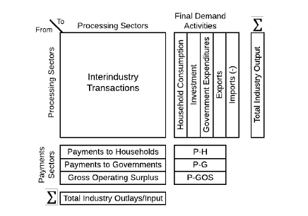
Theory in Brief
Imports-Ridden Input-Output Accounting Framework

Slide 3
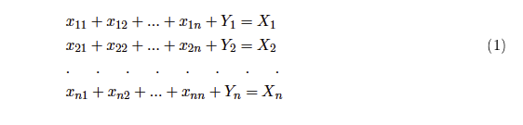
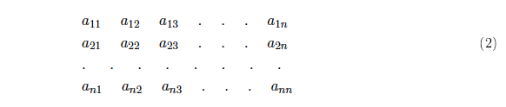
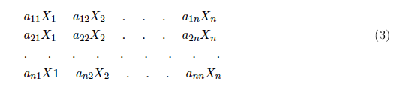
Theory in Brief

Slide 4
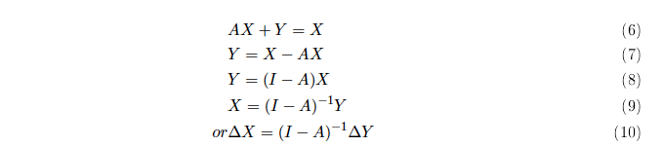
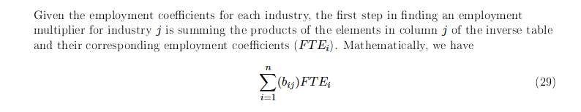
Theory in Brief
How does X changes to a change in Y? Intuitively:

Slide 5
Data Source
Data Source for the I-O Table of the Korean Economy:
1. Bank of Korea
Link: https://www.bok.or.kr/eng/bbs/E0000634/view.do?nttId=10058883&menuNo=400069 (The data files have already been provided.) 2. Data available at three levels of detail: We used the most detailed table of 165X165 industries.
3. The year chosen was the latest available -2018.

Slide 6
Employment Data of Korea
Same data source: Bank of Korea.
We used the Full Time Equivalent Employment numbers.
Year of data chosen, 2018, corresponds to the same year as I-O (will be explained later).
4. The same detailed table matched the I-O industry level.

Slide 7
Alternative Data sources for I/O
http://www.wiod.org/database/
Step 1: Click on the link National Input-Output Tables
Step 2: Click on the country and choose the year (corresponding to the year of employment data).

Slide 8
Steps to arrive at the Employment Figures for Green Energy Program
STEP-1 : Three important categories of data: Input-output table, Gross output and Total Employment.
STEP-2: Generate the (I-A) inverse matrix from Input-Output Matrix
STEP-3: Calculate the Employment–Output Ratio for each individual levels of industry.
STEP-4: Sort/Match the Employment– Output Ratio according to the Input-Output table.
Note#1: The individual industries mentioned in the employment column may not always exactly correspond to the individual industry names in the Input-Output table. Choose the closest possible industry and sum it up for grouping (if required).

Slide 9
Steps to arrive at the Employment Figures (Contd.)
STEP-5: Multiply the Employment – Output ratio with the Input- Output Table to calculate the figures for employment generated in each industry.
STEP-6 : Calculate the total, direct and indirect employment figures for each individual energy sector using the weights.
Note#2: The diagonal elements in the new matrix gives the direct employment figures and the remainder is the indirect employments generated.
Note#3: You can also change the weights to levels which you feel apt and calculate the employment figures.

Slide 10
Steps to arrive at the Employment Figures (Contd.)
STEP-7: Calculate the Total Employment Generated in the Green program.
Note#4: You can also change the weights of the program in case you think a particular energy sector deserves more importance.
STEP-8: Compare the figures with those of the fossil fuel industry like Coal and Oil & Gas.

