Slide 1
Searching for needles in haystacks: A Bayesian approach to chronic disease surveillance
Nicky Best
Department of Epidemiology and Biostatistics
Imperial College, London
Joint work with:
Guangquan (Philip) Li
Lea Fortunato
Sylvia Richardson
Anna Hansell
Mireille Toledano

Slide 2
Outline
Introduction
Example 1: Detecting unusual trends in COPD mortality
BaySTDetect Model
Simulation study to evaluate model performance
Example 2: ‘Data mining’ of cancer registries
Conclusions and further developments

Slide 3
Introduction
Growing interest in space-time modelling of small-area health data
Many different inferential goals
description
prediction/forecasting
estimation of change / policy impact......
surveillance
Key feature is that small area data are typically sparse
Bayesian hierarchical models allow smoothing over space and time
help separate signal from noise
improved estimation & inference

Slide 4
Surveillance of small area health data
For most chronic diseases, smooth changes in rates over time are expected in most areas
However, policy makers, health service providers and researchers are often interested in identifying areas that depart from the national trend and exhibit unusual temporal patterns
These unusual changes may be due to emergence of
localised risk factors
impact of a new policy or intervention or screening programme
local health services provision
data quality issues
Detection of areas with “unusual” temporal patterns is therefore important as a screening tool for further investigations

Slide 5
Retrospective and Prospective Surveillance
WHO defines surveillance as
“the systematic collection, analysis and interpretation of health data and the timely dissemination of this data to policymakers and others”
Retrospective Surveillance
data analyzed once at end of study period
determine if space-time cluster occurred at some point in the past
Prospective Surveillance
data analyzed periodically over time as new observations are obtained
identify if space-time cluster is currently forming
Our focus is on retrospective surveillance
discuss extensions to prospective surveillance at end

Slide 6
Example 1: COPD mortality
Chronic Obstructive Pulmonary Disease (COPD) is responsible for ~5% of deaths in UK
Time trends may reflect variation in risk factors (e.g. smoking, air pollution) and also variation in diagnostic practice/definitions
Objective 1: Retrospective surveillance
to highlight areas with a potential need for further investigation and/or intervention (e.g. additional resource allocation)
Objective 2: “Informal” policy assessment
Industrial Injuries Disablement Benefit was made available for coal miners developing COPD from 1992 onwards in the UK
There was debate on whether this policy may have differentially increased the likelihood of a COPD diagnosis in mining areas, as miners with other respiratory problems with similar symptoms (e.g., asthma) could potentially have benefited from this scheme.

Slide 7
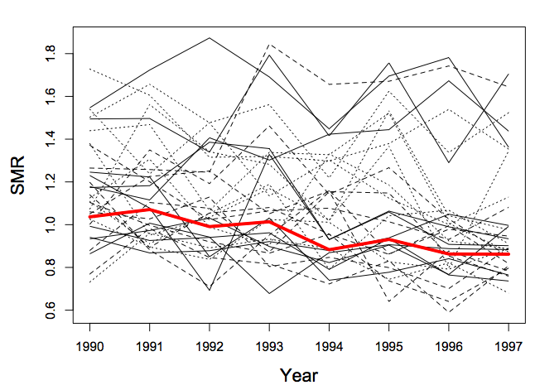
Data
Observed and age-standardized expected annual counts of COPD deaths in males aged 45+ years
374 local authority districts in England & Wales
8 years (1990 – 1997)
Median expected count per area per year = 42 (range 9-331)
Difficult to assess departures of the local temporal patterns by eye
Need methods to
quantify the difference between the common trend pattern and the local trend patterns
express uncertainty about the detection outcomes

Slide 8
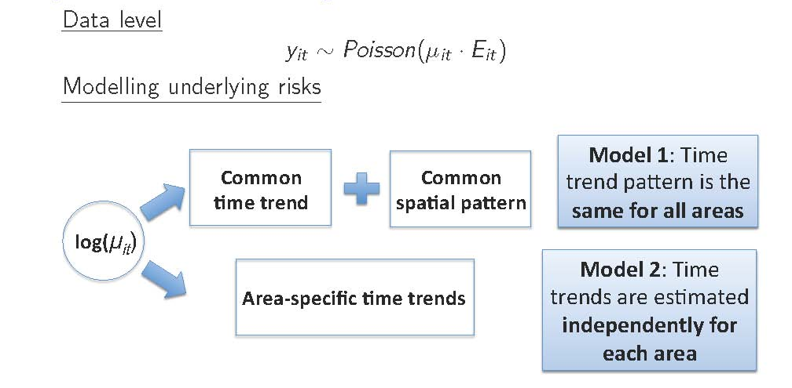
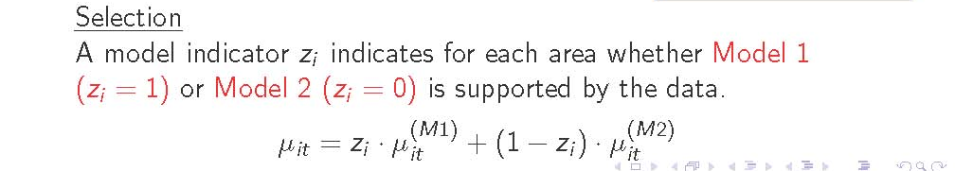
Bayesian Space-Time Detection: BaySTDetect
BaySTDetect (Li et al 2012) - detection method for short time series of small area data using Bayesian model choice between 2 space-time models

Slide 9
BaySTDetect: full model specification
The temporal trend pattern is the same for all areas
Temporal trends are independently estimated for each area.
Model selection
Prior on model indicator: z_{i} ~ Bernoulli(π )
expect only a small number of unusual areas a priori, e.g. π = 0.95
ensures common trend can be meaningfully defined and estimated

Slide 10
Implementation in WinBUGS
Model 1: Common trend
Model 2: Local trend
η_{i}
γ_{t}
u_{i}
φ_{it}
μ_{it}^{[C]}
μ_{it}^{[L]}
E_{it}
E_{it}
y_{it}
y_{it}
‘cut’ link
z_{i}
μ_{it}
Selection model
used to prevent
‘double counting’
of y_{it}
E_{it}
y_{it}

Slide 11
Classifying areas as “unusual”
Areas are classified as “unusual” if they have a low posterior probability of belonging to the common trend model (model 1): p_{i} = Pr(z_{i} = 1| data)
Need to set suitable cut-off value C, such that areas with p_{i} < C are declared to be unusual
Put another way, if we declare area i to be unusual, then p_{i} can be thought of as the probability of false detection for that area
We choose C in such a way that we ensure that the expected average probability of false detection (FDR) amongst areas declared as unusual is less than some pre-set level α

Slide 12
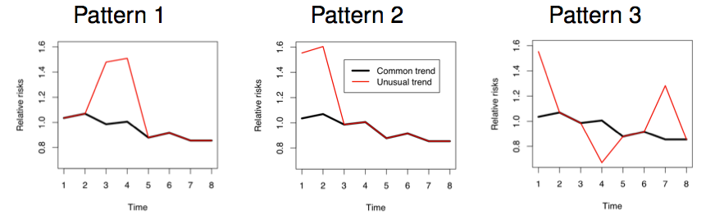
Simulation study to evaluate operating characteristics of BaySTDetect
50 replicate data sets were simulated based on the observed COPD mortality data
3 patterns × small, medium and large departures from common trend
Either the original set of expected counts (median E = 42) or a reduced set (E × 0.2; median E = 8) or an inflated set (E × 2.5; median E = 105) were used
15 areas (4%) were chosen to have the unusual trend patterns
Results were compared to those from the popular SaTScan space-time scan statistic

Slide 13
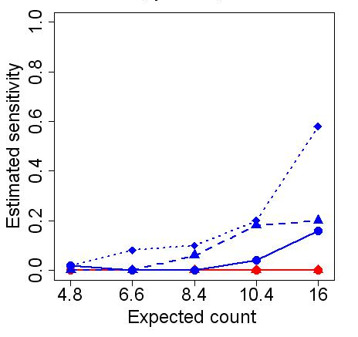
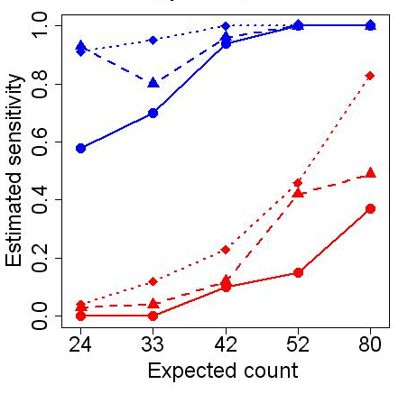
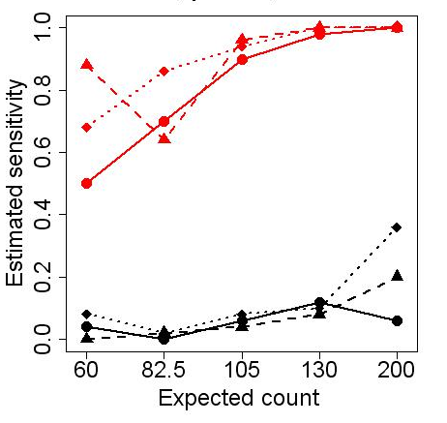
Sensitivity of detecting the 15 truly unusual areas
FDR = 0.05; prior prob. of common trend π = 0.95
Low E
Moderate E
High E
high departures (×2)
moderate departures (×1.5)
low departures (×1.2)
Sensitivity increases as FDR increases and π decreases (not shown)

Slide 14
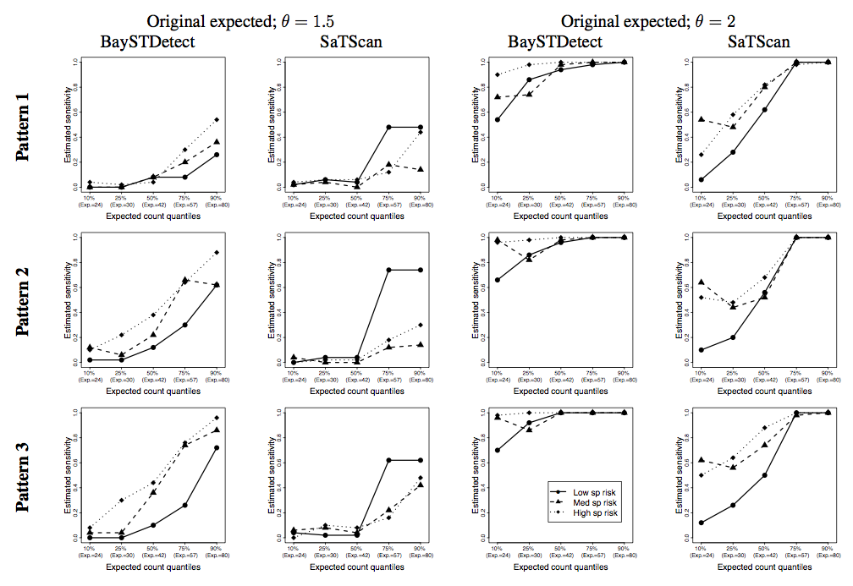
Sensitivity: Comparison with SaTScan
BaySTDetect
SaTScan (p=0.05)
Sensitivity
0.0 0.2 0.4 0.6 0.8 1.0
Sensitivity
0.0 0.2 0.4 0.6 0.8 1.0
moderate departures (×1.5)
E=24 E=33 E=42 E=52 E=80
Expected count quantiles
E=24 E=33 E=42 E=52 E=80
Expected count quantiles
Moderate E
high departures (×2)
Sensitivity
0.0 0.2 0.4 0.6 0.8 1.0
Sensitivity
0.0 0.2 0.4 0.6 0.8 1.0
E=24 E=33 E=42 E=52 E=80
Expected count quantiles
E=24 E=33 E=42 E=52 E=80
Expected count quantiles

Slide 15
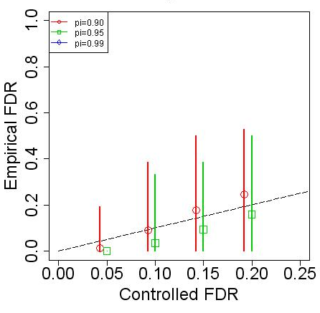
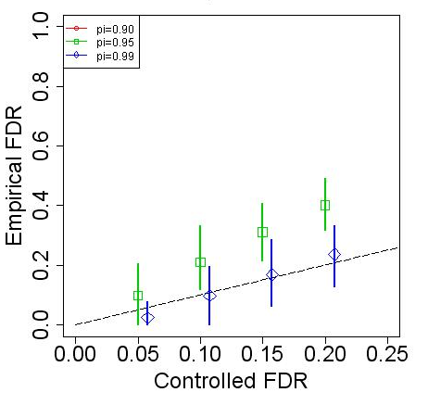
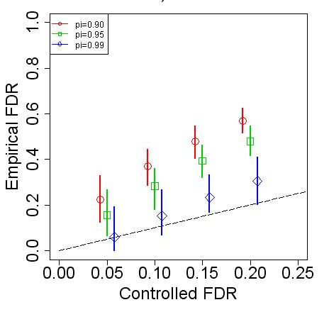
Simulation Study: FDR control
Empirical FDR vs corresponding pre-defined level
Low E: 4-16
High departures (×2)
Moderate E: 20-80
High departures (×2)
High E: 60-200
Moderate departures (×1.5)

Slide 16
FDR control: Comparison with SaTScan
Low E: 4-16
High departures (×2)
Moderate E: 20-80
High departures (×2)
High E: 60-200
Moderate departures (×1.5)
SaTScan (p=0.05)

Slide 17
Simulation Study: Summary
Sensitivity to detect unusual trends
High sensitivity to detect moderate departure patterns with E>80
High sensitivity to detect large departure patterns with E>20
Difficult to detect realistic departure patterns for E<20 unless FDR control less stringent (FDR > 0.4)
Sensitivity of BaySTDetect superior to SaTScan
Control of false discovery rate
Pre-defined FDR corresponds reasonably well with empirical rate of false discoveries
But empirical FDR increases as prior probability of declaring area to be unusual increases (π decreases)
BaySTDetect has lower empirical FDR than SaTScan when controlled at 5% level

Slide 18
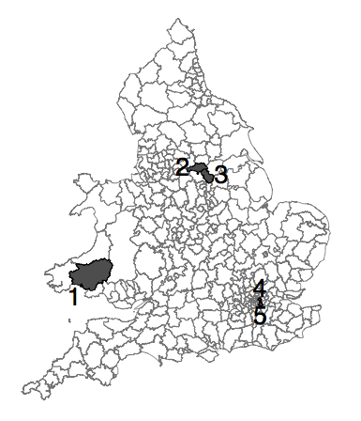
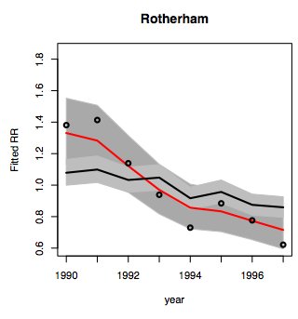
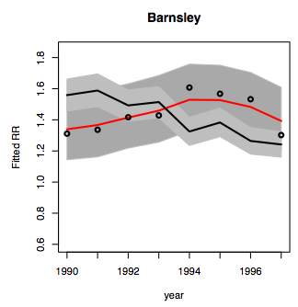
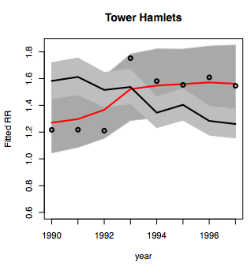
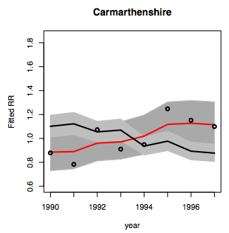
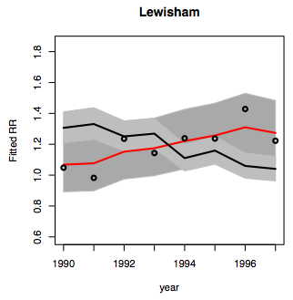
COPD application: Detected areas (FDR=0.05; π =0.95)

Slide 19
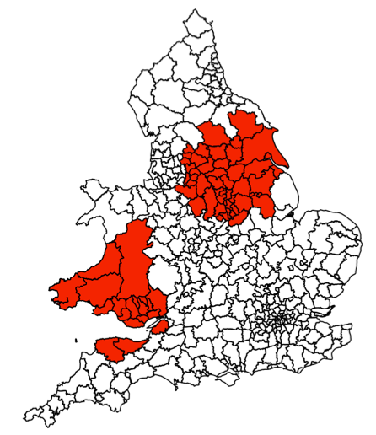
COPD application: SaTScan
Primary cluster: North (46 districts) – excess risk of 1.05 during 1990-92
Secondary cluster: Wales (19 districts) – excess risk of 1.12 during 1995-96

Slide 20
Example 2: Data mining of cancer registries
The Thames Cancer Registry (TCR) collects data on newly diagnosed cases of cancer in the population of London and South East England
We performed retrospective surveillance of time trends by local authority district (94 areas) for several cancer types using BaySTDetect for the period 1981-2008 (split into 7 x 4-year intervals)
aim to provide screening tool to detect areas with “unusual” temporal patterns
automatically flag-up areas warranting further investigations
aid local health resource allocation and commissioning

Slide 21
Results
Unpublished results presented at conference, but supressed for web publication

Slide 22
Summary
We have proposed a Bayesian space-time model for retrospective surveillance of unusual time trends in small area disease rates
Simulation study shows good performance in detecting realistic departures (1.5 to 2-fold change in risk) with relatively modest sample sizes (expected counts >20 per area and time period)
Improved performance and richer output than popular alternative (SaTScan)

Slide 23
Extensions
Possible extensions include:
Spatial prior on z_{i} to detect clusters of areas with unusual trends
Time-specific model choice indicator z_{it}, to allow longer time series to be analysed
Alternative approaches to calibrating posterior model probabilities, e.g. decision theoretic approach balancing false detection and sensitivity
Adapt method for prospective surveillance
Moving ‘window’ to down-weight past data
Adapt control chart methodology (e.g. average time until correct detection)

Slide 24
Future Applications
Quarterly hospital admissions for various diseases by district (cf Atlas of Variation in Healthcare)
Monthly GP data (symptoms) by PCT or CCG
Surveillance: “the systematic collection, analysis and interpretation of health data and the timely dissemination of this data to policymakers and others”
Need timely data collection
Need tools to visualize and interrogate output
Resource implications of conducting such surveillance and follow-up of detected areas
Thank you for your attention!

Slide 25
References
G. Li, N. Best, A. Hansell, I. Ahmed, and S. Richardson. BaySTDetect: detecting unusual temporal patterns in small area data via Bayesian model choice. Biostatistics (2012).
G. Li, S. Richardson , L. Fortunato, I. Ahmed, A. Hansell and N. Best. Data mining cancer registries: retrospective surveillance of small area time trends in cancer incidence using BaySTDetect. Proceedings of the International Workshop on Spatial and Spatiotemporal Data Mining, 2011.
www.bias-project.org.uk
Funded by ESRC National Centre for Research Methods

