Slide 1


Slide 2
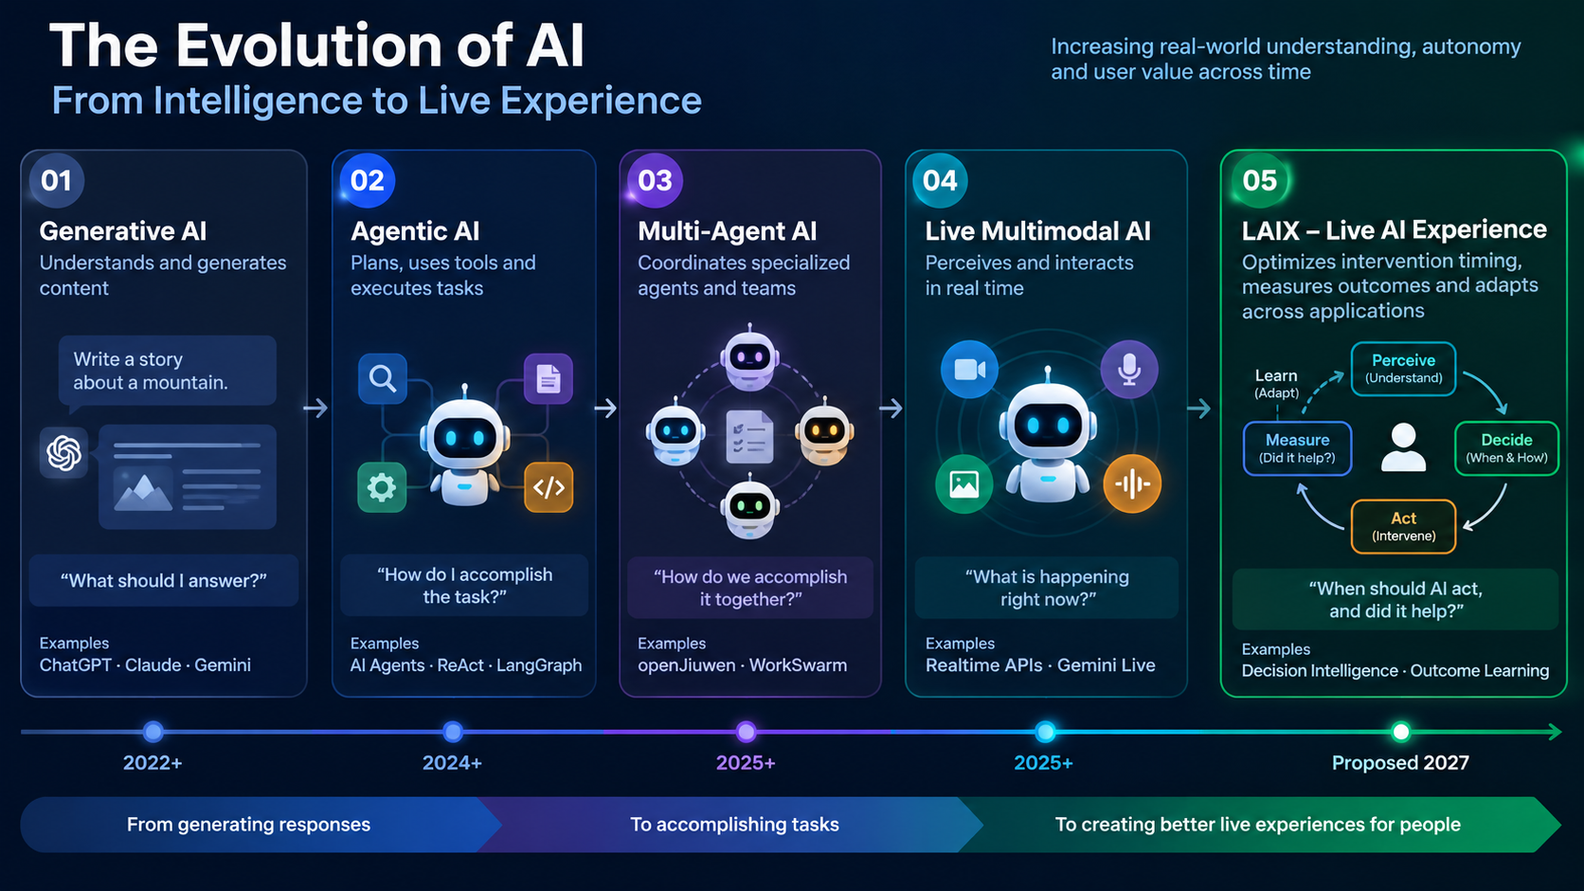

Slide 3
AI apps still react - live experiences need AI that knows when to act
1 / 4 · BACKGROUND & THE REAL PROBLEM
Models, agents and multimodal I/O are strong. The missing piece is the application intelligence that runs an experience over time.
BACKGROUND
FIVE REAL CHALLENGES - EVERY LIVE AI APP HITS THEM
What is already solved
Real-time multimodal APIs are generally available: OpenAI Realtime (GA Aug 2025), Gemini Live (voice + video, preview “proactive audio”).
Agent frameworks give durable state, memory, tools and human approval (LangGraph, openJiuwen / WorkSwarm).
Omni-modal serving is fast and efficient (vLLM-Omni, incl. experimental full-duplex streaming).
What is not
Most AI apps are still request → response. The user carries the context and the timing; the app forgets, interrupts at the wrong moment, or stays silent when help is needed.
1
Continuous state
What is happening now, toward which goal, how certain - over seconds to sessions.
Why today’s tools don’t solve it: Chat history and agent memory store what was said / planned, not the live situation.
2
Right action, right moment
Deciding whether to wait, ask, guide or act - without interrupting the user.
Why today’s tools don’t solve it: Open even for frontier video-LLMs - they spam or go silent (ProactiveBench, ESTP, SPOT-Bench).
3
Compute cost & latency
Always-on multimodal reasoning on every frame is slow and expensive.
Why today’s tools don’t solve it: Serving engines make each call cheaper; nobody decides which calls are worth making.
4
No outcome measurement
Did the cue improve the next rep? Did the user find the object?
Why today’s tools don’t solve it: Apps optimise clicks or satisfaction, not measured improvement.
5
Rebuilt in every app
Timers, thresholds, session state and feedback logic are hand-coded per app.
Why today’s tools don’t solve it: No reusable layer → slow delivery, no learning across apps.
VERIFIED: 1–3 (vendor docs, papers) HYPOTHESIS: 4–5 cost 30–50% of engineering - validate Q1 2027
Notes:
Self-reading slide 1. Background: what models/agents/serving already solve. Problem: apps are still request-response. Five concrete challenges, each with why existing tools do not solve it. Bottom line separates verified evidence from the hypothesis we will validate in Q1 2027. Sources: OpenAI Realtime API GA (Aug 2025); Google Cloud Gemini Live API docs; vLLM-Omni README; LangGraph durable execution docs; ProactiveBench arXiv:2507.09313; ESTP-Bench NeurIPS 2025 arXiv:2510.14560; SPOT-Bench arXiv:2604.24317.

Slide 4
LAIX: a shared intelligence layer above existing models and agents
2 / 4 · PROPOSED SOLUTION & ARCHITECTURE
We build the layer that decides whether, when and how an AI app acts - and reuse openJiuwen, vLLM-Omni and models underneath.
Observe
Understand
Maintain state
Decide
Act
Verify
Adapt
HOW LAIX DIFFERS
Existing | What it does well | Gap LAIX fills
Realtime APIs (OpenAI, Gemini Live) | Live voice / video, tools | No goal state, no outcome learning
Agent frameworks (LangGraph, openJiuwen) | Plans, tools, memory | Not timing- or perception-aware
Serving (vLLM-Omni) | Fast, cheap model calls | Doesn’t decide which calls
Vertical apps (Be My AI, form coaches) | Good single-domain UX | Hand-coded, not reusable
LAIX | Reuses all of the above | Reusable decision + outcome layer
L1 · APPS
Sports coach
Accessibility
Cooking
Creative
News
Future apps
L2 · LAIX EXPERIENCE INTELLIGENCE - WE BUILD
Live Context
cheap detectors always; deep model only when relevant / uncertain
Experience State
goal, phase, beliefs + confidence, expiry (TTL), past actions
Decision Engine ★
wait / ask / guide / act / verify / escalate under cost, latency, interruption, risk
Execution bridge
dispatches to openJiuwen skills; approval, cancel, recovery
Outcome Learning
measures if each action helped; adapts per user & app
Resource policy
model tier, edge vs cloud, skip inference when not needed
L3 · EXISTING INFRASTRUCTURE - WE REUSE
openJiuwen / WorkSwarm (agents, skills, memory, OTel) · vLLM-Omni (omni-modal serving) · speech / vision / LLM models · edge detectors · Huawei Cloud & Ascend
Delivered as: Runtime + SDK (Python/TS) + evaluation & observability tools + 3 reference apps. Edge library for ≤1 s decisions; cloud service for state, learning, evaluation.
Not another model, agent framework, assistant or app studio.
Notes:
Self-reading slide 2. Top strip: the closed loop. Left: three-layer architecture; LAIX builds only L2 (six modules, decision engine is the core research). Right: differentiation - each existing category does part of the job; LAIX's testable gap is a model-agnostic decision and outcome layer reusable across apps. Sources: OpenAI Realtime API; Gemini Live API (proactive audio, preview); LangGraph docs; vLLM-Omni; Be My Eyes.

Slide 5
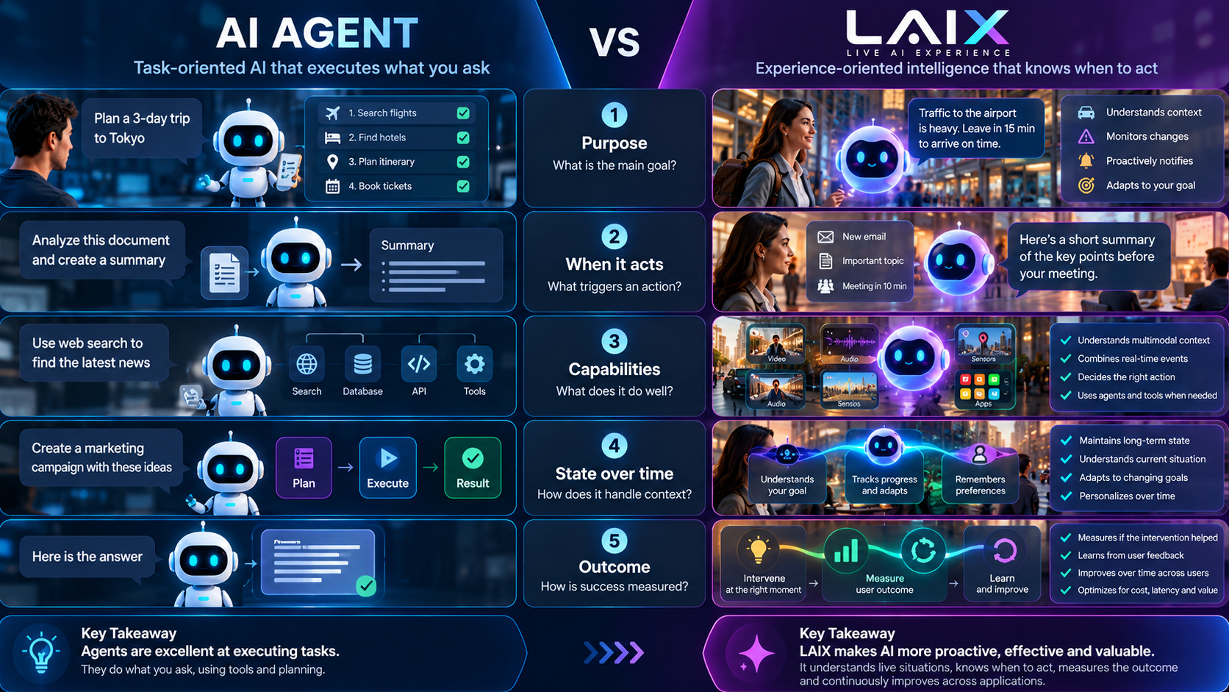

Slide 6
LAIX – How We Build the Intelligence
TECHNICAL APPROACH
Concrete algorithms and engineering approaches behind the Live AI decision loop.
Observe
Understand
Maintain state
Decide
Act
Verify
Adapt
Technology | HOW – Technical Approach | 2027 target
1 Continuous Context | Event-driven perception: lightweight detectors identify changes, uncertainty or anomalies; deep multimodal models are triggered selectively | Deep-model calls per session
2 Experience State | Temporal state graph + Bayesian belief updates + confidence decay and TTL, tracking goals, observations and previous actions | Decision quality with vs. without state
3 Decision Intelligence ★ | Contextual bandits / constrained MDP, selecting WAIT / ASK / GUIDE / ACT using expected benefit, interruption cost, latency and risk | Intervention precision ≥85%
4 Outcome Learning | Causal attribution where feasible + contextual bandit feedback, learning which interventions improve measured outcomes | User outcome +15% vs. baseline
5 Adaptive Inference | Cascaded inference, uncertainty-based model escalation, adaptive sampling and edge/cloud routing under latency and cost budgets | −30% deep calls · ≤1 s response
6 Reliable Execution | Event-driven state machines + openJiuwen skills, with approval gates, action verification, timeouts, cancellation and recovery | Verified-action rate · safe recovery
Design principle Safety rules first, learned policies only when data justifies them · we build the decision layer, reuse openJiuwen, vLLM-Omni and models.
Notes:
Self-reading slide: how each LAIX component is built.
1 Continuous Context — tiered perception (always-on cheap detectors → relevance × uncertainty gate → deep multimodal model only on demand; active perception asks for a better view).
2 Experience State — event-sourced temporal graph of goal, phase, observations and prior actions; beliefs updated Bayesianly, confidence decays and each belief carries a TTL.
3 Decision Intelligence — objective: maximise expected outcome gain minus interruption, cost and latency penalties, subject to hard risk rules and session budgets. Staged path: rules → hybrid LLM proposer + calibrated scorer → contextual bandits → constrained MDP only if delayed effects are proven.
4 Outcome Learning — pre/post measurement windows and micro-randomised hold-outs for causal attribution; doubly-robust off-policy evaluation before any policy update ships.
5 Adaptive Inference — cascade from edge detector to small model to omni model, escalation by uncertainty, adaptive frame sampling, edge/cloud routing within latency and cost budgets (complements vLLM-Omni, which makes each call cheaper).
6 Reliable Execution — event-driven state machines dispatching openJiuwen skills with approval gates, verification, timeouts, cancellation and recovery.
All "Measured by" values are 2027 research targets, not results.

Slide 7
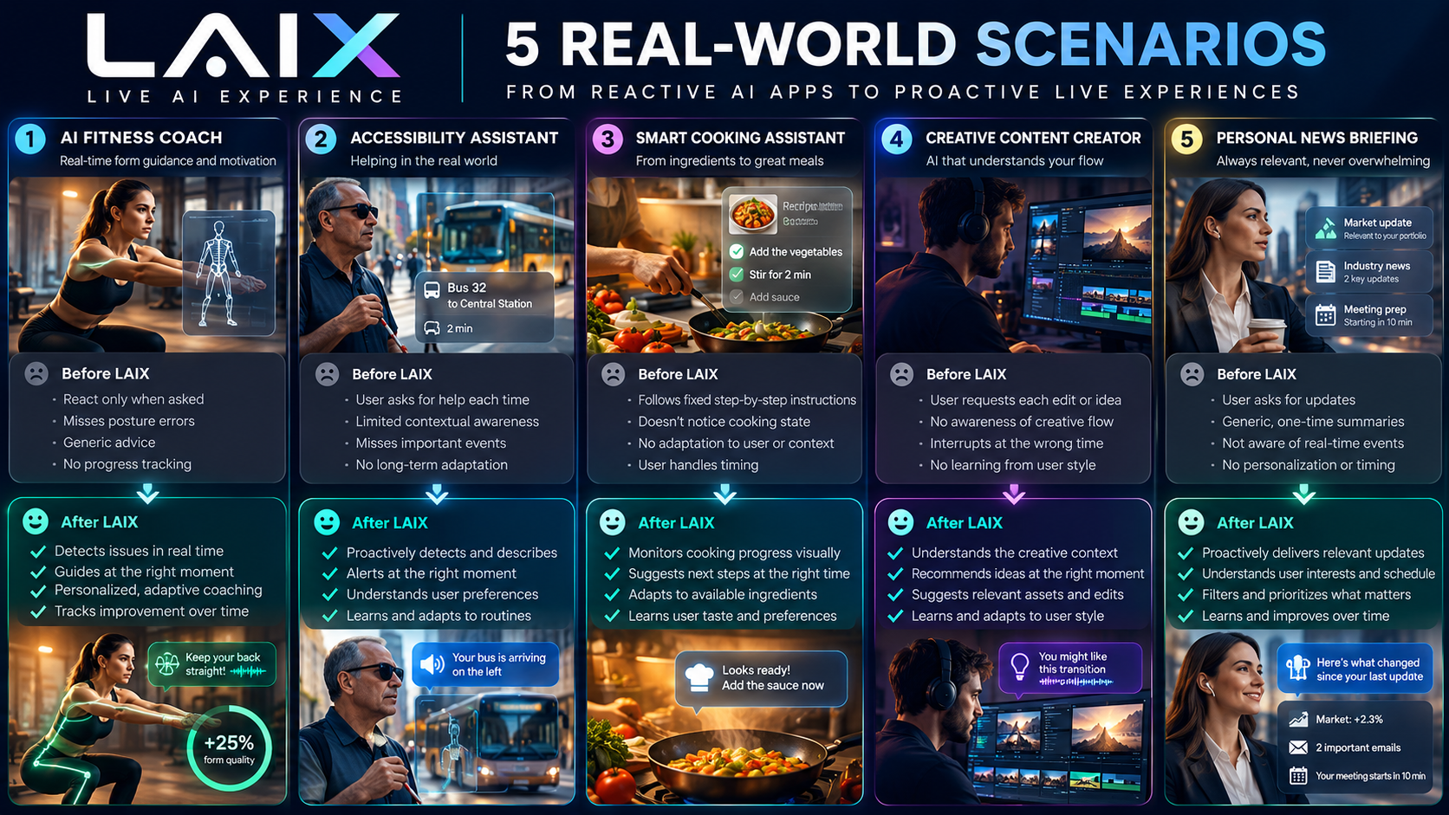

Slide 8
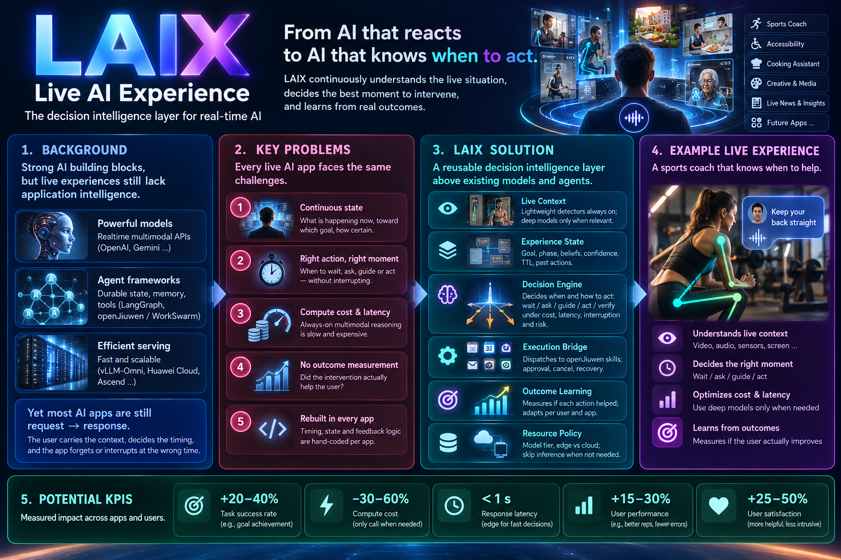

Slide 9
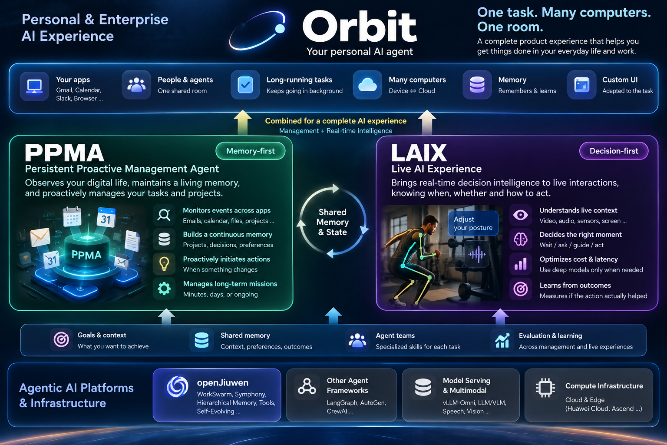

Slide 10
Measured against a strong baseline, proven on demos we already built
3 / 4 · EXPECTED KPIs & DEMOS
All KPIs are 2027 targets, not results. Baseline = same models + stateful agent + LLM-decided timing.
EXPECTED KPIs (2027 TARGETS)
DEMOS WE BUILT - AND WHAT EACH PROVES
+15%
user outcome
≥85%
intervention precision
Demo (exists today) | Today | LAIX capability it proves | 2027 role
Personal sports coach | Pose-based coaching | Continuous perception, cue timing, measurable gain | Flagship 1
Fridge → recipe | One-shot recipe from photo | Task state, changing constraints, approved actions | Flagship 2
Object finder (visually impaired) | Object recognition from images | Uncertainty: better view, verify, escalate | Flagship 3
InkWell | Children’s book from an idea | Creative state continuity across sessions | Reuse probe
News in One Minute | Daily 1-minute summary | Personal priorities, story continuity over days | Reuse probe
task success / measured improvement vs strongest baseline
AI acts only when experts agree it should
−30%
deep-model calls
≤1 s
response timing
same or better quality; lower cost per useful action
cue delivered within 1 s of the right moment
≥60%
core reuse
≤50%
developer effort
runtime components unchanged across 3 apps
time to build a live feature vs today
Method: controlled user studies (e.g. coach: ~24 users × 6 sessions), expert-annotated decisions, A/B in reference apps, quarterly Go/No-Go gates.
Not five products. The demos are test beds for one shared technology across timescales - seconds (object finding), minutes (coaching, cooking), sessions (creative), days (news). 3 flagships prove the loop; 2 probes prove it generalises. No new demos in 2027.
Notes:
Self-reading slide 3. Left: six KPIs, all 2027 targets versus a deliberately strong baseline (same models, stateful agent, LLM-decided timing). Right: the five existing internal demos, what exists today (as reported by the team), the LAIX capability each validates, and its 2027 role. InkWell description per team; to be confirmed.

Slide 11
2027: research, Runtime + SDK, proven reuse - gated every quarter
4 / 4 · INITIAL 2027 WORK PLAN
Goal: not more AI apps, but the technology that lets the next generation of AI apps be smart, proactive and improve over time.
Q1 · FOUNDATIONS
Q2 · CORE LOOP
Q3 · ADAPT & REUSE
Q4 · RELEASE
15+ developer / product-team interviews
Strong baselines set up (realtime APIs, LangGraph / WorkSwarm)
Reference architecture
Experience State runtime v0
Sports-coach baseline instrumented
Live Context integration
Hybrid decision engine (rules + LLM + calibrated scorer)
First closed loop end-to-end: sports coach
First user-outcome study
Outcome learning (bandit on logged data)
Cooking app on the same runtime
Reuse + cost measurement
SDK v0.5; accessibility lab protocol with partner
3 reference apps on one runtime
LAIX-Bench (“right action, right moment”)
Docs + open-source release candidate (openJiuwen ecosystem)
1 external pilot; 1 paper
G1 · Problem confirmed by ≥60% of teams; no overlap with internal Huawei projects
G2 · Intervention precision ≥80% and beats the strong baseline
G3 · ≥60% reuse; −20% cost per useful action
G4 · +15% user outcome; pilot LOI → 2028 decision
TEAM · 11 PEOPLE
Architecture & integration 1 · Context & State 2 · Decision Intelligence 3 · Outcome & Efficiency 2 · SDK & reference apps 3
END-2027 DELIVERABLES
Runtime + SDK · 3 reference apps · LAIX-Bench · KPI study results · OSS release candidate
OUT OF SCOPE · DEPENDENCIES
No models, serving engine, agent framework or new demos. Needs: openJiuwen, vLLM-Omni, Huawei Cloud, accessibility partner.
Notes:
Self-reading slide 4. Four quarters with concrete deliverables and a Go/No-Go gate at the end of each; investment expands in 2028 only if G4 passes. Bottom: team split, end-of-year deliverables, explicit out-of-scope items and dependencies.

