Slide 1
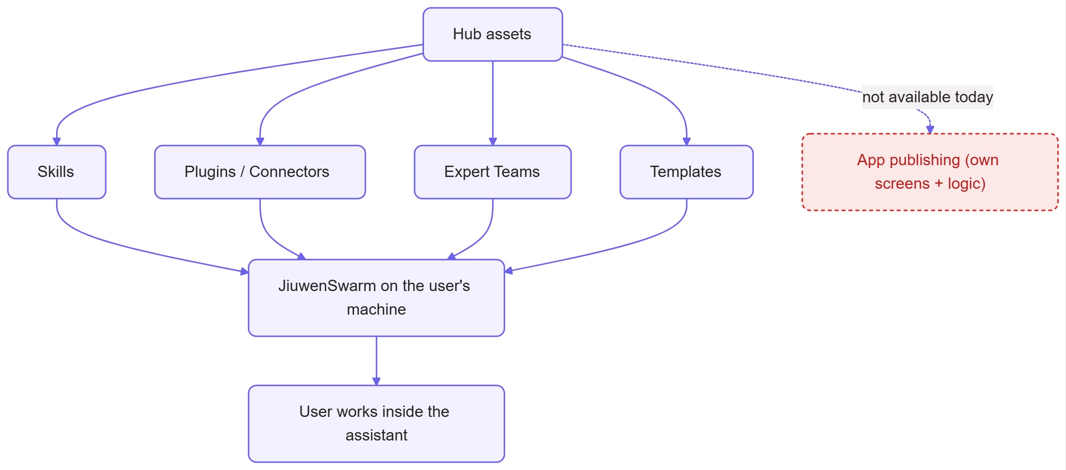
1 · Publishing as a plugin
The suggested route — and where it stops
• OpenJiuwen Agentic Hub publishes Skills · Plugins/Connectors · Expert Teams · Templates — all extend the assistant inside JiuwenSwarm.
• None is a complete app. Apps like InkWell have their own screens + logic, so a plugin can share their knowledge or tools — not the app itself.
• Bottom line: Publishing plugin that has it’s own screens+logic is not available today.
• What would make it possible — OpenJiuwen team would need to add:
(1) a Hub type for complete applications,
(2) install support that shows the app's own interface.

Slide 2
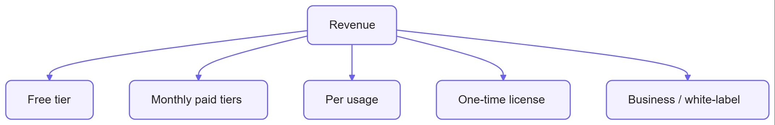
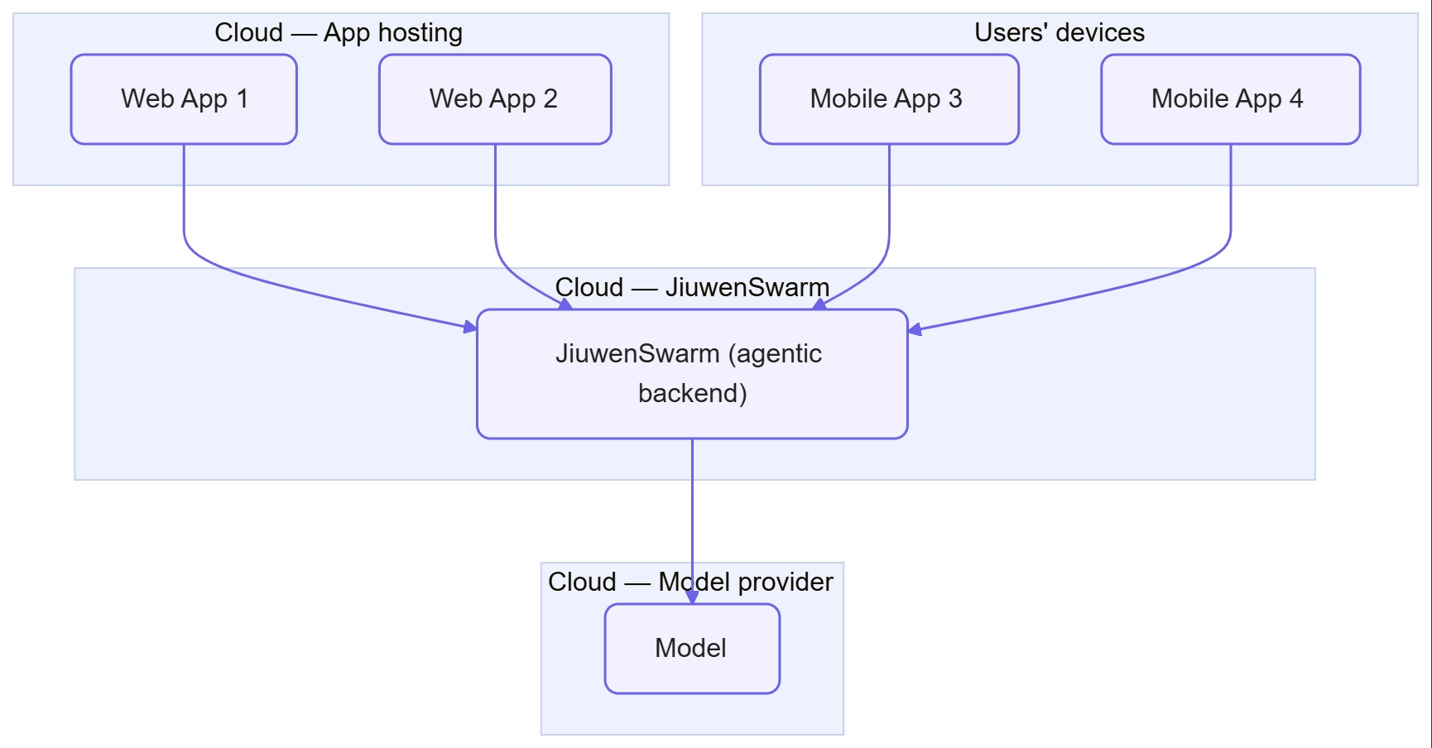
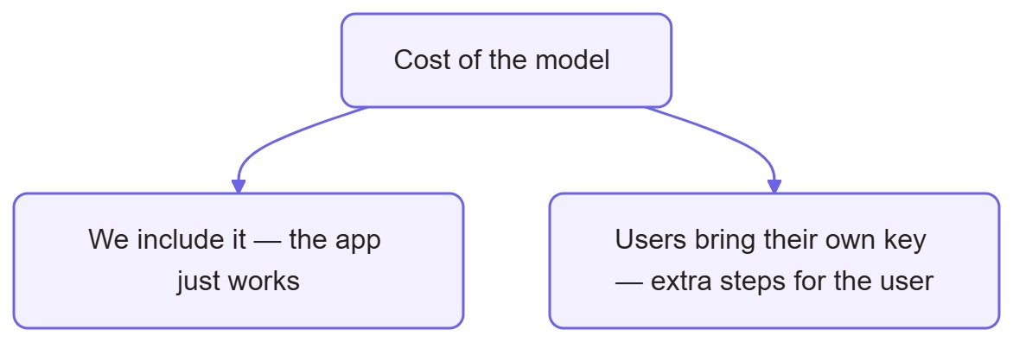
2 · Running it ourselves — and how we earn
Deployment — an always-on agent (like Muse / Dots / Grok)
• Host JiuwenSwarm in the cloud; our apps are the front end, JiuwenSwarm is the agentic backend.
• One backend, many apps. Web = open a link · Mobile = install from a store — otherwise identical.
Monetization
Free tier · Monthly paid tiers · Per usage · One-time license · Business / white-label
Model cost — one choice up front: we include it, or users bring their own key.

