Slide 1
On the way to a core PlanetaryPy Package
Michael Aye

Slide 2
What is this?
PlanetaryPy organization is community effort to
develop a core Python package for planetary science
help other planetary science Python programmers to disseminate their work
This talk is about the core package status only.

Slide 3
Core package work plan
I am since long working on a core package draft.
Nothing is especially clever, the structured unification is the clue!
Shall be submitted (done?) to the community members for review.
After successful review open for public pull requests and hackathons.
Core package focal points
Easier access, download, and local management of
PDS data
SPICE kernels
Removing need to learn various web interfaces for different data
Working easier with collections of PDS data
Easy basic SPICE calculations with human readable I/F
Some web and time related utilities

Slide 4
PDS Indexes

Slide 5
PDS Indexes
PDS Indexes contain useful meta-data for PDS datasets
planetarypy provides access to these via a config file
pull requests to config file will add more findable indices!
config file tells planetarypy where to find index
planetarypy downloads index file and
stored as parquet file, ready for pandas based analysis.
tells user when new index is available

Slide 6
Example use
from planetarypy.pds.apps import get_index df = get_index("cassini.iss", "index") print(df.info()) df.head(3)["FILE_NAME IMAGE_MID_TIME IMAGE_OBSERVATION_TYPE".split()]
<class 'pandas.core.frame.DataFrame'> RangeIndex: 407299 entries, 0 to 407298 Columns: 140 entries, FILE_NAME to STANDARD_DATA_PRODUCT_ID dtypes: Float64(70), Int64(20), datetime64[ns](7), string(43) memory usage: 470.0 MB None

Slide 7
Instrument data

Slide 8
Instrument data
Meant to serve as basic data access, read, and access classes
to be boosted in the future by the GOAT PDS reader pdr by Million, Inc.
config file controls what data levels are accessible
and how they are stored locally
currently CTX, HiRISE, UVIS, CISS are supported (Diviner in the works)

Slide 9
Example use HiRISE
from planetarypy.hirise import ProductPathfinder as PPF ppf = PPF("PSP_003092_0985_RED") print(ppf.jp2_path) print(ppf.homepage) print(ppf.abrowse_path) print(ppf.nomap_thumbnail_path)
Unable to display output for mime type(s): application/javascript, application/vnd.holoviews_load.v0+json
Unable to display output for mime type(s): application/javascript, application/vnd.holoviews_load.v0+json
Unable to display output for mime type(s): text/html
RDR/PSP/ORB_003000_003099/PSP_003092_0985/PSP_003092_0985_RED.JP2 https://uahirise.org/PSP_003092_0985 EXTRAS/RDR/PSP/ORB_003000_003099/PSP_003092_0985/PSP_003092_0985_RED.abrowse.jpg EXTRAS/RDR/PSP/ORB_003000_003099/PSP_003092_0985/PSP_003092_0985_RED.NOMAP.thumb.jpg

Slide 10
Example use CTXCollection
from planetarypy.ctx import CTXCollection coll = CTXCollection.by_month("F01") print(coll.n_items) print(len(coll.get_corrupted()))
1321 35

Slide 11
Archived SPICE kernels

Slide 12
Archived SPICE kernel sets
NAIF offers archived mission kernel sets for 33 missions:
Kernels can be subset by time window using Subset link.
planetarypy offers programmatic wrapper around subset feature.
Zip file unpacked.
Kernel files stored locally and logically.
Meta-kernel edited appropriately and immediately loadable.

Slide 13
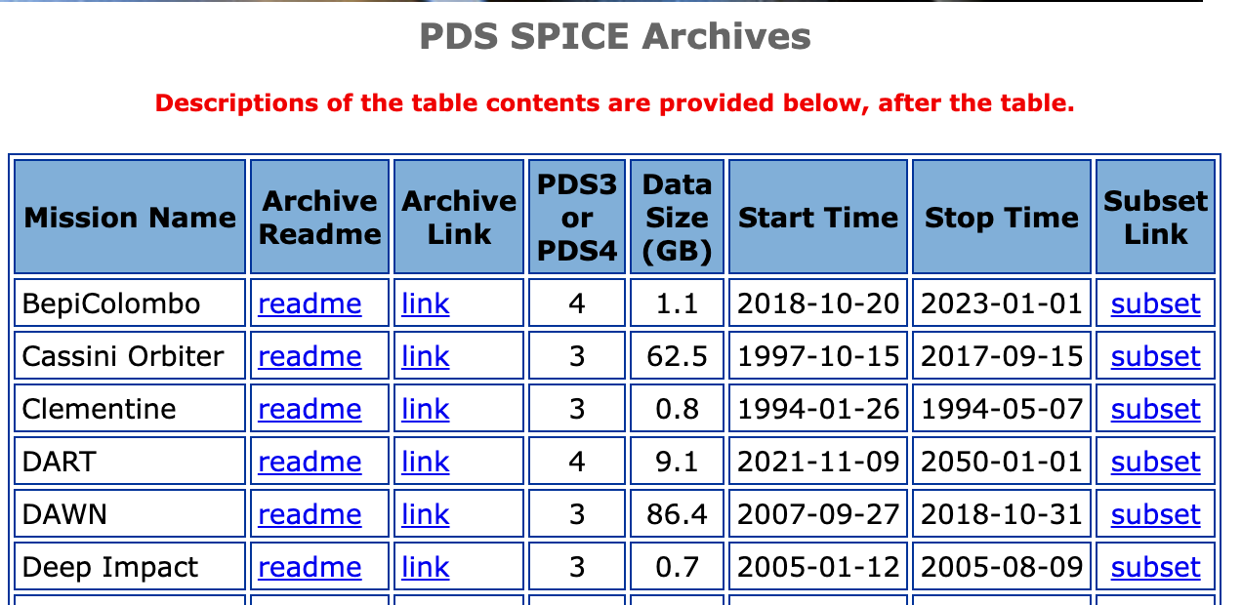

Slide 14
Example use
from planetarypy.spice import kernels kernels.datasets.drop("path", axis=1).head()
Two main user functions:
get_metakernel_and_files
will check if the kernel files are already locally available
if not, download kernels
returns the path to the edited meta-kernel
list_kernels_for_day
will only list kernel filenames valid for the given day

Slide 15
Generic kernels for illumination calculations

Slide 16
Generic kernels
Manages a minimal set for basic illumination calculations
Currently slightly biased for Mars but many other bodies work
Kernels are automatically downloaded and loaded when needed.

Slide 17
Example use
from planetarypy.spice.spicer import MoonSpicer moon = MoonSpicer("2022-02-22") print(f"Sol. const: {moon.solar_constant:.1f}") moon.set_spoint_by(lat=0, lon=0) moon.aspect = 180 moon.tilt = 30 print(f"Irradiance on tilted surface element: {moon.F_tilt:.1f}")
Sol. const: 1388.4 W / m2 Irradiance on tilted surface element: 412.5 W / m2

Slide 18
Come to the demo session!

