Slide 1
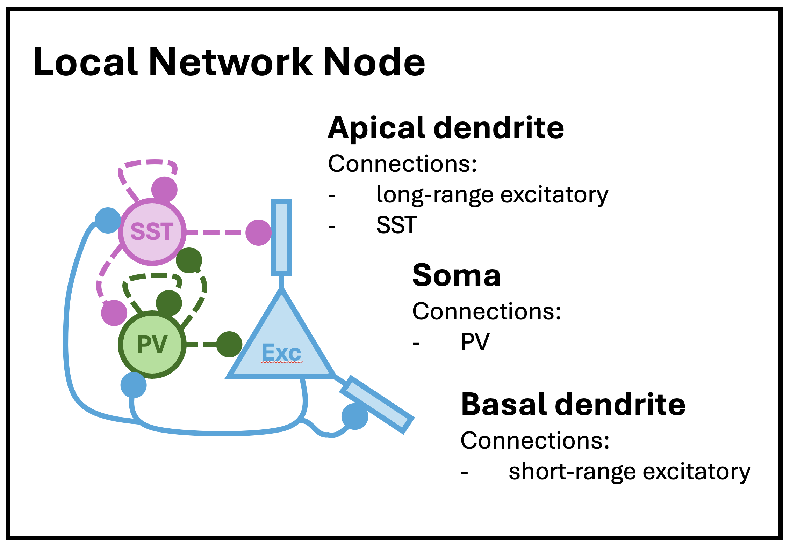
From Park & Geffen (2020)
Augmented with slot for basal dendrite

Slide 2
Bilateral ACx Circuit Motifs
Hi Freq
Anterior
Posterior
Low Freq
L2/3
SST
SST
SST
PV
Exc
PV
Exc
PV
Exc
L4
SST
SST
SST
PV
Exc
PV
Exc
PV
Exc
L5
SST
SST
SST
PV
Exc
PV
Exc
PV
Exc
L6
SST
SST
SST
PV
Exc
PV
Exc
PV
Exc
*di?
Repeats across all layers and columns
Potentially repeats across all columns
MGB
Repeats across all columns
Canonical intracortical and intracolumnar excitatory projections, sensory cortex: (Harris & Mrsic-Flogel 2013)
Each column receives thalamic input to all layers (L4 receiving strongest input).
Each column receives input from a different thalamic site with its own best frequency (tonotopy).
Feedback inputs to the column from downstream cortex and thalamus not shown.
Excitatory outputs to downstream cortex and back to the thalamus are not shown.
Standard ACx lateral motif: transcolumnar lateral connections used by Park & Geffen (2020) in their model.
PNs synapse onto all immediate laminar neighbors (Ant and Post).
SSTs synapse onto both immediate laminar PN neighbors (Ant and Post).
PV make no non-local connections in the standard lateral motif.
Applies to every local network node.
Hypothetical translaminar L5/6 PV arborization: Observed in a small percentage of L5/6 PV basket cells in the visual and somatosensory cortices. (Bortone et al. 2014, Frandolig et al. 2019)
PV cell synapses onto all PNs above it.
Applies sparsely (if at all) to only to a few local network nodes in L5 and L6 (or, applied to all, with attenuation via low weighting or stochastic activation).

Slide 3
Bilateral ACx Circuit Motifs
Hi Freq
Anterior
Posterior
Low Freq
L2/3
SST
SST
SST
PV
Exc
PV
Exc
PV
Exc
L4
SST
SST
SST
PV
Exc
PV
Exc
PV
Exc
L5
SST
SST
SST
PV
Exc
PV
Exc
PV
Exc
L6
SST
SST
SST
PV
Exc
PV
Exc
PV
Exc
Repeats across all layers and columns
Potentially repeats across all columns
MGB
Repeats across all columns
Canonical intracortical and intracolumnar excitatory projections, sensory cortex: (Harris & Mrsic-Flogel 2013)
Each column receives thalamic input to all layers (L4 receiving strongest input).
Each column receives input from a different thalamic site with its own best frequency (tonotopy).
Feedback inputs to the column from downstream cortex and thalamus not shown.
Excitatory outputs to downstream cortex and back to the thalamus are not shown.
Standard ACx lateral motif: transcolumnar lateral connections used by Park & Geffen (2020) in their model.
PNs synapse onto all immediate laminar neighbors (Ant and Post).
SSTs synapse onto both immediate laminar PN neighbors (Ant and Post).
PV make no non-local connections in the standard lateral motif.
Applies to every local network node.
Hypothetical translaminar L5/6 PV arborization: Observed in a small percentage of L5/6 PV basket cells in the visual and somatosensory cortices. (Bortone et al. 2014, Frandolig et al. 2019)
PV cell synapses onto all PNs above it.
Applies sparsely (if at all) to only to a few local network nodes in L5 and L6 (or, applied to all, with attenuation via low weighting or stochastic activation).

Slide 4
Left ACx Circuit Motifs
Hi Freq
Anterior
Posterior
Low Freq
Hypothesized TC→L6PV, Low→Hi-L6PV pathway. (Prelim data)
L2/3
SST
SST
SST
Hi→Low-L6PN and similar pathways. (Levy et al. 2019, Oviedo et al. 2010)
PV
Exc
PV
Exc
PV
Exc
Loops and recurrent pathways unique to the left Acx. (Oviedo et al. 2010)
L4
SST
SST
SST
PV
Exc
PV
Exc
PV
Exc
L5
SST
SST
SST
PV
Exc
PV
Exc
PV
Exc
L6
SST
SST
SST
PV
Exc
PV
Exc
*non-CT-PN?
PV
Exc
Repeats across all columns
*TC-PN
Repeats across all columns
MGB
Repeats across all columns

Slide 5
Right ACx Circuit Motifs
Hi Freq
Anterior
Posterior
Low Freq
Excitatory into inhibitory pathways unique to the right ACx. (Oviedo 2017)
The transcolumnar L6PN to L3SST projection is not always there.
L2/3
SST
SST
SST
PV
Exc
PV
Exc
PV
Exc
Excitatory into excitatory transcolumnar pathways. (Levy et al. 2019)
Loops and recurrent pathways unique to the right ACx. (Oviedo et al. 2010)
L4
SST
SST
SST
PV
Exc
PV
Exc
PV
Exc
L5
SST
SST
SST
PV
Exc
PV
Exc
PV
Exc
L6
SST
SST
SST
PV
Exc
PV
Exc
PV
Exc
Repeats across all columns
Repeats across all columns
Repeats across all columns

Slide 6
Local Network Node
Apical dendrite
Connections:
long-range excitatory
SST
SST
Soma
Connections:
PV
PV
Exc
Basal dendrite
Connections:
short-range excitatory
SST
Local Network Node
PV
Exc
Apical dendrite
Connections:
long-range excitatory
SST
SST
Soma
Connections:
PV
PV
PV
Exc
Basal dendrite
Connections:
short-range excitatory
SST
Exc
Exc

Slide 7
SST
SST
SST
PV
Exc
PV
Exc
PV
Exc
SST
SST
SST
PV
Exc
PV
Exc
PV
Exc
SST
SST
SST
PV
Exc
PV
Exc
PV
Exc
SST
SST
SST
PV
Exc
PV
Exc
PV
Exc

Slide 8
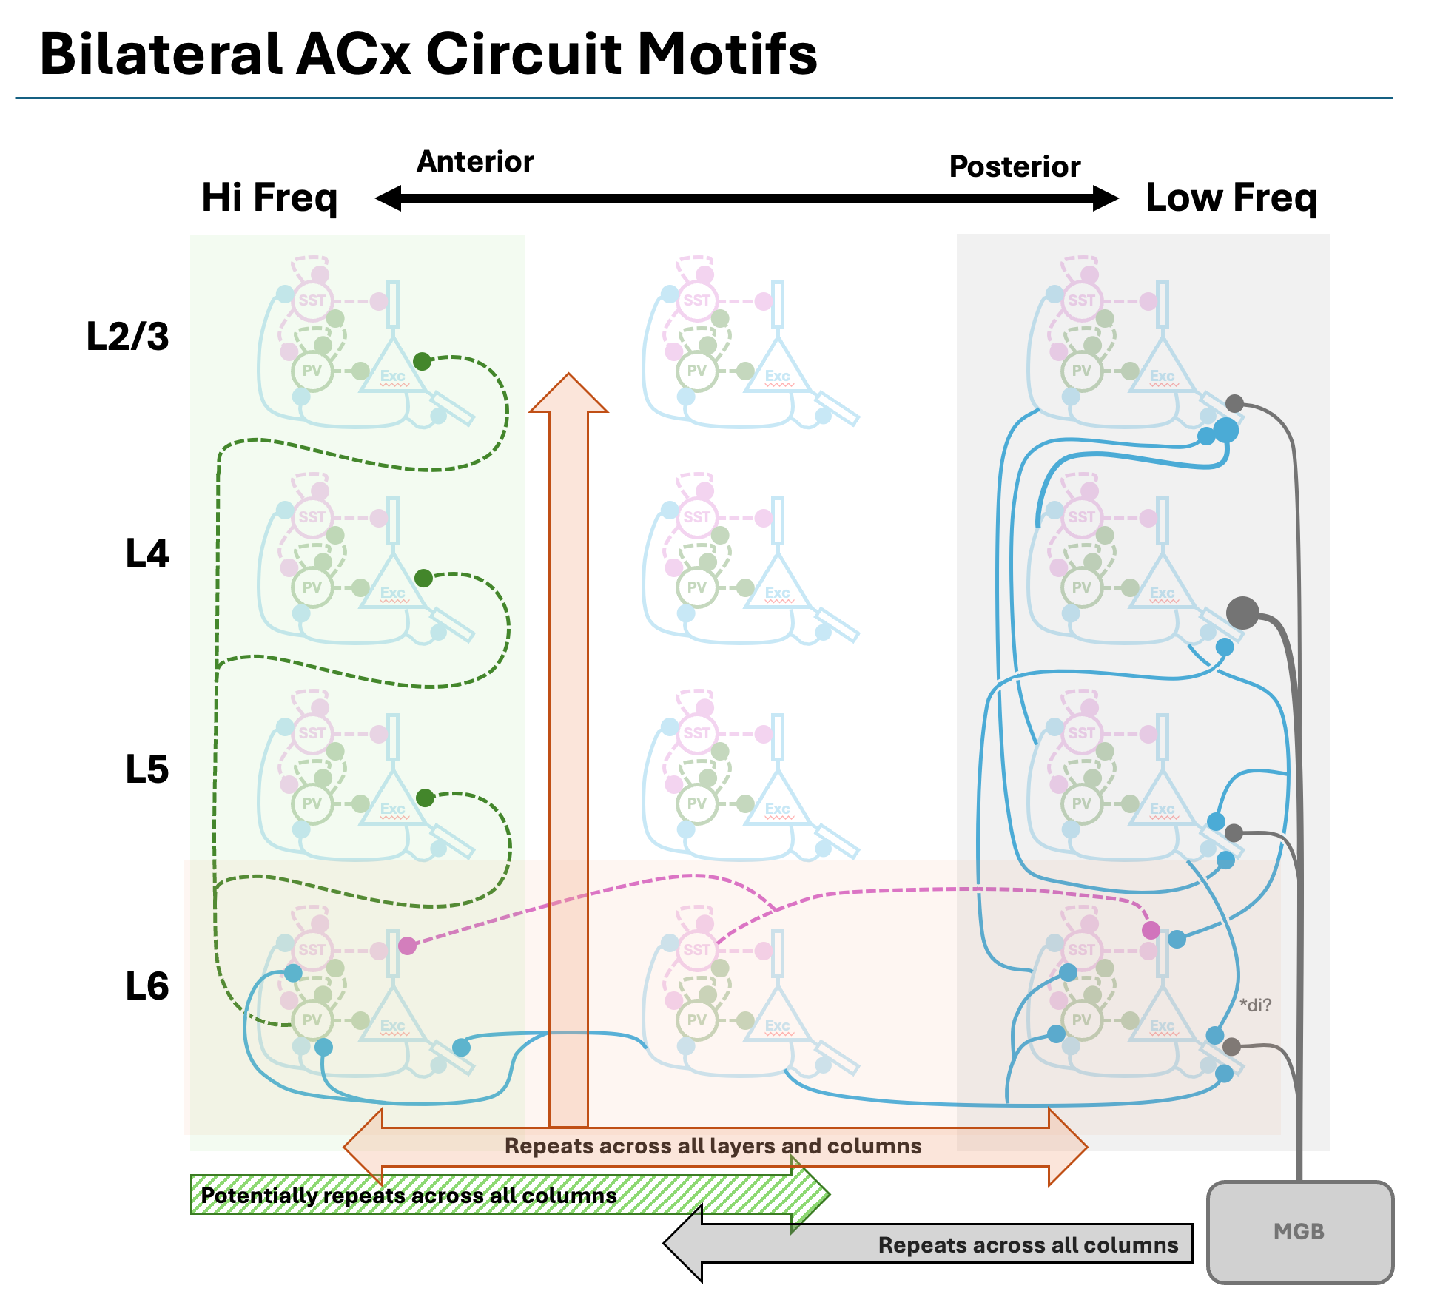
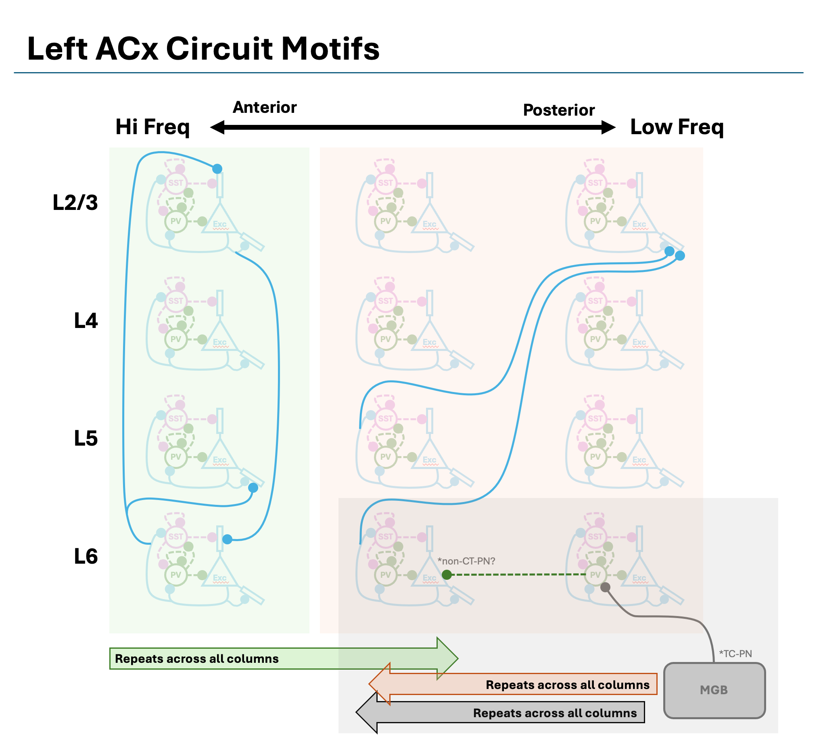

Slide 9
