Slide 1
CMPINF0401 Recitation
Tuesdays 11:00-12:50
Michael Bartlett

Slide 2
Overview
Finalized Office Hours Location
Loops
While Loop
Do-While Loop
For Loop
Lab 4

Slide 3
Finalized Office Hours Location
5806 Sennot Sq.
11:30-1 on Wednesday
12:30-2 on Thursday

Slide 4
Loops
Exactly what it sounds like!
Avoids the need to write the same block of code over and over again
Loops will check to see if a condition is true and execute the code inside of it any number of times depending on whether the condition stays true
Almost like an if statement if it ran over and over…
Three types
While loop
Do-while loop
For loop

Slide 5
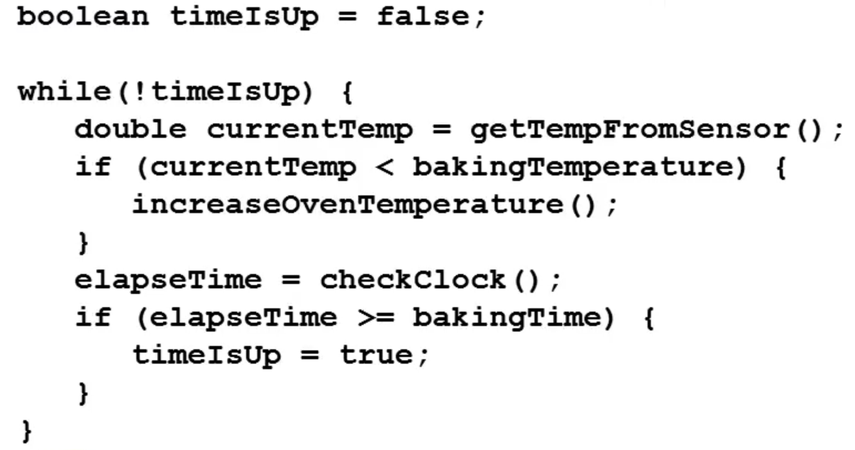
While Loops
In plain English: “While this condition is true, do this action”
To unpack this example
Our condition is checking whether the time on the oven is up or not
While it isn’t, we elapse time and check to see if the elapsed time is equal to the baking time
If they’re equal, then we set timeIsUp to true.
The loop will stop when it goes back to check whether the while clause is true; since timeIsUp is true, !timeIsUp will be false, so we exit the loop

Slide 6
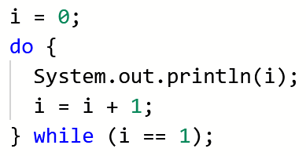
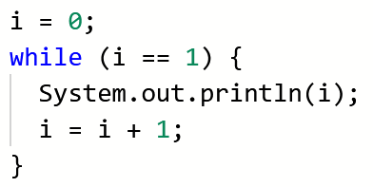
Do-While Loops
In plain English: “Do this action, and while the condition is true, do it again”
Essentially… the same as a while loop, except the code inside of the loop always runs at least once
The loop on the left will print the numbers 0 and 1 (because it will always run at least once, and the second time it runs, the condition at the end is true), but the loop on the right will print nothing because the condition at the beginning is false

Slide 7
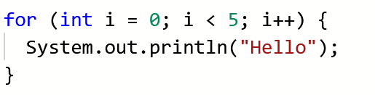
For Loops
Initialization condition update
There are three clauses in a for loop:
Initialization
Condition
Update
The convention when initializing a variable is to use the letter i as your variable name – it’s essentially the only time you should be using single-letter variables!
Notes:
It will print 5 times!

Slide 8
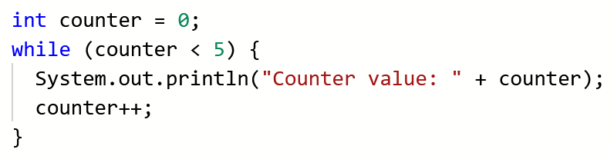
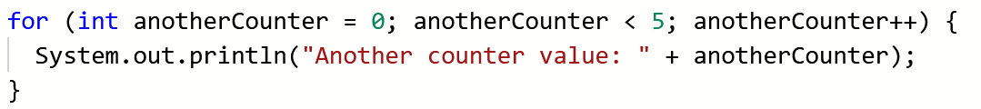
For Loops
A bit harder to translate into plain English, so let’s compare to a while loop
Initialize a variable (1), create a Boolean condition (2), increment the variable (3)
1
2
3
1
2
3

Slide 9
Nested Loops
Think nested if statements, but with loops!
A loop within a loop (within a loop, within a loop…)
These tend to be harder to debug since it’s two loops that can potentially go haywire and never stop… more on infinite loops in a bit
The convention for nested for loops specifically is to have your outer for loop’s variable be i and your inner for loop’s variable be j

Slide 10
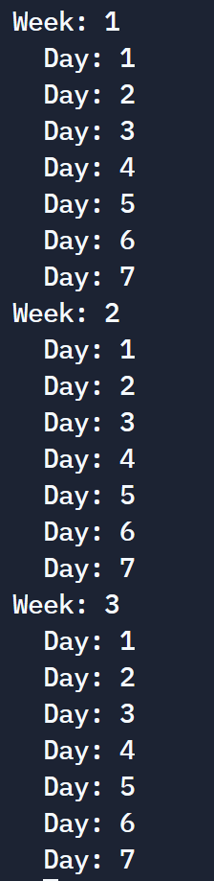
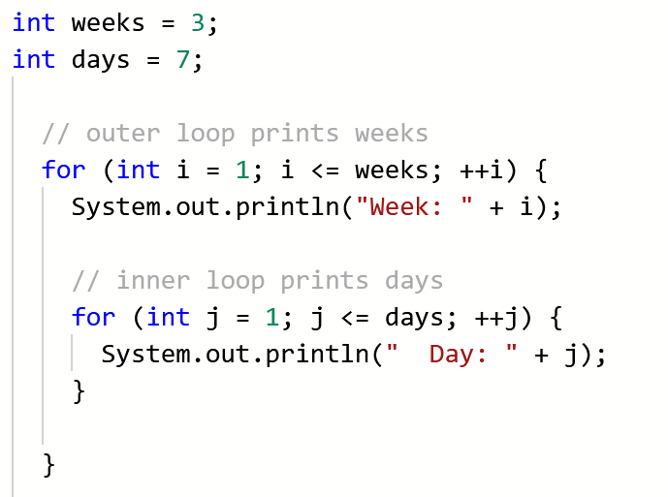
Nested Loops
An example and its output…

Slide 11
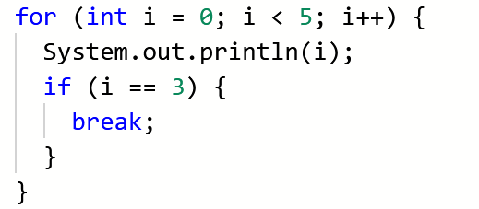
The Break Keyword
Remember this from switch cases?
The break keyword essentially “breaks” the loop
It stops the loop exactly where it is in its tracks; code will continue to run, but outside of the for loop
Very helpful in debugging infinite loops!
Outputs 0 1 2 3 AND THEN STOPS!

Slide 12
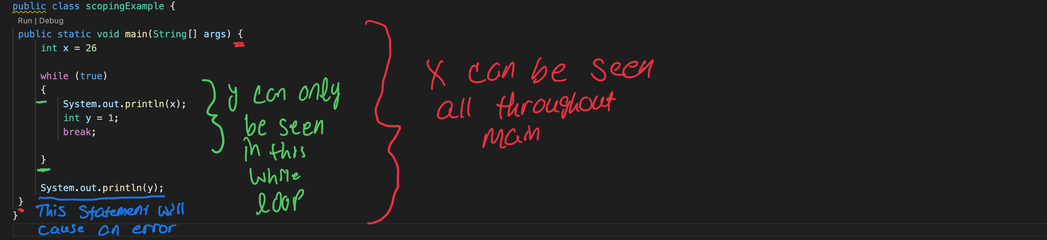
Scoping Blocks
Variables declared in main can be seen anywhere in the main method.
Variables declared in loops and if statements can only be seen in those loops and if statements.
Notes:
Just a reminder, code blocks apply to loops!

Slide 13
Lab 4
Assignment:
https://canvas.pitt.edu/courses/127916/files/8050393?module_item_id=2735263

Slide 14
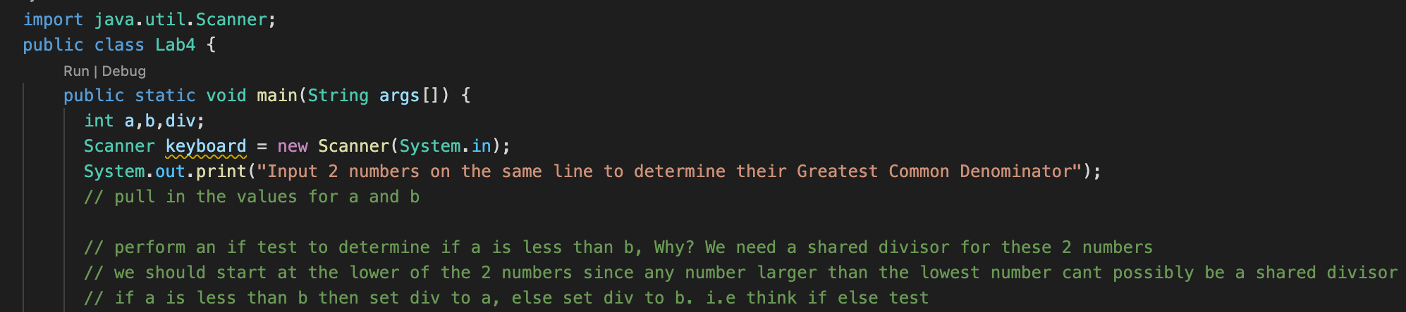
Lab 4
You need to start by getting two values from one prompt on the command line.
Remember we do this with two keyboard.nextInt() calls in a row after the prompt
Then, you need to perform a test to see if a < b
Can be done with if else with div being set equal to the proper variable.

Slide 15
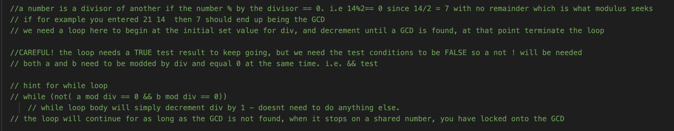
Lab 4
After you write your if-else test and set div equal to the right variable, all you need to do is use the while loop skeleton to write a while loop the decrements div by one every time the condition is in parenthesis is true.
Remember to use the right symbol (!) for not.
And the right symbol (%) for the modulus operator.

