Slide 1
CMPINF0401 Recitation
Tuesdays 11:00-12:50
Michael Bartlett

Slide 2
Overview
In-Person learning starts this week
Code blocks
If Statements
Assignment 1
Lab 3

Slide 3
In-Person Learning
This recitation will be help in CL116.
If we’re told to go hybrid, I’ll continue using the same Zoom link.
Office hours will stay online this week but move to in-person next week.
5806 Sennot Sq.
This may change if more rooms open.
11:30-1 on Wednesday
12:30-2 on Thursday

Slide 4
Code Blocks
Code blocks in Java keep everything together that needs to stay together.
For example, with if-statements, those are a “block” of code. Everything in the if-statement is one “block”
If you try to use a variable that was declared in an if statement outside of the if statement, you won’t be able to because that variable is scoped to only be a part of that if-statement.
The same holds true for for-loops, methods, and so on.

Slide 5
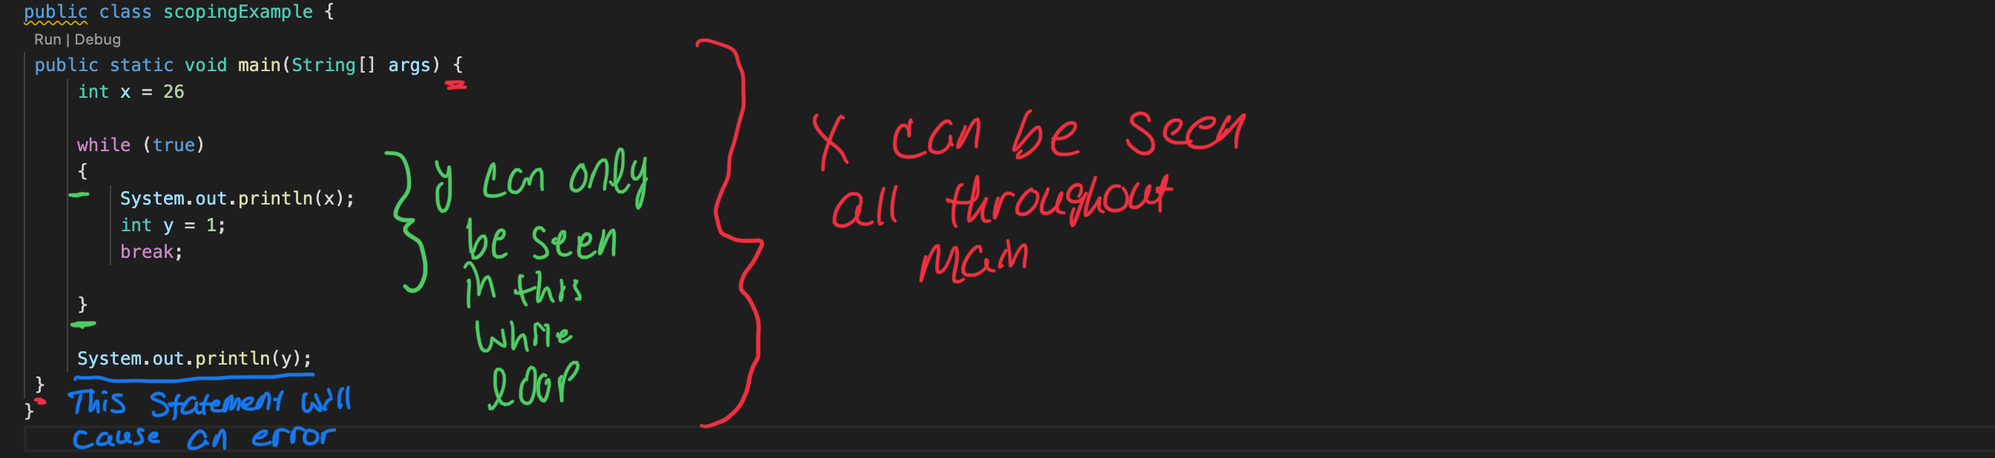
Code Blocks

Slide 6
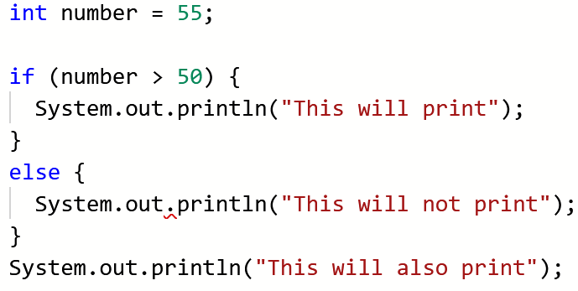
If structures
Simpler than you might think…
If this is true, do this. Otherwise, do that.

Slide 7
What goes in an if statement?
Condition | Meaning
a == b | Equal to
a > b | Greater than
a < b | Less than
a >= b | Greater than or equal to
a <= b | Less than or equal to
a != b | Not equal to
str1.equals(str2) | Seeing if strings are equal
str1.equalsIgnoreCase(str2) | Seeing if strings are equal while ignoring case sensitivity

Slide 8
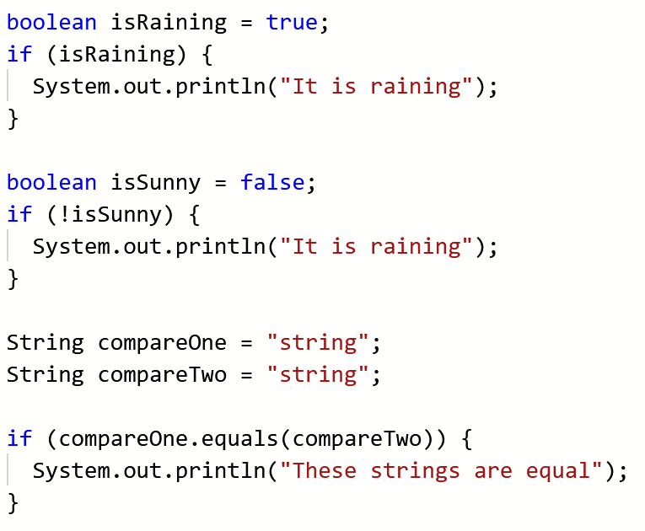
What goes in an if statement?

Slide 9
If Statements Example
LetterGradeTest.java
Provided by Professor Devine

Slide 10
Lab 3
Assignment:
https://canvas.pitt.edu/courses/127916/files/8050392?module_item_id=2735250
I suggest using LetterGradeTest.java (on Canvas) as a starting point.
You’re given the scores and the grades that are needed to obtain each score. Using those, make the proper if else-if statements to set the grade to the correct value.
Be sure that you’re using the proper signs too in your if-statements (greater than vs. greater than or equal to)
It’s best to use a different datatype for grade because chars only hold one character.

Slide 11
Assignment 1
Assignment:
https://canvas.pitt.edu/courses/127916/files/8256163?module_item_id=2824697
For this assignment, you’re getting data from the user and doing calculations
Be sure to use the proper datatype and the proper .next() when using the scanner.
Read the comments which provide pseudocode for the calculations that you need to do.

