Slide 1
CMPINF0401 Recitation
Tuesdays 11:00-12:50
Michael Bartlett

Slide 2
Overview
Object Oriented Programming (OOP)
Lab 9

Slide 3
OOP: What’s an object?
Technically speaking, an object is a bundle of state and behavior:
State: The data contained in the object (the object’s fields)
Behavior: The actions supported by the object (its methods)

Slide 4
OOP: What’s a Class?
Every object has a class
A class defines the object’s methods and fields
A class defines both type and implementation
Type → Where the object can be used (What datatypes is the constructor going to accept?)
Implementation → How the object does things (its methods)

Slide 5
OOP: Class vs. Objects Example
Example of a class:
Fruit
Car
Example of corresponding objects:
Apple, Banana, Mango
Volvo, Audi, Toyota
So, a class is a template for objects, and an object is an instance of a class

Slide 6
OOP: Class vs. Objects Example
When we create individual objects, they inherit all the variables and methods from the class
We’ve seen this with Strings:
String name = “Michael”
name is a String Object where String is a class
name = name.toUpperCase();
Now, name == ”MICHAEL”
name was able to use the predefined method for the String object

Slide 7
OOP: Interfaces vs Classes
Interfaces can be used to define the methods that the class must contain
For example, an interface might define a Car like this:
interface Car { public String getColor();}
The class for a type of Car could look like this:
class Volkswagen implements Car { String color = “blue”; // Normally done with an init method public String getColor() { return(this.color); } }

Slide 8
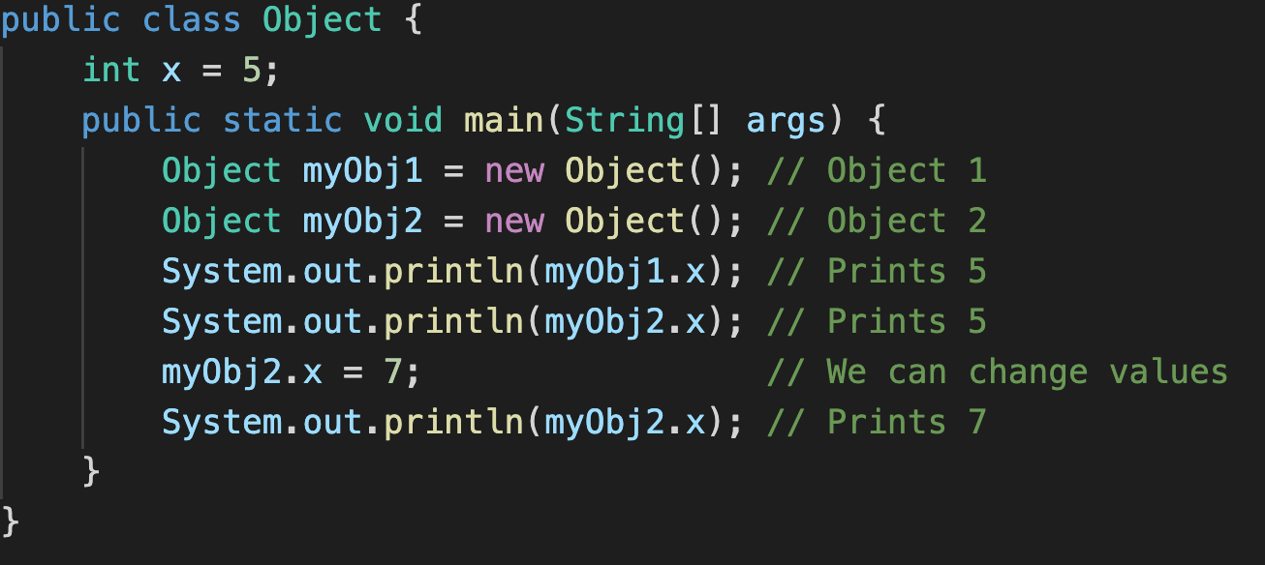
How do we make objects?
We saw the previous String example, but how do we define our own and use them?

Slide 9
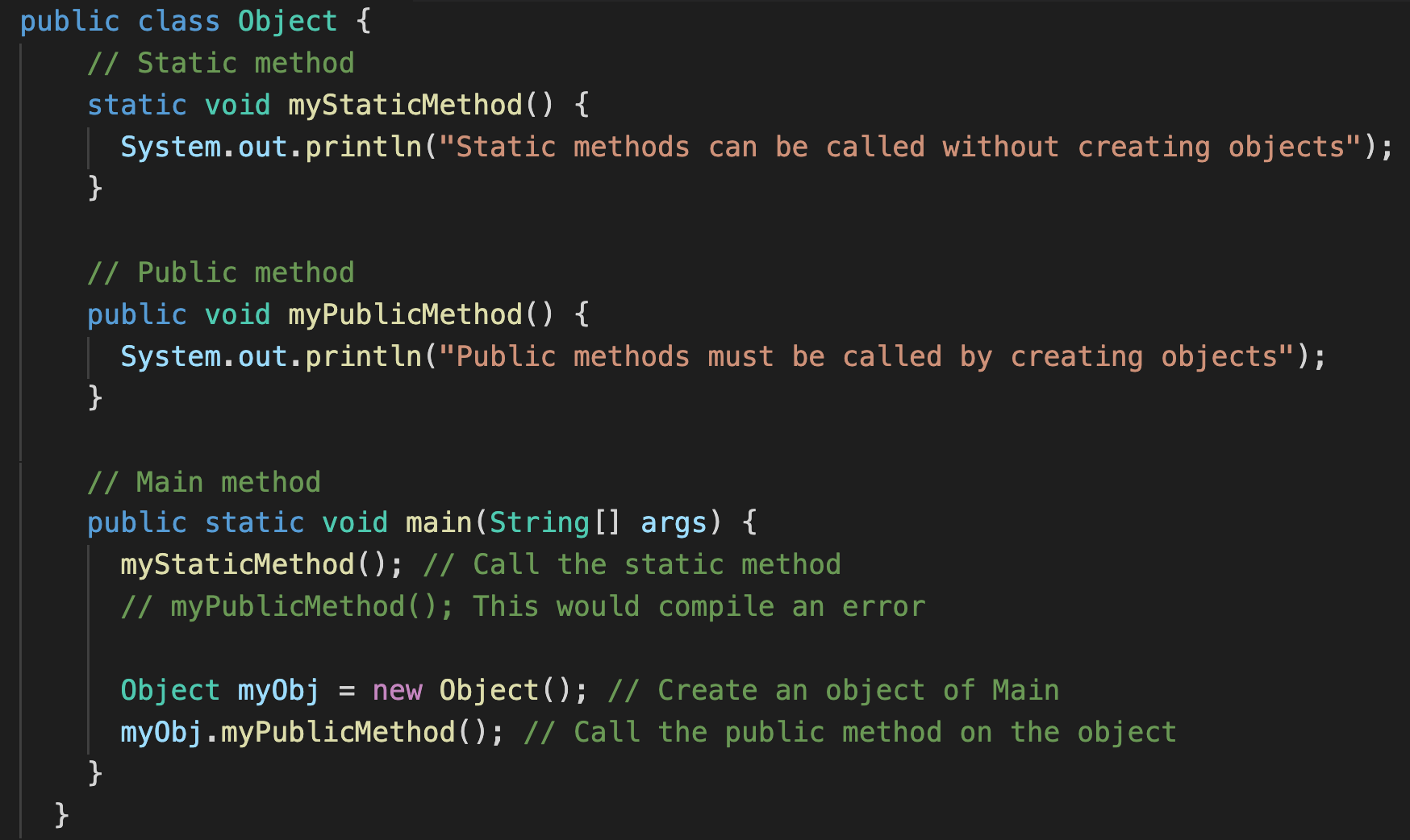
Classes can have methods
As shown before, we know that Classes can have methods. There are two types, static and public.
Static can be accessed without creating an object of the class, public needs an instance of the class to be created.

Slide 10
Constructors
A constructor is a special method that is used to initialize objects.
The constructor is called when an object of a class is created.
It can be used to set initial values for object attributes

Slide 11

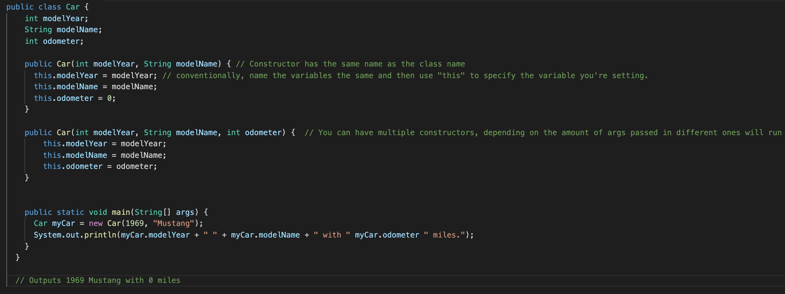
Constructors Example

Slide 12
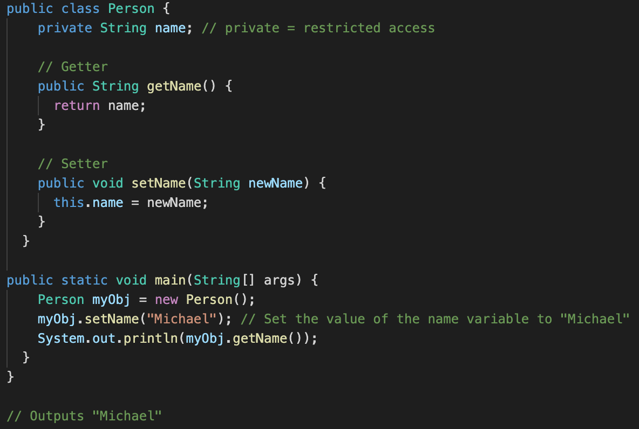
Encapsulation
Encapsulation: make sure that “sensitive” data is hidden from users. To do this:
Declare class variables/attributes as private
Provide public get and set methods to access and update the value of a private variable.

Slide 13
Why Encapsulation?
Better control of class attributes and methods
Class attributes can be read-only (if they can only be accessed through a get method), or write-only (if they can only be accessed through a set method).
Flexible: The programmer can change one part of the code without affecting others
Increased Security: hide data that shouldn’t be available to all users, test to see if the value being set is valid (i.e., a Person’s weight shouldn’t be 0)

Slide 14
Lab 9
Due 4/4
https://canvas.pitt.edu/courses/127916/files/8050409?module_item_id=2735328

Slide 15
Lab 9
Vehicle class:
Add a private attribute for the ‘make’ of the car.
Should use encapsulation which means that you need getter (return make) and setter (store make as an uppercase String) methods for it
Fleet class:
Get rid of the hardcoded values for car1 and car2.
Make car1 by using the BASE CONSTRUCTOR (no args)
Use a Scanner to prompt the user for one variable at a time and use car1’s setters to set the variables
Make car2 by using the OVERLOAD CONSTRUCTOR (provide args)
Get values from the user with a Scanner (store as variables in your main), and then pass those variables into the constructor
Call .stats for both cars and screenshot it as part of your submission

