Slide 1
CMPINF0401 Recitation
Tuesdays 11:00-12:50
Michael Bartlett

Slide 2
Overview
Inheritence & Polymorphism
Lab 10

Slide 3
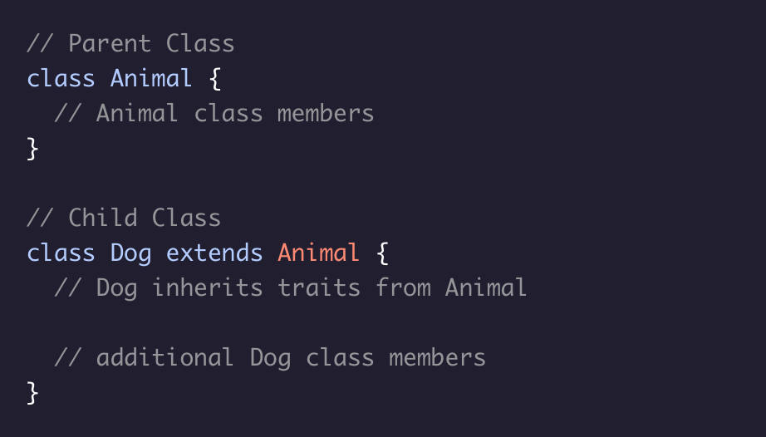
Inheritance
An important feature of OOP, it allows for one class (child class) to inherit the fields and methods of another class (parent class).
When defining a child class, we use the keyword extends to inherit from a parent class

Slide 4
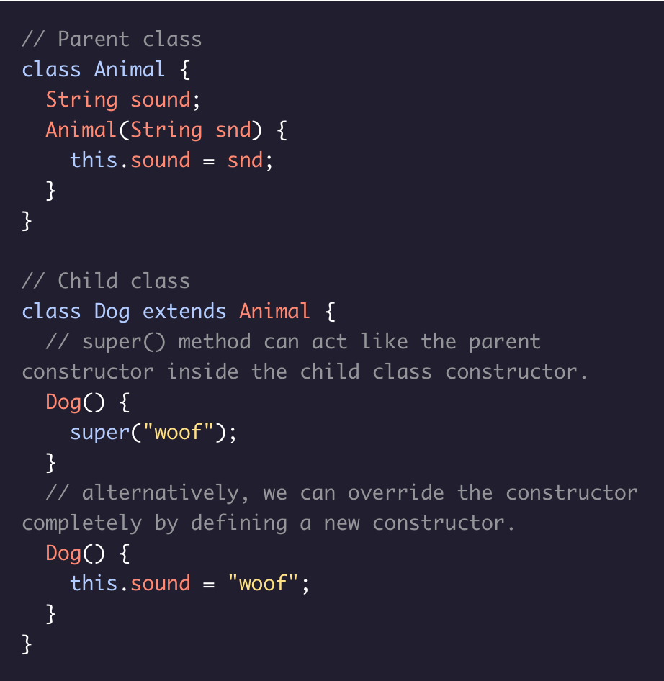
Super()
A child class inherits its parent’s fields and methods, meaning it also inherits the parent’s constructor.
Sometimes we may want to modify the constructor, in which case we can use the super() method, which acts like the parent constructor inside the child class constructor.
Alternatively, we can also completely override a parent class constructor by writing a new constructor for the child class.

Slide 5
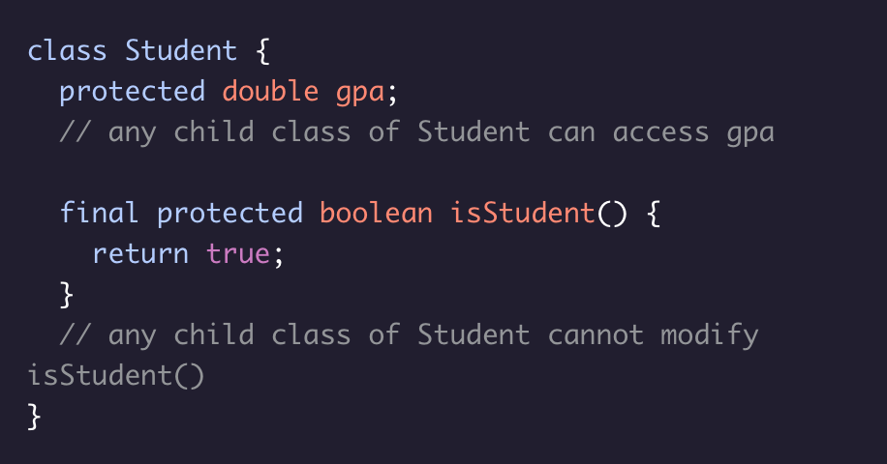
Protected & Final
When creating classes, sometimes we may want to control child class access to parent class members.
We can use the protected and final keywords to do just that.
protected keeps a parent class member accessible to its child classes, to files within its own package, and by subclasses of this class in another package.
Adding final before a parent class method’s access modifier makes it so that any child classes cannot modify that method - it is immutable.

Slide 6
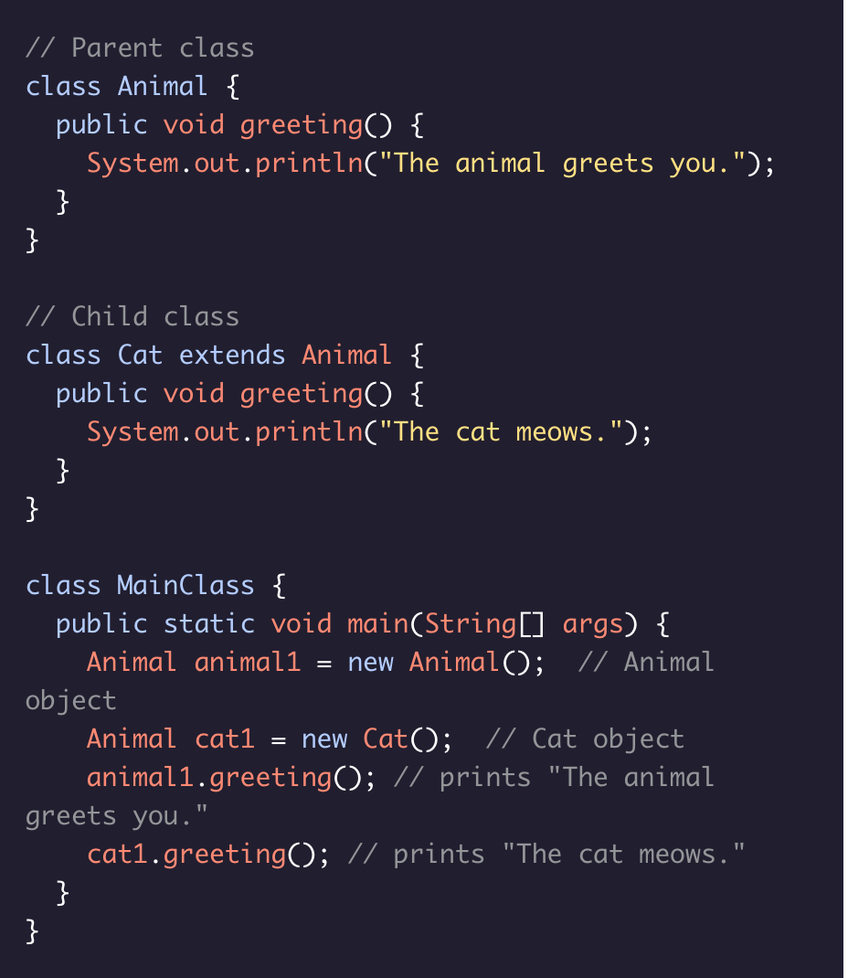
Polymorphism
Java incorporates the object-oriented programming principle of polymorphism.
Polymorphism allows a child class to share the information and behavior of its parent class while also incorporating its own functionality. This allows for the simplified syntax.

Slide 7
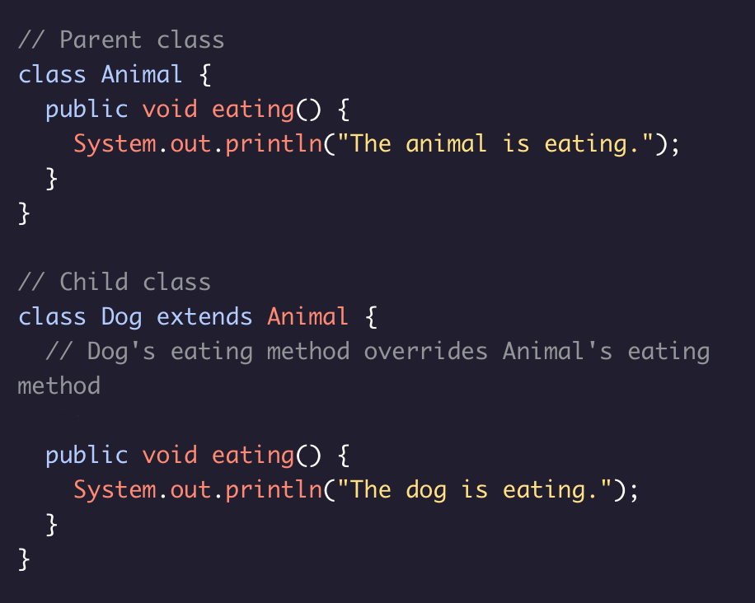
Method Overriding
Wcan easily override parent class methods in a child class. Overriding a method is useful when we want our child class method to have the same name as a parent class method but behave a bit differently.
In order to override a parent class method in a child class, we need to make sure that the child class method has the following in common with its parent class method:
Method name
Return type
Number and type of parameters

Slide 8
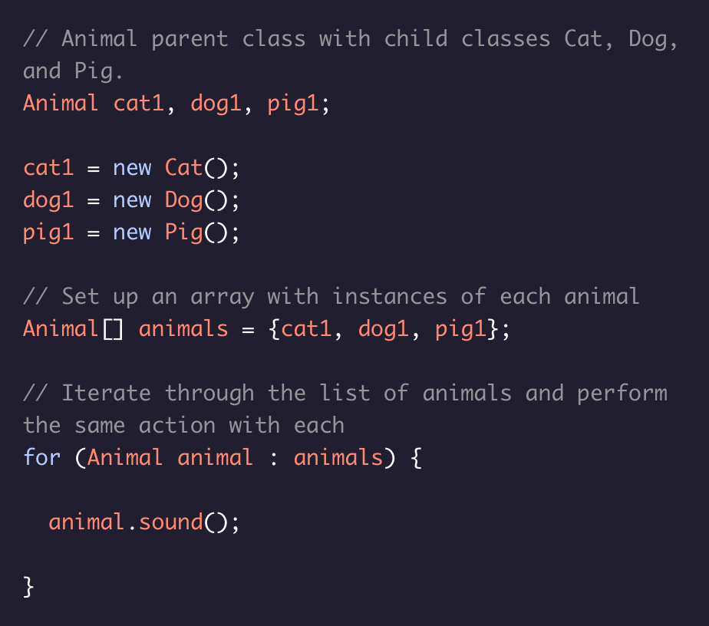
Child Classes in Arrays & Arraylists
Polymorphism allows us to put instances of different classes that share a parent class together in an array or ArrayList.
For example, if we have an Animal parent class with child classes Cat, Dog, and Pig we can set up an array with instances of each animal and then iterate through the list of animals to perform the same action on each.

Slide 9
Lab 10
Due 4/11
Read the writeup on Canvas and watch this week’s recitation video for a walkthrough
Writeup: https://canvas.pitt.edu/courses/127916/files/8050387?module_item_id=2735336
Walkthrough: posted after I make the recording

