Slide 1
CMPINF0401 Recitation
Tuesdays 11:00-12:50
Michael Bartlett

Slide 2
Overview
Assignment 5 break down
Prep for final review

Slide 3
Assignment 5
Due 4/22
Writeup:
https://canvas.pitt.edu/courses/127916/files/9112332?module_item_id=2934278
Pseudo code:
Placeholder
Early Turn in Bonus Reminder:
We will have an early turn in bonus that will be up to 10% added to the score based on when its fully complete and submitted. Beginning April 12 and a 1% deduction of the bonus until the due date of Apr 22. This bonus applies when a FULLY WORKING assignment 5 is handed in. Example: If you turned it in by the end of the 12th it will get a 10% bonus, so 200 + 10% = 220.
Final exam exemption
To further incentivize early and proper completion of A5 there is an option to exempt yourself from the final exam.
A 200 minimum score on A5 is needed. If you obtain a perfection score you are automatically exempt from the exam - its as if it doesn't exist for you in your final grade.

Slide 4
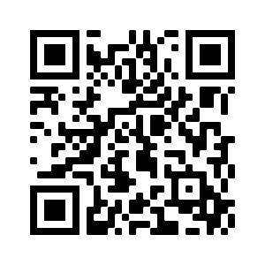
Prep for Final Review
https://forms.gle/BFwn2CpcMDScsZX47

