Slide 1
CMPINF0401 Recitation
Tuesdays 11:00-12:50
Michael Bartlett

Slide 2
Overview
Datatypes
Manipulating Strings
Arithmetic
User Input
Lab 2

Slide 3
Datatypes
Primitives vs. objects
Primitive examples: boolean, byte, short, long, int, double, float, char (all lowercase!)
boolean: true/false value
char: character (‘a’.,‘x’)
short, long, int, double, float, and byte are all numbers of varying lengths
Most of the time, you’ll use int and double of these six
Only double and float can be decimal values
Object examples: String, Scanner, and many… many more (capital first letter!)
Side note: You always need to put the datatype before the name of your variable
i.e.) String myName = Michael;
Notes:
A primitive is a data type that is composed of no other data types and can not be broken down any further. It is like the atoms in the programming scenario. I say atom because atom is a basic unit of matter and there is nothing that can be derived from it.
An object, on the other hand can be thought of a molecule, consisting of more than one primitive type. For example, string comes as part of the Java standard library; however, it is an object and it is composed of smaller data types internally and contains methods.

Slide 4
Strings
We can make a new String (think: array of char) like this:
String myName = “Michael”;
Strings are immutable!
This means that they cannot be change once they’re created
Therefore, whenever you want to do something to a string, you have to call a method that is a part of the String class in Java.
i.e.) Make myName all uppercase:
myName = myName.toUpperCase();
Notes:
TALK ABOUT HOW THIS METHOD RETURNS

Slide 5
Manipulating Strings
More common operations are:
str.toUpperCase(); → returns str in all uppercase letters
str.toLowerCase(); → returns str in all lowercase letters
str.charAt(int num); → returns a char at index num in str
str.length(); → returns an int giving the length of str
As seen on the previous slide, we have to set our String equal to the method call in order to update its value since all these methods are returning a String.
You can concatenate Strings also to form one string using the “+” operator
String firstName = “Michael”;
String lastName = “Bartlett”;
String fullName = firstName + “ ” + lastname;
Notes:
More common operations and returning

Slide 6
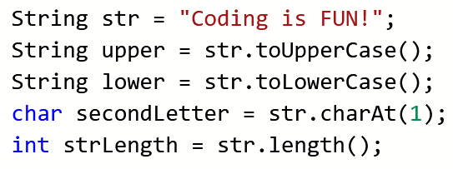
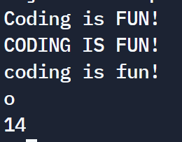
String Methods
Note: string indexing starts at 0!
str.charAt(0); would return ‘C’ while str.charAt(14); gives an error

Slide 7
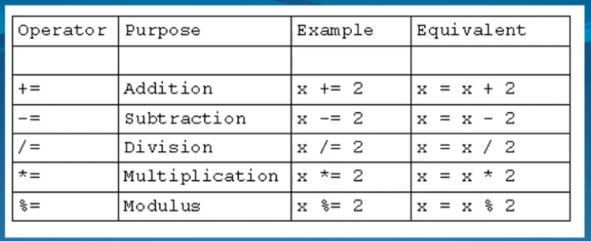
Manipulating Numeric Data: Operations and Operator Precedence
There are shorthand ways of using these operations!

Slide 8
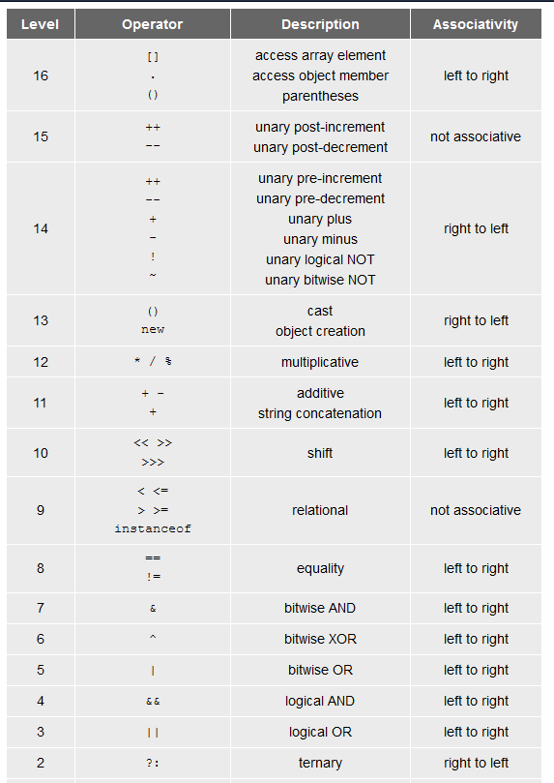
More Operations and Operator Precedence

Slide 9
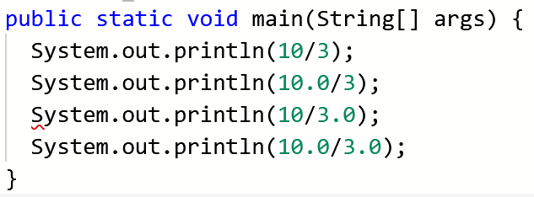
A Quick Note About Integer Division
Integer division and floating point (decimal) division are different!
If you’re dividing two integers, you will end up with a whole number (int). Otherwise, you’ll end up with a decimal (double)
Notes:
Example solved on next slide

Slide 10
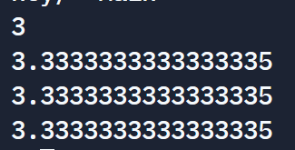
A Quick Note About Integer Division
Notes:
Since we’re dividing two ints, we get the answer w/o the remainder.
When adding a decimal in, the answer automatically gets casted to a double.

Slide 11
Getting User Input
To get user input we need to use a Scanner.
To initialize a Scanner, we make a variable to “hold” our scanner and then make a new Scanner using System.in
Scanner keyboard = new Scanner(System.in)
Once you have a Scanner, you can get input from the user and set the input equal to a variable:
String name = keyboard.next() // .next takes the next line as a String
int num = keyboard.nextInt() // Takes the user input as an int
If an int isn’t entered the program will crash since it’s expecting an int. This exception could be handled though.
More methods: https://docs.oracle.com/javase/7/docs/api/java/util/Scanner.html

Slide 12
Lab 2
Assignment:
https://canvas.pitt.edu/courses/127916/files/8050342?module_item_id=2735237
You only need to write two lines of code for this lab:
One to set userName equal to the part of the input
Another to set income equal to the other part of the input
Hint: When using Scanner methods, you can have the user enter multiple tokens at once and then separate them by calling the correct method:
i.e.) We have a Scanner called keyboard and we want to get two Strings from it for separate variables
stringOne = keyboard.next()
.next() only takes in one token at a time so if a user entered two strings with a space in between, this will only read the first one. .nextLine will read in the entire line
stringTwo = keyboard.next()
Use this hint for your lab where you need to set userName (String) and income (double) from one prompt for the user.

Slide 13
Lab1
Assignment:
https://canvas.pitt.edu/courses/127916/assignments/820334?module_item_id=2735229
Starter Code:
https://canvas.pitt.edu/courses/127916/files/8050341?module_item_id=2735228
Once compiled and run this should print out:
“Hello this is [your name’s] first program”
You should be submitted both a screenshot of the output and your .java file (don’t submit the .class file because the grader cannot view the code)

