Slide 1
CMPINF0401 Recitation
Tuesdays 11:00-12:50
Michael Bartlett
Slides credit to Prof. Devine’s matrices.pdf

Slide 2
Overview
Matrices
Lab 6b

Slide 3
Matrices/Two-Dimensional Arrays
A 2D array is just an array of arrays
We may visualize this as a grid to make it look like a matrix (like we learned in math classes)
But it’s just an array of arrays
Initialized as so: int matrix[][];
This makes an array of int arrays
int[][] matrix = new int[5][3]
Makes a 5x3 array of arrays

Slide 4
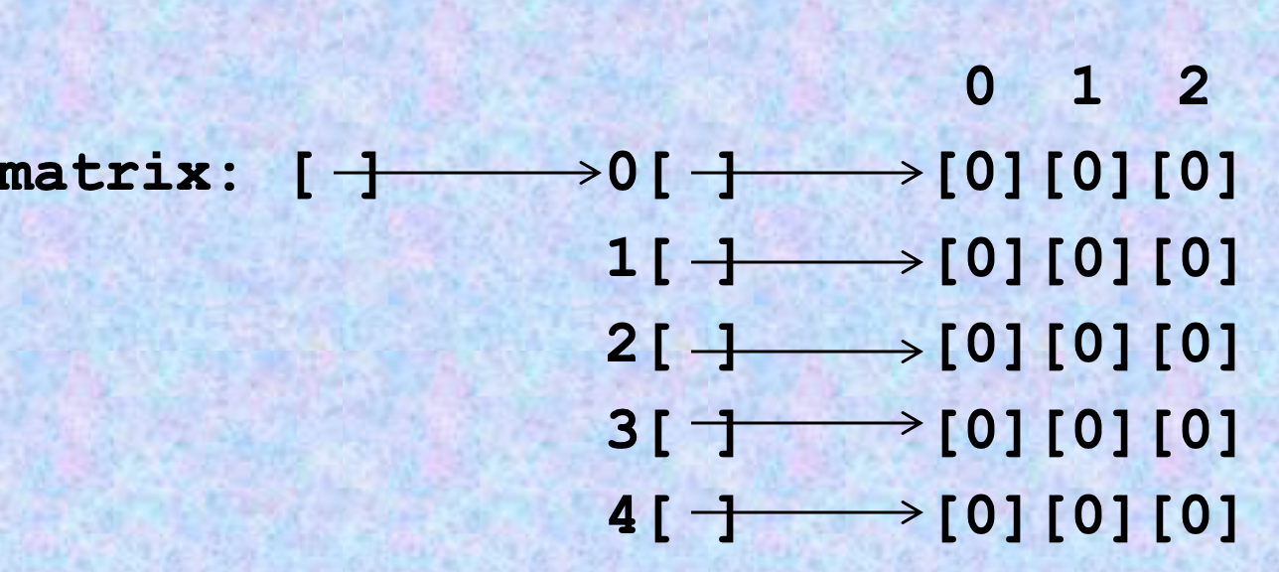
Matrices/Two-Dimensional Arrays
Each row of this array is a 1D array. So, instead of refVar[index] holding a single int element, it contains an array of int elements.
Properties of this matrix:
matrix.length == 5
matrix[0] is a reference to the first array
matrix[0].length == 3
Length of the specific row

Slide 5
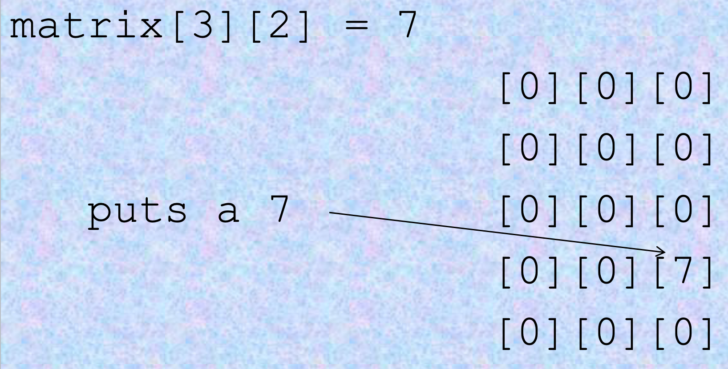
Matrices/Two-Dimensional Arrays
How to access elements at a specific index:
matrix[row][col];

Slide 6
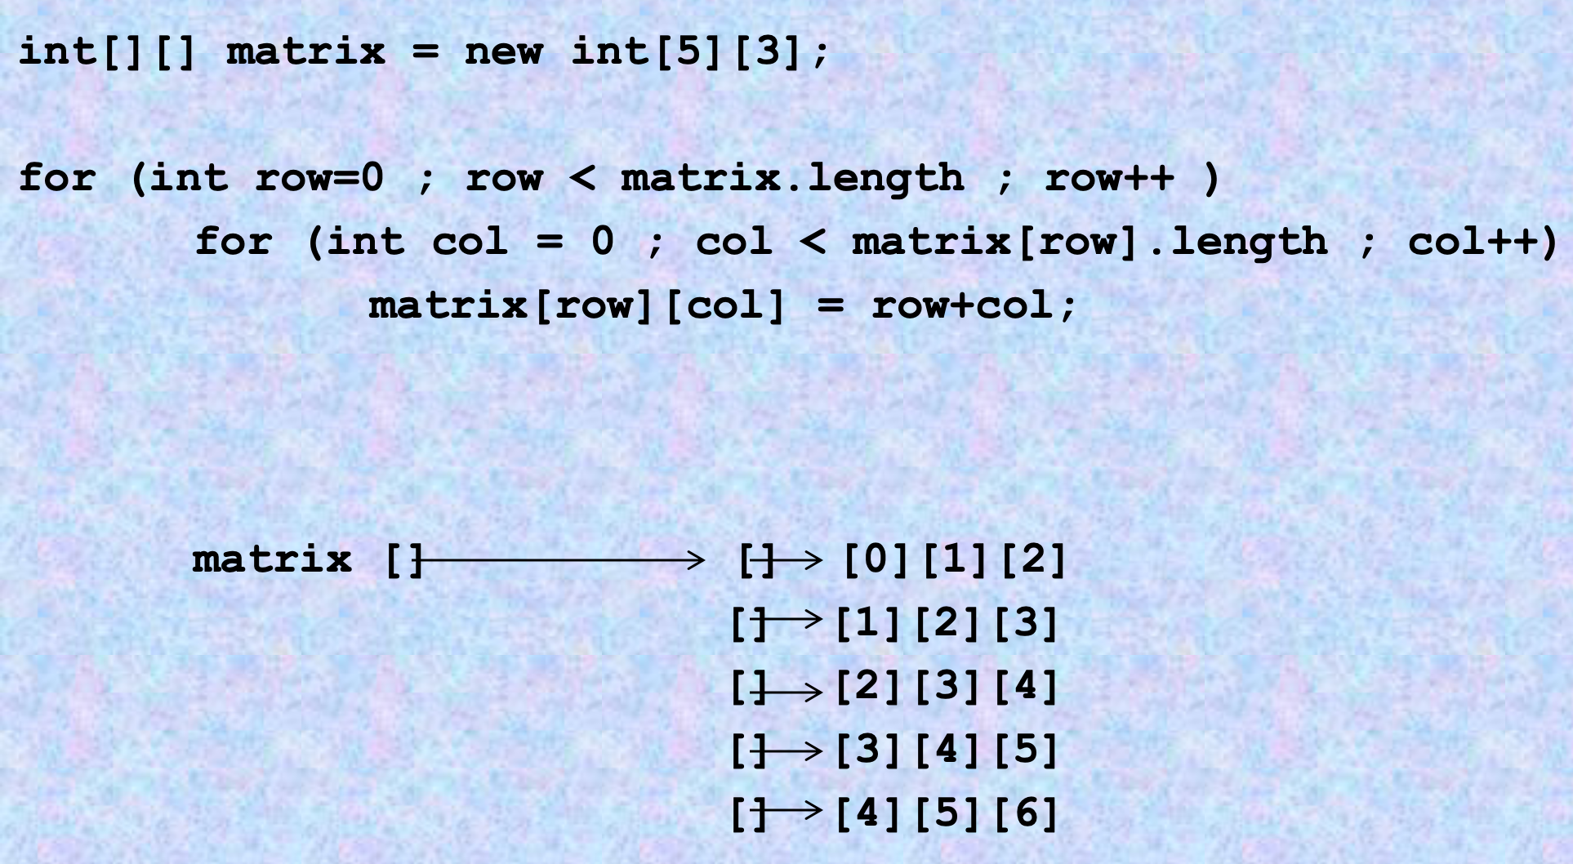
Loop through a 2D array

Slide 7
Lab 6b
Due 3/7
https://canvas.pitt.edu/courses/127916/files/8050368?module_item_id=2735295

Slide 8
Lab 6b
The goal is to find the words in the two-dimensional array and then print them out.
For example, the first word is dank and we can see that it spans from board[4][1] to board[4][3].
So, make a loop (either for or while) to increment your column index while keeping the row hardcoded and print out letter by letter until the whole word is printed.
Follow the same instructions for the next two words as well.

