Slide 1
CMPINF0401 Recitation
Tuesdays 11:00-12:50
Michael Bartlett

Slide 2
Overview
ArrayLists
Recursion
OOP

Slide 3
ArrayLists
All operations on ArrayLists are specified as method calls
Add to the end of an ArrayList by using arrayListName.add(object)
Remove from an ArrayList:
arrayListName.remove(object)
arrayListName.remove(index)
Get the number of elements by using arrayListName.size()
Get a value from an index using arrayListName.get(index)
Get the index of an object by using arrayListName.indexOf(object)
Set a value from an index using arrayListName.set(index, value)

Slide 4
ArrayLists
ArrayLists are initialized using the following syntax:
ArrayList<Type> varName = new ArrayList<Type>();
Let’s break this down:
ArrayList<Type>: Need to make sure your Type is Capitalized.
i.e., ArrayList<int> is not valid → Needs to be ArrayList<Integer>
This is because you can make an ArrayList of any Generic Type. Generics haven’t been covered yet, but you’ll see this later. As a result, by saying ArrayList<Integer> java converts an int to it’s “generic” counterpart. All values are stored as objects.
new ArrayList<Type>();
Because everything with ArrayLists is done using method calls, the () calls the method to create a new ArrayList of the Type you’re passing. An ArrayList is an object.

Slide 5
ArrayLists vs. Arrays
ArrayLists are built off off arrays. Unlike arrays, you do not have to worry about size constraints since they automatically take care of sizing.
As a result, in terms of runtime, it’s better to use an ArrayList for a dynamic set of data
All operations are done using method calls in an ArrayList

Slide 6
Recursion: an overview
Recursion is the process of making a method call itself
This provides a way to break larger problems down into simple subproblems.
When writing a recursive method, you must ensure that you have:
A base case, otherwise known as a halting case, that is attainable
A recursive case in which the method calls itself

Slide 7
Recursion Assignment4 Example
Assignment4.java

Slide 8
Why recursion?
Despite it taking up more memory than iterative methods (i.e., ones that contain loops), recursion can reduce the amount of time that it takes to do certain problems
A recursive function calls itself, so the memory for a called function is allocated on top of the memory allocated for calling the function. When the base case is reached, the function returns its value to the function that it was called from, and its memory is de-allocated.
At its core, recursion is essentially dividing one large problem into several smaller subproblems until they are manageable.

Slide 9
OOP: What’s an object?
Technically speaking, an object is a bundle of state and behavior:
State: The data contained in the object (the object’s fields)
Behavior: The actions supported by the object (its methods)

Slide 10
OOP: What’s a Class?
Every object has a class
A class defines the object’s methods and fields
A class defines both type and implementation
Type → Where the object can be used (What datatypes is the constructor going to accept?)
Implementation → How the object does things (its methods)

Slide 11
OOP: Class vs. Objects Example
Example of a class:
Fruit
Car
Example of corresponding objects:
Apple, Banana, Mango
Volvo, Audi, Toyota
So, a class is a template for objects, and an object is an instance of a class

Slide 12
OOP: Class vs. Objects Example
When we create individual objects, they inherit all the variables and methods from the class
We’ve seen this with Strings:
String name = “Michael”
name is a String Object where String is a class
name = name.toUpperCase();
Now, name == ”MICHAEL”
name was able to use the predefined method for the String object

Slide 13
OOP: Interfaces vs Classes
Interfaces can be used to define the methods that the class must contain
For example, an interface might define a Car like this:
interface Car { public String getColor();}
The class for a type of Car could look like this:
class Volkswagen implements Car { String color = “blue”; // Normally done with an init method public String getColor() { return(this.color); } }

Slide 14
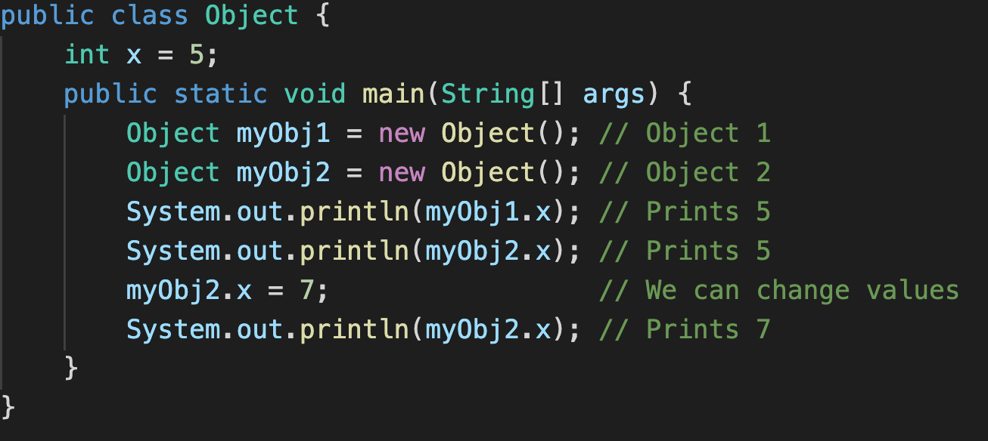
How do we make objects?
We saw the previous String example, but how do we define our own and use them?

Slide 15
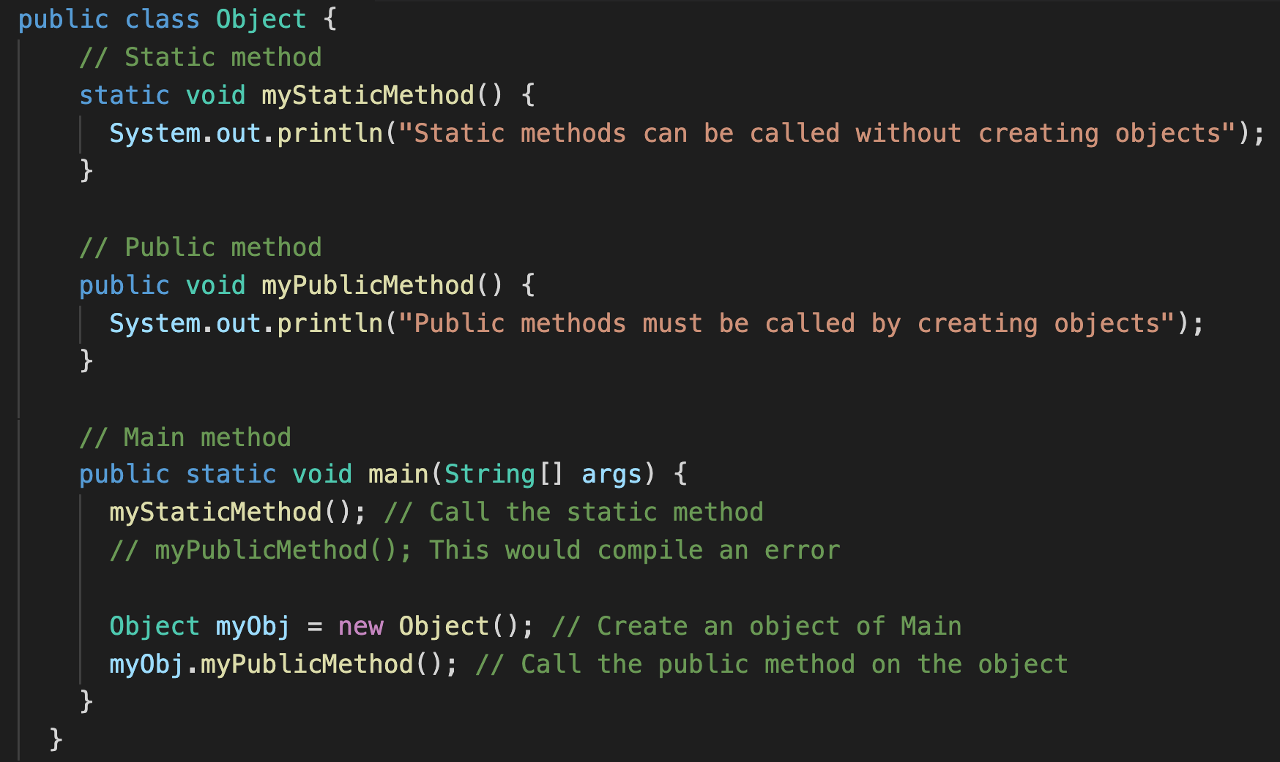
Classes can have methods
As shown before, we know that Classes can have methods. There are two types, static and public.
Static can be accessed without creating an object of the class, public needs an instance of the class to be created.

Slide 16
Constructors
A constructor is a special method that is used to initialize objects.
The constructor is called when an object of a class is created.
It can be used to set initial values for object attributes

Slide 17
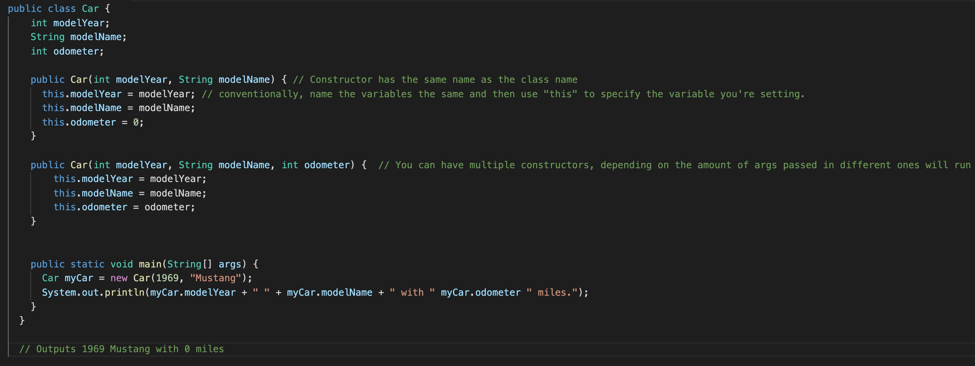
Constructors Example

Slide 18
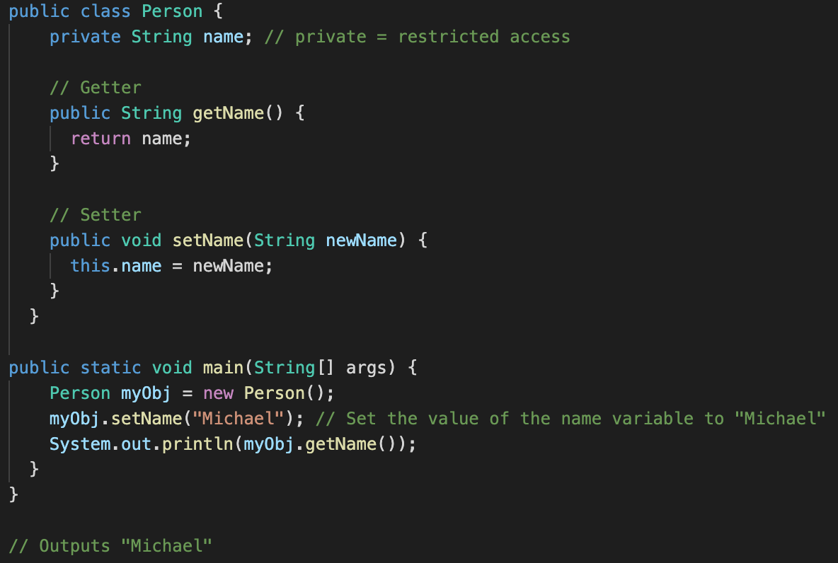
Encapsulation
Encapsulation: make sure that “sensitive” data is hidden from users. To do this:
Declare class variables/attributes as private
Provide public get and set methods to access and update the value of a private variable.

Slide 19
Why Encapsulation?
Better control of class attributes and methods
Class attributes can be read-only (if they can only be accessed through a get method), or write-only (if they can only be accessed through a set method).
Flexible: The programmer can change one part of the code without affecting others
Increased Security: hide data that shouldn’t be available to all users, test to see if the value being set is valid (i.e., a Person’s weight shouldn’t be 0)

Slide 20
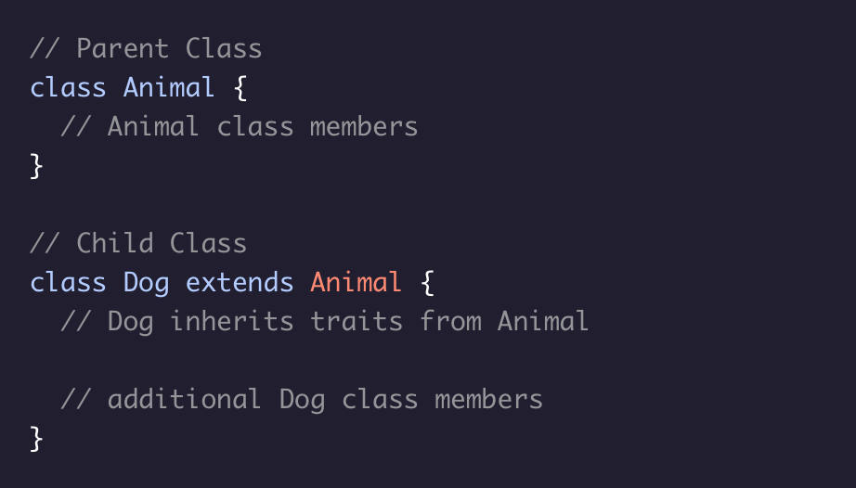
Inheritance
An important feature of OOP, it allows for one class (child class) to inherit the fields and methods of another class (parent class).
When defining a child class, we use the keyword extends to inherit from a parent class

Slide 21
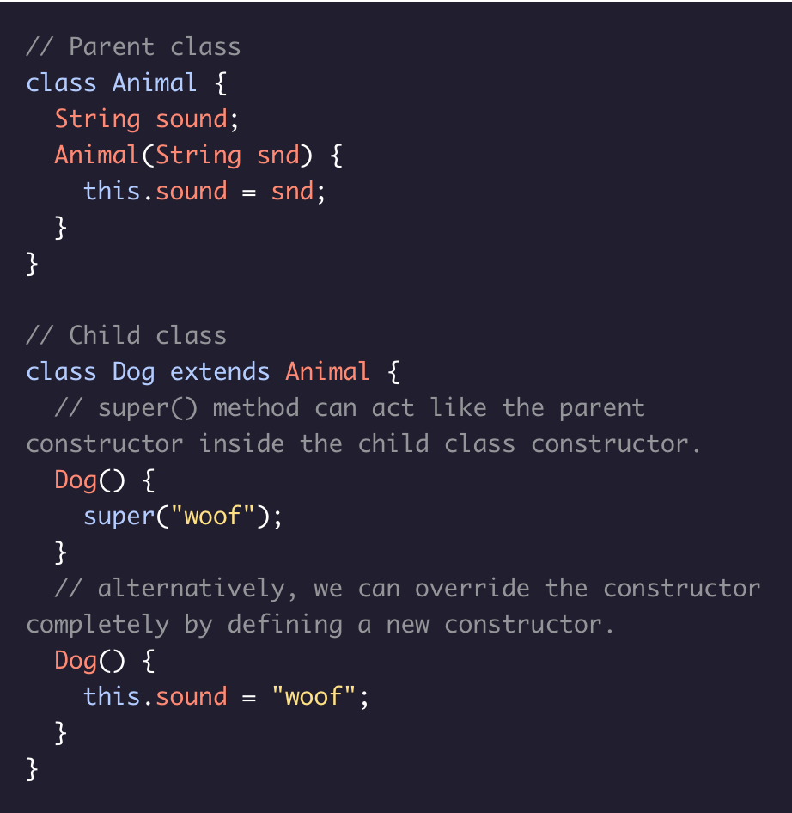
Super()
A child class inherits its parent’s fields and methods, meaning it also inherits the parent’s constructor.
Sometimes we may want to modify the constructor, in which case we can use the super() method, which acts like the parent constructor inside the child class constructor.
Alternatively, we can also completely override a parent class constructor by writing a new constructor for the child class.

Slide 22
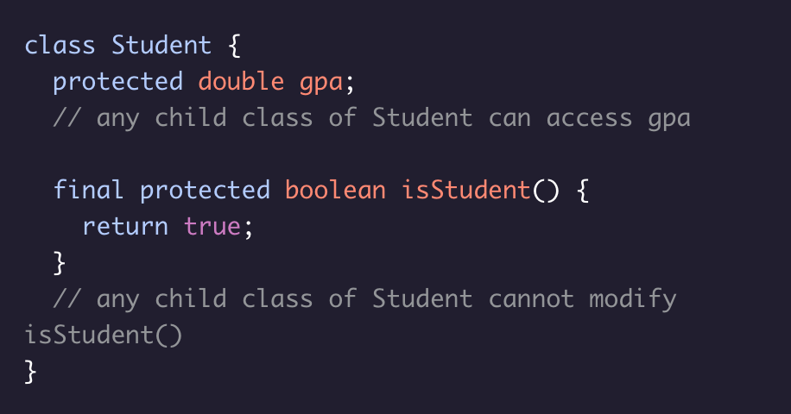
Protected & Final
When creating classes, sometimes we may want to control child class access to parent class members.
We can use the protected and final keywords to do just that.
protected keeps a parent class member accessible to its child classes, to files within its own package, and by subclasses of this class in another package.
Adding final before a parent class method’s access modifier makes it so that any child classes cannot modify that method - it is immutable.

Slide 23
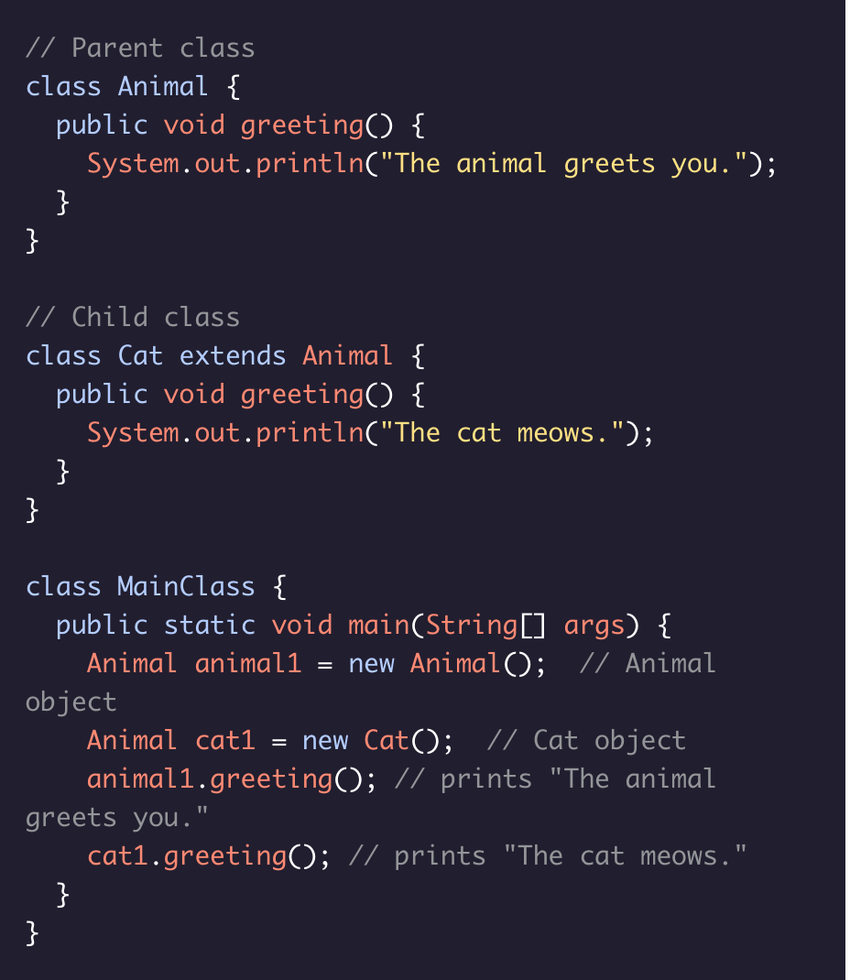
Polymorphism
Java incorporates the object-oriented programming principle of polymorphism.
Polymorphism allows a child class to share the information and behavior of its parent class while also incorporating its own functionality. This allows for the simplified syntax.

Slide 24
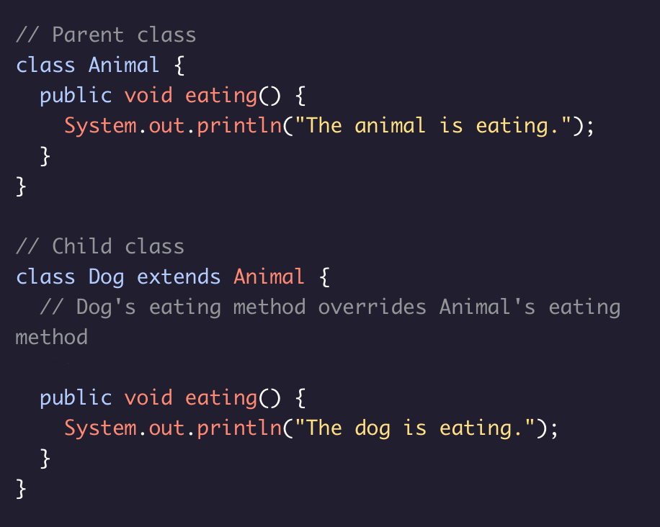
Method Overriding
Wcan easily override parent class methods in a child class. Overriding a method is useful when we want our child class method to have the same name as a parent class method but behave a bit differently.
In order to override a parent class method in a child class, we need to make sure that the child class method has the following in common with its parent class method:
Method name
Return type
Number and type of parameters

Slide 25
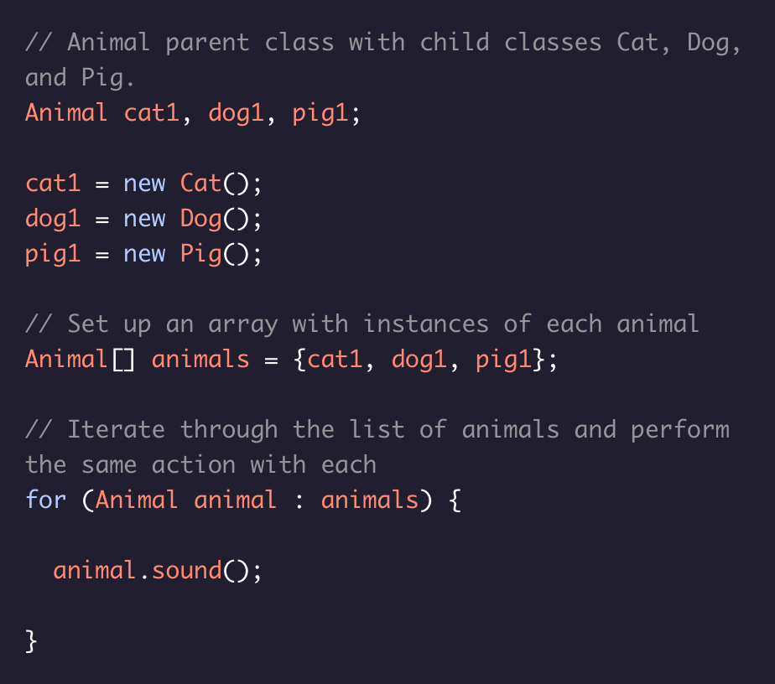
Child Classes in Arrays & Arraylists
Polymorphism allows us to put instances of different classes that share a parent class together in an array or ArrayList.
For example, if we have an Animal parent class with child classes Cat, Dog, and Pig we can set up an array with instances of each animal and then iterate through the list of animals to perform the same action on each.

