Slide 1
CMPINF0401 Recitation
Tuesdays 11:00-12:50
Michael Bartlett

Slide 2
Overview
File I/O
Arrays
Lab 5
Assignment 2

Slide 3
File I/O: Using the Scanner
First, we need to use the File Class to get a reference to the file that we want to read.
Then we use a Scanner to read the file and do something with the data.
Scanner has multiple methods that we can utilize to read the file.
Check out the Java API docs for Scanner

Slide 4
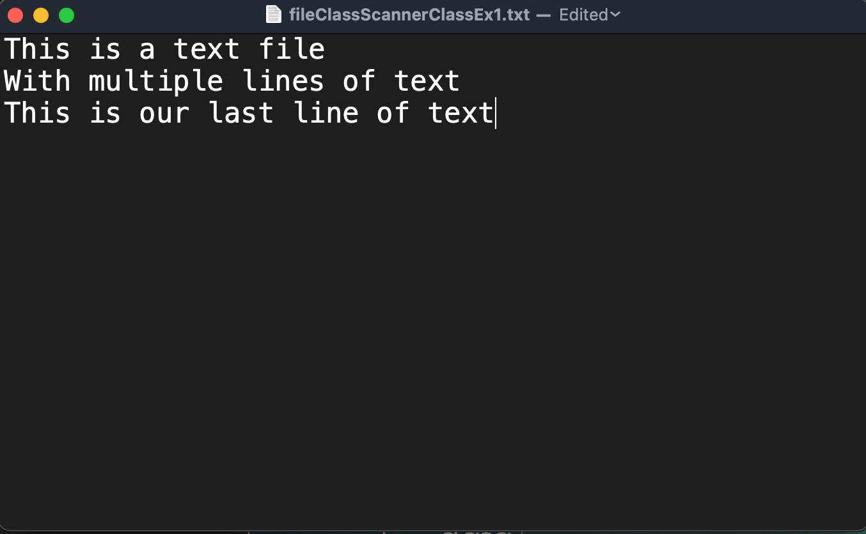
Reading Text Files Using Scanner

Slide 5
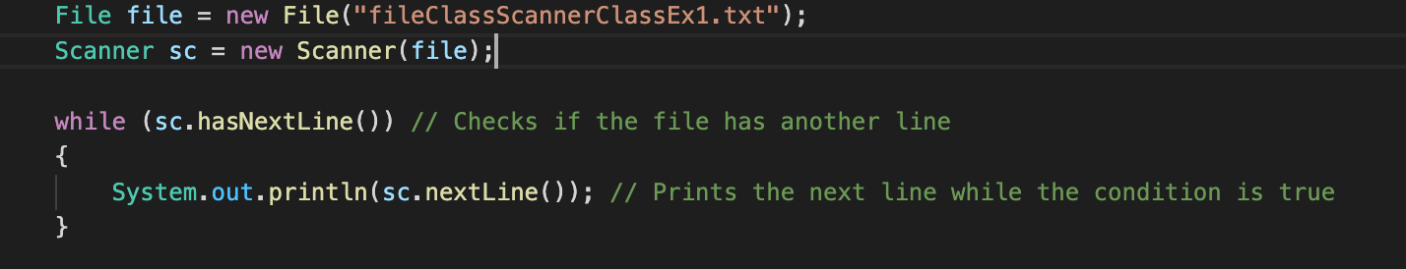

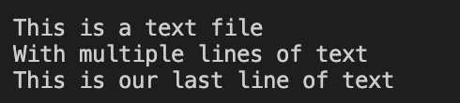
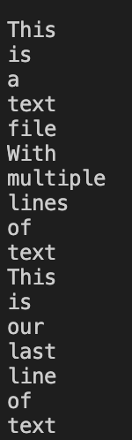
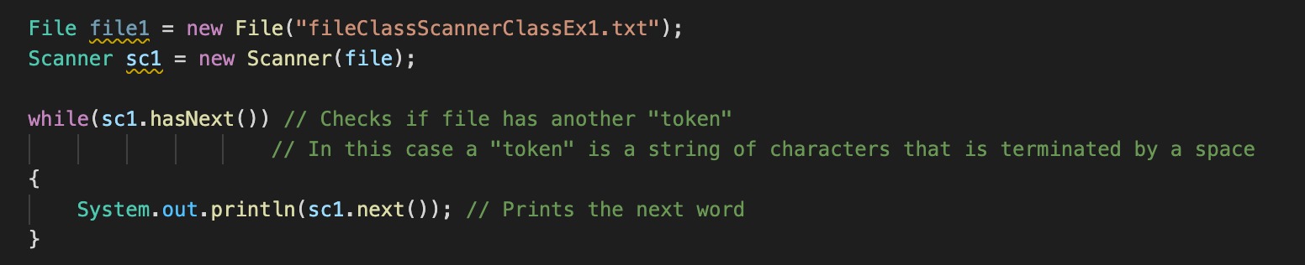
Reading Text Files Using Scanner

Slide 6
Reading Text Files Using BufferedReader
First, we need to use the File Class to get a reference to the file that we want to read.
Then we use a BufferedReader to read the file.
BufferedReader has multiple methods that we can utilize to read the file.
Check out the Java API docs for BufferedReader

Slide 7
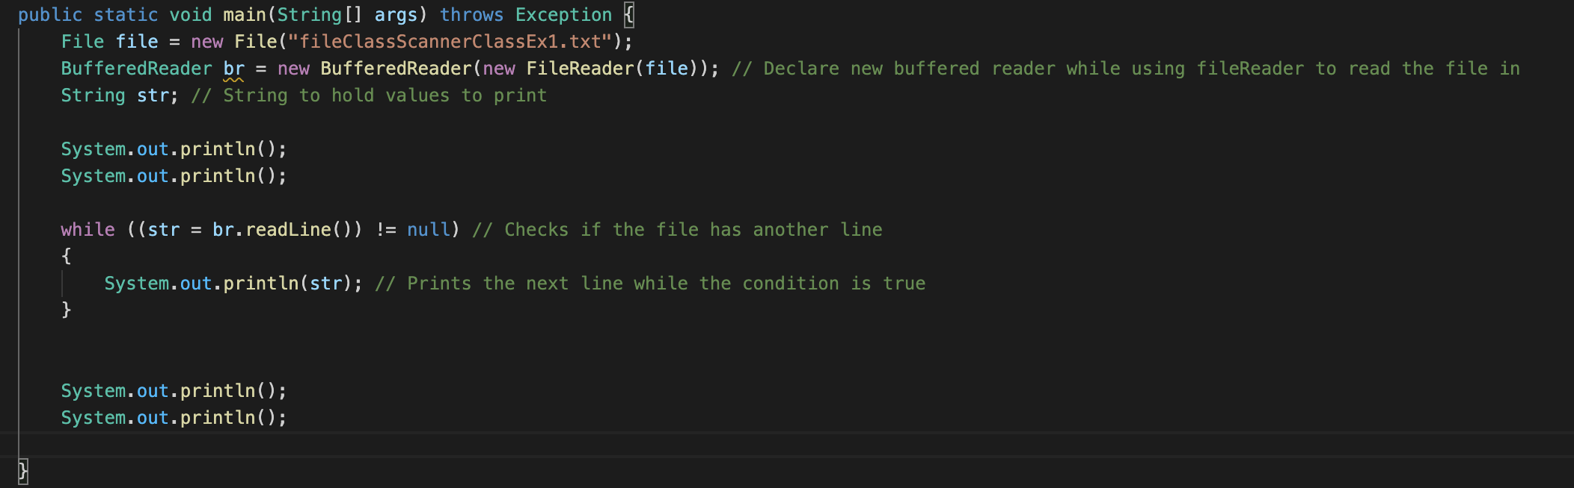
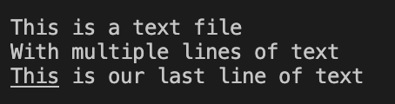
Reading Text Files Using BufferedReader

Slide 8
Scanner Vs. BufferedReader
Scanner will parse every “token” in a file that way you can interpret all the “tokens” in a file
Parsing: Interpreting the given input as tokens (parts). It's able to give back you specific parts directly as int, string, decimal, etc. See also all those nextXx() methods in Scanner class.
BufferedReader will simply read the stream without doing any special parsing
Reading = Dumb streaming. It keeps giving back you all characters, which you in turn have to manually inspect if you'd like to match or compose something useful. But if you don't need to do that anyway, then reading is sufficient.

Slide 9
Writing to files Using PrintWriter
First, make a new PrintWriter object and set the file name.
Then, write your data.
Make sure to close it using writer.close();
Your data won’t write if you don’t do this.

Slide 10
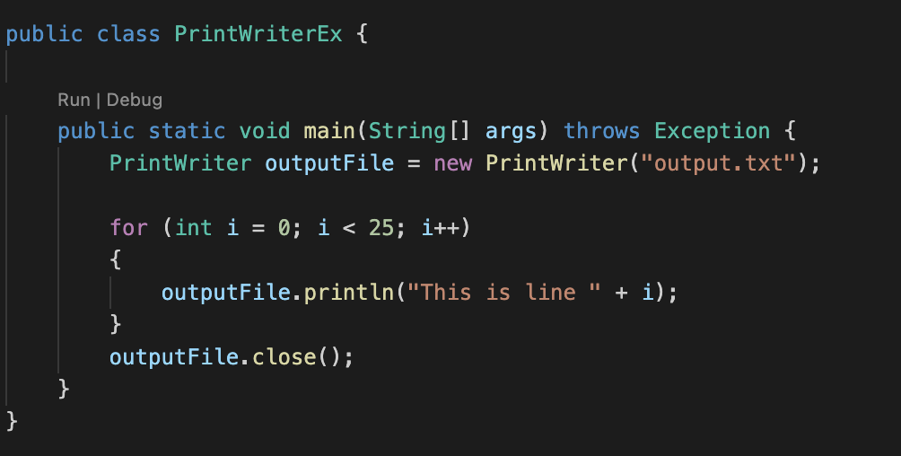
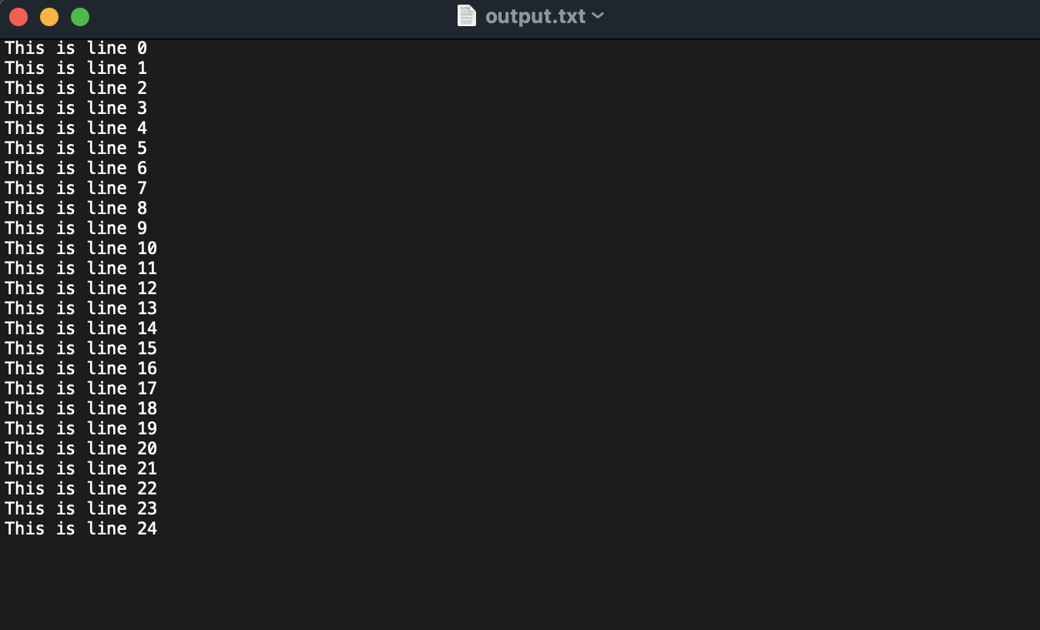
Writing Text Files Using PrintWriter

Slide 11
Appending Data To Existing File Using FileWriter
First, make a new File object
Then, make a new FileWriter object and set the file name.
Then, make a BufferedWriter object out of your FileWriter object
Write your data and then close the BufferedWriter and FileWriter objects.

Slide 12
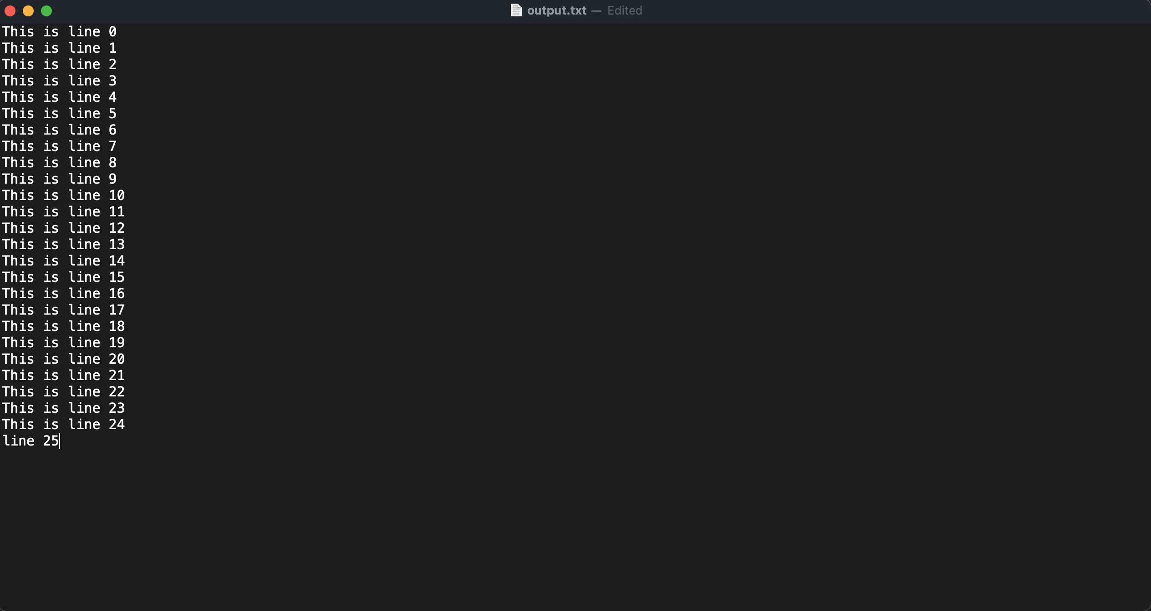
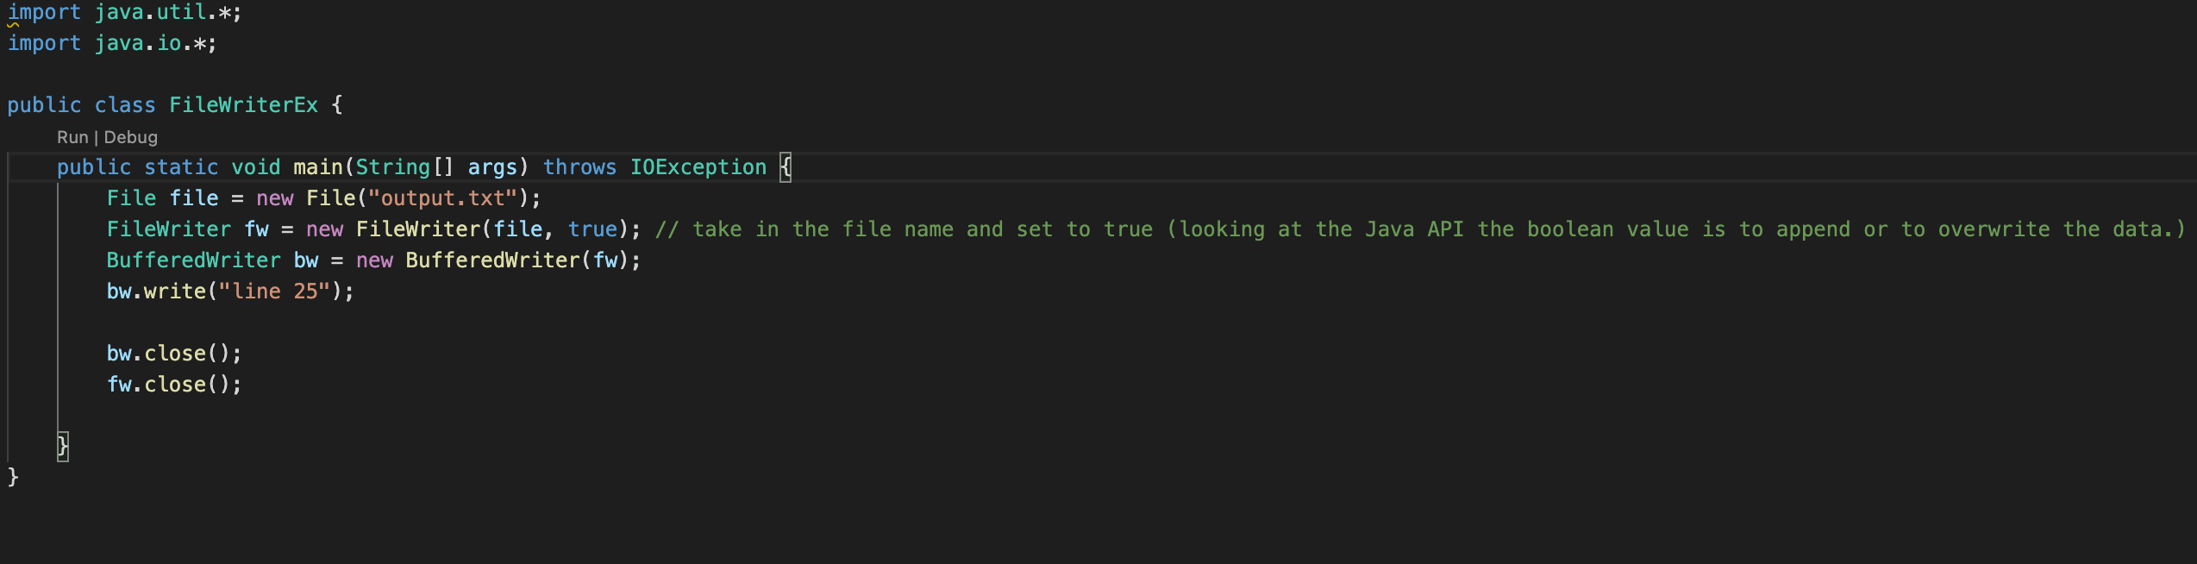
Appending Data To Existing File Using FileWriter

Slide 13
What’s an Array?
Arrays are used to store multiple values in a single variable, instead of declaring separate variables for each value.
This variable is a “reference variable.” This means it “points” to the first object in the array and then all the objects in the array are stored next to it in memory.
Therefore, we uses indices when accessing an array. Let’s say we have an array named arr and we want the first item, arr[0] will give us that item, arr[1] gives us the second item and so on…
When making an array, declare the type that’s going to be stored in it and name it. Then set the values that you want in the array.
Or you can declare an array that’s not equal to anything and just has its size in the square brackets.

Slide 14
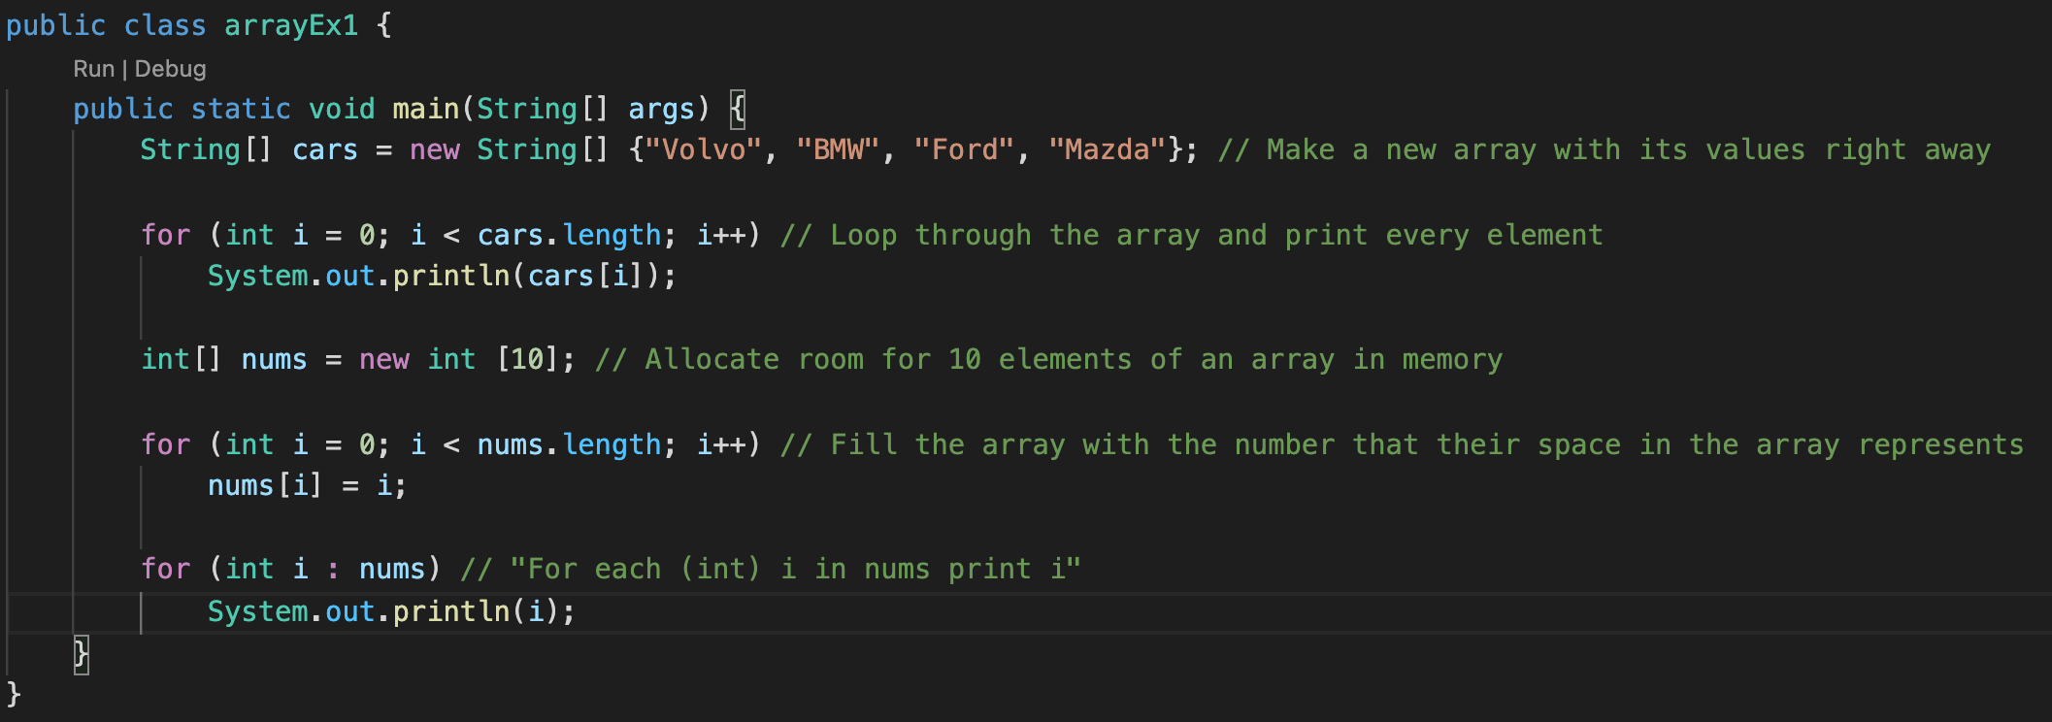
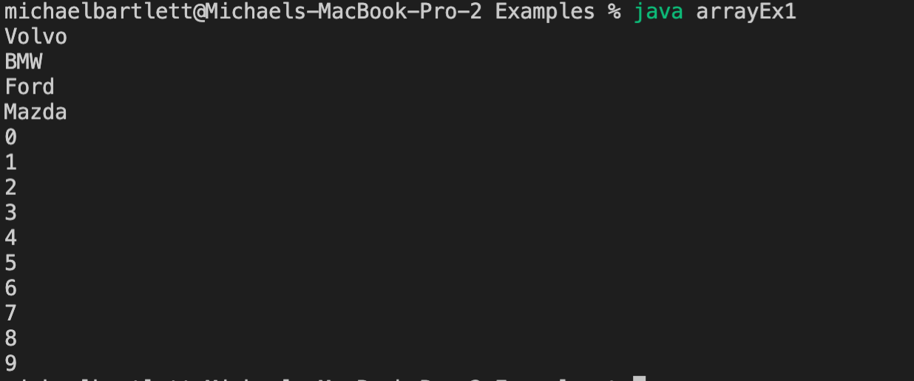

Creating/Reading Arrays
Notes:
Talk about the array initialization in this slide, why we don’t have the size
Talk about what the loop is doing and how we’re using the indices
Then talk about the next array and how we’re looping through that one
Finally mention the enhanced for loop

Slide 15
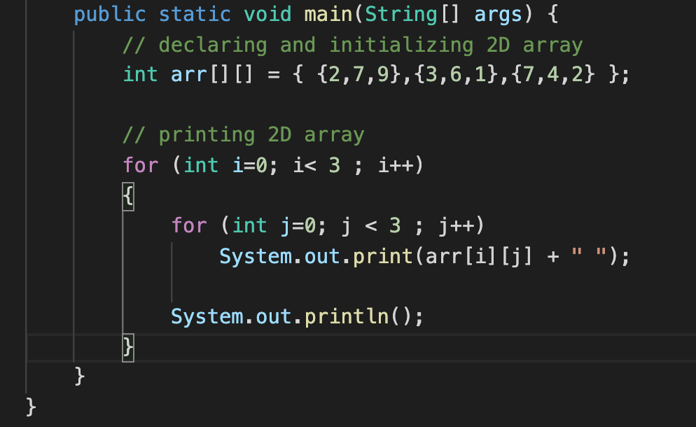
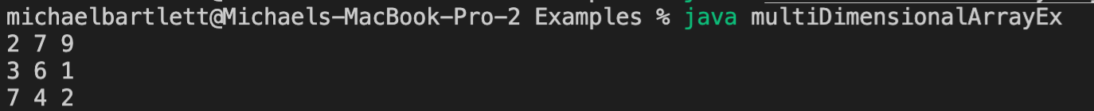
Multidimensional Arrays

Slide 16
The Array Discipline
When you declare an array you should declare an int named count or such to track how many values you have put into the array
Initialize count to 0 and then use count to represent two things:
The number of values you have put into the array so far
The index position of where the next value should be stored
Credit: Prof. M. Devine
Notes:
Something that’s emphasized in this class and beyond is the array discipline…

Slide 17
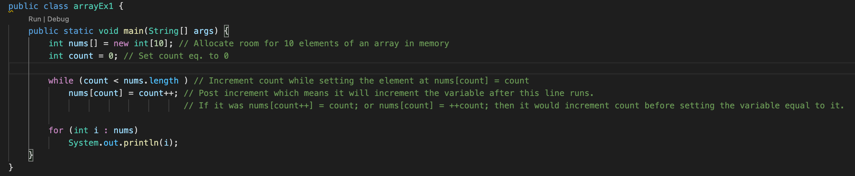
Let’s look at the example again using Array Discipline

Slide 18
Lab 5
Assignment:
https://canvas.pitt.edu/courses/127916/files/8050395?module_item_id=2735274
Make sure to change the name of the class because it currently says “Project 4” but needs to be the same name as the java file which is “Lab5”.
You’re finding four values in this lab.
Minimum value in the array
Maximum value in the array
Average of all the values in the array
Product of all the values in the array

Slide 19
Lab 5: How?
You’re going to use loops!
You can do this in one loop, but your professor would like to see you use one loop per calculation to get you used to them.
Let’s check out some pseudocode

Slide 20
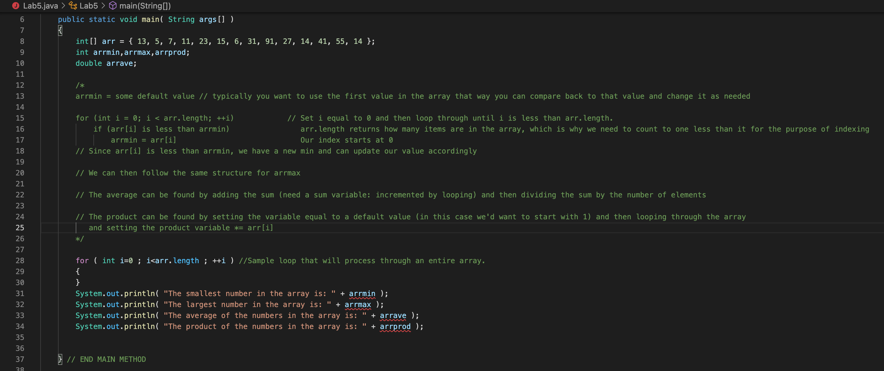
Lab 5: Pseduocode

Slide 21
Assignment 2
Assignment:
https://canvas.pitt.edu/courses/127916/files/8421170?module_item_id=2846089
Let’s check out some pseudocode

Slide 22
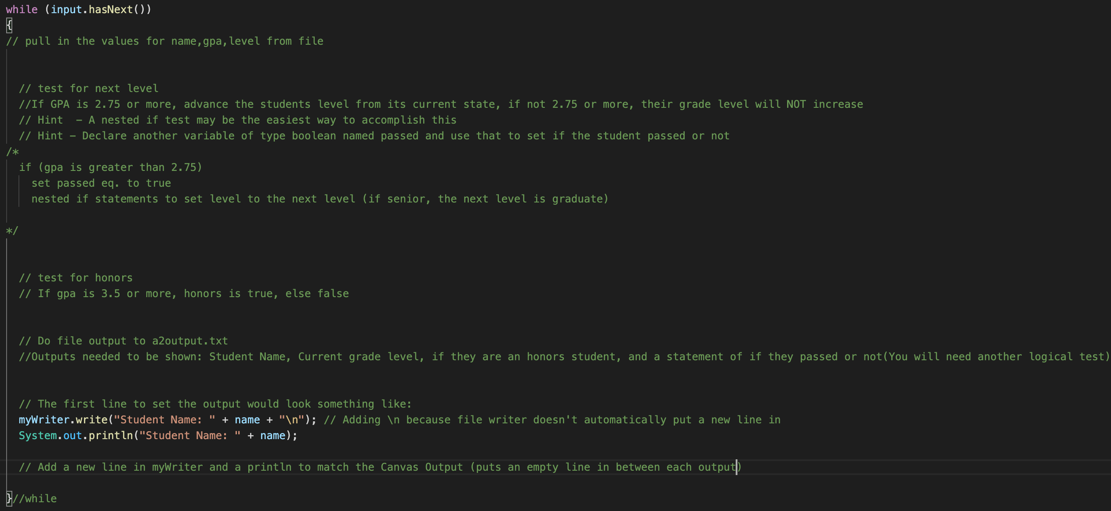
Assignment 2: Pseduocode
Notes:
Explain the nested if statements and passed variable
Explain the setting honors variable
Explain the outputs -> especially the passed

