Slide 1
CMPINF0401 Recitation
Tuesdays 11:00-12:50
Michael Bartlett

Slide 2
Overview
Midterm Review
Assignment Reminder

Slide 3
Variables and Datatypes
Declare a variable like so:
datatype variableName = value;
Datatypes:
Primitive: boolean, char, int, short, byte, long, float, and double
Objects:
String, Array, etc.

Slide 4
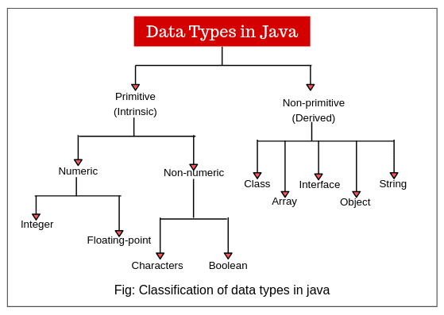
Differences in Datatypes

Slide 5
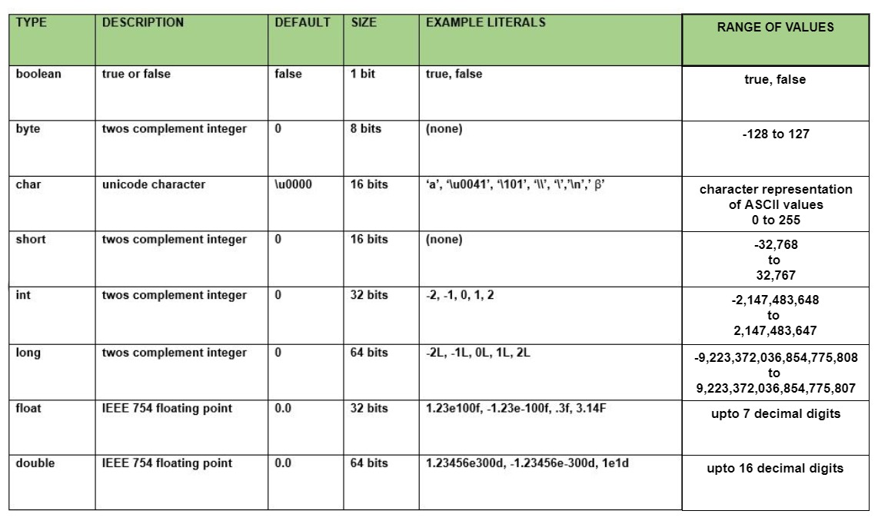
Differences in Datatypes: Primitives
Notes:
Limitations of double and integer
What happens if you try to store a double in an integer? -> Gets truncated

Slide 6
Using Scanner to Read From Keyboad
To get user input we need to use a Scanner.
To initialize a Scanner, we make a variable to “hold” our scanner and then make a new Scanner using System.in
Scanner keyboard = new Scanner(System.in)
Once you have a Scanner, you can get input from the user and set the input equal to a variable:
String name = keyboard.next() // .next takes the next token as a String
int num = keyboard.nextInt() // Takes the user input as an int
If an int isn’t entered the program will crash since it’s expecting an int. This exception could be handled though.
More methods: https://docs.oracle.com/javase/7/docs/api/java/util/Scanner.html

Slide 7
File I/O: Using the Scanner
First, we need to use the File Class to get a reference to the file that we want to read.
Then we use a Scanner to read the file and do something with the data.
Scanner has multiple methods that we can utilize to read the file.
Check out the Java API docs for Scanner

Slide 8
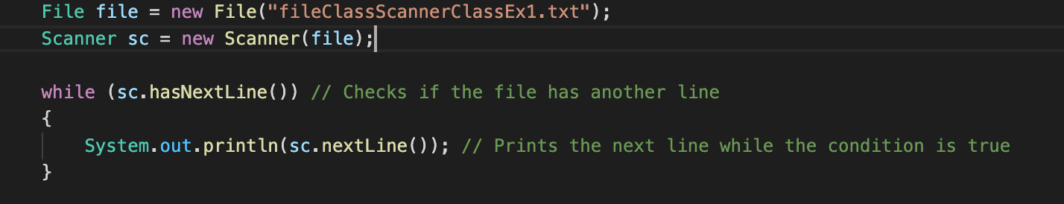

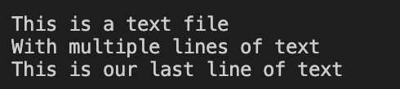
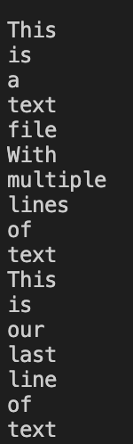
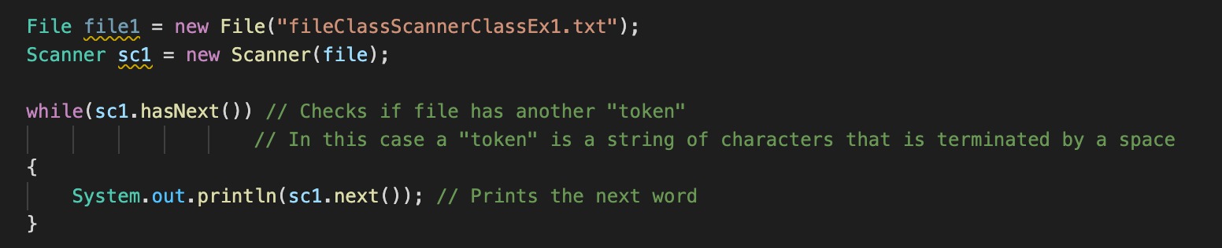
Reading Text Files Using Scanner

Slide 9
Scanner’s Methods
Return Type | Method and Description
boolean | hasNext() Returns true if this scanner has another token in its input. Useful when looping through a file to find its endpoint. There are multiple hasNext() methods such as: hasNextInt(), hasNextLine() and so on.
String | next() Finds and returns the next complete token from this scanner.
String | nextLine() Advances this scanner past the current line and returns the input that was skipped.
int | nextInt() Scans the next token of the input as an int.
double | nextDouble() Scans the next token of the input as a double.
boolean | nextBoolean() Scans the next token of the input into a boolean value and returns that value.

Slide 10

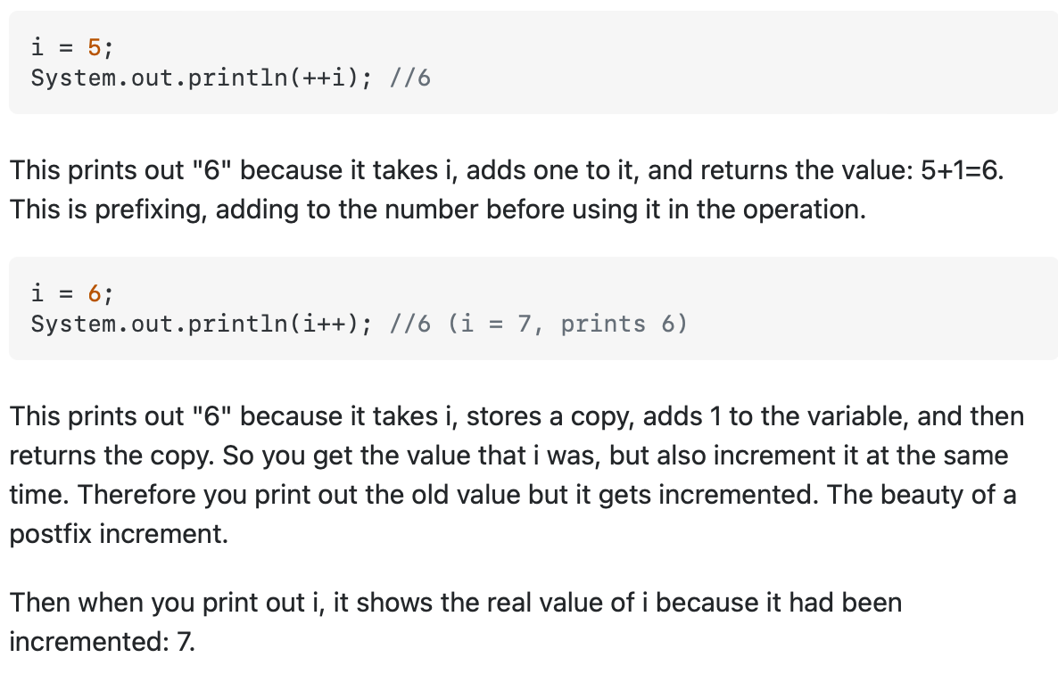



Prefix vs. Postfix Incrementation

Slide 11
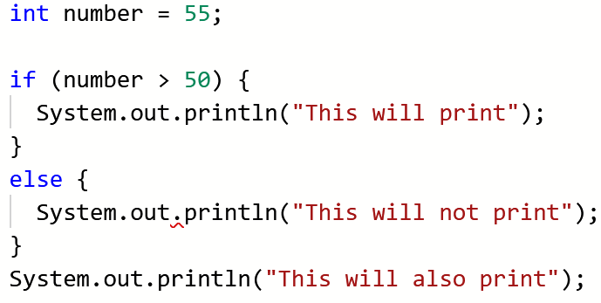
If structures
Simpler than you might think…
If this is true, do this. Otherwise, do that.

Slide 12
What goes in an if statement?
Condition | Meaning
a == b | Equal to
a > b | Greater than
a < b | Less than
a >= b | Greater than or equal to
a <= b | Less than or equal to
a != b | Not equal to
str1.equals(str2) | Seeing if strings are equal
str1.equalsIgnoreCase(str2) | Seeing if strings are equal while ignoring case sensitivity

Slide 13
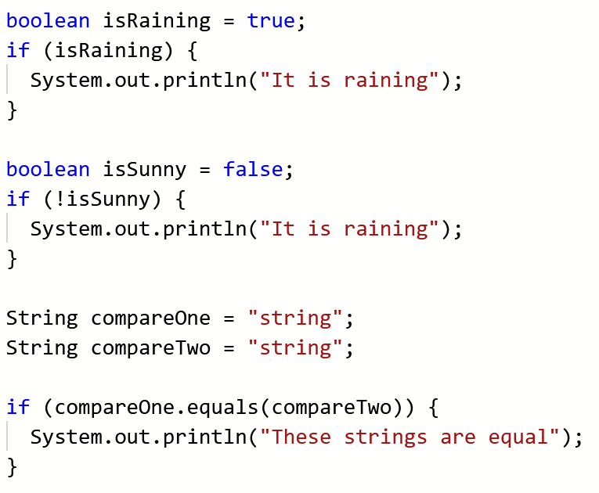
What goes in an if statement?

Slide 14
Some Notes about If Statements
An If statement doesn’t need an else, you can have just an if.
You can also have multiple else cases: else ifs
You can have as many else ifs as the stack allows (a large number)
Remember that the curly braces are for code that you only want to perform if the if statement runs.
Also remember that anything declared in these curly braces is local to the statement.

Slide 15
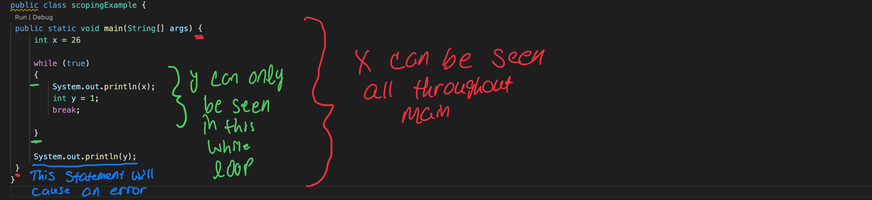
Code Blocks

Slide 16
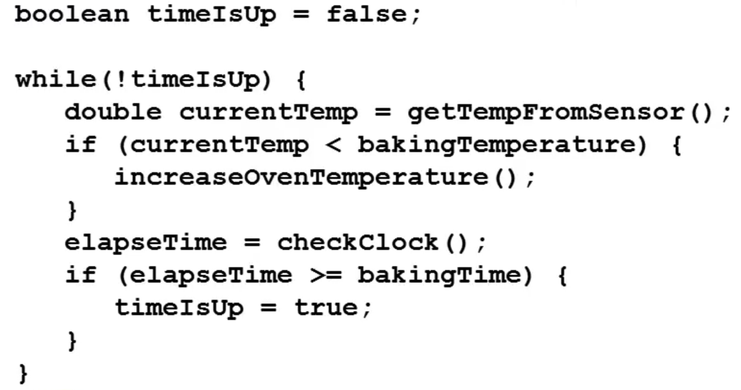
While Loops
In plain English: “While this condition is true, do this action”
To unpack this example
Our condition is checking whether the time on the oven is up or not
While it isn’t, we elapse time and check to see if the elapsed time is equal to the baking time
If they’re equal, then we set timeIsUp to true.
The loop will stop when it goes back to check whether the while clause is true; since timeIsUp is true, !timeIsUp will be false, so we exit the loop

Slide 17
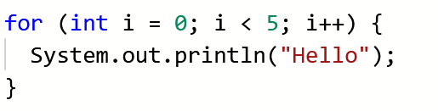
For Loops
Initialization condition update
There are three clauses in a for loop:
Initialization
Condition
Update
The convention when initializing a variable is to use the letter i as your variable name – it’s essentially the only time you should be using single-letter variables!
Notes:
It will print 5 times!

Slide 18
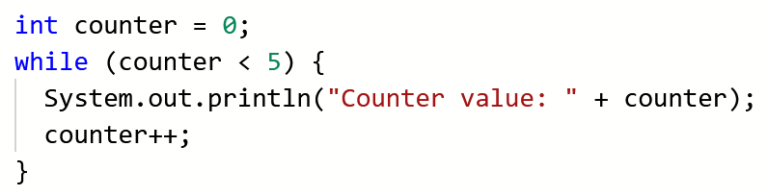
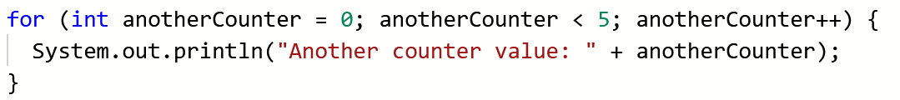
For Loops
A bit harder to translate into plain English, so let’s compare to a while loop
Initialize a variable (1), create a Boolean condition (2), increment the variable (3)
1
2
3
1
2
3

Slide 19
Nested Loops
Think nested if statements, but with loops!
A loop within a loop (within a loop, within a loop…)
These tend to be harder to debug since it’s two loops that can potentially go haywire and never stop… more on infinite loops in a bit
The convention for nested for loops specifically is to have your outer for loop’s variable be i and your inner for loop’s variable be j

Slide 20
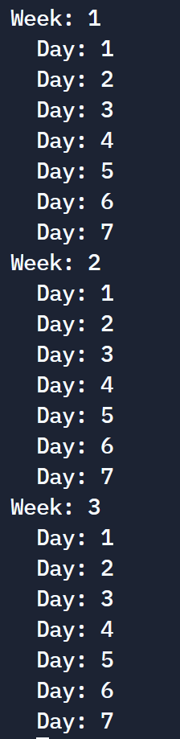
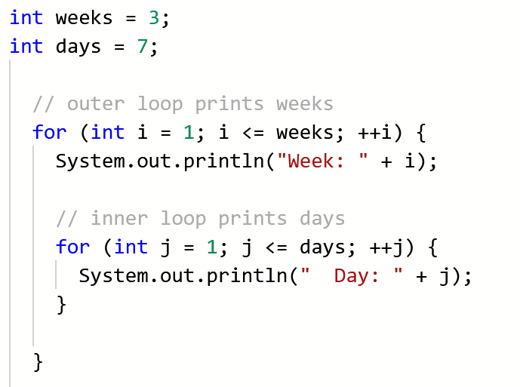
Nested Loops
An example and its output…

Slide 21
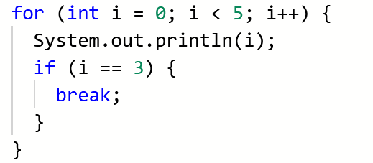
The Break Keyword
Remember this from switch cases?
The break keyword essentially “breaks” the loop
It stops the loop exactly where it is in its tracks; code will continue to run, but outside of the for loop
Very helpful in debugging infinite loops!
Outputs 0 1 2 3 AND THEN STOPS!

Slide 22
What’s an Array?
Arrays are used to store multiple values in a single variable, instead of declaring separate variables for each value.
This variable is a “reference variable.” This means it “points” to the first object in the array and then all the objects in the array are stored next to it in memory.
Therefore, we uses indices when accessing an array. Let’s say we have an array named arr and we want the first item, arr[0] will give us that item, arr[1] gives us the second item and so on…
When making an array, declare the type that’s going to be stored in it and name it. Then set the values that you want in the array.
Or you can declare an array that’s not equal to anything and just has its size in the square brackets.

Slide 23
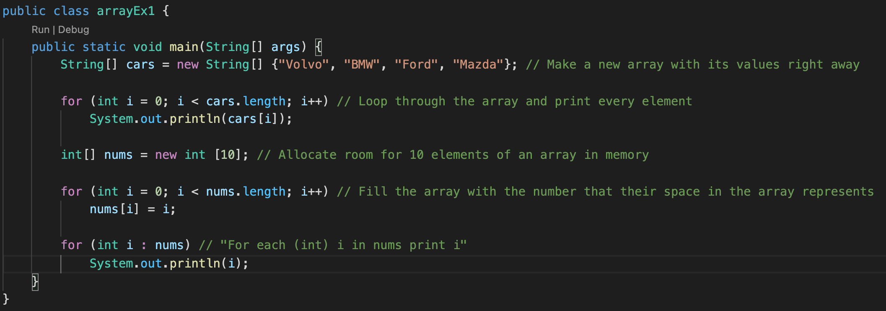
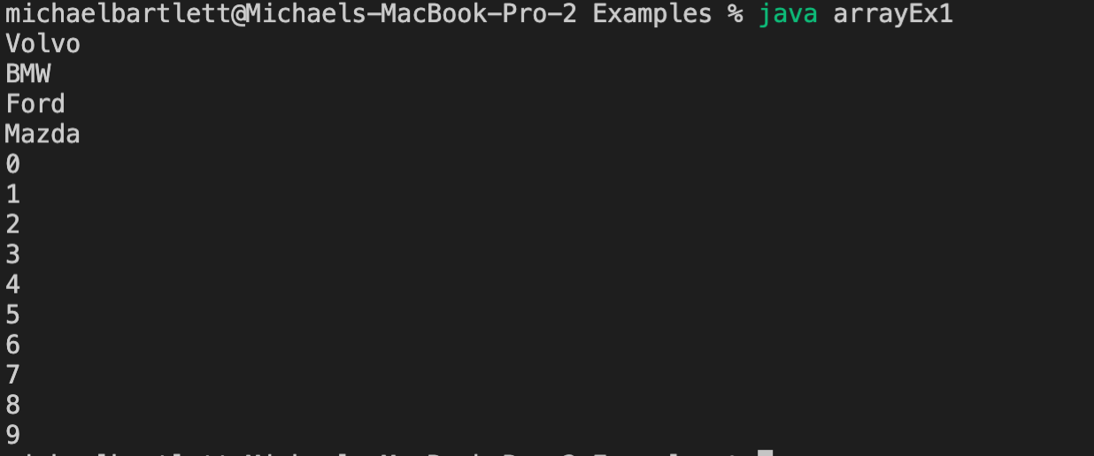

Creating/Reading Arrays
Notes:
Talk about the array initialization in this slide, why we don’t have the size
Talk about what the loop is doing and how we’re using the indices
Then talk about the next array and how we’re looping through that one
Finally mention the enhanced for loop

Slide 24
The Array Discipline
When you declare an array you should declare an int named count or such to track how many values you have put into the array
Initialize count to 0 and then use count to represent two things:
The number of values you have put into the array so far
The index position of where the next value should be stored
Credit: Prof. M. Devine
Notes:
Something that’s emphasized in this class and beyond is the array discipline…

Slide 25
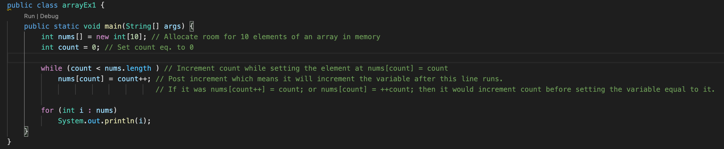
Let’s look at the example again using Array Discipline

Slide 26
Notes About Arrays
Array length vs the upperbound of an array
The length returns the number of items that can be stored in the array whereas the upperbound is 1 – arr.length.
This is because arrays are 0 indexed.
I.e., an array of length 5 has an upper bounds of 4
If you try to access an index that is out of bounds, you get an: ArrayIndexOutOfBounds exception

Slide 27
Writing to files Using PrintWriter
First, make a new PrintWriter object and set the file name.
Then, write your data.
Make sure to close it using writer.close();
Your data won’t write if you don’t do this.

Slide 28
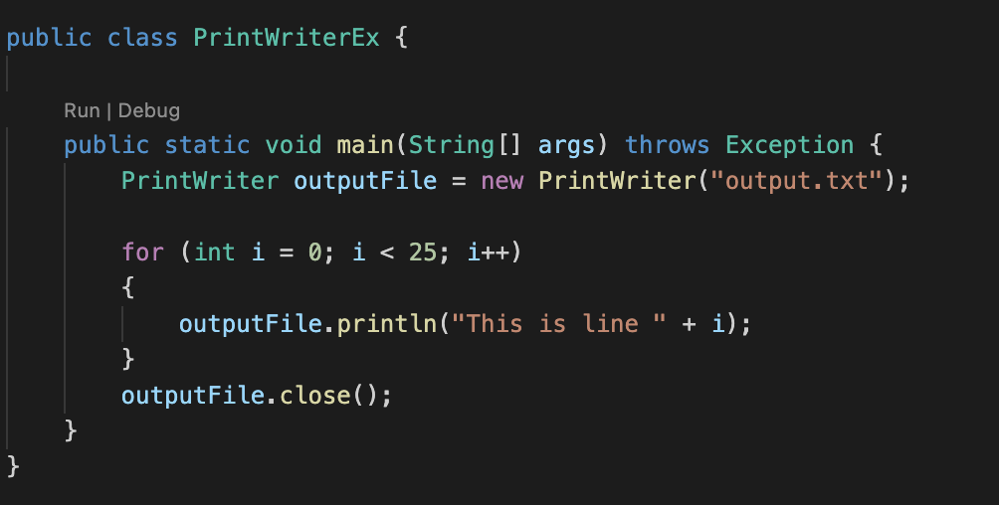
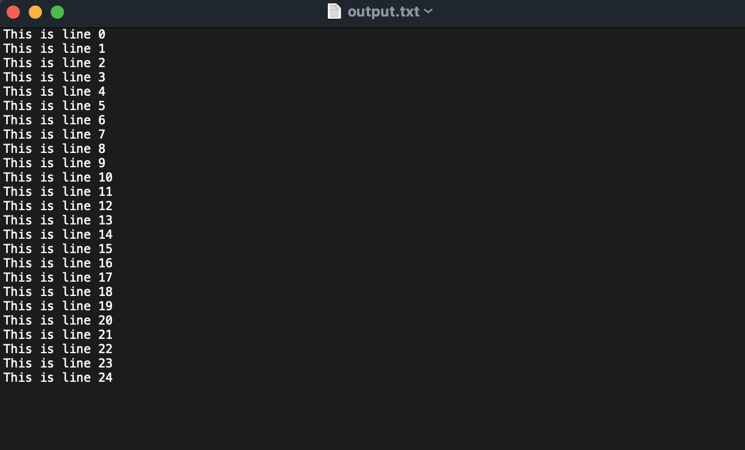
Writing Text Files Using PrintWriter

Slide 29
Appending Data To Existing File Using FileWriter
First, make a new File object
Then, make a new FileWriter object and set the file name.
Then, make a BufferedWriter object out of your FileWriter object
Write your data and then close the BufferedWriter and FileWriter objects.

Slide 30
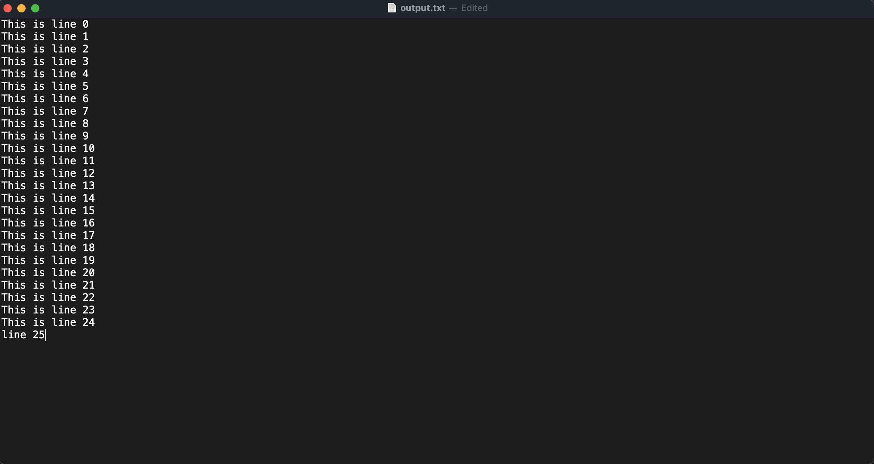
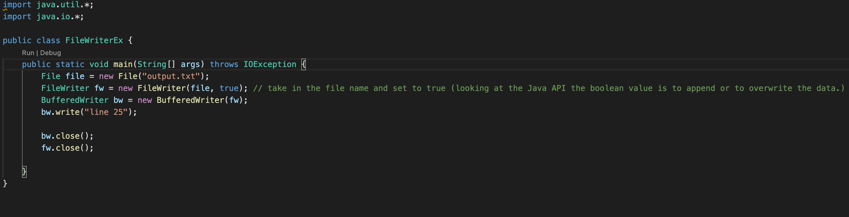
Appending Data To Existing File Using FileWriter

Slide 31
Assignment 3
Due 2/28
Check out last week’s slides if you need some hints

