Slide 1
CS0007 Recitation
Thursdays 12:00-12:50PM
Michael Bartlett
Today’s slides are adopted from lin rojtas, another cs0007 Ta

Slide 2
Overview
OneDrive Review
A Note on Primitives
If structures
Boolean operations
Switch case
Printf
Midterm Q&A

Slide 3
Today’s Office Hours
I had to move today’s office hours to tomorrow.
They’ll be 1:30-3:30 in 5806 Sennott Square and the Zoom link on Canvas that’s normally used for Thursdays.
If that time doesn’t work for you, use the calendly link on Canvas to schedule a time with me that works for the both of us.

Slide 4
Onedrive… thoughts?
Submitting things for us UTAs to grade is hard
This was our solution
You should have received an email from OneDrive… let me know if you didn’t!
Save that link so you can submit things later (or just go to the Shared tab in your own OneDrive)
If you had any specific troubles with it, I’m gonna be lenient about lab submissions. Technically the lab was due last night, but I won’t start actually grading until sometime Friday afternoon…

Slide 5
A Note on primitives
Sometimes in the lab it can be difficult to decide which variable to use for what… here’s some notes
Primitive Type | Notes
byte | Possible values: [-128 thru 127]
short | Possible values: [-32,768 thru 32,767]
char | Make sure you use single quotes! (char letter = ‘A’;)
int | Possible values: -2,147,483,648 thru 2,147,483,647
long | Possible values: [(-2^63) thru (2^63)-1] Add an l when defining! (long num = 3000000l;)
float | Add an f when defining! (float num = 2.50f;)
double | Ultra precise decimals!
Notes:
Byte – 8 bits
Short – 16 bits
Int – 32 bits
Long – 64 bits
Float – 32 bits
Double – 64 bits (More precise)

Slide 6
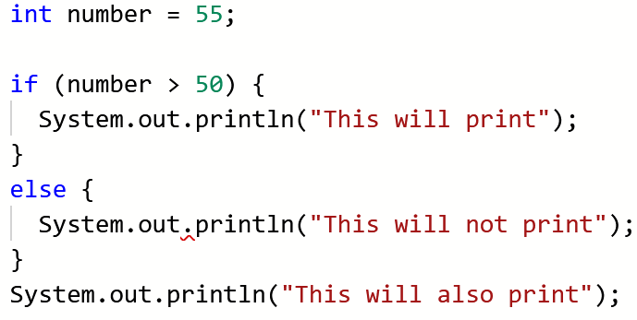
If structures
Simpler than you might think…
If this is true, do this. Otherwise, do that.

Slide 7
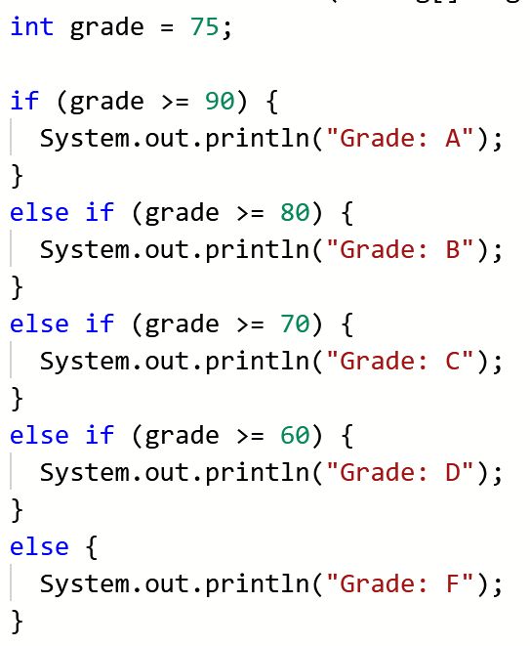
Extended if statements

Slide 8
What goes in an if statement?
Condition | Meaning
a == b | Equal to
a > b | Greater than
a < b | Less than
a >= b | Greater than or equal to
a <= b | Less than or equal to
a != b | Not equal to
str1.equals(str2) | Seeing if strings are equal
str1.equalsIgnoreCase(str2) | Seeing if strings are equal while ignoring case sensitivity

Slide 9
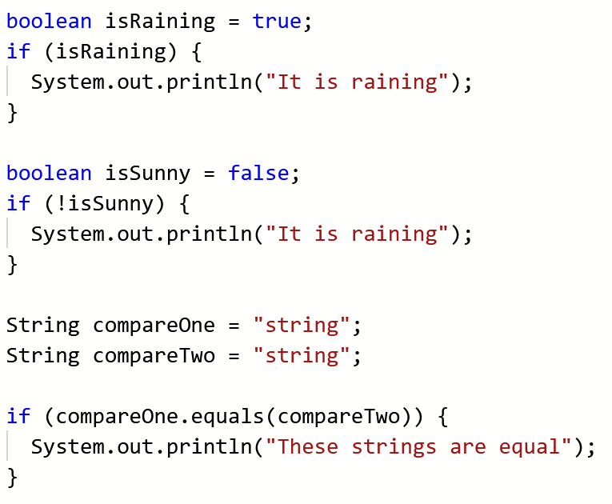
What goes in an if statement?

Slide 10
Boolean operations: Not, and, or
A | B | A && B
TRUE | TRUE | TRUE
TRUE | FALSE | FALSE
FALSE | TRUE | FALSE
FALSE | FALSE | FALSE
A | B | A || B
TRUE | TRUE | TRUE
TRUE | FALSE | TRUE
FALSE | TRUE | TRUE
FALSE | FALSE | FALSE
A | !A
TRUE | FALSE
FALSE | TRUE
Notes:
Conditional and
Conditional or

Slide 11
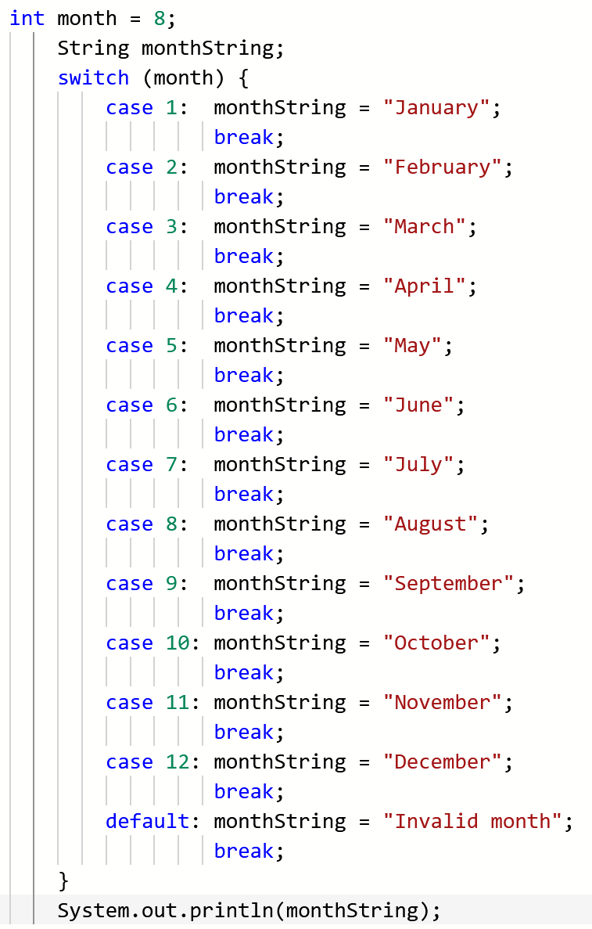
SWITCH CASE
The default keyword is similar to a final “else” in a chain of if statements
MAKE SURE YOU INCLUDE BREAKS!!!
Without the break keyword, monthString keeps getting reassigned and will end up as “Invalid month”

Slide 12
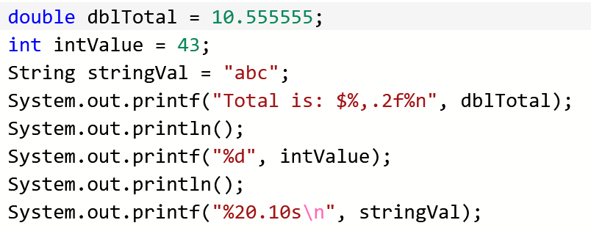
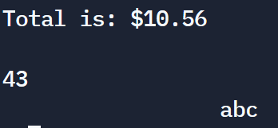
Printf/formatting
Lots of other easy examples here: https://www.jquery-az.com/10-examples-learn-java-string-formatting-printf-method/

Slide 13
MIDTERM Q&A And then a Kahoot

Slide 14
For next week
No lab this week – study!!
Come to office hours if you’re struggling!
We made a Discord server! https://discord.gg/tU2Uh5SV
Joining is optional, but it’ll be a good point of contact with us and your peers.

