Slide 1
CS0007 Recitation
Thursdays 12:00-12:50PM
Michael Bartlett

Slide 2
Overview
Review of recent concepts
While/Do-While loops
For Loops
Reading/Writing Text Files
Exceptions
Arrays

Slide 3
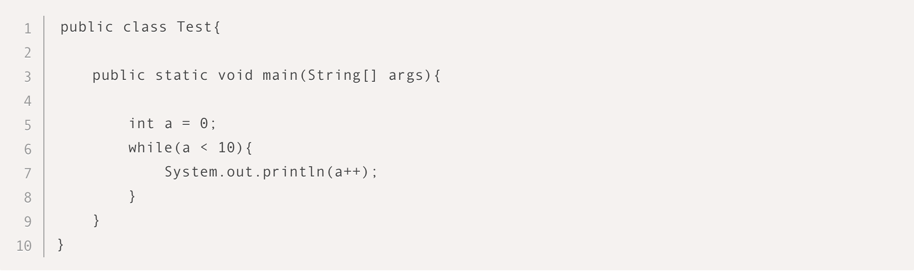
What will happen when you run the following code?
Compilation error
Code will print 1 to 9
Code will print 0 to 9
Code will print 1 to 10

Slide 4
What will happen when you run the following code?
Compilation error
Code will print 1 to 9
Code will print 0 to 9
Code will print 1 to 10
Option C is the correct choice. Variable a is started with zero. Since a is incremented using post increment operator (a++), its value is printed first and then value gets incremented. When a is 9 then it is printed and incremented to 10, so in next while iteration a < 10 becomes false. Program will print 0 to 9.

Slide 5
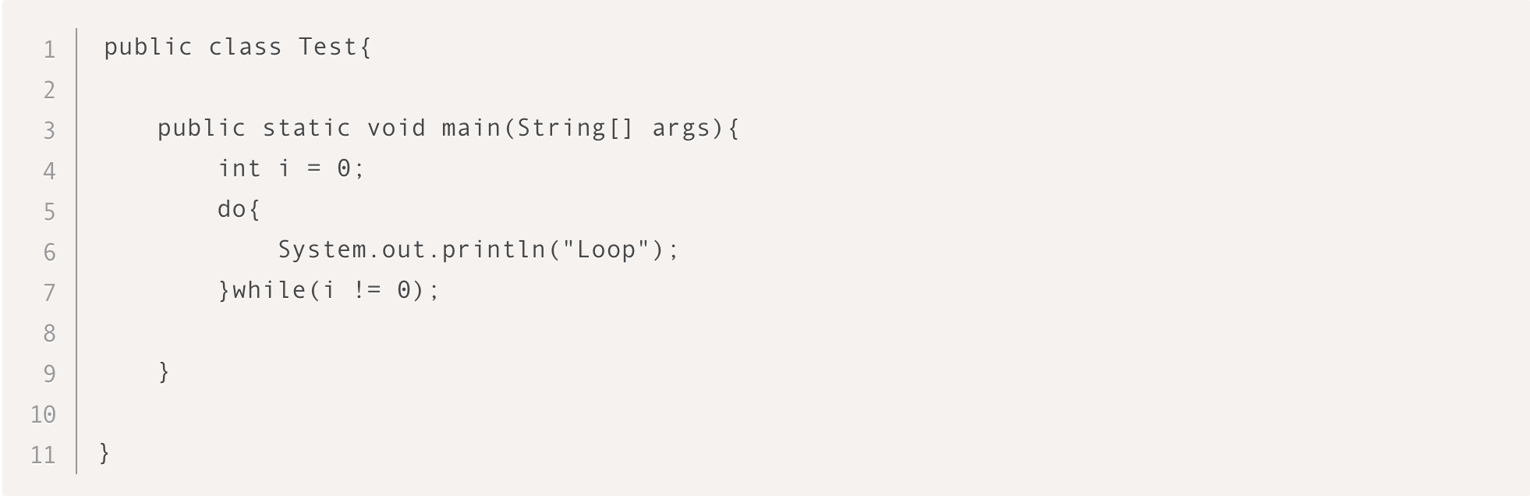
What will happen when you run the following code?
Compilation error
“Loop” will be printed once
”Loop” will be printed infinite times
No output

Slide 6
What will happen when you run the following code?
Compilation error
“Loop” will be printed once
”Loop” will be printed infinite times
No output
Option B is the correct choice. Do while loop always has one iteration of the code block regardless of the condition. Code will execute and print “Loop”, then the condition will be checked which is false and hence the loop will be terminated.

Slide 7
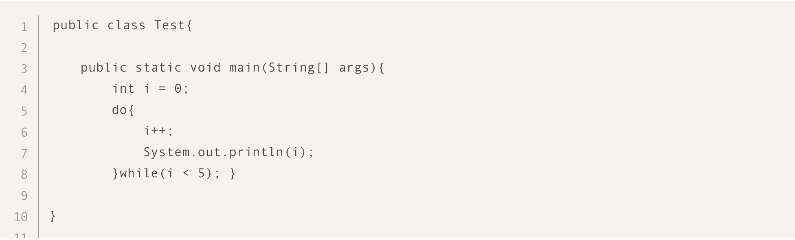
What will happen when you run the following code?
Compilation error
Code will print 0 to 4
Code will print 1 to 4
Code will print 1 to 5

Slide 8
What will happen when you run the following code?
Compilation error
Code will print 0 to 4
Code will print 1 to 4
Code will print 1 to 5
Option D is the correct choice. Do while loop always has one iteration of the code block regardless of the condition. Code will execute and increment i first and then print its value. This will go on until i equals 5 since the condition isn’t checked until the end of the loop and i becomes equal to 5 within the loop.

Slide 9


Regardless of the Boolean condition of the do while lop, there is always at least one iteration of the loop
True
False

Slide 10
Regardless of the Boolean condition of the do while lop, there is always at least one iteration of the loop
True
False
True is the correct choice. Do while loop executes the code block once and then checks for the associated condition. If it is true, it continues to the next iteration otherwise control goes out of the loop to the next statement in code.

Slide 11
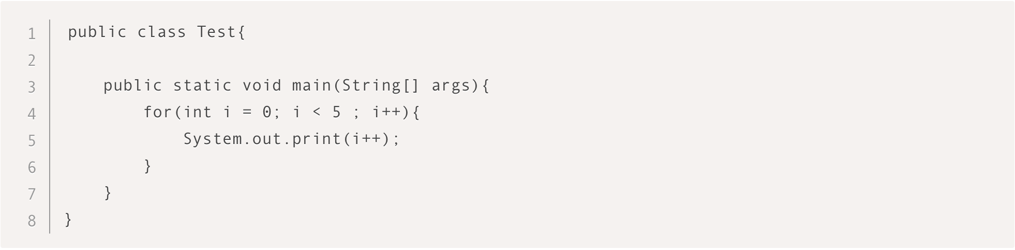
What will happen when you run the following code?
Compilation error
01234
135
024

Slide 12
What will happen when you run the following code?
Compilation error
01234
135
024
Option D is correct choice. For loop goes from 0 to 4 but the value of variable i is incremented in the loop body as well. So for each iteration variable i is incremented by 2. Code will print 0, 2 and 4 in respective iterations before the condition becomes false (i = 6 which makes i < 5 condition false).

Slide 13
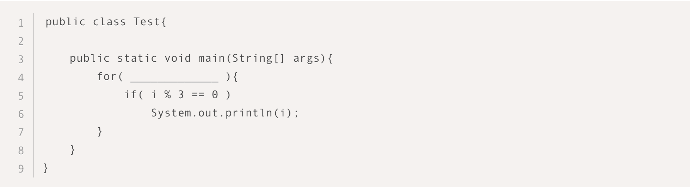
What will you write inside the for loop to make the code print numbers divisible by 3 between 1 and 10 (both inclusive)?
int i = 0; i < 10; i++
int i = 1; i <= 10; i++
int i = 0; i <= 9; i++

Slide 14
What will you write inside the for loop to make the code print numbers divisible by 3 between 1 and 10 (both inclusive)?
int i = 0; i < 10; i++
int i = 1; i <= 10; i++
int i = 0; i <= 9; i++
Option 2 is correct choice. First option starts with 0 and goes up to 9 only. Third option is also same, starting from 0 to 9. Fourth option is logically correct but uses variable name as j which will cause compilation error because we have used variable i in the if condition inside for loop.

Slide 15
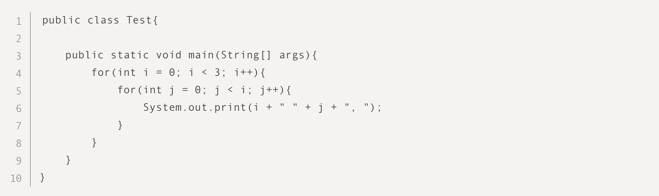
What will happen when you run the following code?
0 0, 0 1, 0 2, 1 0, 1 1, 1 2, 2 0, 2 1, 2 2,
0 0, 0 1, 0 2, 0 3, 1 0, 1 1, 1 2, 1 3, 2 0, 2 1, 2 2, 2 3,
1 0, 2 0, 2 1,

Slide 16
What will happen when you run the following code?
0 0, 0 1, 0 2, 1 0, 1 1, 1 2, 2 0, 2 1, 2 2,
0 0, 0 1, 0 2, 0 3, 1 0, 1 1, 1 2, 1 3, 2 0, 2 1, 2 2, 2 3,
1 0, 2 0, 2 1,
Option 3 is correct choice. Condition of inner for loop is j < i so in the first iteration of the outer loop, there will not be any iteration of the inner for loop (because of 0 is not less than 0). In the second iteration of the outer for loop, value of variable i is 1 so there will be one iteration of the inner loop which will print 1 and 0 for i and j respectively. In the third iteration i becomes 2, so the inner loop will have two iterations and will print 2 0 and 2 1 respectively.

Slide 17
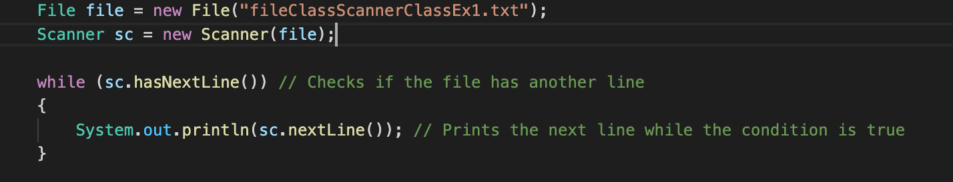
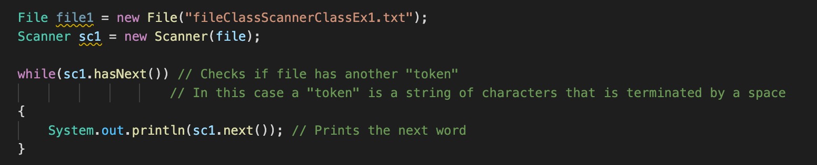


Given a text file, which of the following prints out each line one at a time?
A
B

Slide 18

Given a text file, which of the following prints out each whole line one at a time?
A
A is correct because b would’ve printed out each “token” (individual word in this case) one at a time.

Slide 19
Which of the following statements opens a file named MyFile.txt and allows you to append data to its existing contents?
PrintWriter outfile = new PrintWriter("MyFile.txt", true);
PrintWriter outfile = new PrintWriter(true, "MyFile.txt");
FileWriter fwriter = new FileWriter("MyFile.txt", true); PrintWriter outFile = new PrintWriter(fwriter);
FileWriter fwriter = new FileWriter("MyFile.txt"); PrintWriter outFile = new PrintWriter(fwriter);

Slide 20
Which of the following statements opens a file named MyFile.txt and allows you to append data to its existing contents?
PrintWriter outfile = new PrintWriter("MyFile.txt", true);
PrintWriter outfile = new PrintWriter(true, "MyFile.txt");
FileWriter fwriter = new FileWriter("MyFile.txt", true); PrintWriter outFile = new PrintWriter(fwriter);
FileWriter fwriter = new FileWriter("MyFile.txt"); PrintWriter outFile = new PrintWriter(fwriter);
C is correct because A & B don’t use a FileWriter object. D doesn’t add the true Boolean value to append the data which means the file would be overwritten.

Slide 21
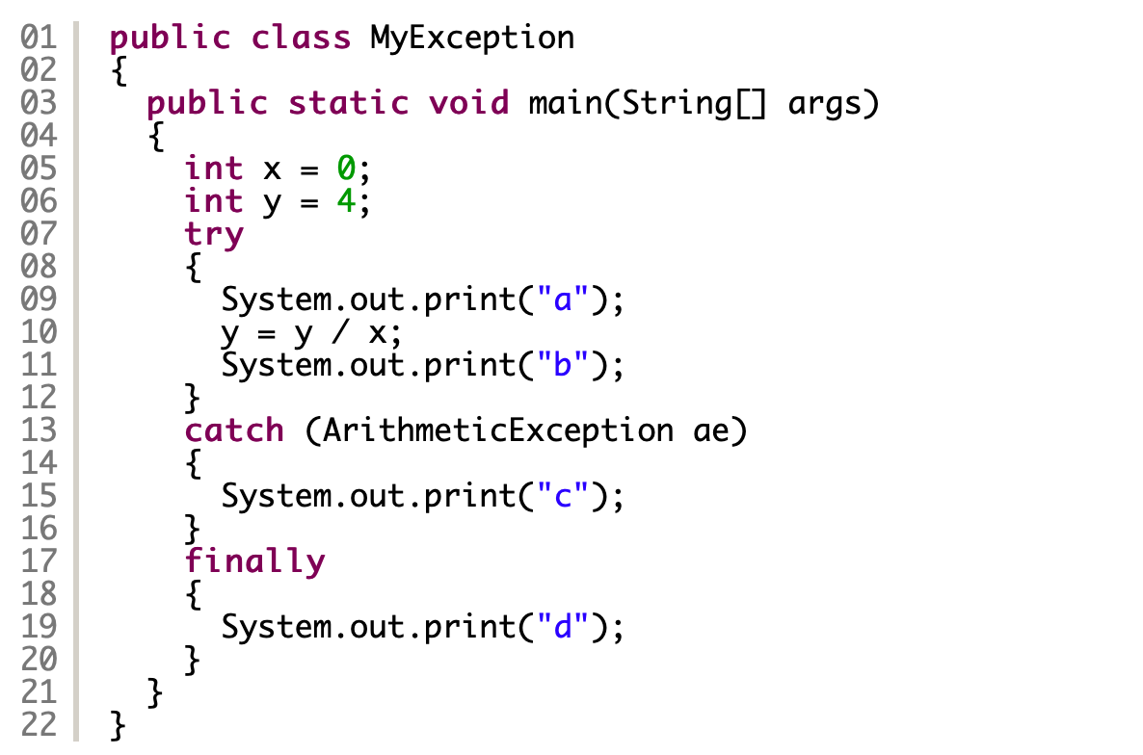
What is output to the terminal when you run the following code?
This program writes "a" to the standard output.
This program writes "ab" to the standard output.
This program writes "acd" to the standard output.
This program writes "ac" to the standard output.
This program writes "ad" to the standard output.
This program writes "b" to the standard output.,

Slide 22
What is output to the terminal when you run the following code?
This program writes "a" to the standard output.
This program writes "ab" to the standard output.
This program writes "acd" to the standard output.
This program writes "ac" to the standard output.
This program writes "ad" to the standard output.
This program writes "b" to the standard output.,
Here is obviously an arithmetic exception occurs, because the statement y = y/x; divides y by 0. In the try block the first statement writes the letter “a” to the terminal, but the statement y = y/x; causes an arithmetic exception. Therefore, the rest of the try block will be ignored.
The type of the exception is an arithmetic exception. Therefore, the catch block is executed and the statement System.out.print(“c”); writes the letter “c” to the terminal.
The finally block is always executed. Therefore, the statement System.out.print(“d”); writes the letter “d” to the standard output. So, the correct answer is option c.

Slide 23
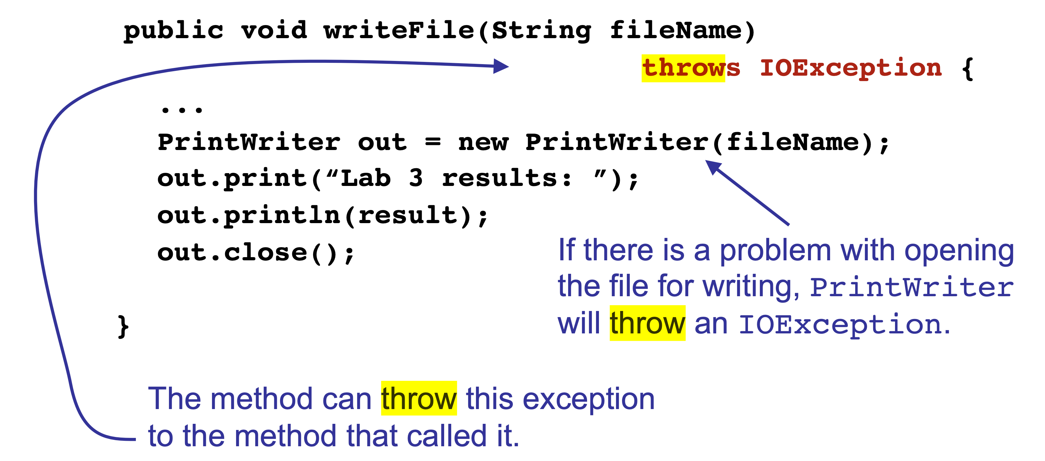






What Exception needs to be thrown at the beginning of this method to handle what PrintWriter might throw?
IOException
FileNotFoundException
NullPointerException

Slide 24
What Exception needs to be thrown at the beginning of this method to handle what PrintWriter might throw?
IOException
FileNotFoundException
NullPointerException

Slide 25
Which of the following declares an array of integers named number?
int number ;
int [ ] number ;
int new number [ ] ;
int number = int [ ] ;

Slide 26
Which of the following declares an array of integers named number?
int number ;
int [ ] number ;
int new number [ ] ;
int number = int [ ] ;

Slide 27

What is the output of the code fragment?
1 5
6
1 7
8

Slide 28
What is the output of the code fragment?
1 5
6
1 7
8

Slide 29
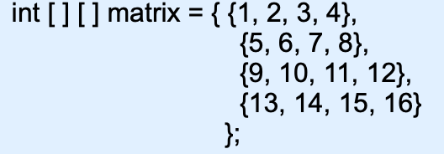
What is the index of 12
matrix[3][4]
matrix[11]
matrix[2][3]
Matrix[2][4]

Slide 30
What is the index of 12
matrix[3][4]
matrix[11]
matrix[2][3]
Matrix[2][4]

Slide 31
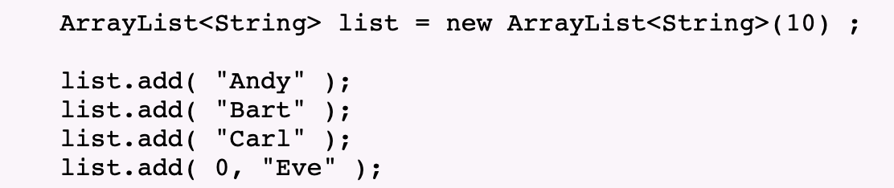
What element will be at index 2 of the list?
Eve
Andy
Bart
Carl
What is the capacity of the list? How about the size?
4, 4
4, 10
10, 4
10, 10

Slide 32
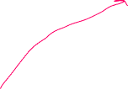
What element will be at index 2 of the list?
Eve
Andy
Bart
Carl
What is the capacity of the list? How about the size?
Capacity is how many items the list can hold and size is how many elements are in the list.
4, 4
4, 10
10, 4
10, 10

Slide 33
Questions?
What concepts would you like to know more about?

Slide 34
For next week
If you have an exam, good luck! That’ll mean no recitation again if it’s on Wednesday.
If the exam isn’t Wednesday then we’ll go over this stuff again.
Please email me or if you’re having issues with submitting labs on time
Or if you’re having any issues with the labs/quizzes! If you don’t understand how to do something just ask!
Lab 6 is now due 10/27 && Lab 7 is due 10/30
As always, here’s the Discord link: https://discord.gg/W5PeVfw7
Joining is optional, but it’ll be a good point of contact with us

