Slide 1
CS0007 Recitation
Thursdays 12:00-12:50PM
Michael Bartlett
Today’s slides are adopted from lin rojtas, another cs0007 Ta

Slide 2
Today’s Agenda
Variables and arithmetic, pt 2
Integer division
Casting
The final keyword
Strings!
Review of primitives and objects
Lab 3 hints

Slide 3
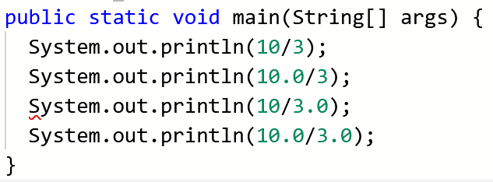
Integer Division
Integer division and floating point (decimal) division are different!
If you’re dividing two integers, you will end up with a whole number (int). Otherwise, you’ll end up with a decimal (double)
Notes:
Example solved on next slide

Slide 4
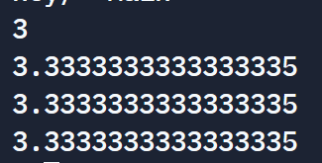
Integer division
Notes:
Since we’re dividing two ints, we get the answer w/o the remainder.
When adding a decimal in, the answer automatically gets casted to a double.

Slide 5
Casting
When working with primitives, you can change certain data types into other data types!
Widening casting (small to large)
byte → short → char → int → long → float → double
Narrowing casting (large to small)
double → float → long → int → char → short → byte

Slide 6
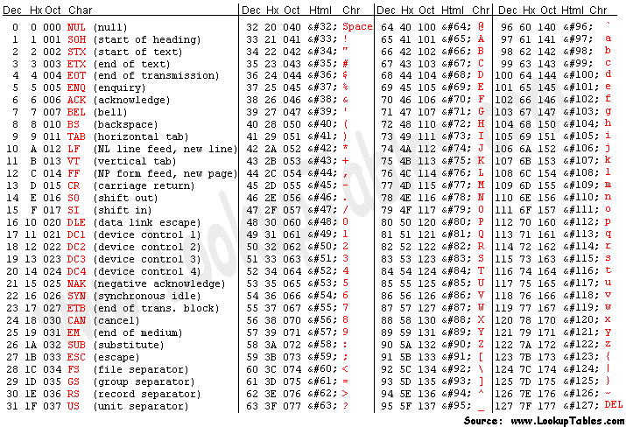
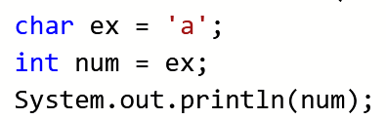

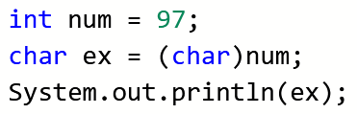

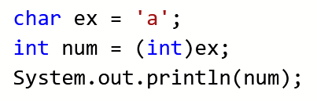
Casting
Widening casting is done automatically…
While narrowing casting has to be done manually…
In general, though, it’s good practice to do all casting manually
Notes:
Does anyone know why this char becomes 97?

Slide 7

The final Keyword
The final keyword is used when you’re declaring a constant
(a variable that cannot be changed or reassigned!)
Convention: variable names with the final keyword are given names in all caps

Slide 8

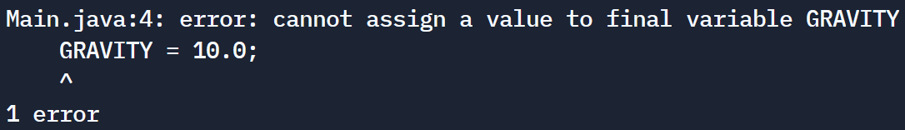
What happens if we try to change a final variable?
Well…

Slide 9
Strings
Recall: Strings are objects, meaning they come with their own special operations
Instead of calling Strings “variables”, we typically say “objects” or “instances of”
Variable num versus object name
Say we have a String object named str. Common operations are:
str.toUpperCase(); → returns str in all uppercase letters
str.toLowerCase(); → returns str in all lowercase letters
str.charAt(int num); → returns a char at index num in str
str.length(); → returns an int giving the length of str
Notes:
Like mentioned last week, Strings are objects because they have all these built in methods. Java makes it easy to do a lot that you would have to code otherwise.

Slide 10
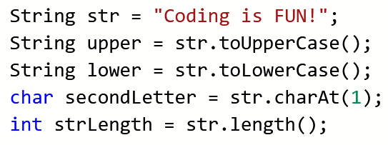
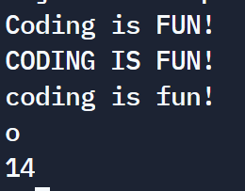
String Methods
Note: string indexing starts at 0!
str.charAt(0); would return ‘C’ while str.charAt(14); gives an error

Slide 11
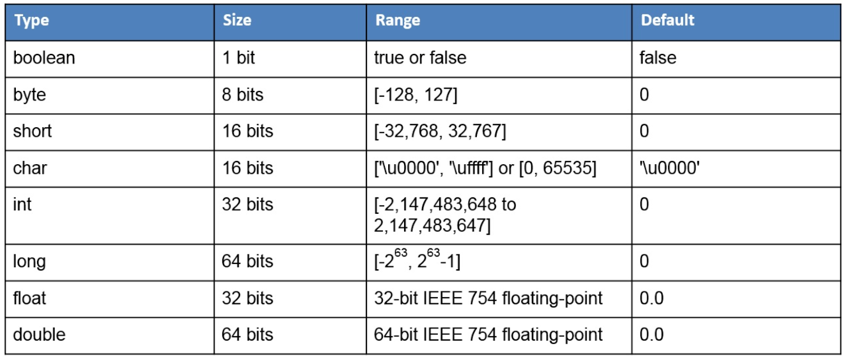
Lab 3 hints
Helpful Table for Activity 2
Activity 1: Temperature Conversion
Tip: USE THE FORMULA GIVEN TO YOU!! Think about how you would do this problem on paper, and then do your best to translate that into code.
Activity 2: Variable Types
Tip: You don’t need to print anything; we’re just looking to see that you’re using the appropriate variable type and naming conventions!
Remember, these are constants so be sure to use final.

Slide 12
Lab 3 hints
Activity 3: Game Playtime
Tip: make sure you’re using integer division and the modulus (%) operation! This is another instance in which it would be helpful to do this on paper first and then do your best to convert it into code
Activity 4: Degrees to Radians
Tip: reference the Java Math API! Don’t be intimidated by the long equation; the computer does all of the heavy lifting for you. Just think about which methods in the Math class help with exponents and keep the order of operations in mind. Parentheses are your friend, too!
There is a sin Method in the Java API, but the point of this activity is to implement the formula using other Methods.

Slide 13
Other general lab tips
Coding is hard! It’s okay if you don’t get it on the first go around.
Make sure to check for common syntax errors (meaning, sometimes you’ll forget to add a semicolon at the end of a line; it happens!)
Before you come to me asking for help, make sure you try working on your own first! There’s only so much that I can help you with and you already having some code we can work with helps a great deal.
Again, don’t cheat. Cheating is for losers.

Slide 14
For next week
Lab 3 is out!
I gave some tips in my slides, use them! It’s your first actual coding assignment, so I expect you guys to have a little trouble. That’s what my office hours are for, though. I will answer questions to the best of my ability.
The way you all submit assignments may change; keep an eye on Canvas for new submission instructions.
Next week: Coding style, inputting data, and maybe if-structures!

