Slide 1
CS0007 Recitation
Thursdays 12:00-12:50PM
Michael Bartlett
Today’s slides are adopted from lin rojtas, another cs0007 Ta

Slide 2
Today’s Agenda
Introduction
Let’s talk the command line again
Java API
Variables and Arithmetic
Notes:
For today, I’m gonna give you guys a quick intro about myself, I’ll talk to you about the command line one more time, we’ll go over a little bit about the Java API, and talk about variables and arithmetic

Slide 3
About Me
My name is Michael
I’m a sophomore majoring in CS
I’m from the Lehigh Valley (Other side of the state)
Specifically, Northampton, PA
Outside of academics on campus, I’m also in Pathfinders, a video editor for TPN, and in the CS club.
Join Pathfinders: forms.gle/hREBWGdVktviWcuLA
Join Pitt CSC: http://pittcsc.org
Y’all are always welcome to email me with questions: mab650@pitt.edu
I’ll try to email back as quickly as possible and we can always setup a time to talk and go over anything you need to.
Notes:
Hey y’all I’m Michael and I’m a sophomore majoring in CS. I’m from the Lehigh Valley, specifically Northampton, which is on the other side of the state.
Outside of academics, I’m a Pathfinder, a video editor for TPN, and in the CS club.
Two side notes, one we are recruiting for Pathfinders please join. We’re in desperate need of CS majors.
Also the CS club has great resources for anyone, CS or not. Consider joining to further your professional career.
Please email me if you ever have questions that you think I can answer. I try to respond as quickly as possible. I don’t sleep much so I’m probably awake and can respond. I’ll try to setup a time to meet with you/Zoom if it’s something that’s in depth.

Slide 4
About These Recitations
Slides will be available on my Github
https://github.com/michaelbartlett17/cs7-recs/
Link is on Canvas on the Recitation and TA info page.
I determine due dates for the labs and submit grades to the grader, so please ask me first about the labs.
Recitations will always be here (and on Zoom while required by the University)
I’ll try not to take all 50 minutes.
Office hours!
Tuesdays and Thursdays 4PM-6PM
On Zoom (link on Canvas) until hybrid posture ends and I find out what room I can use.
Also, make an appointment with me if those times don’t work for you.

Slide 5
Policies
Attendance isn’t required, but I strongly recommend you come because I’ll go over concepts from the class and give you as much information about solving the labs as I can
Labs are due Wednesdays at 11:59PM
I don’t care how you solve it, as long as you understand what you did.
That being said, I’ll be able to figure out if you found solutions online, especially if you use concepts we haven’t learned yet, so please don’t cheat.
If you need an extension, please let me know.
There will be submission links on Canvas starting today or tomorrow. There will links for each section so please be sure to submit to the right one.

Slide 6
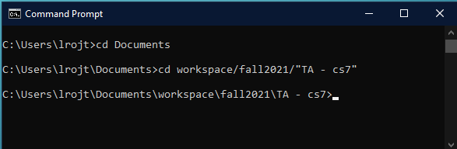
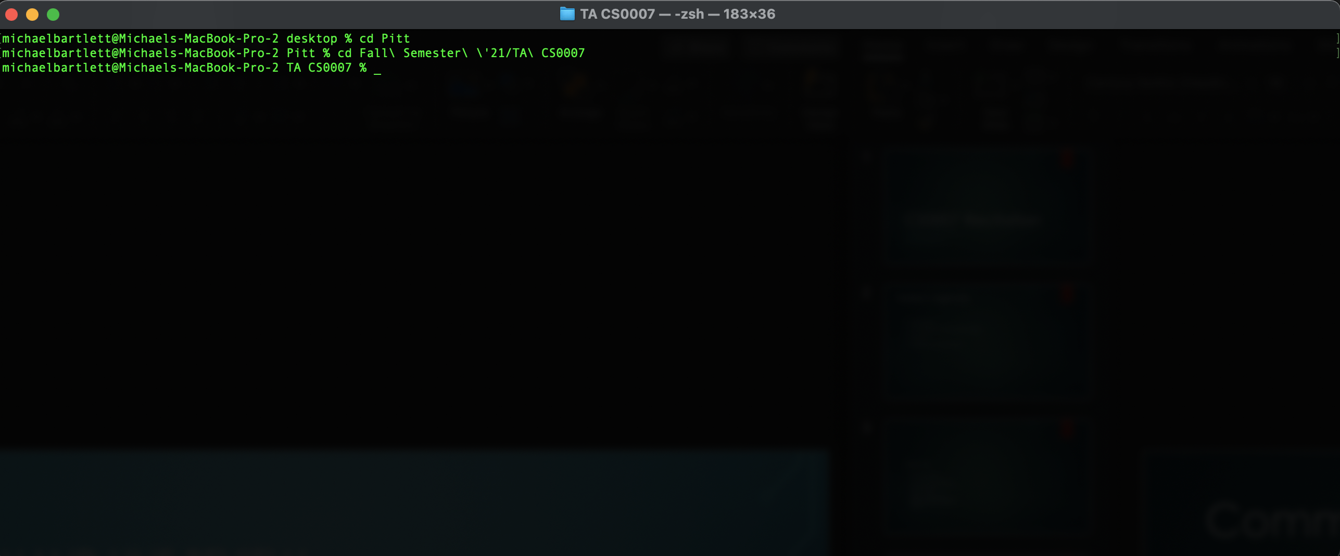
Command Line Review
USEFUL COMMAND: cd (folder name) – go into a folder in your current directory
Use cd ../ (Mac) or cd .. (Windows) to go to a folder outside the current directory (ex. Say I want to go to Fall Semester ‘21)
Try not to use spaces in your folder names, but if you do, use backslash after each space
Or put the whole name in quotes on Windows
Notes:
Let’s go over the command line again! I mentioned that cd command in the last lecture.
Explain example

Slide 7
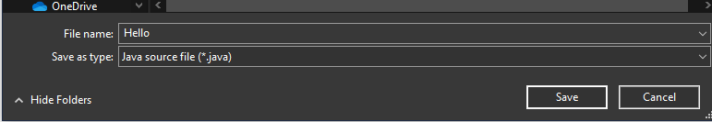
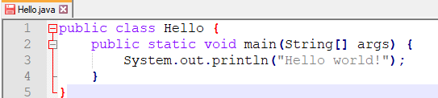
Command Line Review
Before we run our program, we need to make sure that:
We are saving as a .java file
The name of our program is the same as the word that follows public class in that program.
Notes:
Explaining java and javac
HINT for hello world

Slide 8

Command Line Review
USEFUL COMMAND: javac (file name).java – compiles our written code into bytecode
USEFUL COMMAND: java (file name) – runs the machine code that was compiled
ALWAYS javac BEFORE YOU java!!!
When using javac, make sure you include .java at the end of your file name!

Slide 9
Java API – Math Examples
With APIs, Google is your friend!!
https://docs.oracle.com/javase/7/docs/api/java/lang/Math.html
Highlights
Math.sqrt(double a) – returns the square root of a number a.
Math.sqrt(4) returns 2.0
Math.pow(double a, double b) – returns the value of a number a raised to the power of another number b (or a^{b})
Math.sqrt(3, 2) returns 9.0
Feel free to explore and test on your own!
Notes:
API: application programming interface.
Defined as: a set of functions and procedures allowing the creation of applications that access the features or data of an operating system, application, or other service.
There are APIs for everything! Getting weather data, our Pitt dining hall menus, and even to code in Java.
I mentioned that we’ll talk some math examples, so here is an example using the Math API
Use jshell quick

Slide 10

Java API – Scanner
The Scanner API is typically used for accepting user input
Asking for two numbers to be added together, entering your first name, etc.
Unlike the Math class, you need to import this class into your program by including import java.util.Scanner; at the very top of your program (above your class!)
Note: you can import all the classes in java.util with import java.util.*;

Slide 11
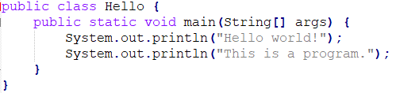
Parts of a program
1
2
3
Comments can be formatted
// like this
/ * like this */
/* and
* like
* this */
1 – Class
2 – Method
3 – method delimiter

Slide 12
Data Types
Primitives vs. objects
Primitive examples: boolean, byte, short, long, int, double, float, char (all lowercase!)
boolean: true/false value
char: character (‘a’.,‘x’)
short, long, int, double, float, and byte are all numbers of varying lengths
Most of the time, you’ll use int and double of these six
Only double and float can be decimal values
Object examples: String, Scanner, and many… many more (capital first letter!)
Notes:
A primitive is a data type that is composed of no other data types and can not be broken down any further. It is like the atoms in the programming scenario. I say atom because atom is a basic unit of matter and there is nothing that can be derived from it.
An object, on the other hand can be thought of a molecule, consisting of more than one primitive type. For example, string comes as part of the Java standard library; however, it is an object and it is composed of smaller data types internally and contains methods.

Slide 13
Variable Naming Conventions
It’s important to name your variables in ways that both you and anyone else that may see your programs (Paulo, myself, the grader) will understand.
DO NOT use single letters or non-descriptive names!!!
DO NOT use Java built-in keywords!!! (List: https://en.wikipedia.org/wiki/List_of_Java_keywords)
Variable names are case-sensitive (myVariable is not the same as myvariable)
Conventionally, you name your variables in camelCase.
Variables cannot start with numbers or special symbols (except for _ and $).
In this class (and in any other coding classes unless you are told otherwise), avoid the use of anything non-alphanumeric.
Notes:
Variable conventions: camelCase, other things listed on the slide

Slide 14
Variable Naming Conventions
If you’re naming your variable one word, you’ll typically name your variable that word in all lowercase
Examples: height, movie, speed
If your variable name is more than one word, the first word will be lowercase with the subsequent words’ first letter capitalized
Examples: myHeight, username, correctAnswer, myFavoriteClass

Slide 15

Variable Naming Conventions
Format: (variable type) (variable name) = (variable value);
System.out.println(myNumber); will print 7
Notes:
You always need a variable type before the variable, otherwise your program won’t compile

Slide 16
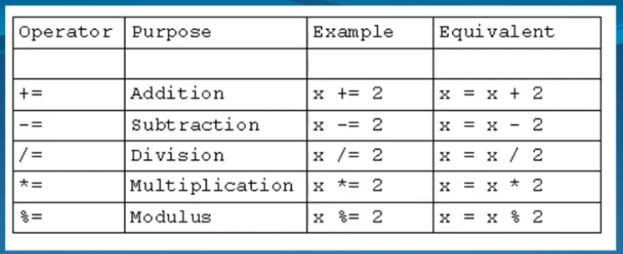
Operations and Operator Precedence
There are shorthand ways of using these operations!

Slide 17
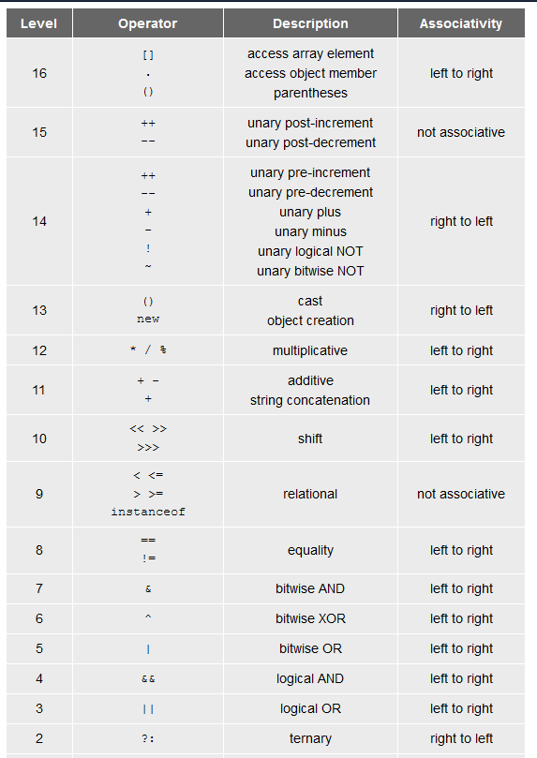
Operations and Operator Precedence
You don’t need to know all of these!!
The most important ones are additive (+, -) and multiplicative (*, /, %)
You may end up using some of the other ones in the future, but… we’ll cross that bridge when we get there.

Slide 18
Next week…
Labs 1 and 2 are out!
Lab 1 is an easy one. All you have to do is show me that you have Java installed and can print “Hello world.”
Lab 2 is also easy. All you have to do is explain concepts you learned in class.
If one of the questions don’t make sense to you please come to my office hours or email me and I can guide you through it.
I also added some helpful readings in the Github repo with the slides.
Both are due next Wednesday (9/15) at 11:59!
Keep an eye on Canvas; it’ll be posted some time tonight (email me if Friday comes and I forgot to post the assignment).
Next week: casting, the final keyword, strings and input, and style!

