Slide 1
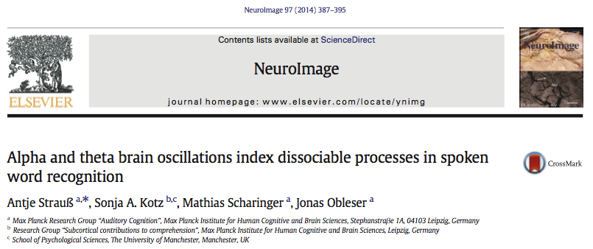
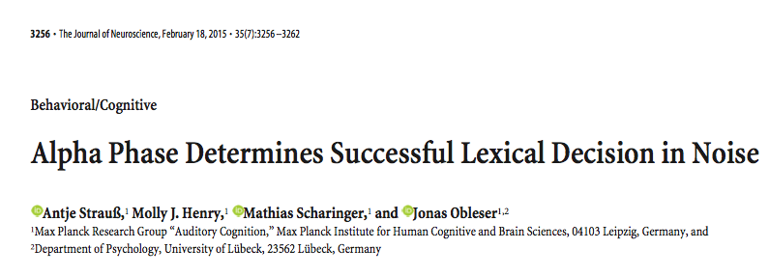

Slide 2
Strauss et al. (2014, 2015)
Examine role of theta/θ (3-7Hz) and alpha/α (8-12Hz) in modulating neural processes of speech comprehension
Strauss et al. (2014)
Focus: Functional dissociation of θ and α power in lexical integration and ambiguity resolution
Manipulation: ‘ambiguity’ and ‘wordness’
Strauss et al. (2015)
Focus: Influence of oscillatory phase on lexical decision (correct vs incorrect)
Manipulation: Embed words and pseudowords with noise

Slide 3
Strauss et al. 2014
Is there a functional differentiation between α and θ during higher cognitive processes?
Not yet shown for speech processing

Slide 4
α and cognitive functions
Observed in various domains
Auditory processing (e.g., Hartmann et al., 2012)
Attention (Kilmesch, 2012)
Working Memory (e.g., Obleser et al., 2012)
Decision making (e.g., Cohen et al., 2009)
Such processes arguably require functional inhibition of task irrelevant neural activity

Slide 5
α and functional inhibition
Inhibitional account: α remains high when language network is inhibited.
α suppression associated with more effective language processing (Obleser & Weisz, 2012)
α oscillations modulated by speech intelligibility
Enhancement for more acoustically degraded words
Suppression for less acoustically degraded words

Slide 6
θ oscillations
Consistently associated with
Episodic memory (e.g., Hanslmayer et al., 2009)
Sequencing of memory content (e.g., Roux & Uhlhaas, 2014)
Matching new information with memory content (e.g., Kilmesch, 1999)
Reactivation of information in short term memory (Fuentemilla et al., 2010)

Slide 7
θ power enhancement
Found in various language/speech specific effects
Semantic violations (Hagoort et al., 2004)
Retrieval of lexico-semantic information (Bastiaansen et al., 2008)
Increasing intelligibility of acoustically degraded speech, proportional to α suppression (Obleser & Weisz, 2012)

Slide 8
ERP N400 amplitude
Robust index of ‘wordness’
Elicited by
Unexpected words (e.g, Kutas & Hilliard, 1980)
Infrequent words (Dufour et al., 2013)
Pseudowords (Friedrich et al., 2006)
Reflects increasing processing difficulty of matching new input to memory content (lexical access).

Slide 9
Strauss et al. 2014
Goal
Dissociate α and θ neural oscillations
Link dissociation with functions of speech recognition
Compare with ERP N400 responses as index of ‘wordness’
EEG experiment
Auditory lexical decision task
Speech along word-pseudo word continuum

Slide 10
Stimuli
3 syllable items, 4 conditions (60 in each)
Condition | Example | Type | Neighbors | Difficulty
FILLER-words | botanik | Abstract |  | NA
REAL-words | banane | Concrete |  | Easy
AMBIGUOUS-pseudo -switch 2nd core vowel | banene | Concrete | One | Hard
CLEAR-pseudo -scramble syllables | bapossner | Concrete Abstract | Several | Easy
Controlled for ratio of stress patterns across conditions
Substitution of vowel marked deviation point to real German words
Lexically but not phonetically ambiguous

Slide 11
Stimuli (adapted from Raettig and Kotz, 2008)
Natural speech (trained female speaker)
Digitized at 44.1 kHz.
Down-sampled to 22.05 kHz
Cropped around articulation onset and offset
In total: 240 stimuli (4 conditions, 60 in each)
Duration: 754 ms ± 83 ms (M ± SD)

Slide 12
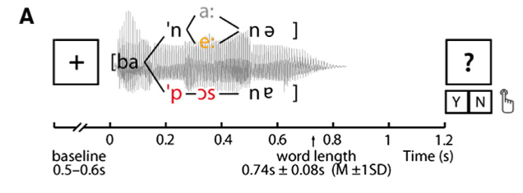
Procedure
p. 389

Slide 13
Predictions
α
Lexical accessibility is reduced along word-pseudoword continuum
Reduction in α power for real words
Means α enables lexical integration
θ
Ambiguous stimuli should lead to re-evaluation of input
Variation in θ power as a function of ambiguity resolution
Should answer whether recognition is
serial, feed-forward (Norris et al., 2000), OR
parallel, interactive (Marslen-Wilson, 1987)

Slide 14
Data analysis: ERPs
Fieldtrip toolbox (Oostenveld et al., 2011)
BPF from .1-100 Hz
ICA artifact rejection,
LPF (5 Hz), Baseline correction (-200-0 ms)
Averaging over trials per condition
N400 component: ROIs from midline electrodes (FPz, AFz, Fz, FCz, Cz, CPz, Pz, POz, Oz)
Time-series analysis over 0-1250 ms range (49 steps of 50 ms width, 25 ms overlap)
Repeated measures ANOVA (factor: ‘wordness’)
p. 389

Slide 15
Time frequency analysis
Time-frequency representations
Mortlet wavelet power estimates: 20 ms steps (–700-2100 ms)
Baseline correction: -500 to 0 ms
Multilevel/random-effects statistics approach
t-tests: condition as DV (word, pseudo, ambiguous)
Effects of interest
α ‘Wordness’ Effect: pseudo > ambiguous > real
θ ‘Ambiguity’ Effect: ambiguous > (pseudo, real)
Source localization of time-frequency effects
Fieldtrip protocol of beamformer techniques (Haegens et al., 2010)
DICS - Dynamic Imaging of Coherent sources based on estimation of single trial FFT of time windows and frequencies of interest (TOI, FOI)
p. 390

Slide 16
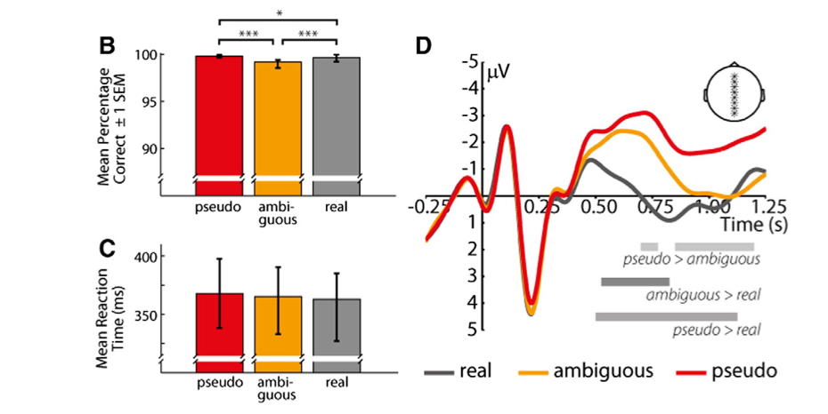
Accuracy
Lowest for ambiguous
Greatest for clear-pseudo
RT: ns

Slide 17
Accuracy
Lowest for ambiguous
Greatest for clear-pseudo
RT: ns
Amplitude
pseudo > real (.5-1.125s)
ambiguous > real (.525-.825s)
pseudo > ambiguous (.85-1.2s)

Slide 18
Time frequency results

Slide 19
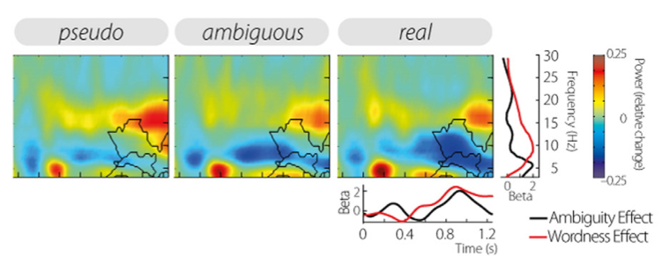
Grand average power changes
Grand average of TF power changes relative to 500 ms pre-stimulus baseline over all electrodes for three conditions separately. Black contours mark cluster boundaries.
α (8-12 Hz): suppressed throughout, lowest at ~800 ms
θ (3-7 Hz): enhanced ~200 ms, decreasing from 400-1000ms
p. 391

Slide 20
Assessment of relative power changes
Multilevel statistics approach
1st level: linear contrasts
‘Wordness’ effect: real > ambiguous > pseudo (Weird, doesn’t match prediction on p. 390, end of paragraph1)
‘Ambiguity’ effect: ambiguous > (real, pseudo)
2nd level: cluster permutation test of betas against zero
p. 391

Slide 21
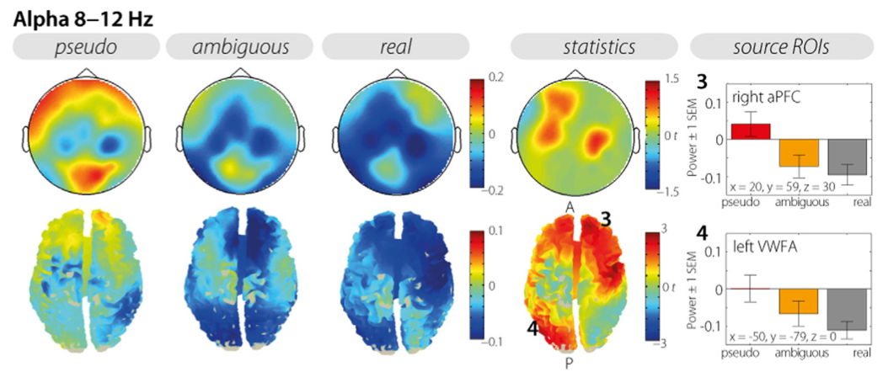
Results: Alpha: Test of ‘wordness effect’
Columns 1-3: Scalp topographies and source projections for relative α power changes (10 ± 2 Hz, 1000 ± 350 ms, in dependence on time and frequency window used for source localization). Column 4: statistical differences.
Test of ‘wordness’ effect
Positive cluster over α freqs, largest differences over LH frontal, LH and RH central electrodes
Extracted power: significant differences between all conditions
p. 391

Slide 22
Results: Alpha: Source localization
5
Columns 1-3: Source projection. Column 4: statistical differences. Column 5: bar graphs extracted from source peaks in the left VWFA and right aPFC.
Source localization of alpha
Alpha oscillations distributed over scalp with a central focus
Less power with increasing wordness.
p. 391

Slide 23
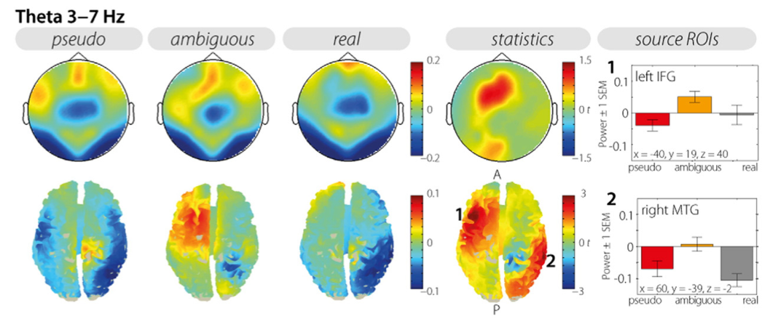
Results: θ: ‘Ambiguity’ effect
Fig 2. Columns 1-3: Scalp topographies for relative power changes in θ band (4.5 ± 2.5 Hz, 500–1200 ms, in dependence on time and frequency window used for the source localization) and correspondent source projection; Column 4: statistical differences;
Test of ‘ambiguity’ effect: ambiguous > (pseudo, real)
Positive θ cluster at left-central anterior and parietal electrodes
Post-hoc t-tests of power
real vs. pseudo power not significantly different
p. 391

Slide 24
Results: θ: Source localization
Fig 2. Columns 1-3: Scalp topographies for relative power changes in θ band (4.5 ± 2.5 Hz, 500–1200 ms, in dependence on time and frequency window used for the source localization) and correspondent source projection; Column 4: statistical differences; Column 5: bar graphs extracted from in the left IFG and the right MTG for theta.
Theta power spreading indicates two generators:
Left frontal origin, 2) Right parietal origin
*highest increase for ambiguous stimuli
p. 391

Slide 25
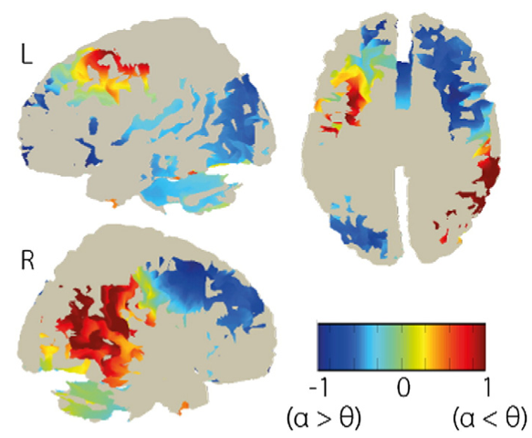
2 separate networks disclosed by α-θ index
Fig. 3. α–θ index. The index compares the θ effect (A) and the α effect (B) per source space grid point. The index has been calculated for grid points only which exceeded the critical value of t19 = 1.7291 such that only areas are highlighted which either show an α (blue) or θ (red) effect. Areas with index values around zero (green) show equal sensitivity to both effects, e.g., left frontal regions.
Three of four identified source peaks selective for either alpha-indexed lexical integration, or theta-indexed ambiguity resolution
Left IFG shows equally strong effects of alpha and theta activities as indicated by index values around zero.
p. 391

Slide 26
Discussion
Results suggest parallel processes of lexical integration and ambiguity resolution
α suppression
scales with ‘wordness’ (akin to N400)
part of left temporo-occipital and right frontal networks
θ enhancement
marks re-evaluation of available sensory evidence?
localized in left frontal and right MT regions

Slide 27
General discussion
α
Low α seems to index lexical integration.
Scaling of α power with ‘wordness’ complements previous finding of α suppression for more intelligible words (Obleser & Weisz, 2012)
θ
Previous work found linear decrease in theta with increasing word processing difficulty (Obleser and Weisz, 2012)
Present study found enhancement of θ for ambiguous (most difficult) stimuli. Also, θ did not increase linearly with processing difficulty

Slide 29
Background
Pre-stimulus oscillatory brain states influences detection of low-level stimuli
Effect found in various domains of low level perception
Visual (e.g., Spaak et al. 2014)
Auditory (e.g.,Lakatos et al., 2005)
Audiovisual (e.g., Keil et al., 2014)
In general, increasing performance for targets coincides with excitable phase of oscillation

Slide 30
Strauss et al. 2015
Does speech processing depend on neural phase?
Specifically, what is the role of α (8-12Hz) and θ (3-7Hz) for lexical decision performance?

Slide 31
Background
α: modulates neuronal firing and determines phase associated with best discrimination performance in visual and auditory domains (e.g., Mathewson et al., 2009; Neurling et al., 2012)
θ: also thought to modulate neuronal firing; oscillation periods correspond with mean syllable duration of ~250ms (e.g., Doelling et al., 2014)
May index discrimination performance in lexical decision

Slide 32
Strauss et al. (2015): Hypothesis, approach
Hypothesis: Lexical decision accuracy should depend on low-frequency neural oscillatory phase
Lexical decision task with speech of varying difficulty
Speech embedded in titrated levels of white noise
Increasing difficulty should increase amount of errors
Simultaneous EEG recording

Slide 33
Stimuli (adapted Raettig & Kotz, 2008)
3 syllables
Equal ratio of stress patterns across conditions
Distributed formant distances
Lexically but not phonetically ambiguous
Condition | Example | Type | Neighbors | Difficulty
FILLER-words | botanik | Abstract |  | NA
REAL-words | banane | Concrete |  | Easy
AMBIGUOUS-pseudo -switch 2nd core vowel | banene | Concrete | One | Hard
Opaque-pseudo -scramble syllables | bapossner | Concrete Abstract | Several | Easy
Notes:
Stimuli were the same as those used in the 2014 study, but only the real word and ambiguous pseudo-word conditions were employed in the analysis. Pseudo-words weren’t included because there weren’t enough incorrect trials to contrast correct and incorrect trials.

Slide 34
SNR estimation
Adaptive tracking procedure
Present 2nd syllable extracted from stimuli
Present 2 successive syllables embedded in noise
Participants indicate if vowels are “same” or “different”
Syllable intensity adjusted relative to white noise w/ 2-down-1-up staircase procedure
Resulting SNR: -10.2 +/- 1.95 dB (M +/- SD)
Identical white noise then used for all participants
p. 3257
Notes:
Before each EEG session, the individual SNRS were estimated using an adaptive tracking procedure.

Slide 35
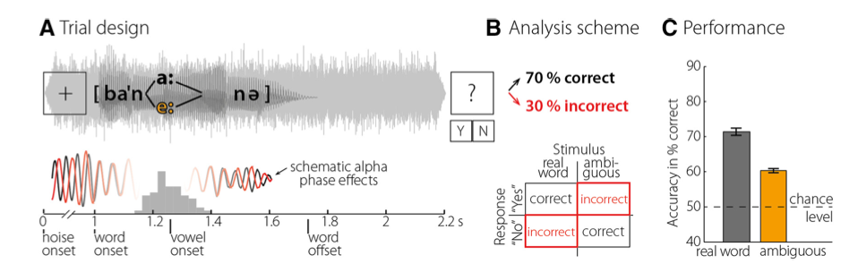
Procedure
p. 3257

Slide 36
EEG acqusition and processing
smpr: 500 Hz
Passband: DC to 140 Hz
EEG preprocessing: Fieldtrip toolbox
Broadband epochs defined ranging between -700 ms and 2100ms relative to stimulus onset
Bandpass filter: .1-100 Hz
ICA artifact rejection

Slide 37
Phase analysis
TFRs estimated from single-trial data
Mortlet wavelets applied to TFRs in 20 ms steps
Convolution of TFR (3-30 Hz) w/ linearly increasing windows (2-12 cycles)
Phase, Power estimation
(channel X frequency X timepoint)

Slide 38
Analysis: Phase bifurcation index (BI)
Split correct and incorrect trials
Calculate intertrial phase coherence (ITPC)
BIs calculated for each channel X freq X time bin
Positive BI: conditions have same ITPC values, different phase
Negative BI: one condition more phase locked than the other
Unbalanced number of correct and incorrect trials
Use randomization procedure (see methods)
Test BIs against zero for α and θ for each time point (-0.35s – 1.1s stimulus onset) via Monte Carlo randomization
p. 3258

Slide 39
Further analysis
To characterize phase effects from test of BI and to test potential confounds, evaluation of:
α and θ ITPC
Absolute α and θ power
ERPs
t-test against zero of differences between ITPC correct vs. incorrect averaged by participant

Slide 40
Power estimates
Squared magnitude of single-trial Fourier data
Same correct and incorrect trials selected
Estimate power difference, take mean > 1000 per subject
Group-level analysis same as for BI and ITPC

Slide 41
ERP analysis
LPF: 15 Hz
Baseline correction: -200ms pre-stim
Amplitude averaging in time windows over channels
Channel selection based on peristimulus BI cluster
Pairwise t-test comparison of amplitude for correct and incorrect trials
Effect sizes for all channel X freq X time in significant clusters estimated by averaging r values

Slide 42
Results: Accuracy of lexical decision
p. 3257

Slide 43
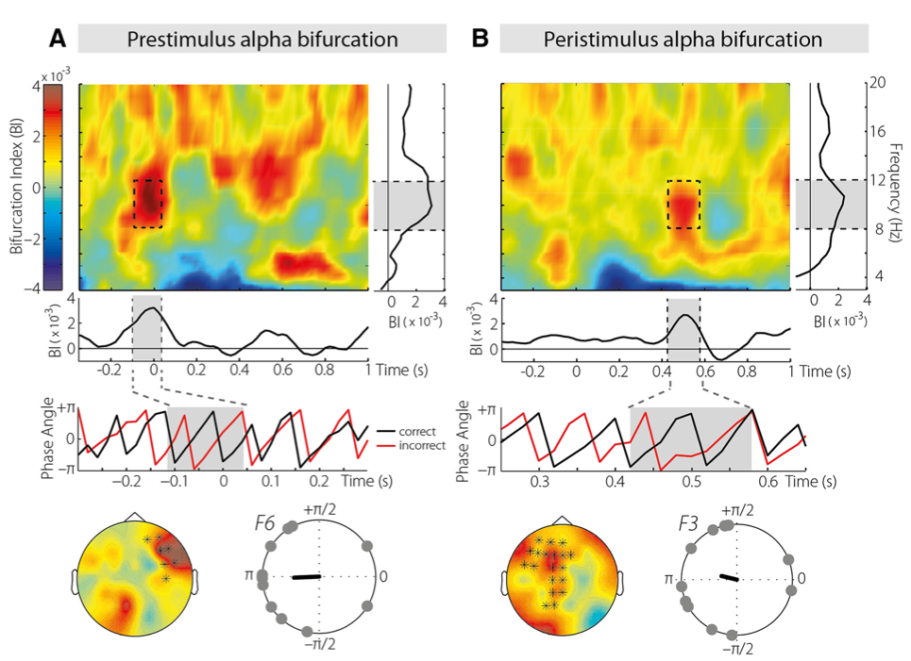
Neural phase in the α band predicts lexical-decision accuracy
Figure 2. Results from BI analysis. A, Prestimulus α phase bifurcation (time–frequency plots). One cluster was found in the α band (8 –12 Hz) with right anterior scalp distribution. Correct and incorrect trials differed in their mean phases between -120 and 40 ms [0 ms is (pseudo-)word onset]. Below, α phase extracted from and averaged over the cluster is shown in radians for correct (black) and incorrect (red) trials separately as a function of time. Phase differences (per subject) are plotted for electrode F6 along with resultant vector. B, Peristimulus α bifurcation. Second cluster was found in the α band (8 –12 Hz) with left anterior central scalp distribution. Conditions differed in their mean phases from 420 to 580 ms [0 ms is (pseudo)word onset]. α phase extracted from and averaged over the cluster is shown in radians as a function of time, for correct (black) and incorrect (red) trials separately. Phase differences (per subject) are plotted for electrode F3. Electrodes belonging to significant clusters are highlighted in topographies as asterisks.

Slide 44
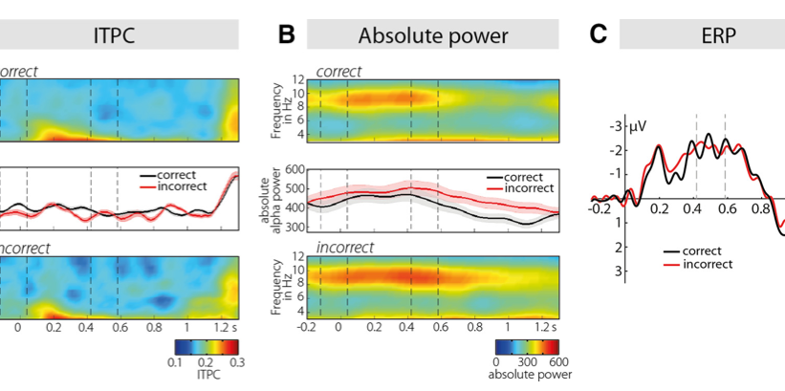
Lexical-decision accuracy was not predictable from phase coherence, power, or ERP amplitude
Figure 3. Time–frequency and time-domain analyses. A, ITPC shown separately for correct (top) and incorrect (bottom) trials. ITPC specifically for the α (8 –12 Hz) band is shown in the middle, separately for correct (black) and incorrect (red) trials. No differences were observed in the α or θ bands. Vertically dotted lines mark the time window of the prestimulus and peristimulus α phase bifurcations. Shades in time-series plot (middle) depict 􏰁1 SEM. B, Absolute power shown for correct (top) and incorrect (bottom) trials. Conditions diverged only in a late time window after both α phase effects (see middle, which shows α-band power for correct trials in black and incorrect trials in red). C, ERPs. No effect of correct (black) versus incorrect (red) trials was found.
p. 3259

Slide 45
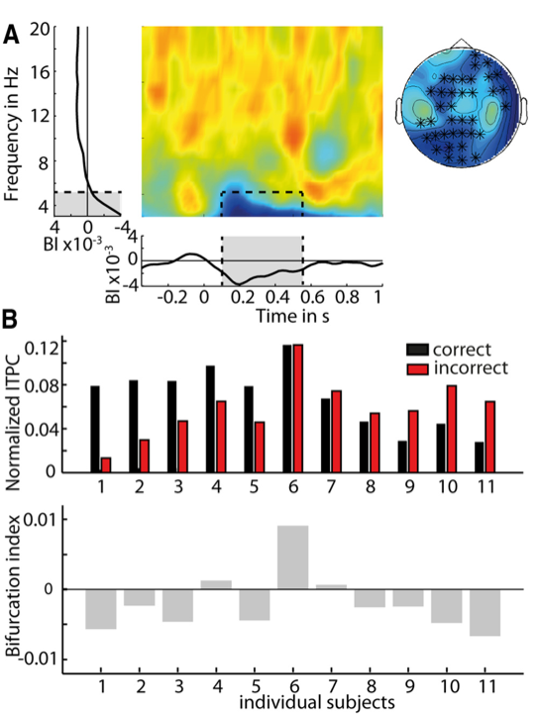
Results: Phase effects in θ band
Theta-band phase effects are not consistent across participants. A, Negative BI cluster. A negative cluster was found in the theta band (3–5 Hz) with a widespread scalp distribution in the time window ranging from 120 to 580 ms [0 ms is (pseudo)word onset]. B, Mean BI was consistently negative despite inconsistent individual data. The bar plot (middle) shows normalized ITPC for correct (black bars) and incorrect (red bars) trials as required by the BI formula (see Materials and Methods). Normalization is obtained by subtracting the ITPC of all trials from the ITPC of correct and incorrect trials, respectively. Conditions differ in both directions across participants, leading to a consistently but misleadingly negative BI (bottom).
p. 3260

Slide 46
Findings: α
Phase determines lexical decision accuracy in perceptually uncertain situations
Bifurcation emerged at -75 ms and at 500 ms.
Correct judgments coincided with opposite prestimulus phase of ongoing oscillation
Incorrect trials: beginning phonemes coincide with suboptimal windows for sensory input (i.e., inhibitory phase of ongoing α)

Slide 47
Findings: α
Peristimulus phase bifurcation over left frontal regions
Effect occurred after 2nd vowel, but not phase locked to onset of vowel
Suggests decision- rather than stimulus-related interpetation of phase effect

Slide 48
Remaining issues
Nature of relationship between pre- and peri-stimulus α phase
Proposal: effects reflect dissociable perceptual and decisional processes
Pre- and peristimulus α phase reflect partly independent mechanisms
Pre- and peri- BIs not directly correlated
Different topographical distribution

Slide 49
Remaining issues: Accuracy
Accuracy not predicted by ERP, power, or ITPC; only associated with α BIs
Accuracy not predicted by θ phase (issue with negative sign of bifurcation index?)

Slide 50
Conclusion
Pre- and peristimulus α phase predicts lexical decision in uncertain conditions
In addition to stimulus selection for perceptual processing, may play role in decisional weighting?
Dependence on rhythmic fluctuations is encouraged when evidence is limited

