Slide 1
Customer Segmentation
K-means using R
Basta, Michael
Kent State University

Slide 2
Objective & Approach
Data is Mall Customers from Kaggle for 200 Customers
Parameters are Gender, Age, Annual Income, Spending Score
The objective is to do customer segmentation for the Mall Customers
The approach is to use the K-means algorithm in R to do the analysis
The result should be a number of clusters, each one with different characteristics
Results could be used by marketing teams to put a marketing plan to target customers

Slide 3
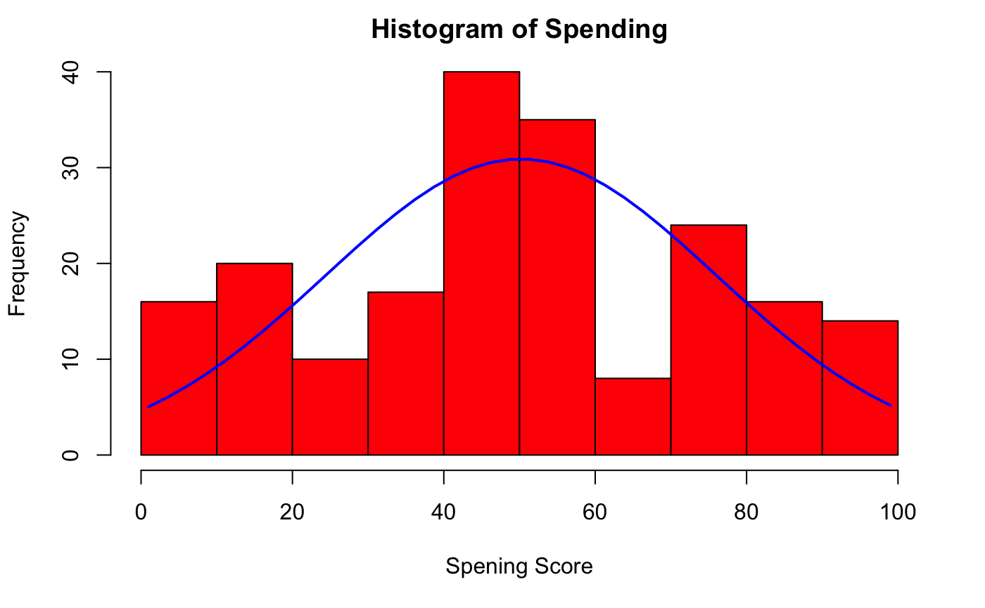
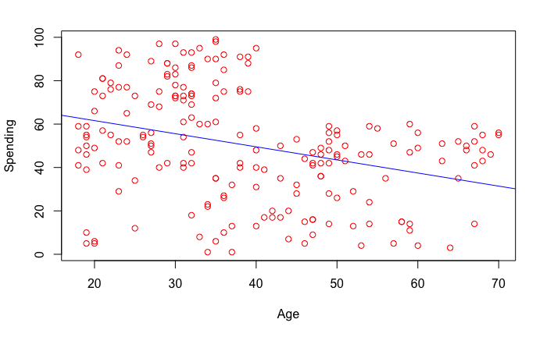
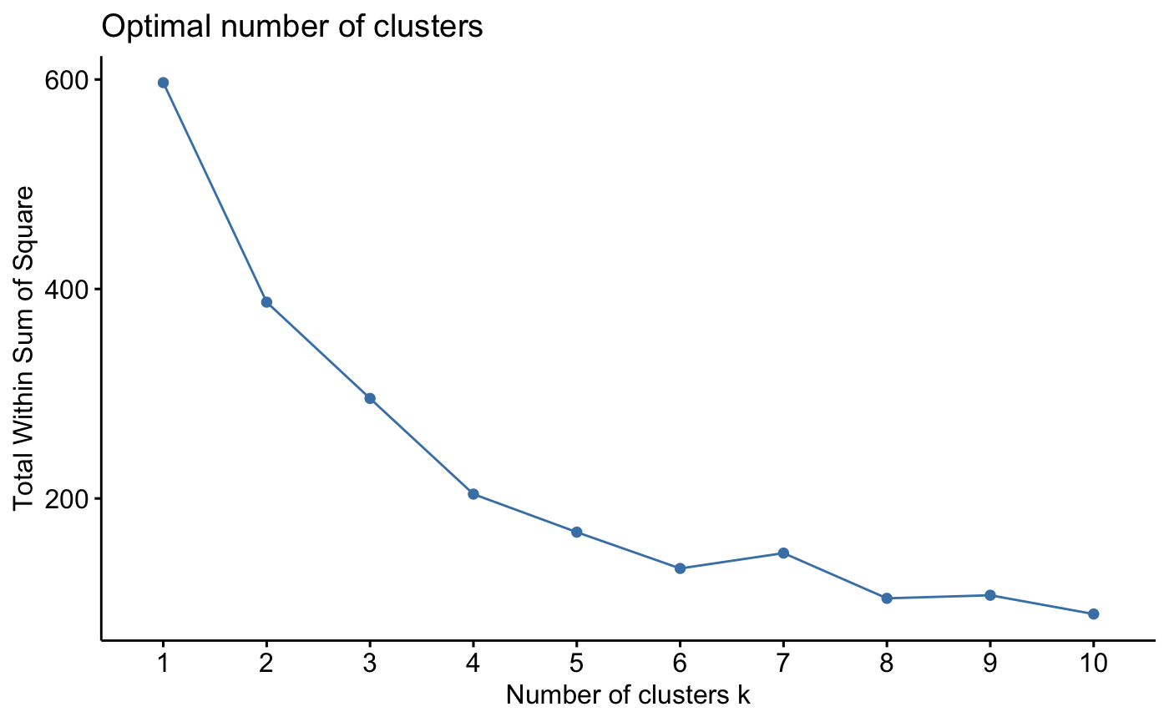
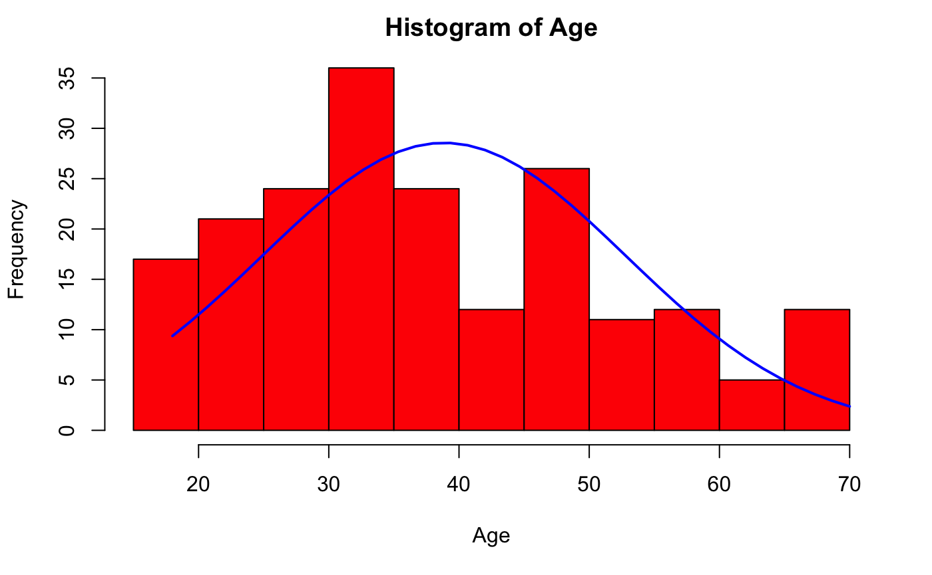
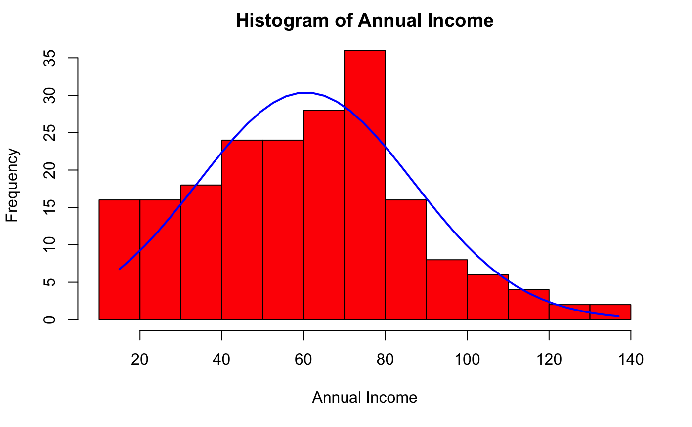
Analysis
The highest number of customers are between the age of 30 & 50
More people come to the mall from younger ages under 30 than those over 50
The majority of customers are in the range of 40k to 80k annual income
The highest range of spending is between 40 and 80
Slight relation between the increase in age and the decrease in spending
4 clusters are the best value to avoid bias and overfitting

Slide 4
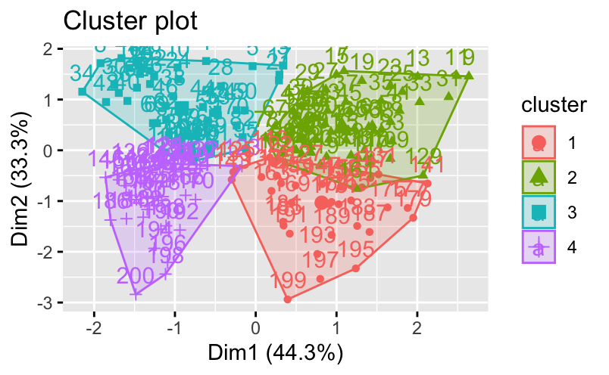
Results
The solution indicates 4 clusters with centroid values shown in the image
First cluster is mid-range people with very high salaries and low spending
Second cluster is older people with low income and relatively low spending
Third cluster is young people with low income and mid-range spending scores
Fourth cluster is relatively younger people with high incomes and very high spending scores

