Slide 1
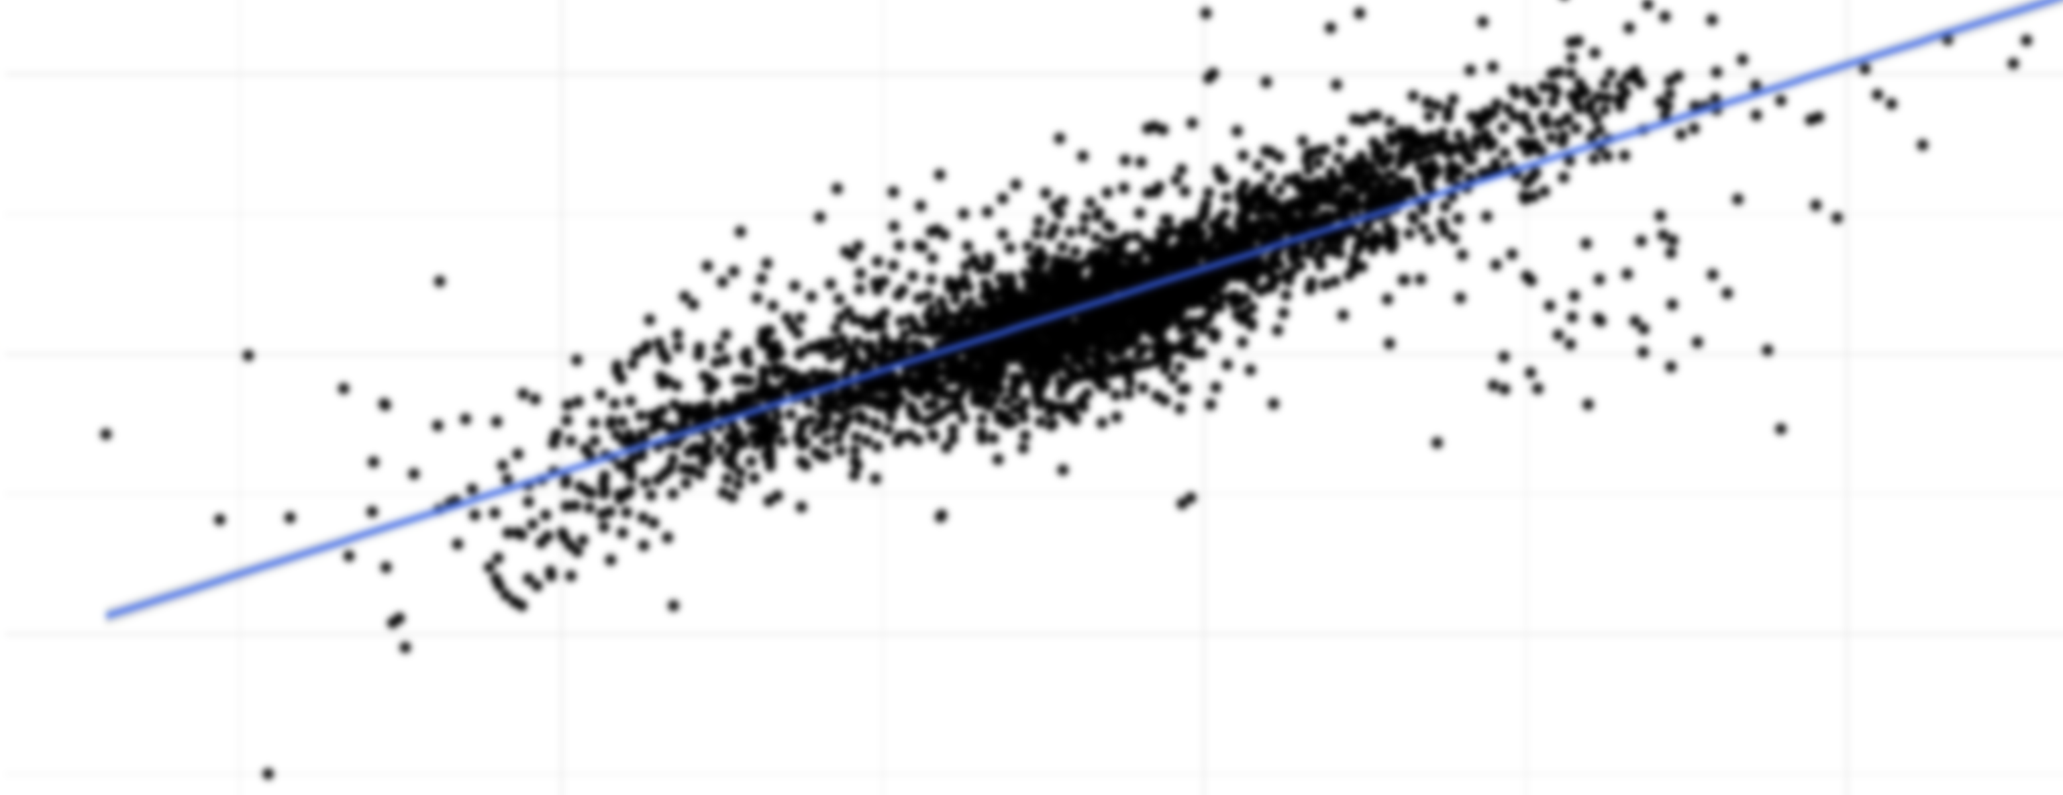
Population Density
and
COVID Cases

