Slide 1

QuantSoc
Quantitative Finance Society
Machine Learning for Quantitative Finance
Part 1 · A QuantSoc workshop · about 70 minutes
Open the workshop notebook in Colab now and run section 0, Setup. Link: quant-soc.com/links/workshop-2
quant-soc.com
Notes:
Minutes 0 to 1 (1 min).
Welcome everyone, this is Part 1 of Machine Learning for Quantitative Finance from the Quantitative Finance Society. Please open the workshop notebook in Colab and run section 0, Setup, while I talk: the download takes a few seconds, the imports a few more. You need no machine learning and no finance background, only a little Python. Every term I use will be defined the first time it appears.
Cue: Ask the room to run notebook section 0, Setup, now. Wait for most hands to show it finished before slide 4.

Slide 2
What we're building
1
Prices
daily prices of 40 stocks
2
Features
clues computed only from the past
3
Model
a rule learned from past examples, giving a forecast per stock
4
Check
is the result real or luck?
5
Portfolio
which stocks to buy and which to sell
6
Backtest
a replay on years the model never saw
Five short tasks. Each one sets one knob of your own strategy.
At the end, the backtest runs your choices, and you take the code home.
Task 1
momentum lookback
Task 2
extra feature
Task 3
train and test dates
Task 4
forest size and depth
Task 5
long/short counts and rebalance
QuantSoc · Quantitative Finance Society
quant-soc.com 2 / 45
Notes:
Minutes 1 to 3 (2 min).
This is the whole journey on one slide: prices, then features, then a model that gives a forecast for each stock, then a check that the result is real and not luck, then a portfolio, then a backtest. From the next slide on, the strip across the top of every slide shows where we are on this map, with the current step lit in blue. A feature is just a clue we compute from past prices, and a model is a rule the computer learns from past examples. You will do five tasks, and each one is copy and change: a worked example sits right above, and you change one to three numbers on its first line. Each task sets one knob of your strategy, so the final result is genuinely yours.

Slide 3
1 Prices
2 Features
3 Model
4 Check
5 Portfolio
6 Backtest
Textbook ML vs finance ML
Textbook ML
Finance ML
Data
Independent draws from one fixed process
Time-ordered, regimes change, and failed firms drop out (survivorship)
Signal
Strong: a cat photo shows a cat
Tiny next to the noise
Validation
Shuffled k-fold cross-validation
Walk-forward or purged, with a gap
Labels
Independent of each other
Overlapping in time
Sample size
Often huge
Fewer independent observations than it looks
Models
Whatever wins benchmarks: often deep nets
Regularised linear models, tree ensembles, small neural nets; deep learning mainly on raw order-book data
Features
Often raw inputs (pixels, words), learned end to end
Engineered from prices, accounts and alternative data
Success
Accuracy or loss on held-out data
Out-of-sample IC, then Sharpe after costs
Reference: López de Prado (2018), The 10 Reasons Most Machine Learning Funds Fail, J. Portfolio Management 44(6), 120-133; Gu, Kelly, Xiu (2020), Empirical Asset Pricing via Machine Learning, RFS 33(5), 2223-2273
QuantSoc · Quantitative Finance Society
quant-soc.com 3 / 45
Notes:
Minutes 3 to 6 (3 min).
Machine learning, ML for short, means a computer learning a rule from examples instead of being told the rule. Most courses teach it on textbook problems such as recognising cats in photos, and finance breaks almost every assumption those problems make, row by row. Data: in a textbook each example is a fresh, independent draw from one process that never changes; market data arrives in time order, and the process itself changes, which is called a change of regime, for example calm years followed by a crisis. And companies that fail tend to drop out of the data, so what is left looks better than the past really was; that is survivorship bias, slide 21. Signal: a photo of a cat really does show a cat, but a stock's past gives only a tiny hint about its future, buried in random day to day noise. Validation means testing a model fairly on data it did not learn from. Textbooks shuffle the rows and cut them into k groups, testing on each group in turn, which is called k-fold cross-validation; in finance we test only on later years, called walk-forward, or we remove the training rows that overlap the test, called purging, and leave a gap. Labels are the answers we train on. Ours are five-day returns, so the labels of neighbouring days share four of their five days, and that overlap is why the sample size row says there are fewer independent observations than the row count suggests. Models: regularised means a model is held back from fitting too closely, and a tree ensemble is many decision trees averaged, which we build later. On tables of stock characteristics, Gu, Kelly and Xiu found that trees and neural networks beat linear models, and that among neural networks a few hidden layers, best at three, beat deeper ones. Deep learning is used mainly on raw order-book data, the live list of orders waiting to buy and sell, as in Sirignano and Cont. Text models are often simple, as in Ke, Kelly and Xiu, who use a screening and topic model rather than a deep network. Features are the inputs: textbook models often read raw inputs such as pixels or words and learn their own features end to end, while finance features are engineered by hand from prices, company accounts and other data. Success: a textbook scores accuracy, or a loss, on held-out data. In finance the first question is whether the forecasts rank the stocks correctly on data the model never saw, measured by the information coefficient, IC, the correlation between forecasts and outcomes across stocks on one day; then a trader scores money made per unit of risk after paying for every trade, the Sharpe ratio after costs, which slide 19 defines. López de Prado lists ten common mistakes in financial machine learning; today we meet two of them, leakage and backtest overfitting, and the noise in the signal row is why they bite. From now on, a small blue tag at the top right of a slide, In finance, names the row of this table that the slide is about.
Full citation: López de Prado, M. (2018). "The 10 Reasons Most Machine Learning Funds Fail." The Journal of Portfolio Management, 44(6), 120-133. https://doi.org/10.3905/jpm.2018.44.6.120 (free copy: SSRN 3104816) Gu, S., Kelly, B. and Xiu, D. (2020). "Empirical Asset Pricing via Machine Learning." The Review of Financial Studies, 33(5), 2223-2273. (Models row: tables of stock characteristics.) Sirignano, J. and Cont, R. (2019). "Universal features of price formation in financial markets: perspectives from deep learning." Quantitative Finance, 19(9), 1449-1459. (Models row: deep learning on order books.) Ke, Z. T., Kelly, B. T. and Xiu, D. (2019). "Predicting Returns with Text Data." NBER Working Paper 26186. (Models row: text, with a screening and topic model.)

Slide 4
1 Prices
2 Features
3 Model
4 Check
5 Portfolio
6 Backtest
The data
▶ Notebook: run section 1
The data
Return: how much the price moved: today's price divided by yesterday's, minus 1. Up 2% is a return of 0.02.
Adjusted close: the closing price corrected for share splits and dividends, so returns are fair.
40 large US companies, one price per trading day, 2000 to 2019.
Adjusted close, rescaled so each stock starts at 100 (real data, Yahoo snapshot)
Reference: López de Prado (2018), Advances in Financial Machine Learning, Wiley, ch. 2, Financial Data Structures
QuantSoc · Quantitative Finance Society
quant-soc.com 4 / 45
Notes:
Minutes 6 to 9 (3 min).
Run notebook section 1 now: it loads the prices and draws a chart like this one. Each line is one company's price over twenty years, rescaled so they all start at 100, so you can compare them. We never model prices directly; we model returns, which is how much the price moved, as a fraction. We use the adjusted close, which is corrected for splits and dividends, so a stock splitting in two does not look like a crash.
Cue: ▶ Notebook: run section 1, The data.
Full citation: López de Prado, M. (2018). Advances in Financial Machine Learning. Wiley. Chapter 2 "Financial Data Structures"; Chapter 7 "Cross-Validation in Finance"; Chapter 11 "The Dangers of Backtesting". This slide: chapter 2.

Slide 5
1 Prices
2 Features
3 Model
4 Check
5 Portfolio
6 Backtest
Where it came from
Every dataset deserves a label saying where it came from and what is wrong with it.
Source
Yahoo Finance, downloaded once with the yfinance package and saved, so nothing downloads live
Universe
40 US large caps (big companies by stock market value), from the S&P 100
Real prices of real companies, but not a fair sample of the market.
Period
2000 to 2019, daily, 5,030 trading days, 201,200 rows
Columns
date, symbol, open, high, low, close, adjusted close, volume
Warning
Survivorship-biased: we kept only companies that still trade today. Slide 21 explains why that matters.
QuantSoc · Quantitative Finance Society
quant-soc.com 5 / 45
Notes:
Minutes 9 to 11 (2 min).
This is the data card, the label on the tin. The prices are a Yahoo Finance snapshot, downloaded once with the yfinance package and saved with the workshop, so nothing depends on a live download. The universe is 40 large US companies, large caps, chosen from the S&P 100, daily from 2000 to 2019. The red row matters: we only kept companies that still trade today, which is called survivorship bias, and it flatters every result you will see. We come back to it on slide 21.

Slide 6
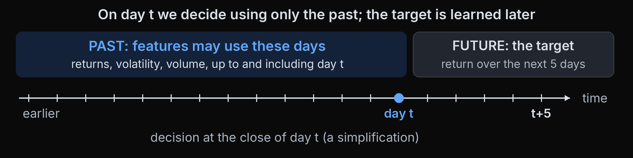
1 Prices
2 Features
3 Model
4 Check
5 Portfolio
6 Backtest
Past vs future: the target
▶ Notebook: run section 2
Features, the target and the no-peeking rule
In finance: Labels
Feature: a number we know on day t, computed only from data up to and including day t.
The rule: never read a date after day t.
Target: what we want to predict: the return over the next 5 trading days.
QuantSoc · Quantitative Finance Society
quant-soc.com 6 / 45
Notes:
Minutes 11 to 14 (3 min).
This is the single rule the whole workshop teaches. On any day t, a feature may only use information up to and including day t: that is the past, in blue. The target is the future we want to predict, the return over the next five trading days. For simplicity we pretend we trade at the close of day t; a real system would trade at the next open. Run section 2 now and do Tasks 1 and 2: each one builds a feature by copying the example and changing one number. The In finance tag says Labels: our five-day targets on neighbouring days share four of their five days, so the labels overlap in time.
Cue: ▶ Notebook: run section 2 (Tasks 1 and 2: momentum lookback and the extra feature).

Slide 7
1 Prices
2 Features
3 Model
4 Check
5 Portfolio
6 Backtest
The feature universe
In finance: Features
partly in our notebook
partly in our notebook
partly in our notebook
Price and technical
Volatility and risk
Volume and liquidity
Fundamentals
Momentum, short-term reversal, 52-week high
Realised volatility, beta, idiosyncratic volatility
Volume surprise, turnover, bid-ask spread, Amihud illiquidity
Value: book-to-market, earnings yield. Quality: profitability. Asset growth
Ours: past returns, 52-week high
Ours: 21 and 63-day volatility
Ours: volume surprise
Data: daily prices
Data: daily prices
Data: daily volume, quotes
Data: company accounts
Analysts and events
Alternative data
Order book
Macro, cross-asset
Earnings surprise and post-earnings drift, forecast revisions, earnings dates
News and filings text, web traffic, card spending, satellite images
Microstructure: order imbalance, queue depth
Interest rates, credit spreads, the VIX, currency moves
Data: analyst forecasts
Data: specialist vendors
Data: exchange tick data
Data: market series
Marked: families our notebook draws on, because daily prices and volume are free. Not exhaustive: also options-implied measures, short interest, ownership and insider trades, seasonality, ESG.
Reference: Green, Hand, Zhang (2017), RFS 30(12), 4389-4436; Hou, Xue, Zhang (2020), Replicating Anomalies, RFS 33(5), 2019-2133; Fama, French (1993), J. Financial Economics 33(1), 3-56; Bernard, Thomas (1989), J. Accounting Research 27 (Supplement), 1-36
QuantSoc · Quantitative Finance Society
quant-soc.com 7 / 45
Notes:
Minutes 14 to 18 (4 min).
A feature is any number we know on day t that might hint at what a stock does next, and researchers have proposed hundreds of them. Here they are in eight families, each with the data it needs. Price and technical features come from the price alone: momentum, the recent trend; short-term reversal, recent winners slipping back; and how far the price sits below its highest point of the past year, the 52-week high. Volatility and risk: realised volatility is how much the price actually swung; beta is how strongly a stock moves with the whole market; idiosyncratic volatility is the part of its swings the market does not explain. Volume and liquidity: a volume surprise is trading far above or below the usual level; turnover is shares traded as a share of all shares; the bid-ask spread is the gap between the price you can buy at and the price you can sell at; Amihud illiquidity measures how far the price moves for each dollar traded. Fundamentals come from company accounts. Value compares the accounting worth of a company with its market price, for example book-to-market, which Fama and French built into their famous risk factors; quality asks how profitable the company is and how much of its profit is real cash rather than accruals, which are accounting entries not yet paid in cash; investment asks how fast the company is growing its assets. Analysts and events: an earnings surprise is reported profit minus what analysts expected, and Bernard and Thomas documented that prices keep drifting in the direction of the surprise after the announcement, called post-earnings-announcement drift; revisions are analysts changing their forecasts. Alternative data is anything new and unusual: the text of news and company filings, website visits, card spending, even satellite pictures of car parks. The order book is the live list of orders waiting to buy and sell, and imbalance means more waiting on one side. Macro and cross-asset features describe the whole economy: interest rates, credit spreads, which are the extra interest risky companies pay, and the VIX, a measure of expected market volatility taken from option prices. A warning about the universe: more features is not more signal. Green, Hand and Zhang tested 94 characteristics and found only 12 gave independent information among stocks that are not microcaps, the tiniest companies, from 1980 to 2014, and just two since 2003. Of 452 published anomalies, 65% fail the usual t of 1.96 once microcaps are down-weighted (Hou, Xue and Zhang 2020). Our notebook draws on only the three marked families, and only on the members named on each card: past returns and the 52-week high, 21 and 63-day volatility, and the volume surprise. Beta, spreads, Amihud illiquidity and everything else on the slide are not in it, because they need data we do not have for free. The list is not exhaustive either: options-implied measures, short interest, who owns the shares and what insiders trade, calendar seasonality and ESG scores, ratings of environmental, social and governance behaviour, are all used too.
Full citation: Green, J., Hand, J. R. M. and Zhang, X. F. (2017). "The Characteristics that Provide Independent Information about Average U.S. Monthly Stock Returns." The Review of Financial Studies, 30(12), 4389-4436. Hou, K., Xue, C. and Zhang, L. (2020). "Replicating Anomalies." The Review of Financial Studies, 33(5), 2019-2133. Fama, E. F. and French, K. R. (1993). "Common risk factors in the returns on stocks and bonds." Journal of Financial Economics, 33(1), 3-56. (Value: book-to-market.) Bernard, V. L. and Thomas, J. K. (1989). "Post-Earnings-Announcement Drift: Delayed Price Response or Risk Premium?" Journal of Accounting Research, 27 (Supplement), 1-36. (Post-earnings drift.)

Slide 8
1 Prices
2 Features
3 Model
4 Check
5 Portfolio
6 Backtest
Momentum and reversal, from the literature
Momentum: stocks that rose over the past 3 to 12 months tended to keep rising for a while.
1
Momentum scale
ret_63, the past 3 months
Reversal: last month's winners tended to slip back the next month.
2
Reversal scale
Both are price features: the first family on the last slide.
ret_1 and ret_5, the past day and week
3
Your Task 1 lookback
replaces the 21-day return: 63 to 252 days leans towards momentum, 21 or fewer towards reversal
Reference: Jegadeesh & Titman (1993), Returns to Buying Winners and Selling Losers, J. Finance 48(1), 65-91; Jegadeesh (1990), Evidence of Predictable Behavior of Security Returns, J. Finance 45(3), 881-898
QuantSoc · Quantitative Finance Society
quant-soc.com 8 / 45
Notes:
Minutes 18 to 21 (3 min).
Two of the oldest features in the universe come from price alone, and they come from decades of research rather than from today. Jegadeesh and Titman found that buying past winners and selling past losers paid off over three to twelve month horizons in historical US data: that is called momentum. Jegadeesh found the opposite at the one month scale: last month's winners tended to fall back, which is called reversal. In our notebook, ret_63, the return over the past 63 trading days or about three months, sits at the short end of the momentum range, while ret_1 and ret_5, the past day and week, are short-horizon returns at the scale where reversal would show. Your Task 1 lookback replaces the 21-day return in the feature list, so ret_21 is there only if you keep the lookback at 21: a lookback of 63 to 252 days leans towards momentum, 21 or fewer towards reversal. Whether these effects survive in our 40 stocks and our years is exactly what the notebook tests; a published result is a reason to try a feature, not a promise.
Full citation: Jegadeesh, N. and Titman, S. (1993). "Returns to Buying Winners and Selling Losers: Implications for Stock Market Efficiency." The Journal of Finance, 48(1), 65-91. Jegadeesh, N. (1990). "Evidence of Predictable Behavior of Security Returns." The Journal of Finance, 45(3), 881-898.

Slide 9
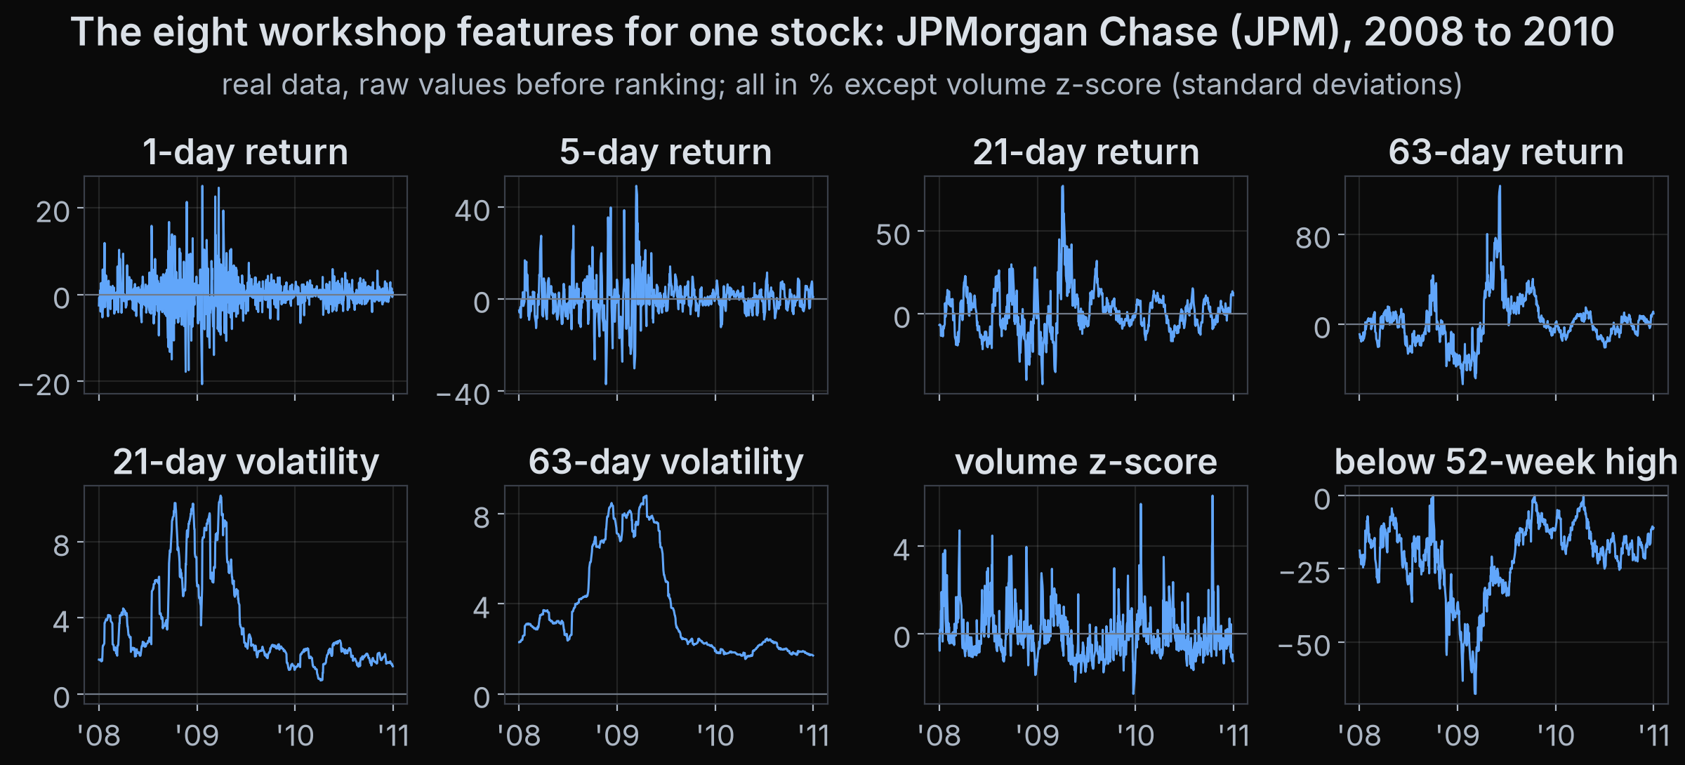
1 Prices
2 Features
3 Model
4 Check
5 Portfolio
6 Backtest
Our eight features, drawn
Price: returns over 1, 5, 21 and 63 days, and the distance below the 52-week high. Volatility over 21 and 63 days. Volume against its usual level.
All eight use only data up to and including day t.
QuantSoc · Quantitative Finance Society
quant-soc.com 9 / 45
Notes:
Minutes 21 to 24 (3 min).
This is what our eight features actually look like for one well-known stock, the bank JPMorgan Chase, over 2008 to 2010, which includes the financial crisis, one panel per feature. The first four panels are past returns over 1, 5, 21 and 63 trading days: the short ones jump about from day to day, the long ones move slowly, because they average over more days. Volatility over 21 and 63 days is how much the daily returns swung in that window; watch it climb from the autumn of 2008 into early 2009, when markets became violent. Volume surprise is today's trading volume compared with its usual level over the past 63 days, measured in standard deviations, which are the typical size of a move away from the average. The last panel is how far the price sits below its highest close of the past year: zero at a new high, and negative below it; in early 2009 it was about 68 percent below. Every one of them is computed only from data up to and including day t, which is the rule from slide 6.

Slide 10
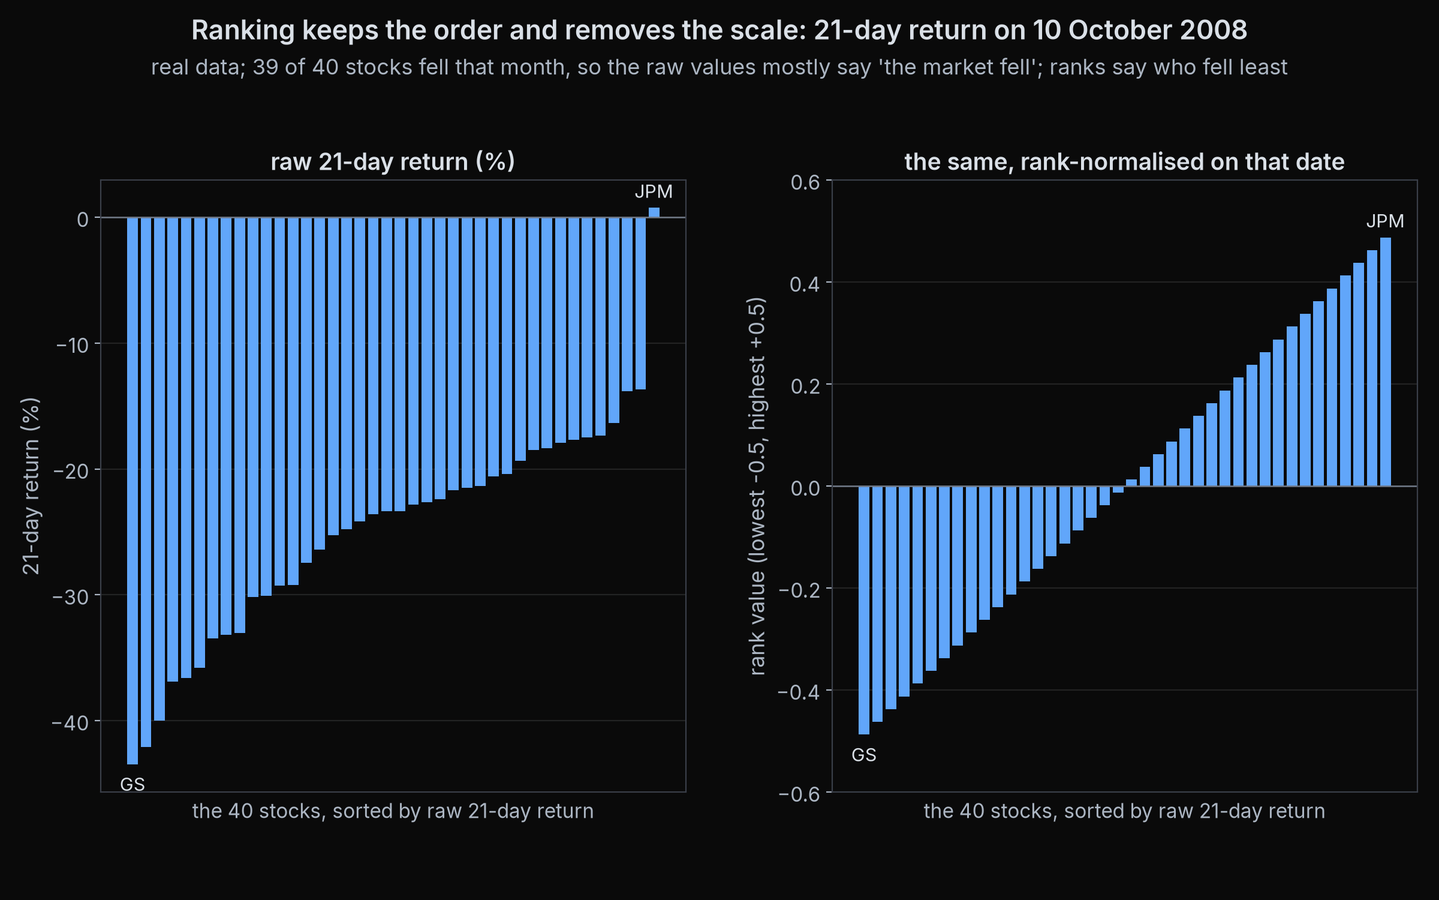
1 Prices
2 Features
3 Model
4 Check
5 Portfolio
6 Backtest
Making features usable
Rank across stocks on each date (what we do): the order is kept, the scale is gone.
Z-score and winsorise: subtract the day's average, divide by its spread, cap the extremes.
Interactions: combine two features, such as momentum times volatility.
Fractional differencing: make a price series stable but keep some memory.
Point-in-time: accounts get restated, and the revised number leaks the future (slide 11).
10 October 2008, 40 stocks: raw 21-day return (left), its rank (right), real data
Reference: López de Prado (2018), Advances in Financial Machine Learning, Wiley, ch. 5, Fractionally Differentiated Features
QuantSoc · Quantitative Finance Society
quant-soc.com 10 / 45
Notes:
Minutes 24 to 27 (3 min).
Raw features are awkward for a model: in a calm year every return is small, in a crisis every return is large, so the same raw number means different things in different years. What our notebook does is rank: on each date, each feature is replaced by its position among the 40 stocks, scaled so the middle stock is zero. The chart shows one date, 10 October 2008, in the week of the crash: on the left, the raw 21-day return, where 39 of the 40 stocks were down and the average was minus 24.9 percent; on the right, the rank, which still spreads evenly from about minus a half to plus a half. The order of the stocks is kept and the scale is thrown away, so the model sees which stocks did better than the others, which is what a long/short book trades. A z-score does something similar while keeping distances: subtract the day's average and divide by the day's spread, its standard deviation. Winsorising caps the most extreme values, so one wild stock cannot dominate. An interaction combines two features, for example momentum multiplied by volatility, for a model that cannot combine them by itself. Fractional differencing, from López de Prado's book, is a way to make a price series stable, so its behaviour does not drift over time, while keeping more of its memory than plain returns do. And one warning for anyone who goes on to use company accounts: companies sometimes correct, or restate, their numbers months later, and a database may show only the corrected figure. Using it on the original date leaks information nobody had then. Data stored as it was known on each date is called point-in-time data. That is leakage, which is the next slide.
Full citation: López de Prado, M. (2018). Advances in Financial Machine Learning. Wiley. Chapter 5 "Fractionally Differentiated Features".

Slide 11
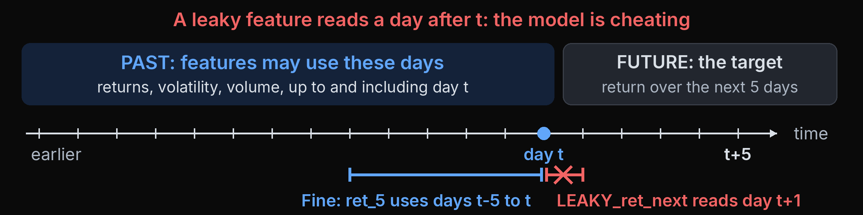
1 Prices
2 Features
3 Model
4 Check
5 Portfolio
6 Backtest
Leakage, live
▶ Notebook: run section 2
Features, the target and the no-peeking rule
In finance: Data
Leakage: information the model could not have had at decision time sneaks into its inputs.
It makes results look far better than they really are.
Watch: we add one feature that secretly reads tomorrow's price.
Reference: Kaufman, Rosset, Perlich, Stitelman (2012), Leakage in Data Mining: Formulation, Detection, and Avoidance, ACM TKDD 6(4), art. 15
QuantSoc · Quantitative Finance Society
quant-soc.com 11 / 45
Notes:
Minutes 27 to 31 (4 min).
Leakage means information from the future sneaking into the model's inputs. Kaufman and colleagues describe it as one of the most common mistakes in data mining, because it makes a model look much better than it is. In section 2 there is a deliberately leaky feature called LEAKY_ret_next, which uses tomorrow's return; run that cell and look at how good it looks. Then notice it could never work live, because tomorrow has not happened yet. The notebook removes it straight after the demo. The In finance tag says Data: market data arrives in time order, so the question is always what was known on that date. The point-in-time warning on the last slide is the same mistake, made by a database instead of by us.
Cue: ▶ Notebook: run section 2, the leakage demo cell (LEAKY_ret_next).
Full citation: Kaufman, S., Rosset, S., Perlich, C. and Stitelman, O. (2012). "Leakage in Data Mining: Formulation, Detection, and Avoidance." ACM Transactions on Knowledge Discovery from Data, 6(4), Article 15.

Slide 12
1 Prices
2 Features
3 Model
4 Check
5 Portfolio
6 Backtest
Baseline: predict zero
▶ Notebook: run section 3
A baseline and a fair test
Baseline: the simplest possible forecast. A model must beat it before we celebrate.
0
the forecast for every stock, every day
Short-term returns are so noisy that zero is surprisingly hard to beat.
Score: is our model's error smaller than the zero forecast's error?
QuantSoc · Quantitative Finance Society
quant-soc.com 12 / 45
Notes:
Minutes 31 to 33 (2 min).
Before any machine learning, we need something to beat. The baseline here is the laziest forecast possible: predict a return of zero for every stock on every day. Because short-term returns are so noisy, zero turns out to be a tough opponent. Every model today is scored against it: if a model's errors are not smaller than zero's, the model has learned nothing useful. Run section 3 now to score the zero model.
Cue: ▶ Notebook: run section 3, first cells (the zero baseline).

Slide 13
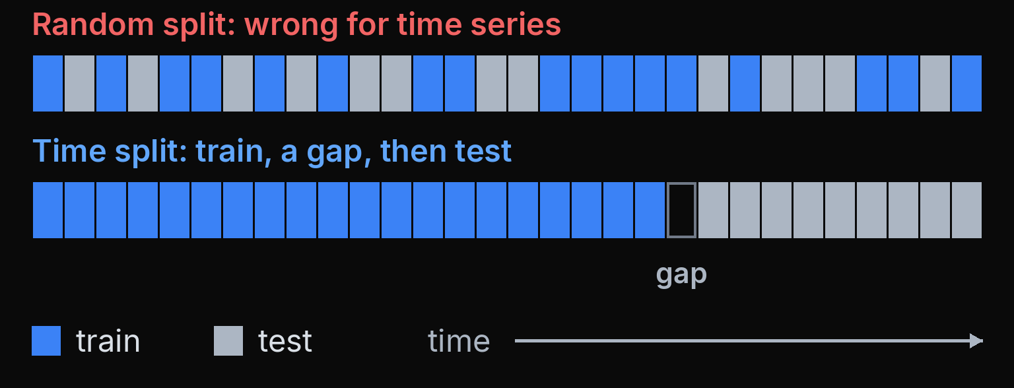
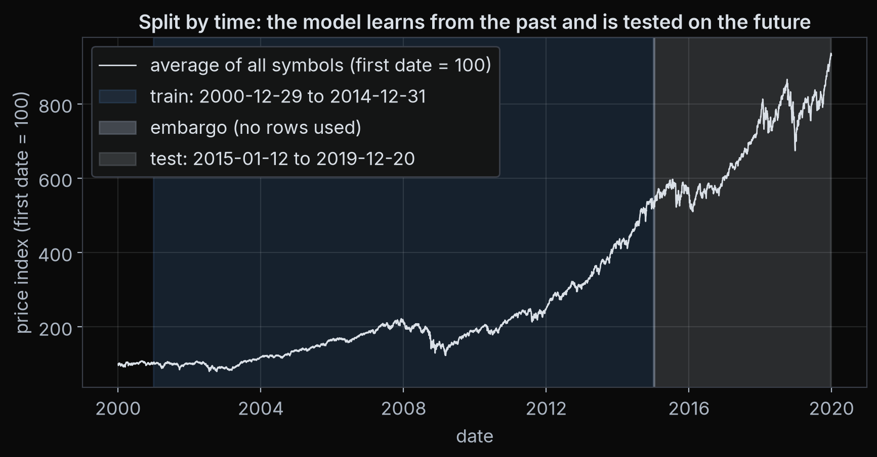
1 Prices
2 Features
3 Model
4 Check
5 Portfolio
6 Backtest
Split by time, never at random
▶ Notebook: run section 3
A baseline and a fair test
In finance: Validation
Train / test: train is the years the model learns from; test is later years it never sees until the end.
Shuffling days at random lets the model learn from its test days' neighbours, even their future.
We leave a gap between train and test so 5-day targets cannot overlap.
Our split: training years, gap, test years
Reference: López de Prado (2018), Advances in Financial Machine Learning, Wiley, ch. 7, Cross-Validation in Finance, §7.2
QuantSoc · Quantitative Finance Society
quant-soc.com 13 / 45
Notes:
Minutes 33 to 37 (4 min).
To test a model fairly, we hide some data from it, train on the rest, then check it on the hidden part. In most machine learning courses you shuffle rows at random, but in finance that leaks: neighbouring days are related, and a shuffled training set contains days just after a test day. López de Prado explains why ordinary shuffled cross-validation fails on financial data. So we split by time, train first, then a small gap, then test, and the gap stops five-day targets overlapping the boundary. Task 3 in section 3: choose your own two dates. The In finance tag says Validation: this is the finance side of that row of the table, testing on later years with a gap.
Cue: ▶ Notebook: run section 3, Task 3 (train_end and test_start dates).
Full citation: López de Prado, M. (2018). Advances in Financial Machine Learning. Wiley. Chapter 2 "Financial Data Structures"; Chapter 7 "Cross-Validation in Finance"; Chapter 11 "The Dangers of Backtesting". This slide: chapter 7, section 7.2.

Slide 14
1 Prices
2 Features
3 Model
4 Check
5 Portfolio
6 Backtest
What a tiny edge looks like
In finance: Signal
R²: the share of the ups and downs a forecast explains. 1% explains one hundredth.
Strong ML models on individual stock returns score an out-of-sample R² under 1%.
Out-of-sample means on data the model never saw.
Tiny, but over many stocks and many days it can still add up.
Synthetic illustration: forecast vs outcome with R² = 1%
Reference: Gu, Kelly, Xiu (2020), Empirical Asset Pricing via Machine Learning, Review of Financial Studies 33(5), 2223-2273
QuantSoc · Quantitative Finance Society
quant-soc.com 14 / 45
Notes:
Minutes 37 to 39 (2 min).
Here is how small a real edge is. Gu, Kelly and Xiu tested many machine learning methods on stock returns, and even the good ones explained under one percent of the ups and downs on data they had not seen. The chart is synthetic: it shows what a relationship with an R squared of one percent looks like, and it looks like a cloud. The lesson is not that machine learning is useless; it is that you must expect small numbers, and be suspicious of big ones. The In finance tag says Signal: this is what tiny next to the noise means in numbers.
Full citation: Gu, S., Kelly, B. and Xiu, D. (2020). "Empirical Asset Pricing via Machine Learning." The Review of Financial Studies, 33(5), 2223-2273.

Slide 15
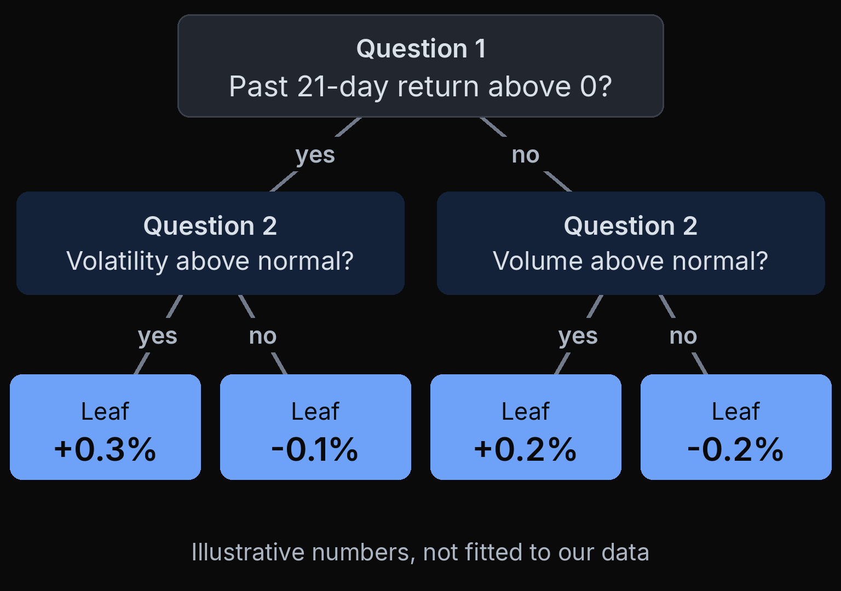
1 Prices
2 Features
3 Model
4 Check
5 Portfolio
6 Backtest
A decision tree in one picture
A decision tree asks yes or no questions about the features, one after another.
Each end point, a leaf, holds the average target of the training rows that landed there.
Deeper trees ask more questions: more detail, and more room to memorise noise.
QuantSoc · Quantitative Finance Society
quant-soc.com 15 / 45
Notes:
Minutes 39 to 41 (2 min).
A decision tree is the easiest model to picture. It asks a yes or no question about a feature, then another, and each path ends in a leaf. The leaf's forecast is simply the average target of the training examples that ended up there. The numbers in this picture are made up for illustration; the important idea is depth: a deeper tree can fit more detail, including noise.

Slide 16
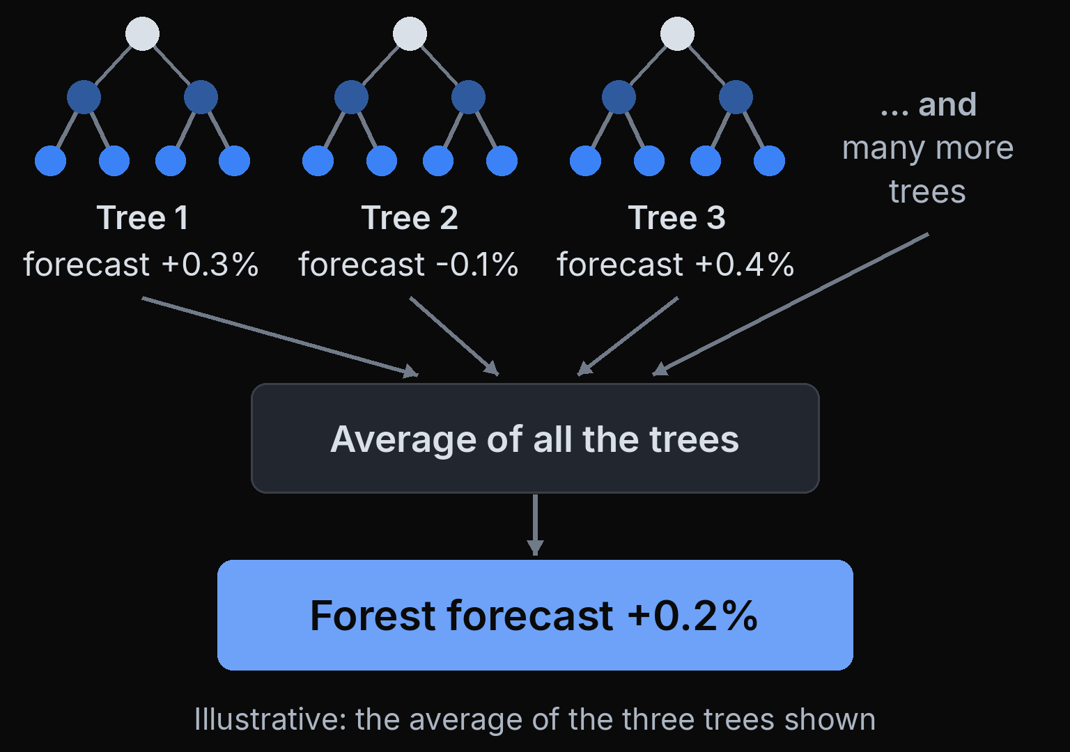
1 Prices
2 Features
3 Model
4 Check
5 Portfolio
6 Backtest
A forest
▶ Notebook: run section 4
A real ML model
In finance: Models
A random forest grows many trees, each on a random sample of the rows and features.
Its forecast is the average of all the trees.
Your knobs in Task 4: how many trees, and how deep.
Reference: Breiman (2001), Random Forests, Machine Learning 45(1), 5-32
QuantSoc · Quantitative Finance Society
quant-soc.com 16 / 45
Notes:
Minutes 41 to 45 (4 min).
One tree is jumpy: change the data a little and the tree changes a lot. Breiman's random forest grows many trees, each on a random sample of the data, and averages their forecasts, which is much steadier. In Task 4 you choose the number of trees and the maximum depth, copying the example and changing two numbers. Then compare its score with the zero baseline and a simple linear model in the table the notebook prints. The In finance tag says Models: a random forest is one of the tree ensembles from the models row of the table.
Cue: ▶ Notebook: run section 4 (Task 4: n_estimators and max_depth).
Full citation: Breiman, L. (2001). "Random Forests." Machine Learning, 45(1), 5-32.

Slide 17
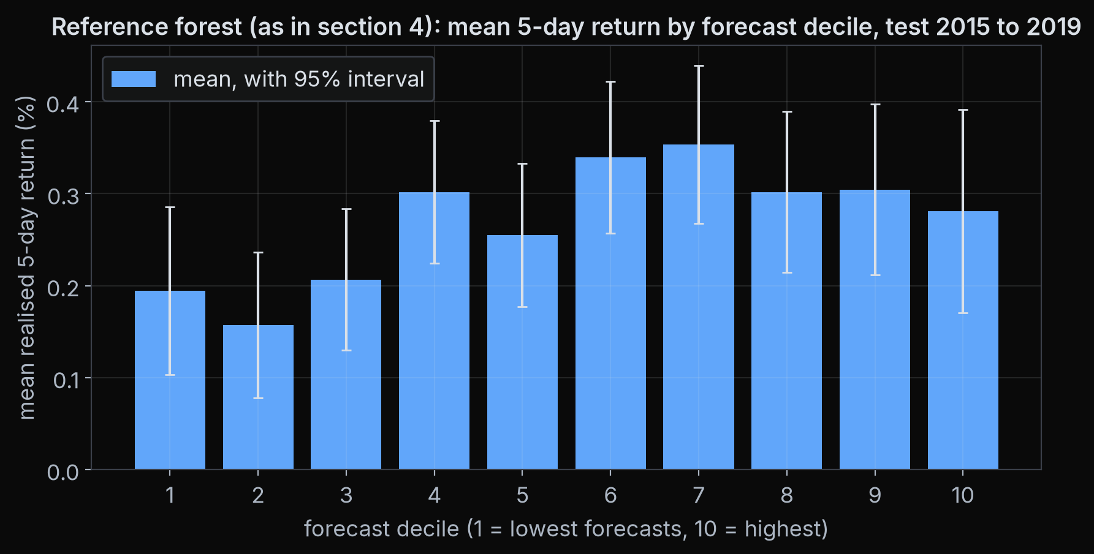
1 Prices
2 Features
3 Model
4 Check
5 Portfolio
6 Backtest
Reading the decile plot
Decile: sort the forecasts from lowest to highest and cut them into 10 equal groups.
Each bar: the average real 5-day return of one group, on test data.
A useful model: bars rise from left to right, even if unevenly.
Krauss, Do and Huck ranked S&P 500 stocks by forecast the same way.
Average 5-day return by forecast decile, test period
Reference: Krauss, Do, Huck (2017), Deep neural networks, gradient-boosted trees, random forests: Statistical arbitrage on the S&P 500, European J. Operational Research 259(2), 689-702
QuantSoc · Quantitative Finance Society
quant-soc.com 17 / 45
Notes:
Minutes 45 to 48 (3 min).
Scores like R squared are hard to feel, so here is a picture that is easier to read. We sort every forecast in the test period from lowest to highest and cut them into ten equal groups, called deciles. For each group we plot the average return that really happened next. If the bars rise from left to right, the model's ranking carries information; Krauss, Do and Huck ranked S&P 500 stocks by model forecasts in a similar way. Ours barely rise: the three lowest-forecast groups do earn the least, but the top group is not the best and the middle is a jumble. That is what a thin edge looks like, and the error bars show how much of it could be luck. Your notebook draws the same plot from the same forest.
Full citation: Krauss, C., Do, X. A. and Huck, N. (2017). "Deep neural networks, gradient-boosted trees, random forests: Statistical arbitrage on the S&P 500." European Journal of Operational Research, 259(2), 689-702.

Slide 18
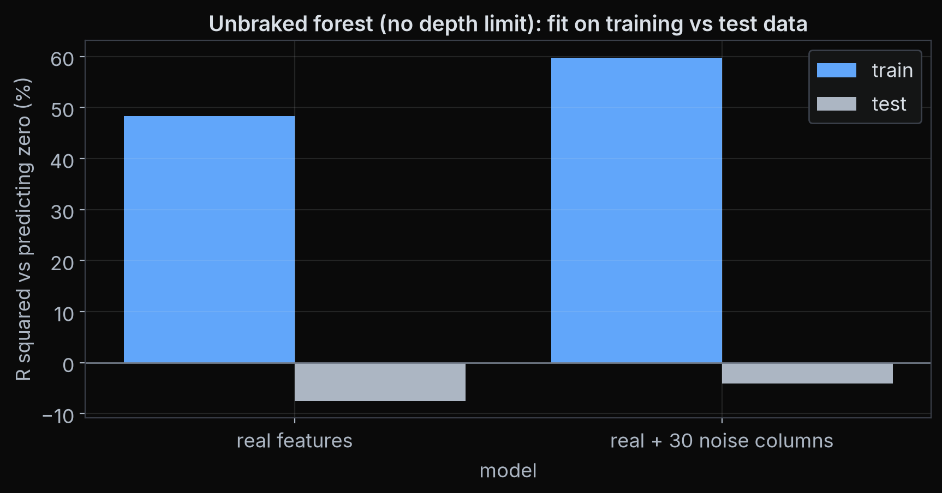
1 Prices
2 Features
3 Model
4 Check
5 Portfolio
6 Backtest
Overfitting, live
▶ Notebook: run section 5
Overfitting, live
Overfitting: learning the noise in the training data instead of a pattern that lasts.
Experiment: add 30 columns of pure random numbers as extra features, to a forest with its brakes off.
Training score rises (about +48% to +60% R²); the test score stays below zero.
Train vs test score, real features vs real plus 30 noise features
QuantSoc · Quantitative Finance Society
quant-soc.com 18 / 45
Notes:
Minutes 48 to 52 (4 min).
Overfitting is when a model memorises the training data, noise included, instead of learning something that lasts. Section 5 runs a live experiment: we add thirty columns of random numbers, which by construction contain no information. For this demo the forest runs with its brakes off, no depth limit, so it can memorise. Watch the training score go up, from about forty-eight to about sixty percent, because a flexible model happily finds patterns in noise, while the test score stays negative. That gap between training and test is the signature of overfitting. The cell takes ten to thirty seconds, depending on the machine, so start it and talk over it.
Cue: ▶ Notebook: run section 5 (the noise experiment).

Slide 19
1 Prices
2 Features
3 Model
4 Check
5 Portfolio
6 Backtest
Trying many things is the problem
In finance: Success
Sharpe ratio: average yearly return divided by how much returns swing. Higher is better.
Try about 7 versions of a useless strategy on 2 years of data and expect one with a Sharpe above 1, by luck alone.
7 tries: Sharpe 1.0, by luck alone
So count your tries, and look at the test set once.
Expected best Sharpe among N strategies with zero true skill, 2-year backtest (Bailey et al. approximation)
Reference: Bailey, Borwein, López de Prado, Zhu (2014), Pseudo-Mathematics and Financial Charlatanism, Notices of the AMS 61(5), 458-471
QuantSoc · Quantitative Finance Society
quant-soc.com 19 / 45
Notes:
Minutes 52 to 54 (2 min).
The Sharpe ratio is the standard score for a strategy: average yearly return divided by how much it swings, so higher is better. Bailey and colleagues show that if you try enough variations, one will look great by luck alone. With a two-year backtest, about seven tries of strategies with no skill at all is enough to expect one with a Sharpe ratio around one. The curve is that calculation: it keeps rising as you try more, with zero real skill. This is why you should count your tries and touch the test set once. The In finance tag says Success: in finance success is scored with numbers like the Sharpe ratio, and those are exactly the numbers that luck inflates when you try many things.
Full citation: Bailey, D. H., Borwein, J. M., López de Prado, M. and Zhu, Q. J. (2014). "Pseudo-Mathematics and Financial Charlatanism: The Effects of Backtest Overfitting on Out-of-Sample Performance." Notices of the AMS, 61(5), 458-471. (open access at ams.org)

Slide 20
1 Prices
2 Features
3 Model
4 Check
5 Portfolio
6 Backtest
Forecast to portfolio, costs
▶ Notebook: run section 6
From forecasts to a portfolio
In finance: Success
Long / short: long: buy, gain if the price rises. Short: borrow and sell, gain if it falls.
Stocks ranked by forecast (illustrative numbers)
Stock A
+0.8%
Buy (long)
weight +1/4 each
Stock B
+0.7%
Every rebalance (your knob: 5, 10 or 21 trading days): buy the top 4 forecasts, short the bottom 4, equal sizes.
Stock C
+0.5%
Stock D
+0.4%
Stock E
+0.2%
No position
weight 0
Stock F
+0.1%
Each trade costs 5 bps (basis points: 0.05%) of the amount traded.
Stock G
-0.1%
Stock H
-0.2%
Stock I
-0.4%
Sell short
weight -1/4 each
Stock J
-0.5%
Stock K
-0.7%
Stock L
-0.8%
Reference: López de Prado (2018), Advances in Financial Machine Learning, Wiley, ch. 11, The Dangers of Backtesting
QuantSoc · Quantitative Finance Society
quant-soc.com 20 / 45
Notes:
Minutes 54 to 58 (4 min).
A forecast is not yet a trade, so we turn forecasts into a portfolio. Every rebalance, by default every twenty-one trading days, we rank the stocks by forecast, buy the top few and short the bottom few, in equal sizes. How often to rebalance is one of your knobs: five, ten or twenty-one days. Going long means buying and gaining if the price rises; going short means borrowing shares and selling them, gaining if the price falls. Every change of position costs money, and we charge five basis points, five hundredths of a percent, on each trade. Task 5 in section 6: choose how many to buy, how many to short, and how often to rebalance. Rebalancing more often costs more. The In finance tag says Success: in finance a result only counts after trading costs, and this is where the costs come in.
Cue: ▶ Notebook: run section 6 (Task 5: n_long, n_short and rebalance_days).
Full citation: López de Prado, M. (2018). Advances in Financial Machine Learning. Wiley. Chapter 2 "Financial Data Structures"; Chapter 7 "Cross-Validation in Finance"; Chapter 11 "The Dangers of Backtesting". This slide: chapter 11.

Slide 21
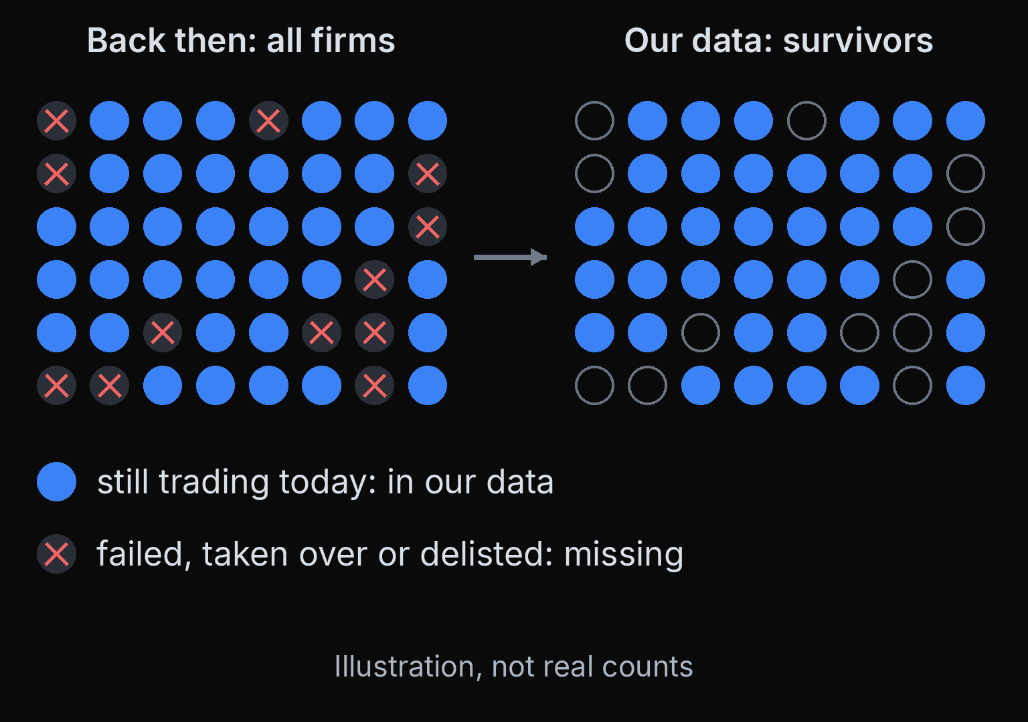
1 Prices
2 Features
3 Model
4 Check
5 Portfolio
6 Backtest
Survivorship
In finance: Data
Survivorship bias: studying only the companies that survived until today.
Our 40 were chosen because they still trade today. Firms that failed or were taken over are missing.
That makes the past look kinder than it was.
Even large research databases have missed delisted stocks' returns.
Reference: Shumway (1997), The Delisting Bias in CRSP Data, J. Finance 52(1), 327-340
QuantSoc · Quantitative Finance Society
quant-soc.com 21 / 45
Notes:
Minutes 58 to 60 (2 min).
Here is the honest flaw in our data. We picked companies that still trade today, so every company that went bust or was taken over between 2000 and 2019 is missing. An investor in 2000 could not have known which companies would survive, so our backtest gets a hint from the future. Shumway showed that even a major research database was missing many delisting returns, so this is a real problem, not a classroom one. The In finance tag says Data: what is missing from a dataset can matter as much as what is in it.
Full citation: Shumway, T. (1997). "The Delisting Bias in CRSP Data." The Journal of Finance, 52(1), 327-340.

Slide 22
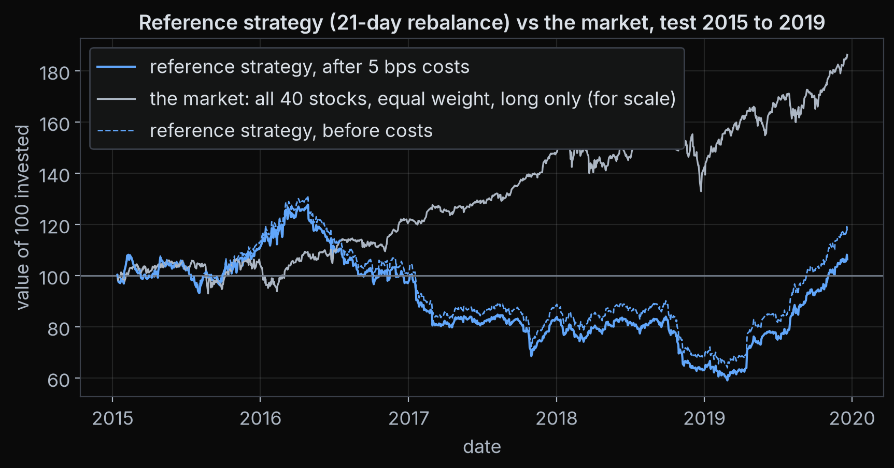
1 Prices
2 Features
3 Model
4 Check
5 Portfolio
6 Backtest
Your backtest, read honestly
▶ Notebook: run section 7
Your strategy's backtest
Backtest: replaying the strategy on past test years, with costs.
Drawdown: the fall from the highest point so far. Max drawdown is the worst one.
Read it before and after costs: at 5 bps, costs decide whether a thin edge survives.
The equal-weight line is the market, for scale, not a benchmark. One period, one biased universe: evidence, not proof.
Growth of 100: the reference strategy before and after costs, with the market line for scale. Your notebook draws yours.
Reference: Arnott, Harvey, Markowitz (2019), A Backtesting Protocol in the Era of Machine Learning, J. Financial Data Science 1(1), 64-74
QuantSoc · Quantitative Finance Society
quant-soc.com 22 / 45
Notes:
Minutes 60 to 65 (5 min).
Run section 7: it backtests your strategy with your five knobs, after costs, on the test years. Read four numbers: total return, Sharpe ratio, max drawdown, which is the worst fall from a peak, and turnover. Look at the strategy before and after costs: with the reference knobs the edge is thin, so five basis points a trade decides whether anything is left: the five-day version of the same book paid nearly forty percent of its value in costs over the five years and ended in the red. The differences between rebalance frequencies before costs are mostly luck of the path, so do not read them as a ranking. The equal-weight line, all forty stocks held long, is the market drawn for scale; a dollar-neutral long/short book is not trying to beat it. Arnott, Harvey and Markowitz give a checklist for honest backtests; by that standard, one test period on a survivorship-biased universe is evidence, not proof.
Cue: ▶ Notebook: run section 7 (your strategy's backtest).
Full citation: Arnott, R., Harvey, C. R. and Markowitz, H. (2019). "A Backtesting Protocol in the Era of Machine Learning." The Journal of Financial Data Science, 1(1), 64-74.

Slide 23



1 Prices
2 Features
3 Model
4 Check
5 Portfolio
6 Backtest
→ take it home
Export, paper trading, Part 2, QR codes
▶ Notebook: run section 8
Export and paper trading
Export: download your ZIP, with your model, settings and strategy code.
Paper trading is practice with pretend money. In this room: preview only, it proposes orders and sends nothing.
Website
quant-soc.com
Instagram
LinkedIn
Part 2 next week: purged cross-validation, triple-barrier labels, feature importance, deflated Sharpe.
Scan to follow QuantSoc
Nothing here is investment advice.
Reference: Part 2: Bailey, López de Prado (2014), The Deflated Sharpe Ratio, J. Portfolio Management 40(5), 94-107
QuantSoc · Quantitative Finance Society
quant-soc.com 23 / 45
Notes:
Minutes 65 to 71 (6 min).
Run section 8: it saves your strategy and lets you download the ZIP, so please download it now, because Colab forgets everything when the session ends. The demo runs run_paper.py in preview mode against an offline mock broker, so it needs no account and sends nothing; at home the same script talks to an Alpaca paper account, which is practice with pretend money, and still submits nothing unless you ask it to. Part 2 next week fixes the problems we only named today: purged cross-validation, triple-barrier labels, feature importance and the deflated Sharpe ratio. Nothing in this workshop is investment advice. Scan the codes to follow QuantSoc, and thank you. If there is time, the bonus section on learning theory follows straight after this slide; it needs no notebook.
Cue: ▶ Notebook: run section 8 (export ZIP, then the run_paper.py --preview demo).
Full citation: Bailey, D. H. and López de Prado, M. (2014). "The Deflated Sharpe Ratio: Correcting for Selection Bias, Backtest Overfitting, and Non-Normality." The Journal of Portfolio Management, 40(5), 94-107. (Part 2 reading.)

Slide 24
1 Generalisation
2 Honest testing
3 Trade-offs
4 Model families
5 Finance
Bonus: core principles of learning theory
1
Generalisation
does it work on data it never saw?
2
Honest testing
fit, choose and judge on separate data
3
Trade-offs
bias, variance and the noise floor
4
Model families
what each kind of model is good at
5
Finance
how markets change the rules
The ideas underneath Part 1: why a model that fits the past can fail on the future, and what to do about it.
QuantSoc · Quantitative Finance Society
quant-soc.com Bonus · 24 / 45
Notes:
Bonus minutes 0 to 1 (1 min).
This bonus section steps back from the code and asks why the rules of Part 1 exist. It has five short chapters, shown in the strip at the top of every slide from now on: generalisation, honest testing, trade-offs, model families, and what finance changes. Learning theory is the study of when a rule learned from examples will keep working on new examples, and it is the reason for every warning we gave in Part 1. Where a slide builds on something from Part 1, a small blue tag at the top right says which slide. Three slides are marked optional; skip them if time is short, nothing later depends on them.

Slide 25
1 Generalisation
2 Honest testing
3 Trade-offs
4 Model families
5 Finance
The one question
Seen in Part 1: slide 18
Generalisation: doing well on data the model never saw, not just on the data it learned from.
Training error: how wrong the model is on the examples it learned from.
Test error: how wrong it is on new examples. This is the one that matters.
Training error almost always flatters, because the model has already seen the answers.
Part 1's noise experiment: a high training score, a test score below zero
Reference: Hastie, Tibshirani, Friedman (2009), The Elements of Statistical Learning, 2nd ed., Springer, ch. 7, Model Assessment and Selection
QuantSoc · Quantitative Finance Society
quant-soc.com Bonus · 25 / 45
Notes:
Bonus minutes 1 to 2 (1 min).
All of learning theory comes down to one question: will this rule work on data it has never seen? That ability is called generalisation. Training error is how wrong the model is on the examples it learned from; test error is how wrong it is on new examples, and only the test error tells you what will happen next. Hastie, Tibshirani and Friedman open their chapter on model assessment with exactly this distinction, and show that training error keeps falling as a model gets more flexible while test error does not. You saw it in Part 1: the unbraked forest scored about 48 to 60 percent R squared on its training rows and below zero on the test years. The picture on the right is that experiment again.
Full citation: Hastie, T., Tibshirani, R. and Friedman, J. (2009). The Elements of Statistical Learning (2nd ed.). Springer. Chapter 7 "Model Assessment and Selection".

Slide 26
1 Generalisation
2 Honest testing
3 Trade-offs
4 Model families
5 Finance
What every model assumes
Seen in Part 1: slide 3
Every model assumes the future comes from the same process as the past it learned from.
1
Same process
past and future examples are drawn the same way, so test error predicts future error
In a textbook that is true by construction. In markets it is not: rules, players and regimes change.
2
Regimes change
a crisis, a new regulation, a crowded trade: the process itself moves
So test on later years, expect results to fade, and prefer models that fail gently.
3
What we do
walk-forward tests, regular retraining, and simple models with few knobs
Reference: Hastie et al. (2009), The Elements of Statistical Learning, ch. 7; López de Prado (2018), J. Portfolio Management 44(6), 120-133
QuantSoc · Quantitative Finance Society
quant-soc.com Bonus · 26 / 45
Notes:
Bonus minutes 2 to 3 (1 min).
Behind every test score sits one assumption: the new data comes from the same process as the old data. Statisticians say the examples are drawn from the same distribution, which just means the same random mechanism produces them. If that holds, the error on a fair test set is a good estimate of the error you will see tomorrow; the theory in Hastie, Tibshirani and Friedman's chapter 7 rests on it. Markets break it. The rules change, the people trading change, and when a pattern becomes well known, traders crowd into it and it can fade. A lasting change in how the market behaves is called a regime change. This is the data row of the table on slide 3, and it is why testing on later years matters. López de Prado warns that a test drawn from the same years cannot reveal a change of regime, and he recommends purged cross-validation over a single walk-forward path.
Full citation: Hastie, T., Tibshirani, R. and Friedman, J. (2009). The Elements of Statistical Learning (2nd ed.). Springer. Chapter 7 "Model Assessment and Selection". López de Prado, M. (2018). "The 10 Reasons Most Machine Learning Funds Fail." The Journal of Portfolio Management, 44(6), 120-133.

Slide 27
1 Generalisation
2 Honest testing
3 Trade-offs
4 Model families
5 Finance
Train, validation, test
Seen in Part 1: slide 13
Train
Validation
Test
time
Train: fit
Validation: choose
Test: judge
the model learns its parameters, such as the splits of each tree, from these rows.
compare settings, such as tree depth, and keep the best one.
score the final choice once, and report that number.
Three sets, three jobs, in time order. Choose with the test set and it quietly becomes a second validation set.
Part 1 had only train and test, so every knob you tuned on the test years spent a little of them.
Reference: Hastie et al. (2009), The Elements of Statistical Learning, ch. 7, Model Assessment and Selection
QuantSoc · Quantitative Finance Society
quant-soc.com Bonus · 27 / 45
Notes:
Bonus minutes 3 to 4 (1 min).
An honest workflow splits the data three ways, each with one job. The training set is for fitting: the model learns its parameters there, the numbers it adjusts itself, such as where each tree splits. The validation set is for choosing: settings that we pick rather than the model, called hyperparameters, such as the depth of a tree, are compared on it, and the best one is kept. The test set is for judging: the final choice is scored on it once, and that number is the one you report. In finance the three sets follow time order, oldest first, with gaps between them. If you look at the test score and then change something, the test set has started doing the validation set's job, and its score is no longer an honest estimate. Part 1 used only a training and a test period to keep things short, which means every knob you tuned while watching the test years spent a little of their honesty.
Full citation: Hastie, T., Tibshirani, R. and Friedman, J. (2009). The Elements of Statistical Learning (2nd ed.). Springer. Chapter 7 "Model Assessment and Selection".

Slide 28
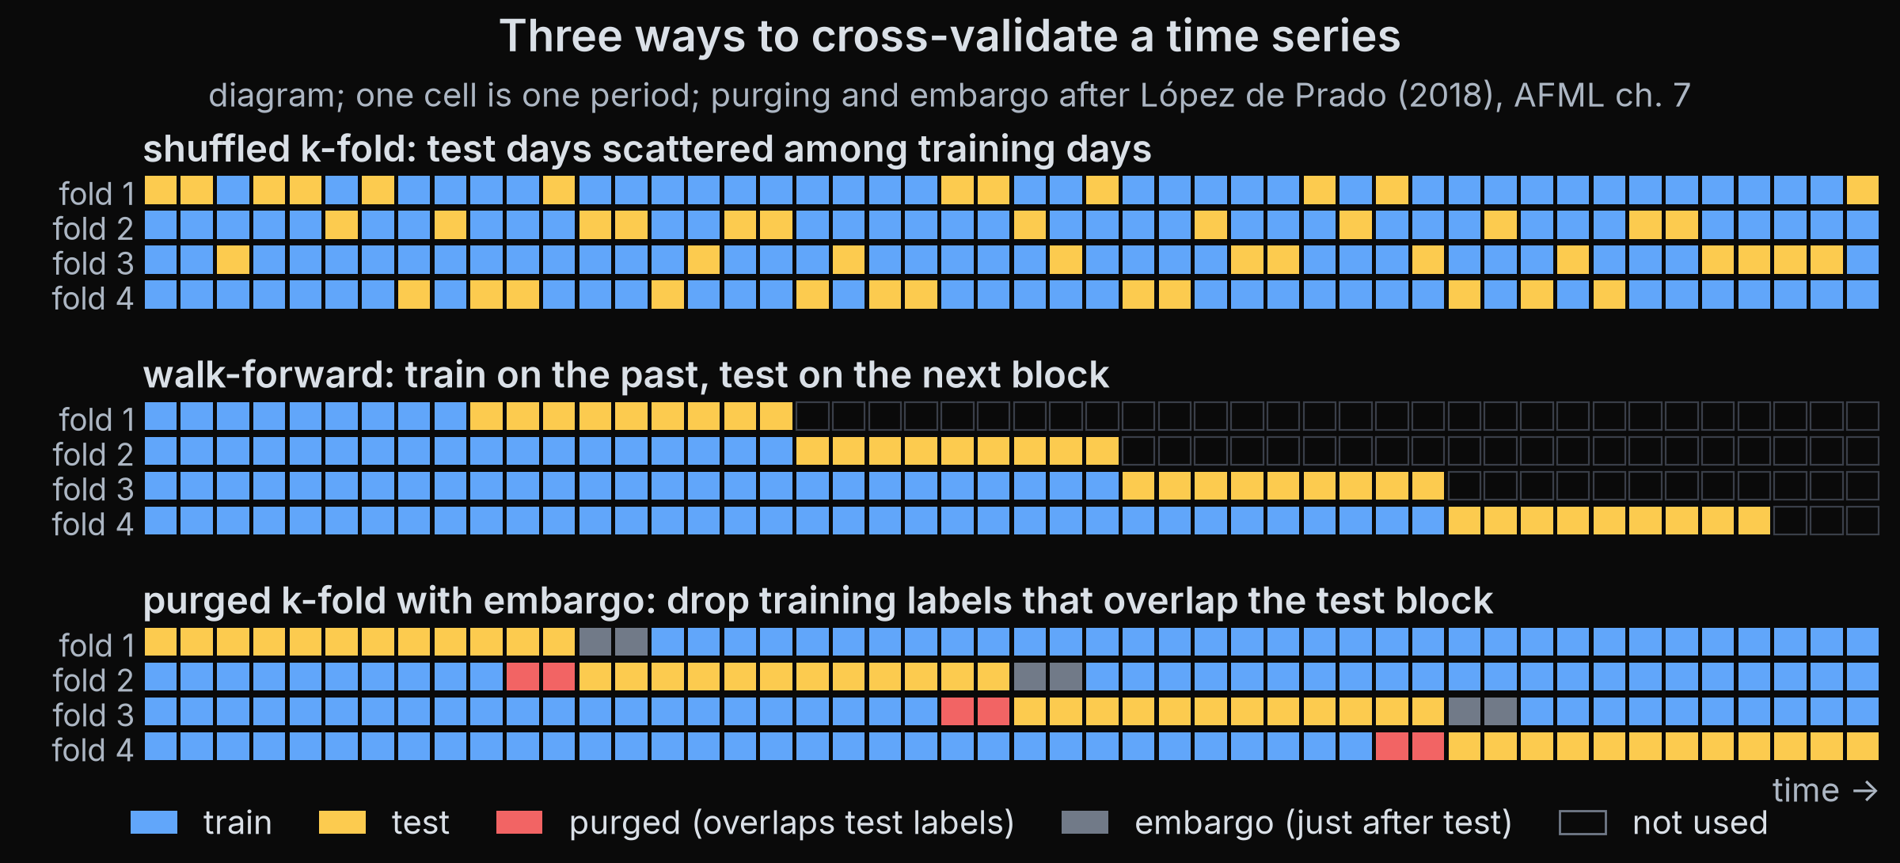
1 Generalisation
2 Honest testing
3 Trade-offs
4 Model families
5 Finance
Cross-validation
Seen in Part 1: slide 13
Shuffled k-fold puts test days next to training days that share their future.
Walk-forward trains on the past only. Purged k-fold with an embargo drops training rows that overlap the test, plus a gap after it.
Reference: Stone (1974), Cross-Validatory Choice and Assessment of Statistical Predictions, J. Royal Statistical Society B 36(2), 111-147; López de Prado (2018), Advances in Financial Machine Learning, ch. 7
QuantSoc · Quantitative Finance Society
quant-soc.com Bonus · 28 / 45
Notes:
Bonus minutes 4 to 6 (2 min).
One validation set gives one noisy score. Cross-validation, formalised by Stone in 1974, reuses the data: cut it into k pieces called folds, train on all but one, test on the one left out, repeat until every fold has been the test once, and average the scores. The top row of the picture is the textbook version, with the rows shuffled first. That is fine when every row is independent, but in finance a test day sits right next to training days whose five-day labels overlap its own, so the model has effectively seen part of the answer. That is the random split from Part 1, which looked five times better on R squared, plus 0.56 percent against plus 0.11 percent, and nearly twice as good on the daily IC, 0.0201 against 0.0123, for exactly this reason. The middle row is walk-forward: the training window always ends before the test block begins, and grows as we move through time. The bottom row is López de Prado's purged k-fold. Purging removes training rows whose label period overlaps the test fold, and the embargo removes a few more rows just after the test fold, because information can leak forwards too. This lets every year take a turn as the test while keeping the test honest. Part 2 builds purged cross-validation in code.
Full citation: Stone, M. (1974). "Cross-Validatory Choice and Assessment of Statistical Predictions." Journal of the Royal Statistical Society: Series B, 36(2), 111-147. López de Prado, M. (2018). Advances in Financial Machine Learning. Wiley. Chapter 7 "Cross-Validation in Finance".

Slide 29
1 Generalisation
2 Honest testing
3 Trade-offs
4 Model families
5 Finance
The test set is spent once
Seen in Part 1: slide 19
Data snooping: reusing the same data to choose among many ideas, so the winner looks better than it is.
1
Look
check the test score
Every look at the test set, followed by a change, leaks a little of it into your choices.
2
Tweak
White's reality check asks whether the best of everything you tried beats the benchmark, accounting for every strategy you tried, not only the winner.
change a setting because of what you saw
3
Repeat
Keep a final hold-out, open it once, and report how many things you tried.
after enough loops, the test set has become a training set
Reference: White (2000), A Reality Check for Data Snooping, Econometrica 68(5), 1097-1126
QuantSoc · Quantitative Finance Society
quant-soc.com Bonus · 29 / 45
Notes:
Bonus minutes 6 to 7 (1 min).
A test set works like an exam paper: it measures you fairly only if you have not seen it. Data snooping is reusing the same data again and again to choose among ideas; each idea may be tested honestly, but the winner of the contest is flattered by luck. White's reality check is a statistical test built for this: instead of asking whether your final strategy beats a benchmark, it asks whether the best of all the strategies you tried does, which is a much harder bar. This is slide 19 from Part 1 again, where about seven useless strategies were enough to expect one with a Sharpe ratio near one by luck. The practical rule: keep a final period of data locked away, open it once at the very end, and write down how many things you tried before that.
Full citation: White, H. (2000). "A Reality Check for Data Snooping." Econometrica, 68(5), 1097-1126.

Slide 30
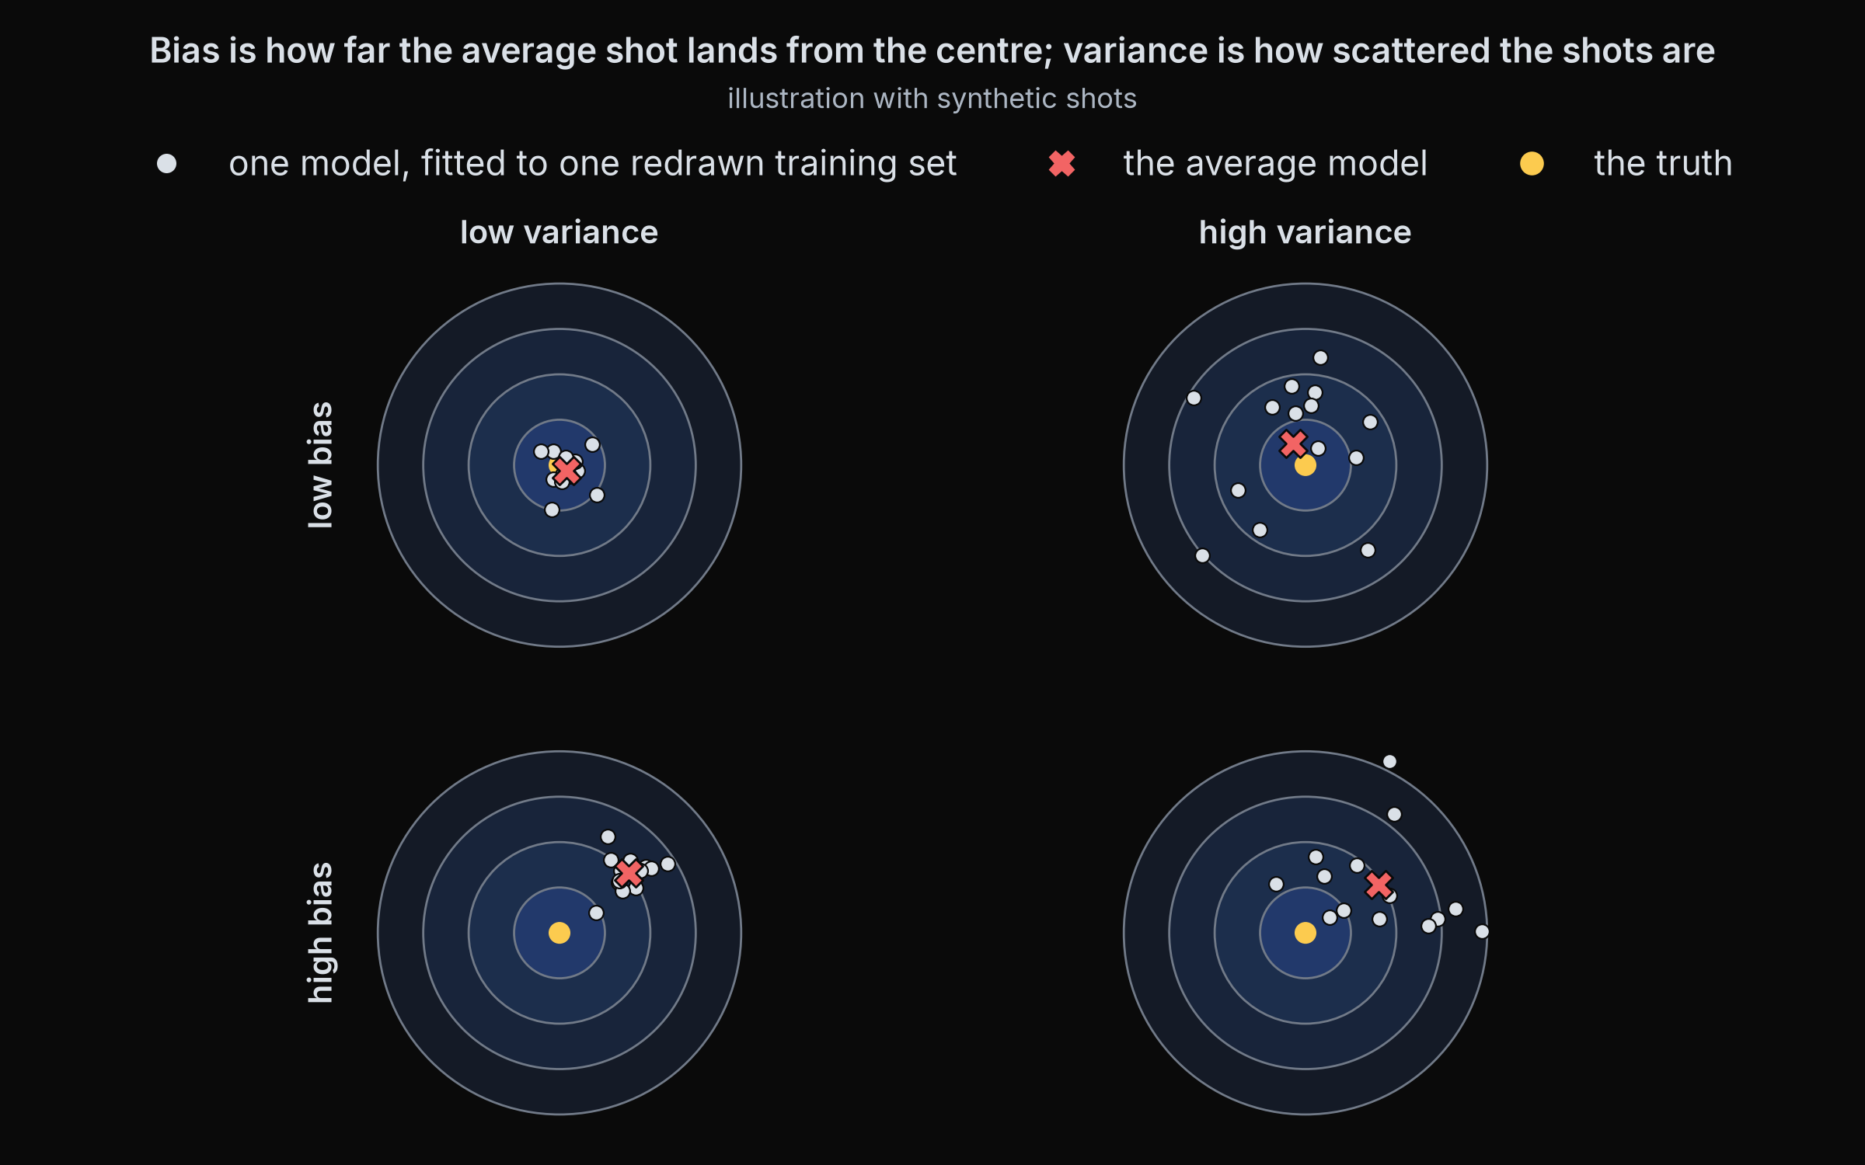
1 Generalisation
2 Honest testing
3 Trade-offs
4 Model families
5 Finance
Bias and variance
Seen in Part 1: slide 15
Bias: error from a model too simple for the real pattern: wrong on average.
Variance: error from a model so flexible that it changes with every new training sample.
Expected test error = bias² + variance + noise.
Noise is the part no model can remove. We can only trade bias against variance.
Low or high bias, low or high variance (illustration)
Reference: Geman, Bienenstock, Doursat (1992), Neural Networks and the Bias/Variance Dilemma, Neural Computation 4(1), 1-58; Hastie et al. (2009), ESL, ch. 7
QuantSoc · Quantitative Finance Society
quant-soc.com Bonus · 30 / 45
Notes:
Bonus minutes 7 to 9 (2 min).
Imagine training the same kind of model many times, each time on a fresh sample of training data, and throwing darts at a target with each fitted model. That is what the four dartboards show. Bias is how far the centre of the darts is from the bullseye: the model is wrong on average, usually because it is too simple, like a straight line fitted to a curve. Variance is how scattered the darts are: the model changes a lot depending on which training sample it happened to get, usually because it is very flexible, like a deep decision tree. For squared error there is an exact identity, made famous for machine learning by Geman, Bienenstock and Doursat: the expected test error equals the bias squared, plus the variance, plus the noise. Squared means multiplied by itself. Noise is the randomness in the outcome itself, which no model can predict. So the only choice we have is how to trade bias against variance: simpler models have more bias and less variance, flexible models the other way round. Part 1's single tree on slide 15 is the high variance case, and the forest that averages many trees is the standard way to cut variance.
Full citation: Geman, S., Bienenstock, E. and Doursat, R. (1992). "Neural Networks and the Bias/Variance Dilemma." Neural Computation, 4(1), 1-58. Hastie, T., Tibshirani, R. and Friedman, J. (2009). The Elements of Statistical Learning (2nd ed.). Springer. Chapter 7 "Model Assessment and Selection".

Slide 31
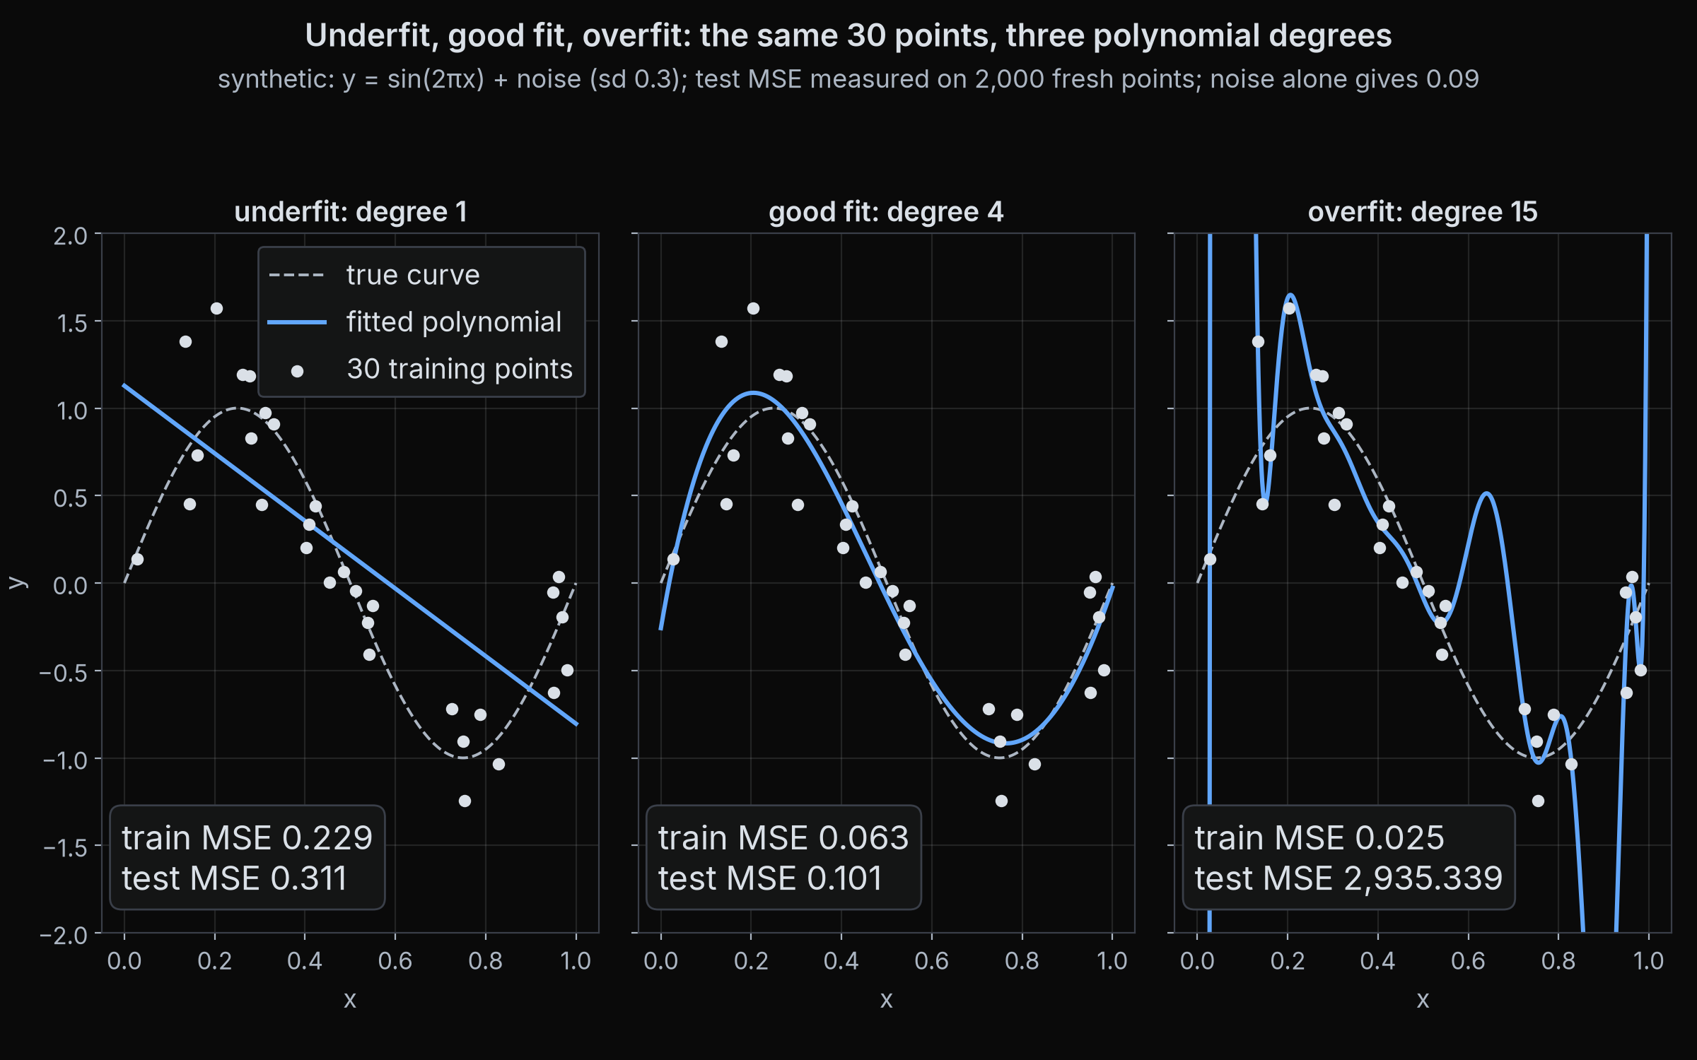
1 Generalisation
2 Honest testing
3 Trade-offs
4 Model families
5 Finance
Underfit, good fit, overfit
Seen in Part 1: slide 18
Underfit: too simple, high bias. Poor on the training points and on new ones.
Good fit: follows the shape, ignores most of the noise.
Overfit: follows the noise, high variance. Good on train, poor on test.
Three polynomials of rising flexibility on 30 noisy points (synthetic)
Reference: James, Witten, Hastie, Tibshirani (2021), An Introduction to Statistical Learning, 2nd ed., Springer, ch. 2, Statistical Learning
QuantSoc · Quantitative Finance Society
quant-soc.com Bonus · 31 / 45
Notes:
Bonus minutes 9 to 10 (1 min).
Here is the trade-off on a toy problem we generated ourselves: 30 points from a smooth wave, plus random noise. We fit three polynomials, curves whose flexibility is set by their degree, the highest power of x they use: degree 1 is a straight line, degree 4 can bend a few times, degree 15 can bend almost anywhere. The straight line underfits: it misses the wave, so it is poor on the training points and on new points alike. Its measured mean squared error is 0.229 on the training points and 0.311 on fresh points; the noise alone accounts for 0.09, the floor no curve can get below. Degree 4 fits the shape and ignores most of the noise: training error 0.063, test error 0.101, close to that floor. Degree 15 overfits: it chases individual noisy points, so its training error falls to 0.025 while its test error explodes to about 2,935, because between and beyond the training points the curve swings wildly. Every number on the panels was measured, by fitting on the 30 points and testing on 2,000 fresh points from the same wave; this is the pattern Part 1's noise experiment showed on real data.
Full citation: James, G., Witten, D., Hastie, T. and Tibshirani, R. (2021). An Introduction to Statistical Learning (2nd ed.). Springer. Chapter 2 "Statistical Learning".

Slide 32
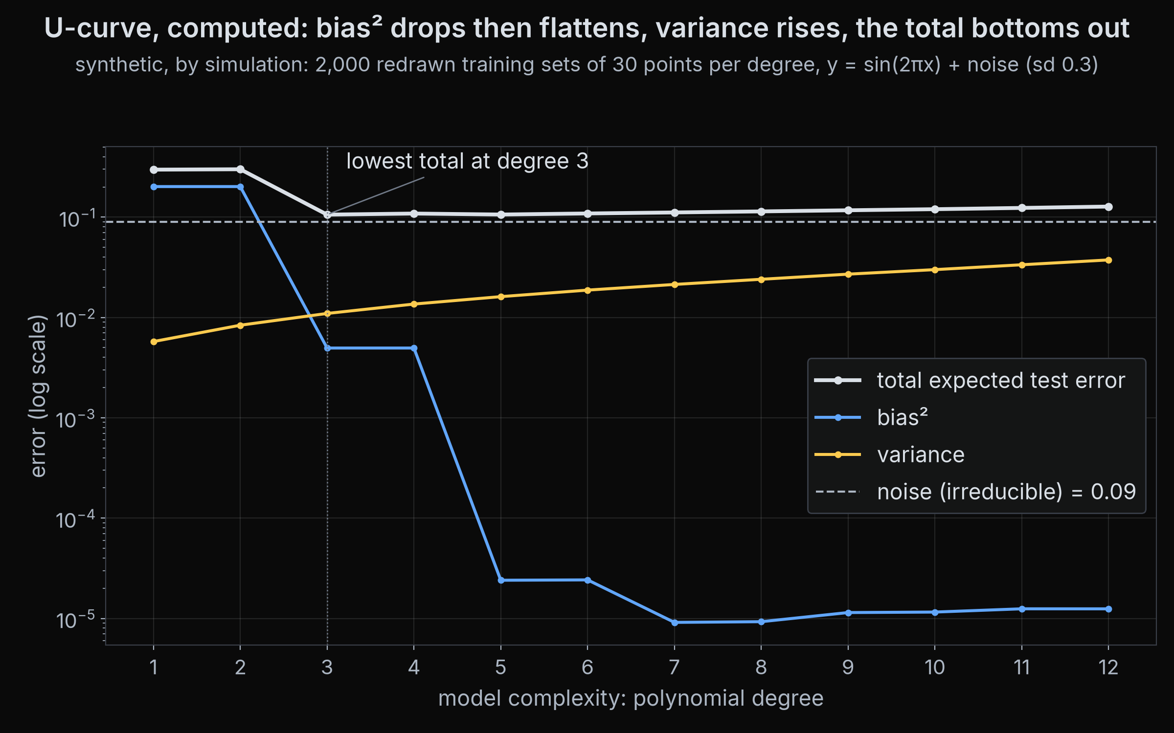
1 Generalisation
2 Honest testing
3 Trade-offs
4 Model families
5 Finance
The U-curve, in theory
As flexibility grows, bias falls and variance rises, so test error is lowest in the middle.
Reference: Hastie et al. (2009), The Elements of Statistical Learning, ch. 7, Model Assessment and Selection
QuantSoc · Quantitative Finance Society
quant-soc.com Bonus · 32 / 45
Notes:
Bonus minutes 10 to 11 (1 min).
This is the textbook U-curve, and it is computed, not sketched: we simulated many training sets, fitted polynomials of degree 1 to 12 to each, and measured the bias squared, the variance and the test error at every degree. Bias falls and variance rises as the degree grows, so the test error, their sum plus the noise, falls and then rises, with its lowest point in the middle, at degree 3. Bias plus variance plus noise matched the directly measured test error at every degree, which is the check that the decomposition holds. The next slide runs the same idea on our own stocks.
Full citation: Hastie, T., Tibshirani, R. and Friedman, J. (2009). The Elements of Statistical Learning (2nd ed.). Springer. Chapter 7 "Model Assessment and Selection".

Slide 33
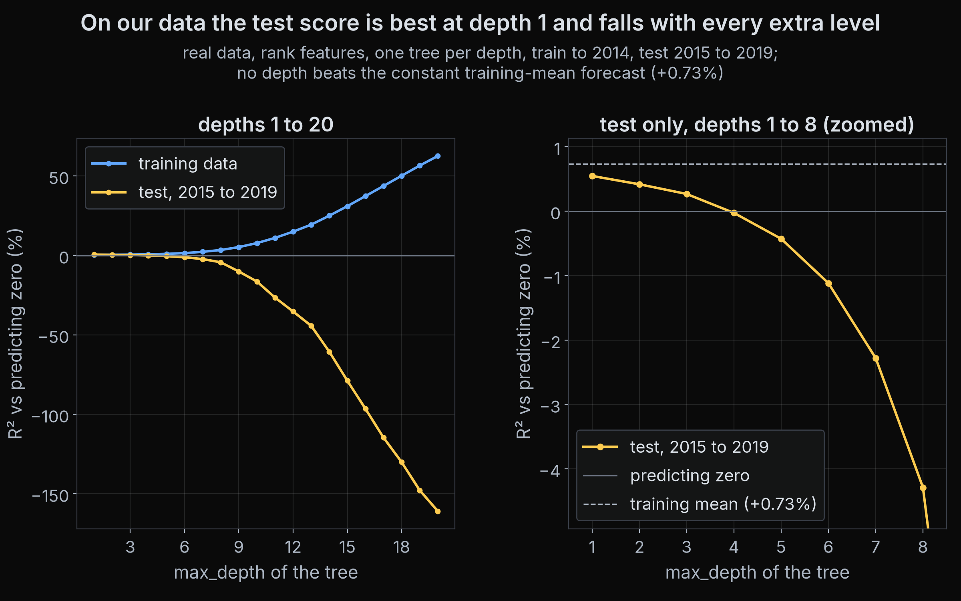
1 Generalisation
2 Honest testing
3 Trade-offs
4 Model families
5 Finance
Our data has no U
Seen in Part 1: slide 15
The best single tree is depth 1, and no depth beats a constant forecast: the noise floor at work.
Reference: Hastie et al. (2009), The Elements of Statistical Learning, ch. 7, Model Assessment and Selection
QuantSoc · Quantitative Finance Society
quant-soc.com Bonus · 33 / 45
Notes:
Bonus minutes 11 to 12 (1 min).
This is the same experiment on our real data, using Part 1's training years, test years and ranked features: a single decision tree at every depth from 1 to 20, scored by R squared against predicting zero, as in Part 1. There is no U. The best test score is at depth 1, a single yes or no question, with a test R squared of plus 0.55 percent, and it falls at every extra level: about zero by depth 4, minus 16 percent at depth 10 and minus 161 percent at depth 20. Meanwhile the training R squared climbs to about 63 percent at depth 20. And no depth beats the constant forecast, the training average, at plus 0.73 percent. So the textbook minimum in the middle has moved all the way to the simplest model. That is not a failed experiment; it is the finance lesson. The noise floor is so high that any extra flexibility is spent fitting noise, which is the next slide.
Full citation: Hastie, T., Tibshirani, R. and Friedman, J. (2009). The Elements of Statistical Learning (2nd ed.). Springer. Chapter 7 "Model Assessment and Selection".

Slide 34
1 Generalisation
2 Honest testing
3 Trade-offs
4 Model families
5 Finance
The noise floor
Seen in Part 1: slide 14
In finance almost all of the error looks like noise that no model can remove.
99.9%
of the zero forecast's test error is still there after Part 1's forest (R² vs zero +0.09%)
So bias is not the main enemy. Variance is: a flexible model spends its freedom fitting noise.
Strong ML models on individual stock returns score an out-of-sample R² under 1%.
Reference: Gu, Kelly, Xiu (2020), Empirical Asset Pricing via Machine Learning, Review of Financial Studies 33(5), 2223-2273
QuantSoc · Quantitative Finance Society
quant-soc.com Bonus · 34 / 45
Notes:
Bonus minutes 12 to 13 (1 min).
Remember the decomposition: test error is bias squared plus variance plus noise. In Part 1 the reference forest scored an R squared of plus 0.09 percent against predicting zero on the test years, which means its squared error was 99.91 percent of the zero forecast's. Almost all of the error was still there. We cannot split that leftover error into bias and noise exactly, but the research says most of it is noise: Gu, Kelly and Xiu found that even strong machine learning models explain under one percent of individual stock returns out of sample. When noise is the floor, there is little bias left to remove, so the extra flexibility of a complex model has almost nothing real to fit and fits the noise instead. That is why, in finance, controlling variance matters most, and why the next slide, regularisation, is the most useful tool in this section.
Full citation: Gu, S., Kelly, B. and Xiu, D. (2020). "Empirical Asset Pricing via Machine Learning." The Review of Financial Studies, 33(5), 2223-2273.

Slide 35
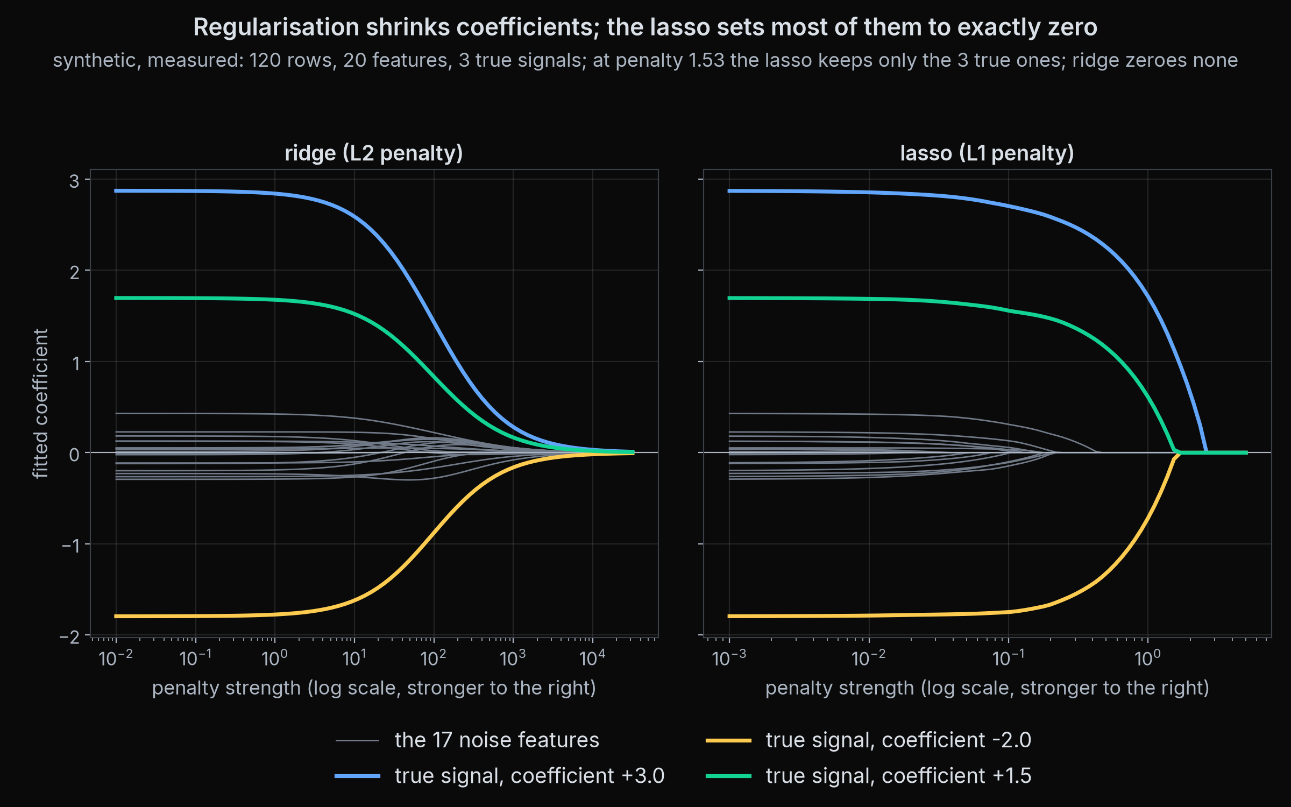
1 Generalisation
2 Honest testing
3 Trade-offs
4 Model families
5 Finance
Regularisation
Seen in Part 1: slide 16
Regularisation: any brake that stops a model fitting the noise: a little bias, traded for a lot less variance.
Ridge shrinks every coefficient towards zero. Lasso sets many exactly to zero.
Trees: limit the depth, require a minimum number of rows per leaf.
Boosting, neural nets: stop early, when the validation error stops falling.
Averaging: a forest averages many noisy trees, as in Part 1.
Ridge and lasso paths as the penalty grows (synthetic, 3 real signals of 20)
Reference: Hoerl, Kennard (1970), Ridge Regression, Technometrics 12(1), 55-67; Tibshirani (1996), J. Royal Statistical Society B 58(1), 267-288
QuantSoc · Quantitative Finance Society
quant-soc.com Bonus · 35 / 45
Notes:
Bonus minutes 13 to 14 (1 min).
Regularisation is any brake on a model's flexibility. It deliberately adds a little bias in exchange for a large cut in variance, which is the right trade when noise dominates. For a linear model, a coefficient is the weight on one feature. Ridge regression, from Hoerl and Kennard, adds a penalty for large coefficients, so they all shrink towards zero as the penalty grows. The lasso, from Tibshirani, uses a slightly different penalty that pushes many coefficients to exactly zero, so it also chooses features. The chart is a toy problem we generated: 20 features, of which only 3 truly matter. As the penalty grows, ridge shrinks all twenty smoothly, while the lasso drops the useless ones to zero; in the measured run, at a penalty of 1.53 the lasso keeps exactly three coefficients, and they are the three true signals, while ridge sets none of the twenty exactly to zero at any penalty. Trees have their own brakes: a maximum depth, and a minimum number of training rows in each leaf. Part 1's reference forest used depth 6 and at least 50 rows per leaf, and the noise experiment showed what happens with the brakes off. Boosted trees and neural networks are trained step by step, so the standard brake is early stopping: watch the validation error and stop when it stops improving. And averaging, as a forest does, cancels much of the variance of its individual trees.
Full citation: Hoerl, A. E. and Kennard, R. W. (1970). "Ridge Regression: Biased Estimation for Nonorthogonal Problems." Technometrics, 12(1), 55-67. Tibshirani, R. (1996). "Regression Shrinkage and Selection via the Lasso." Journal of the Royal Statistical Society: Series B, 58(1), 267-288.

Slide 36
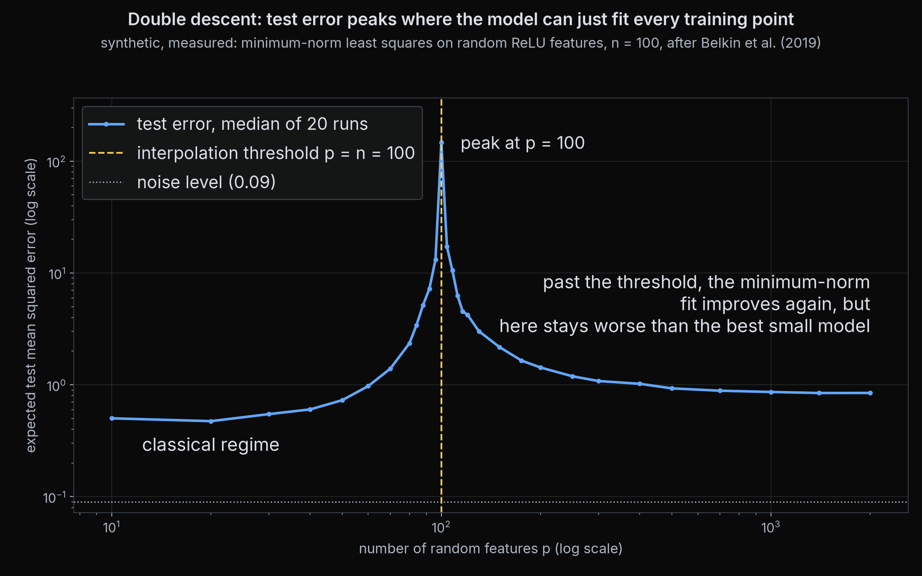
1 Generalisation
2 Honest testing
3 Trade-offs
4 Model families
5 Finance
Double descent
optional
Past the point where a model can fit every training row exactly, test error can fall again.
The peak sits at that threshold, where the model has just enough freedom to fit every point, noise included.
A refinement of the U-curve, not a promise that bigger is better: here the largest models still lose to the best small one.
Test error vs number of random features (synthetic, minimum-norm fit)
Reference: Belkin, Hsu, Ma, Mandal (2019), Reconciling modern machine-learning practice and the classical bias-variance trade-off, PNAS 116(32), 15849-15854
QuantSoc · Quantitative Finance Society
quant-soc.com Bonus · 36 / 45
Notes:
Bonus minutes 14 to 15 (1 min).
Optional slide: skip it when time is short; nothing later depends on it.
This is a modern twist on the U-curve, and it offers one explanation of why very large networks can still generalise. We fitted a linear model on randomly generated features of the input, on a toy problem with 100 training points, and varied the number of features from a handful to 2,000. With few features we see the usual U. As the number of features approaches the number of training points, written p equals n, the model can just fit every point exactly, noise included, and the test error spikes. Past that threshold there are many ways to fit the points exactly, and the method we used picks the smallest, smoothest one, called the minimum-norm solution. Test error then falls again: the second descent that Belkin, Hsu, Ma and Mandal described. Two cautions. The peak is real: at 100 features, exactly the number of points, the median test error was about 147, against 0.47 for the best small model with 20 features. And the second descent does not win here: the best of the very large models, at 1,400 features, reached about 0.85, still worse than the best small one. So say that error can fall again past the interpolation point, never that bigger models simply generalise better, and never skip validation because of it.
Full citation: Belkin, M., Hsu, D., Ma, S. and Mandal, S. (2019). "Reconciling modern machine-learning practice and the classical bias-variance trade-off." Proceedings of the National Academy of Sciences, 116(32), 15849-15854.

Slide 37
1 Generalisation
2 Honest testing
3 Trade-offs
4 Model families
5 Finance
The family map
Seen in Part 1: slide 16
used in Part 1
used in Part 1
Linear and GLMs
k-nearest neighbours
Decision trees
Random forests
A weighted sum of the features; GLMs add a link, as in logistic regression
Average the outcomes of the k most similar past examples
Yes or no questions about the features, a value in each leaf
Many trees on resampled data, averaged (bagging)
parametric
non-parametric
non-parametric
non-parametric
Boosting
Kernels, SVMs
Neural networks
Parametric or not?
Small trees added one at a time, each correcting the errors so far
Compare examples by a similarity function, then fit a simple boundary
Layers of weighted sums with simple bends between them
Parametric: a fixed number of parameters. Non-parametric: grows with the data
parametric, very many parameters
non-parametric
non-parametric
a rough guide, not a law
Marked: the two families Part 1 compared, the linear model and the random forest.
Reference: James, Witten, Hastie, Tibshirani (2021), An Introduction to Statistical Learning, 2nd ed., Springer, ch. 2, Statistical Learning
QuantSoc · Quantitative Finance Society
quant-soc.com Bonus · 37 / 45
Notes:
Bonus minutes 15 to 16 (1 min).
Here are the seven families of models you will meet most often, each in one line. A linear model forecasts with a weighted sum of the features; a generalised linear model, a GLM, passes that sum through a link function, for example logistic regression, which turns it into a probability. k-nearest neighbours finds the k past examples most similar to today and averages what happened next. A decision tree asks yes or no questions, as in Part 1. Bagging fits many trees on resampled copies of the data and averages them; a random forest also gives each tree a random subset of the features. Boosting adds small trees one at a time, each one fitted to the errors left by the ones before. Kernel methods, including support vector machines, compare examples through a similarity function and then fit a simple boundary in that space. Neural networks stack layers of weighted sums with simple bends between them. The last card is a useful distinction from James and colleagues: a parametric model has a fixed number of parameters whatever the size of the data, while a non-parametric model can grow more detailed as data arrives. Part 1 compared the two marked families.
Full citation: James, G., Witten, D., Hastie, T. and Tibshirani, R. (2021). An Introduction to Statistical Learning (2nd ed.). Springer. Chapter 2 "Statistical Learning".

Slide 38
1 Generalisation
2 Honest testing
3 Trade-offs
4 Model families
5 Finance
Model properties
Family
Flexibility
Interpretability
Data needed
Captures interactions
Extrapolates
Needs feature scaling
Training cost
Linear and GLMs
low
high
little
only if added
yes, linearly
with penalties
low
k-nearest neighbours
high
medium
lots
yes
no
yes
slow to predict
Decision trees
medium
high if shallow
medium
yes
no, flat
no
low
Random forests
high
low
medium
yes
no
no
medium
Boosting
high
low
medium
yes
no
no
high
Kernels, SVMs
high
low
medium
yes
depends
yes
high
Neural networks
very high
low
lots
yes
unreliably
yes
high
Qualitative ratings, not measurements: a rough guide from experience and the textbooks. Your data can overturn any cell.
Reference: James et al. (2021), An Introduction to Statistical Learning, 2nd ed., ch. 2; Hastie et al. (2009), The Elements of Statistical Learning, 2nd ed.
QuantSoc · Quantitative Finance Society
quant-soc.com Bonus · 38 / 45
Notes:
Bonus minutes 16 to 17 (1 min).
This table is a rough guide, not a measurement: every cell is a judgement, and a particular dataset can overturn any of them. Flexibility is how many different shapes a model can fit. Interpretability is how easily a person can see why it made a forecast. Data needed is how many examples it takes before the model is reliable. Captures interactions asks whether it can learn that two features matter together, for example momentum only working when volatility is low, without being told. Extrapolates asks what happens outside the range of the training data: a linear model carries its straight line onwards, while a tree just repeats the value of its last leaf. Needs feature scaling asks whether the features must first be put on the same scale; trees do not care, because they only compare values, while distances and penalties do. Training cost is how much computing it takes. For noisy financial data, the columns that matter most are flexibility and data needed: the more flexible the model, the more data it needs before its variance is under control.
Full citation: James, G., Witten, D., Hastie, T. and Tibshirani, R. (2021). An Introduction to Statistical Learning (2nd ed.). Springer. Chapter 2 "Statistical Learning". Hastie, T., Tibshirani, R. and Friedman, J. (2009). The Elements of Statistical Learning (2nd ed.). Springer.

Slide 39
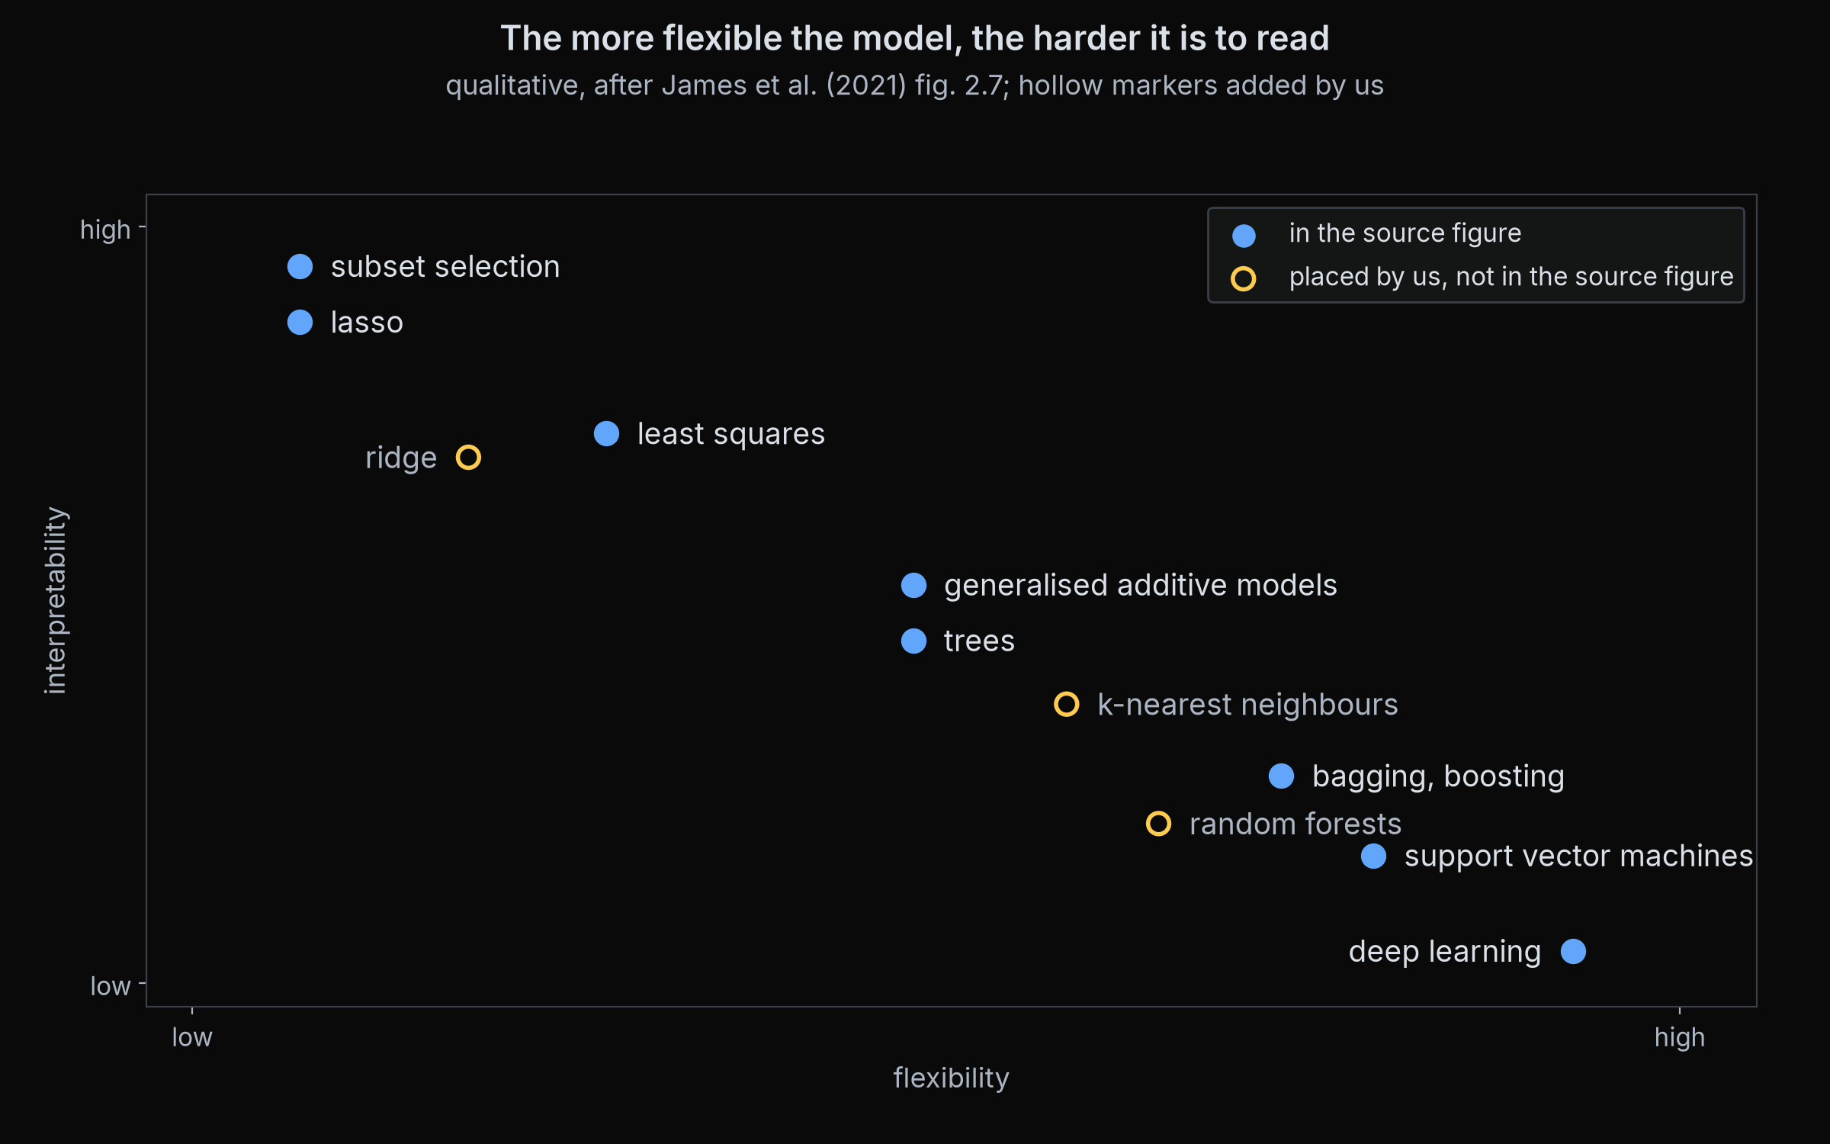
1 Generalisation
2 Honest testing
3 Trade-offs
4 Model families
5 Finance
Interpretability vs flexibility
More flexible models can fit more shapes, and are harder to explain.
In finance, flexibility buys less than usual, because most of the extra shapes are noise.
So start simple, and add flexibility only when the validation score earns it.
Qualitative, after James et al. (2021) fig. 2.7, with some families added by us
Reference: James, Witten, Hastie, Tibshirani (2021), An Introduction to Statistical Learning, 2nd ed., Springer, ch. 2, fig. 2.7
QuantSoc · Quantitative Finance Society
quant-soc.com Bonus · 39 / 45
Notes:
Bonus minutes 17 to 18 (1 min).
This picture places the families on two axes: across, how flexible a model is; up, how easy it is to interpret. It follows a figure in James and colleagues' textbook, which places subset selection, the lasso, least squares, generalised additive models, trees, bagging and boosting, support vector machines and deep learning; we added ridge, k-nearest neighbours and random forests ourselves, and the chart marks those; ridge sits level with least squares, slightly to its right. Like the last slide, the positions are qualitative judgements, not measurements. A generalised additive model, a GAM, is a sum of separate smooth curves, one per feature: more flexible than a straight line, still readable. The general rule is that flexibility costs interpretability. In finance it also buys less than usual, because the extra shapes a flexible model can fit are mostly noise. So a sensible order of work is: a simple, readable model first, then more flexibility only if a fair validation test shows it helps.
Full citation: James, G., Witten, D., Hastie, T. and Tibshirani, R. (2021). An Introduction to Statistical Learning (2nd ed.). Springer. Chapter 2 "Statistical Learning", figure 2.7.

Slide 40
1 Generalisation
2 Honest testing
3 Trade-offs
4 Model families
5 Finance
Explaining a model
optional
Ask what a model relies on before you trust it.
Coefficients
Impurity vs permutation
Linear models: each weight is the effect of one feature, holding the others fixed
Impurity: how much a feature's splits helped in training. Permutation: shuffle it on test data and measure the damage
Importance measured on training data shows what was fitted; on test data, what lasted.
SHAP values
Interpretable by design
Split each single forecast into a contribution from every feature
For high-stakes decisions, prefer a model simple enough to read directly
Reference: López de Prado (2018), Advances in Financial Machine Learning, ch. 8, Feature Importance; Lundberg, Lee (2017), NeurIPS 30; Rudin (2019), Nature Machine Intelligence 1(5), 206-215
QuantSoc · Quantitative Finance Society
quant-soc.com Bonus · 40 / 45
Notes:
Bonus minutes 18 to 19 (1 min).
Optional slide: skip it when time is short; nothing later depends on it.
Before trusting a model, ask what it relies on. There are four common ways to look. In a linear model, each coefficient is the change in the forecast for a one-unit change in that feature, holding the others fixed. For trees there are two kinds of feature importance, discussed in López de Prado's chapter 8. Impurity importance adds up how much each feature's splits improved the fit during training; it is fast, but it measures what was fitted, noise included. Permutation importance shuffles one feature on test data, breaking its link with the outcome, and measures how much worse the forecasts get; it measures what lasted. When we measured permutation importance on the workshop's reference forest with raw features, only ret_5, the one-week reversal feature, helped on the test years by more than one standard deviation; shuffling most of the others made the test error slightly smaller. SHAP values, from Lundberg and Lee, split each single forecast into a contribution from every feature, so you can explain one decision at a time. Rudin argues that for high-stakes decisions it is better to use a model that is interpretable by design than to explain a black box after the fact. Part 2 covers feature importance in code.
Full citation: López de Prado, M. (2018). Advances in Financial Machine Learning. Wiley. Chapter 8 "Feature Importance". Lundberg, S. M. and Lee, S.-I. (2017). "A Unified Approach to Interpreting Model Predictions." Advances in Neural Information Processing Systems 30. Rudin, C. (2019). "Stop explaining black box machine learning models for high stakes decisions and use interpretable models instead." Nature Machine Intelligence, 1(5), 206-215.

Slide 41
1 Generalisation
2 Honest testing
3 Trade-offs
4 Model families
5 Finance
No free lunch
Seen in Part 1: slide 12
Averaged over every possible problem, no learning algorithm beats any other on data it has not seen.
1
Assumptions are the price
every model wins only where its built-in assumptions fit the problem
So a model wins only by matching the structure of a particular problem.
2
Part 1's evidence
Practical rule: give a simple baseline a fair chance first, and let honest validation pick.
a constant forecast beat both the linear model and the forest on R² vs zero
3
So
start simple, compare honestly, keep what validation supports
Reference: Wolpert (1996), The Lack of A Priori Distinctions Between Learning Algorithms, Neural Computation 8(7), 1341-1390
QuantSoc · Quantitative Finance Society
quant-soc.com Bonus · 41 / 45
Notes:
Bonus minutes 19 to 20 (1 min).
Wolpert proved a sobering result, nicknamed the no free lunch theorem: averaged over every possible problem, no learning algorithm does better than any other on examples it has not seen. It does not mean all models are equally good on your problem. It means that whenever a model wins, it wins because its built-in assumptions happen to match the structure of that problem, for example a forest assuming that the answer depends on yes or no questions about the features. So there is no best model in general, only a best model for a given kind of data, and the only way to find it is an honest comparison. Part 1 is a small example: on R squared against predicting zero, the constant forecast scored plus 0.73 percent, the linear model plus 0.45 percent and the forest plus 0.09 percent, so the simplest forecast won on that score. That is why every model in Part 1 was compared with a baseline first.
Full citation: Wolpert, D. H. (1996). "The Lack of A Priori Distinctions Between Learning Algorithms." Neural Computation, 8(7), 1341-1390.

Slide 42
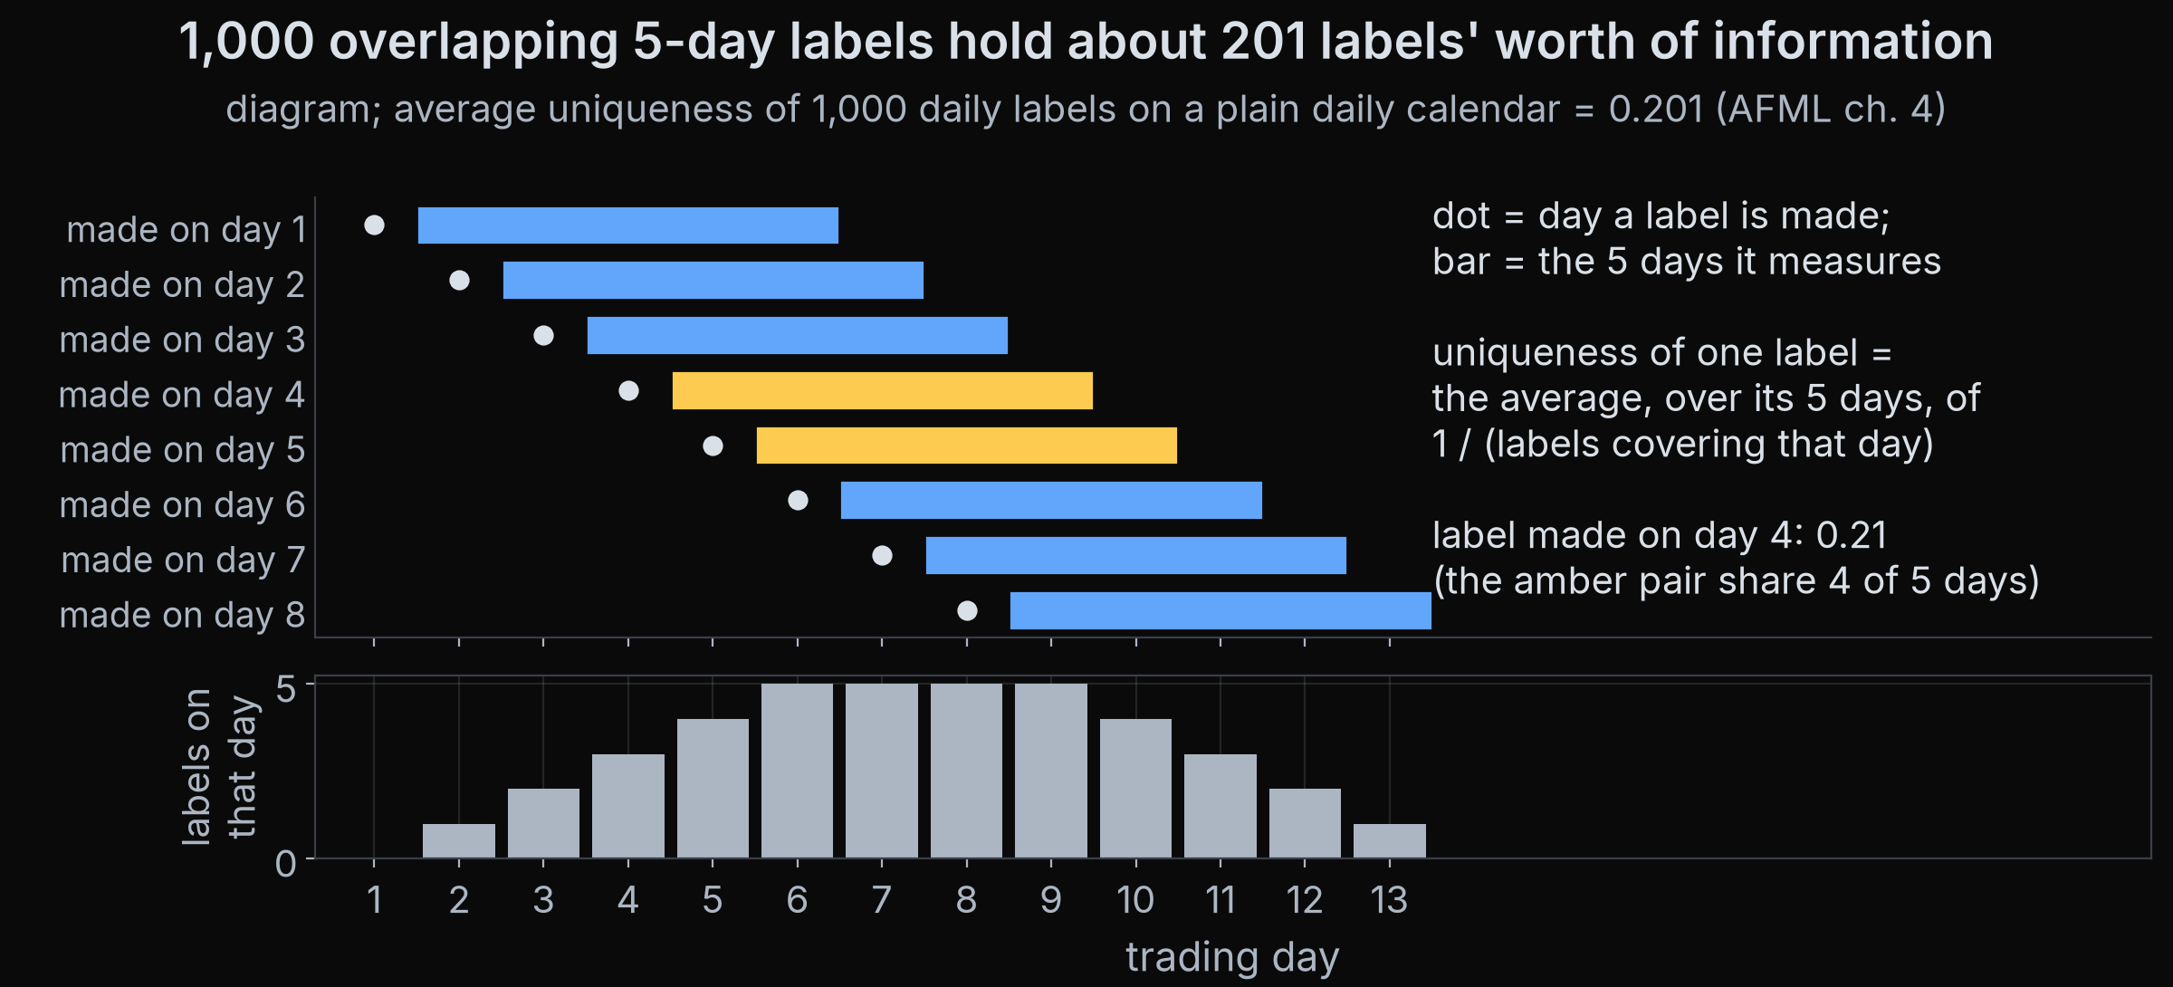
1 Generalisation
2 Honest testing
3 Trade-offs
4 Model families
5 Finance
Finance changes the rules
Seen in Part 1: slide 3
Overlapping labels: 1,000 daily 5-day labels hold far fewer independent observations.
Match the metric to the decision: Part 1's forest lost to a constant on R² (+0.09% vs +0.73%), yet its daily IC was slightly positive (+0.011).
Reference: López de Prado (2018), Advances in Financial Machine Learning, ch. 4, Sample Weights; Bellman (1961), Adaptive Control Processes
QuantSoc · Quantitative Finance Society
quant-soc.com Bonus · 42 / 45
Notes:
Bonus minutes 20 to 22 (2 min).
Everything in this section holds in finance, but the table from slide 3 changes how it applies. Three changes matter most. First, effective sample size: the number of truly independent observations. Our labels are five-day returns, so the label for Monday and the label for Tuesday share four of their five days. López de Prado measures this with average uniqueness: for each label, the average over its days of 1 divided by the number of labels covering that day; it is about 0.2 for 5-day labels. Computed for 1,000 five-day labels on a plain daily calendar it is 0.201, so 1,000 daily labels carry about the information of 201 independent ones, as the chart shows. Second, the curse of dimensionality, Bellman's phrase: every feature you add spreads the same data more thinly, so with few independent observations, many features make overfitting easier. Third, the metric must match the decision. In Part 1 the forest lost to a constant forecast on R squared, plus 0.09 percent against plus 0.73 percent, because the constant knew that shares rose on average. But a long/short book does not care about the average; it only cares which stocks beat the others on the same day. That is measured by the information coefficient, IC: the correlation between the forecasts and the outcomes across the stocks on one day. There the forest's mean daily IC was plus 0.011, above zero on 52.5 percent of days. That is small, and with overlapping labels it is not proof of skill, but it shows that the same forecasts can lose on one score and edge ahead on another. Choose the score that matches the trade you will make.
Full citation: López de Prado, M. (2018). Advances in Financial Machine Learning. Wiley. Chapter 4 "Sample Weights". Bellman, R. (1961). Adaptive Control Processes: A Guided Tour. Princeton University Press. Part 1 numbers: docs/core-results.md, "Numbers the notebook prints", section 4 (reference forest, test 2015-01-12 to 2019-12-20).

Slide 43
1 Generalisation
2 Honest testing
3 Trade-offs
4 Model families
5 Finance
Two cultures
optional
Data modelling: assume a simple model of how the data were made, then estimate its parameters.
1
Data modelling
linear regression, factor models: readable, but wrong if the assumed form is wrong
Algorithmic modelling: treat the process as unknown, and judge any method by how well it predicts.
2
Algorithmic modelling
Our view: finance needs both. Prediction picks the trades; a reason why it works says when to stop trusting it.
forests, boosting, neural nets: flexible, judged only by accuracy on new data
Reference: Breiman (2001), Statistical Modeling: The Two Cultures, Statistical Science 16(3), 199-231
QuantSoc · Quantitative Finance Society
quant-soc.com Bonus · 43 / 45
Notes:
Bonus minutes 22 to 23 (1 min).
Optional slide: skip it when time is short; nothing later depends on it.
Leo Breiman, who invented the random forest, wrote a famous essay about two ways of doing statistics. The data modelling culture assumes a simple model of how the data were produced, for example a straight line plus noise, estimates its parameters, and reads conclusions from them. Factor models in finance, which explain returns with a few common drivers, belong here. The algorithmic modelling culture treats the process as unknown and judges any method, a forest or a neural network, purely by how well it predicts new data. Breiman argued that statisticians relied too much on the first. Our own view, not Breiman's: finance needs both. Prediction picks the trades, but an economic reason why a signal works is what tells you when the regime has changed and the signal should no longer be trusted.
Full citation: Breiman, L. (2001). "Statistical Modeling: The Two Cultures." Statistical Science, 16(3), 199-231.

Slide 44
1 Generalisation
2 Honest testing
3 Trade-offs
4 Model families
5 Finance
→ checklist
The checklist
Chapter
Ask yourself
Generalisation
Is this number from data the model never saw?
Honest testing
Did I fit, choose and judge on separate data, in time order, with a gap?
Trade-offs
Is the model's freedom earned, or is it fitting noise?
Model families
Did a simple baseline get a fair chance first?
Finance
Do my labels overlap, and does my score match the trade I will make?
QuantSoc · Quantitative Finance Society
quant-soc.com Bonus · 44 / 45
Notes:
Bonus minutes 23 to 24 (1 min).
If you remember one slide from the bonus section, make it this one: one question per chapter. Generalisation: is the number I am looking at from data the model never saw? Honest testing: did I fit, choose and judge on three separate sets, in time order, with gaps? Trade-offs: has the model's flexibility been earned on validation data, or is it fitting noise? Model families: did a simple baseline, even predicting zero or a constant, get a fair chance first? Finance: do my labels overlap, so that I have fewer independent observations than rows, and does my score match the decision I will actually make?

Slide 45
1 Generalisation
2 Honest testing
3 Trade-offs
4 Model families
5 Finance
→ follow us
Thank you, and follow QuantSoc
Part 2 next week: purged cross-validation, triple-barrier labels, feature importance, deflated Sharpe.
Part 1 is in the notebook you take home. The bonus section needs no notebook: these slides are all of it.
Website
quant-soc.com
Instagram
LinkedIn
Nothing here is investment advice.
Scan to follow QuantSoc
QuantSoc · Quantitative Finance Society
quant-soc.com Bonus · 45 / 45
Notes:
Bonus minutes 24 to 25 (1 min).
That is the end of the bonus section. Part 2 next week puts several of these ideas into code: purged cross-validation, triple-barrier labels, which decide a trade's outcome by whichever of a profit target, a loss limit or a time limit is hit first, feature importance, and the deflated Sharpe ratio, which corrects a Sharpe ratio for the number of things you tried. Nothing in this workshop is investment advice. Scan the codes to follow QuantSoc, and thank you.

