Slide 1
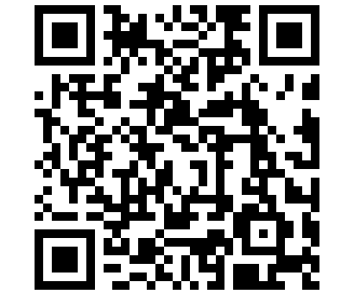
From Gaps to Gains
Rethinking AI in Education
Michael Borck
https://michaelborck.education/ai

Slide 2
Today’s Journey
From Gaps to Gains: setting the scene
Talk Buddy: student practice with feedback
Insight Lens: turning surveys into action
Quick Win: FAQ → interactive quiz
Discussion & Concerns: practical realities
Closing: where do we go from here?

Slide 3
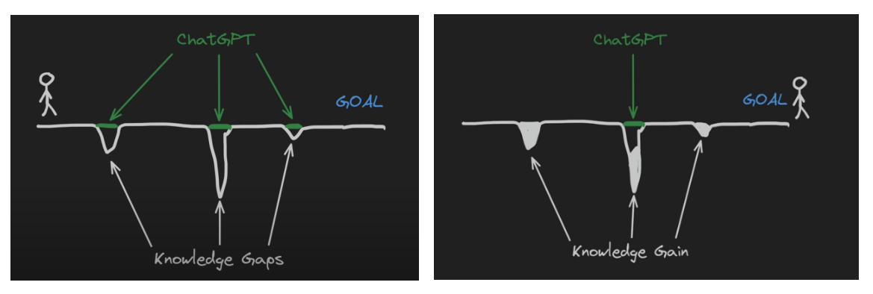
From Gaps to Gains
Gaps-to-Gains: Start -> End
Notes:
Start → End
- Students begin with gaps in knowledge
- Our goal: help them transform gaps into genuine gains
“So the question is: which story do we want to write in our classrooms?”

Slide 4
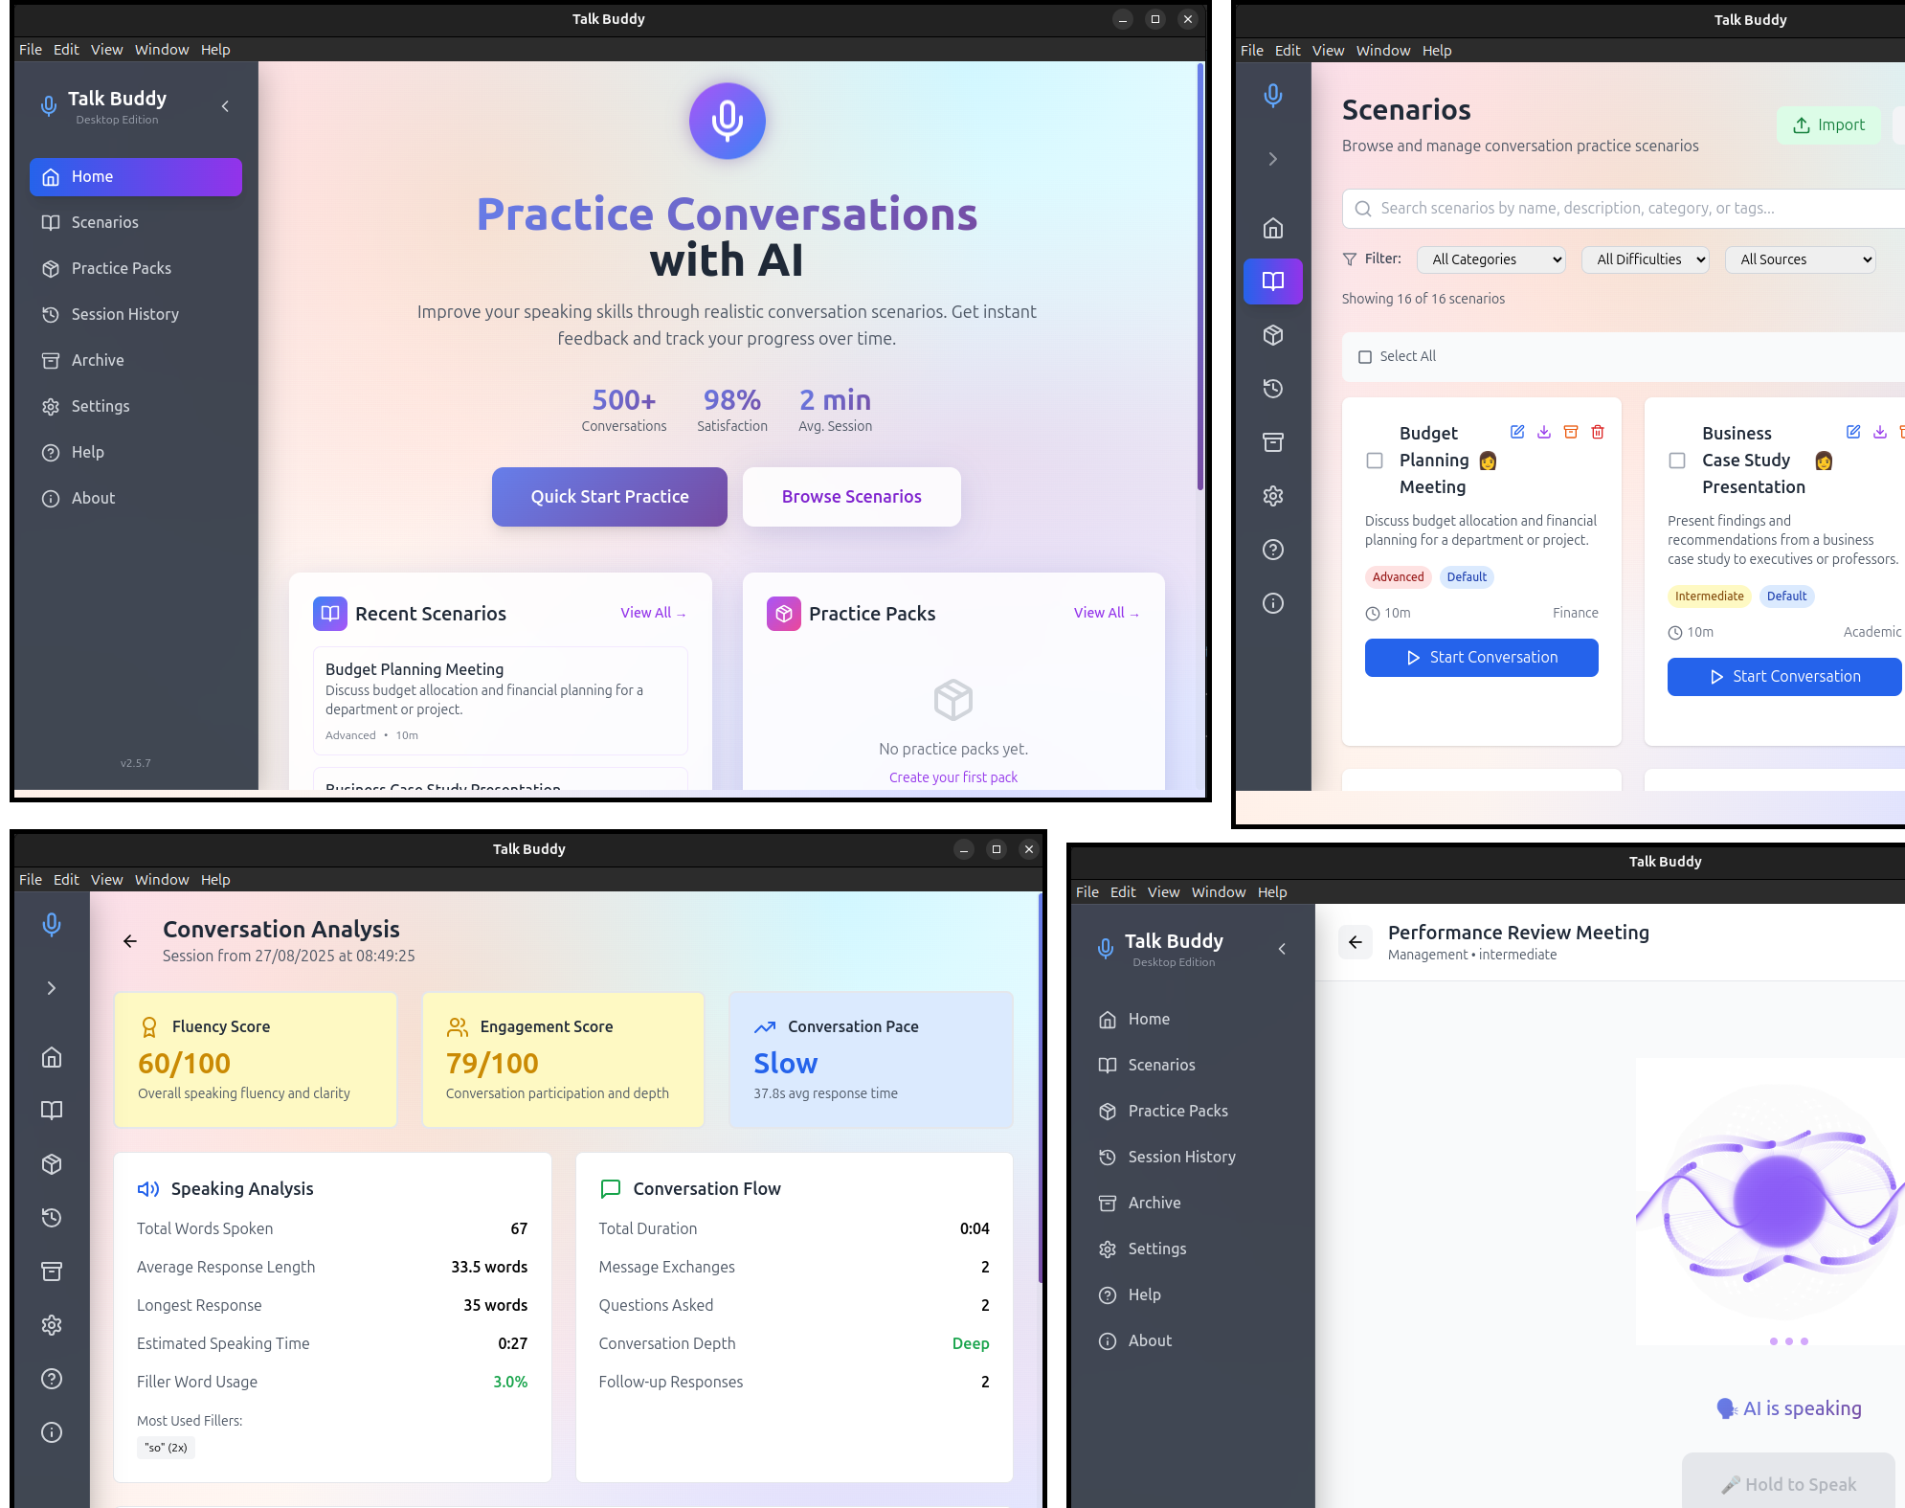
Talk Buddy — Conversation Practice
Notes:
Students:
- Practice professional conversations
- Role-play difficult scenarios
- Get instant feedback
- Build confidence safely
Lecturers:
- Create custom scenarios
- Track common struggles
- Provide targeted support
- Value: Fail safely, learn, try again — no real-world consequences.

Slide 5
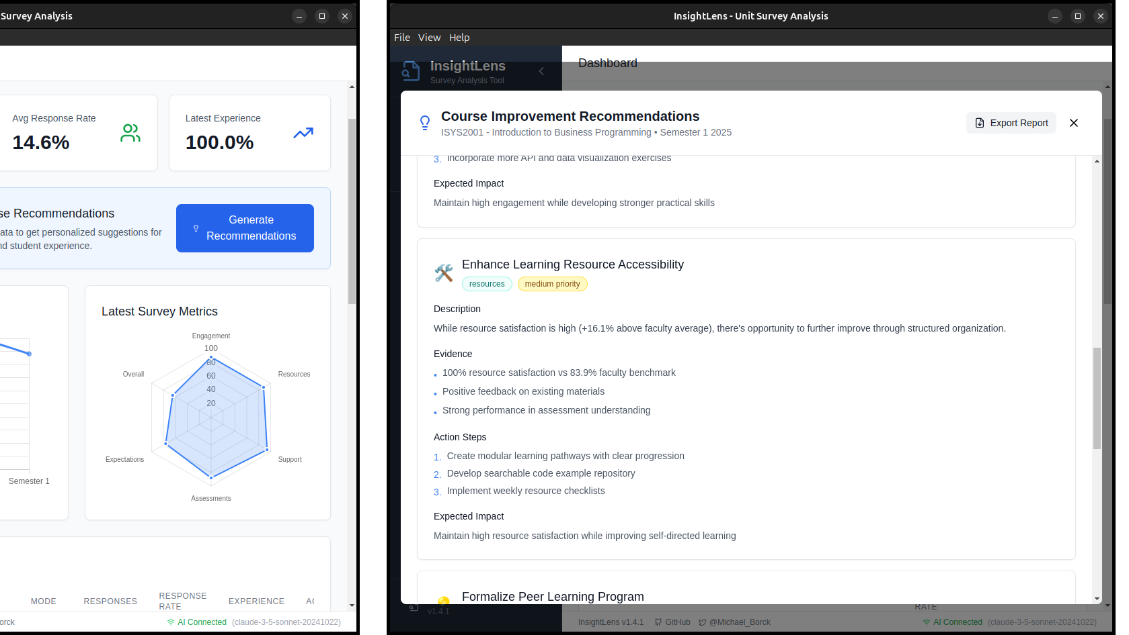
Insight Lens — Your Feedback, Actionable
Notes:
You upload:
- Student evaluations
- Unit surveys
- Mid-semester reviews
Insight Lens finds:
- Common themes
- Hidden patterns
- Specific improvements
Value: Your expertise + data insights = better outcomes.

Slide 6
Quick Win: Static → Interactive
In 2 minutes:
1. Take an FAQ or worksheet
2. Ask AI to make a interactive web page 3. Upload to Blackboard
4. Students interact, save locally
“No programming required — copy template, swap questions, done.”
Privacy First
Runs in the browser. No logins. No data leaves the device.

Slide 7
Common Concerns
Plagiarism?
→ Use AI as editor + require transparency
Lazy students?
→ Design critique & reflection tasks
Replace teachers?
→ No, AI handles routine, we do relationships
Data privacy?
→ Use safe tools, no sensitive data in consumer AI
Notes:
Reassure without lecturing. Keep it short, confident, balanced.

Slide 8
Beyond Today
CloudCore – Scenario-based teaching platform
https://cloudcore.serveur.au
FeedForward – Structured learning from feedback
https://feedforward.serveur.au
Curriculum Curator – AI-assisted course design
https://cc.serveur.au
TechNova-Sim – Cybersecurity simulation
https://technova.serveur.au
Study Buddy – Offline AI tutor
Critique Quest – AI-powered case studies
Explore more: michaelborck.education

Slide 9
Beyond Teaching: AI in Research
Audio transcription & thematic analysis (Otter-style tools)
Literature review assistance (search, summarise, compare)
Data handling & visualisation (survey analysis, charting)
Drafting & editing support (grants, papers, reviews)

Slide 10
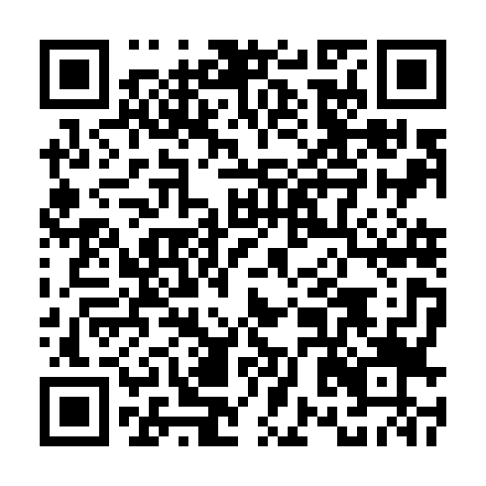

Shaping Our Support
Poll open for the next few days
Your input will shape how this role develops.
https://forms.office.com/r/4h36NYwdU7?origin=lprLink
Notes:
Guidance on safe use & policy
Practical demos & workshops
Help with curriculum integration
Tools & resource curation
One-to-one support for teaching/assessment
Research support (e.g. transcription, analysis, writing)
Other (open text)

Slide 11
Closing Reflection
AI isn’t about replacing educators
it’s about amplifying teaching and learning.
So the real question is:
How do we take our students from gaps… to gains?

