Slide 1
AI in Pedagogical Design and Delivery
Michael Borck

Slide 2
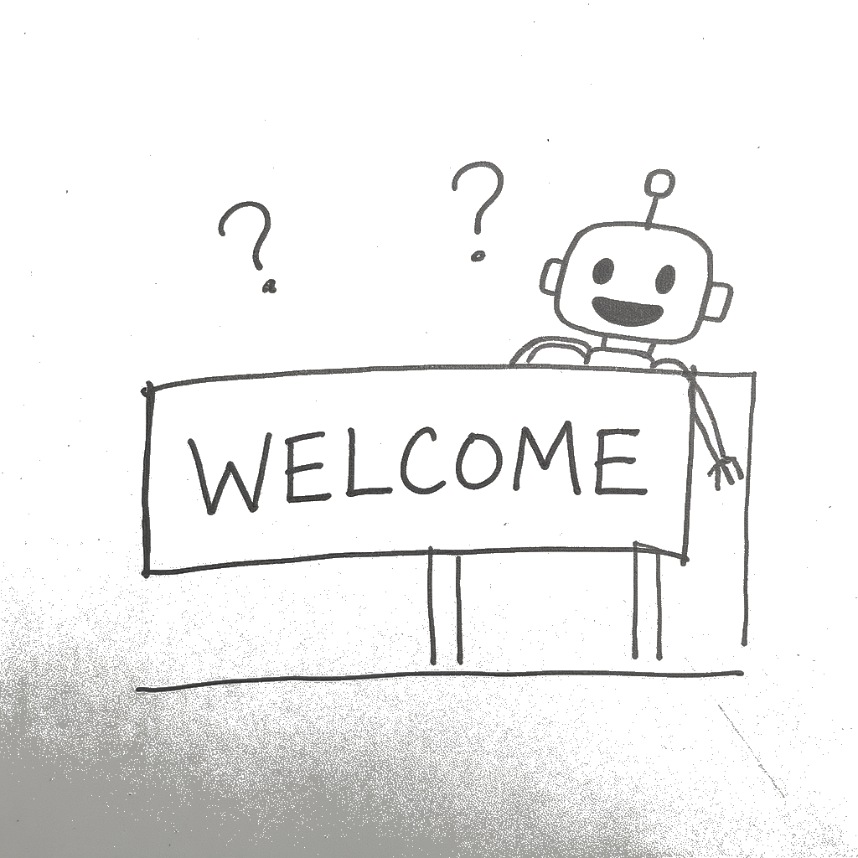
Welcome & The AI Landscape

Slide 3
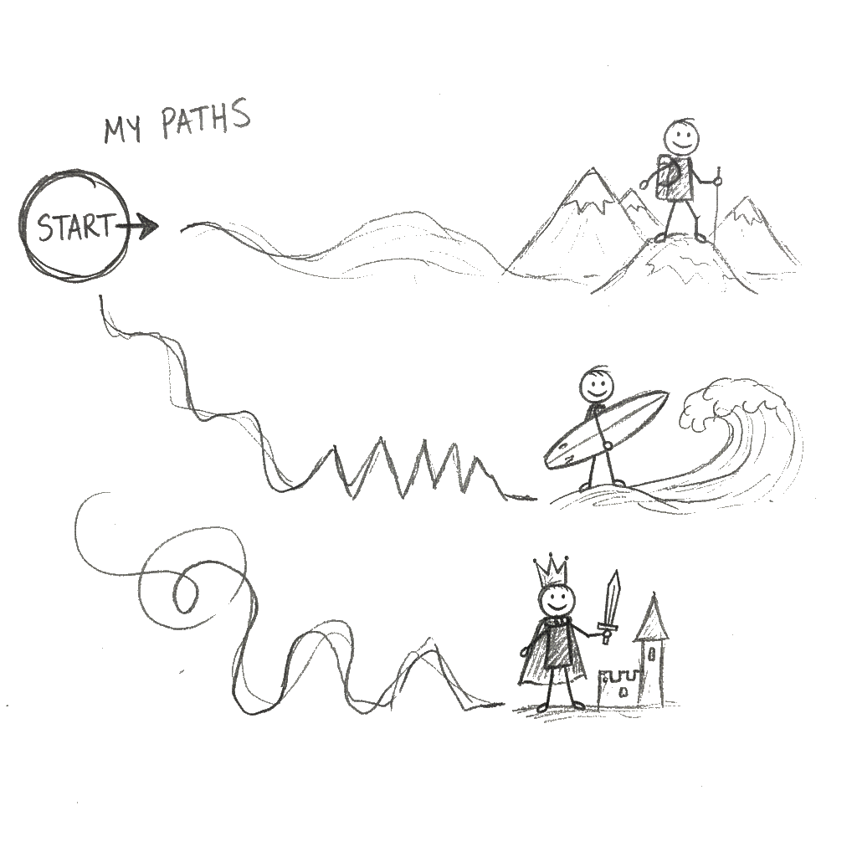
Intelligent Tutoring Systems (ITS)

Slide 4
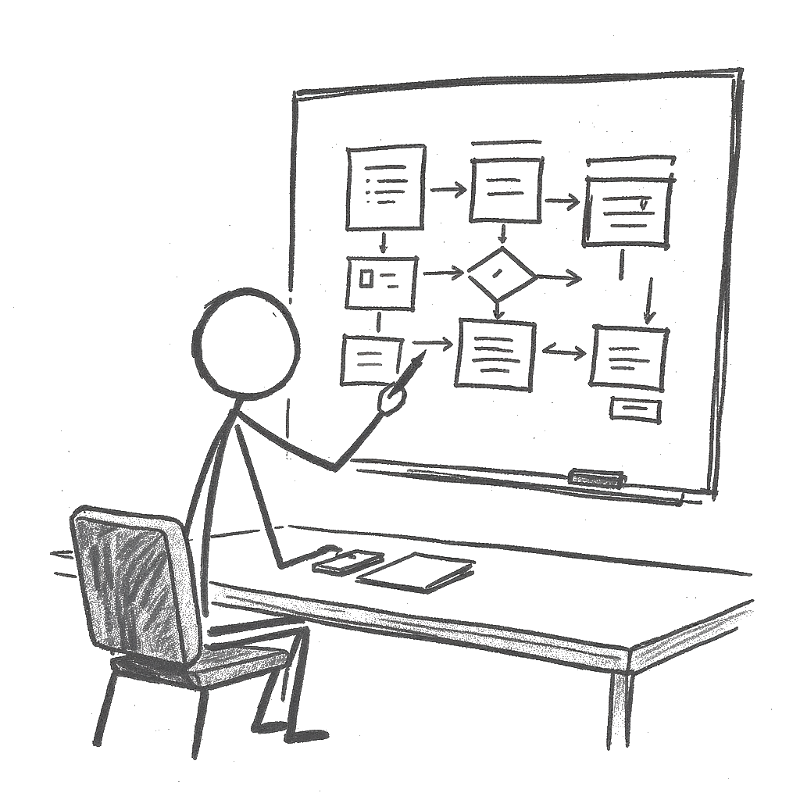
The Architect (Pedagogical Design)

Slide 5
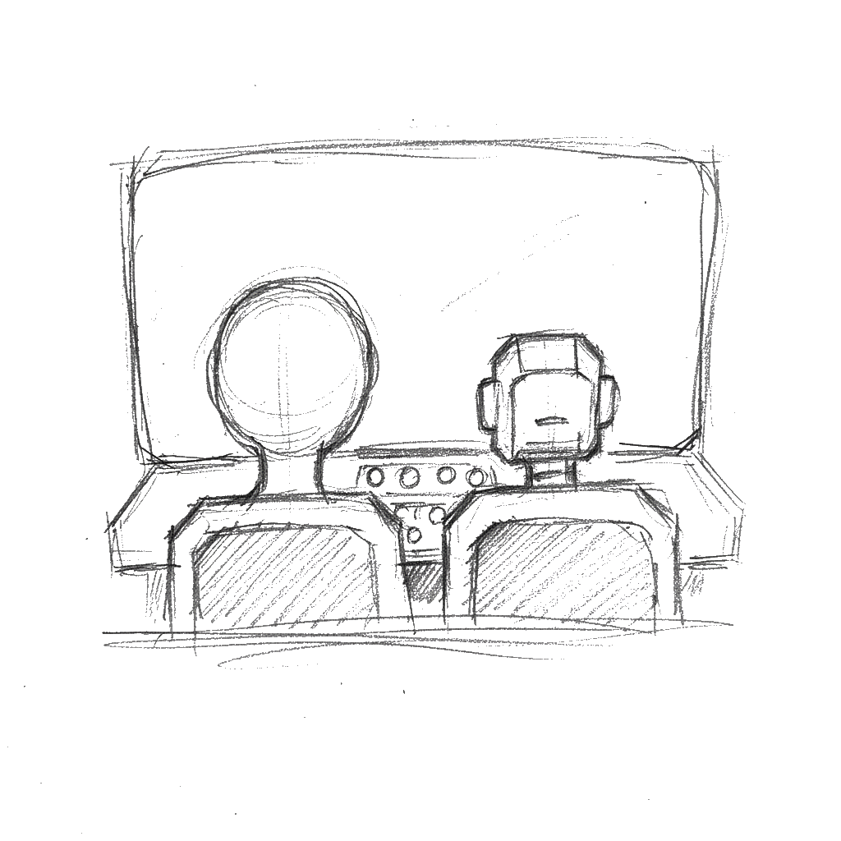
The Practitioner (Pedagogical Delivery)

Slide 6
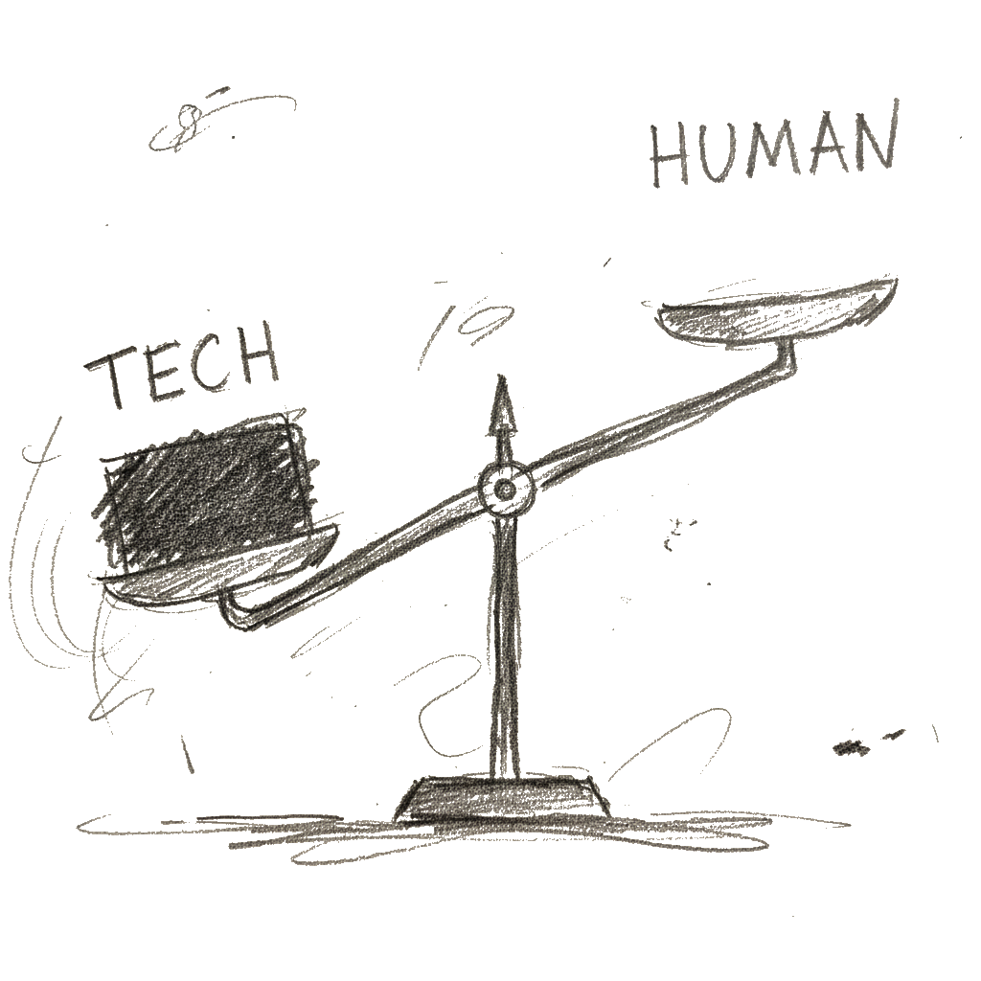
Challenges & Limitations

Slide 7
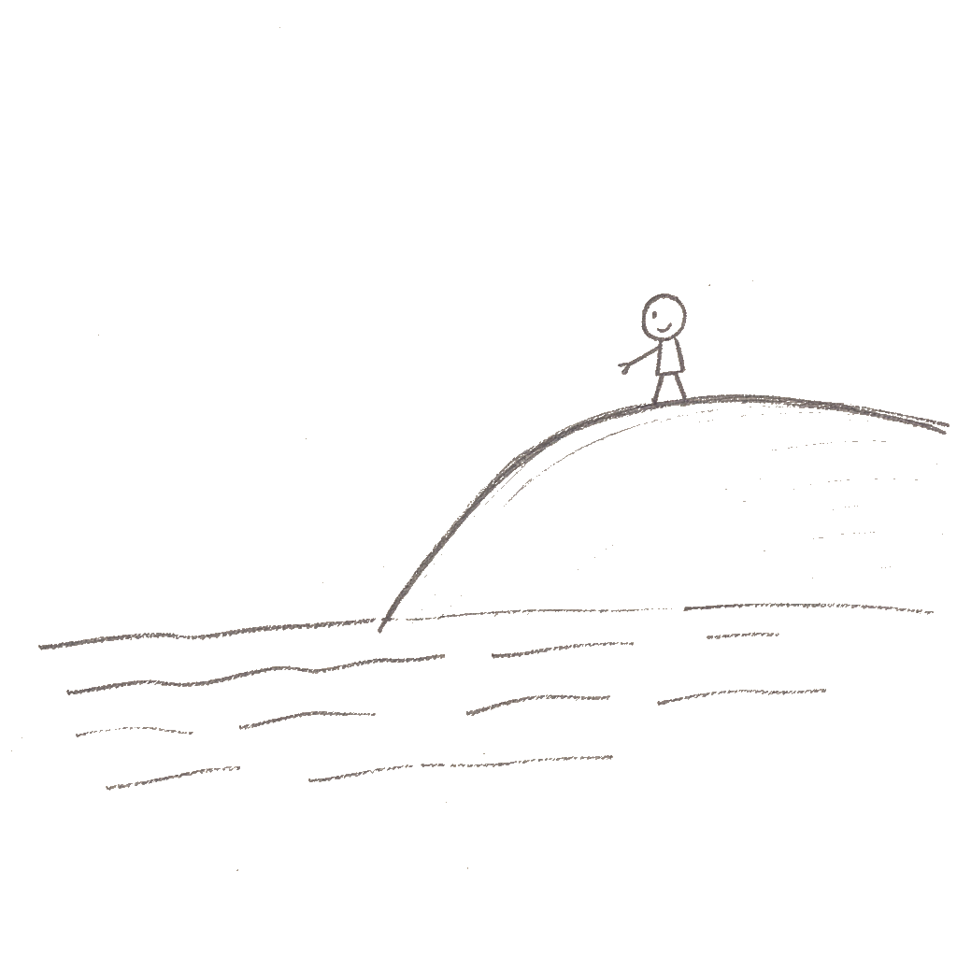
The Evolving Role of the Educator

Slide 8
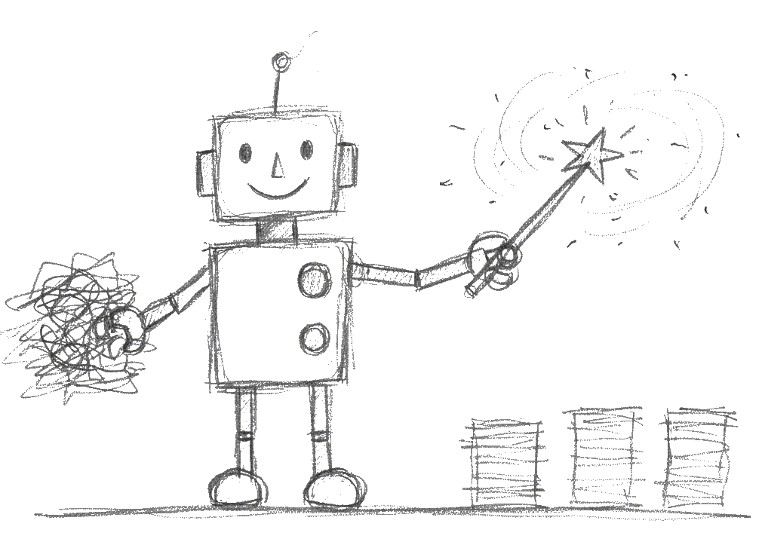
Activity 1: Automate the Tedious

Slide 9
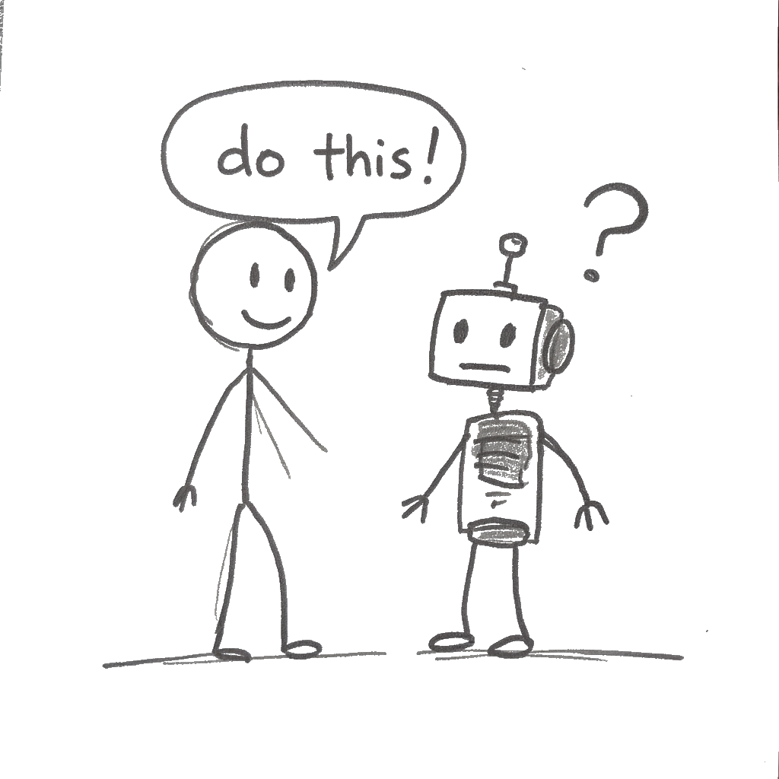
Activity 2: The Art of the Prompt

Slide 10
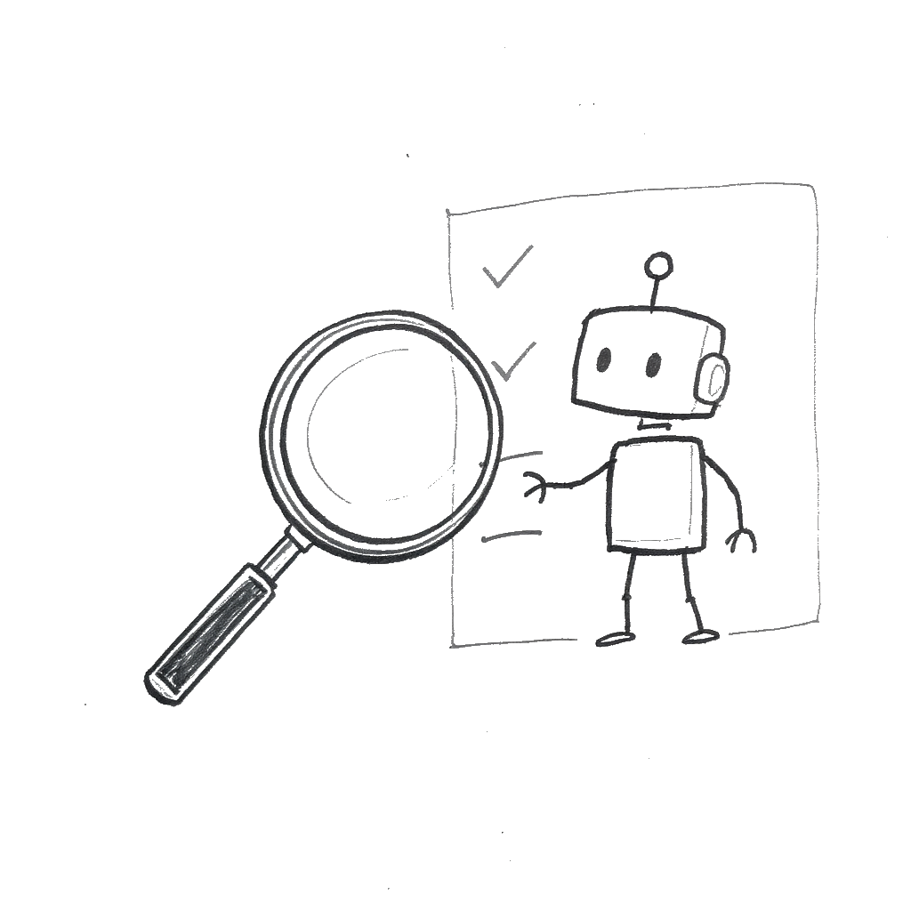
Activity 3: Your 5-Step Critique Framework

Slide 11
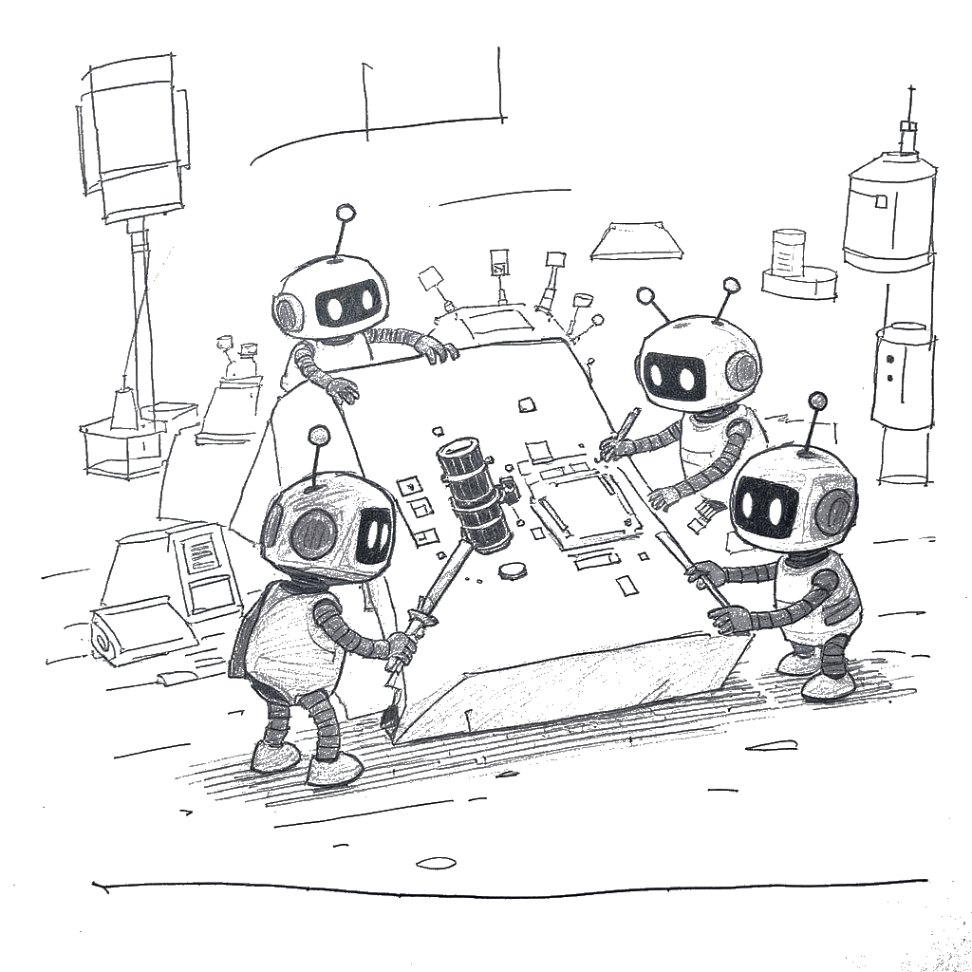
Activity 4: The “Assessment Stress-Test”

Slide 12

Activity 5: Secure, Safe, and Sustainable AI

Slide 13
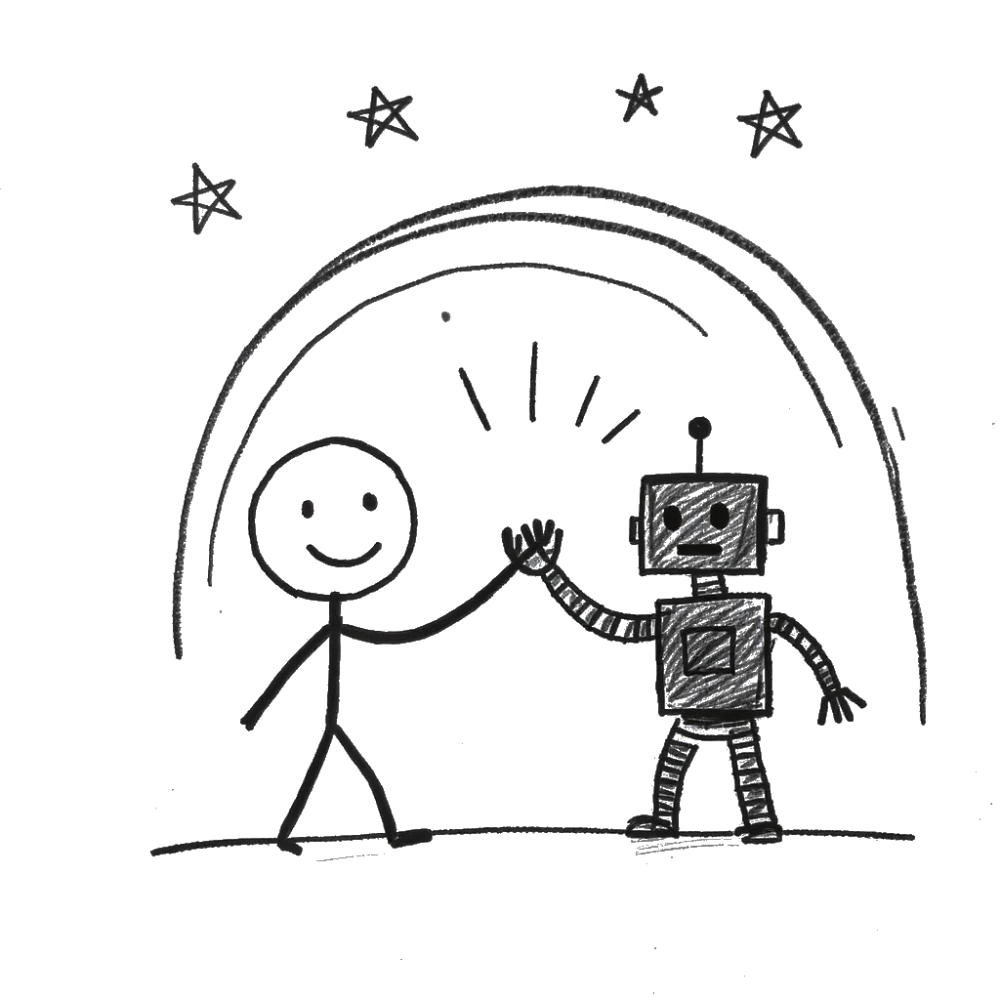
Wrap-Up & Next Steps

