Slide 1
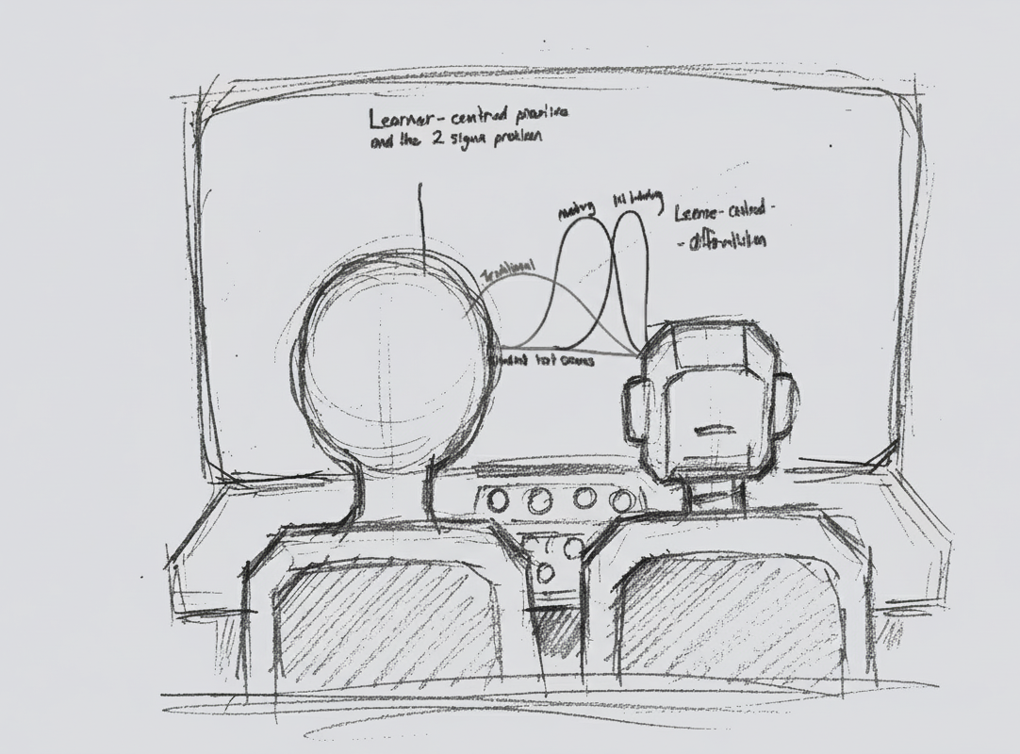
AI in Pedagogical Design and Delivery
Michael Borck
Drafting and ideation for these materials were supported by generative AI tools, Python scripts, Quarto, and standard image editors under human oversight. All content has been reviewed, edited and verified by the author.
Notes:
“Two standard deviations.” [pause 2–3 seconds, make eye contact] That’s the gap Benjamin Bloom reported in the 1980s between students in a typical classroom and students who received one‑to‑one human tutoring – enough to turn an average student into a top performer.
Fast‑forward forty years. Sal Khan – the Khan Academy guy – stands on a TED stage and says: with AI tutors and AI teaching assistants, we might finally be able to get something like that 2‑sigma effect at scale. A personal tutor for every student, and an AI assistant for every teacher.
Whether that makes you excited or slightly ill, it raises a very practical question for us here at Curtin:
If tools like this are going to sit in our students’ hands – and in our own enterprise Copilot environment – how do we design teaching, assessment and support so that we get the upside without losing what actually matters?
And how does that sit alongside Assessment 2030, academic integrity, and the reality that students can now summon a ‘tutor’ at 2am from their phone?”
“Even if you’re not teaching every day, there’s a similar promise in our research and professional roles – a kind of co‑pilot for the boring parts of our jobs – drafting, summarising, chasing patterns – so we can spend more time on work that needs human judgement and relationships.”
“That’s what this session is about. We’re going to: – Experiment with using AI to automate some of the tedious work, – Practise how to design prompts and critique AI outputs, and – Stress‑test our own assessments and practices in the spirit of Assessment 2030 – not to ban AI, but to redesign so that student judgement, process, and human skills remain irreplaceable.”
“We also know from recent work that if we lean too hard on these tools, we risk cognitive offloading, students feeling less connected, and making cheating easier if our assessments are too automatable. So we’ll spend as much time on how to critique and design around AI as we do on the shiny productivity side.”

Slide 2
What We’ll Do Today
Set the scene: AI, Assessment 2030, and your context
Try out 5 hands‑on activities:
Automate some of the tedious work
Design better prompts
Critique AI outputs with a simple framework
Use AI in a multi‑step workflow to probe or redesign a task
Make one small commitment about safe AI use
Wrap up with key takeaways and next steps
Notes:
So the shape of the next two hours is roughly this: a bit of context to connect AI to Assessment 2030, then five very practical activities – automate, prompt, critique, multi‑step workflows, and safe use – and then a short wrap‑up.
It’s designed to be mostly hands‑on and beginner‑friendly, with space for questions and discussion as we go.
For Activity 4 we have two possible paths, depending on how much Assessment 2030 you’ve already had today: we can either probe one of our assessments with AI and discuss redesign, or we can use a multi‑step AI workflow to tackle one of those ‘impossible’ teaching or design problems. We’ll pick on the day based on the room.
“Just as we’ll explore today, these slides and the website were developed with AI support – for drafting, structuring and idea generation – but always with human oversight, editing and verification. So this session is very much about walking the talk as well as talking about it.”

Slide 3
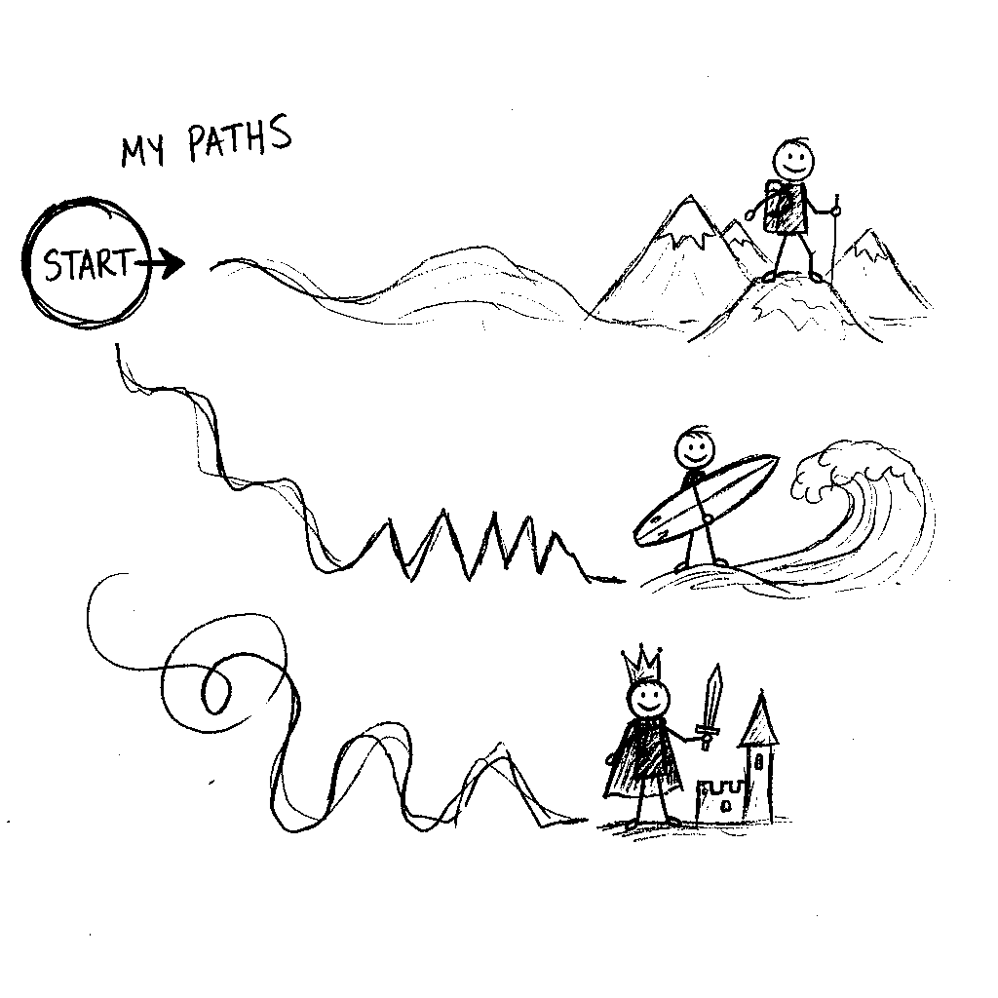
Intelligent Tutoring Systems (ITS)
AI Generated Image
Notes:
Key Takeaway: ITS deliver personalised, one-on-one instruction by relying on an integrated architecture of four key components: the Domain Model (what is taught), the Learner Model (who is learning, including successes and misconceptions), the Tutoring Model (how to teach), and the User Interface Model (interaction). The quality of instruction is directly determined by the sophistication of these underlying models, which collectively ensure that the system adjusts the pace, difficulty, and focus of lessons in real-time.
Analogy: Intelligent Tutoring Systems function much like an automated personal trainer at a gym. Just as the trainer analyzes your current fitness level, pace, and weaknesses (the Student Model), knows the curriculum of exercises (the Domain Model), and determines the optimal routine to challenge you without overwhelming you (the Tutoring Model), the ITS continuously adjusts the learning path to ensure instruction is both challenging and achievable, promoting deeper understanding.

Slide 4
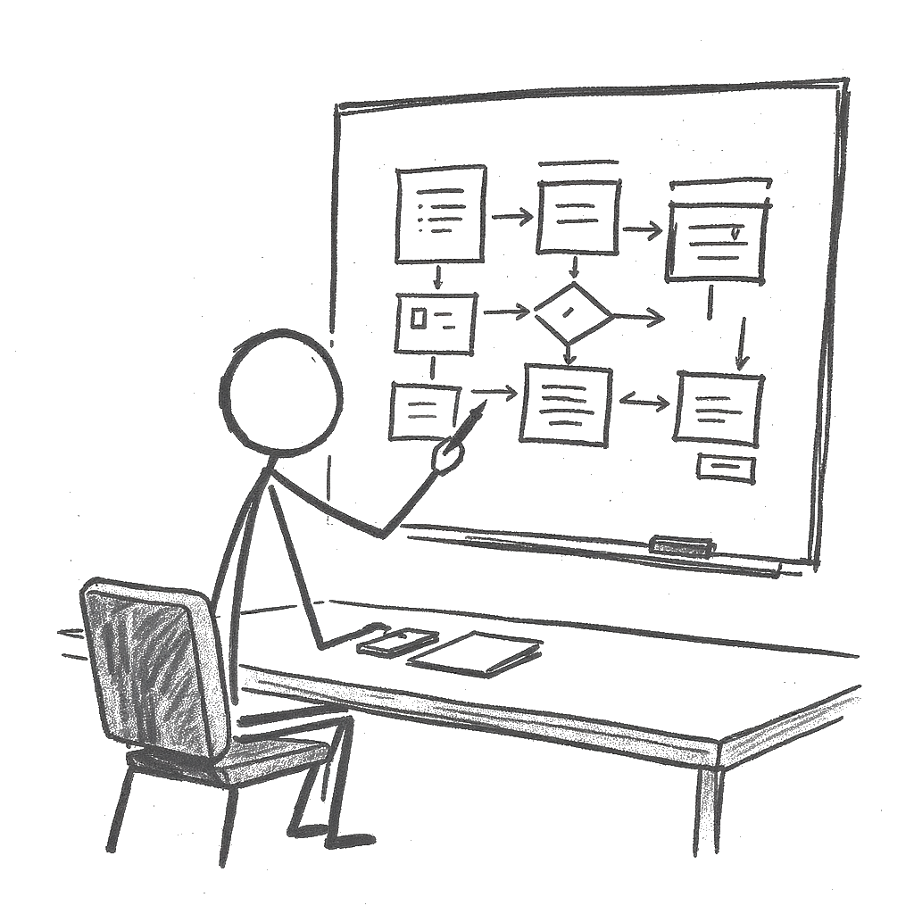
The Architect (Pedagogical Design)
AI Generated Image
Notes:
Key Takeaway: AI fundamentally transforms the pedagogical designer’s role from a manual content creator to a Strategic Architect by automating previously slow and tedious tasks, such as generating course outlines, assessments, and multimedia. This automation forces the designer to focus on high-level, human-centric design—creating flexible, dynamic frameworks and addressing emotional barriers to learning, rather than formatting slides or writing quiz questions.
Analogy: If traditional pedagogical design was like crafting a single, hand-built ship (a static course) that everyone had to sail on, the AI era redesigns the role of the architect. The new Pedagogical Architect now designs a complex, adaptive fleet where each ship (module) can adjust its sails, speed, and navigation (difficulty, pace, content) based on the real-time weather (student performance data), ensuring everyone reaches their destination, but along a personalised route. The architect’s most critical new job is ensuring the human crew (teachers and students) still communicate and build rapport, not just follow the automated navigation system.

Slide 5
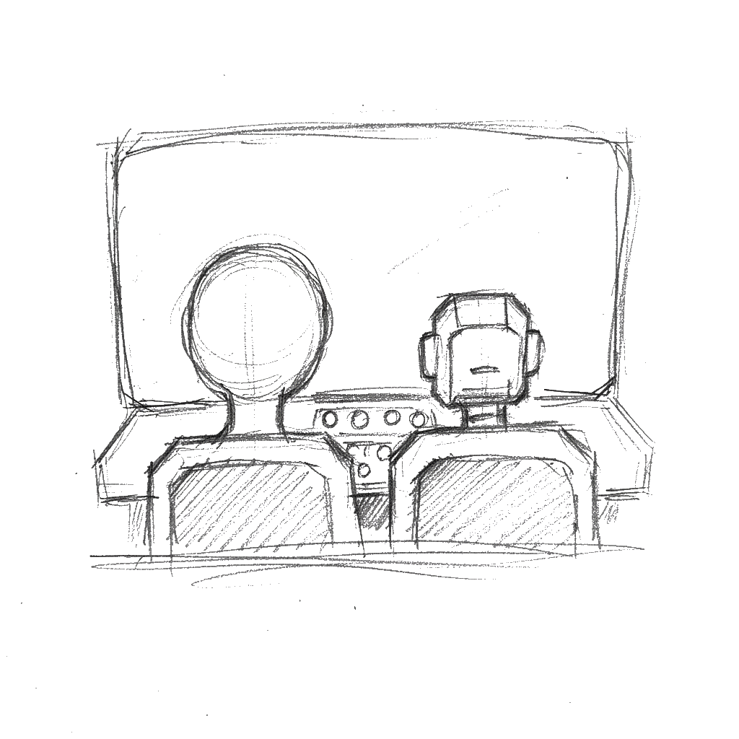
The Practitioner (Pedagogical Delivery)
AI Generated Image
Notes:
Key Takeaway: AI revolutionizes pedagogical delivery by collapsing the feedback loop and providing educators with real-time data insights into student progress, performance patterns, and cognitive states. This data-driven delivery allows the human teacher to transition into a “real-time interventionist,” enabling them to abandon content presentation to the “average” student and instead focus on targeted, high-value interventions based on immediate, actionable data. It can be viewed the impact of AI on pedagogical delivery not as a replacement for the teacher, but as an augmented reality for the classroom. AI handles the mechanics of instruction and data analysis, allowing the human practitioner to execute their craft with surgical precision, focusing their limited time on high-value, empathetic, and complex human interactions.
Analogy:. AI in the classroom functions as an AI Co-Pilot. The AI (co-pilot) handles the routine mechanics of flight (content delivery, system monitoring, and performance tracking), allowing the human pilot (the educator) to focus on complex navigation, communicating with the crew (students), and managing unexpected turbulence (misconceptions or emotional barriers) with surgical precision.

Slide 6
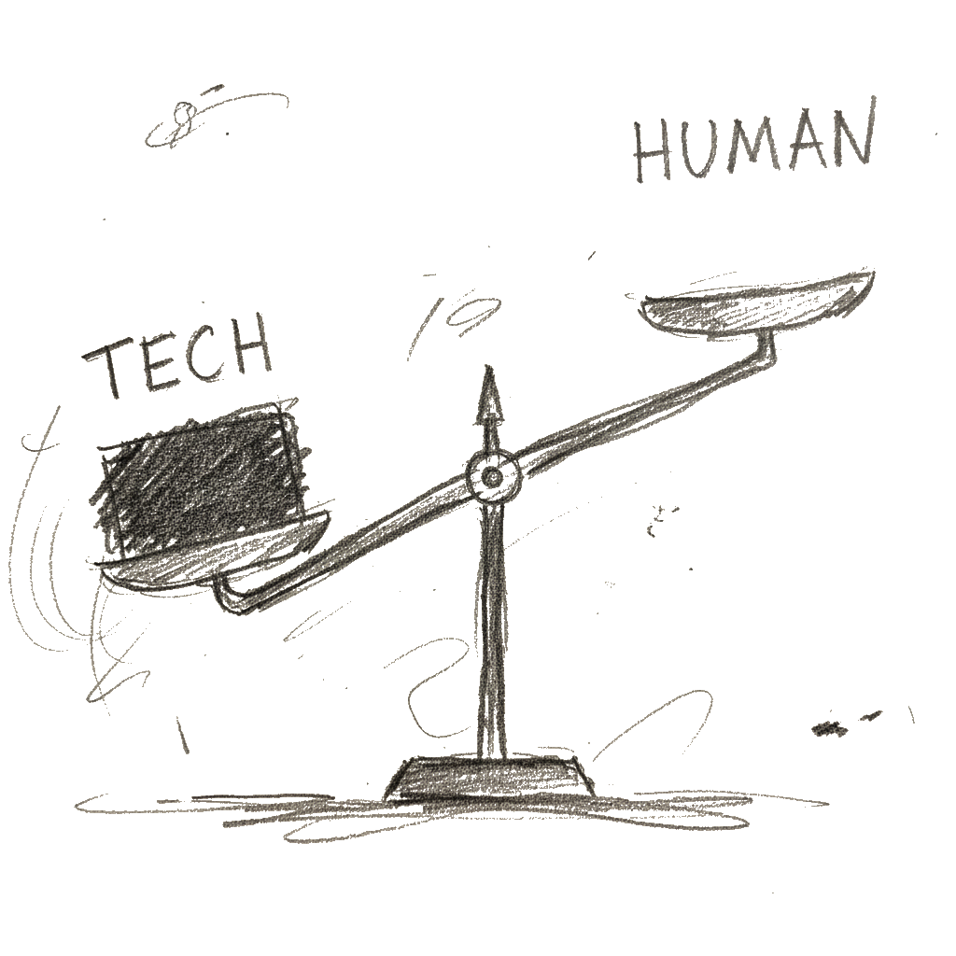
Challenges & Limitations
AI Generated Image
Notes:
Key Takeaway: Despite the technological promise, a critical challenge for AIED is the risk of eroding the human element and exacerbating educational inequity through algorithmic bias. Over-reliance on ITS and generative tools can reduce valuable face-to-face interactions, while studies show that students using AI sometimes feel less connected to their teachers (the “paradox of connection”). Furthermore, predictive models trained on historical data risk perpetuating existing biases against marginalized groups when allocating resources or flagging “at-risk” learners.
Recent work also highlights broader risks: generative AI can hallucinate plausible but incorrect information, enable large‑scale misinformation and deepfakes, and make it easier to circumvent traditional assessments if those tasks are easily automated. These are not reasons to ban AI outright, but reasons to redesign tasks and guardrails so that human judgement and process remain visible.
You can link this directly to Assessment 2030 and later activities:
“Assessment 2030 is essentially our institutional response to these challenges. Rather than pretending AI doesn’t exist, we redesign assessment and learning activities so that student thinking and judgement are what really matter. Activities 3–5 in this workshop are about giving you practical ways to do that.”
Analogy: Think of AIED as a new, highly efficient Automated Factory. While it produces learning materials at scale (efficiency), it risks creating a sterile, one-size-fits-all product that lacks the “human touch” (eroding connection). More dangerously, if the factory’s blueprints (the algorithm) have a flaw (bias), it doesn’t just create one bad product; it replicates that flaw thousands of times, perpetuating the inequity at scale.

Slide 7

The Evolving Role of the Educator
AI Generated Image
Notes:
Key Takeaway: The long-term impact of AI is a forced re-humanization of the educator’s role, where the practitioner is compelled to abandon the commoditized, technical tasks (which AI can perform) and focus on the Human Edge of AI. This means prioritizing empathy, creativity, strategic thinking, mentorship, and socio-emotional support—the unique human skills vital for holistic student development that AI fundamentally cannot replicate. Educators must also become proficient in interpreting AI data and developing ethical reasoning to guide responsible technology use.
Analogy: The integration of AI is like a Rising Tide. As the AI “tide” rises, it automates and submerges all the routine, technical “lowlands” of the job (grading, content delivery). This forces the educator to move to the “high ground”—the uniquely human skills of empathy, mentorship, and creative problem-solving that the tide cannot reach. Their value is no longer in the submerged tasks, but on this new, more human-centric high ground.

Slide 8
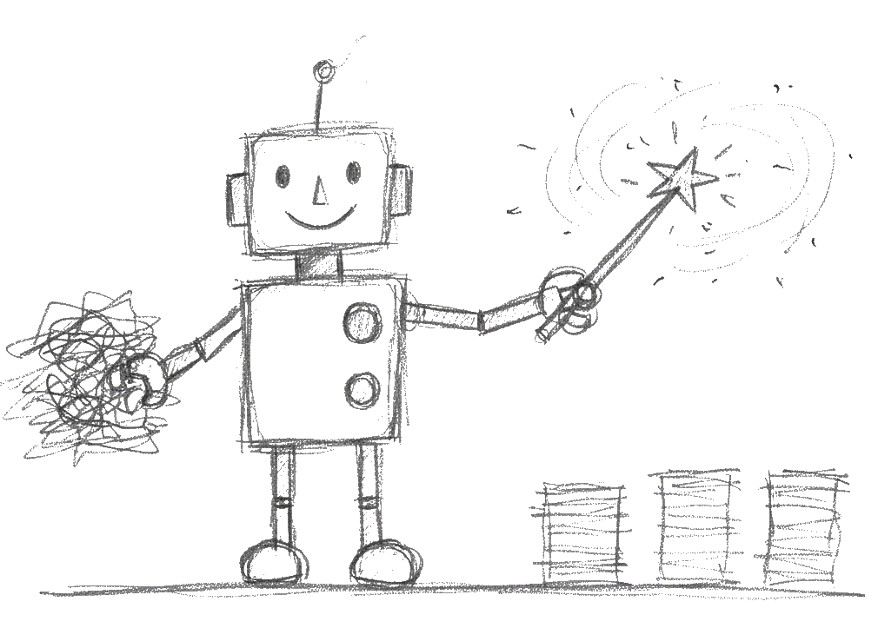
Activity 1: Automate the Tedious
AI Generated Image
Notes:
In Activity 1 you use AI as a summariser and re‑packager. You start from a real text (such as a reading excerpt, assignment brief or policy section), ask AI for a short, student‑friendly summary, then turn that summary into something useful: an LMS announcement, a two‑slide outline, or a short quiz.
The key idea is that AI can speed up routine drafting, but you still review and edit the output so it fits your unit, students and voice. For step‑by‑step prompts and variants for research and professional roles, see the handout ‘Activity 1 – Automate the Tedious’ and the ‘Quick Start Guide: AI in Education’.

Slide 9
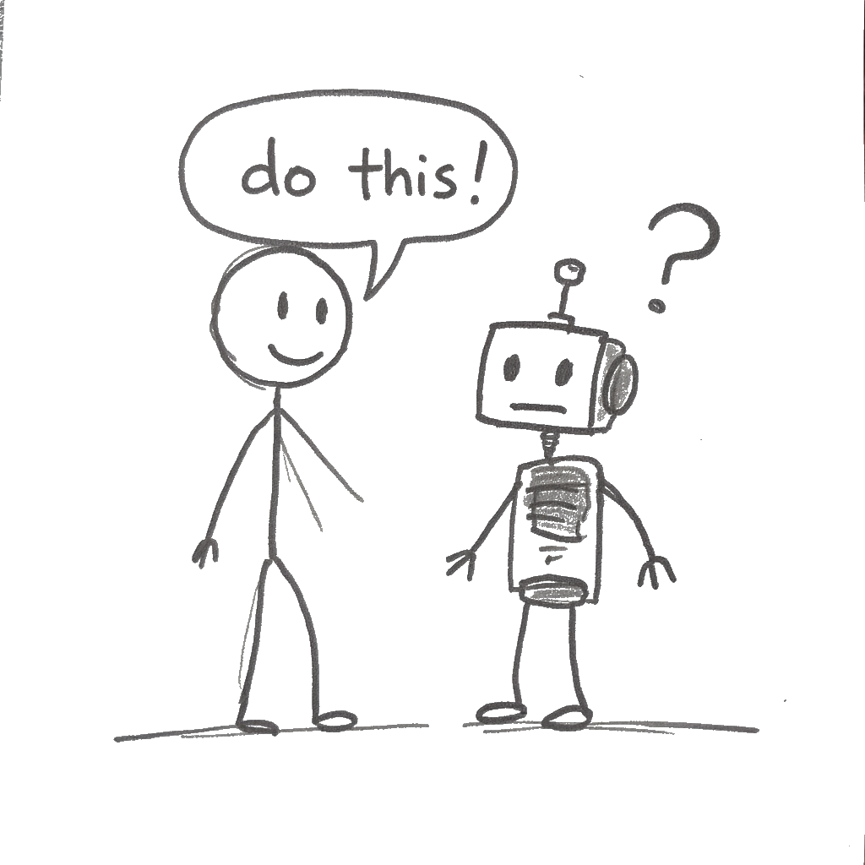
Activity 2: The Art of the Prompt
AI Generated Image
Notes:
Activity 2 is about improving how you ask AI for help. You take a vague prompt you actually used, then rewrite it using a simple structure: context, role, action, format and tone/constraints. Running both prompts side‑by‑side shows how much clearer, more relevant and more usable the structured output is.
This activity links directly to the C.R.A.F.T. approach to prompting. For worked examples and extra patterns (including feedback helpers and redesign prompts), see ‘Activity 2 – The Art of the Prompt’ and the ‘C.R.A.F.T. Prompting Framework’.

Slide 10
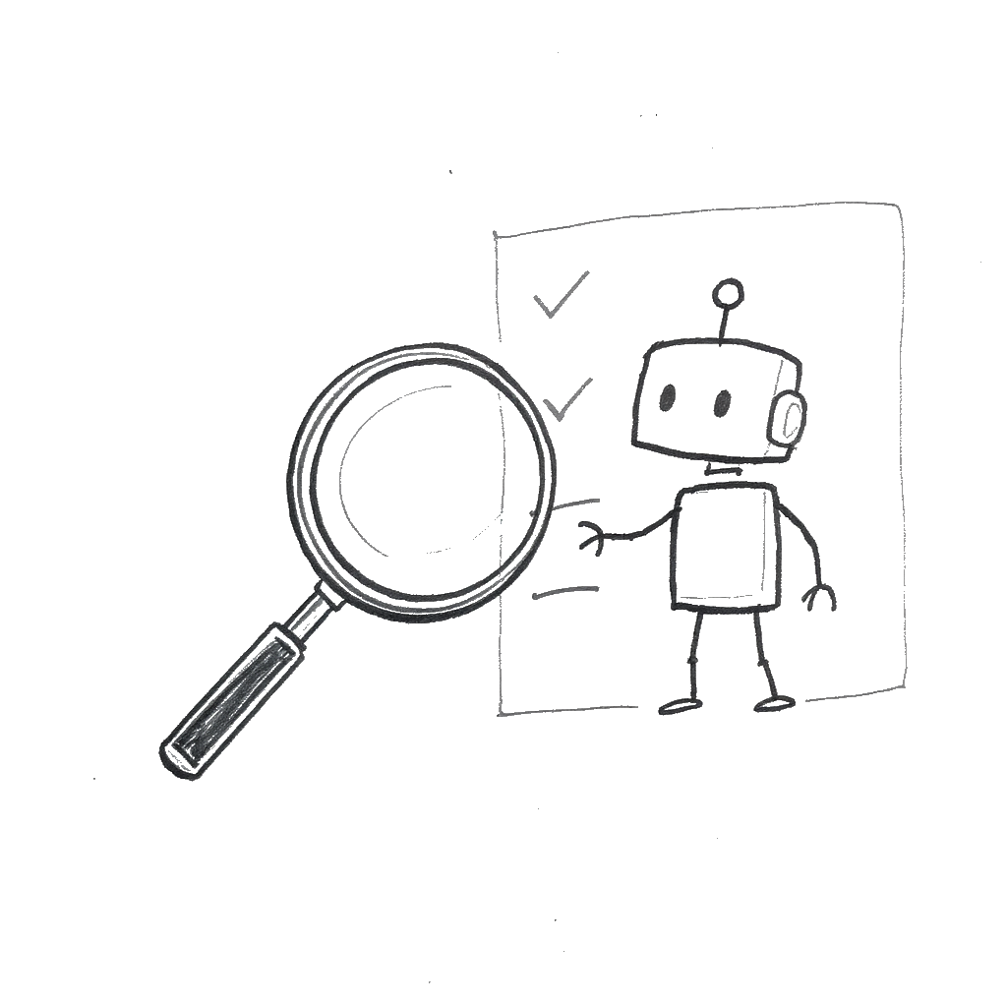
Activity 3: Your 5-Step Critique Framework
AI Generated Image
Notes:
In Activity 3 you learn a quick 5‑step critique for any AI output: Purpose, Plausibility, Evidence, Stakes, and Action. You apply it to something AI produced earlier (for example a summary, announcement, quiz or teaching idea) and record one strength and one concern for each step.
The goal is to decide whether to keep and lightly edit, re‑prompt in a new direction, or discard and start again. For a fuller explanation and templates you can reuse, see ‘Activity 3 – 5‑Step Critique Framework’, ‘Cognitive Prompting in Education’, and ‘AI Critique Toolkit – Becoming a Smart Business Professional’.

Slide 11
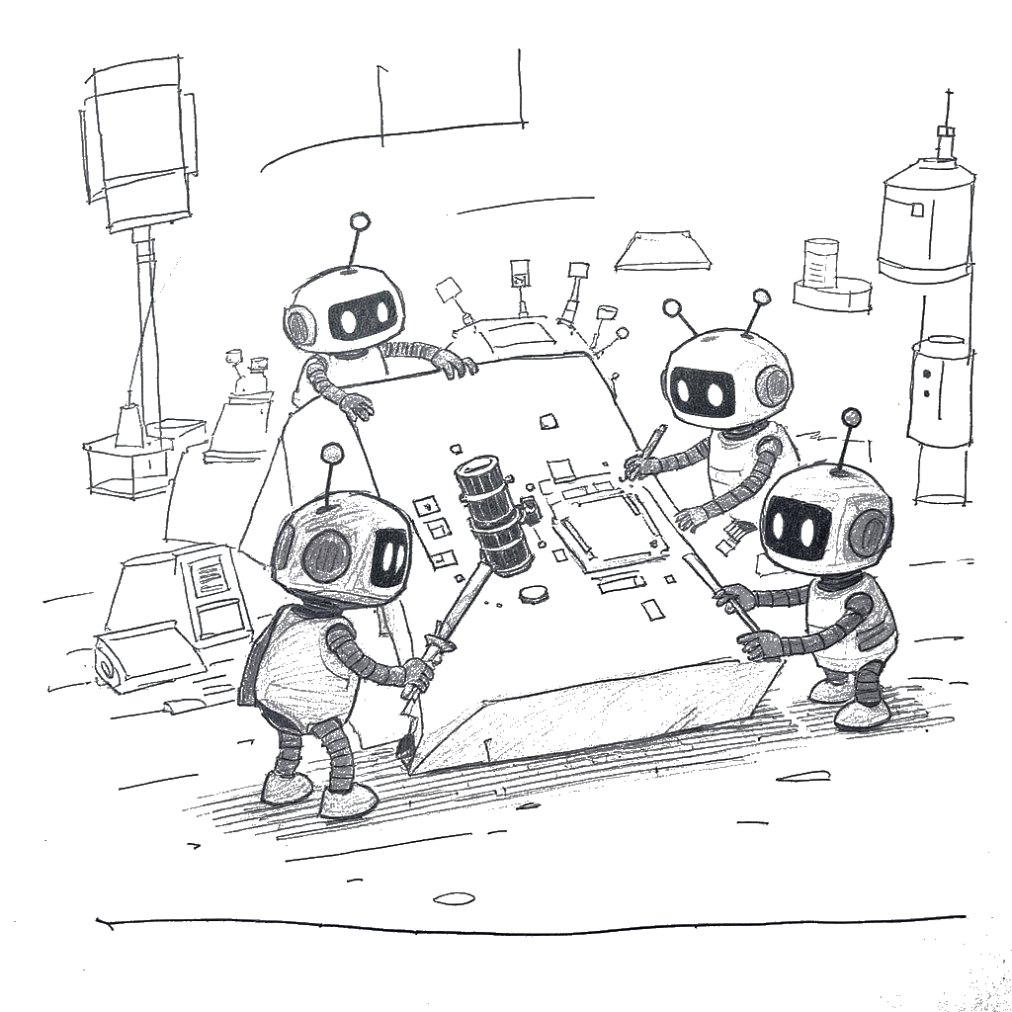
Activity 4: Unlocking The Impossible
AI Generated Image
Notes:
Activity 4 invites you to test how your assessment (or a similar task) behaves when AI is allowed. You first see how well AI can complete the task, then analyse where the response looks like a strong submission and where genuine student thinking or personal context is missing.
From there, you sketch small redesigns—such as adding an in‑class component, requiring an AI use log, or anchoring the task in local or personal examples—to make student judgement more visible while still allowing transparent, limited AI use. For detailed prompts and variants, see ‘Activity 4 – Unlocking the Impossible’ and the overview ‘AI in Pedagogical Design and Delivery’.

Slide 12
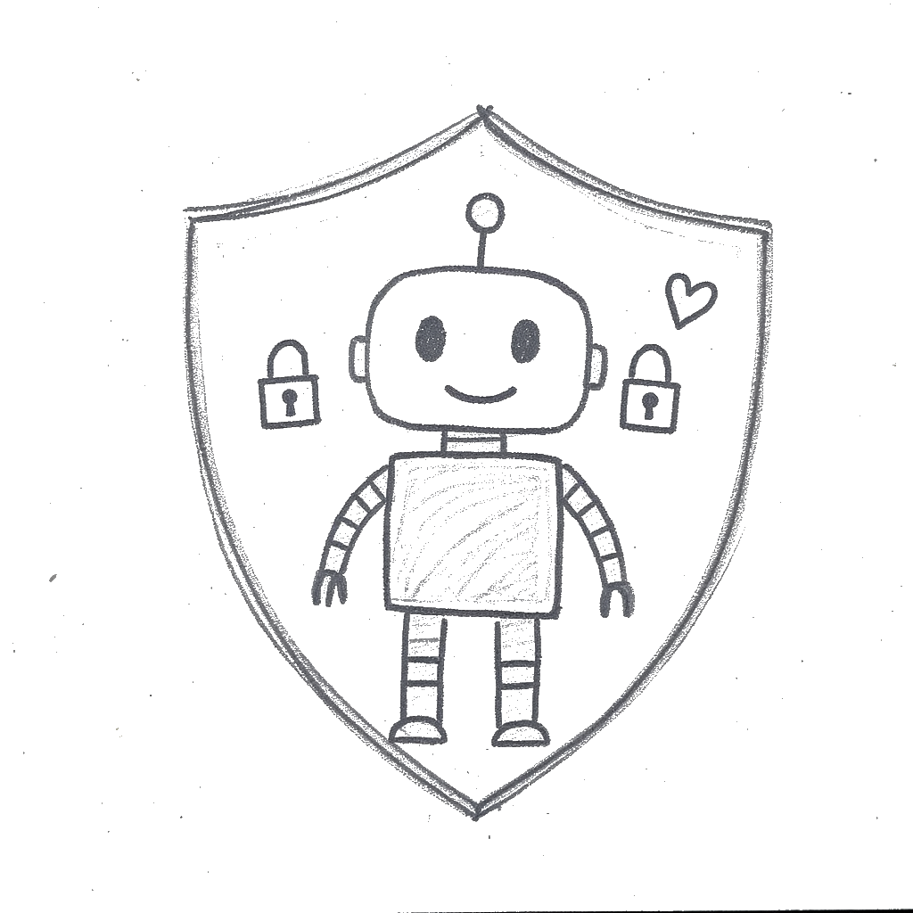
Activity 5: Secure, Safe, and Sustainable AI
AI Generated Image
Notes:
Activity 5 is about choosing one small, concrete next step for secure, safe and sustainable AI use in your own context. You might draft a short guideline for AI use in your unit or team, run a quick risk–benefit check on one planned AI use, or write a Week 1 statement you could say to students or colleagues.
The emphasis is on clear expectations, transparency, and keeping human judgement central, rather than banning AI or outsourcing decisions to tools like Copilot or Turnitin Clarity. For example prompts and micro‑tasks that you can adapt after the workshop, see ‘Activity 5 – Secure, Safe, and Sustainable AI’, ‘Ethics, Data Governance & Integrity’, and ‘Using AI in Education: Roles for Teaching & Research’. For framing broader AI risk, Black Swans and Grey Swans, see ‘Black & Grey Swans in AI’.

Slide 13
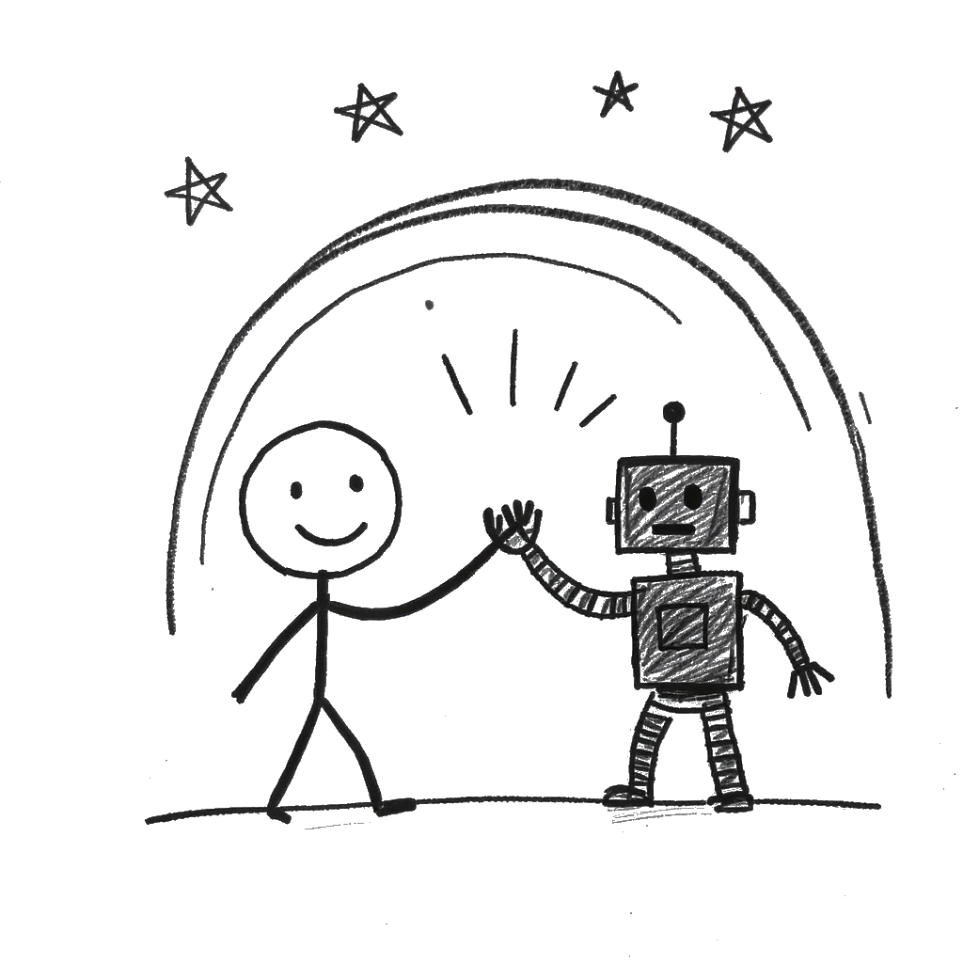
Wrap-Up & Next Steps
AI Generated Image
Notes:
Recap the journey very briefly: “We started by seeing how AI can automate tedious tasks and draft first versions for us. We then worked on designing better prompts, critiquing AI outputs, and finally stress‑testing our assessments and thinking about safe, sustainable use.”
Tie back to Assessment 2030 and your stance: “All of that sits inside the Assessment 2030 idea: we’re not trying to ban AI, and we’re not blindly embracing it. We’re redesigning assessment and teaching so that student judgement, process, and human skills are what really matter.”
Reinforce the human edge: “As more routine writing and summarising gets automated, the value of what only we can do – empathy, feedback, facilitation, contextual judgement – actually goes up. AI is the infrastructure; our job is to design how it supports learning, not replaces it.”
Point to next steps and resources: “If you want to keep experimenting, the companion website has the handouts, prompt frameworks, and references we’ve touched on today. You can pick one activity and try it in a small way in your own unit or team.”
Pause for questions (no dedicated Q&A slide): “I’ll pause here – what questions, worries, or ideas are bubbling up for you? They can be about the tools, the activities, or how this fits with Assessment 2030 in your own context.”
“If things come to you later, feel free to grab me in the corridor, drop me a message, or send through a sample assessment you’d like to stress‑test. I’m very happy to keep working on this with you.”

Slide 14
Reference (short) | Main slide(s) / themes
Bloom (1984) – 2 Sigma Problem | Welcome & AI Landscape (1‑to‑1 tutoring vs classroom; what we’re trying to approximate).
Sal Khan TED (2023) – How AI Could Save (Not Destroy) Education | Welcome (idea of AI tutor for every student, AI assistant for every teacher).
Noroozi et al. (2025) | Practitioner (human agency, real‑time intervention); Challenges & Limitations; Evolving Role of the Educator.
Pireci Sejdiu & Sejdiu (2025) | Architect & Practitioner (quiet transformation of HE); Evolving Role of the Educator.
Park University (2025) | Intelligent Tutoring Systems (overview of ITS and benefits).
Li et al. (2025); Budiman et al. (2025); Kwak (2025); Chen (2025) | ITS & Practitioner slides (evidence that AI‑mediated teaching can improve outcomes).
Rojas (2025) | Architect slide (instructional design in the AI era); Evolving Role of the Educator.
Dwivedi et al. (2023) | Challenges & Limitations (opportunities vs misuse, integrity, policy gaps).
Gerlich (2025); Kosmyna et al. (2025) | Challenges & Activity 3 (cognitive offloading / cognitive debt in AI‑assisted work).
Yin et al. (2025); EDUCAUSE (2025); TEQSA (2025); Russell Group (2023) | Challenges & Activity 5 (fairness, bias, ethics, institutional guidelines and guardrails).
Notes:
This slide links key readings to the main ideas in the workshop (for example Bloom’s work on tutoring, research on intelligent tutoring systems, and recent studies on AI in higher education, integrity and ethics).
If you want to explore the evidence base or cite work in your own teaching or research, see the ‘References’ document and the overview ‘AI in Pedagogical Design and Delivery’.

