Slide 1

From Manual to Magical
Hands-on Practice & Creating Your AI Research Agent Michael Borck

Slide 2
Welcome Back!
What We’ll Do:
Practice the workflow hands-on
Analyse real(istic) food science data
Create your own AI research agent
Level up your research game
What You Need:
Microsoft Copilot access
One of our datasets
Your curiosity!
A research topic in mind

Slide 3
Today’s Goal: By the end, you’ll confidently use AI for your own research projects!

Slide 4
System Check & Troubleshooting
Problem | Solution
“Response seems generic” | Add “Be specific” to prompts
“AI is confused” | Start new chat session
“Access denied” | Try incognito/private browsing
✅ Can you access:
Microsoft Copilot (copilot.microsoft.com)
File download capability
New chat sessions
Help available: Raise your hand anytime - we’ll have micro-breaks every 15 minutes!

Slide 5
Quick Recap: The 10-Step Workflow
Step | Task | Output
1 | Idea Generation | 5 hypotheses table
2 | Parallel Exploration | 10-15 total ideas
3 | Feasibility Testing | Experimental plan + data
4 | Optimisation | Best parameters
5 | Full Study | Complete methodology
6 | Component Analysis | Key factors identified
7 | Visualisation | Figures + captions
8 | Writing | Full paper draft
9 | Review | Feedback report
10 | Iteration | Refined manuscript
Today we’ll practice Steps 1-3 together, then learn to build systems to handle the rest!​

Slide 6
Let’s Get Started!
Step 1: Idea Generation
Everyone follow along:
Open Microsoft Copilot
Copy this prompt exactly:
"What are some food science research ideas?"

Slide 7
What Did You Notice? 🤔
Did Copilot generate hypotheses?
Were they all truly distinct?
How was the formatting?
Any surprising ideas?
Quality of the abstracts?

Slide 8
Introducing CRAFT: Better Prompts, Better Results
The Problem We Experienced
Vague outputs? Missing context.
Generic responses? No role assigned.
Wrong format? Didn’t specify what you wanted.

Slide 9
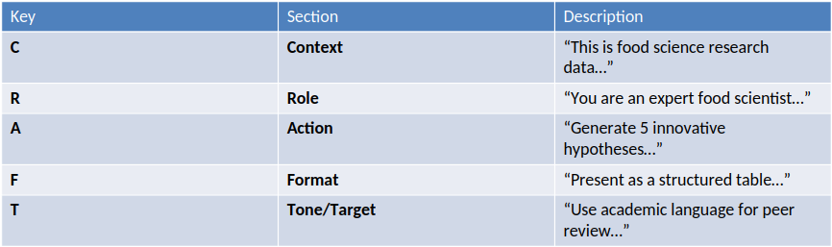
Introducing CRAFT: Better Prompts, Better Results
Try it now: Look at the earlier prompt. Which CRAFT elements were missing? How could you improve it?
Remember: CRAFT is your conversation starter, not your final answer. Follow up, refine, iterate!

Slide 10
CRAFT Analysis
❌ Before CRAFT (weak example):
"What are some food science research ideas?"
or
"Give me some research ideas about plant milk."
Missing:
Context: No research level, paper type, or constraints
Role: AI doesn’t know what expertise to use
Action: Vague “some ideas” vs. specific “5 hypotheses”
Format: No structure for output
Tone: Unclear if academic, industry, or casual

Slide 11
Let’s Get Started! (again!)
You are an AI research scientist specialising in Food Science. Given the following research area, generate 5 distinct and innovative scientific hypotheses suitable for a Masters-level research paper. For each hypothesis, include: - A clear Title - 3-5 Keywords - A short Abstract (under 200 words) - An explanation of its Novelty and Significance Research Area: "[YOUR TOPIC FROM HOMEWORK]"

Slide 12
What Did You Notice?
Share Your Observations
Did Copilot generate exactly 5 hypotheses?
Were they all truly distinct?
How was the formatting?
Any surprising ideas?
Quality of the abstracts?
Key Learning: Even with identical CRAFT structures, AI generates different outputs based on YOUR specific topic. This diversity is valuable!

Slide 13
✅ CRAFT Analysis of This Prompt:
Element | ✅/❌ | What’s There
Context | ✅ | “Given the following research area” + “Masters-level research paper”
Role | ✅ | “You are an AI research scientist specialising in Food Science”
Action | ✅ | “generate 5 distinct and innovative scientific hypotheses”
Format | ✅ | Detailed list: Title, Keywords, Abstract, Novelty explanation
Tone/Target | ✅ | “scientific hypotheses” + “Masters-level” = academic tone
Notes:
This is Actually a STRONG Prompt!
Why it works well:
Specific role: AI knows to think like a food science researcher
Clear task: Exactly 5 hypotheses, not vague “some ideas”
Detailed format: Structured output requirements
Appropriate level: Masters-level sets the complexity
Rich context: Specific research area provided

Slide 14
Did it work?
Success Check: ✅
Ideas are specific and detailed
Academic language throughout
Clear research questions
Red Flags: ❌
Vague or generic suggestions
Repetitive ideas
No specific methodology mentioned

Slide 15
Step 2: Scoring and Selection
Copy your hypotheses back into Copilot
Here are 5 research hypotheses I generated. Please score each from 1-10 on: - Originality (1=common, 10=groundbreaking) - Feasibility (1=impossible, 10=easily doable for Masters) - Potential Impact (1=minor contribution, 10=field-changing) Present as a table with total scores and recommend the top 3. Explain your reasoning for the scores. [PASTE YOUR 5 HYPOTHESES HERE]
Question: Which hypothesis scored highest? Do you agree with the AI’s reasoning?

Slide 16
Step 3: Feasibility Testing
Let’s Design an Experiment!
Select your top hypothesis and use this CRAFT prompt:
I have selected this hypothesis: [PASTE YOUR #1 HYPOTHESIS] Design a minimal, step-by-step experimental plan to test its basic feasibility. This should be a small-scale prototype, not a full study. Include: - Materials needed (be specific about equipment) - Step-by-step procedure (numbered list) - Expected measurements and units - Estimated timeline with milestones - Budget estimate (if possible) - Potential challenges and solutions After the plan, generate a small table of simulated data (5-10 rows) showing what results we might expect.

Slide 17
Success Metrics for Steps 1-3
Your outputs should have:
✅ Quality Indicators:
Specific numerical values
Clear timelines
Detailed procedures
Realistic resource needs
Academic language
❌ Warning Signs:
Vague instructions
Unrealistic timelines
Missing key details
Generic recommendations
No specific measurements

Slide 18
Quick Self Assessment
Quick Poll: How Are We Doing?
🟢 Green: My outputs are detailed and actionable
🟡 Yellow: Some good parts, some vague parts
🔴 Red: Most outputs are too generic
If you’re yellow/red: Try adding “Be more specific” to your prompts!

Slide 19
Working with Real Data (Optional Demo)
If You Have Data to Practice With…
For those who brought data or want to try our sample datasets:
Upload your CSV to Copilot
Ask basic questions about patterns and trends
Request simple visualisations
Generate interpretations

Slide 20
Sample CRAFT prompt for data:**
I've uploaded a food science dataset from [study type/context].
You are an experienced data analyst specialising in food research. Summarise the key findings and suggest 3 areas for deeper investigation that would be suitable for follow-up studies.
Present as bullet points suitable for a research meeting, with each point including a brief rationale.
Remember: Always verify AI interpretations of your data!

Slide 21
✅ CRAFT Analysis of This Prompt
Element | ✅/❌ | What’s There
Context | ✅ | “I’ve uploaded a dataset form [study/type]”
Role | ✅ | “You are an experienced food research data analyst”
Action | ✅ | “Summarise key findings and suggest 3 areas for deeper investigation”
Format | ✅ | “Present as bullet points”
Tone/Target | ✅ | “suitable for a research meeting and rationale” (professional/academic tone)
Notes:
Why This Works Well:
Clear context about the data type
Specific role that guides AI’s analytical approach
Dual action with exact quantity (3 areas)
Defined format (bullet points)
Audience-specific tone (research meeting = professional)

Slide 22
Building Your Research Process
From Manual Steps to Systematic Approach
What we just did manually:
Step 1: Generated ideas with specific prompts
Step 2: Evaluated and ranked systematically
Step 3: Designed feasibility studies
How to make this repeatable:
Save your successful prompts in a document
Create templates for your research area
Build prompt libraries for different tasks
Develop your personal workflow
The goal: Turn today’s manual process into your efficient research system

Slide 23
Advanced CRAFT Techniques
Beyond the Basics
Prompt Chaining:
“Generate 5 hypotheses about [topic]”
“Score the above hypotheses for feasibility”
“Design an experiment for the top-ranked hypothesis”
Role Switching:
“As a journal reviewer, critique this hypothesis”
“As an industry expert, assess commercial potential”
“As a student, explain this in simple terms”
Iterative Refinement:
“Make this more specific”
“Add industry applications”
“Consider budget constraints”
“Include potential risks”

Slide 24
Your Personal Prompt Library
Start Building Today
Essential Templates to Save:
Idea Generation:
You are an AI research scientist specialising in [FIELD]. Generate [NUMBER] innovative hypotheses for [LEVEL]-level research on [TOPIC]. Include title, keywords, abstract, and significance for each.
Literature Review:
You are an academic researcher. Summarise the current state of research on [TOPIC]. Identify 3 key gaps that warrant further investigation. Use academic tone suitable for peer review.
Methodology Design:
Design a [SCALE] experimental protocol to test [HYPOTHESIS]. Include materials, procedures, measurements, timeline, and expected challenges. Present as a structured research plan.

Slide 25
Quality Control and Verification
Your AI Safety Checklist
Always Check:
- ✅ Do the numbers make scientific sense?
- ✅ Are the methodologies appropriate for the question?
- ✅ Do timelines and budgets seem realistic?
- ✅ Are safety and ethical considerations included?
- ✅ Can you actually access the suggested equipment or materials?
Red Flags:
- ❌ Unusually perfect or round numbers
- ❌ Methodologies that seem too complex or too simple
- ❌ Missing safety protocols
- ❌ Unrealistic timelines or budgets
- ❌ Citations you can’t verify
When in doubt: Ask a follow-up question or consult with supervisors

Slide 26
Reflection Moment
What You’ve Accomplished Today
In 30 minutes of hands-on practice:
- ✅ Generated research hypotheses for YOUR topic
- ✅ Systematically evaluated and ranked ideas
- ✅ Designed feasibility studies
- ✅ Learned CRAFT framework for better prompts
- ✅ Built your personal prompt templates
Traditional Approach Time:
- Literature review to find gaps: 2-3 weeks
- Hypothesis development: 1-2 weeks
- Initial experimental design: 1 week
- Total: 4-6 weeks
But remember: AI accelerates the process - human expertise ensures quality and makes final decisions

Slide 27
Integration with Your Studies
This Week:
Apply the 3-step process to your current assignments
Build your prompt library with successful templates
Practice CRAFT framework on different topics
Share successes (and failures!) with classmates
This Month:
Use for literature reviews and research proposals
Apply to lab report writing and data interpretation
Integrate with thesis planning and development
Develop field-specific prompt variations
This Semester:
Build comprehensive research workflows
Create collaboration templates for group projects
Develop peer review and feedback processes

Slide 28
Best Practices for Long-term Success
Sustainable AI-Assisted Research
Do:
✅ Always verify AI outputs with peer-reviewed sources
✅ Keep humans central to all strategic decisions
✅ Document your processes for reproducibility
✅ Iterate and improve based on results
✅ Cite AI assistance appropriately in academic work
Don’t:
❌ Accept first outputs without refinement
❌ Use AI for final decisions without human judgment
❌ Skip verification of facts and figures
❌ Plagiarise or misrepresent AI-generated content
❌ Ignore institutional AI policies

Slide 29
Ethical Guidelines & Academic Integrity
Required Citation Example: “Research methodology development was assisted by Microsoft Copilot (Microsoft Corporation, 2024). All generated hypotheses and experimental designs were subsequently validated against peer-reviewed literature and refined through expert consultation.”
What to Always Cite:
✅ Hypothesis generation assistance
✅ Experimental design suggestions
✅ Data analysis approaches
✅ Writing structure and organisation
Institution-specific guidelines: Always check your university’s AI policy - requirements may vary!

Slide 30
Next Steps & Advanced Applications
Advanced Applications:
Multi-study research planning
Grant proposal development
Conference presentation creation
Peer review simulation
Research collaboration planning
Community Building: Consider forming study groups to share AI research techniques and improve workflows together

Slide 31
Can you?
✅ Use CRAFT framework to write effective research prompts
✅ Apply the 3-step workflow to any research topic
✅ Critically evaluate AI-generated research suggestions
✅ Build and maintain your personal prompt library
✅ Integrate AI tools with traditional research methods

Slide 32

Thank You!
You’re Now AI-Empowered Researchers!
Amplification, Not Replacement
You’re not replacing your scientific expertise you’re amplifying it with powerful AI tools that handle routine tasks so you can focus on creative thinking and critical analysis.

Slide 33
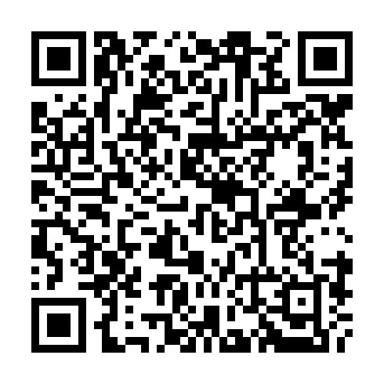
Resources & Links
Everything You Need
Presentation slides
All datasets
Audio version
Video explainer
Quick reference
Created with assistance from Claude (Anthropic)

