Slide 1
Manufacturing Downtime project
This data tracks Productivity & downtime data for a soda bottling production line, including information on the operator, product, start & end times, and downtime factors for each batch.
After examining the data we had four main questionnaires:
What's the current line efficiency? (total time / min time)
Are any operators underperforming?
What are the leading factors for downtime?
Do any operators struggle with particular types of operator error?
All these questions we have answered using the following slide which represent the insights to answer each question.

Slide 2
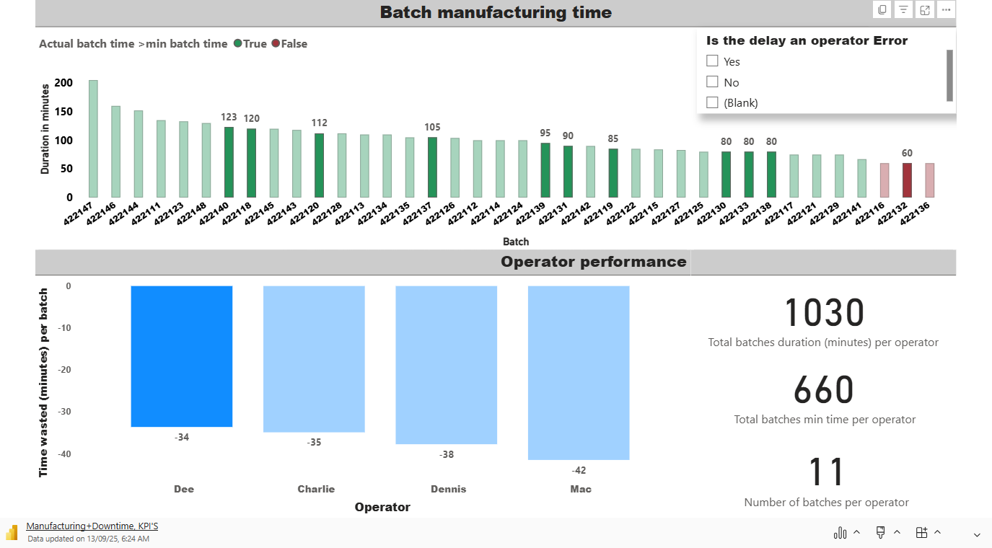

Slide 3
