Slide 1

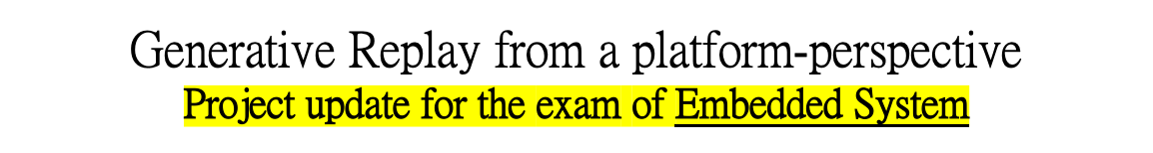
UNIVERSITÀ DEGLI STUDI DI TRENTO
Dipartimento di Ingegneria Industriale
Corso di Laurea Magistrale in Ingegneria Meccatronica
Studente:
Michael Bragagnolo, matr. 214207
Docente di corso:
Prof. Davide Brunelli
Anno accademico 2021 - 2022

Slide 2
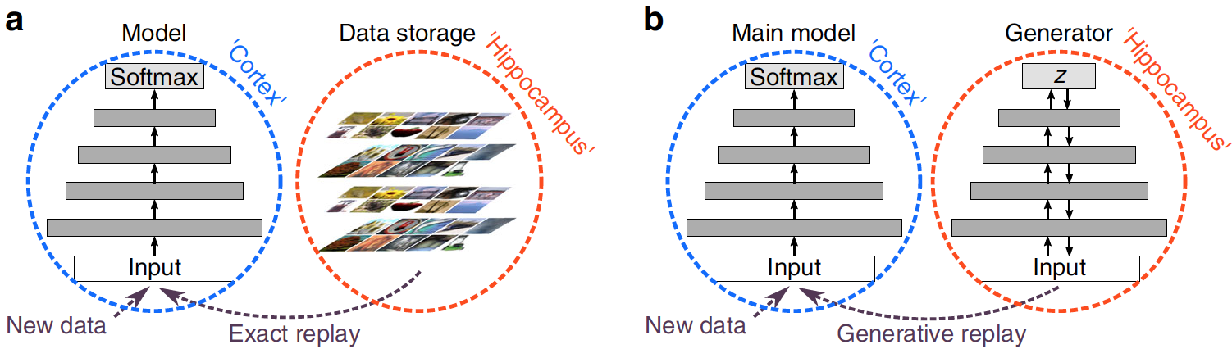
Project setup
The Generative Replay strategy implemented relies on the framework proposed by Shin et al., which consists of a main model for solving the tasks and a separate generative model trained to generate the data to be replayed.
Scripts are organized as follows:
  GenerativeModel.ipynb defines the VAE generative model of data;
  Generator.ipynb wraps the VAE generator in a trainable strategy, serves as simulative training of the generator for the Scholar model;
  TrainingInstances.ipynb creates the instances of the training strategies for the VAE generative model and Generative Replay;
  GenerativeReplay.ipynb implements the Continual Learning strategy of Deep Generative Replay.
Studente: Michael Bragagnolo
Anno accademico 2021 - 2022

Slide 3
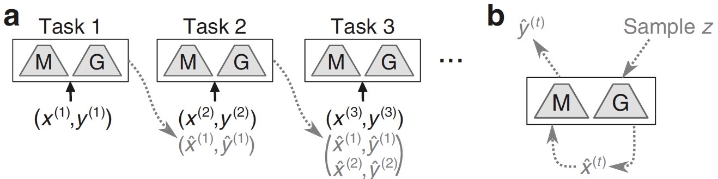
Strategy training and evaluation
Protocol for training ANN with generative replay:
The current minibatch of the strategy is updated before training an experience by:
sampling the generator;
concatenating the replay data to the current batch.
The file ideas.md includes the objectives to test and evaluate the Continual Learning strategy, together with some additional ideas to further develop the work.
The public Github repository contains all the reference materials and scripts.
Studente: Michael Bragagnolo
Anno accademico 2021 - 2022

Slide 4
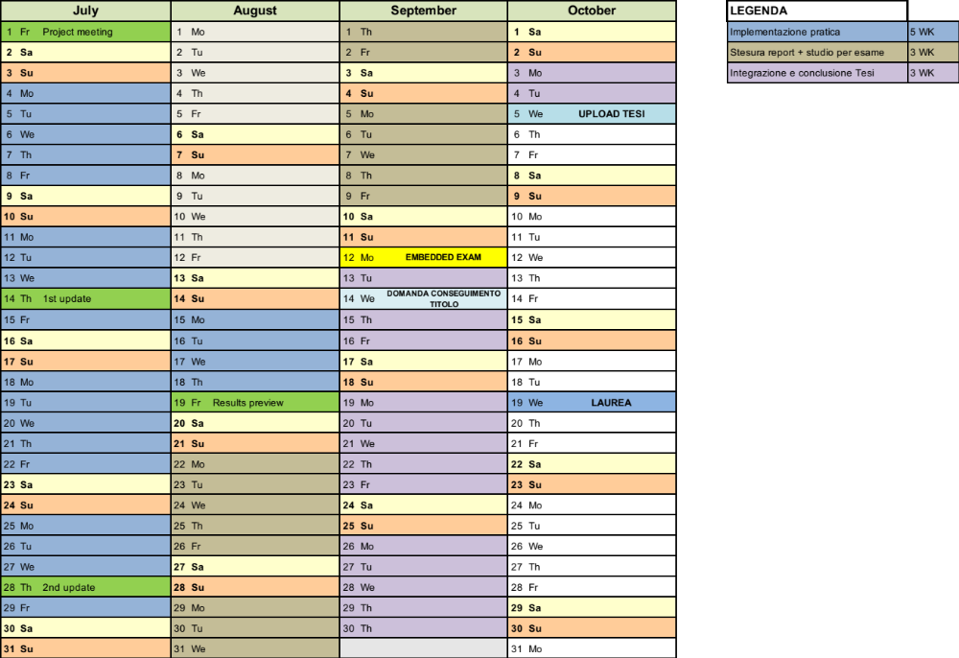
Gantt
Studente: Michael Bragagnolo
Anno accademico 2021 - 2022

Slide 5


