Slide 1

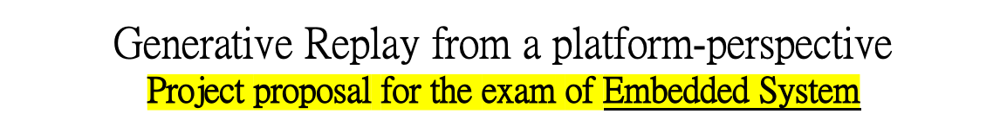
UNIVERSITÀ DEGLI STUDI DI TRENTO
Dipartimento di Ingegneria Industriale
Corso di Laurea Magistrale in Ingegneria Meccatronica
Studente:
Michael Bragagnolo, matr. 214207
Docente di corso:
Prof. Davide Brunelli
Anno accademico 2021 - 2022

Slide 2
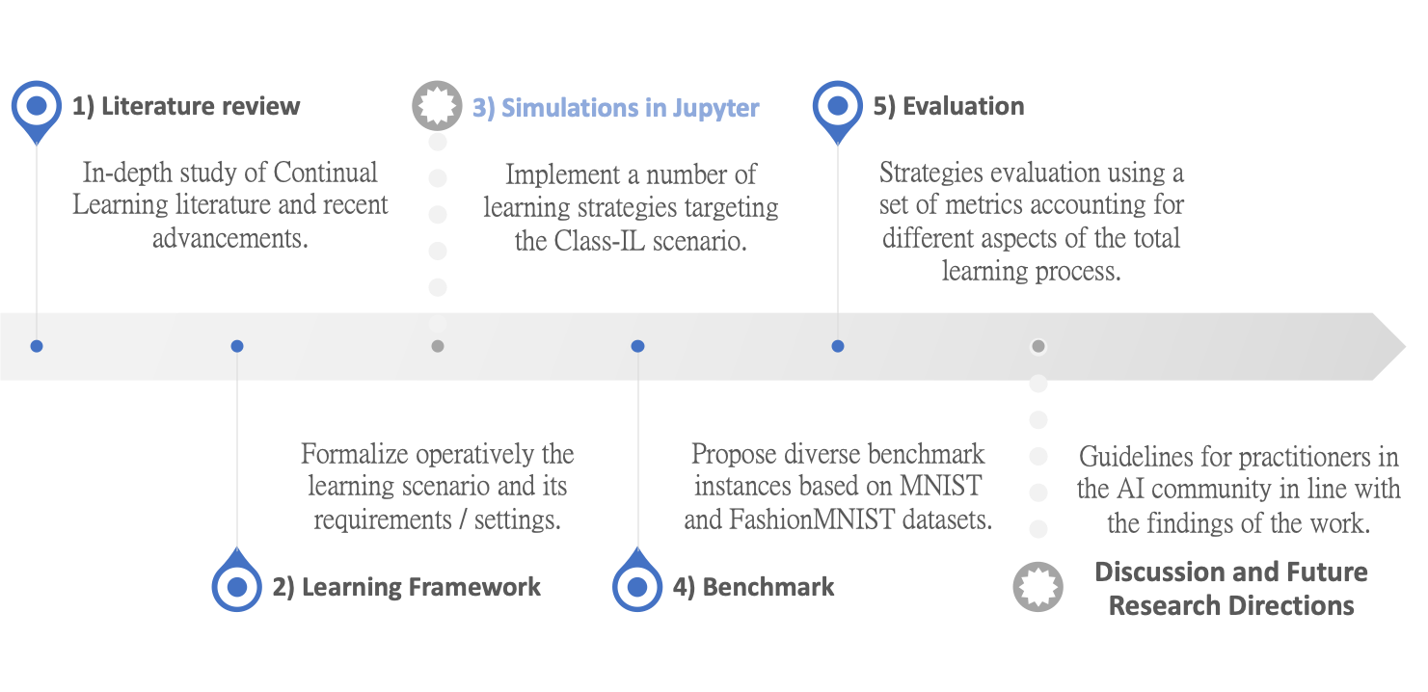

Thesis Milestones
The research and development project is organized as follows:
Studente: Michael Bragagnolo
Anno accademico 2021 - 2022

Slide 3
Project in two lines
The presented work aims at providing interesting improvements to replay and memory-based approaches that store past data to alleviate catastrophic forgetting, by performing extensive experimental evaluation on the novel framework of Generative Replay.
Replay has been shown to be an effective strategy in Continual Learning if performance is the main objective.
Although simply replaying previous data alleviates the problem..
  Data storage and replay may be not viable in real-world applications, where the access to past data is limited;
  Replay requires large working memory to store and replay past inputs, not a good efficiency-effectiveness trade-off;
  A definitive study of replay in deep continual learning is still missing.
Studente: Michael Bragagnolo
Anno accademico 2021 - 2022

Slide 4
Generative Replay
Recent evidence suggests that the hippocampus is more than a simple experience replay, but instead it is better paralleled with a generative model than a replay buffer.
The experimental part of this work addresses Generative Replay.
Episodic memory systems that store past data
  Recorded examples are regularly replayed with real samples drawn from the new task and network parameters are jointly optimized.
Generative Replay
  Key Idea : Instead of replay memory, why not generating examples?
  Train a NN without referring to past data;
  Train a generative model to mimic past data and later jointly optimize the network using an ensemble of generated past data and real current data;
  The quality of the generative model is the only constraint of the task performance;
      → Which generative model is the most suitable for Continual Learning?
  Good accuracy-memory-computation trade-offs are possible.
Studente: Michael Bragagnolo
Anno accademico 2021 - 2022

Slide 5
Resources
Generative Replay is quite a new topic in Continual Learning, very recent papers:
  Continual Learning with Deep Generative Replay (2017, https://arxiv.org/abs/1705.08690)
  Generative Models from the perspective of Continual Learning (2019, https://arxiv.org/abs/1812.09111)
  Brain-inspired replay for Continual Learning (2020, https://www.nature.com/articles/s41467-020-17866-2)
  An investigation of Replay-based approaches for Continual Learning (2021, https://arxiv.org/abs/2108.06758)
  An investigation of Generative Replay in deep reinforcement learning (2021, http://essay.utwente.nl/85772/)
  Generative Negative Replay for Continual Learning (2022, https://openreview.net/forum?id=MWQCPYSJRN)
New release of Avalanche v.0.2.0 supports Generative Replay!
https://avalanche.continualai.org/#cite-avalanche
GitHub repository: https://github.com/ContinualAI/avalanche
Good integration for the Master Thesis: Generative Replay on disjoint sequential image tasks.
Studente: Michael Bragagnolo
Anno accademico 2021 - 2022

Slide 6


