Slide 1

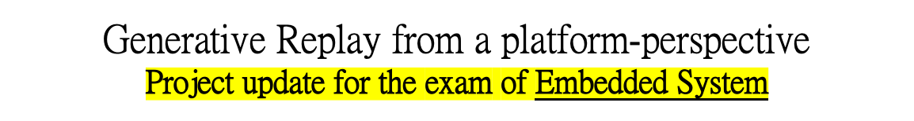
UNIVERSITÀ DEGLI STUDI DI TRENTO
Dipartimento di Ingegneria Industriale
Corso di Laurea Magistrale in Ingegneria Meccatronica
Studente:
Michael Bragagnolo, matr. 214207
Docente di corso:
Prof. Davide Brunelli
Anno accademico 2021 - 2022

Slide 2
Project in two lines
The presented work aims at providing interesting improvements to replay and memory-based approaches that store past data to alleviate catastrophic forgetting, by performing extensive experimental evaluation on the novel framework of Generative Replay.
Episodic memory systems that store past data
  Recorded examples are regularly replayed with real samples drawn from the new task and network parameters are jointly optimized.
Generative Replay
  Key Idea : Instead of replay memory, why not generating examples?
  Train a NN without referring to past data;
  Train a generative model to mimic past data and later jointly optimize the network using an ensemble of generated past data and real current data;
  The quality of the generative model is the only constraint of the task performance;
  Good accuracy-memory-computation trade-offs are possible.
Studente: Michael Bragagnolo
Anno accademico 2021 - 2022

Slide 3
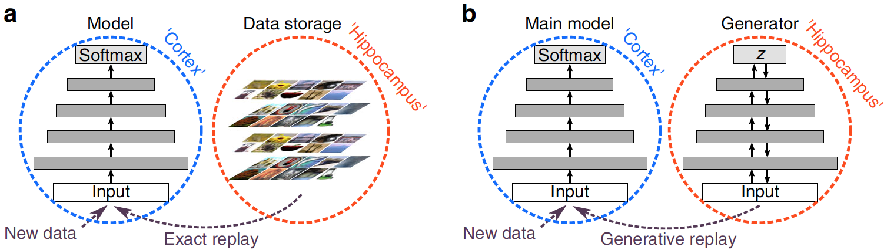
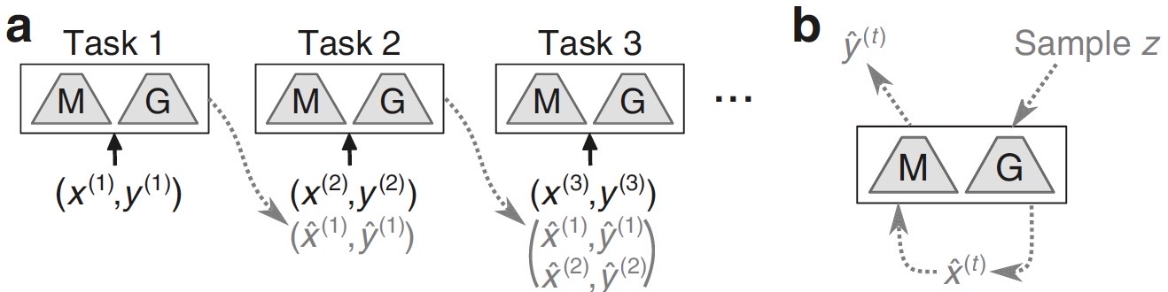
Generative Replay
For the implementation of Generative Replay, the general framework consists of:
  Main model for solving the tasks (i.e., a classifier);
  A separate generative model trained to generate the data to be replayed.
Protocol for training ANN with generative replay:
Model and Generator are trained normally;
Trained models produce the samples to be replayed;
Generated samples are replayed with the data of the current task;
Both models are trained further on the dataset.
Studente: Michael Bragagnolo
Anno accademico 2021 - 2022

Slide 4
Metrics of evaluation
The computational and memory requirements of the continual learning algorithm with generative replay are evaluated on a MCU-class architecture perspective.
Accuracy-latency-memory trade-offs are evaluated based on the chosen system architecture.
The contributions of the work are:
  Revisit the use of replay as a tool for continual learning in ANNs. The focus is on generating the data to be replayed with a generative model of past observations;
  Evaluate the computational and memory requirements of a CL algorithm with generative replay in a MCU-class architecture perspective.
Studente: Michael Bragagnolo
Anno accademico 2021 - 2022

Slide 5
Repository
The public Github repository is intended to keep track of the work and contains all the reference materials and scripts developed in this respect.
All the code is based on the Avalanche framework and is publicy available.
The script ideas.md includes some ideas for testing and improvement of the Continual Learning strategy.
Reference:
  https://github.com/michaelbragagnolo/EmbeddedProject
Studente: Michael Bragagnolo
Anno accademico 2021 - 2022

Slide 6
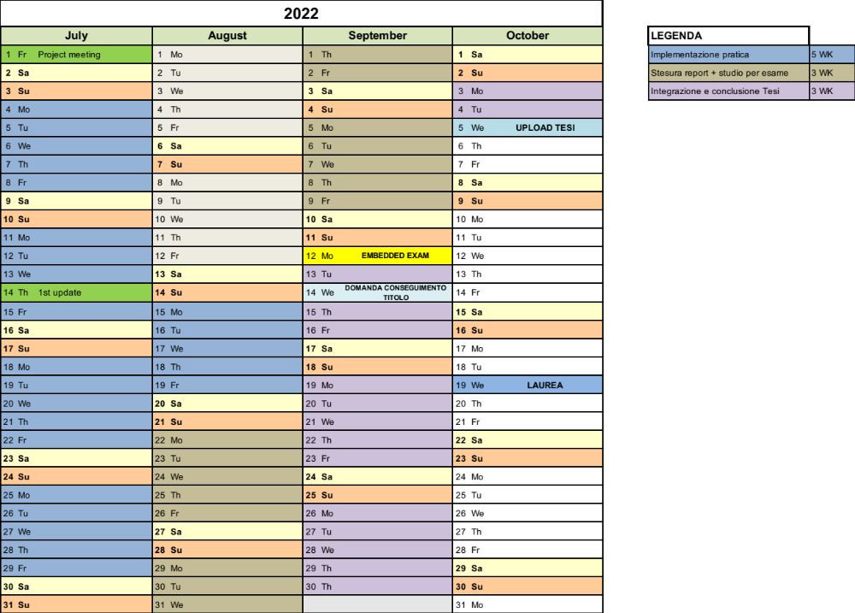
Gantt
Studente: Michael Bragagnolo
Anno accademico 2021 - 2022

Slide 7


