Slide 1

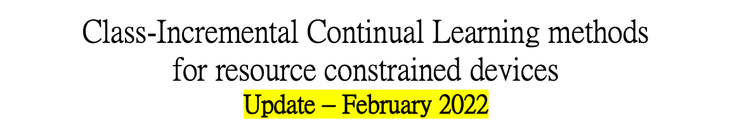
UNIVERSITÀ DEGLI STUDI DI TRENTO
Dipartimento di Ingegneria Industriale
Corso di Laurea Magistrale in Ingegneria Meccatronica
Studente:
Michael Bragagnolo, matr. 214207
Relatore:
Prof. Brunelli Davide
Anno accademico 2021 - 2022

Slide 2
Introduction
Comprehensive research that compares the performance of different continuos learning algorithms on small images dataset for tinyML applications involving on-device, low-power image recognition and classification, and investigates (in a simulated scenario) the trade-offs between performance, storage, computational costs and memory footprint.
Main references
Avalanche library for Continual Learning
https://arxiv.org/abs/2104.00405
Online Continual Learning in Image Classification
https://arxiv.org/abs/2101.10423
Performance of Continual Learning for Embedded sensing applications
https://arxiv.org/abs/2110.13290
Continual Learning at the edge: Real-time training of smartphone devices
https://arxiv.org/abs/2105.13127
Studente: Michael Bragagnolo
Anno accademico 2020 - 2021

Slide 3
Project in two lines
In consequence of the catastrophic forgetting problem, enabling deep learning models to train continuously is extremely difficult in practice.
Many approaches have been proposed but most of the existing CL techniques do not take into account the resource requirements, so it's unsure if they'd work in severly resource constrained devices, such as embedded systems.
For these reasons, to further investigate whether an approach could be relevant to resource-constrained devices, I'll start from the findings discussed in the underlying papers and, as main part of the work, try to complete a comprehensive survey and simulated comparison of these state of the art algorithms.
Studente: Michael Bragagnolo
Anno accademico 2020 - 2021

Slide 4

Avalanche library for CL
Ref: https://github.com/ContinualAI/avalanche
Avalanche is an End-to-End Continual Learning Library based on PyTorch born within ContinualAI with the unique goal of providing a shared and collaborative open-source (MIT licensed) codebase for fast prototyping, training and reproducible evaluation of continual learning algorithms.
Library is organized in five main modules:
Benchmarks
Data handling, mostly generating a stream of data from one or more datasets, it contains all the major CL benchmarks.
Training
  Provides all the necessary utilities concerning model training.
Evaluation
  Provides all the utilities and metrics that can help evaluate a CL algorithm with respect to all factors considered to be important for a continually learning system.
Models
  Several model architectures and pre-trained models.
Logging
  Advanced logging and plotting features, tracking the experiment metrics in real time
Studente: Michael Bragagnolo
Anno accademico 2020 - 2021

Slide 5
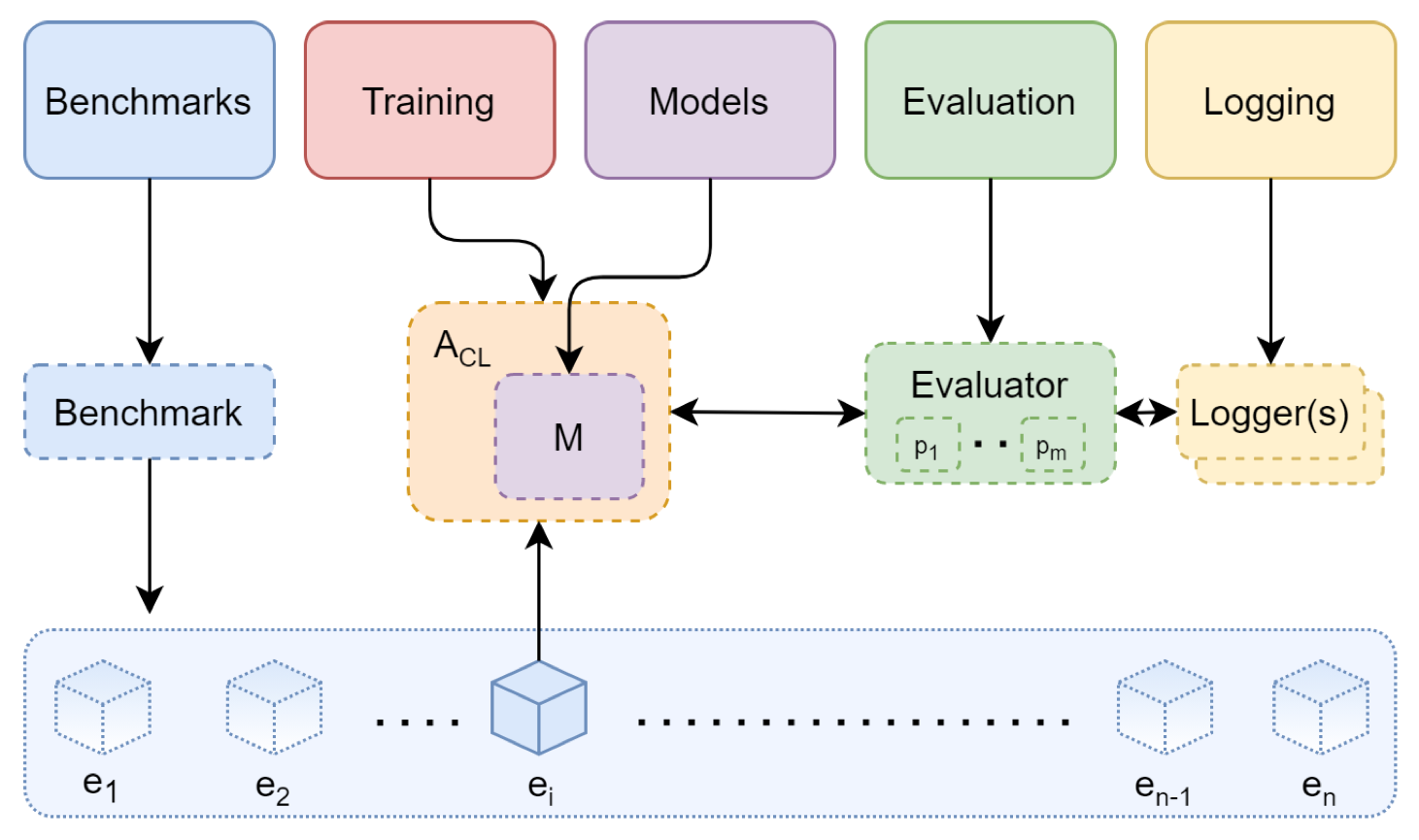
Avalanche library for CL
Studente: Michael Bragagnolo
Anno accademico 2020 - 2021

Slide 6

Research objectives
This thesis contributes to the study of different Continual Learning algorithms, focused on continual supervised learning for vision tasks, that could best suit resource-constrained devices.
Through the development of some simulated experiments, the goal is to better understand the specific configuration needed to achieve optimal results in resource-constrained devices, which means in turn to play with different hyper-parameters and such.
Studente: Michael Bragagnolo
Anno accademico 2020 - 2021

Slide 7
Research methods
ACTION PLAN
1. EXPERIMENT
The very first step of this thesis-project is to provide a set of experiments validating and reproducing existing works in continual learning. To guarantee fair implementations, I rely on the Avalanche library, developed and maintained by ContinualAI.
A critical design objective is to allow experimental results to be seamlessly reproduced; Continual Learning algorithms today are often designed and implemented from scratch with different assumptions, settings, and benchmarks that make them difficult to compare among each other or even port to slightly different contexts.
Studente: Michael Bragagnolo
Anno accademico 2020 - 2021

Slide 8
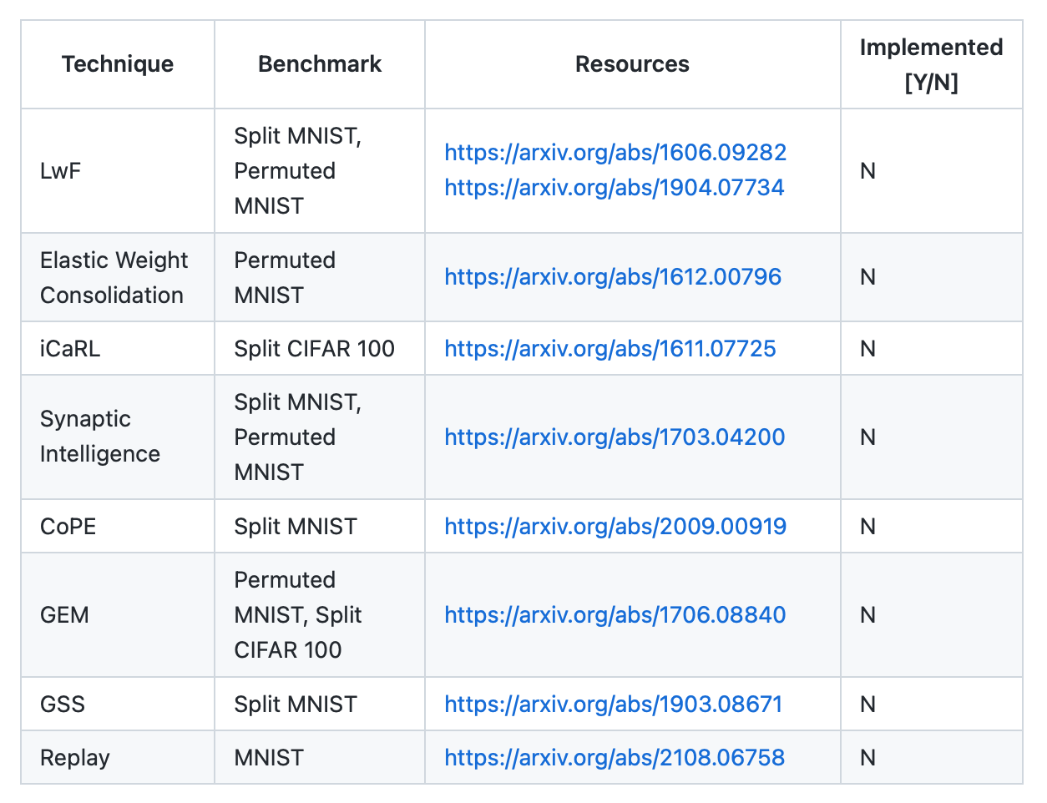
Research methods
Here I propose a list of experiments based on some of the most popular, yet interesting, CL techniques inspired by the state of the art.
Studente: Michael Bragagnolo
Anno accademico 2020 - 2021

Slide 9
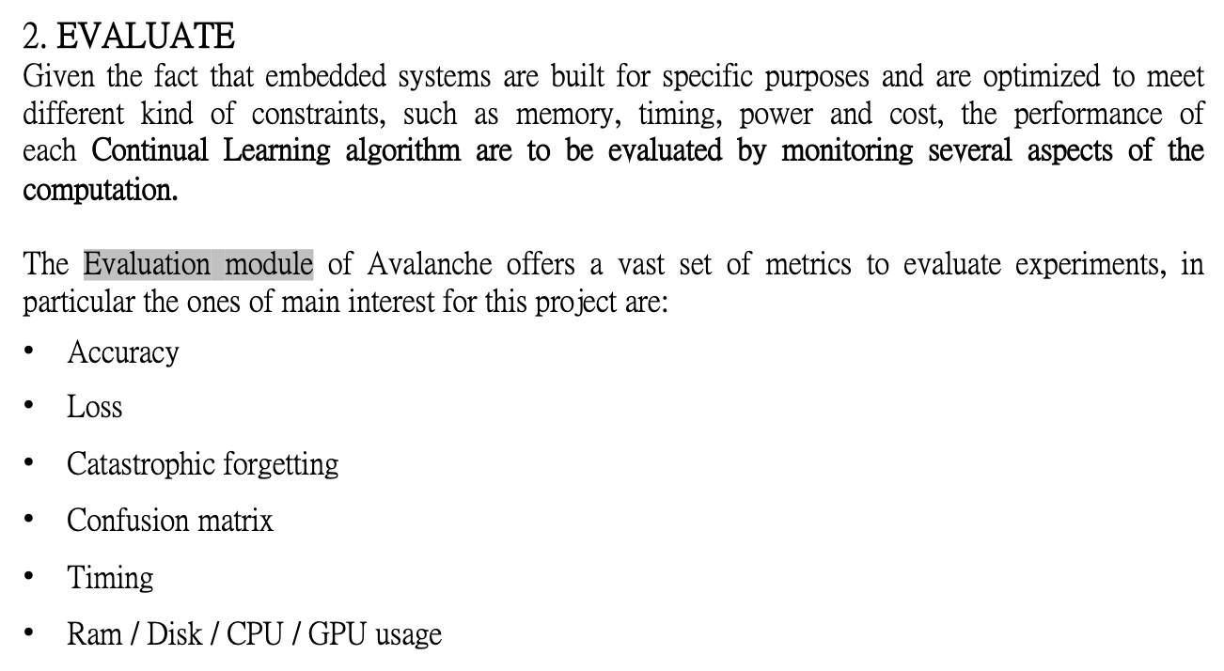
Research methods
Studente: Michael Bragagnolo
Anno accademico 2020 - 2021

Slide 10
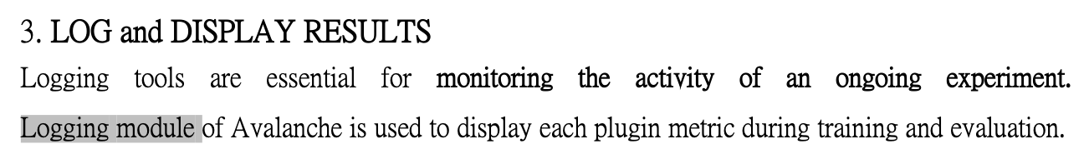
Research methods
Studente: Michael Bragagnolo
Anno accademico 2020 - 2021

Slide 11
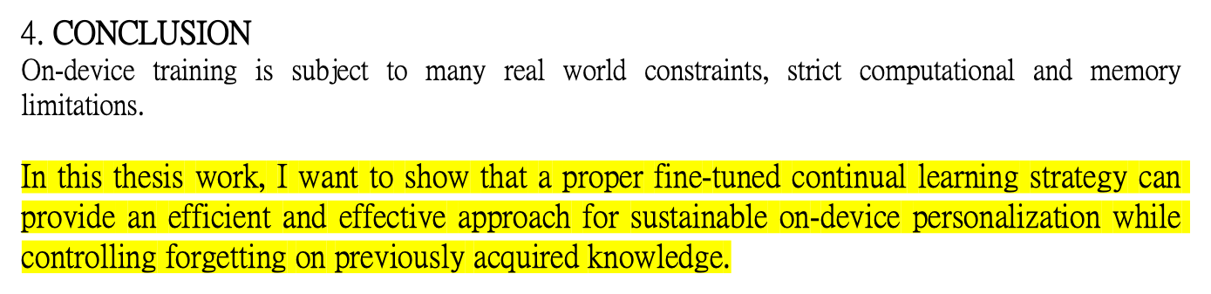
Research methods
Studente: Michael Bragagnolo
Anno accademico 2020 - 2021

