Slide 1

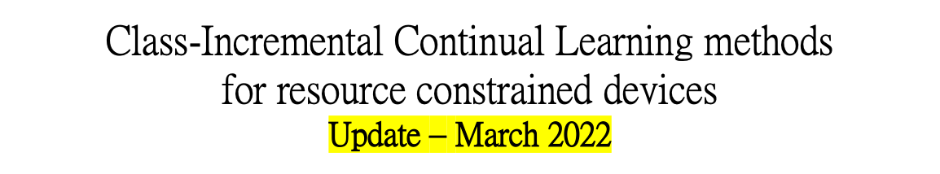
UNIVERSITÀ DEGLI STUDI DI TRENTO
Dipartimento di Ingegneria Industriale
Corso di Laurea Magistrale in Ingegneria Meccatronica
Studente:
Michael Bragagnolo, matr. 214207
Relatore:
Prof. Brunelli Davide
Anno accademico 2021 - 2022

Slide 2
Project in two lines
This thesis contributes to the study of different Class-Incremental Continual Learning algorithms that could best suit resource-constrained devices.
In consequence of the catastrophic forgetting problem, enabling NN models to train continuously is extremely difficult in practice.
Many approaches have been proposed but most of the existing CL techniques do not take into account the resource requirements, so it's unsure if they would work in severly resource constrained devices, such as embedded systems.
Studente: Michael Bragagnolo
Anno accademico 2021 - 2022

Slide 3

Objectives
Comprehensive research that compares the performance of different Continuous Learning algorithms on small images dataset for tinyML applications involving on-device, low-power image recognition and classification, and investigates (in a simulated scenario) the trade-offs between performance, storage, computational costs and memory footprint.
Strategies implementation relies on Avalanche, an End-to-End Continual Learning Library based on PyTorch, born within ContinualAI with the goal of providing a shared and collaborative open-source (MIT licensed) codebase for fast prototyping, training and reproducible evaluation of continual learning algorithms.
Ref: https://github.com/ContinualAI/avalanche
Studente: Michael Bragagnolo
Anno accademico 2021 - 2022

Slide 4
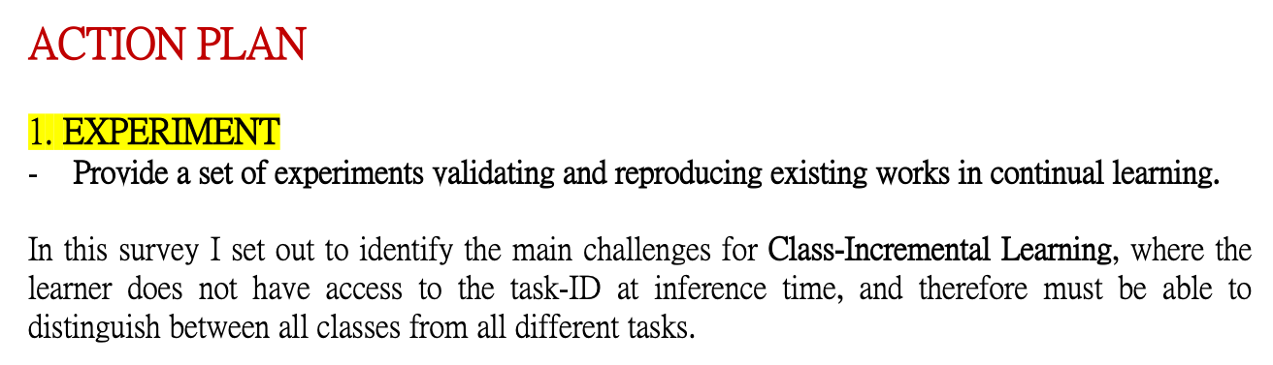
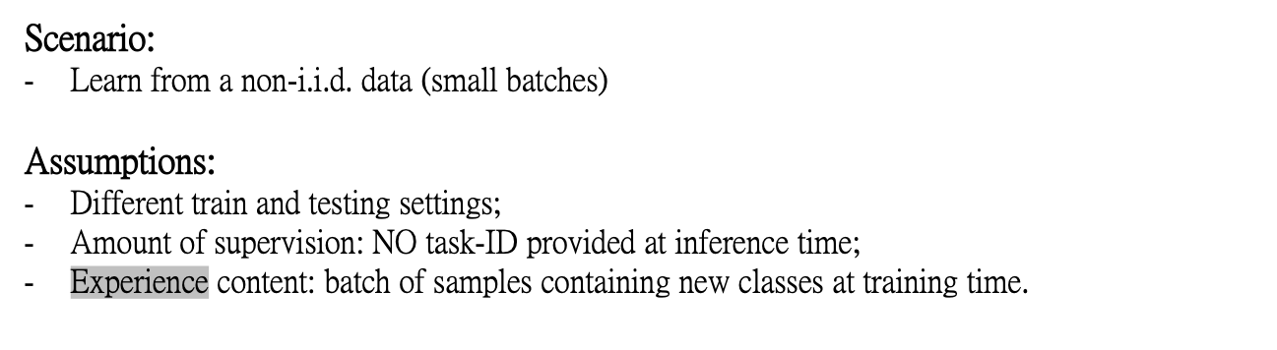
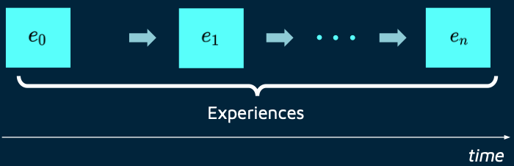
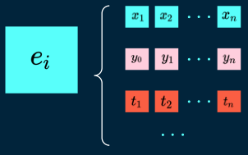
Experimental Setup
Studente: Michael Bragagnolo
Anno accademico 2021 - 2022

Slide 5
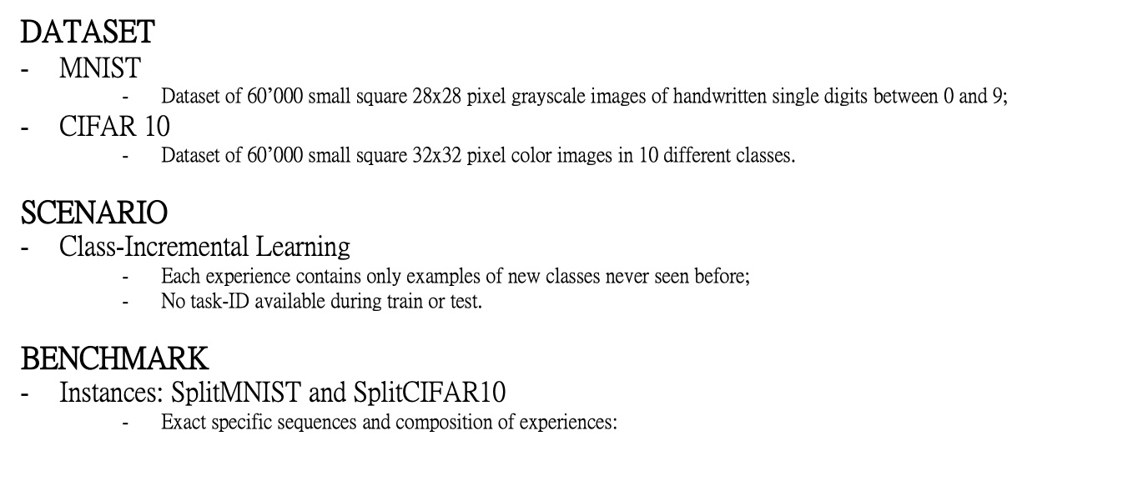
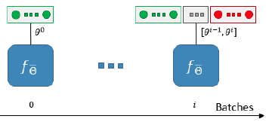
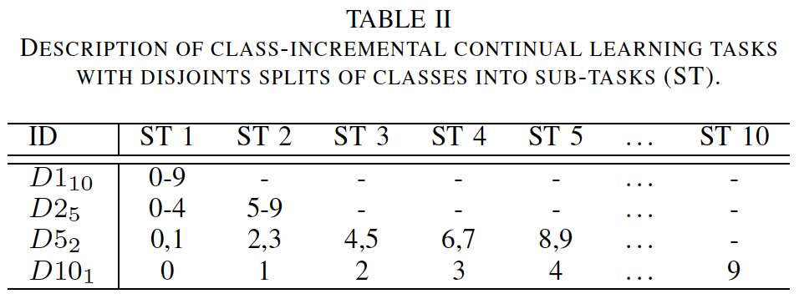
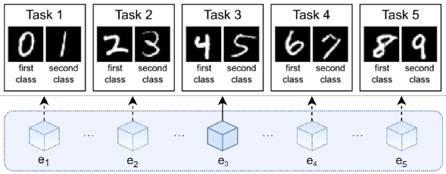
Experimental Setup
Studente: Michael Bragagnolo
Anno accademico 2021 - 2022

Slide 6
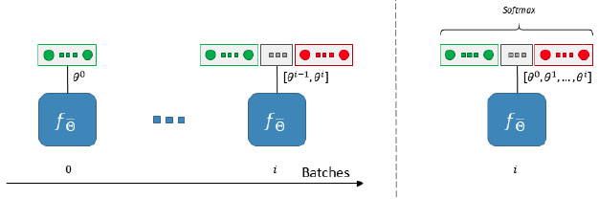
Experimental Setup
CATEGORIZATION SCHEME
Single-headed layout
  Architectural layout of a NN that uses a single output layer including all the neurons of the classes encountered so far (same output-layer for every task);
  Weights learned for the old classes could be exploited when learning only the current batch classes;
  The evaluation is performed agnostically with respect to the membership of a sample to a specific incremental batch and the final probabilities are computed through a unique softmax layer. (Strong impact on final accuracy)
Studente: Michael Bragagnolo
Anno accademico 2021 - 2022

Slide 7
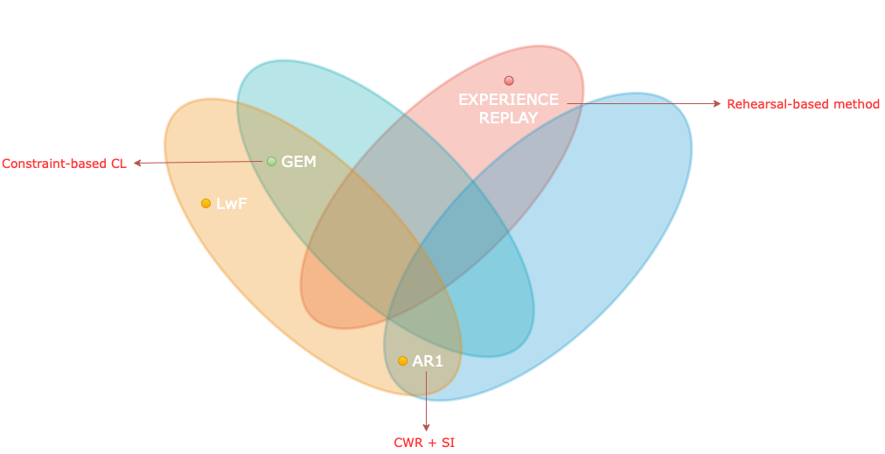
Experimental Setup
Is Class-Incremental enough for Continual Learning?
Real-world environments may naturally include repetition: more repetition equals less forgetting (replay/rehearsal)
A growing number of approaches have been presented on Continual Learning based on both variations of already existing and well known strategies or completely novel approaches with different degrees of success.
Here I propose a list of experiments based on some of the most popular, yet interesting, Continual Learning techniques inspired by the state of the art.
Combining different strategies allows to find the best solutions to tackle catastrophic forgetting.
Studente: Michael Bragagnolo
Anno accademico 2021 - 2022

Slide 8
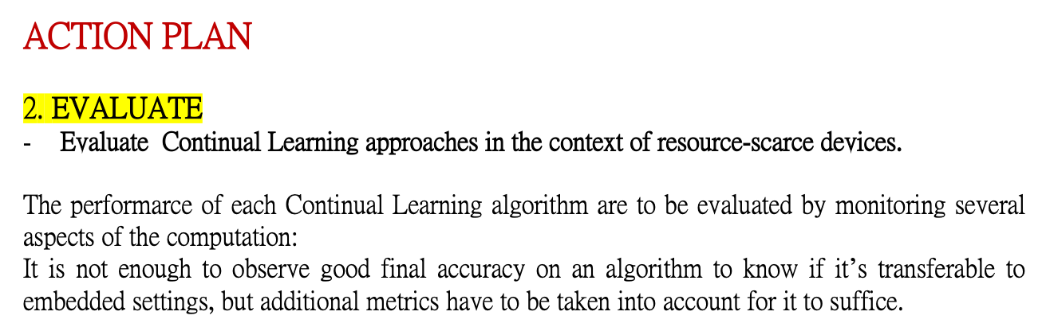
Experimental Setup
I propose a more comprehensive set of implementation independent metrics accounting for several factors I believe have practical implications worth considering in the deployment of real AI systems that learn continually.
Studente: Michael Bragagnolo
Anno accademico 2021 - 2022

Slide 9
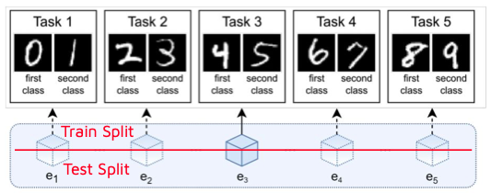
Experimental Setup
EVALUATION PROTOCOL
Split by experiences
  Evaluation based on experiences (stream of datasets).
  Model selection on a first set of experiences;
  Model assessment on a second set of experiences.
When to test?
  At the end of each experience, usually.
Studente: Michael Bragagnolo
Anno accademico 2021 - 2022

Slide 10
Experimental Setup
ACCURACY and LOSS
  Accuracy on each evaluation experience;
  Average accuracy only for experiences that the model has been trained on;
  After training on all experiences, average accuracy over all the test experiences.
FWT (Forward Knowledge Transfer)
How much learning the current experience improves my performance on future experiences?
  Accuracy on experience i-th after training on last experience;
  Accuracy on experience i-th before training on the first experience.
BWT (Backward Knowledge Transfer)
How much learning the current experience improves my performance on previous experiences?
  Accuracy on experience i-th after training on last experience;
  Accuracy on experience i-th before training on the first experience.
Studente: Michael Bragagnolo
Anno accademico 2021 - 2022

Slide 11
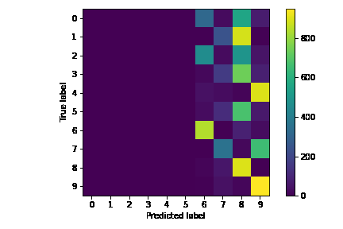
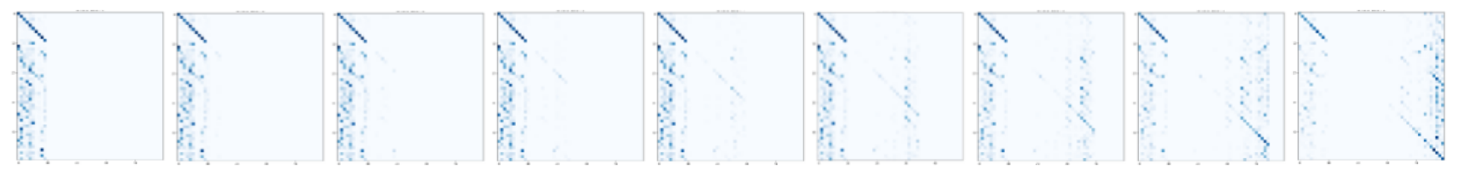
Experimental Setup
CONFUSION MATRIX
Confusion matrix metrics
  Log the confusion matrix relative to all the patterns seen during evaluation.
MEMORY FOOTPRINT
Memory Size
  Space occupied by the model, with the idea that it should not grow too rapidly with respect to the size of the model that learned the first task;
Samples Storage Size
  Increment in space required for each new experience.
EFFICIENCY
Computational efficiency
  Computational overhead during training (MACs, Running time, CPU usage, …) and inference.Comput
Studente: Michael Bragagnolo
Anno accademico 2021 - 2022

Slide 12
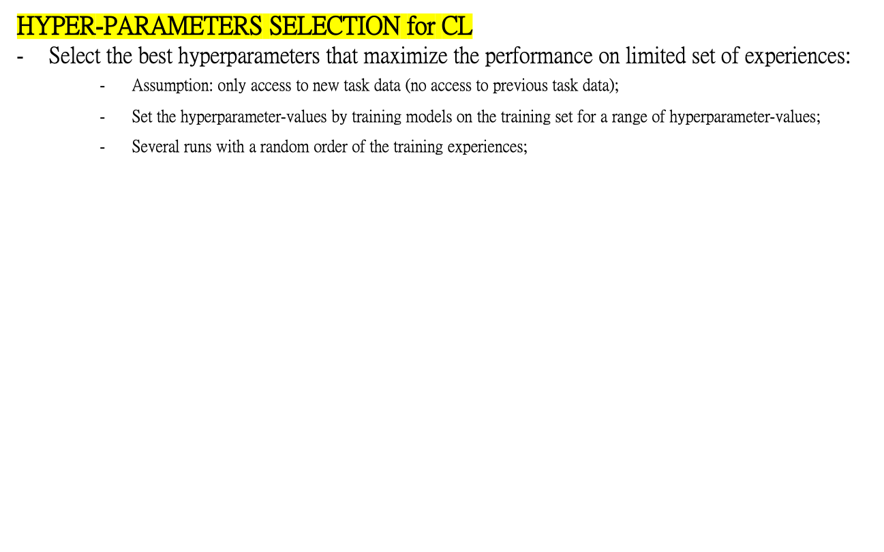
Experimental Setup
Studente: Michael Bragagnolo
Anno accademico 2021 - 2022

Slide 13
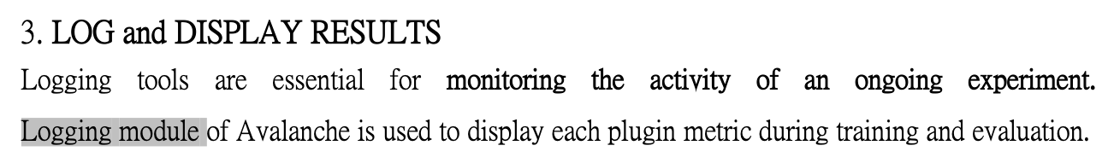
…more to follow
Studente: Michael Bragagnolo
Anno accademico 2021 - 2022

