Slide 1
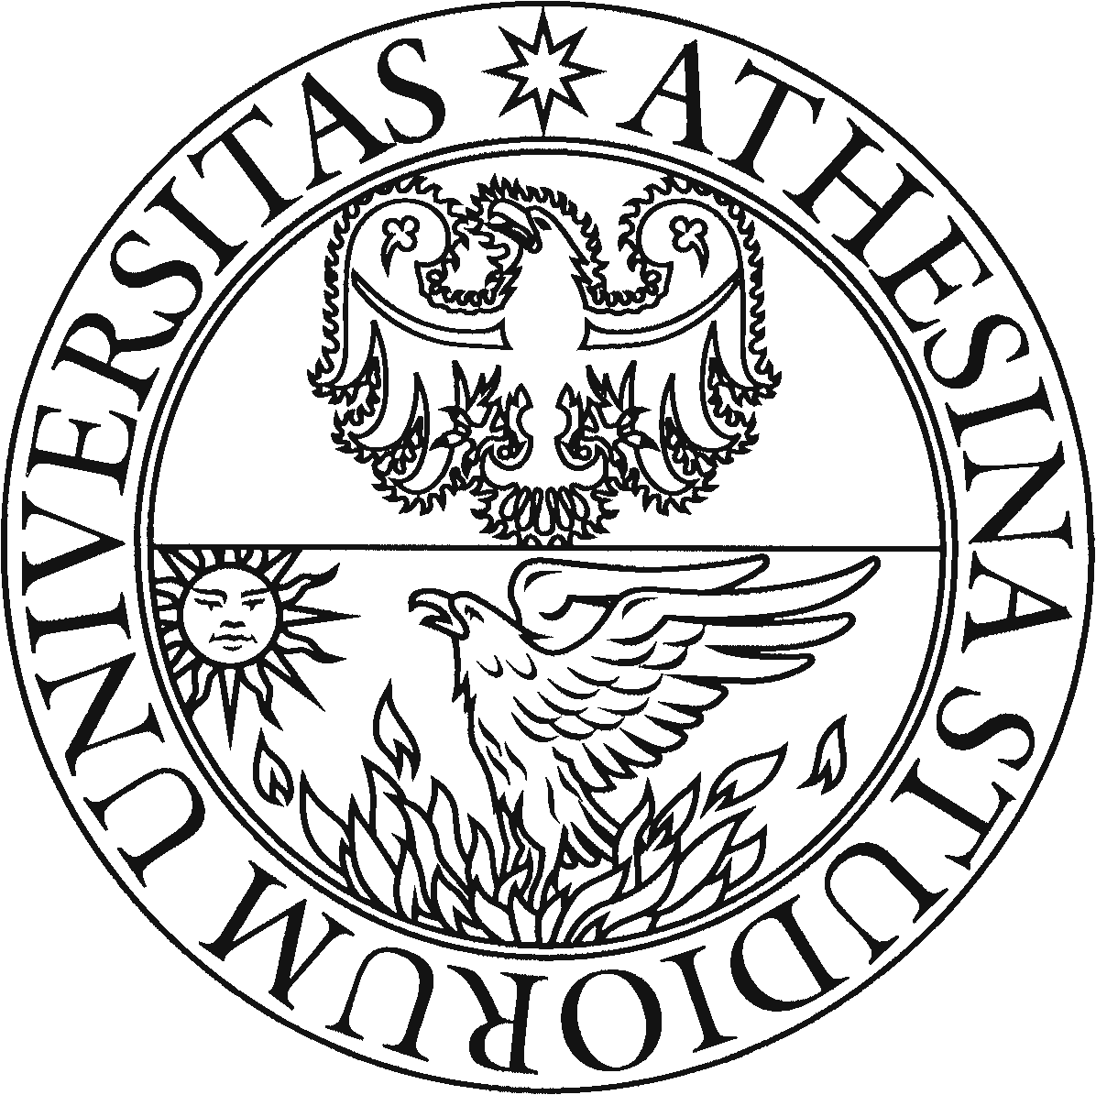
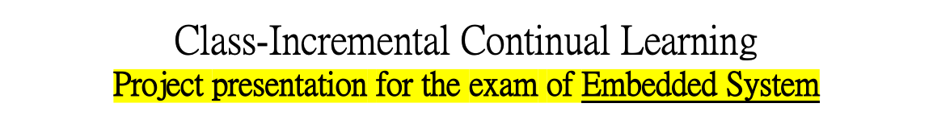
UNIVERSITÀ DEGLI STUDI DI TRENTO
Dipartimento di Ingegneria Industriale
Corso di Laurea Magistrale in Ingegneria Meccatronica
Studente:
Michael Bragagnolo, matr. 214207
Docente di corso:
Prof. Davide Brunelli
Anno accademico 2021 - 2022

Slide 2
Introduction
Continual Learning is a particular machine learning paradigm where all the training data and objective criteria are never available at once. The evolution of the learning process is modeled by a sequence of learning experiences where the goal is to be able to learn new skills all along the sequence without forgetting what has been previously learned.
In consequence of the catastrophic forgetting problem, enabling neural network models to train continuously is extremely difficult in practice.
Most early methods for incremental learning considered the Task-IL scenario, in which the algorithm has access to a task-ID at inference time.
Recently, there has been a shift towards the more difficult scenario of Class-IL, where the learner must discriminate at inference time between all the classes seen in previous tasks without recourse to a task-ID.
Studente: Michael Bragagnolo
Anno accademico 2021 - 2022

Slide 3

Project in two lines
The presented work provides a complete survey of Continual Learning (CL) approaches inspired by the state of the art, and in particular it performs extensive experimental evaluation of four Class-Incremental learning methods for image classification.
The important challenge for CL is not necessarily finding solutions that work in the real world but rather finding stable algorithms that can learn in real world.
Strategies implementation relies on Avalanche, an End-to-End Continual Learning Library based on PyTorch, born within ContinualAI with the goal of providing a shared and collaborative open-source (MIT licensed) codebase for fast prototyping, training and reproducible evaluation of continual learning algorithms.
https://avalanche.continualai.org/#cite-avalanche
GitHub repository: https://github.com/ContinualAI/avalanche
Studente: Michael Bragagnolo
Anno accademico 2021 - 2022

Slide 4

Continual learning: what’s the problem ?
The main issue of computational models regarding continual learning is that they are prone to catastrophic forgetting or catastrophic interference.
Training a model with new information interferes with previously learned knowledge: Stability-Plasticity Dilemma
Abrupt performance decrease.
Old knowledge completely overwritten by the new one.
Studente: Michael Bragagnolo
Anno accademico 2021 - 2022

Slide 5

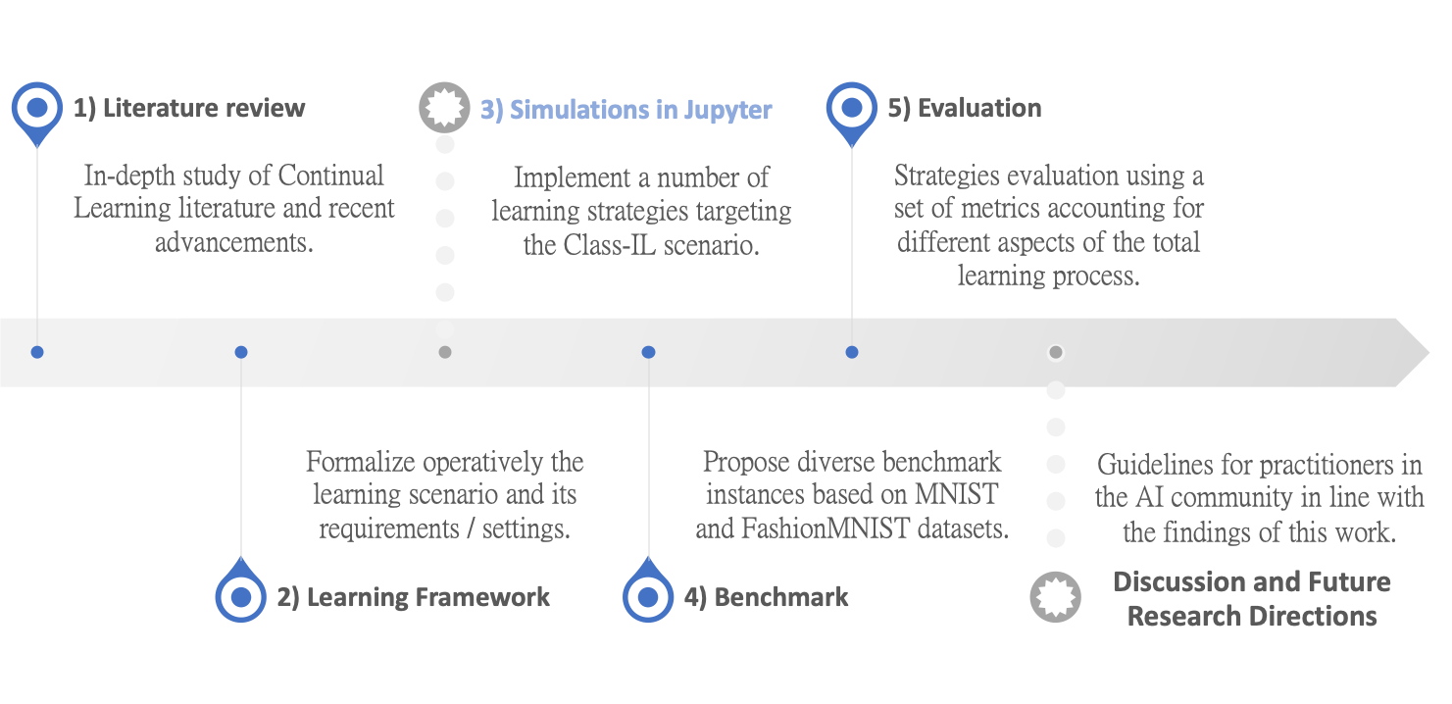

Project Milestones
Master Thesis:
Evaluation in the context of resource-scarce devices
The research and development project
is organized as follows:
Studente: Michael Bragagnolo
Anno accademico 2021 - 2022

Slide 6
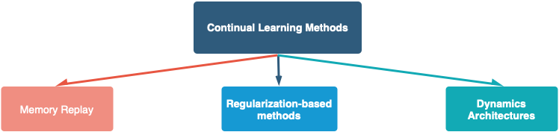
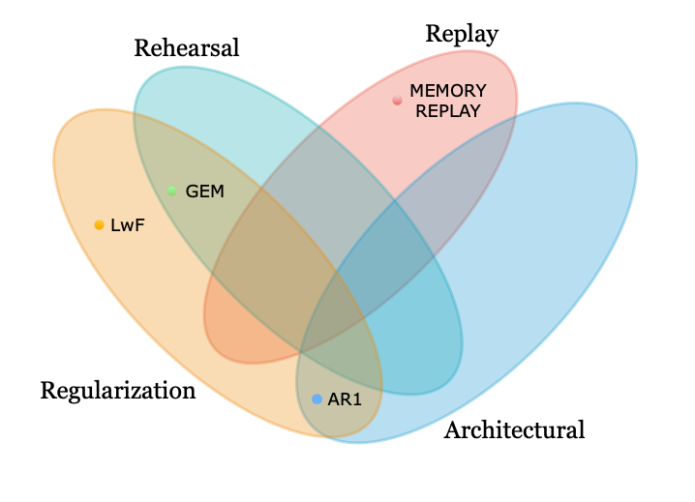
How to Solve Forgetting ?
Using different Neural Network approaches for lifelong learning that mitigate, to different extents, catastrophic forgetting:
Frase INTRO:
- Have the model parameters the same importance?
- Can just a portion of the previously encountered data be stored?
- How the model topology effects forgetting?
Studente: Michael Bragagnolo
Anno accademico 2021 - 2022

Slide 7
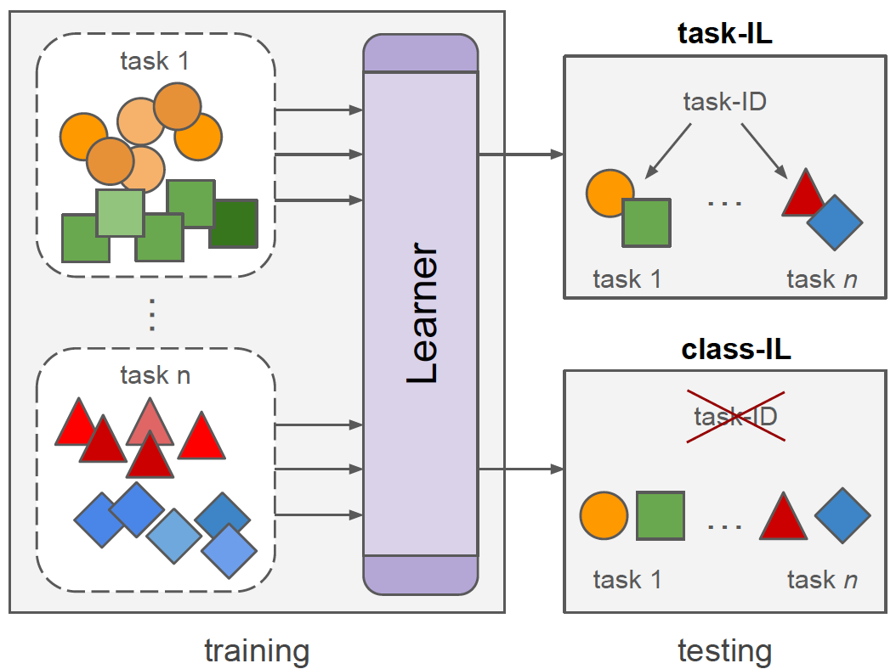
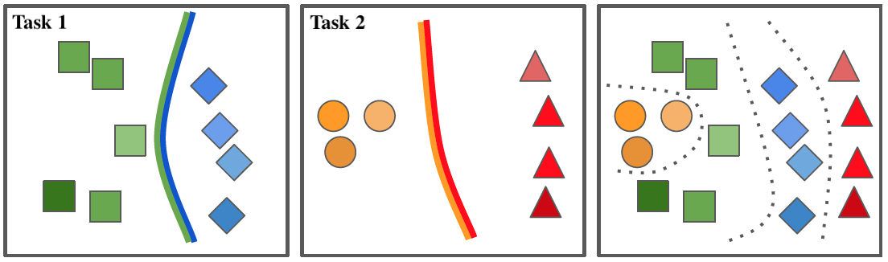
Key-settings and Scenario
The experimental part of this work addresses Class-Incremental learning, as it depicts the typical real-world problem of incrementally learning new classes of objects.
The algorithm must learn a set of classes disjoint from classes in previous or future tasks.
In each training session, the learner has only access to data from a single task.
To the scope of this survey, Class-IL methods considered are:
  Task-agnostic in evaluation: able to predict classes from all previously learned tasks without recourse to a task oracle at inference providing a subset of possible classes.
  Incremental network trained from scratch: no need to pretrain on labeled datasets.
  This property eliminates potential biases introduced by class distributions seen during pretraining.
  Mature: methods applicable to real image classification problems.
Studente: Michael Bragagnolo
Anno accademico 2021 - 2022

Slide 8
Learning Strategies
The proposed list of experiments is based on some of the most popular, yet interesting, continual learning techniques inspired by the state of the art.
Technique
Brief description
LwF
AR1
GEM
Replay
Studente: Michael Bragagnolo
Anno accademico 2021 - 2022

Slide 9
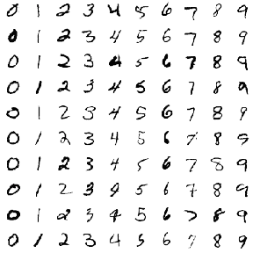
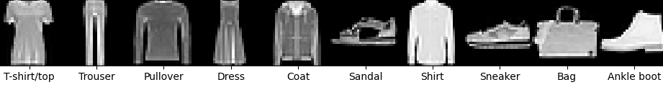
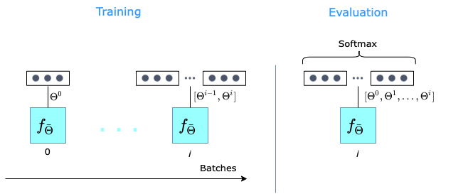
Experimental Setup
Datasets
MNIST
  Dataset of 60’000 small square 28x28 pixel grayscale images of handwritten single digits between 0 and 9;
Fashion MNIST
  Dataset of 60’000 small square 28x28 pixel grayscale images of Zalando’s articles balanced over 10 classes.
Neural Network Model
Multi-Layer Perceptron (MLP).
  Model consists of an input layer, two hidden layers of 256 units and an output layer, all fully connected in sequence.
  Single-head output layer including all the neurons of all the classes encountered so far.
Studente: Michael Bragagnolo
Anno accademico 2021 - 2022

Slide 10
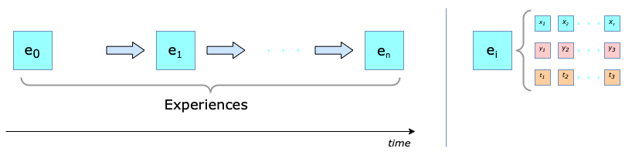
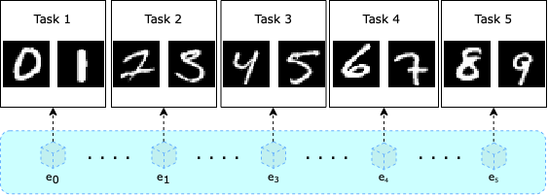
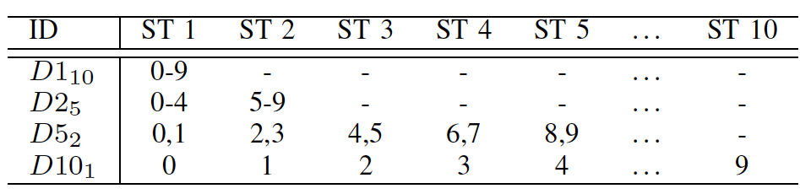
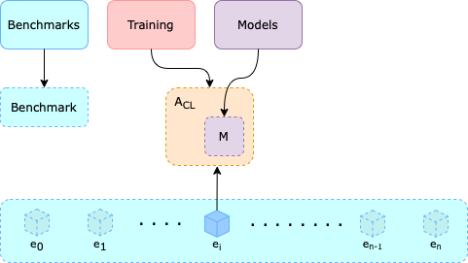
Benchmarks
BENCHMARK
Instances: Split-MNIST and Split-FashionMNIST
  Data is modeled as an ordered stream composed of n learning experiences:
  Some degrees of freedom are retained to obtain different benchmark instances:
  The algorithm updates its internal state M based on the sequential exposure to stream of experiences, in order to expand its capabilities:
Studente: Michael Bragagnolo
Anno accademico 2021 - 2022

Slide 11
Run experiments with Python
Experiments are based on the unittest unit testing framework, particularly the TestCase base class, which is used to create different test cases.
Each experiment can be run with a python script by simply:
  Creating an instance of the strategy object;
  Execute the strategy on a benchmark: the input argument to each experiment is an optional dictionary of parameters to be used in the experiments. If None, default parameters will be used.
# Create the strategy
strategy = LwF()
# Run the experiment with custom parameters
s.test_smnist({‘lwf_alpha’: 1, ‘lwf_temperature’: 2, 'cuda’: 0}
… to be completed
Studente: Michael Bragagnolo
Anno accademico 2021 - 2022

Slide 12

Evaluation
Idea of the Master Thesis:
Investigate the generalizability, trade-off between performance, storage and computational costs of each continual learning method to know if it’s transferable to embedded settings.
SWOT analysis on Continual Learning in edge-devices:
STRENGTHS
  + Privacy
  + Efficiency
  + On the edge
WEAKNESSES
- Energy consumption
- Limited resources
- Difficult to scale on higher-dimensional problems and without task labels
  + Fast adaption
  - Internet connection
  + Autonomous systems
OPPORTUNITIES
- Little literature
- Lack of consensus in evaluating continual learning algorithms
THREATS
Studente: Michael Bragagnolo
Anno accademico 2021 - 2022

Slide 13
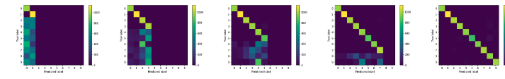
Results
The fundamentals obstacles to effective class-incremental learning are in practice very challenging to overcome and often tuning is very specific to the stream content.
Looking at the Confusion Matrices (CM) was useful to understand the direction of change of parameters that characterize each of the learning strategies. CM were exploited over the entire sequence of sub-tasks:
Results were compared in terms of:
  Catastrophic forgetting
    Average accuracy only for experiences that the model has been trained on;
    How stream length affects forgetting;
    Replay with diverse ratio of new examples to replay examples.
  Storage, Latency and Memory footprint
    Overall storage overhead for each strategy;
    Mean training and class-incremental learning time.
Studente: Michael Bragagnolo
Anno accademico 2021 - 2022

Slide 14

Conclusion
In this thesis, some of the most common continual learning techniques were tested particularly targeting the Class-Incremental scenario, which, especially considering its additional complexity, was not very much explored until now.
The proposed approaches were organized along four main lines:
  Architectural, Regularization, Rehearsal and Memory Replay.
Future Research Directions:
  Extensively investigate continual learning directly on resource-scarse devices such as microcontrollers;
  Study how model compression techniques such as pruning and quantization affect performances;
  Extend the codebase for continual learning, in order to avoid diffuculties in integrating new softwares.
In conclusion, while certainly not completely exhaustive and improvable from several
points of view, I hope this work helps the research community in classifying and comparing
approaches for class incremental continual learning, pushing Tiny-ML forward to find
solutions that facilitate continuous learning in the matter of resource-scarse systems.
Studente: Michael Bragagnolo
Anno accademico 2021 - 2022

Slide 15


