Slide 1
Electronically Returned Assignments
A Senior Project By: Zachary Auer
Joshua Raben,
CS425 Michael Rhodes,
17 Oct 2017 Cameron Scott

Slide 2
Overview
Team Introductions
Product Requirements
Product Plan
Slide 1

Slide 3
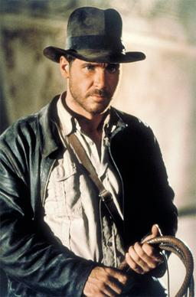
Client
Dr. Myron Jones (Southern Illinois University Edwardsville)
Slide 2

Slide 4
Product Requirements
NFRs
Two components: Uploader and Server
The Uploader must be a desktop app that runs on Windows and MacOS
The server must use CAS for authentication
FRs
The Uploader must generate, print, and scan QR codes
The Uploader must either store PDFs locally or send them to the Server
The Server must store PDF versions of assignments for student viewing
Slide 3
Michael Rhodes
Notes:
The Uploader component must run on both Windows (7 or higher) and MacOS. While the Server component must be able run on a Virtual Machine provided by ITS
Students and Graders must be authenticated using the SIUE’s Central Authentication Service (CAS)
The Uploader component must generate, print, and scan QR codes. These QR codes will match students to their specific assignments. Additionally, there are going to be “dummy” QR codes for students who forget their QR codes when turning in their assignments.
The Uploader component can either store scanned PDFs into just the local filesystem or the local filesystem and the database hosted on the server.
The Server component exists to present students the assignments that we matched to them. The assignments will be stored and presented in PDF format.
When documents are finally uploaded to the Server, the server will email each student in the class a link to their test.

Slide 5
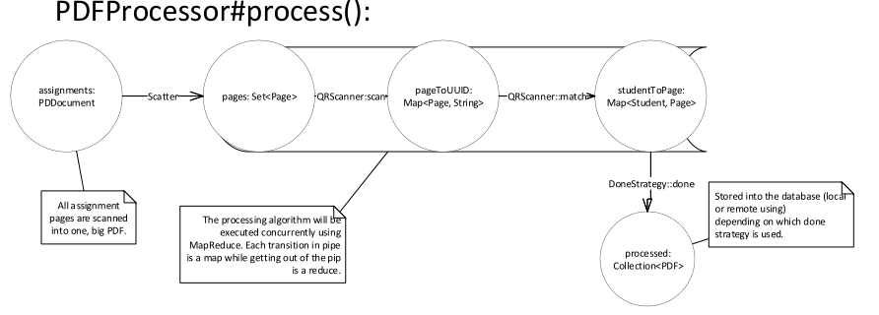
Architecture
Both components will be written in Java
Classes will be organized into a Model-View-Controller based architecture
The Uploader will be a desktop app that inputs assignments from a Scanner into our system
The Server will be a web app that presents assignments to students
Communication between the two components will be REST based.
The algorithm for processing PDFs will be MapReduce based.
Slide 4
Michael Rhodes
Notes:
Both components will be written in Java.
Since both components will be GUI driven, our overall architecture for both will be Model-View-Controller (MVC) based.
The “Uploader” will be an JavaFX based desktop application.
The “Server” will be a Spring based web application.
The Uploader will communicate to the Server using a Representational State Transfer (REST) based web API.
The Uploader will have an embedded SQLite database while the Server will have a MariaDB database.
The algorithm by which we process scanned PDFs of assignments will have a parallel pipelined architecture where we will scatter a massive PDF of all assignments into individual pages, then map on scanning Universally Unique IDs off of QR codes, then map on matching those UUIDs to students, and then reduce by inserting all assignments into the local and remote databases.

Slide 6
Major Milestones
QR Code Creation: Oct 21st 2017 (Sprint 2)
QR Code Scanning : Nov 4th 2017 (Sprint 3)
Offline Database : Nov 27th 2017 (Sprint 4)
Online Database : Nov 27th 2017 (Sprint 4)
Ordering of multi-page PDF documents: Dec 11th (Sprint 5)
ITS Authentication implemented: Mar 12th 2018 (Sprint 9)
Archival of Class Files: Mar 26th (Sprint 10)
Online Server Interface: April 5th (Sprint 11)
Slide 5
Zachary Auer

Slide 7
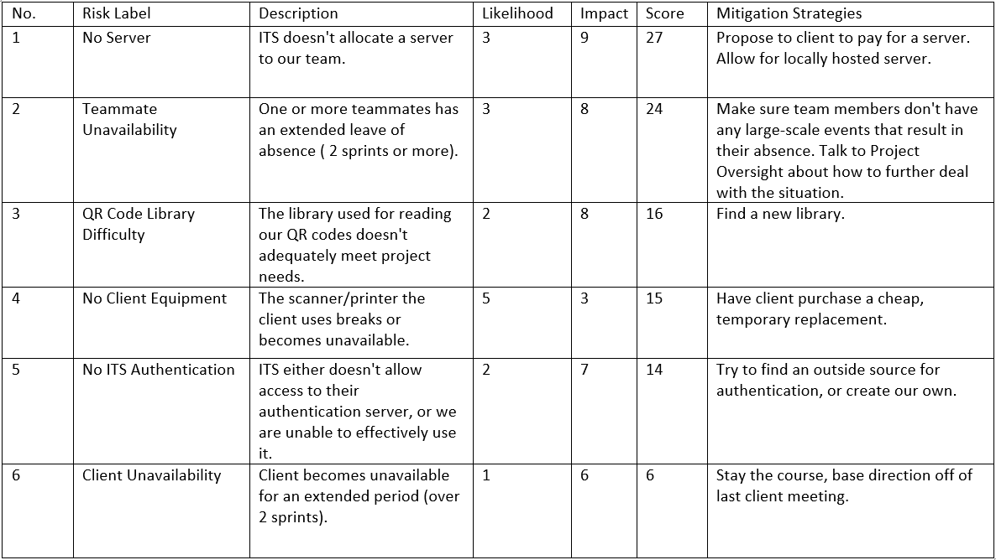
Risk Plan: Table
Highest Scoring Risk is ITS resource allocation of the server.
Lowest Scoring is client unavailability.
What does this tell us?
Slide 6
Joshua Raben

Slide 8
Risk Plan: Strategy
Risk Monitoring
Risk Assessment meeting in conjunction with Sprint Retro.
Current state of the project.
Risk Evaluation from pressing to non-critical.
Update the Risk Table with new information.
Risk Mitigation
Initial sprint risk sweep.
Performed at the start of a new sprint during planning.
Team members will agree upon and investigate risks that will have the greatest impact to the goal of the current sprint. Communicate findings, if any.
Risks are mitigated using the strategies present on the Risk Table, or otherwise formulated by the team .
Slide 7
Joshua Raben

Slide 9
Quality Plan
Open Project
Meeting minutes, User Stories, Burndown chart, Documentation
Refer back to documentation when questions arise about specific tasks members must complete
Repository
Each member branches off main develop
Develop locally
Merge into a User Story specific develop branch, and then into the general develop branch
Merge into master at the end of each sprint
Slide 8
Cameron Scott

Slide 10
Quality Plan (cont.)
Unit Testing (occurs each sprint during development)
Each member will test their code individually before integrating
Client Acceptance Testing (occurs each sprint after development)
Show our client what we have developed in each sprint
Field Testing (occurs when we have finished the core element of PDF processing)
Walk through the entire process that is expected to occur in the workplace
Stress test our software to ensure that it is scalable
Usability Testing (occurs when we have a beta release of our software)
Make sure that teachers and teacher’s assistance are able to easily use our software
Slide 9
Cameron Scott

