Slide 1

Hop on Board the Swinging EventBus!
Michael Bushe
President, Bushe Enterprises, Inc.
www.bushe.com
http://eventbus.dev.java.net
BoF-0381
Notes:
I figured I had to send in a catchy name to give a BoF on a library that has a 21K jar.
This is a great BoF for 9:30 on a Thursday Night. Your brain is spin
If you are planning to go to Scott Ambler’s talk after this one, then I may be a good lead in. I’ve got a lot of energy. Not like Scott Ambler, but I get excited easily, even by 21K libraries. I plan on going, since there’s no way I can talk about a library this small for an hour and have anyone with any questions left.
We will have some fun here though.

Slide 2
The EventBus & Decoupling Patterns
Towards Component-Based Swing Development
  Learn how to use Open Source EventBus library to solve real world problems (especially Swing problems).
  Revive an age-old practice.
Notes:
Neil Cassidy used to drive his bus on the streets of San Francisco.

Slide 3
Agenda (Stops on the Tour)
Bus Background and History
EventBus API Drive Through
Real Problems, Patterns, and Solutions
Swing Component-Based Development
Notes:
We’ll talk about coupling and a little history, other event-bus like things.
I literally mean a drive through of the API. This is a very small library -
Hopefully we’ll talk some baseball along the way.

Slide 4
Agenda
Bus Background and History
EventBus API Drive Through
Real Problems, Patterns, and Solutions
Swing Component-Based Development

Slide 5
Coupling
A Very Old Problem
“If changing one module in a program requires changing another module, then coupling exists.” – Martin Fowler
Long and Deep Past
  1960s
      Introduced as a software measurement technique.
      One of the earliest measures of software quality.
  1970s
      Led to Data Abstraction and Object Orientation
  2006
      DI, IoC, Annotations, AOP, Spring
Source: Please add the source of your data here
Notes:
Without a quote from Martin Fowler, it’s really not much of a talk.
If you have to include a jar, then you are coupled to it. I’m not saying the EventBus is solving the problems these technologies solve, but we’ll see how it solves some of the problems that commonly occur, especially in Swing applications.

Slide 6
Coupling
A Very Old Solution
Fowler : “The Universal Solution for all Patterns: Introduce a Layer of Indirection”
Bus-like Indirection History
  1970s
      Computer System Bus
  1980s
      Message Oriented Middleware – Publish/Subscribe
  1990s
      Smalltalk must have had one. ☺
      InfoBus, Lotus (IBM), MA
  2006
      Somnifugi – Cool, full JMS
      EventBus – simple
      ELF – Event Listening Framework
      See Spring RCP, Eclipse RCP?
Notes:
IBM – Groove + Microsoft guy
Publish/Subscribe

Slide 7



Real World Coupling Example
Newspaper Delivery
Newspaper
Publishers
Newspaper
Readers
Notes:
This is a very inconvenient state of affairs.
Each publisher has four sets of customer relation teams dealing with individual customers’ subscription requests, cancellations and delivery issues.
If the newspaper reader wants to start a subscription, or pause it for vacation, they will have to call up to four newspapers to get it to stop.
Worst of all, it’s not very efficient or green, since there are four delivery trucks traversing the same roads to deliver each of the delivery issues, four newspapers.

Slide 8

Real World Coupling Example
Newspaper Delivery
Newspaper
Publishers
Newspaper
Distributor
Newspaper
Subscribers
Notes:
This looks much more reasonable, no?
Newspaper distributors add the extra layer of indirection that make things more efficient and simple for all involved (except the distributor, of course, but he’s happy to provide the service).
Publishers don’t need as many customer relationship managers, since the newspaper readers can change subscriptions with the distributor instead of the publishers.
If the newspaper reader wants to start a new subscription, or pause their many subscriptions for vacation, they only have to call one person.
Best of all, it’s now very efficient and green, since there is only one delivery truck traversing the roads to deliver all the issues of the four newspapers.

Slide 9
Agenda
Bus Background and History
EventBus API Drive Through
Real Problems, Patterns, and Solutions
Swing Component-Based Development
Lots of Demos
Notes:
Now that we have a little background on coupling and bus-like mediator solutions, let’s dive right into an Event Bus example.
I will introduce the EventBus API through a contrived newspaper program initially.
This talk is really about how you can use the EventBus in a real world programs. We will get to real-world problems shortly.
I’m not a big fan of contrived examples, especially for Swing applications, since real Swing applications get complicated quickly and the patterns of contrived examples often break down.
The EventBus is most useful in medium to large sized real world applications. Again, we’ll see those shortly.

Slide 10
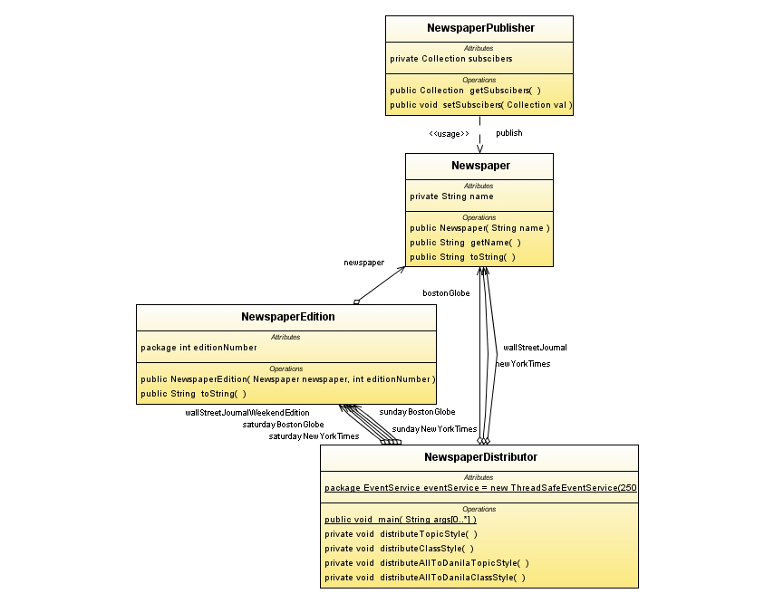
Event Bus API Intro : Domain Model
Simple Newspaper Domain Model

Slide 11
Event Bus API Intro : Domain Code
Simple Newspaper Domain Model
Newspaper bostonGlobe = new Newspaper("The Boston Globe");
Newspaper newYorkTimes = new Newspaper("The New York Times");
Newspaper wallStreetJournal = new Newspaper("The Wall Street Journal");
//Newspaper Editions for Saturday Delivery
NewspaperEdition saturdayBostonGlobe = new NewspaperEdition(bostonGlobe, 1001);
NewspaperEdition saturdayNewYorkTimes = new NewspaperEdition(newYorkTimes, 901);
NewspaperEdition wallStreetJournalWeekendEdition = new NewspaperEdition(wallStreetJournal, 555);
//Newspaper Editions for Sunday Delivery
NewspaperEdition sundayBostonGlobe = new NewspaperEdition(bostonGlobe, 1002);
NewspaperEdition sundayNewYorkTimes = new NewspaperEdition(newYorkTimes, 902);
Notes:
[REMOVE!]

Slide 12
Event Bus API Intro : #1 Topic Style
Create Topic-Style Readers
import org.bushe.swing.event.EventTopicSubscriber;
public class TopicStyleReader implements EventTopicSubscriber {
String address;
TopicStyleReader(String address) {
this.address = address;
}
public void onEvent(String topic, Object data) {
System.out.println("Newspaper Edition:"+data+" read
by customer at "+address);
}
…
anna = new TopicStyleReader ("1 Elm Street");
benito = new TopicStyleReader ("2 Elm Street");
charlie = new TopicStyleReader ("3 Elm Street");
Notes:
The EventBus API uses a publish/subscribe mechanism, which is convenient for our newspaper distributor since it has subscribers..
In order for the readers to receive an newspaper, they must subscribe to it in one of two ways.
The simplest of the subscribers is a topic subscriber. The other type of subscriber is an class-based subscriber, which we will see in a moment. Also in a moment we will see the subscription and publication code, right now let’s just look at a subscriber.
A topic subscriber subscribes to a named topic (a String). Other code can publish payload objects on the topic name. The onEvent method is called for all topic subscribers that were subscribed with that topic name. The data parameter is the data published on the topic, in this case a Newspaper Edition.
Our demo creates three readers on Elm Street. Next we will subscribe our readers to the newspapers that we read.

Slide 13
Event Bus API Intro : #1 Topic Style
Subscribe Readers
EventService eventService = new ThreadSafeEventService(250L);
eventService.subscribe("The Boston Globe", anna);
eventService.subscribe(“New York Times”, benito);
eventService.subscribe("The Boston Globe", charlie);
eventService.subscribe(“The Wall Street Journal”, charlie);
Notes:
The central interface in the EventBus API is the EventService. The EventBus API provides two implementations of the EventService. The first one contains about 90% of the code for the EventBus – the ThreadSafeEventService. The other implementation is a SwingEventService, which we will cover in a moment.
Our NewspaperDistributor creates a ThreadSafeEventService. The parameter is required. Though not critical, it’s something I want to force users to think about – the longest a subscriber should take in handling an event. This is only for reporting inefficient subscribers – I remember delivering newspapers as a boy and stopping at friends houses to chat or hit a wiffleball around. This flag would have reported me to my distributor – I’m glad things were simpler then. The parameter can set to be null to suppress reporting altogether.
Now that we have an EventService, we subscribe anna and benito to the Globe and Times respectively, Charlie is a big reader and reads both the Globe and the Wall Street Journal.
Note that an illegal argument exception is thrown if one tries to subscribe to a null topic or if one tries to subscribe a null subscriber..

Slide 14
Event Bus API Intro : #1 Topic Style
Publish Newspaper Editions
//Publish Saturday Papers
eventService.publish("The Boston Globe", saturdayBostonGlobe);
eventService.publish(“New York Times”, saturdayNewYorkTimes);
eventService.publish(“The Wall Street Journal”, wallStreetJournalWeekendEdition);
//Publish Sunday Papers
eventService.publish(bostonGlobe.getName(), sundayBostonGlobe);
eventService.publish(“New York Times”, sundayNewYorkTimes);
Notes:
Finally, we publish NewspaperEditions for both Saturday and Sunday to readers subscribed to the newspapers using the EventService’s publish method.
All NewspaperEditions are published on the newspaper’s name You may remember that the subscribers were subscribed to the same newspaper name,. The topic strings don’t have to match by reference, instead equals() is always checked. Publishing a null topic throws an illegal argument exception. The NewspaperEdition is passed as the second “data” variable. Unlike a real newspaper, the subscribers all receive the same data reference.
Note that the Wall Street Journal only has one weekend edition put out on Saturday.

Slide 15
DEMO
EventBus Topic Style Newspaper Delivery
Notes:
I plan on OpenSourcing this progress bar and other EventBus components to either the EventBus library or an ancillary EventBus component jar.

Slide 16
Event Bus API Intro : #1 Topic Style
Demo Program Output
Newspaper:The Boston Globe, Edition:1001 read by customer at 1 Elm St
Newspaper:The Boston Globe, Edition:1001 read by customer at 3 Elm St
Newspaper:New York Times, Edition:901 read by customer at 2 Elm St
Newspaper:The Wall Street Journal, Edition:555 read by customer at 3 Elm St
Newspaper:The Boston Globe, Edition:1002 read by customer at 1 Elm St
Newspaper:The Boston Globe, Edition:1002 read by customer at 3 Elm St
Newspaper:New York Times, Edition:902 read by customer at 2 Elm St
Notes:
And of course, it works.
Let’s talk about the order of delivery. Unlike a real newspaper delivery system (at least an efficient one), the Boston Globe is published to all subscribers, and then the Times, then the Wall Street Journal, so it’s not “real” but it is “correct.”
The EventService guarantees that the listener that subscribes first is called first, so 1 Elm Street will always get their paper before 2 Elm Street will.
ARE THERE ANY QUESTIONS???????????????????????????????????????????????????????????????????????????????????????????????????????????
OK then, now I have to tell you that I rarely use topic based subscriptions, though it’s very handy in one-off situations. I strongly prefer the other style – class-based publication.

Slide 17
Event Bus API Intro : #2 Class Style
Create Class-Style Reader
import org.bushe.swing.event.EventServiceEvent;
import org.bushe.swing.event.EventSubscriber;
public class ClassStyleReader implements EventSubscriber {
private String address;
public ClassStyleReader(String address) {
this.address = address;
}
public void onEvent(EventServiceEvent evt) {
NewspaperDistributionEvent newsDistroEvent =
(NewspaperDistributionEvent)evt;
System.out.println("Newspaper:"+
newsDistroEvent.getEdition()+" read by customer
at "+address);
}}
Notes:
The second style of subscriber is a class-style subscriber, signified by the EventSubscriber interface.
Similar to the EventTopicSubscriber the EventSubscriber has one method called onEvent.
The difference is that this time there is only one parameter – the Event itself.
The Event contains the payload – the NewspaperEdition, which is output in the sys’out line. As we will see, the event is also used in place of a topic.

Slide 18
Event Bus API Intro : #2 Class Style
Create EventServiceEvents
import org.bushe.swing.event.EventServiceEvent;
public class NewspaperDistributionEvent implements EventServiceEvent {
Object source;
NewspaperEdition edition;
public NewspaperDistributionEvent(Object source,
NewspaperEdition edition) {
this.source = source; this.edition = edition;
}
public Object getSource() {return source;}
public NewspaperEdition getEdition(){return edition;}
}
BostonGlobeEvent, NewYorkTimesEvent & WallStreetJournalEvent extend NewspaperDistributionEvent
Note: can extend AbstractEventServiceEvent
Notes:
For class style event publication an EventServiceEvent implementation is required.
The EventServiceEvent interface has one required method: getSource(). This is not required by the EventBus API per se, but is again something I want to force EventBus API users to think about. The EventBus API is not final yet, and I could be convinced to use take out the method and the interface and publish arbitrary objects (or add a new method to publish arbitrary objects). We’ll see how the source comes in quite handy when building frameworks. Instead of implementing the class directly and event class can extend AbstractEventServiceEvent which simply has the source property.
I’m a big fan of class-style eventing since you can use your IDE to “Find Usages” and immediately see all the players involved in publishing and receiving an event. You can do this with well-named strings too, but it’s slower and less safe (your IDE won’t find newspaper.getName()).
The downside is that you have to create an additional class for each event, which is a real drag if you are working in a constrained environment such as a cell phone.

Slide 19
Event Bus API Intro : #2 Class Style
Subscribe Readers
eventService.subscribe(BostonGlobeEvent.class, anna);
eventService.subscribe(NewYorkTimesEvent.class, benito);
eventService.subscribe(BostonGlobeEvent.class, charlie);
eventService.subscribe(WallStreetJournalEvent.class, charlie);
Notes:
We’ll reuse the same event service – it can take class and topics, no problem.
This time the subscription call on the event service is sent the class of an EventServiceEvent instead of a topic name.

Slide 20
Event Bus API Intro : #2 Class Style
Publish Newspaper Editions
//Publish Saturday Papers - CLASS STYLE
eventService.publish(new BostonGlobeEvent(this, saturdayBostonGlobe));
eventService.publish(new NewYorkTimesEvent(this, saturdayNewYorkTimes));
eventService.publish(new WallStreetJournalEvent(this, wallStreetJournalWeekendEdition));
//Publish Sunday Papers - CLASS STYLE
eventService.publish(new BostonGlobeEvent(this, sundayBostonGlobe));
eventService.publish(new NewYorkTimesEvent(this, sundayNewYorkTimes));
Notes:
Finally, to publish NewspaperEditions for Saturday and Sunday we publish a new EventServiceEvent. The subscribers that subscribed to the particular event will have their onEvent emthod called with the event as a parameter. The event itself contains the NewspaperEdition.
In case you were wondering, you cannot to subscribe to the String version of the class name and expect to receive the event.
Note that you can reuse the same event instance for multiple publication, if necessary. There is currently no consumed() method on an event, though this may change in the future.

Slide 21
DEMO
EventBus Class Style Newspaper Delivery
Notes:
I plan on OpenSourcing this progress bar and other EventBus components to either the EventBus library or an ancillary EventBus component jar.

Slide 22
Event Bus API Intro : #2 Class Style
Demo Program Output
Newspaper:The Boston Globe, Edition:1001 read by customer at 1 Elm St
Newspaper:The Boston Globe, Edition:1001 read by customer at 3 Elm St
Newspaper:New York Times, Edition:901 read by customer at 2 Elm St
Newspaper:The Wall Street Journal, Edition:555 read by customer at 3 Elm St
Newspaper:The Boston Globe, Edition:1002 read by customer at 1 Elm St
Newspaper:The Boston Globe, Edition:1002 read by customer at 3 Elm St
Newspaper:New York Times, Edition:902 read by customer at 2 Elm St
Notes:
And of course, this works too. It yields the same result as the topic example.
Let me expand on this example a bit before we take a breather for question.

Slide 23
Event Bus API : Event Class Hierarchy
The Voracious Reader
Danila is an architect, and reads everything: Art, Science, Economics, Politics. How can she subscribe to everything?
eventService.subscribe(NewspaperDistributionEvent.class, danila);
eventService.publish(new BostonGlobeEvent(this, saturdayBostonGlobe));
eventService.publish(new NewYorkTimesEvent(this, saturdayNewYorkTimes));
eventService.publish(new WallStreetJournalEvent(this, wallStreetJournalWeekendEdition));
Class subscription is hierarchical, as expected.

Slide 24
Event Bus API : Regular Expressions
The Voracious Reader
Can Danila subscribe to everything using topics?
TopicStyleReader danila=new TopicStyleReader("10 Elm St");
Pattern topicPattern = Pattern.compile("News*");
eventService.subscribe(topicPattern, danila);
Yes, topic matching can be based on regular expressions!*
* We’d have to change our topics to “News : The Boston Globe”, etc. to get match-able topic names in our example (or use “*”).
Notes:
There are a few more features of the EventBus that we will skip until later, but for the most part, you’ve seen the EventBus API.
Let’s talk a little about threading and then about what the EventBus is not, and turn to some examples of how the EventBus steps into many situations.

Slide 25
Event Bus API : Threading
Thread Safe Eventing
EventService implementations are thread safe.
  Simultaneous publishing is OK
  Simultaneous subscribing is OK
  Simultaneous publishing & subscribing is OK
The list of subscribers is copied before first subscriber is called.
Publication occurs in the same stack frame. (with and important exception).

Slide 26
Event Bus API : Memory Management
Leak Safe Eventing
Weak References to subscribers are used by default
  No remove() necessary
  Eliminates most common source of Swing memory leaks
  Caution – your subscriber may disappear!
The subscribeStrongly() methods are available for strong reference semantics

Slide 27
Event Bus API : SwingEventService
Thread Safe Eventing for Swing
SwingEventService implements EventService
Accepts publications & subscriptions on any thread
Only publishes on the Swing Event Dispatch Thread
Publishing from the EDT is a pass-through (occurs in the same stack frame)
Notes:
Much of the rest of this talk will be about usages of the SwingEventService. There are a couple of cool features the EventBus has that makes for some novel Swing-related solutions.

Slide 28
Event Bus API : The EventBus
A Convenient Wrapper
So what is the EventBus?
A class for central dispatching for Swing publish/subscribe eventing.
Simply a convenience class
Wraps a single SwingEventService instance
Provides static wrapper methods that pass through to the private Swing event service
EventBus.publish(new BostonGlobeEvent(edition));

Slide 29
Event Bus API : Miscellany
More Features Shown in Demos
Event Service Locator
  Many Event Services for Different Purposes
Event Veto
  Better than Bean Vetoable Properties
Container Event Service
  Limit events to a container
  Useful for Form Validation
  Great for Docking Frameworks
Event Actions
  Bridge from Buttons to Buses
Notes:
[QUICKLY]

Slide 30
Event Bus API : Maturity
API not yet final (but close)
High quality documentation
Pretty well tested (recent slip from 80% coverage)
Good support (tiny codebase, changes are simple)

Slide 31
Agenda
Bus Background and History
EventBus API Drive Through
Real Problems, Patterns, and Solutions
Swing Component-Based Development
Notes:
The EventBus is simple, it’s just a small bit of code really. The important part of this talk is to see novel ways to solve real problems. I hope you’ll find that using publish/subscribe patterns provides huge advantages and gets you out of some tight corners.
[Pull up the demo!]

Slide 32
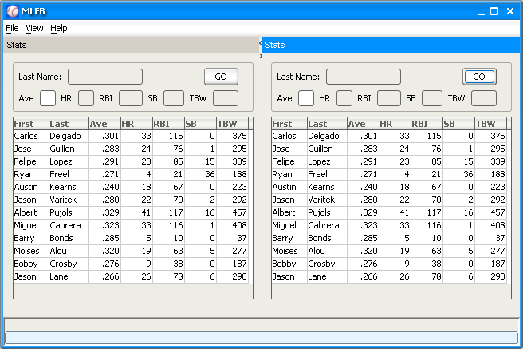


Real Application Introduction
MLFB Fantasy Baseball Application
Well, Almost Real
EJBQL
EJB 3.0
MLFBPlayer
PostgreSQL
Notes:
This application is

Slide 33
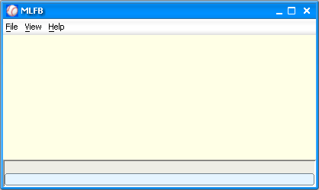

Real Application Introduction
MLFB Fantasy Baseball Application
GUI Framework
GUI Application Framework
SAM
FlexDock
Plug-in
Facility
EventBus
Synthetica Look and Feel
Notes:
This is a little homegrown application framework.
This is a pluggable, flexible application framework.
The framework discovers the SAM action XML files to load it’s menus. FlexDock can show multiple views from multiple plugins.
It also discovers plugin services. The default framework configuration has a Dynamic EJBQL Query Plugin (this is all a bit overblown).
We’ll see that the EventBus is used in multiple places and ties much of the application and the plugins together. This is a reasonable complex app.

Slide 34


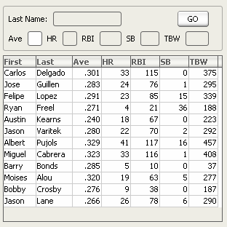
Real Application Introduction
MLFB Fantasy Baseball Application
MLFB Components
Hitter Stats Menu
SAM
Dynamic EJBQL
Plug-in
Hitter Stats Panel
EventBus
Glazed Lists
Notes:
MLFB does not know about FlexDock

Slide 35
Real Application Introduction
MLFB Fantasy Baseball Application
Dependency Diagram
How can we keep these 3 modules decoupled?
Client Framework
EJB 3.0 Data
MLFB Client Components
MLFB Core
FlexDock
Dynamic EJBQL
Plug-in
Glazed Lists
SAM
Java EE 5
SwingFX
SAM
Notes:
Our Client Framework is like my wife – she knows nothing about baseball. (That’s a joke). But this is a framework, and shouldn’t know about our domain.
Our data plugin knows nothing but Java EE 5
We’d like the MLFB GUI to work in any Framework (Eclipse RCP, Spring RCP, Netbeans RCP), perhaps even use any DataService (such as one that does Web Services).

Slide 36
Real Application Introduction
MLFB Fantasy Baseball Application
Dependency Diagram
How can we keep these 3 modules decoupled?
Client Framework
EJB 3.0 Data
MLFB Client Components
Java EE 5
MLFB Core
FlexDock
Dynamic EJBQL
Plug-in
Glazed Lists
SAM
Data Events
SAM
SwingFX
Event Bus UI Components & UI Events
Event Bus
Notes:
We introduce the EventBus, along with some EventBus Events and EventBus-aware components. We’ll see exactly how this works next.
The key is that the Events are the contract between the components. They share events and the eventbus, and that’s it. There are no hooks onto each other, and except for a few things you’d forgive me about for the demo, they don’t reference or listen to each other.

Slide 37
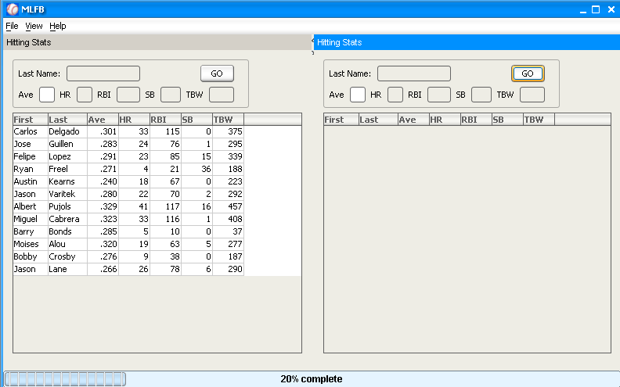
Real Problem #1: Progress Bar
How can the Client Framework Show Query Progress?
Client Framework
EJB 3.0 Data Service
Dynamic EJBQL
Plug-in
2. Publish
EBProgressBar
ProgressEvent
1. Subscribe
EventBus
Notes:
How would you normally handle progress in this situation? (Hopefully someone gives the Big Brother controller that adds a listener to the Data Service)

Slide 38
DEMO
EventBus Progress Bar
Notes:
I plan on OpenSourcing this progress bar and other EventBus components to either the EventBus library or an ancillary EventBus component jar.

Slide 39
EBProgessBar Code
public class EBProgressBar extends JProgressBar
implements EventSubscriber {
EBProgressBar(…) {
EventBus.subscribe(ProgressEvent.class, this);
}
public void onEvent(EventServiceEvent evt) {
ProgressEvent pEvent = (ProgressEvent)evt;
…
if (pbEvent.getMax() != null) {
setMaximum(pbEvent.getMax().intValue());
}
repaint();
}
//Data Service Publication
EventBus.publish(new ProgressEvent(this,percentComplete));
Notes:
The ProgressEvent extends AbstractEventServiceEvent
We are going to look more closely at the DataService in a minute, for now just know that it periodically publishes a ProgressEvent.
As we’ll see in the next example, the DataService doesn’t have to use the Swing EventBus, it could use any EventService. On a server, a subscriber to the event service might publish JMS messages to update clients regarding progress of long-running operation (progress messages must not be transactional, otherwise the progress messages would not get fired until after completion of the transaction).

Slide 40
So What?
So the layers are “decoupled”, what does that buy me?
Client Framework and DataService can vary independently.
  Can introduce a new DataService (say, Web Services) without changing ANY code.*
  DataService can be used in other Client Frameworks
There are no listeners to hook up and manage between the layers. They “rendezvous” instead.
*DataService is “discovered” by the client framework, think Spring.
Notes:
Next we will hook up a progress veil in the application framework, in addition to the status bar.

Slide 41
DEMO
EventBus Progress Veil
Notes:
I plan on OpenSourcing this progress bar and other EventBus components to either the EventBus library or an ancillary EventBus component jar.

Slide 42
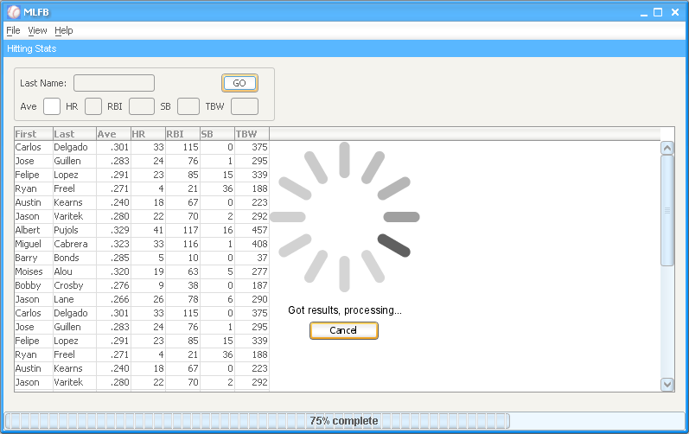
Progress Veil
Veil is a second subscriber to the same event on the bus.
Glass Pane from SwingFX (Romain Guy)
Client Framework varied without DataService knowledge.
Can be driven by any component without listeners.

Slide 43
Cancelable Veil Code
public class EBCancelableVieledProgressPane extends
CancelableProgressPanel implements EventSubscriber {
public EBCancelableVieledProgressPane(JComponent compToVeil,
EventService eventService) {
super(text, 12, 0.35f, 15.0f, 100);
this.compToVeil = compToVeil;
eventService.subscribe(ProgressEvent.class, this);
}
public void onEvent(EventServiceEvent evt) {
ProgressEvent progressEvent = (ProgressEvent)evt;
if (progressEvent.getValue() > 0.00001d) {
compToVeil.getRootPane().setGlassPane(this);
start();
}
setText(progressEvent.getPreString());
} else {
stop();
compToVeil.getRootPane().setGlassPane(lastGlassPane);
}
Notes:
The veil subscribes to the same event. It accepts a component to veil and listens for ProgressEvents.
Notice that in this case we are passing in the EventService on construction. You’ll see why we do this in a little bit when we talk about the Container EventService.

Slide 44
Real Problem #2: Query Processing
Multiple Buses and the Request/Reply Strategy
“QueryEventService”
Hitter Stats Panel
EJB 3.0 Data Service
1. Create
3. Locate
Dynamic EJBQL
Plug-in
QueryRequestEvent
2. Subscribe
5. Publish
6. Run Query
(onEvent())
7. Publish
4. Subscribe
QueryCompleteEvent
EventBus or Container EventService
“Callback” EventService
8. Update Table
(onEvent())
9. Unsubscribe()
Notes:
This is the most complicated thing I’ll throw at you today. It’s not very complicated, it’s just a number of steps and introduces a couple of new ideas.
This is what happens under the covers between the GO button being clicked. Two EventServices are used
Firstly, the QueryEventService..
Then the subscribe once…
You could make the DataService publish back on the same bus, and that would make more sense, then have the table do an invokeLater

Slide 45
DEMO
Multiple Event Services for Data
Notes:
Now let’s change the client framework to show progress in a different way.
[Uncomment the last line of DemoFrame’s initComponent method].
This code uses Romain Guy’s Progress glass pane.

Slide 46
Data Service Setup Code
public class DataService implements EventSubscriber, EventTopicSubscriber{
private MLFBSession mlfbSessionBean;
private Executor singleThreadedExecutor =
Executors.newSingleThreadExecutor();
public void init() {
//Gets server session bean
hookUpToServer();
//Create a special event service for handling queries
EventService queryEventService = new
ThreadSafeEventService(250L);
EventServiceLocator.setEventService("QueryEventServiceBus",
queryEventService);
queryEventService.subscribe(QueryRequestEvent.class, this);
…
EventBus.subscribe("Cancel", this);
}
}
public class HitterStatsUIComponent {

Slide 47
“GO” Button Code
public HitterStatsUIComponent() {
…
public void actionPerformed(ActionEvent evt) {
EventService queryEventService =
EventServiceLocator.getEventService("QueryEventService");
final String queryId = getNextQueryId();
EventBus.subscribeStrongly(QueryCompletionEvent.class, new
EventSubscriber() {
public void onEvent(EventServiceEvent evt) {
QueryCompletionEvent event = (QueryCompletionEvent) evt;
if (event.getQueryId() != queryId) {
//not our query
return;
}
EventBus.unsubscribe(QueryCompletionEvent.class, this);
setPlayers(event.getResult());
}
});
queryEventServiceBus.publish(new QueryRequestEvent(getQuery() + "", queryId, this));
Notes:
Lots of things to point out here:
EventServiceLocator usage
Subscription is strong since it’s an inner class without another reference. (Good example of why final must be final)
Subscribe for result before publishing request
Subscribers have the job of filter, not the bus (for now)
Unsubscribe since it’s a one-off

Slide 48
Data Service Query Execution Code
public void onEvent(EventServiceEvent evt) {
final QueryRequestEvent queryEvent=(QueryRequestEvent)evt;
publishProgress(10, "Starting...");
singleThreadedExecutor.execute(new Runnable() {
public void run() {
publishProgress(20, "Issuing query...");
List result = runQuery(queryEvent.getQuery());
publishProgress(75, "Got results, processing...");
if (!currentRequestIsCanceled) {
EventBus.publish(new QueryCompletionEvent(
result, queryEvent.getQueryId(), this));
publishProgress(100, "Complete");
}
publishProgress(0, "Reset");
currentRequestIsCanceled = false;
}}
public void onEvent(String string, Object object) {
currentRequestIsCanceled = true;
}
Notes:
The veil subscribes to the same event. It accepts a component to veil and listens for ProgressEvents.
Notice that in this case we are passing in the EventService on construction. You’ll see why we do this in a little bit when we talk about the Container EventService.

Slide 49
Data-Client Communications
Major Use Case
EventBus is perfect for updating client from server
Live Data (JMS)
Alerts
Chat
Event Oriented Architecture (similar to SOA)
Accept update in any thread, update client models, then post an event on the EDT.

Slide 50
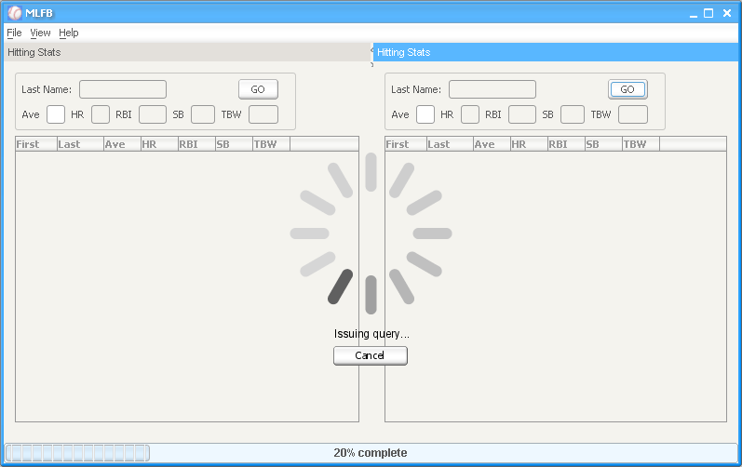
Real Problem #3: Dynamic GUIs
How Can Events Be Contained to a “Dockable”?
Glass pane over the whole app is a little heavy-handed in a docking framework…
Notes:
[Demo this bad behavior.]

Slide 51
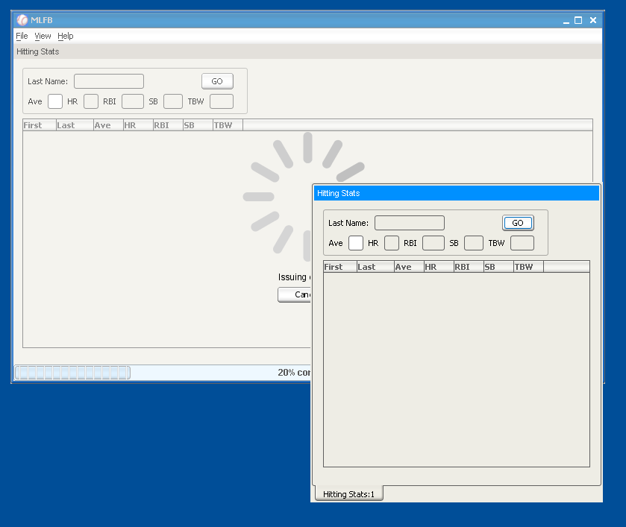
Real Problem #3: Dynamic GUIs
How Can Events Be Contained to a “Dockable”?
And could be very confusing to the user…
“But I clicked here!”
Notes:
[Demo this too.]
[Then change hitterstatUIComp actionPerformed EB to container]

Slide 52
DEMO
The Fix: A Container EventService Veil
Notes:
I plan on OpenSourcing this progress bar and other EventBus components to either the EventBus library or an ancillary EventBus component jar.

Slide 53
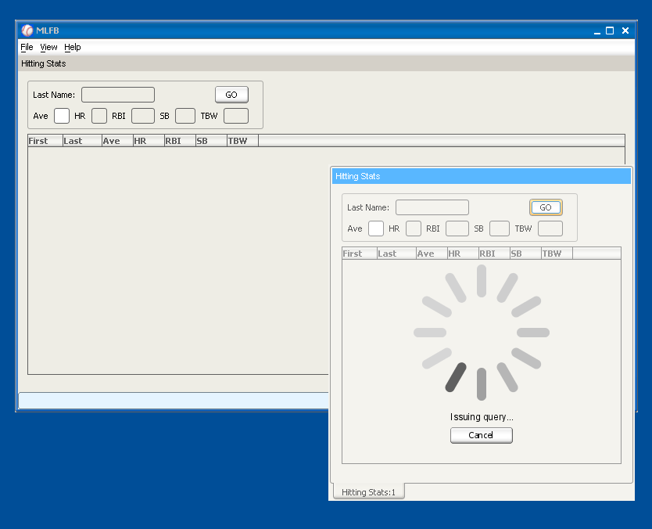
Solution: A Container EventService
A Private Conversation
The new code limits Events to a Container EventService.
How does this work?

Slide 54
Data Service Query Execution Code
DataService can callback on any EventService.
Replace EventBus with an EventService supplied by the Event.
public void onEvent(EventServiceEvent evt) {
final QueryRequestEvent queryEvent=(QueryRequestEvent)evt;
final EventService eventService =
queryEvent.getCallbackEventService();
publishProgress(10, "Starting...", eventService);
singleThreadedExecutor.execute(new Runnable() {
public void run() {
publishProgress(20, "Issuing query... “, eventService);
List result = runQuery(queryEvent.getQuery());
…
Notes:
Important point here is that the contract between components is the Event. To do more, you often have to change your event. This is nice since it’s self-contained and standalone.
We’ve actually further decoupled the DataService from Swing or UI logic of the application. It only depends on an EventService now, outside of itself.

Slide 55
MLFB UI Component Code
Rendezvous on the EDT
“Find” the ContainerEventService and pass it to the Event
goButton.addActionListener(new ActionListener() {
public void actionPerformed(ActionEvent evt) {
final EventService eventService =
ContainerEventServiceFinder.getEventService(
hitterStatsPanel);
queryEventServiceBus.publish(new
QueryRequestEvent(getQuery() + "",
queryId, this, eventService));
Notes:
Important point here is that the contract between components is the Event. To do more, you often have to change your event. This is nice since it’s self-contained and standalone.
We’ve actually further decoupled the DataService from Swing or UI logic of the application. It only depends on an EventService now, outside of itself.

Slide 56
ContainerEventServiceFinder
ContainerEventServiceFinder walks a component’s hierarchy until it finds either:
  An explicit definition
  public interface ContainerEventServiceSupplier {
        public EventService getContainerEventService();
        }
  An implicit definition
  A JRootPane (the “top” of Dialogs, Dockables, etc.)
  The Finder will dynamically create an EventService rootPane.putClientProperty(
  “ContainerEventServiceFinder.createdService”,
  new SwingEventService());

Slide 57
ContainerEventServiceRegistrar
But wait! When the container changes (docks/undocks), the subscription would be lost or misplaced!
The ContainerEventServiceRegistrar maintains EventService subscriptions when a component’s parent changes
(and therefore when its ContainerEventService changes).
ContainerEventServiceRegistrar even works when the component has no parent. (Solves Swing listener sequencing)
public EBCancelableVieledProgressPane(String text,
JComponent compToVeil) {
ContainerEventServiceRegistrar registrar =
new ContainerEventServiceRegistrar(compToVeil,
this, ProgressEvent.class);
}
Notes:
The top level dockable view class uses a special constructor for the progress veil.
ANY QUESTIONS????????????????????

Slide 58
ContainerEventService : Use Cases
FormPanel
  Data Binding
    EventBus components can publish their ValueModel changes on the Container Event Bus
  Validation
    Validation errors can be published to the Container
    Validation display components subscribe to Container
Dialogs, particularly non-modal
Dockables
  Note that a docked JIDE frame has a JRootPane (not FlexDock)
All without explicit listeners or exposing child components!

Slide 59
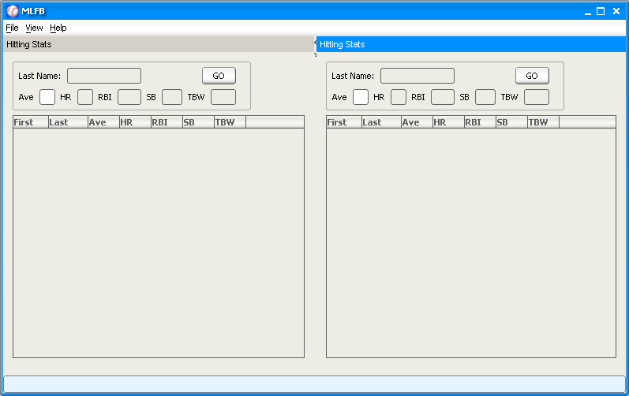
Real Problem #4 : Preferences
Nastiest of all Swing Coupling Problems
Usual Solution – Deeply Couple Everything
Preference nodes are passed all the way down and back up on change
<App Node>
  <All Views Node>
    <Left View Node>
      < ….. >
    <Right View Node>
      <Form Node>
        <Last Filter Node>
        <…>
      <Table Node>
        <Column Order>
        <Hidden Cols>
        <Last Sort>
Notes:
Problem – each view wants to save it’s own filter as a preference.
Coupled Solution – make a parent context and then pass that context all the way down the chain.
Problem – when the subcomponent changes it’s pref, it has to inform the parent that it has a preference that changed and that preferences should be changed. (This especially true if you save multiplt named preferences).
One cool part of the solution is that the parent controls where in the app hierarchy the preference goes. The app chooses it’s view name, and there can be mulitple views per name. The child doesn’t have to find it.

Slide 60
Real Problem #4 : Preferences
The Knee Bone’s Connected to the Thigh Bone…
AppController
<App Node>
<Frame Node>
  <All Views Node>
    <Left View Node>
      < ….. >
    <Right View Node>
      <Form Node>
        <Last Filter Node>
        <…>
      <Table Node>
        <Column Order>
        <Hidden Cols>
        <Last Sort>
FrameController
LeftController
RightController
FormController
TableController
Notes:
Frame Controller is connected to each view controller
The view controller is connected to each panel controller
The panel controller is connected to each widget controller
The widget controller updates/reads the preference nodes.

Slide 61
Real Problem #4 : Preferences
Solution Breaks Down in the Loosely Coupled World
Dockables don’t know what components they are showing.
They can’t pass a node to their children unless the children implement some PrefAware interface
Lots of work (touches many classes), very prone to error (if any child forgets…)
Preferences.userNodeForPackage(…) doesn’t work when the same component has two instances.
Notes:
Problem – each view wants to save it’s own filter as a preference.
Coupled Solution – make a parent context and then pass that context all the way down the chain.
Problem – when the subcomponent changes it’s pref, it has to inform the parent that it has a preference that changed and that preferences should be changed. (This especially true if you save multiplt named preferences).
One cool part of the solution is that the parent controls where in the app hierarchy the preference goes. The app chooses it’s view name, and there can be mulitple views per name. The child doesn’t have to find it.

Slide 62
Real Problem #4 : Preferences
An EventBus Solution
Publish Nodes on the Container EventService
  PopulatePreferencesNodeEvent publishes a Preference Node to the container’s components for saving user preferences
  ApplyPreferencesNodeEvent publishes a Preference Node to the container’s components for reading and applying the previously saved values
No Listeners
No interfaces required (convenience interfaces are supplied)
Notes:
Problem – each view wants to save it’s own filter as a preference.
Coupled Solution – make a parent context and then pass that context all the way down the chain.
Problem – when the subcomponent changes it’s pref, it has to inform the parent that it has a preference that changed and that preferences should be changed. (This especially true if you save multiplt named preferences).
One cool part of the solution is that the parent controls where in the app hierarchy the preference goes. The app chooses it’s view name, and there can be mulitple views per name. The child doesn’t have to find it.

Slide 63
DEMO
EventBus-Style Preferences
Notes:
I plan on OpenSourcing this progress bar and other EventBus components to either the EventBus library or an ancillary EventBus component jar.

Slide 64
Preferences Adapter Code
public class PrefContainerAdapter implements EventHandler {
public PrefContainerAdapter(JComponent jComp,
PrefComponent prefComponent) {
this.prefComponent = prefComponent;
new ContainerEventServiceRegistrar(jComp, this, new
Class[]{ApplyPreferencesNodeEvent.class,
PopulatePreferencesNodeEvent.class});
}
public void handleEvent(EventServiceEvent evt) {
if (evt instanceof ApplyPreferencesNodeEvent) {
prefComponent.applyPreferences(
(ApplyPreferencesNodeEvent)evt).getNode());
} else if (evt instanceof PopulatePreferencesNodeEvent) {
prefComponent.populateNode(
(PopulatePreferencesNodeEvent)evt).getNode());
}
}
Notes:
Important point here is that the contract between components is the Event. To do more, you often have to change your event. This is nice since it’s self-contained and standalone.
We’ve actually further decoupled the DataService from Swing or UI logic of the application. It only depends on an EventService now, outside of itself.

Slide 65
Real Problem #5: Application Exit
Veto Events & EventAction
User wants to exit, but some component may have unsaved work
Solution: Publish an SystemShutdownEvent, but allow any component to veto its publication
The EventAction comes in handy too
Notes:
It’s true – some of us Bush’s understand the word “veto”

Slide 66
DEMO
Application Exit
Notes:
I plan on OpenSourcing this progress bar and other EventBus components to either the EventBus library or an ancillary EventBus component jar.

Slide 67
Preferences Adapter Code
Alt-F7! (Show Usages)
Notes:
Important point here is that the contract between components is the Event. To do more, you often have to change your event. This is nice since it’s self-contained and standalone.
We’ve actually further decoupled the DataService from Swing or UI logic of the application. It only depends on an EventService now, outside of itself.

Slide 68
Problem: Error Reporting
Not EventBus related
AWTExceptionHandler
  Dsun.awt.exception.handler=
  org.bushe.swing.exception.AWTExceptionHandler
  Djava.library.path=.\lib
Notes:
Problem –Swing exception handling.
Loss of exception problem.
Note that the exception event takes a causing component for centering error dialogs.

Slide 69
Toward Component-Based
Swing Development
Component market for Swing is small
Components must play nicely together (even from different vendors)
What’s Needed?
  A Swing Container
      JSR 296? (Desktop Framework)
      JSR 295 (Data Binding)
      Spring Rich
      OSGi
      Much more
EventBus could aid in the integration of these efforts

Slide 70
Other EventBus Use Cases
Application monitoring
  Command Log
  You haven’t used <this feature> yet.” tool for Tip of the Day.
Similar to JMX, excellent management layer
Unit Testing

Slide 71
What’s Next?
Annotations
    @Subscribe(name=“MyTopicName”)
    @Subscribe(class=MyEvent.class, container=true)
Generics for Typesafety
<T> boolean subscribe(eventClass<T>, EventSubscriber(EventServiceEvent<T>))
Publication and Delivery strategies
  SwingEventService has “invokeLater() if necessary strategy, make them pluggable.
ContainerEventService improvements
  “Publish up” flag (on the Event or the Service?)
  ContainerEventService interface?
  Integrate with DataBinding and Validation Frameworks
Consumed() flag on the EventServiceEvent
An EventBus JSR for J2SE?

Slide 72
Summary
EventBus is a single VM pub/sub library
Open Source Swing is alive and growing
What can you do with the EventBus?

Slide 73
For More Information
EventBus http://eventbus.dev.java.net
FlexDock http://flexdoc.dev.java.net
SwingFX https://swingfx.dev.java.net/
Glazed Lists http://publicobject.com/glazedlists/
Synthetica http://javasoft.zgalaxy.de/jsf/public/products/synthetica
Glassfish https://glassfish.dev.java.net/
PostgreSQL www.postgresql.org
InfoBus http://java.sun.com/products/javabeans/faq/faq.infobus.html

Slide 74
Q&A
Michael Bushe
Bushe Enterprises, Inc.
www.bushe.com
http://eventbus.dev.java.net

