Slide 1
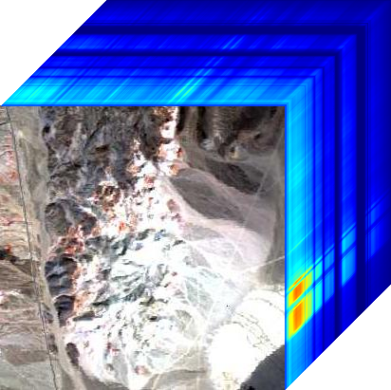
m
n

Slide 2
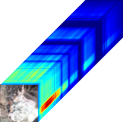

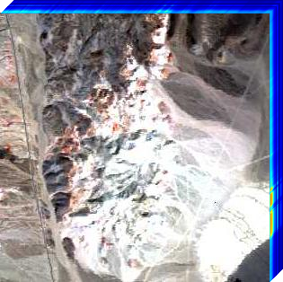
HS Image
Full-resolution Image
MS Image

Slide 4

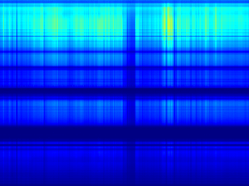

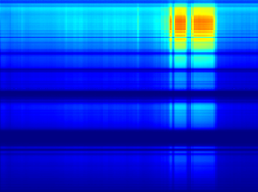
Folded Hyperspectral Image
m
Unfolded Hyperspectral Image
…
…
m
m
m

