Slide 1
CS 5163 Intro to Data Sci
Regression Analysis

Slide 2
Machine learning intro
Regression
Classification
Clustering
Dimension reduction
Feature selection

Slide 3
This topic
Simple linear regression
Multi linear regression
Ridge regression
Lasso
Logistic regression (for classification)

Slide 4
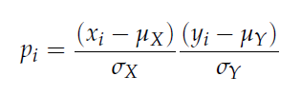
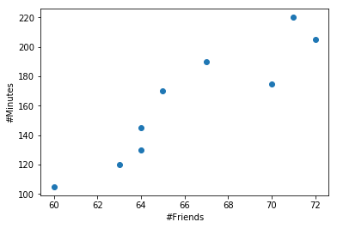

Recall: Pearson Correlation Coefficient

Slide 5
Linear regression
In correlation, the two variables are treated as equals. In regression, one variable is considered independent (=predictor) variable (X) and the other the dependent (=outcome) variable Y.
The output of a regression is a function that predicts the dependent variable based upon values of the independent variables.
Simple regression fits a straight line to the data.

Slide 6
What is “Linear”?
Remember this:
Y=α + β X?
y
β
1
slope
x
α
A slope of β means that every 1-unit change in X yields a β -unit change in Y.
intercept

Slide 7
Prediction
If you know something about X, this knowledge helps you predict something about Y. (Sound familiar?…sound like conditional probabilities?)

Slide 8
Regression equation…
Expected value of y at a given level of x =

Slide 9
Predicted value for an individual…
y_{i} = α + β*x_{i} + random error ε_{i}
Fixed – exactly on the line
Follows a normal distribution

Slide 10
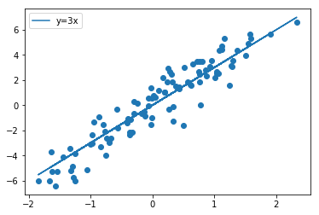
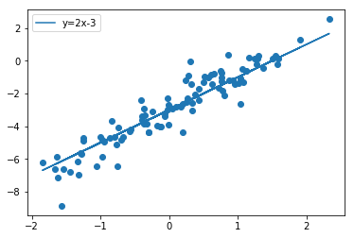
Examples

Slide 11
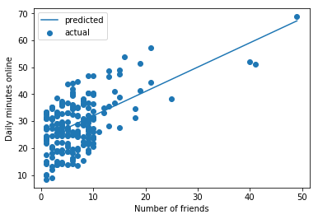
Number of Friends vs Daily Minutes Online
What does best fit mean?
Best fit line
Y = 0.9039 X + 22.95

Slide 12
The standard error of Y given X is the average variability around the regression line at any given value of X. It is assumed to be equal at all values of X.
Sy/x
Sy/x
Sy/x
Sy/x
Sy/x
Sy/x

Slide 13
Simple linear regression
Observation: y
^
Prediction: y
Dependent variable
Zero
Independent variable (x)
The function will make a prediction for each observed data point.
The observation is denoted by y and the prediction is denoted by y.
^

Slide 14
Regression Error
Prediction error: ε
Observation: y
^
Prediction: y
Zero
For each observation, the variation can be described as:
y = y + ε
Actual = Explained + Error
^

Slide 15
Sum of squares of error (SSE)
Dependent variable
Independent variable (x)
A least squares regression selects the line with the lowest total sum of squared prediction errors.
This value is called the Sum of Squares of Error, or SSE.

Slide 16
Sum of squares of regression (SSR)
Population mean: y
Dependent variable
Independent variable (x)
The Sum of Squares Regression (SSR) is the sum of the squared differences between the prediction for each observation and the population mean.

Slide 17
SST, SSR and SSE
The Total Sum of Squares (SST) is equal to SSR + SSE.
Mathematically,
SSR = ∑ ( y – y ) (measure of explained variation)
SSE = ∑ ( y – y ) (measure of unexplained variation)
SST = SSR + SSE = ∑ ( y – y ) (measure of total variation in y)
^
2
^
2
2

Slide 18
Least square regression
ˆ
=
β
+
α
y
x
y_{i}
C
i
i
A
B
y
B
A
C
*Least squares estimation gives us the parameters (α, β) that minimizes C² and SSE
y_{i}
x
Equality holds when least square solution is found
A² B² C²
SST: Total variation in y
Total squared distance of observations from naïve mean of y
SSR: variation explained by x
Distance from regression line to naïve mean of y
SSE: unexplained variance
Variance around the regression line

Slide 19
The Coefficient of Determination (aka R-squared)
The proportion of total variation (SST) that is explained by the regression (SSR) is known as the Coefficient of Determination, and is often referred to as R² .
The value of R can range between 0 and 1, and the higher its value the more accurate the regression model is. It is often referred to as a percentage.
R²=B²/A²=SSR/SST= 1 – SSE/SST
2

Slide 20
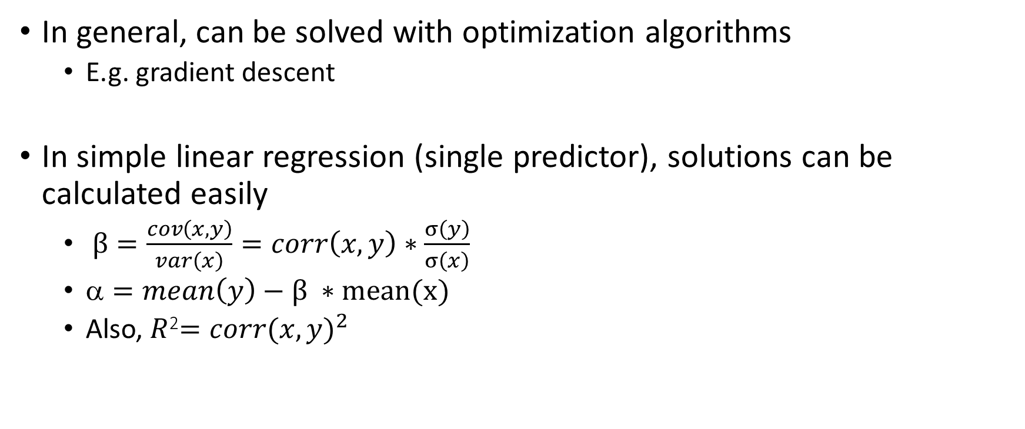
Solutions for least square fit
In general, can be solved with optimization algorithms
E.g. gradient descent
In simple linear regression (single predictor), solutions can be calculated easily
$β=\frac{cov\left(x,y\right)}{var\left(x\right)}=corr\left(x, y\right)∗\frac{σ\left(y\right)}{σ\left(x\right)}$
$=mean\left(y\right)−β ∗mean(x)$
Also, $R$²$={corr(x,y)}^{2}$
In correlation, the two variables are treated as equals. In regression, one variable is considered independent (=predictor) variable (X) and the other the dependent (=outcome) variable Y.

Slide 21
Significance test
Is the coefficient significantly different from 0?
Slope
Distribution of slope ~ T_{n-2}(β, s.e.( ))
H0: β1 = 0 (no linear relationship)
H1: β1 ≠ 0 (linear relationship does exist)
T_{n-2}=

Slide 22
Significance test

Slide 23
Number of Friends vs Daily Minutes Online
= 22.95
β = 0.9039
ρ = 0.574
R² = 0.329
s.e. (β) = 0.091
T₂₀₁ = 0.9039/0.091 = 9.93
P-value
= 1 – scipy.stats.t.cdf(9.93, 201)
= spipy.stats.t.cdf(-9.93, 201)
= 1.8e-19
Best fit line
Y = 0.9039 X + 22.95

Slide 24
Sklearn example
In [2629]: from sklearn import linear_model
...: from sklearn.metrics import mean_squared_error as mse
...: from sklearn.metrics import r2_score as r2
...:
...: lr = linear_model.LinearRegression()
...: lr.fit(x, y)
...: pred = lr.predict(x)
...:
...: print('beta = %.2f' % lr.coef_)
...: print('alpha = %.2f' % lr.intercept_)
...: print('r2 = %.2f' % r2(y, pred))
...: print('mse = %.2f' % mse(y, pred))
...:
beta = 0.90
alpha = 22.95
r2 = 0.33
mse = 65.01
= 22.95
β = 0.9039
ρ = 0.574
R² = 0.329
s.e. (β) = 0.091
T₂₀₁ = 0.9039/0.091 = 9.93
P-value
= 1 – scipy.stats.t.cdf(9.93, 201)
= spipy.stats.t.cdf(-9.93, 201)
= 1.8e-19
mse: SSE/n

Slide 25
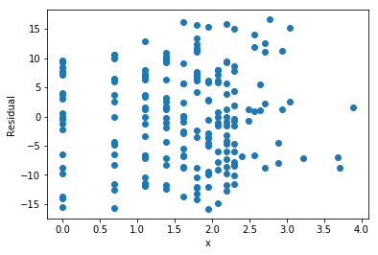
Residual analysis
Residual = observed - predicted
plt.scatter(x, y)
plt.plot(x, pred, '-')
plt.scatter(x, y-pred)

Slide 26
Assumptions (or the fine print)
Linear regression assumes that…
The relationship between X and Y is linear
Y is distributed normally at each value of X
The variance of Y at every value of X is the same (homogeneity of variances)
The observations are independent

Slide 27
Residual Analysis for Linearity
Y
Y
x
x
residuals
x
x
residuals
Not Linear
✓
Linear

Slide 28
Residual Analysis for Homoscedasticity
Y
Y
x
x
residuals
x
x
residuals
✓
Non-constant variance
Constant variance

Slide 29
Residual Analysis for Independence
Not Independent
✓
Independent
residuals
X
residuals
X
residuals
X

Slide 30
Multiple linear regression…
More than one independent variables can be used to explain variance in the dependent variable, as long as they are not linearly related.
A multiple regression takes the form:
y = A + β₁ X ₁ + β₂ X ₂ + … + β _{k} X _{k} + ε
where k is the number of variables, or parameters.
Each regression coefficient is the amount of change in the outcome variable that would be expected per one-unit change of the predictor, if all other variables in the model were held constant.

Slide 31
Multiple linear regression in matrix form
Data
Unknown parameters to be solved
Error to be minimized
Y
1
X
ε
β
=
*
+
*
+
α
(1,1)
(k,1)
(n,1)
dummy
(n,1)
(n,k)
(n,1)

Slide 32
Multiple linear regression in matrix form - 2
Some packages such as the scipy.linalg.lstsq() needs you to add the dummy variable. sklearn does it for you.
Y
1
X
ε
α
β
=
*
+
k should to be smaller than n. Otherwise the system may be underdetermined. (infinity number of solutions and ε = 0.)
(k+1,1)
(n,1)
(n,k+1)
(n,1)

Slide 33
Boston house price
:Attribute Information (in order):
- CRIM per capita crime rate by town
- ZN proportion of residential land zoned for lots over 25,000 sq.ft.
- INDUS proportion of non-retail business acres per town
- CHAS Charles River dummy variable (= 1 if tract bounds river; 0 otherwise)
- NOX nitric oxides concentration (parts per 10 million)
- RM average number of rooms per dwelling
- AGE proportion of owner-occupied units built prior to 1940
- DIS weighted distances to five Boston employment centres
- RAD index of accessibility to radial highways
- TAX full-value property-tax rate per $10,000
- PTRATIO pupil-teacher ratio by town
- B 1000(Bk - 0.63)^2 where Bk is the proportion of blacks by town
- LSTAT % lower status of the population
- MEDV Median value of owner-occupied homes in $1000's
:Missing Attribute Values: None
In [2665]: from sklearn import datasets, linear_model
...: boston = datasets.load_boston()
...: print(boston.DESCR)
Boston House Prices dataset
===========================
Notes
------
Data Set Characteristics:
:Number of Instances: 506
:Number of Attributes: 13 numeric/categorical predictive
:Median Value (attribute 14) is usually the target

Slide 34
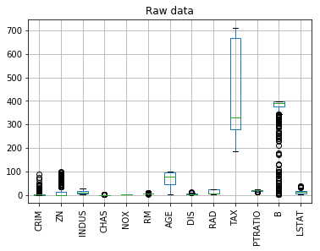
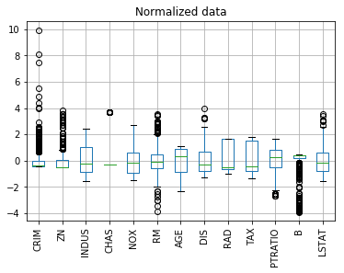
Boston house price data
In [2669]: data = DataFrame(boston.data, columns=boston.feature_names)
In [2670]: data.boxplot(rot=90)
In [2671]: def zscore(s): return (s - s.mean()) / s.std()
In [2672]: normData=data.apply(zscore)
In [2673]: normData.boxplot(rot=90)

Slide 35
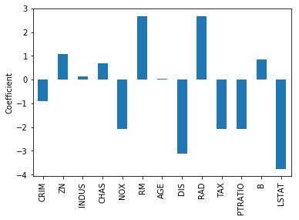
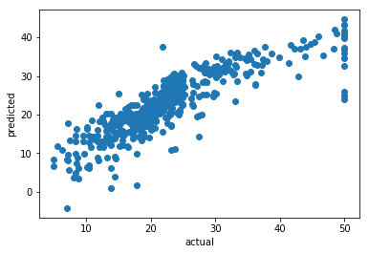
Predicting Boston house price
In [2686]: from sklearn import linear_model
...: y = boston.target
...: x = normData
...: lr = linear_model.LinearRegression()
...: lr.fit(x, y)
...: coef=Series(lr.coef_, index=boston.feature_names)
...: coef.plot(kind='bar'); plt.ylabel('Coefficient')
In [2690]: r2(y, pred)
Out[2690]: 0.7406077428649428

Slide 36
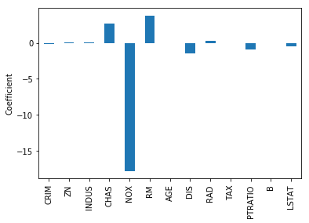
Without normalization
With normalization
In [2690]: r2(y, pred)
Out[2690]: 0.7406077428649428
In [2693]: r2(y, pred)
Out[2693]: 0.7406077428649428
Coefficient value does not necessarily reflect significance/relevance, especially if data is not normalized.

Slide 37
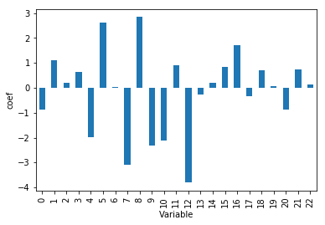
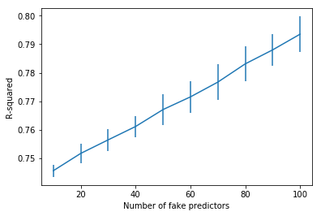
Overfitting
Real predictors
Fake predictors
The more variables you add, the better the fit
Smaller SSE and MSE
Larger R²
True even if the variables are random (i.e., irrelevant)
In [2700]: fakedata = np.random.rand(len(y), 10)
...: data2=pd.concat([normData, DataFrame(fakedata)], axis=1)
...: x = data2;
...: lr.fit(x, y)
...: pred = lr.predict(x)
...: r2(y, pred)
...:
Out[2700]: 0.74575835459198614

Slide 38
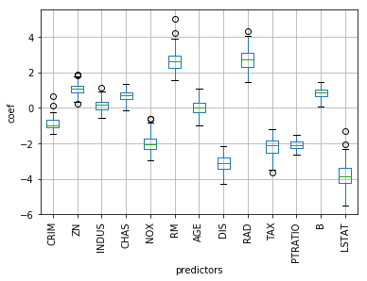
Bootstrapping
A way to estimate the distribution given limited data
Key idea: draw random samples with replacement
x = normData
y = np.array(boston.target)
n = 100
dataSize = len(y)
coef_bs = np.zeros((n, x.shape[1]))
for i in range(n):
sample = np.random.choice(np.arange(dataSize), size=dataSize, replace=True)
newY = y[sample]
newX = x.iloc[sample, :]
lr.fit(newX, newY)
coef_bs[i,:] = lr.coef_
coef_bs = DataFrame(coef_bs, columns=boston.feature_names)
coef_bs.boxplot(rot=90)
sample:
len(y) random int from 0 to len(y)-1, repeats allowed

Slide 39
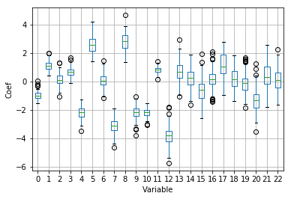
Bootstrap with real and fake predictors
Real predictors
Fake predictors
Index 0-12 are real predictors
Index 13-22 are fake predictors

Slide 40

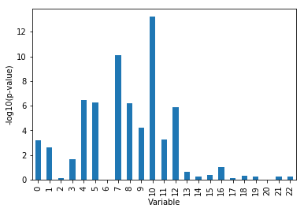
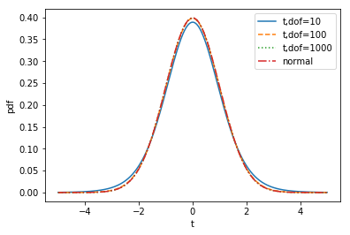
Significance testing for coefficients using bootstrapping
t = coef / coef_bs.std(axis=0)
pvalue = 2*stats.t.cdf(-np.abs(t), dataSize - data2.shape[1]-1)
Real predictors
Fake predictors
follows a t-distribution with n-k-1 degree of freedom

Slide 41
Polynomial regression
e.g. y = A + β₁ X ₁ + β₂ X₂ + β₁₂ X₁ X₂ + β₁₁ X₁² + β₂₂ X₂² + ε
Precompute the high-degree terms from x1, x2, …
Still a linear regression …
Sometimes only the interaction terms are considered
i.e. y = A + β₁ X ₁ + β₂ X₂ + β₁₂ X₁ X₂ + ε
Can be solved exactly the same way as for regular multiple linear regression.

Slide 42
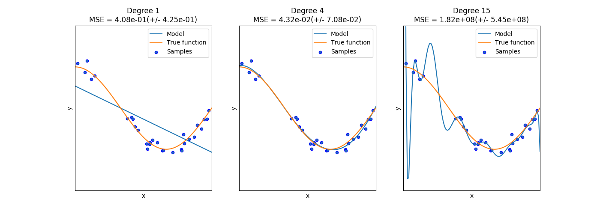
Polynomial regression – overfitting vs underfitting

Slide 43
Multicollinearity
Multicollinearity arises when two variables that measure the same thing or similar things (e.g., weight and BMI) are both included in a multiple regression model; they will, in effect, cancel each other out and generally destroy your model.
Model building and diagnostics are tricky business!

Slide 44
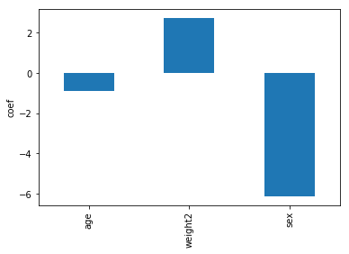
Predicting height from weight, age and gender
brfss = pd.read_csv('brfss.csv', index_col = 0);
brfss2 = brfss.dropna(axis=0, how='any');
y = brfss2['htm3']
x=brfss2.drop(['wtyrago', 'wtkg2', 'htm3'], axis=1).apply(zscore)
lr.fit(x, y)
In [2926]: x.columns
Out[2926]: Index(['age', 'weight2', 'sex'], dtype='object')
In [2928]: pred = lr.predict(x)
In [2929]: r2(y, pred)
Out[2929]: 0.55700902357112936
In [2930]: Series(lr.coef_, index=x.columns).plot(kind='bar')
Out[2930]: <matplotlib.axes._subplots.AxesSubplot at 0x15c3ad6d8>

Slide 45
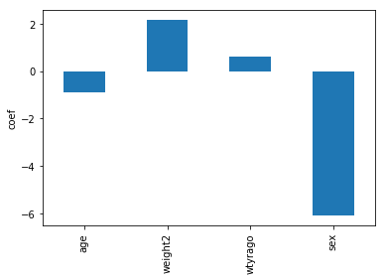
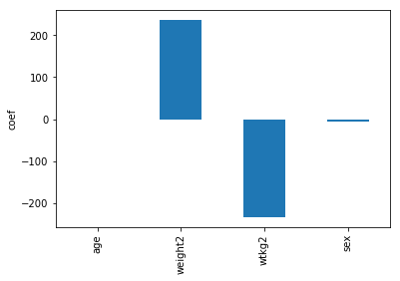
Including wtyrago/wtkg2 as predictor
In [2938]: r2(y, pred)
Out[2938]: 0.55741517914915306
In [2934]: r2(y, pred)
Out[2934]: 0.55701938503927018

Slide 46
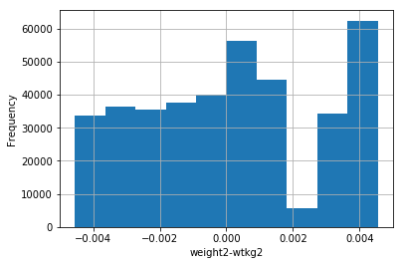
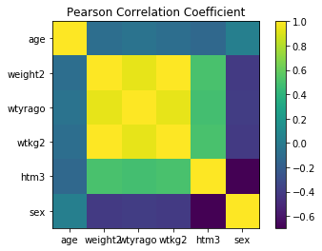
Correlation between predictors
weight2, wtyrago and wtkg2 are highly correlated
In [2961]: brfss2[['wtkg2','wtyrago']].corrwith(brfss2['weight2'])
Out[2961]:
wtkg2 1.000000
wtyrago 0.936271
weight2, and wtkg2 are almost but not identical
plt.imshow(brfss2.corr());
plt.colorbar();

Slide 47
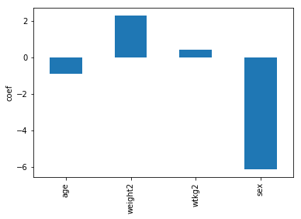
Ridge regression
Force all coefficients to be small by adding a penalty term that is the sum of squares of all coefficients (replace w in the formula with α)
x=brfss2.drop(['wtyrago', 'htm3'], axis=1).apply(zscore)
y = brfss2['htm3']
reg = linear_model.Ridge(alpha=1)
reg.fit(x, y)
pred = reg.predict(x)
In [2969]: r2(y, pred)
Out[2969]: 0.55700898468780091
Series(reg.coef_, index=x.columns).plot(kind='bar')

Slide 48
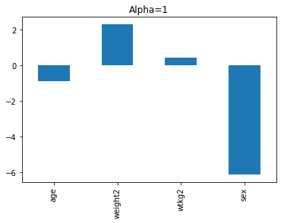
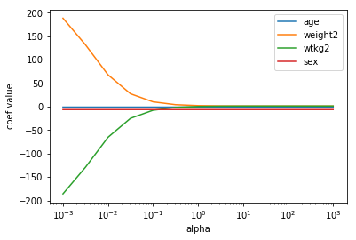
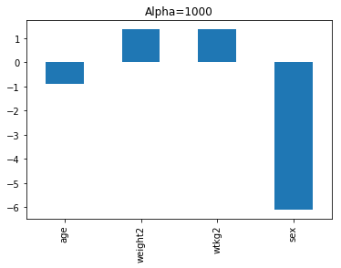
Ridge regression – impact of alpha

Slide 49

Recall: overfitting
Real predictors
Fake predictors
The more variables you add, the better the fit
Smaller SSE and MSE
Larger R²
True even if the variables are random (i.e., irrelevant)
In [2700]: fakedata = np.random.rand(len(y), 10)
...: data2=pd.concat([normData, DataFrame(fakedata)], axis=1)
...: x = data2;
...: lr.fit(x, y)
...: pred = lr.predict(x)
...: r2(y, pred)
...:
Out[2700]: 0.74575835459198614

Slide 50

Lasso regression
A sparse model (that uses less predictors) may be more preferred than a larger model (that uses much more predictors) with slightly better R-squared
Easier to interpret
Less likely to overfit – better prediction performance on new data
Lasso regression prefers less non-zero coefficients by adding a penalty term that is the sum of the absolute value of the coefficients

Slide 51
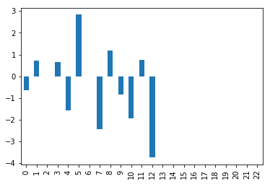
Predicting Boston house price with lasso
Real predictors
Fake predictors
y = np.array(boston.target)
fakedata = np.random.rand(len(y), 10)
data2=pd.concat([normData, DataFrame(fakedata)], axis=1)
x = data2
las = linear_model.Lasso(alpha=0.1)
las.fit(x, y)
pred = las.predict(x)
Series(las.coef_).plot(kind='bar')
lasso
In [3000]: r2(y, pred)
Out[3000]: 0.73525927648386513
In [3002]: lr = linear_model.LinearRegression()
...: lr.fit(x, y)
...: pred = las.predict(x)
...: Series(lr.coef_).plot(kind='bar')
...: pred2=lr.predict(x)
...: r2(y, pred2)
...:
Out[3002]: 0.74504944738308576
Ordinary
Least square

Slide 52
Regularization
Both Ridge and Lasso fall into the category of regularization
An approach in which we add to error terms a penalty that depends on other properties of the model
In ridge, the penalty is the sum of the squared coefficients
In lasso, the penalty is the sum of the absolute values of coefficients
Usually there is a parameter that determines the relative weight of the two terms, which needs to be determined empirically

Slide 53
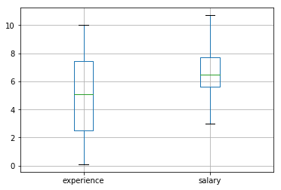
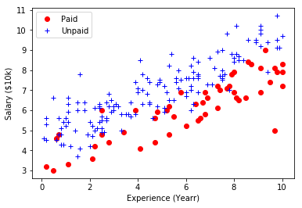
Logistic regression
Logistic regression instead of linear regression is used when y has only categorical values (e.g., Yes and No)
Example: predicting data scientist who has paid account of a website using salary and years of experience as predictors

Slide 54
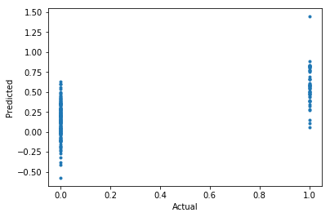
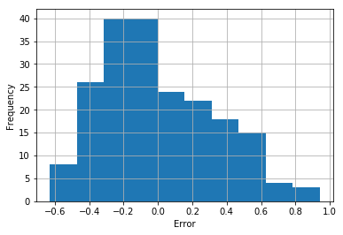
Predicting paid account with linear regression
Y = 1.325 + 0.154 * experience – 0.275 * salary
Paid: 1; Unpaid: 0
Problem:
Predicted value lacks intuitive meaning
error may be not normally distributed
Error may be correlated with predictors
How good is the model?
0.5 as cutoff
“Accuracy”: 88.5%
More on this later
 | paid | unpaid
>=0.5 | 34 | 5
< 0.5 | 18 | 143

Slide 55
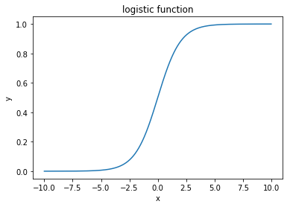
Logistic function
def logistic(x):
return 1.0 / (1 + np.exp(-x))
f: logistic function
Logistic regression maximize the log likelihood of the parameters given the data. Additional regularization terms such as the ones used in ridge or lasso are often also included.

Slide 56
Using logistic regression in sklearn
In [1097]: import sklearn.linear_model as lm
...: lr = lm.LogisticRegression()
...: lr.fit(x, y)
...: pred_prob=lr.predict_proba(x)
...: lr.coef_
...:
Out[1097]: array([[ 0.96525847, -1.43503454]])
Y = logistic(3.104+0.965 * experience – 1.435 * salary)
In [1064]: lr.intercept_
Out[1064]: array([ 3.10391548])
 | paid | unpaid
>=0.5 | 28 | 4
< 0.5 | 24 | 144
“Accuracy”: 86.0%

Slide 57
Using logistic regression in sklearn
In [1097]: import sklearn.linear_model as lm
...: lr = lm.LogisticRegression()
...: lr.fit(x, y)
...: pred_prob=lr.predict_proba(x)
...: lr.coef_
...:
Out[1097]: array([[ 0.96525847, -1.43503454]])
Y = logistic(3.104+0.965 * experience – 1.435 * salary)
In [1064]: lr.intercept_
Out[1064]: array([ 3.10391548])
 | paid | unpaid
>=0.3 | 45 | 19
< 0.3 | 7 | 129
“Accuracy”: 87.0%
Is accuracy on training data a good measure?

