Slide 1
JPEG Encoder
Tai-Sheng Cheng (tscheng2)
Yen-Chieh Sung (ycsung2)

Slide 2
Outline

Slide 3
JPEG
Lossy compression for digital image
Tradeoff between storage and image quality
10:1 compression with little perceptible loss in image quality

Slide 4
Steps of JPEG Encoder
Color Transformation
Subsampling
Block splitting
Forward Discrete Cosine Transform
Quantization
Entropy Coding
JPEG Serialization

Slide 5
Color Transformation
RGB to a different color space YCbCr
Y represents the brightness
Cb and Cr represent the chrominance (Cb for blue, Cr for red)

Slide 6
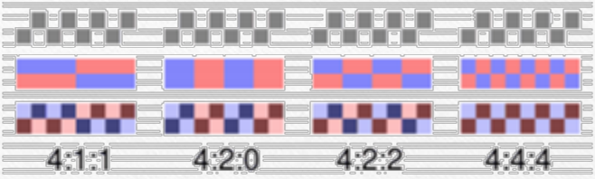
Subsampling
Human vision is not sensitive to chrominance domain
Reduce chrominance blocks to save storage
4:1:1 in our implementation
Cr
Cb
Y
Cb
Cr
Y

Slide 7
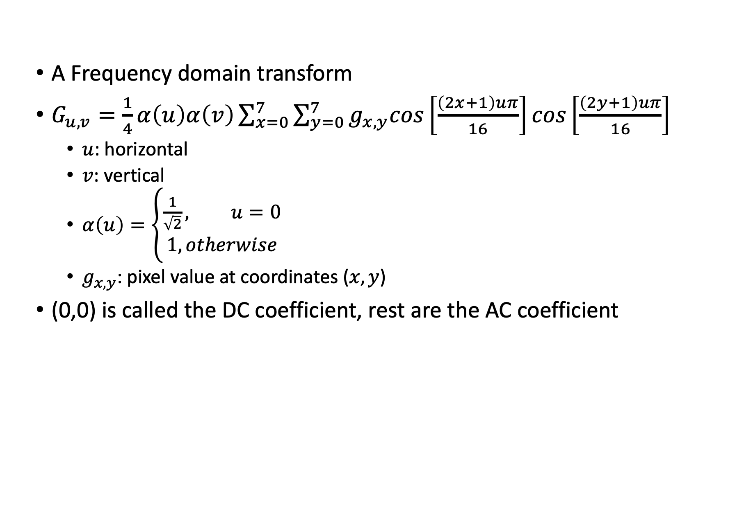
Forward Discrete Cosine Transform
A Frequency domain transform
$G_{u,v}=\frac{1}{4}α\left(u\right)α\left(v\right)\sum_{x=0}^{7}{\sum_{y=0}^{7}{g_{x,y}cos\left[\frac{\left(2x+1\right)uπ}{16}\right]cos\left[\frac{\left(2y+1\right)uπ}{16}\right]}}$
$u$: horizontal
$v$: vertical
$α\left(u\right)=\left\{\begin{aligned}\frac{1}{\sqrt{2}}, u=0 \\ 1, otherwise\end{aligned}\right.$
$g_{x,y}$: pixel value at coordinates ($x,y$)
(0,0) is called the DC coefficient, rest are the AC coefficient

Slide 8
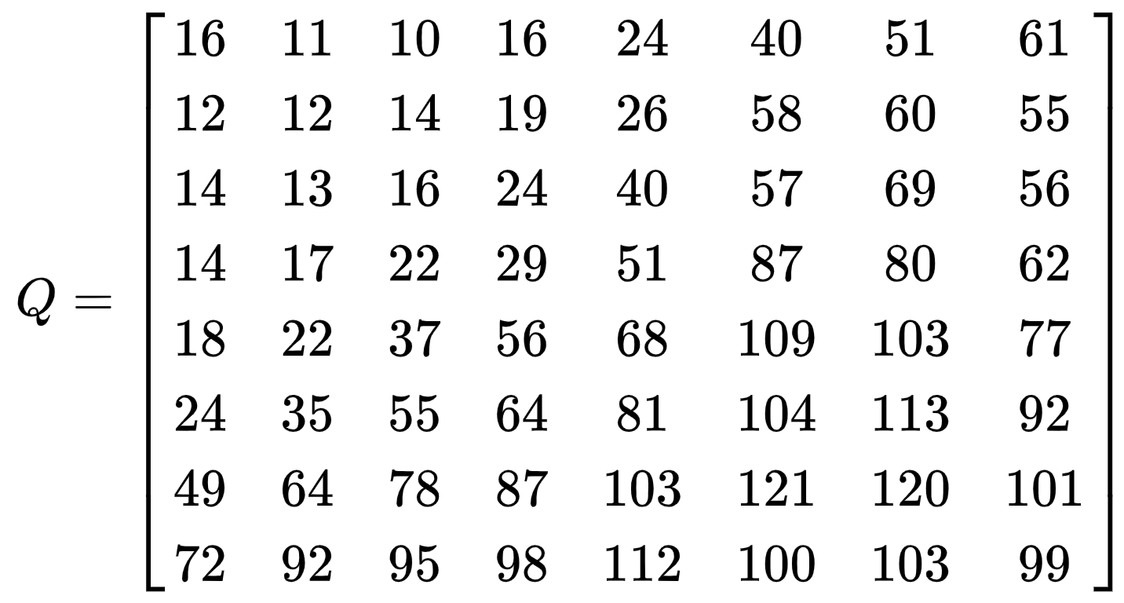
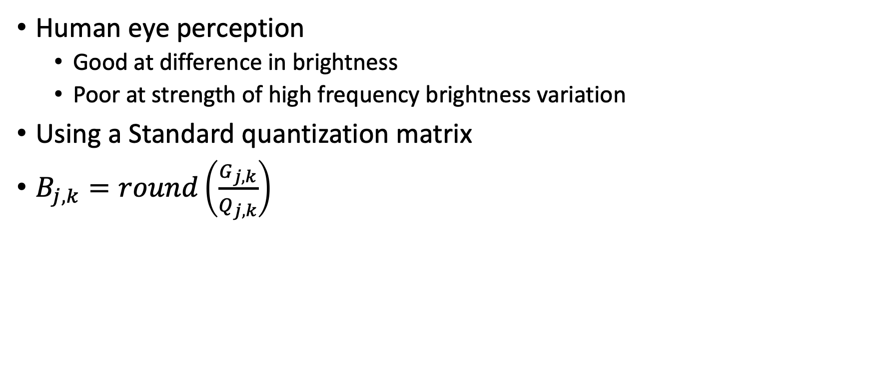
Quantization
Human eye perception
Good at difference in brightness
Poor at strength of high frequency brightness variation
Using a Standard quantization matrix
$B_{j,k}=round\left(\frac{G_{j,k}}{Q_{j,k}}\right)$

Slide 9
Entropy Encoding
Lossless data compression
Zigzag:
Run Length Encoding:

