Slide 1



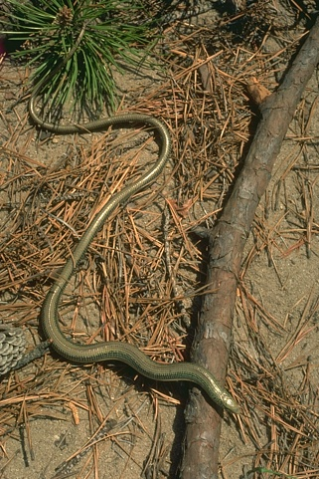
Reliable and scalable variational inference
for the hierarchical Dirichlet process
Python code
bitbucket.org/michaelchughes/bnpy-dev
Michael C. Hughes, Dae Il Kim, & Erik B. Sudderth Dept. of Computer Science, Brown University
HDP topic model
Scalable variational inference
HDP prior: data-driven learning of number of topics K
Our direct assignment representation better than alternatives
New variational objective
Memoized algorithm
Hughes & Sudderth, NIPS ’13
Neal & Hinton ’99
Goal: Find approximate factorized posterior
As scalable as stochastic, without pesky learning rate.
Requires tracking statistics for each batch & topic.
p(topic)
Algorithm template
several possibilities…
batch 1
batch 2
batch 3
batch 4
: total count of tokens assigned to topic k
dinosaur
Jurassic
space
asteroid
Batch-Specific
Must also track summaries
for k = 1, 2, … K.
p(word|topic)
fossil
Mars
Initialize global factors
Loop until converged:
a) For each batch in dataset:
Whole-Dataset
Update batch 1
Local step
Summary step
Global step
Updating tracked statistics
p(topic | doc.)
Local / Summary step gives new batch value:
+=
-
-
Incremental update to whole-dataset value:
token
indicator
Stochastic algorithm
Hoffman, Blei, et al ‘12
Global
Local
document-specific
observed
word token
b) Try merge proposals
c) Try delete proposals
Natural gradient descent for global step update.
Less effective for merges/deletes. Can’t exactly check whole-dataset objective.
Experiments
Reliable inference
Memoized alg. with merges/deletes rapidly finds small set of high-quality topics.
Other algorithms get stuck quickly or improve very slowly.
Algorithm should recover similar compact set of topics, regardless of initialization.
Algorithm should avoid local optima & remove useless junk topics.
Toy bars
1000 docs
900 vocab types
Wiki articles
Model selection
Delete move
7961 docs
6131 vocab types
Chosen form of is important.
MAP Point Estimate:
Fails to penalize empty topics effectively.
Full distribution:
Integrate away all parameters that grow with K.
Junk topic mass reassigned among all remaining topics.
More flexible than merge, but only scales with smaller topics.
Requires extra local step on small target dataset.
Liang et al. ‘07
Bryant & Sudderth ‘12
Legend:
Train on toy data with assignments fixed to truth, with extra empty topics.
Goal: does objective increase or decrease as more empty topics added?
Example documents
Drawn from 10 true topics.
memo + delete & merge
initial K=100 final K=10
memo + delete & merge, init=smart
memo + delete & merge, init=random
memoized, init=random
stochastic, init=random
Gibbs sampler
stochastic (CRF)
true topic assignments
empty
topics
change in ELBO
bad!
Teh et al. ‘06
0 1 0 … 0
1 0 0 … 0
0 0 0 … 1
0 0 1 … 0
0…0
0…0
0…0
0…0
good
Merge move
Wang et al. ‘11
memoized
initial K=100 final K=100
NY Times articles
Gibbs
initial K=100 final K=67
1.8 million docs
8000 vocab
Surrogate objective
Redundant pair of topics combined into one single topic.
Exact evaluation of proposal possible via tracked summaries.
No extra local step required, only a few pair-wise statistics.
Oct ‘14: single thread
May ‘15: 8 workers
New function lower bounds intractable ideal objective.
Penalizes junk topics; key to merge/delete moves.
Accepted Merge
Accepted Merge
series
song
release
star
television
york
award
friend
film
magazine
direct
production
actor
career
hollywood
appeared
language
latin
letter
dialect
speak
speaker
sound
verb
linguistic
linguist
language
speech
linguistics
grammatical
pronunciation
suffix
Recent parallelization of code makes large-scale analysis possible.
Dirichlet log norm. constant
Lacks closed-form expectation
Tight lower bound
Expectation w.r.t. easy
Holds for all
exact
surrogate
Image patches
Nested truncation
Sparse restarts in local step
3 million 8x8 patches
from 400 images
Model comparison:
image-specific frequencies (HDP admixture)
universal frequencies (DP mixture)
Patch samples from trained model
Showing top 4 clusters for each image,
ranked out of a shared set of K=200.
Only assign tokens to first K topics of infinite set.
New move for escaping local optima at each doc.
Propose zero values for small-mass topics.
Accept if improves obj. function.
Topics > K are conditionally independent of data.
Need not be represented during inference.
K=8
Easy to contract truncation level.
Makes merge & delete possible.
K=7
Track probability of all inactive topics (k > K).
Notes:
Code available

