Slide 1
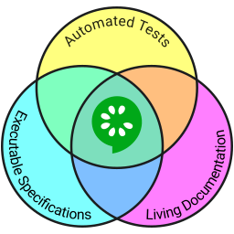
GHERKIN / CUCUMBER
BDD in action

Slide 2


The sample APP
Taken from the spring-petclinic application
https://github.com/spring-projects/spring-petclinic
Modified with gherkin scenario
https://github.com/michaelcourcy/spring-petclinic

Slide 3
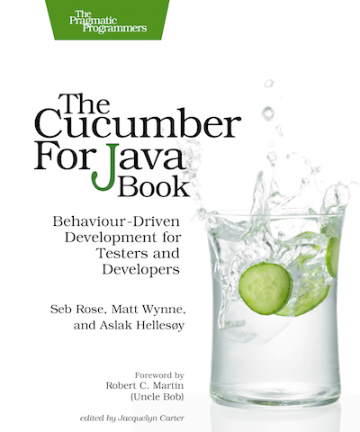
Inspiration source
Every developper should have read at list one major book on test automation
This book is one of them

Slide 4
Schedule
Why cucumber
How cucumber/gherkin work
Internationalization
Browser automation
Collaborate on Requirement
Working with Spring and database
Working with Spring and database

Slide 5
What's the problem ?
A project faces serious problems when its language is fractured. Domain experts use their jargon while technical team members have their own language tuned for discussing the domain in terms of design…Across this linguistic divide, the domain experts vaguely describe what they want. Developers, struggling to understand a domain new to them, vaguely understand.”
Eric Evans in his book Domain Driven Design

Slide 6
A common language
The team need a common language
A language used consistently in
  Conversation
  Documentation
  Code
It reduces the cost of translation
Chances of misunderstanding is greatly reduced

Slide 7
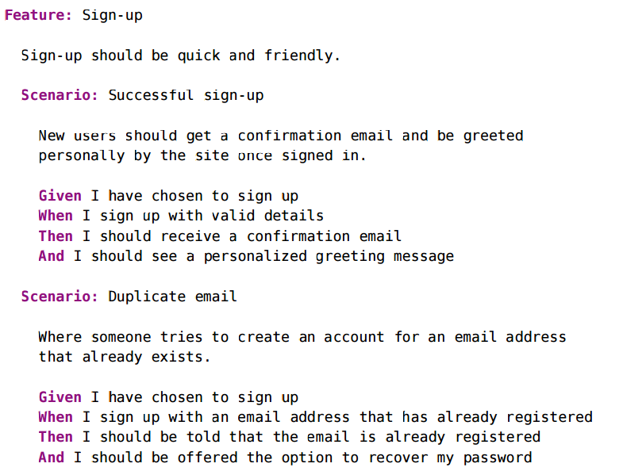

Slide 8
Specification by example
We specified the system by examples
The way we want the system to behave
All the team can read it
Spark the imagination into new scenarios ...
It's a living documentation
For all the team member it often become the source of truth

Slide 9
Schedule
Why cucumber
How cucumber/gherkin work
Internationalization
Browser automation
Collaborate on Requirement
Working with Spring and database

Slide 10
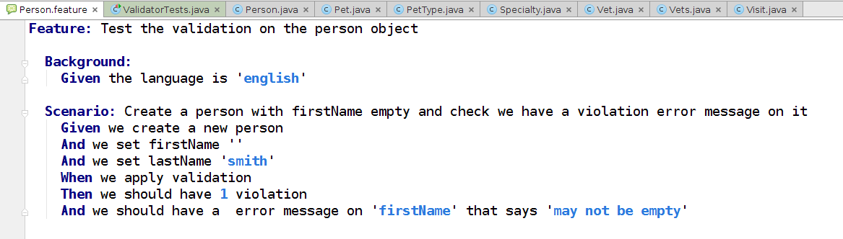









How it works ?
Gherkin is the langage, natural langage with steps
Cucumber is the engine, you have one for each language

Slide 11
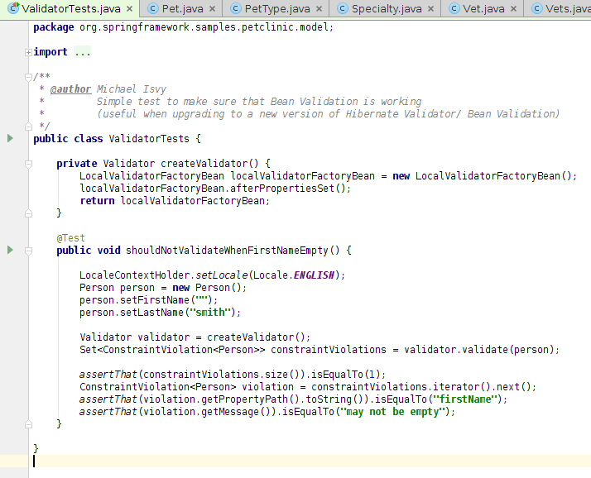
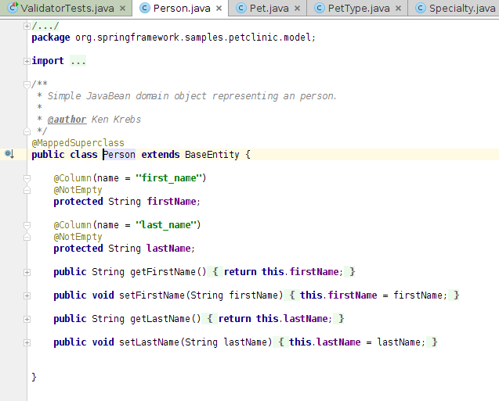
A classic test
This is a classical
technical test
We check that if firstName is empty we get
a violation and a violation message

Slide 12
Express it as a behaviorial test
No technical detail on
how we set english
Or how we
create a person
We describe how the system should behave and not how it should work internally
Feature : Describe a set of scenario
Background : what's will be true for all the scenarios in the feature
Scenario : start a test and give a description
Given, And, When, Then : are the steps of the scenarios

Slide 13
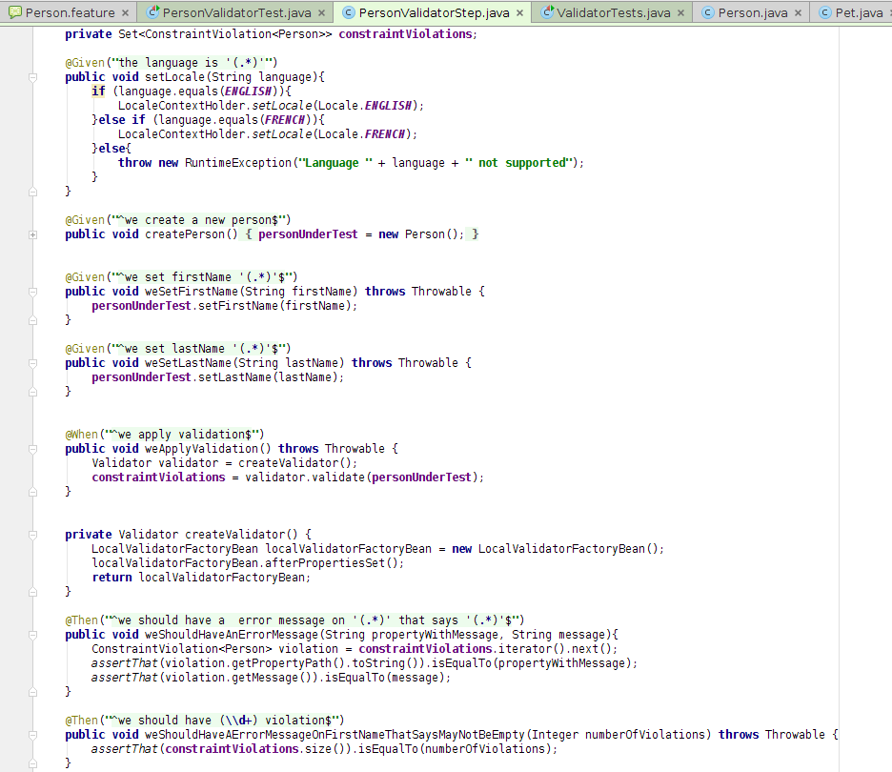
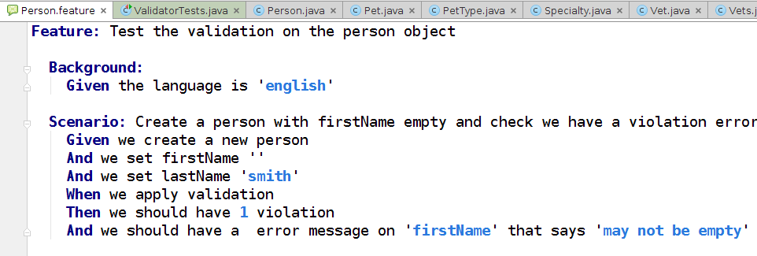
Work with annotation
The java file PersonValidatorStep is called the step definition
Often stateful
The step is instantiated at each scenario
Every regexp capture is passed to the parameters

Slide 14
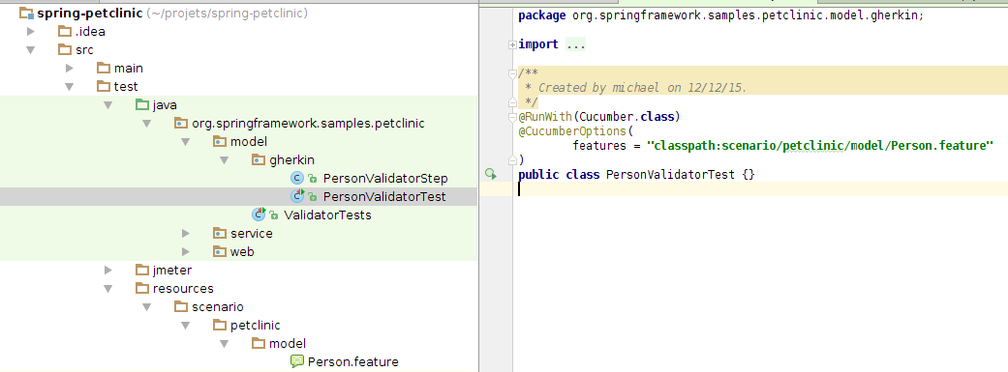
The test class
We have scattered the test code in the step class
The test class become much simpler

Slide 15
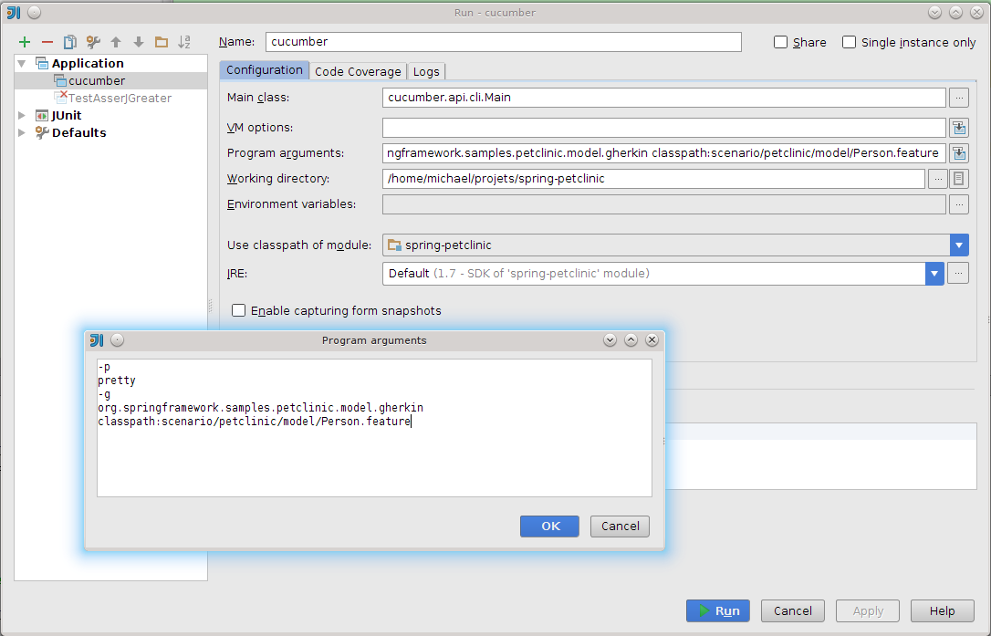
Or run it with the cucumber client

Slide 16
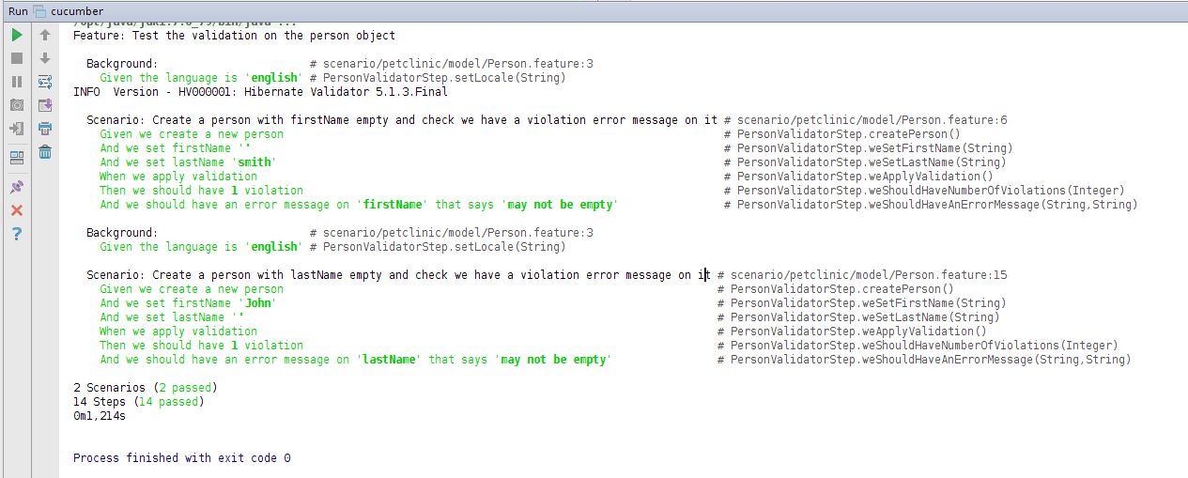
More output with -p pretty

Slide 17
Let's try it ...
https://www.youtube.com/watch?v=QJqLY3Wj7e0

Slide 18
Schedule
Why cucumber
How cucumber/gherkin work
Internationalization
Browser automation
Collaborate on Requirement
Working with Spring and database

Slide 19
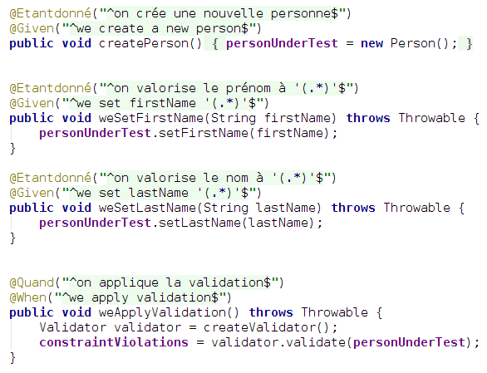
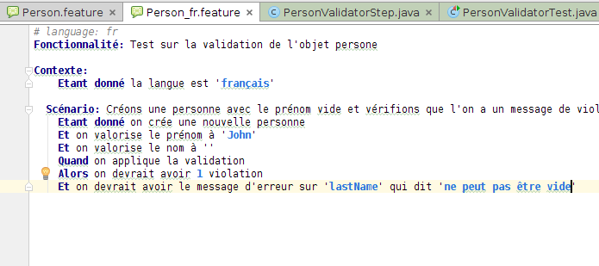
Internationalization
You need it in french ? No problem !

Slide 20
Schedule
Why cucumber
How cucumber/gherkin work
Internationalization
Browser automation
Collaborate on Requirement
Working with Spring and database

Slide 21
Browser automation
Doing Browser automation is not specific to gerkin/cucumber
You can call Selenium from the step definition
Stay in BDD spirit, the behaviour not the implementation

Slide 22
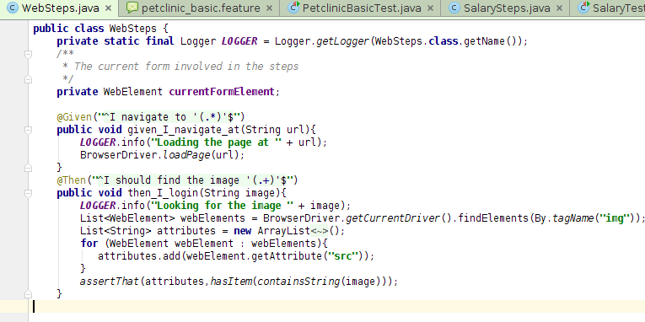
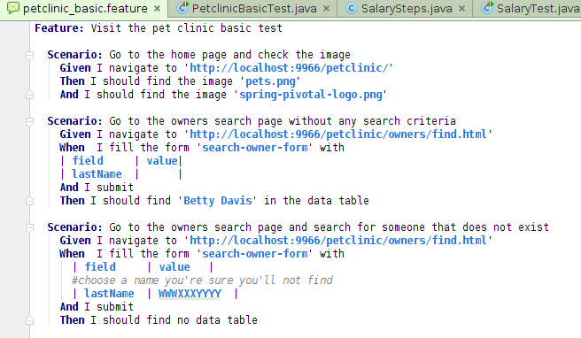
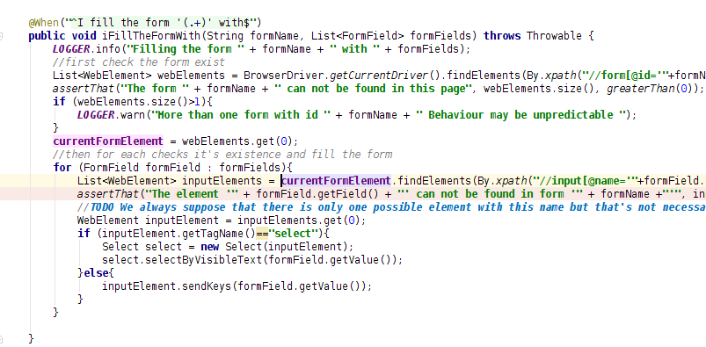
Browser automation

Slide 23
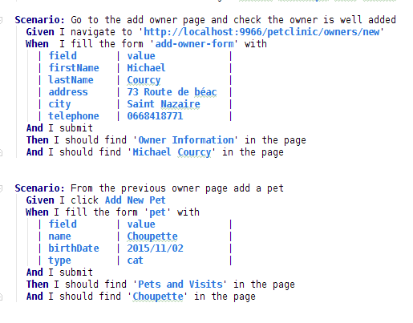
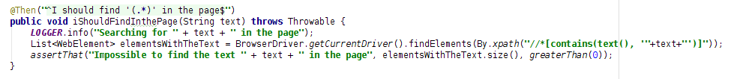
Browser automation

Slide 24
Let's try it
https://youtu.be/JI6nVI-JfkU

Slide 25
Schedule
From BDD To BDD
How cucumber/gherkin work
Internationalization
Browser automation
Collaborate on requirement
Working with Spring and database

Slide 26

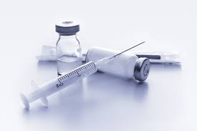
Contractual requirement
This is comming from the customer, one line in the mantis bug tracker...
Mantis #281 Send automaticaly an email 2 month before the renewal of the vaccine. Add a gift code to refund 5% on the visit if the visit is booked the day of the email.

Slide 27
From there let's build the solution requirement
But before make words clear

Slide 28

Avoid the word mess
Contractual requirement could be a user story
But features are not user stories ...
Features are solution requirement
The contractual requirement are forgotten/absorbed along the versions
The solution requirement (or feature) remains
A contractual requirement may not be a user story (a performance requirement for instance)
A mantis/jira/ticket may not be a contractual requirement (just a bug)
Sometime user story could be directly translated in a solution requirement if we express a change that's going to be definitive, but it's rare
...

Slide 29
Solution requirement
Vet can create vaccine type defining the recurrence rule
When closing the visit the vet can add vaccines on the current date and create automaticaly the next vaccine based on the recurence rule
Every day at 1 AM a batch send a mail to all owners who own a pet having the next vaccine date within 2 months
When booking the visit if the gift code is on the day add a refund of 5 % on the visit
....

Slide 30
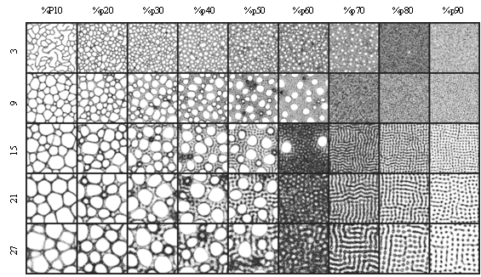
Granularity ...
Often granularity is claimed to be a problem on solution requirement
Should I add a rule like “if the mail was already sent, then wait 2 weeks before resending” to the solution requirement ?
Solution requirement explain how the solution is possible
They let the reader grasp easily the system
The rest is the body of the feature

Slide 31
Organisation
In which folder should I put this features ?
  #Mantis 281
  Vaccine
  Emailing
  Visit
Probably not #Mantis 281 for the rest don't bother with that ! Choose something meaningful for you
You'll be reorganizing anyway ..

Slide 32
Let's Gherkin
“Vet can create vaccine type defining the recurrence rule”

Slide 33
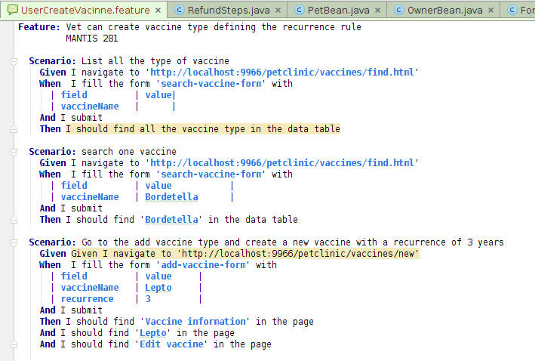
The developper comes up with that
Dev : This is common to all
searchs it's more a
smoke test
Dev : A smoke test again,
It's worth not doing that
Manually every time we
deliver
PM : He ! this is common
sentences on all the screen
It costs 0 to automate this
test
Dev : I have a doubt if it's
enough to work with the
recurrence this way.
I should ask the BA.

Slide 34
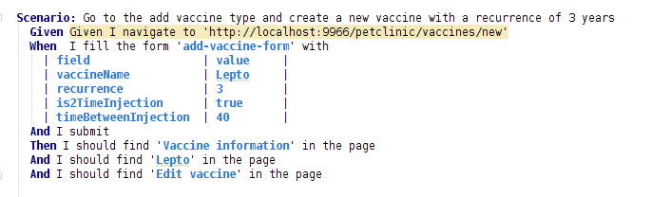
Dev and BA works together
BA want to know what's the unity of the recurrence
BA notice that some vaccine are in two injections so the scenario elvove
BA: What's the unity?
Dev : Year I guess
BA: Too gross ! Month
is better
BA: Some vaccine
Need 2 injects
Dev : OK I add two
Extra fields

Slide 35
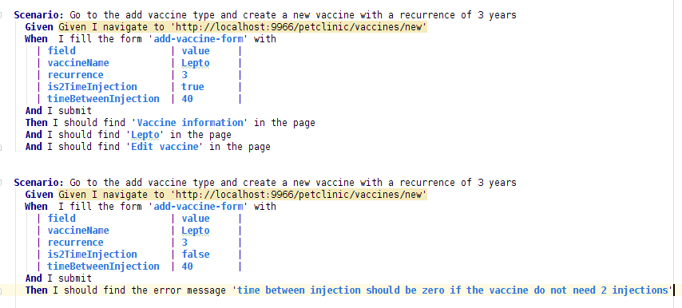
Then the tester show up ...
Tester : The field
timeBetweenInjection
depends of the
previous is2timeInjection
Tester : cover this case with
this test

Slide 36
Gherkin first goal : Collaboration
First goal is collaboration !
Test automation and living documentation are positive side effect ...
If you manage to have tech and no-tech to work together on the feature as we showed previously then your project won't fail.

Slide 37
Schedule
From BDD To BDD
How cucumber/gherkin work
Internationalization
Browser automation
Collaborate on requirement
Working with Spring and database

Slide 38
Tools for working with the database
Liquibase to manage the evolution of the DB
DBSetup to clean and create data
HSQL because for the test we need in memory database
But HSQL is going to be in server mode because we don't want to put all this tools in the same JVM
Thought that would be possible ...

Slide 39
HSQL in server mode
HSQL is started independently
Adapt the data-access.properties configuration file
Run again the app and check data is initialised
Try also the GUI tool
mvn exec:java -Dexec.mainClass="org.hsqldb.server.Server" \
-Dexec.args="--database.0 mem:petclinic --dbname.0 petclinic"
jdbc.url=jdbc:hsqldb:hsql://localhost/petclinic
mvn tomcat7:run
mvn exec:java -Dexec.mainClass="org.hsqldb.util.DatabaseManagerSwing" \
-Dexec.args="--URL jdbc:hsqldb:hsql://localhost/petclinic --user SA"

Slide 40
Liquibase
Liquibase is a tool to manage the change in your database

