Slide 1
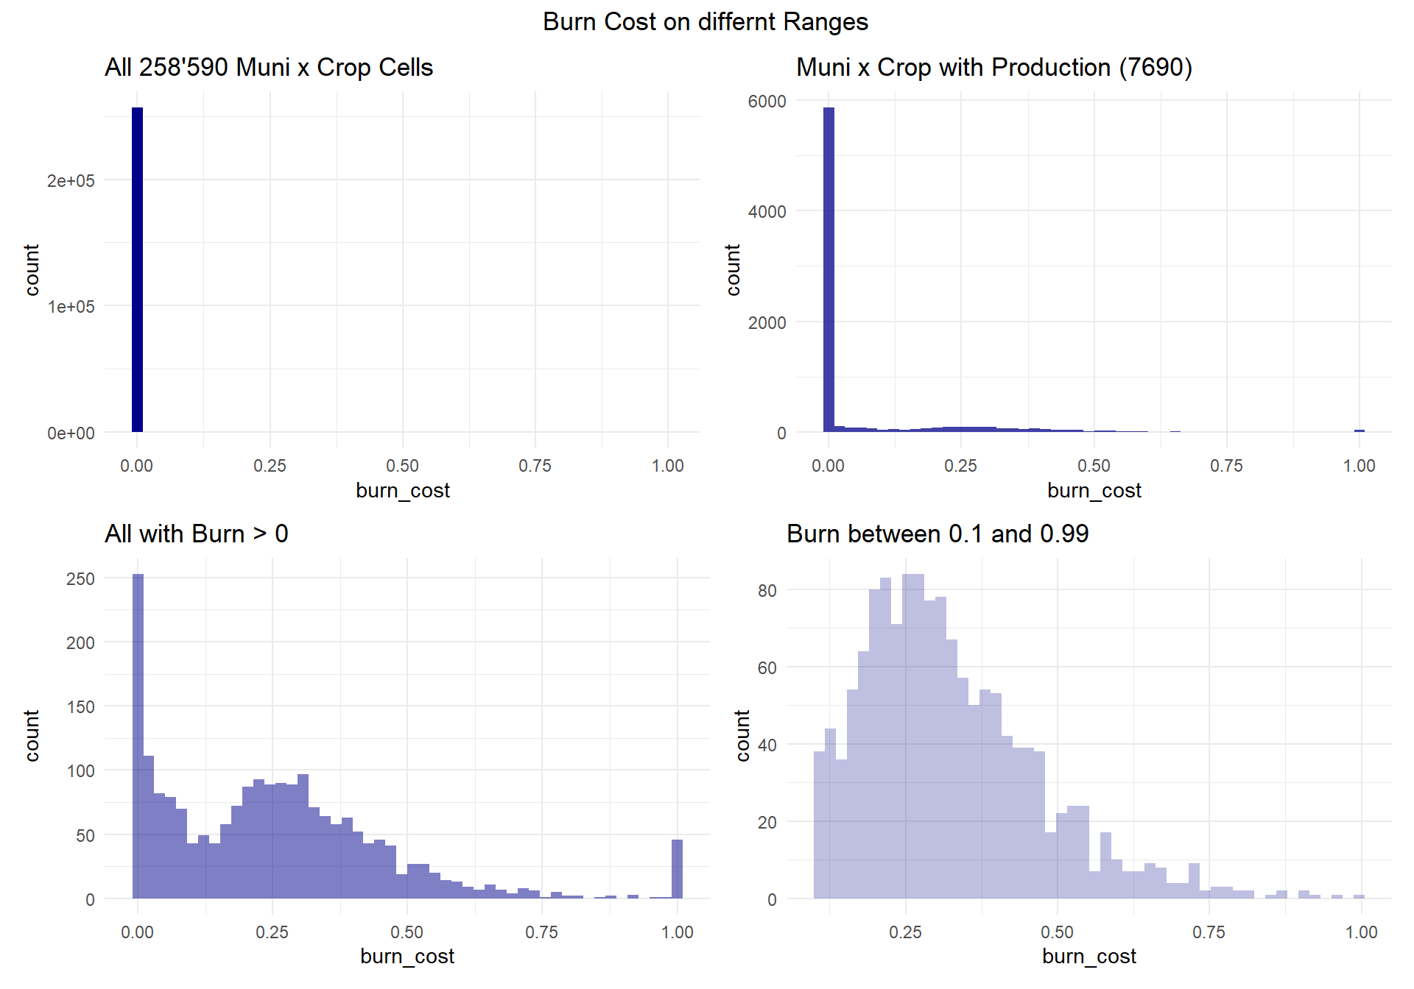
Zero-inflation. Artificial effect. Weather is fine and no damage,, damage cannot be negative. therefore nothing in the data. 99%
Natural phenomena of damage. Here, damage follows a gamma with weather. 0.5%
Some exponential/decay up to ~25%. Looks like a second mode. Could it be some SB-related phenomena? 0.3%
Damage-ceiling. Once the crop is done, it doesn’t take any damage, regardless of weather. Hence mass >1 acummulates at 1. 0.2%

Slide 2
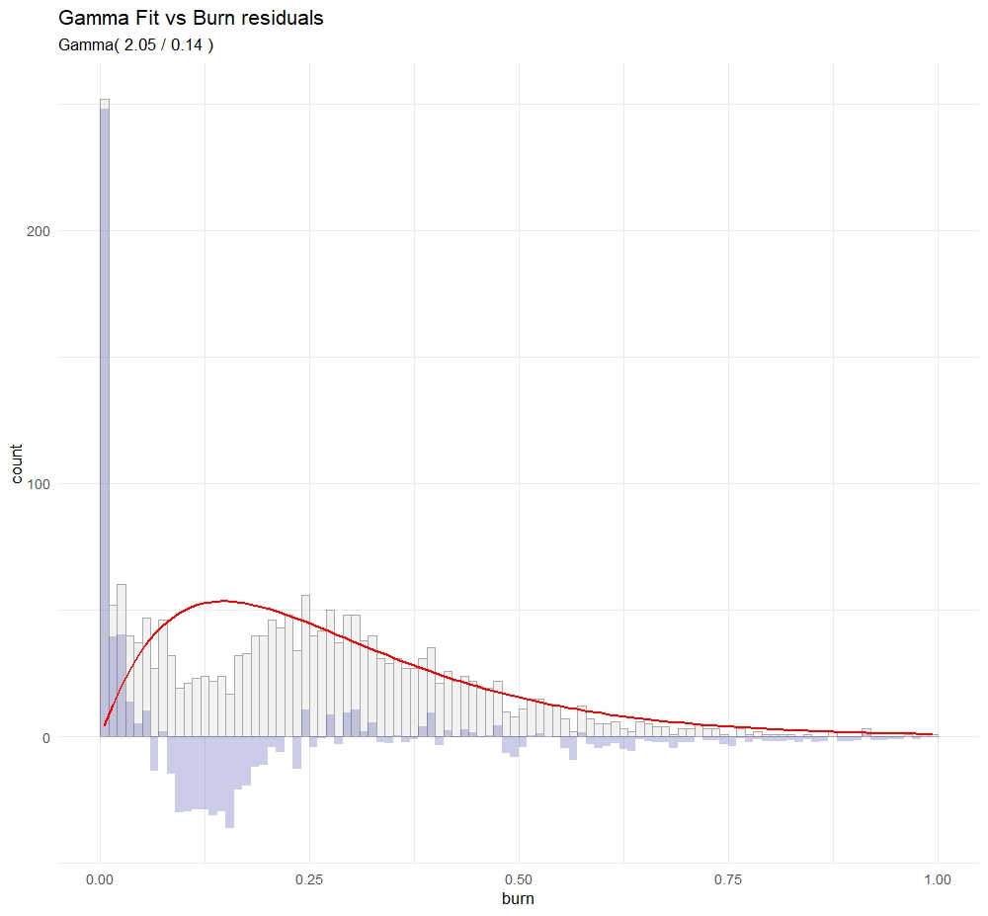

Slide 3
