Slide 1
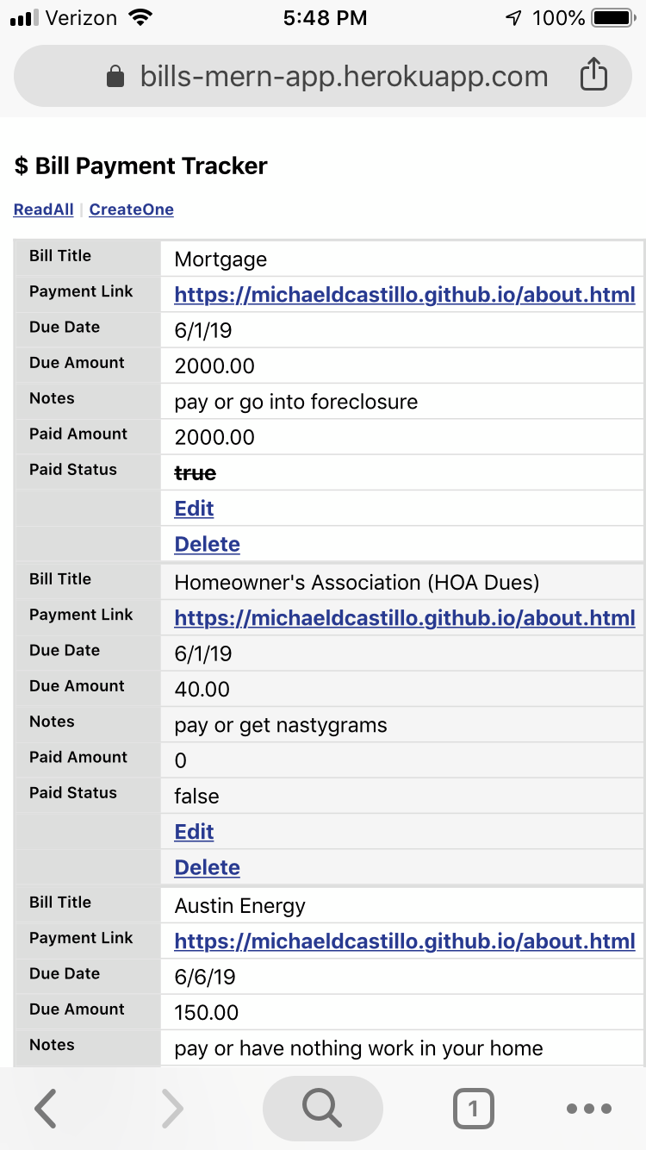
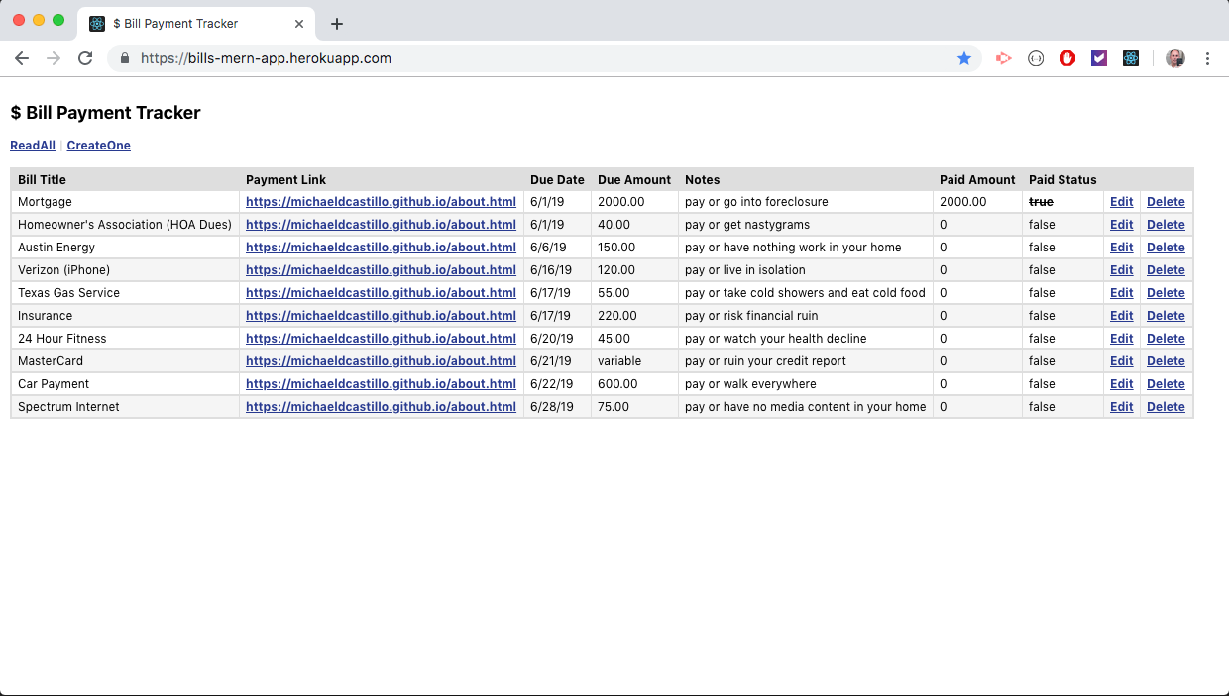
$ Bill Payment Tracker (bills-mern-app)
1 / 7
Notes:
The presentation of any project to an audience must flow like a story. Your narrative should open on a conflict, hint at the potential resolution for that problem, depict the steps taken to resolve the issue, and finally end on the resolution of the conflict with an eye toward the future.
In other words:
What problem does your app focus on?
How does your app solve this problem at a high-level?
What steps did you take to build the app?
Show the app running and solving the problem that began your story
Also talk about what features you'd like to add in an update to your app.

Slide 2
$ Bill Payment Tracker / The Project
Project Description
This project is about creating a web application from front to back that incorporates a complete web server, a responsive user interface, RESTful APIs, and create, read, update, delete (CRUD) operations against a cloud-hosted database.
Technologies Utilized
Visual Studio Code (integrated development environment)
Sketch (visual design and prototyping)
GitHub (source code repository)
Heroku (application hosting platform)
mLab (MongoDB database as a service)
Terminal (Mac OS command line)
Homebrew (Mac OS package manager)
Node.js (JavaScript runtime)
Node Package Manager (npm) (external libraries, frameworks)
Express (web application framework)
React (JavaScript library)
MongoDB (JSON-like document database)
Mongoose (Node.js object data modeling)
HTML5 (markup)
Cascading Style Sheets (CSS) (markup styling)
JavaScript (as a ‘full stack’ language)
Postman (API testing)
2 / 7
Notes:
The presentation of any project to an audience must flow like a story. Your narrative should open on a conflict, hint at the potential resolution for that problem, depict the steps taken to resolve the issue, and finally end on the resolution of the conflict with an eye toward the future.
In other words:
What problem does your app focus on?
How does your app solve this problem at a high-level?
What steps did you take to build the app?
Show the app running and solving the problem that began your story
Also talk about what features you'd like to add in an update to your app.

Slide 3
$ Bill Payment Tracker / The Opportunity
What problem does your app focus on?
The problem this app focuses on is a question every single person must answer. Have you paid your bills?
Each person has their own unique set of bills to pay. Every day, each of must determine where we are with respect to paying these bills. In my case, I have numerous recurring bills where the amount generally does not vary over time and where the due date is on a fixed, recurring schedule. For me, I just need a way to consolidate them so that I can more easily keep track of each bill’s payment status at any given time.
3 / 7

Slide 4
$ Bill Payment Tracker / The Solution
How does your app solve this problem?
This app strives to solve this problem by providing users a way to easily create and manage as many bills entries as desired in a single, consolidated, easy to access location. Each bill stores the essential information required for paying the bill (online) and for checking the status, at a glance.
The web application can be accessed from any internet-connected personal computer or mobile device, making it accessible from virtually anywhere there cellular signal or Wi-Fi hotspot present.
4 / 7

Slide 5
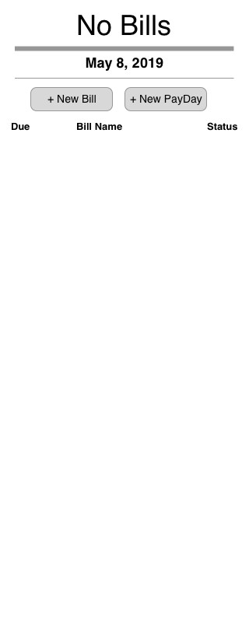
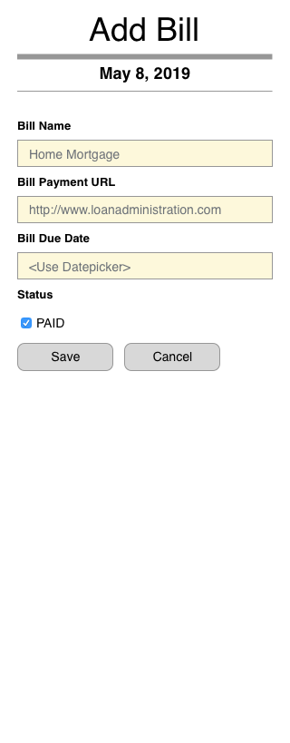
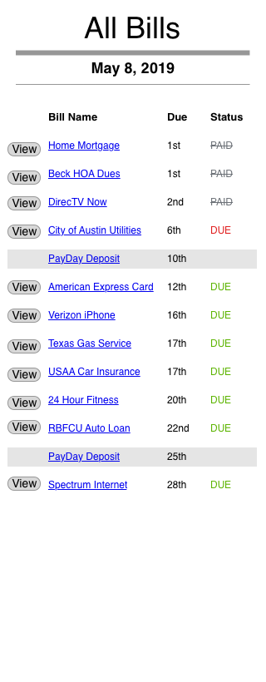
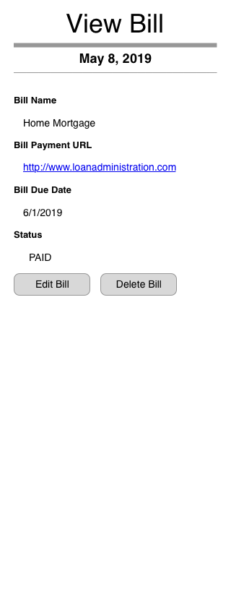
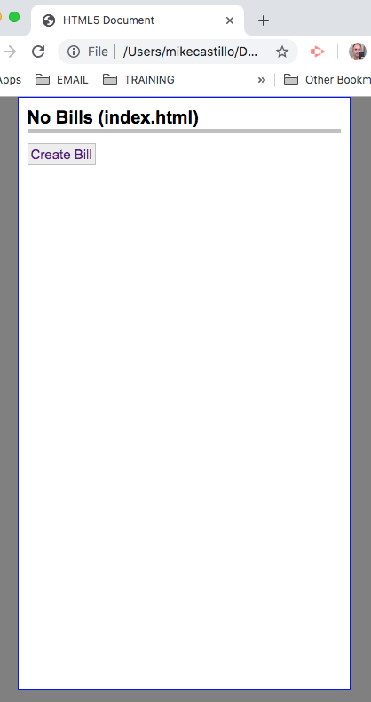
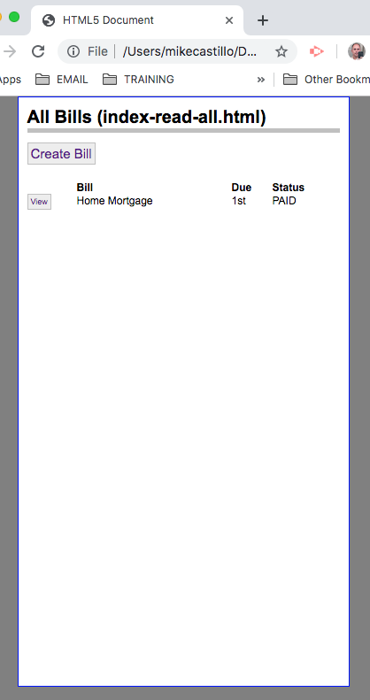
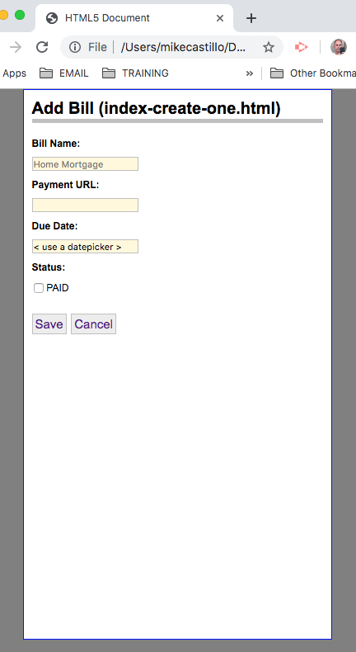
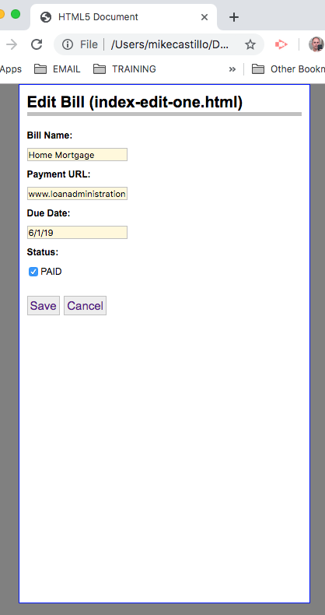
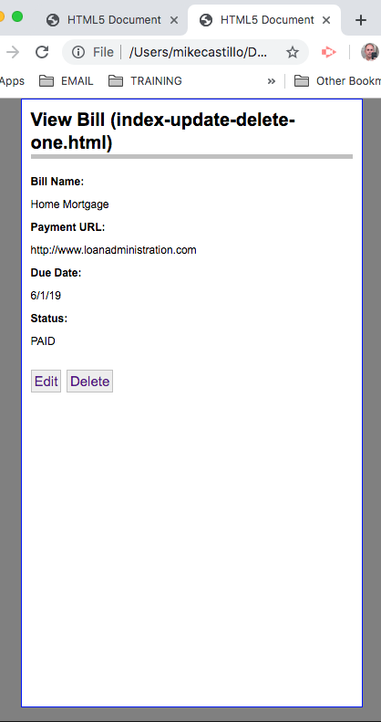
$ Bill Payment Tracker / The Process
What steps did you take to build the app?
Paper sketches
Wireframe documents using Sketch application
Static web page mock-ups (HTML, CSS)
Numerous online tutorials (web blogs and YouTube videos)
Tutorial example starter code
Ongoing code publishing to GitHub
Final deployment to Heroku
5 / 7

Slide 6
$ Bill Payment Tracker / The Demo
Live Demo
Deployment Address
https://bills-mern-app.herokuapp.com/
GitHub Address
https://github.com/michaeldcastillo/bills-mern-app
6 / 7

Slide 7
$ Bill Payment Tracker / After Action Review
Obstacles I encountered
I experienced many moments of severe anxiety. Seriously. It was not fun.
I could not write code without lots of starter example(s).
The organization of files for both front and back end code was challenging and took a lot of time.
I could not determine the correct database schema or determine whether a SQL database would have been a better choice.
React was and continues to be difficult for me (JSX, component architecture, classes vs functions, state & props, routing, basically everything!).
I need more practice with JavaScript ES6+ programming constructs (spread operator, destructuring, object and array methods, arrow functions).
Responsive design is not easy without Bootstrap training wheels (I need to spend time with CSS Grid and CSS Flexbox, etc.).
There is currently no form validation (not good for any production application).
I completed a full tutorial on user authentication with Passport.js and JSON Web Tokens, but unfortunately, I was unable to successfully login with my newly-created users.
I reviewed several blogs and tutorials covering authentication with Auth0, but ultimately could not figure out how to implement that either.
Deployment went fairly smooth, but required a great deal of time and research.
I’m sure I’m leaving out about 1,000 other things that caused me grief and need improvement...
Questions?
7 / 7
Notes:
The presentation of any project to an audience must flow like a story. Your narrative should open on a conflict, hint at the potential resolution for that problem, depict the steps taken to resolve the issue, and finally end on the resolution of the conflict with an eye toward the future.
In other words:
What problem does your app focus on?
How does your app solve this problem at a high-level?
What steps did you take to build the app?
Show the app running and solving the problem that began your story
Also talk about what features you'd like to add in an update to your app.

