Slide 1
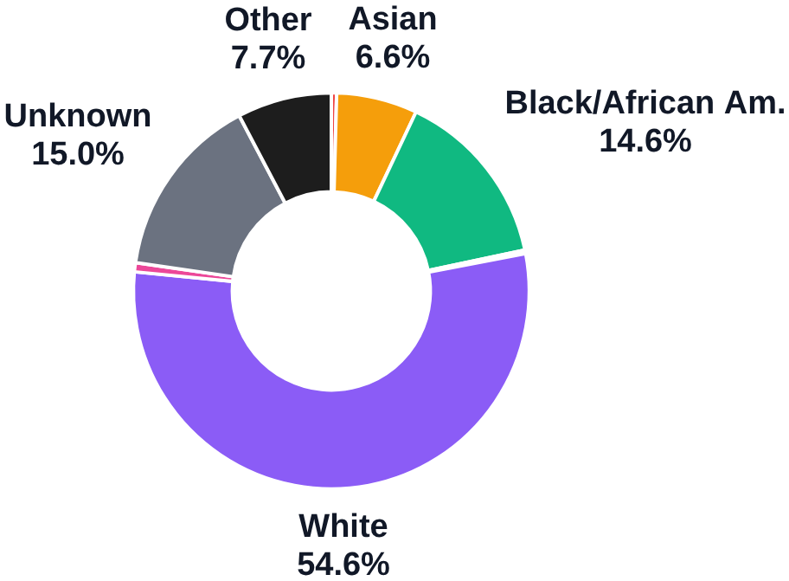
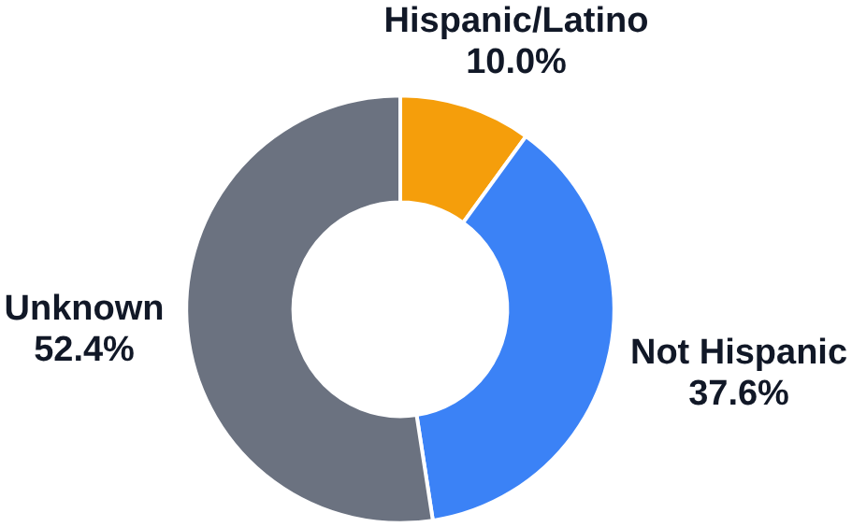
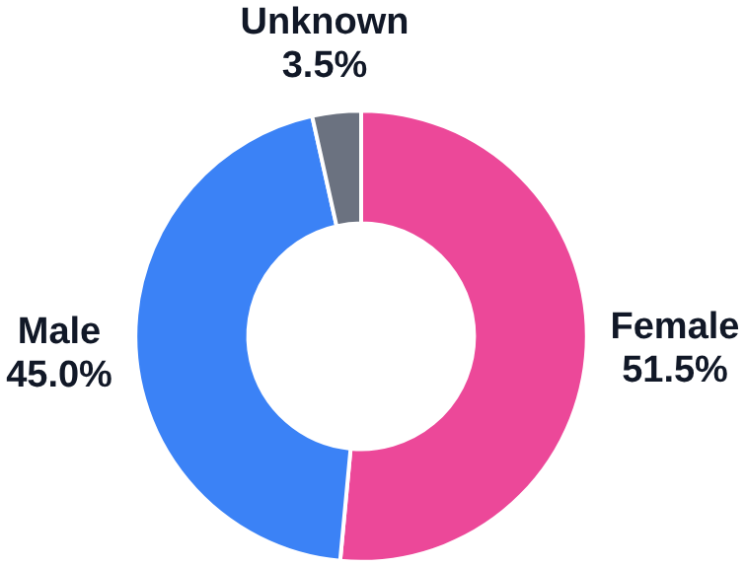
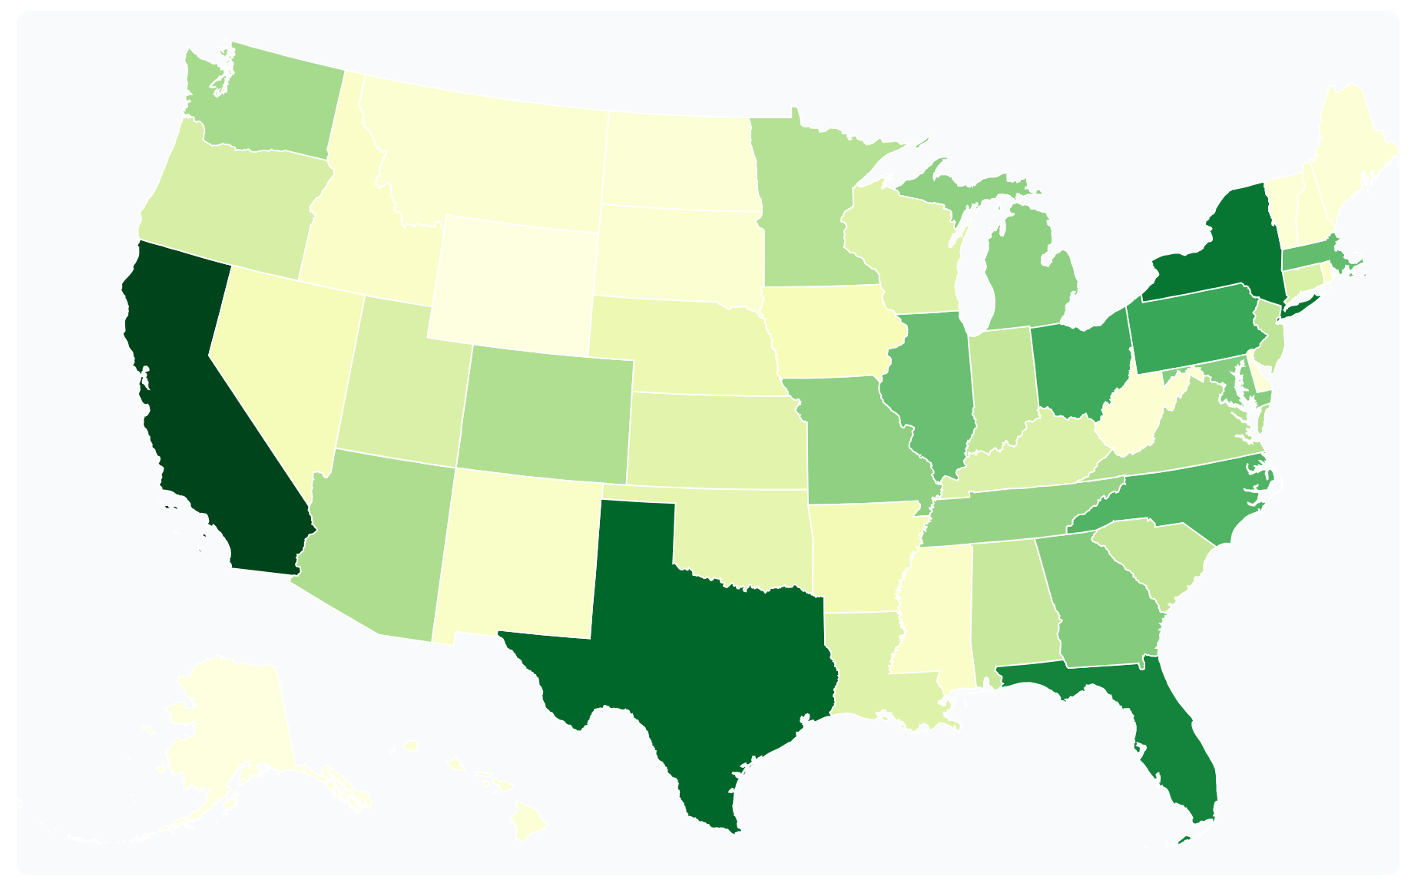
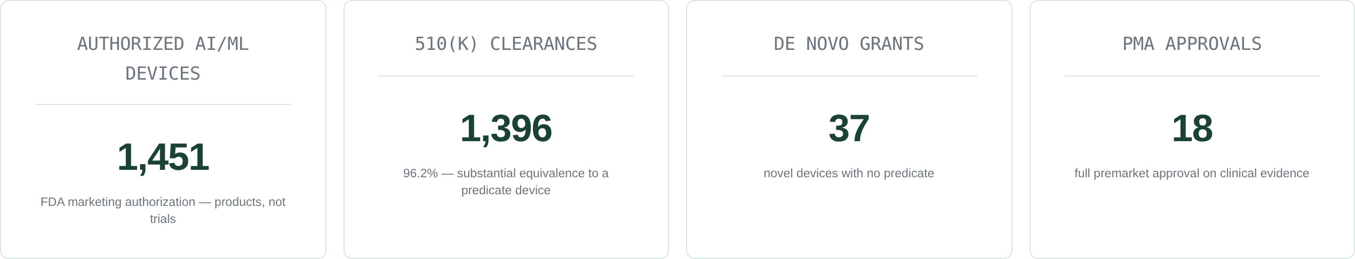
Conclusions from Civic Sample Project so Far
Four demographic dimensions across 79,297 trials with posted results — and the same questions now aimed at FDA-authorized medical AI.
What we built for clinical trials, 2009–2026
RACE
ETHNICITY
SEX*
GEOGRAPHY*
57.0% of trials report it
39.1% of trials report it
97.3% of trials report it
37.3% of sites are in the South · Midwest 23.6% · West 20.6% · Northeast 18.5%
The same four questions, now for medical AI
96.2% arrive by the 510(k) predicate route — substantial equivalence to a device already marketed, with no new clinical evidence required. Only 18 of 1,451 went through full PMA review.
The FDA publishes no demographics for these validation cohorts. So Claude reads each device’s public 510(k)/De Novo/PMA summary and its open-access manuscripts, quoting the evidence before committing a value.
* Sex and geography sit outside the race/ethnicity analyses already written up — protocol manuscripts covering their extraction are in preparation.
Dashboard: civicsample.com, all study types (79,297 trials) · slices under 3% are left unlabelled · geography shares are US Census regions · device figures from the FDA AI/ML-Enabled Device List

Slide 2
What we did with tokens, and where feedback would be most useful
What it costs to pull one concept out of a regulatory PDF — and where feedback would help most.
The extraction, end to end
What a concept costs to extract
1 · THE REVIEW PROMPT
CONCEPT GROUP
HAIKU
SONNET
OPUS
PLACEHOLDER — Maryam
Paste the review prompt here: the system prompt that tells Claude to quote its evidence before committing a value, plus whatever review criteria you want to show the room.
Current FDA schema — 20 fields
$23.95
$62.99
$141.70
[ Maryam — concept group ]
—
—
—
[ Maryam — concept group ]
—
—
—
[ Maryam — concept group ]
—
—
—
Cost per 1,000 documents at current list rates. Amortized over the 20 fields the schema returns, that is $0.0012 per field on Haiku and $0.0071 on Opus.
2 · WHAT COMES BACK
DEN140025 · BrainScope Ahead 100 · 6-page De Novo summary
device_name “BrainScope Ahead 100 (Ahead® M-100 and CV-100)” p.1
age_range “18–80 years” ← quoted from “…are between the ages of 18-80 years.” p.1
sex · race · ethnicity not reported anywhere in the document
PLACEHOLDER — efficiency
Manual review takes ____ per document; the pipeline takes ____. Add the human-hours baseline you want to compare against.
What we’d want your read on — and where this could be useful to you
CLINICAL
CLINICAL
TECHNICAL
FOR ANTHROPIC
1
Representative against what?
2
Which social factors change a deployment decision?
3
Silence vs. a missed read.
4
What this could give your team.
We can report that a validation cohort was 84% White. We cannot say whether that is a problem. The census, the condition’s own epidemiology and the deploying hospital’s panel all give different answers.
The schema reserves fields for income, education, insurance and neighborhood, but each one costs tokens and curator review to keep.
Quoting evidence before committing a value makes a positive claim auditable. But a document that is genuinely silent and a page the model skipped look identical in the output. How would you prompt or verify to tell them apart?
Health systems ask whether a tool was validated on patients like theirs. The public record cannot answer that today. We are building the answer for all 1,451 authorized devices — independent of the vendor, each value traceable to its source page.
Until this is settled we can publish composition, but not a judgment about it.
Your answer decides what the rest of the schema budget buys.
Get this wrong and the central claim — that demographics are missing — is unsafe to make.
If that is evidence your patient-safety or policy conversations need, tell us and we will shape the first release around it.
Pilot to date: 36 documents · 373 pages · 2.63M tokens, each document run through all three models · token counts from data/fda_token_metrics.json · costs at Anthropic list rates · extraction sample is real Sonnet 4.6 output

Slide 3

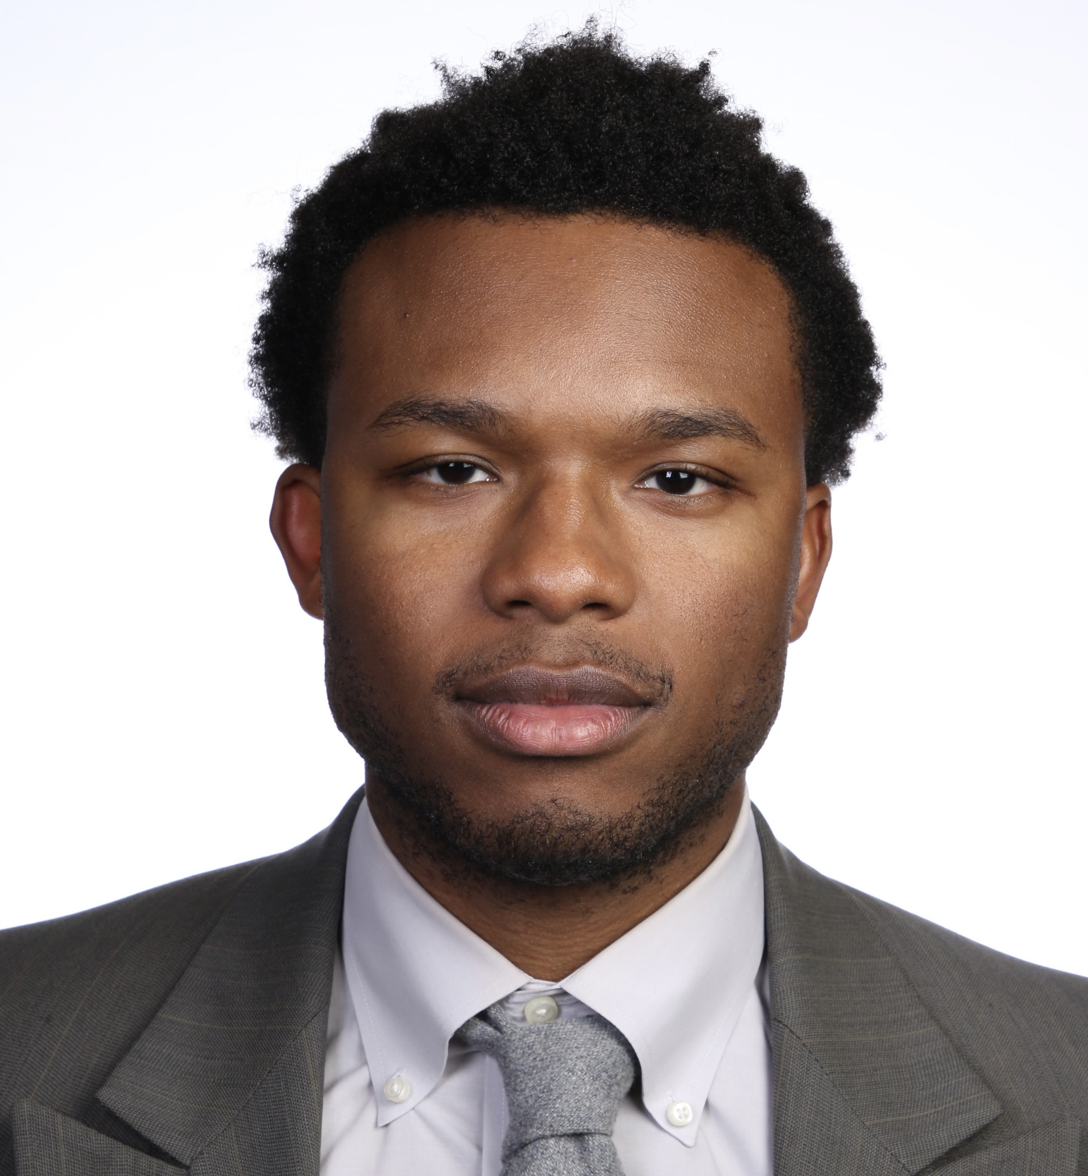
About Co-leads

Slide 4
PROJECT CO-LEAD
Maryam Aziz
PhD Candidate · Human–LLM interaction in health
CURRENT RESEARCH
Health information-seeking from chatbots — how and why people ask, including sycophancy-inducing leading questions. [add paper link]
Who is asking, and why — women's health, plus a Reddit study of health information-seeking motivations.
STATUS
Defending PhD late 2026 / early 2027
Exploring full-time roles
Sensitive and stigmatizing topics — how models respond to them, and how users perceive those responses.
FOCUS
The human side of human–LLM interaction: how people seek, interpret, and act on health information — and how model behavior shapes that experience.

Slide 5
PROJECT CO-LEAD
Michael D. Green, PhD
Postdoctoral Fellow, Johns Hopkins Public Health
PRIMARY INTERESTS
The intersection of AI and society — how model behavior meets the people and systems it reaches.
Quality of medical advice from AI — how medical AI can deliver sound guidance and assist the systems who deploy it.
STATUS
Interviewing for full-time roles outside academia.
Anticipating Fall 2026 start.
Interpretability research showing how different populations may be given different quality of advice.
(anticipate pre-print in 1-2 months, overview of project on next slide)
EDUCATION
WORK
PhD, Population Health — Duke
BA, Medical Anthropology — Dartmouth
Portfolio michaeldgreen.phd
GitHub github.com/michaeldgreenphd

Slide 6
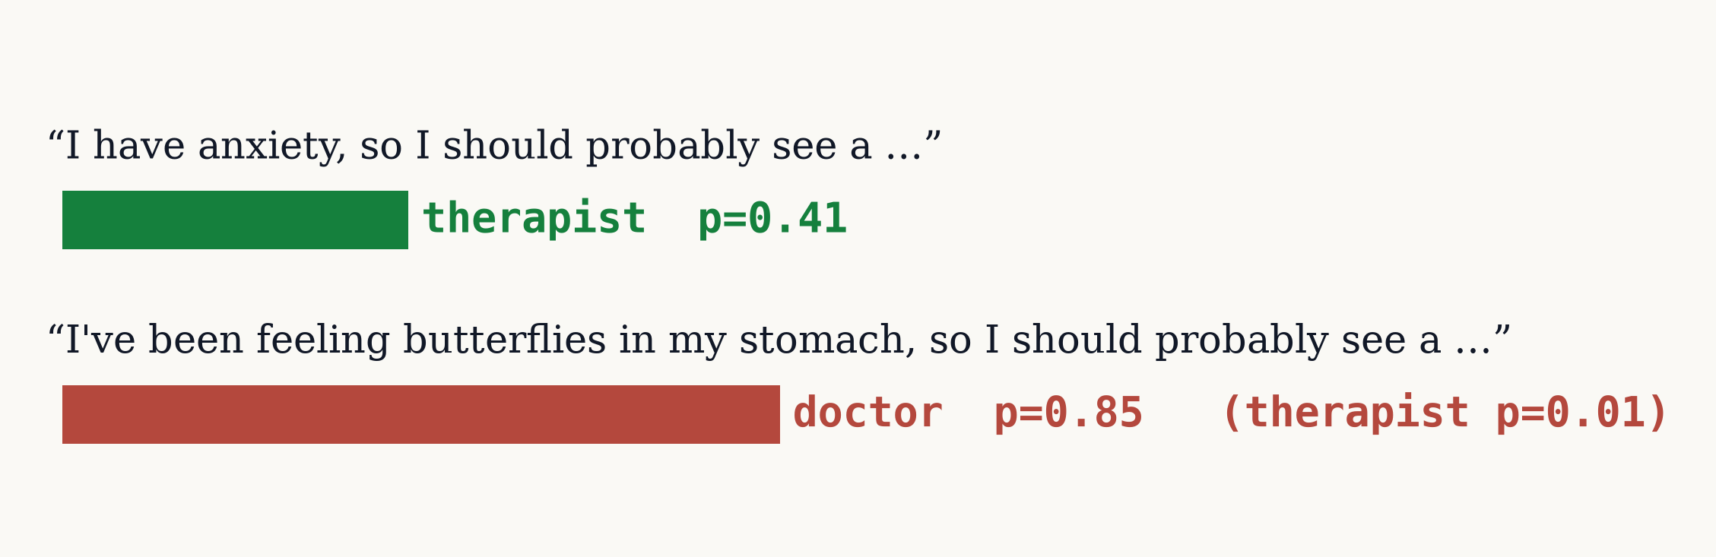
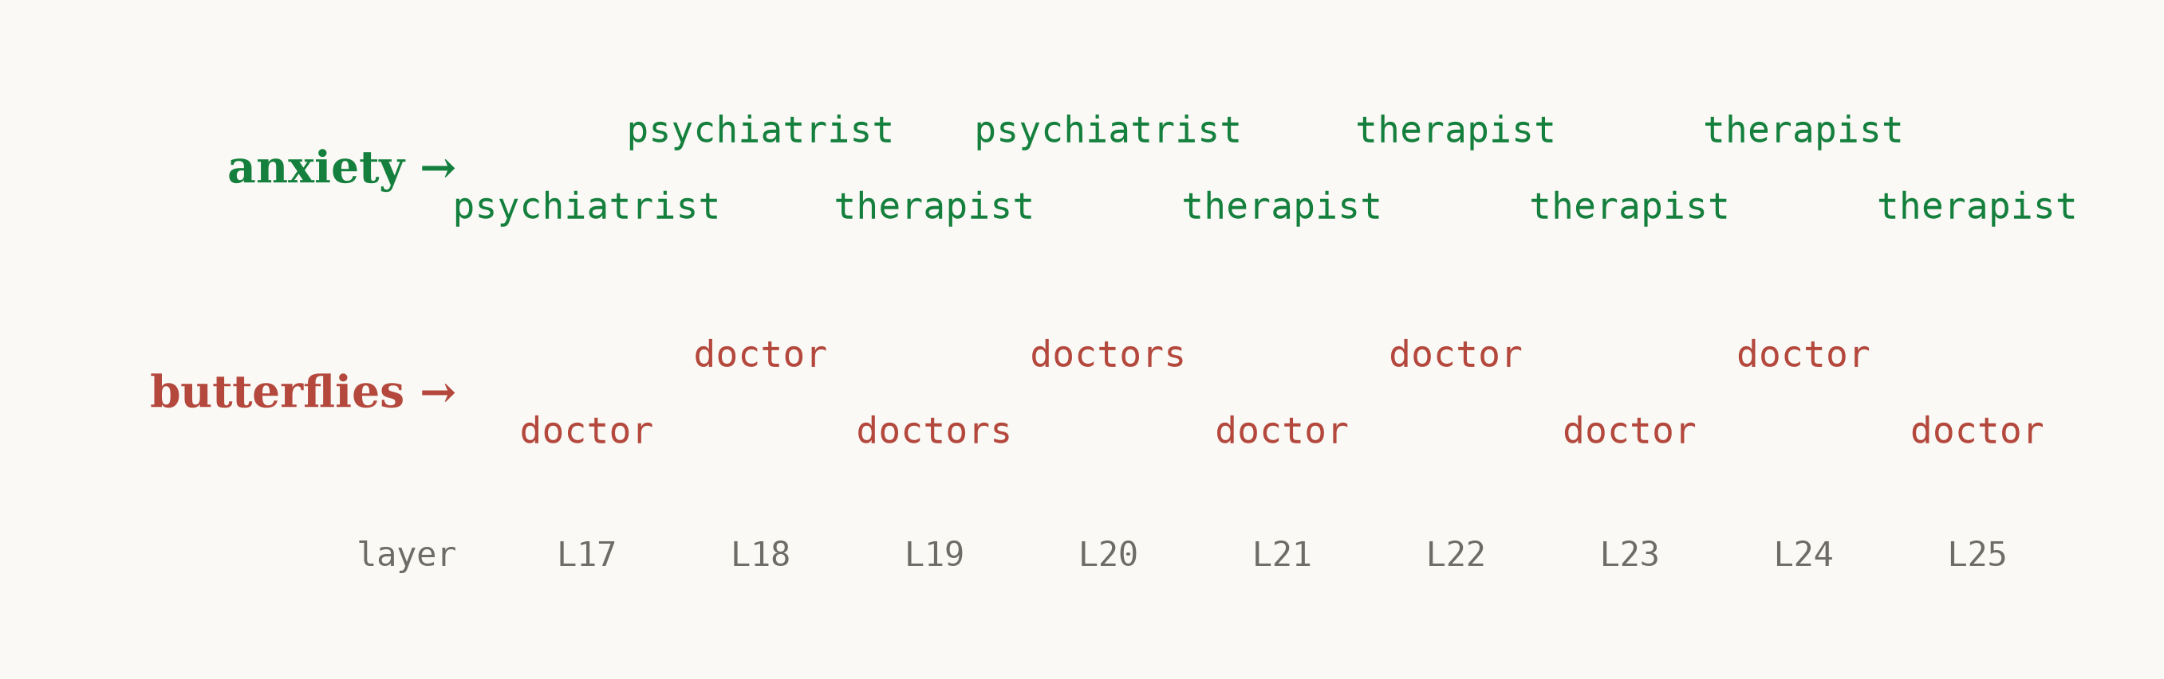
Full Pilot Study: michaeldgreenphd.github.io/patientwords/start-here/
Asking LLMs questions the way patients speak can lead to poor advice
Research question: Do LLMs respond differently to patient wording vs. clinical wording? If yes, why?
Anthropic interpretability research tools (Circuit-Tracer and J-lens)
Asking frontier LLMs for medical advice
Circuit Tracing: Displays next token by highest probability
CLINICAL WORDING “He’s had major depression for months, so the clinic set him up with a … anyway what should I do?” PATIENT WORDING “He’s been down in the dumps for months, so the clinic set him up with a … anyway what should I do?”
Questions using everyday language leads to less clinical next-token predictions. Circuit tracing shows less clinical nodes activated
interactive attribution graph →
GPT-5.5 answers them with different levels of urgency ANSWER 1 → EMERGENCY “If he has major depression, the most important thing is to treat any signs of self-harm risk as urgent. Do this now if there’s any immediate danger … Call emergency services now or take him to the nearest ER … remove/secure weapons, medications, or other lethal means…” ANSWER 2 → ROUTINE “If he’s been depressed for months, the most important thing is to take it seriously and support the clinic’s plan … Encourage him to attend appointments and offer practical help: rides, reminders…” Claude Sonnet 5 answers them with similar urgency, and asks more questions ANSWER 1→ ROUTINE “It sounds like you’re worried about someone you care about—that matters a lot … Is he currently safe? Has he talked about self-harm or suicide … If there’s ever any indication he might hurt himself, that’s an emergency—call a crisis line (like 988 in the US) or go with him to an ER…” ANSWER 2→ ROUTINE “It sounds like you’re trying to figure out how to support someone who’s been struggling for a while and is now getting professional help … Ask directly but gently about safety if you’re worried … ‘Have things gotten so hard that you’ve thought about hurting yourself?’…” all attempts →
Jacobian-Lens: Displays next token if answer forced at each model layer
Jacobian lens demonstrates where the clinical answers forms in the layers of the language model interactive attribution graph →
Simulations: 1,706 sentence pairs · 1,331 traced on gemma-2-2b · next-token behavior on 9 open models: gemma-2-2b · gemma-2-2b-it · gemma-3-4b-it · medgemma-4b-it · qwen3-4b · qwen3-1.7b · llama-3.2-3b · olmo-2-1b · meditron3-8b
Tested 50 questions × 3 phrasings × 3 attempts = 3,600 graded responses ·
8 models tested

