Slide 1

The International Syphilis Symposium
Webinar Series
Webinar #1 · 26 March 2026
Advancing Global Syphilis Control
internationalsyphilissymposium.com

Slide 2



ABOUT THE SERIES
What is the ISS Webinar Series?
A free quarterly webinar series bringing together leading clinicians, academics, public health agencies,
and community organisations to advance global syphilis control.
Research
Global Reach
Community
Highlighting cutting-edge syphilis research from high- and low-income settings worldwide
Connecting clinicians, academics, and public health agencies across continents
Bridging clinical, academic, and community organisations in the fight against syphilis
internationalsyphilissymposium.com

Slide 3

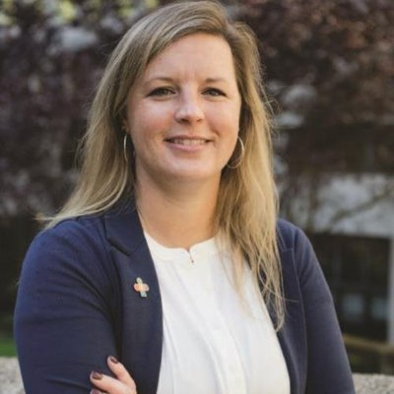
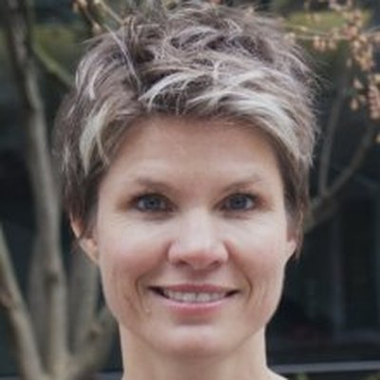

ORGANISING COMMITTEE
Meet the Team
Prof. Michael Marks
Dr Kelly Hawley
Dr Nicole Lieberman
Dr Lisa Frigati
Scientific Committee
Scientific Committee
Scientific Committee
Scientific Committee
London School of Hygiene
& Tropical Medicine
University of
Connecticut
University of
Washington
Stellenbosch
University
internationalsyphilissymposium.com

Slide 4
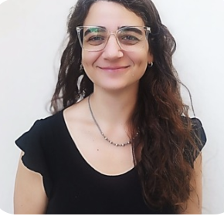
TODAY'S WEBINAR
Our Speakers
26 March 2026
Photo
Michael Marks
London School of Hygiene & Tropical Medicine
Talk: Optimising penicillin treatment in Pregnancy - the STOP Trial
Photo
Luciana Garcia
CONICET
Talk: Recent Research Findings on Syphilis in Children and Adolescents in Buenos Aires
internationalsyphilissymposium.com · 26 March 2026 · 15:00 UTC

Slide 5
JOINING THE SESSION
How Today's Webinar Works
01
Talks
02
Questions
Each speaker will present for 20–25 minutes, followed by a short Q&A discussion
Use the Q&A function in Zoom to submit your questions — please don't use the chat
03
Recordings
04
Website
This webinar will be recorded and made available on our website within one week of the event
Visit internationalsyphilissymposium.com for recordings, upcoming sessions, and more
internationalsyphilissymposium.com

Slide 6
COMING NEXT
Save the Date —
Next ISS Webinar
[ Month ]
[ Webinar Title ]
[ Day ]
[ Brief description of the upcoming session — topics, themes, relevance ]
[ Year ]
[ Time ] · Free to attend · Delivered via Zoom
Register at internationalsyphilissymposium.com →
Thank you for joining today's webinar!
internationalsyphilissymposium.com

