Slide 1
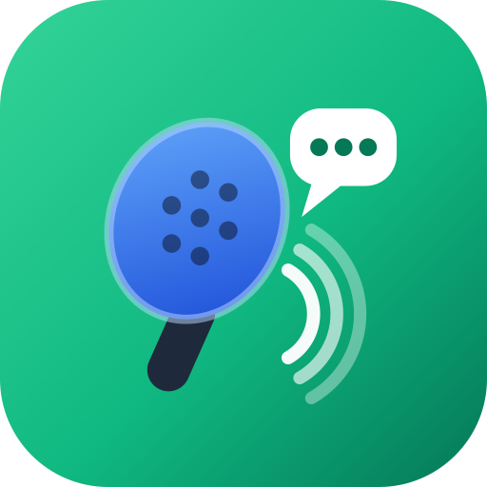
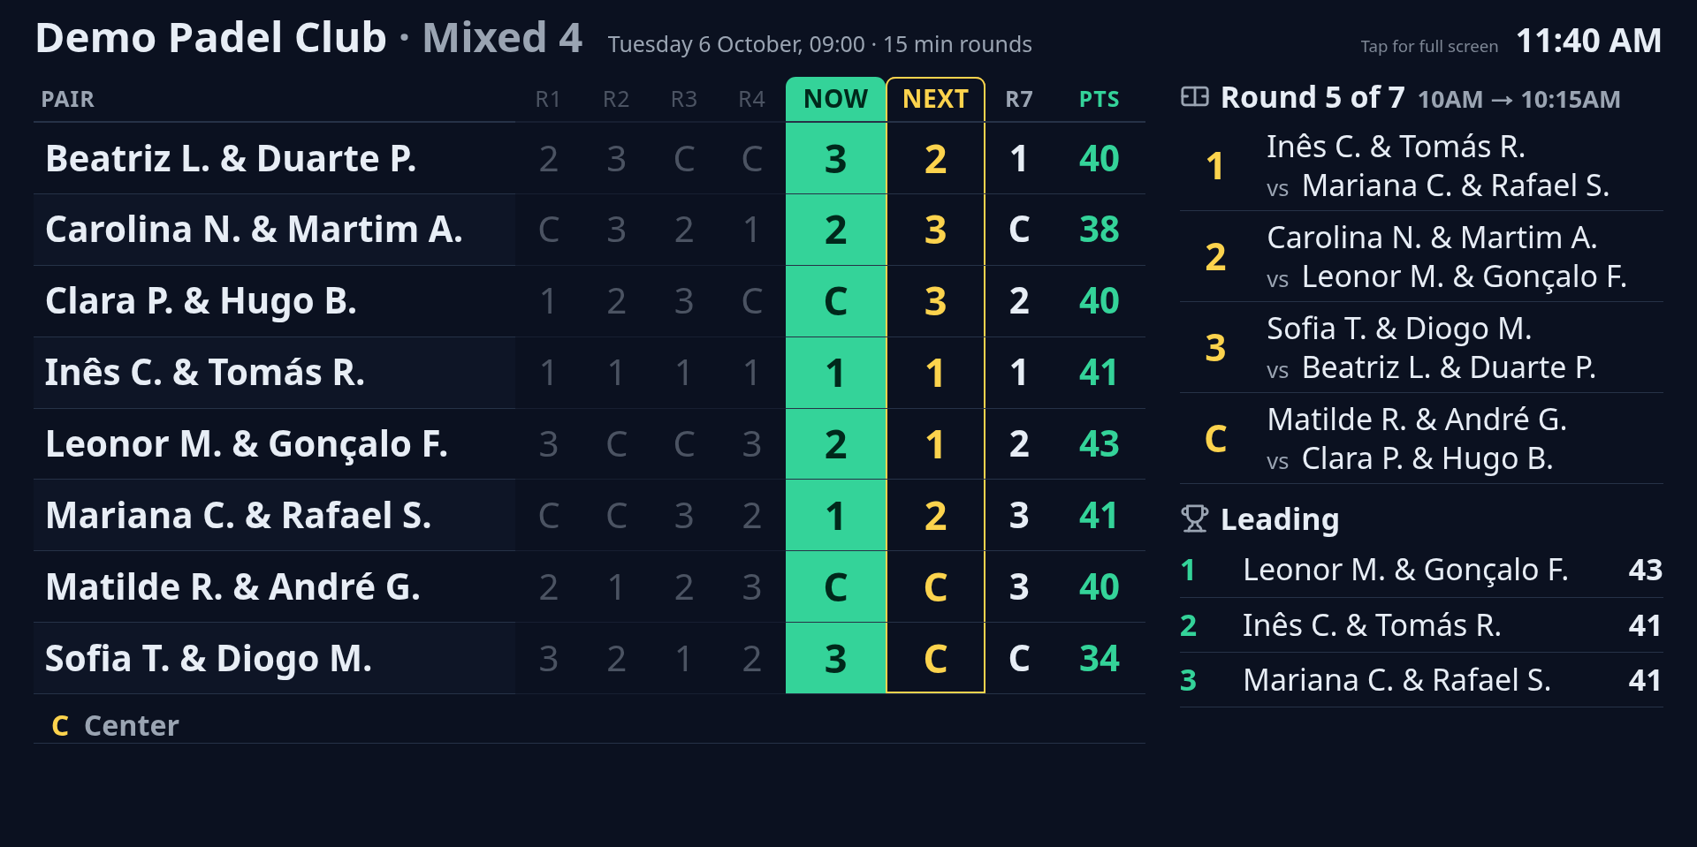
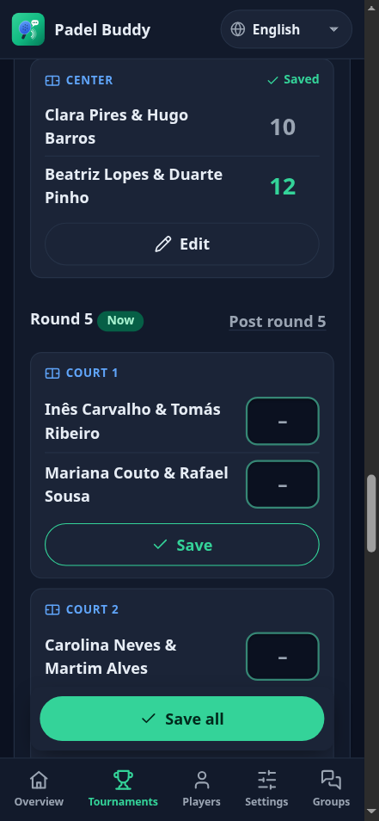
Run your padel tournaments from the group chat
Padel Buddy
Tournaments
No more printed sheets, PDFs or re-typed WhatsApp lists. Paste the club's message, and every player knows where to go next, on their own phone.
Notes:
Padel Buddy Tournaments runs a club's tournaments, morning or evening: sign-ups, pairs, the schedule, scores, standings, and the messages to the group. Everything in this deck is the real app; the players are invented.

Slide 2




Every tournament, the same admin
What a nonstop or Americano tournament costs the organizer today
Re-typing the list
Pairs on paper
The group fills the slots in WhatsApp; someone copies sixteen names into a spreadsheet.
Partners, the odd player out, a pair that cancels at 18:55.
"Which court am I on?"
Scores and the table by hand
Twenty people at the wall between rounds, squinting at a printed grid.
Adding up points afterwards, then a PDF in the group the next day.
Notes:
This is the reality at most clubs: WhatsApp for sign-ups, paper or a spreadsheet for the draw, a printed sheet on the wall, and a PDF of results afterwards. Every step is manual and repeated every week.

Slide 3



A tournament in four steps
The organizer does the first two from a phone; the app does the rest
1
2
3
4
Paste
Pair
Play
Post
The club's usual WhatsApp sign-up message. Date, time, level, club and every name are read from it.
Drag players into pairs, pair the rest at random, or balance them by level.
Type scores on the phone between points. The schedule and the table keep themselves.
Each round goes to the group by itself: who plays where now, and where everyone goes next.
Notes:
Four steps. Paste and Pair happen before the tournament; Play and Post happen during it, and Post is automatic: the last score of a round sends the next round to the group.

Slide 4
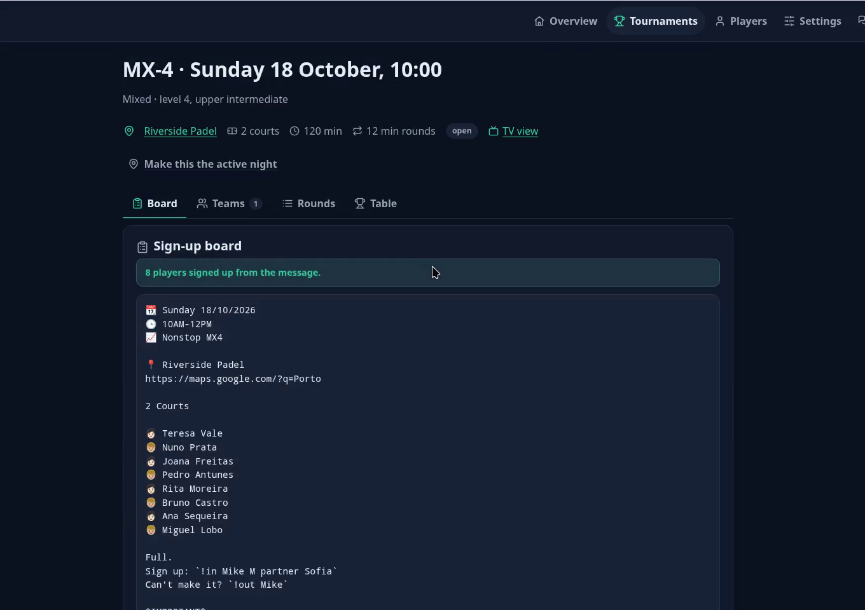
Paste the message you already send
STEP 1 · PASTE
Your format, as it is
The date line, the time line and the numbered list the group already uses. Copied from a phone or from WhatsApp Desktop.
Read, then checked by you
Date, start, duration, level and club fill the form. Anything it could not read is named, not guessed.
One tap creates the tournament
Every player signed up at once; "(dupla)" pairs stay together.
Notes:
Clip: the organizer pastes the club's usual WhatsApp message, presses Read the message, checks what was understood, and creates the tournament with all eight players signed up.

Slide 5
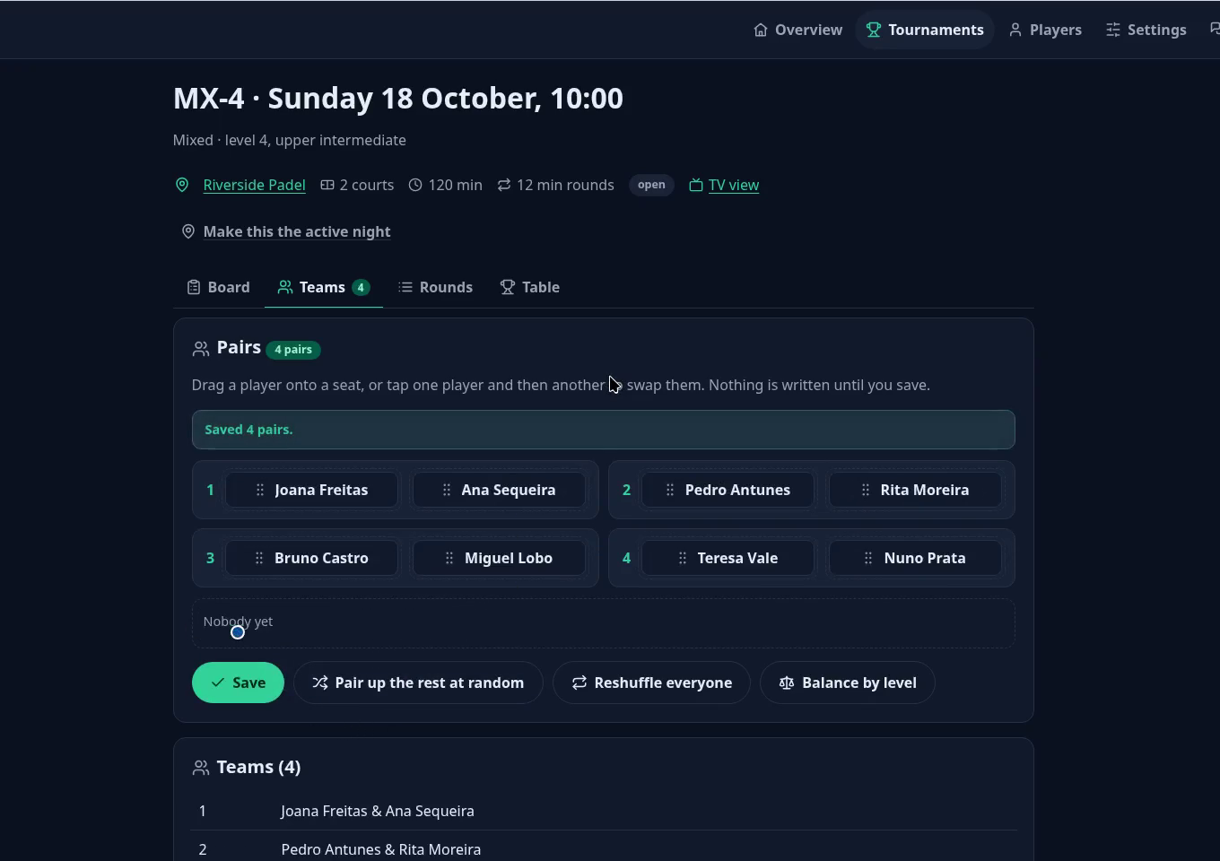
Make the pairs in seconds
STEP 2 · PAIR
Drag, or tap two players
Works with a thumb on a phone as well as a mouse.
Pair up the rest at random
Fills every empty seat; on a mixed level, one of each per pair.
Balance by level
Strongest with weakest, so every pair adds up to about the same.
Notes:
Clip: one player is placed by hand, the rest are paired at random, and the pairs are saved. Balance by level uses each player's saved level.

Slide 6
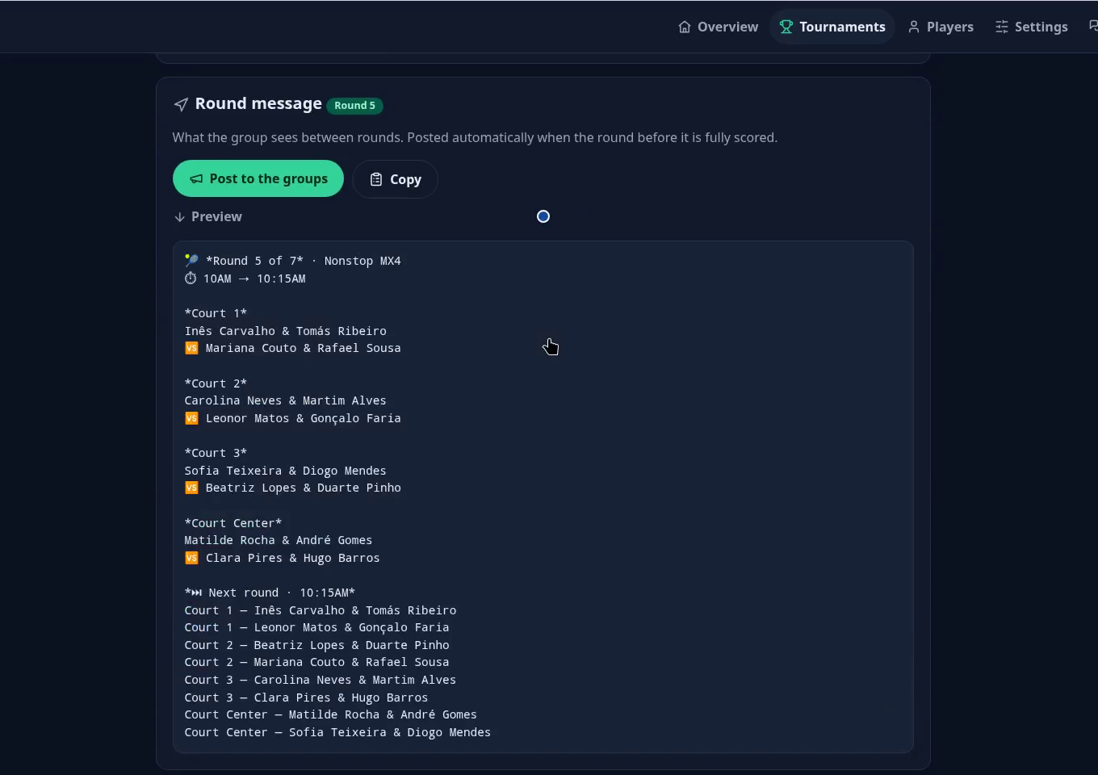
Scores in, next round out
STEP 3 · PLAY
Type the score, press Save
Big score boxes made for a phone at the side of the court. Save one match, or Save all.
Saved means saved
A saved match shows its result; Edit fixes a typo, Cancel puts it back.
The round posts itself
The last score of a round sends the next round's message to the group.
Notes:
Clip: two scores are entered, the round completes, one saved score is corrected with Edit, and the round message for the next round is ready to post.

Slide 7
Everyone knows where to go next
STEP 4 · POST
!where ines
Round 5 of 7 · Nonstop MX4
10AM → 10:15AM
Court 1
Inês Carvalho & Tomás Ribeiro
vs Mariana Couto & Rafael Sousa
Court 2
Carolina Neves & Martim Alves
vs Leonor Matos & Gonçalo Faria
…
Next round · 10:15AM
Court 1 — Inês Carvalho & Tomás Ribeiro
Court 1 — Leonor Matos & Gonçalo Faria
Court 2 — Beatriz Lopes & Duarte Pinho
Court 2 — Mariana Couto & Rafael Sousa
…
Inês Carvalho & Tomás Ribeiro
Now · Court 1 (10AM → 10:15AM)
vs Mariana Couto & Rafael Sousa
Next: Court 1, from 10:15AM
In WhatsApp and Telegram
Telegram posts by itself and keeps one pinned sign-up list up to date. For WhatsApp the message is ready to paste.
Anyone can ask
"!where" with their name answers for one player: court now, court next.
Posted by the app after the last score of round 4
Notes:
This is the message players see between rounds. The "Next round" block is one line per pair, sorted by court, so a player finds their name and the court is already next to it.

Slide 8
A screen in the clubhouse that answers "which court?"
Every pair, every round
One row per pair: where they played, where they are now, where they go next.
Refreshes itself
Put a tablet or a TV by the courts and leave it. Scores entered on a phone appear in seconds.
Readable from the court
Big type, the live round highlighted, the leaders on the side.
Notes:
The TV view. It runs on old tablets too: it was tested on a Galaxy Tab 2 browser.

Slide 9
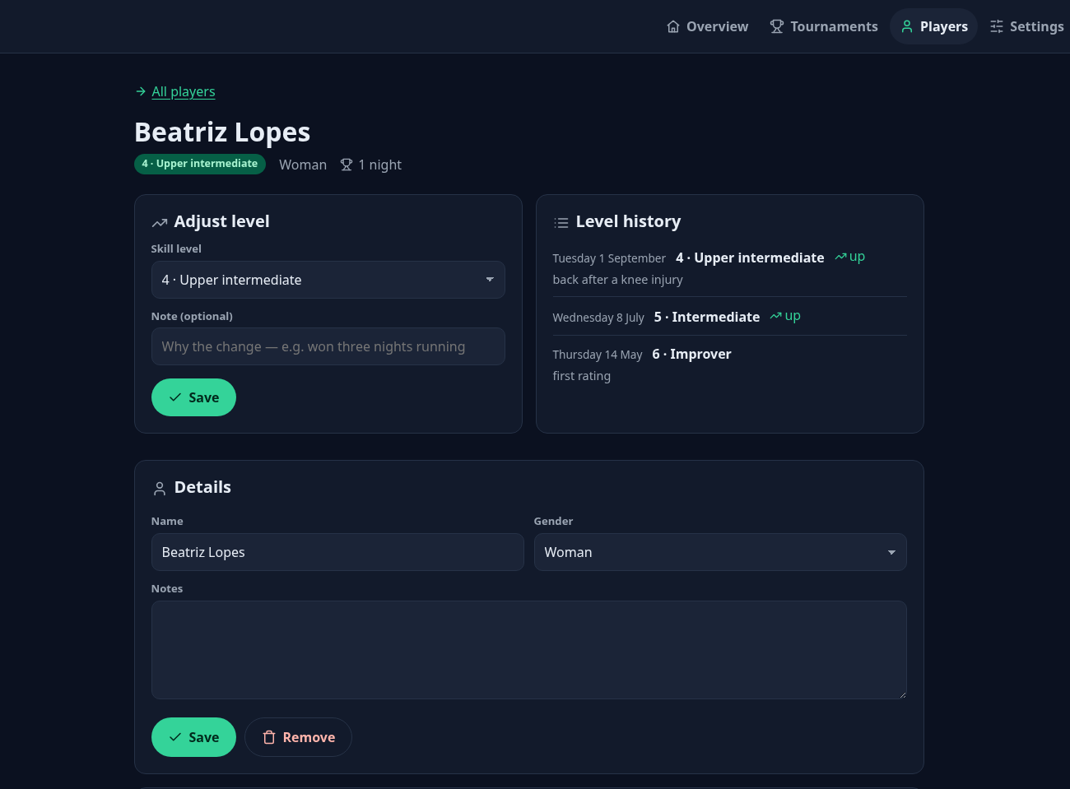
Know your players, and how they are improving
Every player, kept
Everyone who ever signed up, filled in from sign-ups and pasted messages.
Levels with a history
A 1 to 7 level per player. Each change is kept with its date and a note: "won three tournaments running".
Used on the day
Levels show on the pairs board and drive Balance by level.
Notes:
The player register. Levels are the same 1 to 7 ladder the tournaments use; the history makes level decisions explainable to players.

Slide 10




Made for the way clubs actually run
Four languages
Phone first
WhatsApp and Telegram
English, Português, Español and Українська, for the console and the group messages.
Everything works one-handed on a phone; the desktop is a bonus.
One message, both groups. Copy buttons everywhere for WhatsApp.
Several clubs
Courts per tournament
Standings ready to share
Play at home or away. Each club with its own address and map link.
Name them, add or remove them for one tournament without touching the next.
A real table on screen, and the same table as a message for the group.
Notes:
The details that make it fit a real club: languages, phones, both chat apps, several venues, courts that change from one tournament to the next, and standings ready to share.

Slide 11



Coming next
In development. Tell us what your club needs first
More formats
Players on the app
Run it your way
Americano
Mexicano, with rules your club sets
Up and Down
Log in with a code by WhatsApp, SMS or email
Avatars and club logos
Phone, Instagram, left or right handed
Open source: host it at your club
Or hosted for you, on your club's own address
Roles for players, organizers and clubs
Notes:
Roadmap, not yet available: Americano, Mexicano with club-defined rules, Up and Down; player logins by one-time code; avatars and logos; open-source self-hosting or a hosted version on the club's own address.

Slide 12
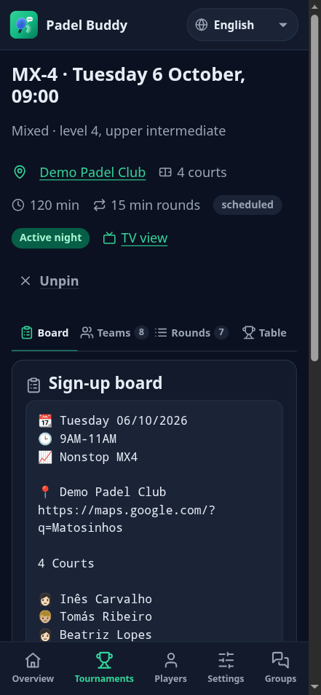
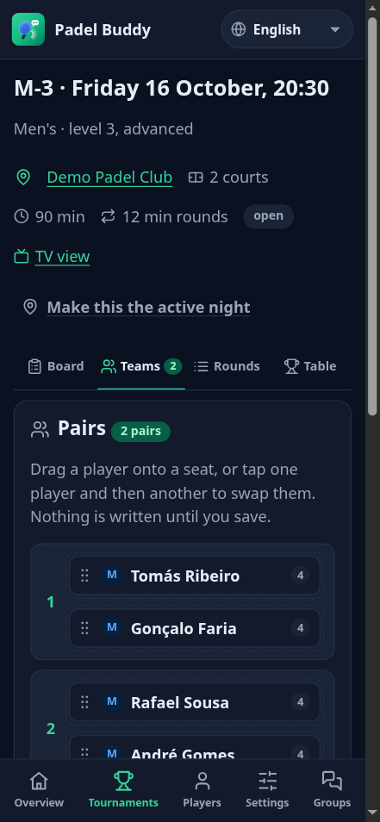
Your next tournament, without the paper
We set up your club and courts. You paste your usual message. Your players get every round on their phones.
Notes:
Close: setting a club up takes minutes; the organizer keeps using the group chat they already have.

