Slide 1
Project 2
Earning potential for individuals

Slide 2
Purpose
The purpose of the dataset is by evaluating an individuals certain characteristics we may be able to determine somebody's likelihood of making over 50k a year.

Slide 3
Data Points
age
Workclass
education
education-num
marital-status
occupation
relationship
race
sex
capital-gain
capital-loss
hours-per-week
native-country

Slide 4
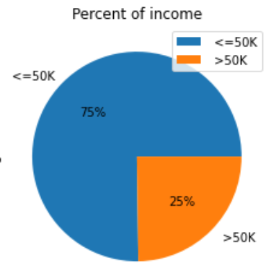
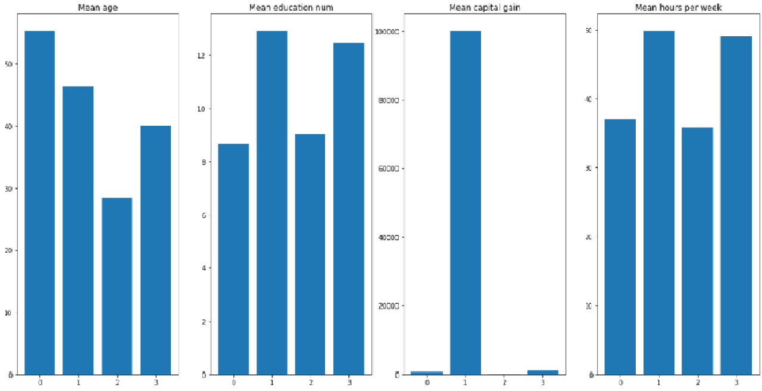
Comparisons
Roughly a 3 to 4 split between income levels
Relation between education, hours worked, and gapital gain

Slide 5
Strengths and Limitations on Classification Model
Strengths:
Simple questions for data points
No identifiable info needed to form predictions
Fast determination
Easy to change 1 or 2 datapoints for an individual to create better odds of outcome
Limitations:
Not much data
Only a little over 80% accuracy
Some data categories may not be tuned due to so many options for individua

Slide 6
Recommendations
I would recommend this to be used as a simple model of bettering an individuals chances of earning a higher wage. Simple and easy to understand.

